Slide 1

WEEK 6 · CHAPTER 7
Functions & structures
Fundamentals of Computer Science
From Scratch blocks to a coffee machine
Name an action
→
Group data
→
Build Coffee
01
Notes:
Lecture 0–1 minutes; teaching 1 minutes, discussion 0 minutes.
Week6 follows the last published Week5 materials and remains an explicitly stated course-week assumption. No calendar date is asserted. This is the opening minute within the existing 0–8 recap block. All pacing and questions live in the separate teacher guide.
Complete programs are linked relative to this PowerPoint file. Keep the accompanying lecture and lab folders together with it.

Slide 2
Do not edit
How to change the design
for (int i = 1; i <= 3; i++) printf("%d ", i); What prints?
The Slido app must be installed on every computer you’re presenting from

Slide 3
Do not edit
How to change the design
What is the final streak?
int streak = 2;
int practised = 0;
if (practised == 1) streak++;
else streak = 0;
The Slido app must be installed on every computer you’re presenting from

Slide 4
Do not edit
How to change the design
Without the first break, what is score?
int score = 0;
char reaction = 'W';
switch (reaction)
{
case 'W': score += 2;
case 'L': score -= 1; break;
}
The Slido app must be installed on every computer you’re presenting from

Slide 5
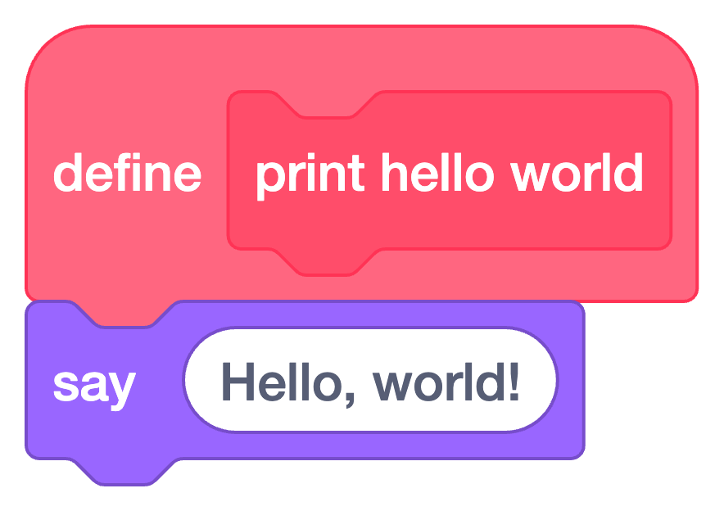
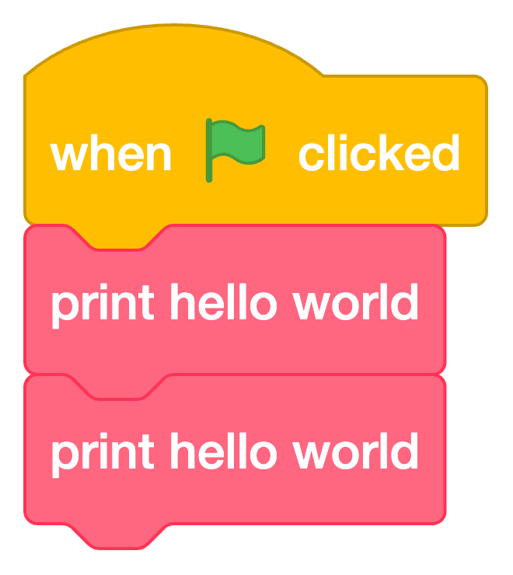
FUNCTIONS
A function is a named set of instructions.
Scratch · custom blocks
C · definition and calls
Define the action
Call it twice
void print_hello_world(void)
{
printf("Hello, world!\n");
}
// calls inside main
print_hello_world();
print_hello_world();
C syntax | Meaning
void before the name | No returned result
(void) | No inputs
Scratch shows a speech bubble.
C prints a line in the terminal.
05
Notes:
Lecture 8–12 minutes; teaching 4 minutes, discussion 0 minutes.
The genuine Scratch blocks are rendered by Scratch Foundation’s Scratch Blocks library from the matching runnable project in lecture/assets/scratch. The familiar custom-block pattern is adapted to Hello; it is not the earlier Metro project. Point to definition and calls on both sides. In C the first void is the return type: no returned value. The void inside parentheses means no parameters. The braces enclose the function body. Distinguish a function’s returned value from printed output. This is an excerpt; the next slide contains the complete runnable program.
Complete programs are linked relative to this PowerPoint file. Keep the accompanying lecture and lab folders together with it.

Slide 6
FUNCTIONS
One clear name. Two calls.
Complete C program
A prototype declares a function before main calls it.
It ends with ; and has no body.
#include <stdio.h>
void print_hello_world(void);
int main(void)
{
print_hello_world();
print_hello_world();
return 0;
}
void print_hello_world(void)
{
printf("Hello, world!\n");
}
Find it in the code | What it means
Prototype | Announce the function
Call | Run it now
Definition | Describe its work
Hello, world!
Hello, world!
06
Notes:
Lecture 12–17 minutes; teaching 5 minutes, discussion 0 minutes.
Trace main into print_hello_world and back to the next call. Point to the declaration, both calls and the definition in this one program. void before the name means no returned value; (void) means no inputs. Change one message and rerun: both calls use the changed definition. Reuse is shared behavior, not just fewer keystrokes. Teacher prompt: Predict → explain: Change the message inside the function. Which calls will use the new message?
Complete programs are linked relative to this PowerPoint file. Keep the accompanying lecture and lab folders together with it.

Slide 7
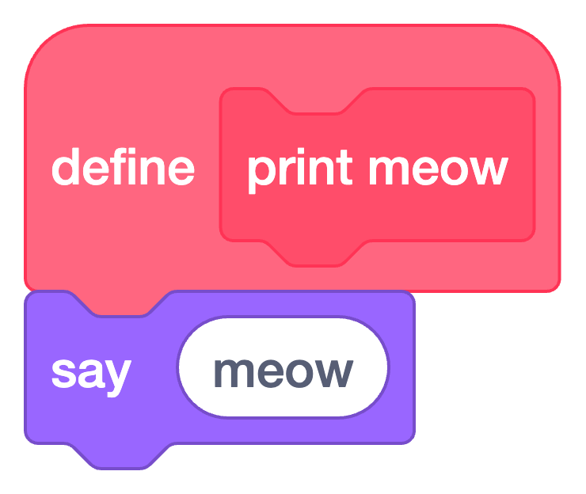
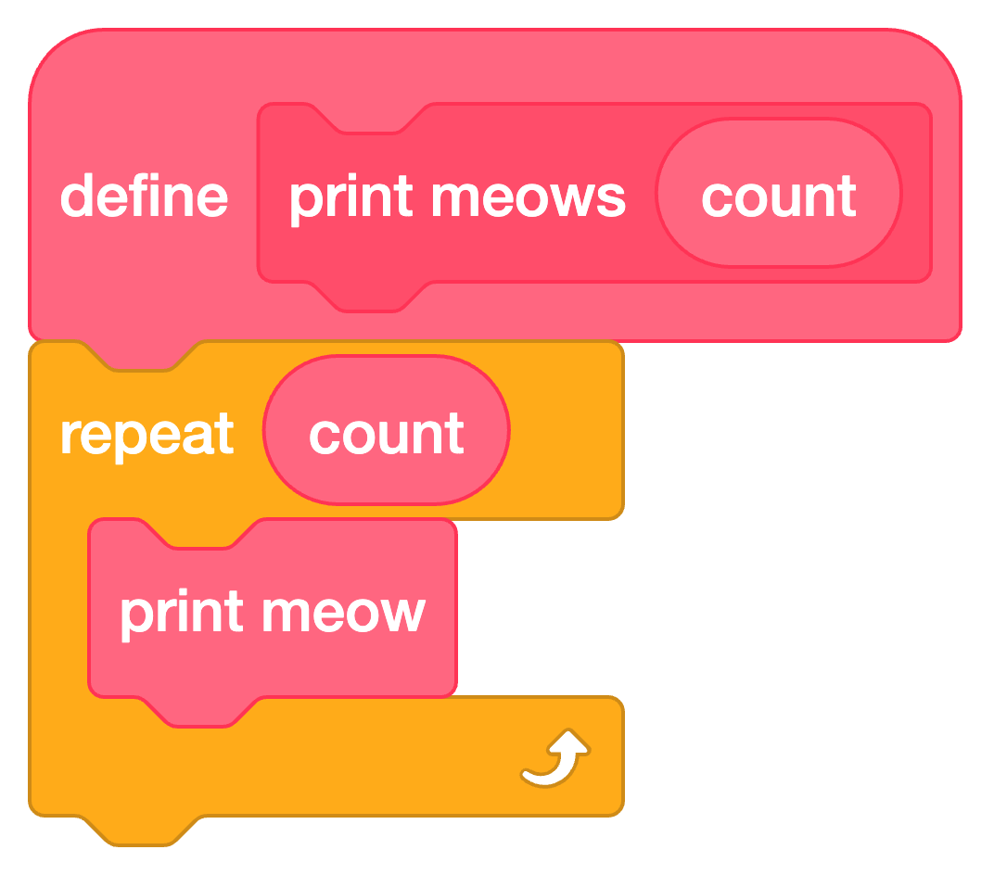
FUNCTIONS
One function can reuse another function.
Scratch · reuse a custom block
C · the same two named actions
void print_meow(void)
{
printf("meow\n");
}
void print_meows(int count)
{
for (int i = 0; i < count; i++)
{
print_meow();
}
}
C calls inside main
print_meows(1);
print_meows(3);
Parameter: count, the input name inside the function.
Argument: 3, the value supplied by a call.
07
Notes:
Lecture 17–28 minutes; teaching 7 minutes, discussion 4 minutes.
Recall the Scratch custom block input. count is local to print_meows: this name can be used inside that function; main supplies a value. Trace print_meows(3), then0and1; count is copied for each call. print_meows reuses print_meow, so changing one output line affects every call. Keep four minutes of discussion within this block. The genuine Scratch Blocks rendering matches the supplied runnable Meows Scratch project; it adapts the earlier custom-block pattern to this new example.
Complete programs are linked relative to this PowerPoint file. Keep the accompanying lecture and lab folders together with it.

Slide 8
FUNCTIONS
A returned value goes back to the caller.
Book example · function supplied
Whole-number square root
int IntegerRoot(int number);
// calls inside main
int first = IntegerRoot(27);
int second = IntegerRoot(16);
printf("%d %d\n", first, second);
For 27: 5 × 5 = 25 ≤ 27; 6 × 6 = 36 > 27.
int: the result’s type.
number: the input parameter.
The caller is the function making the call—here, main.
5 4
IntegerRoot returns the number. The caller uses printf to display it.
08
Notes:
Lecture 28–38 minutes; teaching 8 minutes, discussion 2 minutes.
Keep the IntegerRoot algorithm supplied. Students need only its promise, a call, the returned int and the caller using that value. Do not explain the overflow-avoidance division loop during this block. The calls here are a short selected example; the complete book-adaptation file also runs other boundary cases. Teacher prompt: Predict → explain: Does calling IntegerRoot print an answer? Which line actually prints?
SOURCE
The Art and Craft of Computing · §7.2.1 / Exercise 7.1
Complete programs are linked relative to this PowerPoint file. Keep the accompanying lecture and lab folders together with it.

Slide 9
STRUCTURES
Define a structure type.
Type definition · above main
Syntax | What it does
struct { … } | Groups related fields into one type
int water_ml; | Declares one integer field
typedef | Gives the type a usable name
Stock | The type name, after the closing }
; | Ends the declaration
typedef struct
{
int water_ml;
int milk_ml;
int beans_g;
int paper_cups;
} Stock;
A field is one named value in a record. Stock names the type; a variable comes next.
09
Notes:
Lecture 38–42 minutes; teaching 4 minutes, discussion 0 minutes.
Name every part before using it. The whole typedef declaration defines an anonymous structure type and introduces the typedef name Stock. Stock after the brace is a type name, not a variable and not a struct tag. Each member declaration has its own semicolon, and the overall declaration also ends with a semicolon. Avoid introducing tagged structs or alternate syntax here.
Complete programs are linked relative to this PowerPoint file. Keep the accompanying lecture and lab folders together with it.

Slide 10
STRUCTURES
Create a variable, then use its fields.
Inside main · uses the Stock type
stock · after initialization
Stock stock = {500, 200, 40, 3};
printf("%d\n", stock.water_ml);
stock.water_ml = 450;
printf("%d\n", stock.water_ml);
water_ml
500
milk_ml
200
beans_g
40
Code | Meaning
Stock stock | Declare (create) a variable
= {500, 200, 40, 3} | Initialize: set starting values
stock.water_ml | Access one field using the dot
paper_cups
3
The values follow the field order:
water, milk, beans, paper cups.
Output: 500, then 450.
Only the water field changes.
10
Notes:
Lecture 42–47 minutes; teaching 5 minutes, discussion 0 minutes.
Separate three actions: define a type on the prior slide; declare and initialize a variable here; read/change one field with dot notation. Capital Stock and lowercase stock are different names. Match each initializer value to the field order above. The linked04_stock_basics program runs this exact field-access example. The next slide uses a separate05_stock_copy program and starts again with500ml. Stock is declared above functions as a type name; this stock variable belongs to main.
Complete programs are linked relative to this PowerPoint file. Keep the accompanying lecture and lab folders together with it.

Slide 11
STRUCTURES
A returned Stock is a separate copy.
The helper definition
Caller · stock starts with 500 ml
Stock stock_after_water_use(
Stock stock, int amount_ml)
{
if (amount_ml >= 0 &&
amount_ml <= stock.water_ml)
{
stock.water_ml -= amount_ml;
}
return stock;
}
Stock preview =
stock_after_water_use(stock, 100);
printf("%d\n", stock.water_ml);
printf("%d\n", preview.water_ml);
stock =
stock_after_water_use(stock, 50);
printf("%d\n", stock.water_ml);
The parameter stock is a copy.
The caller chooses where to save it.
Water after each call (ml)
Moment | stock.water_ml | preview.water_ml
After first call | 500 | 400
After saving to stock | 450 | 400
11
Notes:
Lecture 47–56 minutes; teaching 3 minutes, discussion 6 minutes.
Read the original and preview boxes before running the example. The first call returns a changed copy, leaving the original at 500; the later 50 ml call starts from that unchanged 500 and assigns 450 back to stock. Allow six minutes of repetition and questions across the Stock block. If students cannot explain the two boxes, repeat this trace and use the supplied correct helper in Coffee. Teacher prompt: Predict → explain: A call returns a value. Assignment decides which variable keeps it.
Complete programs are linked relative to this PowerPoint file. Keep the accompanying lecture and lab folders together with it.
Show the helper definition first. Its Stock parameter is a copy. Trace the table: after the first call, stock is 500 and preview is 400; after saving to stock, stock is 450 and preview is still 400.

Slide 12
COFFEE MACHINE · CLASSROOM MODEL
Before coding: make one latte on paper.
What the machine has
What one latte needs
water_ml
500
water_ml
100
milk_ml
200
milk_ml
50
beans_g
40
beans_g
10
paper_cups
3
paper_cups
1
Recipe is a structure type.
The variable latte stores the amounts for one drink.
One accepted order uses one paper cup.
12
Notes:
Lecture 56–60 minutes; teaching 4 minutes, discussion 0 minutes.
Use one fixed latte recipe card. Students should obtain 400 ml water, 150 ml milk, 30 g beans and 2 cups. Do not introduce the Recipe or Cup typedefs, menu array or input parser here. They are supplied parts of the runnable program. This classroom coffee-machine idea was proposed by Rakhmonberdi. Teacher prompt: Predict → explain: Subtract each resource. Predict the four numbers before running any C.
Complete programs are linked relative to this PowerPoint file. Keep the accompanying lecture and lab folders together with it.
Distinguish the type Recipe from the variable latte. Recipe describes the grouped fields; latte stores the quantities for this drink.

Slide 13
COFFEE MACHINE · CLASSROOM MODEL
Ask a yes/no question before spending anything.
Decision function
Stock for this latte | Can we make it?
500 / 200 / 40 / 3 | true
100 / 50 / 10 / 1 | true
500 / 200 / 40 / 0 | false
bool can_make_coffee(
Stock stock, Recipe recipe)
{
return
stock.water_ml >= recipe.water_ml &&
stock.milk_ml >= recipe.milk_ml &&
stock.beans_g >= recipe.beans_g &&
stock.paper_cups >= recipe.paper_cups;
}
bool: a true/false result.
>=: at least this amount.
&&: every condition must hold.
return: send the result to the caller.
13
Notes:
Lecture 60–64 minutes; teaching 4 minutes, discussion 0 minutes.
The four quantities in the table are water/milk/beans/cups. Connect this Boolean result to the earlier integer return: a function supplies a value the caller can use. Explain >= and && with the stock cards, using valid nonnegative classroom data. can_make_coffee is also reused by stock_after_coffee, so the resource rule is written once. Teacher prompt: Predict → explain: Why is exactly enough accepted? Why does one missing cup stop the order?
Complete programs are linked relative to this PowerPoint file. Keep the accompanying lecture and lab folders together with it.

Slide 14
COFFEE MACHINE · CLASSROOM MODEL
Calculate the next Stock, then save the result.
Returned record · same Stock type
Compare these two calls
Stock stock_after_coffee(
Stock stock, Recipe recipe)
{
if (can_make_coffee(stock, recipe))
{
stock.water_ml -= recipe.water_ml;
stock.milk_ml -= recipe.milk_ml;
stock.beans_g -= recipe.beans_g;
stock.paper_cups -= recipe.paper_cups;
}
return stock;
}
stock_after_coffee(stock, latte);
// stock is still unchanged
stock =
stock_after_coffee(stock, latte);
// stock now keeps the returned record
Caller’s stock | Water / milk / beans / cups
Before | 500 / 200 / 40 / 3
After saved result | 400 / 150 / 30 / 2
-=: subtract, then save the result.
return stock;: send back the updated copy.
14
Notes:
Lecture 64–69 minutes; teaching 5 minutes, discussion 0 minutes.
Show the helper changing only its copied parameter. In the first call the returned copy is discarded; the second call saves the result. The helper reuses can_make_coffee and returns an unchanged copy when supplies are insufficient. If this checkpoint is not secure, keep the supplied helper and repeat one successful order and one refusal; skip optional second-drink and foam comparisons. Teacher prompt: Predict → explain: Which call keeps the new record? Explain the = sign before running it.
Complete programs are linked relative to this PowerPoint file. Keep the accompanying lecture and lab folders together with it.

Slide 15
COFFEE MACHINE · CLASSROOM MODEL
Reuse the same helpers before and after an order.
Order code · cup starts empty
1 · Make one latte
print_stock(stock);
if (can_make_coffee(stock, latte))
{
stock =
stock_after_coffee(stock, latte);
cup = create_cup(latte, false);
}
print_stock(stock);
print_cup(cup);
Stock | Water / milk / beans / cups
Before | 500 / 200 / 40 / 3
After | 400 / 150 / 30 / 2
cup: Latte
100 ml coffee + 50 ml milk
2 · Retry with no cups
stock.paper_cups = 0;
Retry | Water / milk / beans / cups
Before | 400 / 150 / 30 / 0
After | 400 / 150 / 30 / 0
print_stock and print_cup display data.
create_cup builds the drink record.
false means no foam.
No new drink. cup still stores
the previous latte.
15
Notes:
Lecture 69–79 minutes; teaching 2 minutes, discussion 8 minutes.
First run one accepted plain latte. For a separate boundary experiment, set paper_cups to zero before the next order; that setup is not a deduction caused by the first latte. The failed branch executes neither assignment, so all current stock fields and the prior Cup remain unchanged. Only now show the supplied Cup constructor: it returns a record, not a physical brewing operation. Keep up to eight minutes available across the Coffee block for questions or repeating the concrete trace. Teacher prompt: Predict → explain: Test a refusal. Compare every field—not just whether the program printed a message.
Complete programs are linked relative to this PowerPoint file. Keep the accompanying lecture and lab folders together with it.
Run the order block once with 500/200/40/3. It makes a latte and leaves 400/150/30/2. Then manually set stock.paper_cups to 0 before repeating that same block. The retry changes neither stock nor the previous latte stored in cup.

Slide 16
CREDITS
Sources & classroom idea
BOOK
The Art and Craft of Computing
Ceri et al. · Chapter 7: Functions and procedures
CS50
Harvard’s CS50
Scratch custom blocks, C functions and step-by-step examples
Teaching ideas adapted with attribution · CC BY-NC-SA 4.0
CLASSROOM IDEA
Coffee machine
Proposed by Rakhmonberdi
16
Notes:
OPTIONAL REFERENCE: hidden from the normal slideshow; outside the 80-minute lecture.
Credit the source of the concepts and the origin of this classroom scenario. The coffee-machine idea came from the user’s proposal; this does not claim they invented coffee-machine programming examples in general.
Complete programs are linked relative to this PowerPoint file. Keep the accompanying lecture and lab folders together with it.

