Slide 1

Programming in C
Data Types
and Operators
Week 4
01
Notes:
00–05 minutes | Opening
00–02 / Slides 1–2
DO: Identify each actual type and its example declaration. Distinguish a char from text. Explain that main(void) has no parameters, while a void return type means no returned value.
ASK: Which types store whole numbers, decimal values and one character?
EXPECT: int for whole numbers; float or double for decimal values; char for one character.
02–05 / Editor
DO: Create sphere_precision.c. Type stdio.h, cs50.h and int main(void). Compile the empty scaffold.
ASK: Where does execution begin?
EXPECT: main. stdio.h declares printf; cs50.h declares get_double.
SOURCE
Ceri, Mandrioli & Sbattella, The Art and Craft of Computing, Chapters 4–5. Teaching adaptation in C11 with CS50 input helpers.

Slide 2
Variables and types
Type | C declaration | Typical use
int | int score = 72; | Whole numbers
char | char grade = 'B'; | One basic character
float | float temperature = 23.5f; | Approximate real values
double | double radius = 3.0; | Approximate real values
bool | bool passed = true; | true or false
string | string name = "Ada"; | Text via CS50
C11: bool from <stdbool.h> · CS50: string is a char * alias
main(void): no parameters · void example(void): no return value
02
Notes:
Use actual type names in the table. In C11 char is technically an integer type, but grouping it under Integer beside int obscured its classroom purpose. float and double are real floating types; real types in the C standard also include integers. bool is a macro for _Bool from stdbool.h in C11, and cs50.h also includes that header. string is the CS50 typedef for char *, not a built-in C type; it holds an address, not the text inline. One char holds one byte, suitable for a basic character such as B, not every Unicode character. void cannot declare an ordinary variable. In int main(void), int is the return type and void means no parameters. In void example(void), the first void means no returned value and the second means no parameters.
00–05 minutes | Opening
00–02 / Slides 1–2
DO: Identify each actual type and its example declaration. Distinguish a char from text. Explain that main(void) has no parameters, while a void return type means no returned value.
ASK: Which types store whole numbers, decimal values and one character?
EXPECT: int for whole numbers; float or double for decimal values; char for one character.
02–05 / Editor
DO: Create sphere_precision.c. Type stdio.h, cs50.h and int main(void). Compile the empty scaffold.
ASK: Where does execution begin?
EXPECT: main. stdio.h declares printf; cs50.h declares get_double.
SOURCE
Book Chapter 5, printed pp. 94–102. C11 draft N1570 §§6.2.5, 6.7.6.3 and 7.18: https://www.open-std.org/jtc1/sc22/wg14/www/docs/n1570.pdf; CS50 string alias: https://cs50.readthedocs.io/libraries/cs50/c/

Slide 3
Why use double?
Typical precision
float
double
6
15
significant decimal digits
significant decimal digits
float radius = 3.0f;
double radius = 3.0;
We use double for radius and volume.
03
Notes:
Use only a brief comparison before the sphere task. The figures are FLT_DIG = 6 and DBL_DIG = 15 for common IEEE 754 binary32/binary64 implementations, matching the recorded macOS arm64 reference measurements. They describe significant decimal digits, not the number of digits after the decimal point. C permits implementation differences. double remains approximate. Precision does not fix integer division: keep the following 4/3 prediction. The full platform-specific table stays in the appendix.
05–20 minutes | Sphere precision
05–07 / Slides 3–4, then editor
DO: Briefly compare float and double. Choose double for radius and volume, type const double pi = 3.1415, and read radius with get_double.
ASK: Why use double for the radius?
EXPECT: The radius can have a fractional part. On our platform double has more precision than float. Floating-point values can be approximate; double does not make the chosen pi approximation exact.
07–11 / Slides 5–6
DO: Collect predictions for double fraction = 4 / 3. Run it, then change an operand to 4.0.
ASK: Does the destination type change how 4 / 3 runs?
EXPECT: No. Integer division gives 1 first, then assignment converts it to double. Poll answer A.
11–16 / Editor
DO: Build both sphere calculations. Run radius 3. Print the same correct volume with %.1f and %.4f.
ASK: Did extra displayed digits improve the stored value?
EXPECT: No. The displays are 113.1 and 113.0940; formatting only changes presentation.
16–20 / Slides 7–8, then editor
DO: Trace read → validate → calculate → print. Add the input guard and run the cases below.
ASK: Which inputs should the program reject?
EXPECT: Zero, negative radii and values above 1000. The positive range check also rejects nonfinite input.
SOURCE
Book section 5.2.2, printed pp. 99–101. Simplified from the previous slide 29 and its measured float.h FLT_DIG/DBL_DIG values.

Slide 4
Sphere volume
V = (4 / 3) × π × r³
const double pi = 3.1415;
double radius = get_double("Radius: ");
Today’s input range: 0 < radius <= 1000
04
Notes:
The displayed formula is mathematical notation: V = (4/3)πr³, with radius r and volume V in cubic units. C must use floating-point division for 4/3. pi = 3.1415 deliberately matches the book, so the result is an approximation even with double. Radius and volume must use consistent units. The lab accepts 0 < radius <= 1000.
05–20 minutes | Sphere precision
05–07 / Slides 3–4, then editor
DO: Briefly compare float and double. Choose double for radius and volume, type const double pi = 3.1415, and read radius with get_double.
ASK: Why use double for the radius?
EXPECT: The radius can have a fractional part. On our platform double has more precision than float. Floating-point values can be approximate; double does not make the chosen pi approximation exact.
07–11 / Slides 5–6
DO: Collect predictions for double fraction = 4 / 3. Run it, then change an operand to 4.0.
ASK: Does the destination type change how 4 / 3 runs?
EXPECT: No. Integer division gives 1 first, then assignment converts it to double. Poll answer A.
11–16 / Editor
DO: Build both sphere calculations. Run radius 3. Print the same correct volume with %.1f and %.4f.
ASK: Did extra displayed digits improve the stored value?
EXPECT: No. The displays are 113.1 and 113.0940; formatting only changes presentation.
16–20 / Slides 7–8, then editor
DO: Trace read → validate → calculate → print. Add the input guard and run the cases below.
ASK: Which inputs should the program reject?
EXPECT: Zero, negative radii and values above 1000. The positive range check also rejects nonfinite input.
SOURCE
Book Example 5.3, printed p. 101. The pi approximation follows the supplied book.

Slide 5
What will this print?
Prediction 1
double fraction = 4 / 3;
printf("%f\n", fraction);
A
1.000000
B
1.333333
C
Compilation error
D
0.000000
05
Notes:
05–20 minutes | Sphere precision
05–07 / Slides 3–4, then editor
DO: Briefly compare float and double. Choose double for radius and volume, type const double pi = 3.1415, and read radius with get_double.
ASK: Why use double for the radius?
EXPECT: The radius can have a fractional part. On our platform double has more precision than float. Floating-point values can be approximate; double does not make the chosen pi approximation exact.
07–11 / Slides 5–6
DO: Collect predictions for double fraction = 4 / 3. Run it, then change an operand to 4.0.
ASK: Does the destination type change how 4 / 3 runs?
EXPECT: No. Integer division gives 1 first, then assignment converts it to double. Poll answer A.
11–16 / Editor
DO: Build both sphere calculations. Run radius 3. Print the same correct volume with %.1f and %.4f.
ASK: Did extra displayed digits improve the stored value?
EXPECT: No. The displays are 113.1 and 113.0940; formatting only changes presentation.
16–20 / Slides 7–8, then editor
DO: Trace read → validate → calculate → print. Add the input guard and run the cases below.
ASK: Which inputs should the program reject?
EXPECT: Zero, negative radii and values above 1000. The positive range check also rejects nonfinite input.
SOURCE
Ceri, Mandrioli & Sbattella, The Art and Craft of Computing, Chapters 4–5. Teaching adaptation in C11 with CS50 input helpers.

Slide 6
Do not edit
How to change the design
What will this print? double fraction = 4 / 3;
The Slido app must be installed on every computer you’re presenting from

Slide 7
Division happens before assignment
Expression | Stored in double | Printed with %f
4 / 3 | 1.0 | 1.000000
4.0 / 3.0 | ≈ 1.333333… | 1.333333
(double)(4 / 3) | 1.0 | 1.000000
The operand types decide how / works
06
Notes:
05–20 minutes | Sphere precision
05–07 / Slides 3–4, then editor
DO: Briefly compare float and double. Choose double for radius and volume, type const double pi = 3.1415, and read radius with get_double.
ASK: Why use double for the radius?
EXPECT: The radius can have a fractional part. On our platform double has more precision than float. Floating-point values can be approximate; double does not make the chosen pi approximation exact.
07–11 / Slides 5–6
DO: Collect predictions for double fraction = 4 / 3. Run it, then change an operand to 4.0.
ASK: Does the destination type change how 4 / 3 runs?
EXPECT: No. Integer division gives 1 first, then assignment converts it to double. Poll answer A.
11–16 / Editor
DO: Build both sphere calculations. Run radius 3. Print the same correct volume with %.1f and %.4f.
ASK: Did extra displayed digits improve the stored value?
EXPECT: No. The displays are 113.1 and 113.0940; formatting only changes presentation.
16–20 / Slides 7–8, then editor
DO: Trace read → validate → calculate → print. Add the input guard and run the cases below.
ASK: Which inputs should the program reject?
EXPECT: Zero, negative radii and values above 1000. The positive range check also rejects nonfinite input.
SOURCE
Ceri, Mandrioli & Sbattella, The Art and Craft of Computing, Chapters 4–5. Teaching adaptation in C11 with CS50 input helpers.

Slide 8
Sphere volume
Ask for radius
Valid
radius?
true
false
Calculate both volumes
Show an error
Print both results
Quit
Valid radius: greater than 0, at most 1000
07
Notes:
Use the diagram to trace the whole task: read, validate, calculate twice, then print. Both volumes use the same radius and pi, but one uses integer division and one floating-point division. The range guard stays in the live C program.
05–20 minutes | Sphere precision
05–07 / Slides 3–4, then editor
DO: Briefly compare float and double. Choose double for radius and volume, type const double pi = 3.1415, and read radius with get_double.
ASK: Why use double for the radius?
EXPECT: The radius can have a fractional part. On our platform double has more precision than float. Floating-point values can be approximate; double does not make the chosen pi approximation exact.
07–11 / Slides 5–6
DO: Collect predictions for double fraction = 4 / 3. Run it, then change an operand to 4.0.
ASK: Does the destination type change how 4 / 3 runs?
EXPECT: No. Integer division gives 1 first, then assignment converts it to double. Poll answer A.
11–16 / Editor
DO: Build both sphere calculations. Run radius 3. Print the same correct volume with %.1f and %.4f.
ASK: Did extra displayed digits improve the stored value?
EXPECT: No. The displays are 113.1 and 113.0940; formatting only changes presentation.
16–20 / Slides 7–8, then editor
DO: Trace read → validate → calculate → print. Add the input guard and run the cases below.
ASK: Which inputs should the program reject?
EXPECT: Zero, negative radii and values above 1000. The positive range check also rejects nonfinite input.
SOURCE
Book Example 5.3, printed p. 101.
Visual method: CS50 2025 Lecture 0, slides 103–104 (numbered English pseudocode), https://cdn.cs50.net/2025/fall/lectures/0/lecture0.pdf; Lecture 1, slides 105–109 (flowcharts), https://cdn.cs50.net/2025/fall/lectures/1/lecture1.pdf. Original diagrams and wording for this TashTech lesson; not CS50-authored exercises.

Slide 9
Sphere volume
1
Ask for the radius
2
If the radius is invalid
3
Show an error and quit
4
Calculate once using integer division
5
Calculate again using floating-point division
6
Print both results
Valid radius: greater than 0, at most 1000
08
Notes:
Each numbered line is an English instruction, not C syntax. Line 4 uses 4/3; line 5 uses 4.0/3.0. Keep pi = 3.1415 and the radius the same. Full implementation stays in the editor. Use floating-point division as the technical term; the binary floating-point implementation is not decimal arithmetic.
05–20 minutes | Sphere precision
05–07 / Slides 3–4, then editor
DO: Briefly compare float and double. Choose double for radius and volume, type const double pi = 3.1415, and read radius with get_double.
ASK: Why use double for the radius?
EXPECT: The radius can have a fractional part. On our platform double has more precision than float. Floating-point values can be approximate; double does not make the chosen pi approximation exact.
07–11 / Slides 5–6
DO: Collect predictions for double fraction = 4 / 3. Run it, then change an operand to 4.0.
ASK: Does the destination type change how 4 / 3 runs?
EXPECT: No. Integer division gives 1 first, then assignment converts it to double. Poll answer A.
11–16 / Editor
DO: Build both sphere calculations. Run radius 3. Print the same correct volume with %.1f and %.4f.
ASK: Did extra displayed digits improve the stored value?
EXPECT: No. The displays are 113.1 and 113.0940; formatting only changes presentation.
16–20 / Slides 7–8, then editor
DO: Trace read → validate → calculate → print. Add the input guard and run the cases below.
ASK: Which inputs should the program reject?
EXPECT: Zero, negative radii and values above 1000. The positive range check also rejects nonfinite input.
SOURCE
Book Example 5.3, printed p. 101.
Visual method: CS50 2025 Lecture 0, slides 103–104 (numbered English pseudocode), https://cdn.cs50.net/2025/fall/lectures/0/lecture0.pdf; Lecture 1, slides 105–109 (flowcharts), https://cdn.cs50.net/2025/fall/lectures/1/lecture1.pdf. Original diagrams and wording for this TashTech lesson; not CS50-authored exercises.

Slide 10
Leap years
common year
leap year
365
366
Feb 28 → Mar 1
Feb 28 → Feb 29 → Mar 1
Watch the BBC introduction
+1 day
Leap days keep the calendar aligned with the seasons.
09
Notes:
A common year has 365 days and February has 28. A leap year adds February 29, giving 366 days. This keeps the calendar aligned with the seasons. Usually every four years, with century exceptions. Apply Gregorian arithmetic throughout the lab, including pre-1582 input years. Introduce with the user-selected BBC News video: https://www.youtube.com/watch?v=gvuz0BVy5TM. For the planned 20–22 minute slot, use a brief excerpt, then return to this slide.
20–40 minutes | Leap-year repair
20–22 / Slide 9
DO: Open the BBC introduction before coding. Use a brief excerpt, then show February 29 on the timeline.
ASK: What changes in February?
EXPECT: A common year has 28 days in February. A leap year has 29. The extra day helps keep calendar dates aligned with the seasons.
22–25 / Editor
DO: Start leap_year.c. Read an int year. First use year % 4 == 0 and print leap/common.
ASK: What test could prove this first rule wrong?
EXPECT: Try a century year such as 1900.
25–30 / Slides 10–12, then editor
DO: Poll 1900 versus 2000. Trace the flowchart, read the English steps, then write the C condition.
ASK: Why does 2000 pass but 1900 fail?
EXPECT: 2000 is divisible by 400. 1900 is divisible by 100 but not 400. Poll answer B.
30–32 / Editor
DO: Run 1900, 2000, 2024 and 2025.
ASK: Why were 2024 and 2025 alone insufficient tests?
EXPECT: The incomplete rule classifies both 2024 and 2025 correctly, so those two tests do not expose the century-year bug.
32–37 / Slide 13, then editor
DO: Use “Go back to line 1” to explain repeated input. Implement with while, reading before the loop and again at its end.
ASK: What happens if we forget the next input?
EXPECT: A positive year never changes, so the loop repeats indefinitely.
37–40 / Editor
DO: Run 1900, 2000, 2024, 2025, 0 in one session. Then try 10000.
ASK: Should the program classify 0?
EXPECT: No. Nonpositive input ends the loop. 10000 produces a range message.
SOURCE
Book Example 5.1, printed pp. 98–99 and correction p. 134. Gregorian calendar: https://aa.usno.navy.mil/faq/leap_years and https://cnrc.canada.ca/en/certifications-evaluations-standards/canadas-official-time/what-years-are-leap-years.
Visual method: CS50 2025 Lecture 0, slides 103–104 (numbered English pseudocode), https://cdn.cs50.net/2025/fall/lectures/0/lecture0.pdf; Lecture 1, slides 105–109 (flowcharts), https://cdn.cs50.net/2025/fall/lectures/1/lecture1.pdf. Original diagrams and wording for this TashTech lesson; not CS50-authored exercises.

Slide 11
Which year is a leap year?
Prediction 2
1900 2000
A
Only 1900
B
Only 2000
C
Both
D
Neither
10
Notes:
Ask which year is a leap year, not which century. Gregorian rule: 1900 is common because it is divisible by 100 but not 400; 2000 is leap because it is divisible by 400. Poll answer B.
20–40 minutes | Leap-year repair
20–22 / Slide 9
DO: Open the BBC introduction before coding. Use a brief excerpt, then show February 29 on the timeline.
ASK: What changes in February?
EXPECT: A common year has 28 days in February. A leap year has 29. The extra day helps keep calendar dates aligned with the seasons.
22–25 / Editor
DO: Start leap_year.c. Read an int year. First use year % 4 == 0 and print leap/common.
ASK: What test could prove this first rule wrong?
EXPECT: Try a century year such as 1900.
25–30 / Slides 10–12, then editor
DO: Poll 1900 versus 2000. Trace the flowchart, read the English steps, then write the C condition.
ASK: Why does 2000 pass but 1900 fail?
EXPECT: 2000 is divisible by 400. 1900 is divisible by 100 but not 400. Poll answer B.
30–32 / Editor
DO: Run 1900, 2000, 2024 and 2025.
ASK: Why were 2024 and 2025 alone insufficient tests?
EXPECT: The incomplete rule classifies both 2024 and 2025 correctly, so those two tests do not expose the century-year bug.
32–37 / Slide 13, then editor
DO: Use “Go back to line 1” to explain repeated input. Implement with while, reading before the loop and again at its end.
ASK: What happens if we forget the next input?
EXPECT: A positive year never changes, so the loop repeats indefinitely.
37–40 / Editor
DO: Run 1900, 2000, 2024, 2025, 0 in one session. Then try 10000.
ASK: Should the program classify 0?
EXPECT: No. Nonpositive input ends the loop. 10000 produces a range message.
SOURCE
Ceri, Mandrioli & Sbattella, The Art and Craft of Computing, Chapters 4–5. Teaching adaptation in C11 with CS50 input helpers.

Slide 12
Do not edit
How to change the design
Which year is a leap year: 1900 or 2000?
The Slido app must be installed on every computer you’re presenting from

Slide 13
Leap-year rule
Multiple
of 400?
true
leap year
false
Multiple
of 100?
true
common year
false
Multiple
of 4?
true
leap year
false
common year
11
Notes:
Read from the top. Multiple means divisible with no remainder. 2000: first test true → leap. 1900: false, then true → common. 2024: false, false, true → leap. 2025: false, false, false → common. Ask a student to trace one path at a time. Poll answer B.
20–40 minutes | Leap-year repair
20–22 / Slide 9
DO: Open the BBC introduction before coding. Use a brief excerpt, then show February 29 on the timeline.
ASK: What changes in February?
EXPECT: A common year has 28 days in February. A leap year has 29. The extra day helps keep calendar dates aligned with the seasons.
22–25 / Editor
DO: Start leap_year.c. Read an int year. First use year % 4 == 0 and print leap/common.
ASK: What test could prove this first rule wrong?
EXPECT: Try a century year such as 1900.
25–30 / Slides 10–12, then editor
DO: Poll 1900 versus 2000. Trace the flowchart, read the English steps, then write the C condition.
ASK: Why does 2000 pass but 1900 fail?
EXPECT: 2000 is divisible by 400. 1900 is divisible by 100 but not 400. Poll answer B.
30–32 / Editor
DO: Run 1900, 2000, 2024 and 2025.
ASK: Why were 2024 and 2025 alone insufficient tests?
EXPECT: The incomplete rule classifies both 2024 and 2025 correctly, so those two tests do not expose the century-year bug.
32–37 / Slide 13, then editor
DO: Use “Go back to line 1” to explain repeated input. Implement with while, reading before the loop and again at its end.
ASK: What happens if we forget the next input?
EXPECT: A positive year never changes, so the loop repeats indefinitely.
37–40 / Editor
DO: Run 1900, 2000, 2024, 2025, 0 in one session. Then try 10000.
ASK: Should the program classify 0?
EXPECT: No. Nonpositive input ends the loop. 10000 produces a range message.
SOURCE
Book Example 5.1, printed pp. 98–99 and correction p. 134. Gregorian calendar: https://aa.usno.navy.mil/faq/leap_years and https://cnrc.canada.ca/en/certifications-evaluations-standards/canadas-official-time/what-years-are-leap-years.
Visual method: CS50 2025 Lecture 0, slides 103–104 (numbered English pseudocode), https://cdn.cs50.net/2025/fall/lectures/0/lecture0.pdf; Lecture 1, slides 105–109 (flowcharts), https://cdn.cs50.net/2025/fall/lectures/1/lecture1.pdf. Original diagrams and wording for this TashTech lesson; not CS50-authored exercises.

Slide 14
Leap-year rule
1
Get a valid year (1 to 9999)
2
If the year is a multiple of 400
3
Print "leap year"
4
Else if the year is a multiple of 100
5
Print "common year"
6
Else if the year is a multiple of 4
7
Print "leap year"
8
Else
9
Print "common year"
12
Notes:
Use the numbered English algorithm to establish the order of the exceptions. Indented lines belong to the condition above them. Then translate into the compact live expression: year % 400 == 0 || (year % 4 == 0 && year % 100 != 0). No new C functions are implied by the English wording. This slide assumes a valid input year from 1 to 9999; the following repeated-input algorithm performs the guards.
20–40 minutes | Leap-year repair
20–22 / Slide 9
DO: Open the BBC introduction before coding. Use a brief excerpt, then show February 29 on the timeline.
ASK: What changes in February?
EXPECT: A common year has 28 days in February. A leap year has 29. The extra day helps keep calendar dates aligned with the seasons.
22–25 / Editor
DO: Start leap_year.c. Read an int year. First use year % 4 == 0 and print leap/common.
ASK: What test could prove this first rule wrong?
EXPECT: Try a century year such as 1900.
25–30 / Slides 10–12, then editor
DO: Poll 1900 versus 2000. Trace the flowchart, read the English steps, then write the C condition.
ASK: Why does 2000 pass but 1900 fail?
EXPECT: 2000 is divisible by 400. 1900 is divisible by 100 but not 400. Poll answer B.
30–32 / Editor
DO: Run 1900, 2000, 2024 and 2025.
ASK: Why were 2024 and 2025 alone insufficient tests?
EXPECT: The incomplete rule classifies both 2024 and 2025 correctly, so those two tests do not expose the century-year bug.
32–37 / Slide 13, then editor
DO: Use “Go back to line 1” to explain repeated input. Implement with while, reading before the loop and again at its end.
ASK: What happens if we forget the next input?
EXPECT: A positive year never changes, so the loop repeats indefinitely.
37–40 / Editor
DO: Run 1900, 2000, 2024, 2025, 0 in one session. Then try 10000.
ASK: Should the program classify 0?
EXPECT: No. Nonpositive input ends the loop. 10000 produces a range message.
SOURCE
Book Example 5.1, printed pp. 98–99 and correction p. 134. Gregorian calendar: https://aa.usno.navy.mil/faq/leap_years and https://cnrc.canada.ca/en/certifications-evaluations-standards/canadas-official-time/what-years-are-leap-years.
Visual method: CS50 2025 Lecture 0, slides 103–104 (numbered English pseudocode), https://cdn.cs50.net/2025/fall/lectures/0/lecture0.pdf; Lecture 1, slides 105–109 (flowcharts), https://cdn.cs50.net/2025/fall/lectures/1/lecture1.pdf. Original diagrams and wording for this TashTech lesson; not CS50-authored exercises.

Slide 15
Repeated input
1
Ask for a year
2
If the year is 0 or negative
3
Quit
4
If the year is greater than 9999
5
Show an error and quit
6
Apply the leap-year rule
7
Print the result
8
Go back to line 1
13
Notes:
Go back to line 1 is English pseudocode for repetition, in the style of CS50’s phone-book example. Implement it with the already planned while loop, not C goto. Read before the loop and read again at its end. 0 or negative stops without classification; over 9999 prints an error and stops.
20–40 minutes | Leap-year repair
20–22 / Slide 9
DO: Open the BBC introduction before coding. Use a brief excerpt, then show February 29 on the timeline.
ASK: What changes in February?
EXPECT: A common year has 28 days in February. A leap year has 29. The extra day helps keep calendar dates aligned with the seasons.
22–25 / Editor
DO: Start leap_year.c. Read an int year. First use year % 4 == 0 and print leap/common.
ASK: What test could prove this first rule wrong?
EXPECT: Try a century year such as 1900.
25–30 / Slides 10–12, then editor
DO: Poll 1900 versus 2000. Trace the flowchart, read the English steps, then write the C condition.
ASK: Why does 2000 pass but 1900 fail?
EXPECT: 2000 is divisible by 400. 1900 is divisible by 100 but not 400. Poll answer B.
30–32 / Editor
DO: Run 1900, 2000, 2024 and 2025.
ASK: Why were 2024 and 2025 alone insufficient tests?
EXPECT: The incomplete rule classifies both 2024 and 2025 correctly, so those two tests do not expose the century-year bug.
32–37 / Slide 13, then editor
DO: Use “Go back to line 1” to explain repeated input. Implement with while, reading before the loop and again at its end.
ASK: What happens if we forget the next input?
EXPECT: A positive year never changes, so the loop repeats indefinitely.
37–40 / Editor
DO: Run 1900, 2000, 2024, 2025, 0 in one session. Then try 10000.
ASK: Should the program classify 0?
EXPECT: No. Nonpositive input ends the loop. 10000 produces a range message.
SOURCE
Book Example 5.1, printed pp. 98–99 and correction p. 134. Gregorian calendar: https://aa.usno.navy.mil/faq/leap_years and https://cnrc.canada.ca/en/certifications-evaluations-standards/canadas-official-time/what-years-are-leap-years.
Visual method: CS50 2025 Lecture 0, slides 103–104 (numbered English pseudocode), https://cdn.cs50.net/2025/fall/lectures/0/lecture0.pdf; Lecture 1, slides 105–109 (flowcharts), https://cdn.cs50.net/2025/fall/lectures/1/lecture1.pdf. Original diagrams and wording for this TashTech lesson; not CS50-authored exercises.

Slide 16
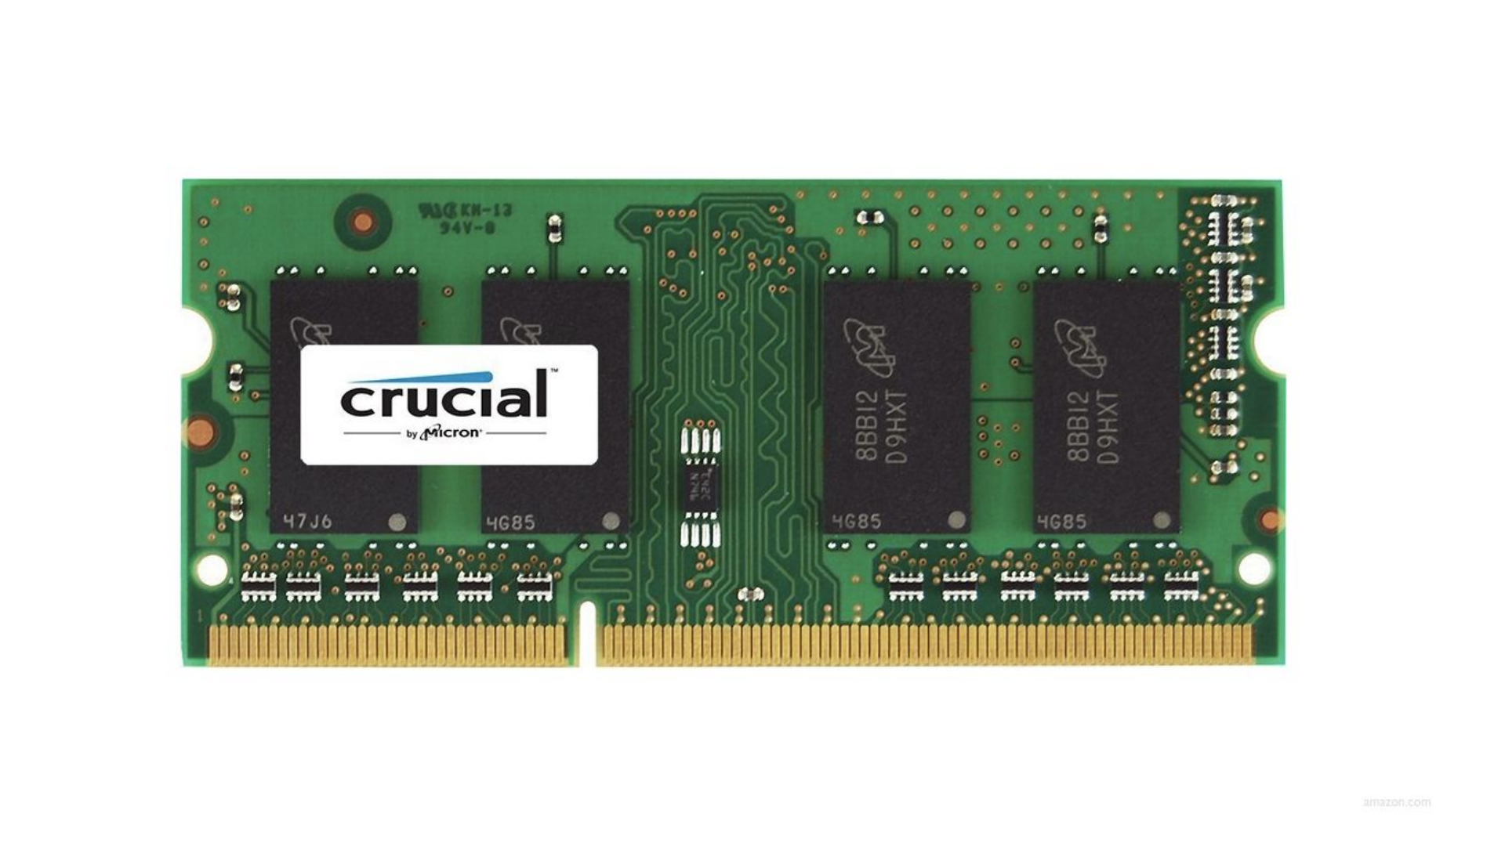
RAM module
CS50 Lecture 2
14
Notes:
RAM module photograph from the CS50 memory introduction. Use this to locate the chips; it does not show individual memory cells.
40–47 minutes | Memory bridge
40–44 / Slides 14–17
DO: Show RAM and one chip, then the conceptual byte grid. Each square represents one byte; it is not a physical map of the chip.
ASK: What does sizeof(char) report?
EXPECT: 1 C byte. CHAR_BIT tells us the number of bits in that byte. Our illustrated environment uses 8.
44–47 / Slide 18
DO: Trace the three slots in first and second. Point to indices 0, 1 and 2.
ASK: Does a three-character array automatically contain a terminator?
EXPECT: No. These arrays contain exactly three characters and no '\0'.
SOURCE
CS50 Lecture 2: Arrays, https://cs50.harvard.edu/x/2026/weeks/2/; original fall 2025 memory slides, https://cdn.cs50.net/2025/fall/lectures/2/lecture2.pdf. Adapted conceptual grid. Photograph credited by CS50 to Amazon.

Slide 17
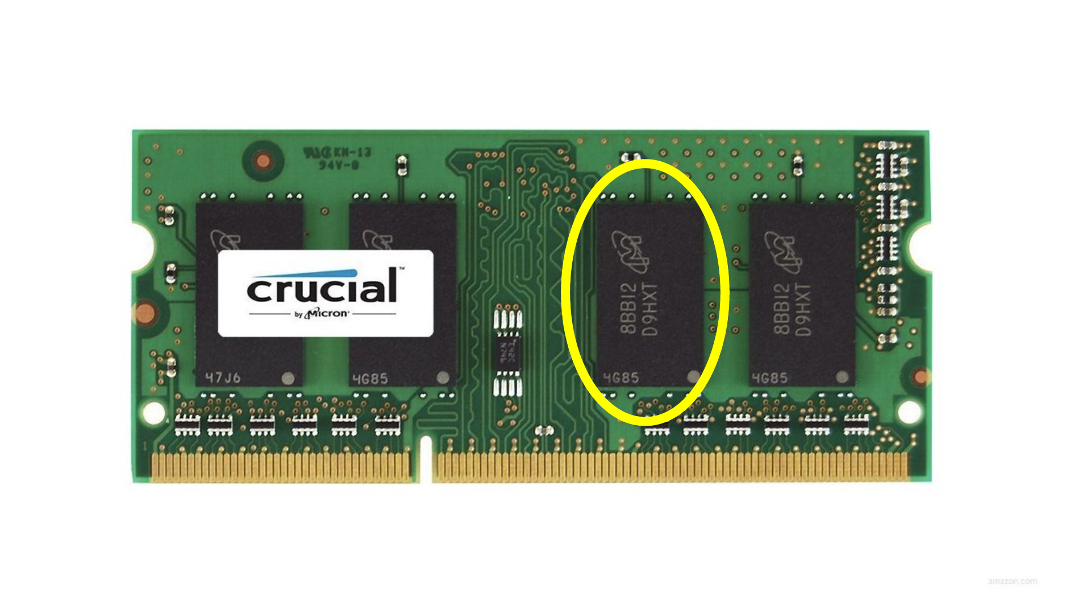
One memory chip
CS50 Lecture 2
15
Notes:
The highlighted black package is one memory chip on the module. It contains many storage cells; the following grid is an explanatory model.
40–47 minutes | Memory bridge
40–44 / Slides 14–17
DO: Show RAM and one chip, then the conceptual byte grid. Each square represents one byte; it is not a physical map of the chip.
ASK: What does sizeof(char) report?
EXPECT: 1 C byte. CHAR_BIT tells us the number of bits in that byte. Our illustrated environment uses 8.
44–47 / Slide 18
DO: Trace the three slots in first and second. Point to indices 0, 1 and 2.
ASK: Does a three-character array automatically contain a terminator?
EXPECT: No. These arrays contain exactly three characters and no '\0'.
SOURCE
CS50 Lecture 2: Arrays, https://cs50.harvard.edu/x/2026/weeks/2/; original fall 2025 memory slides, https://cdn.cs50.net/2025/fall/lectures/2/lecture2.pdf. Adapted conceptual grid. Photograph credited by CS50 to Amazon.

Slide 18
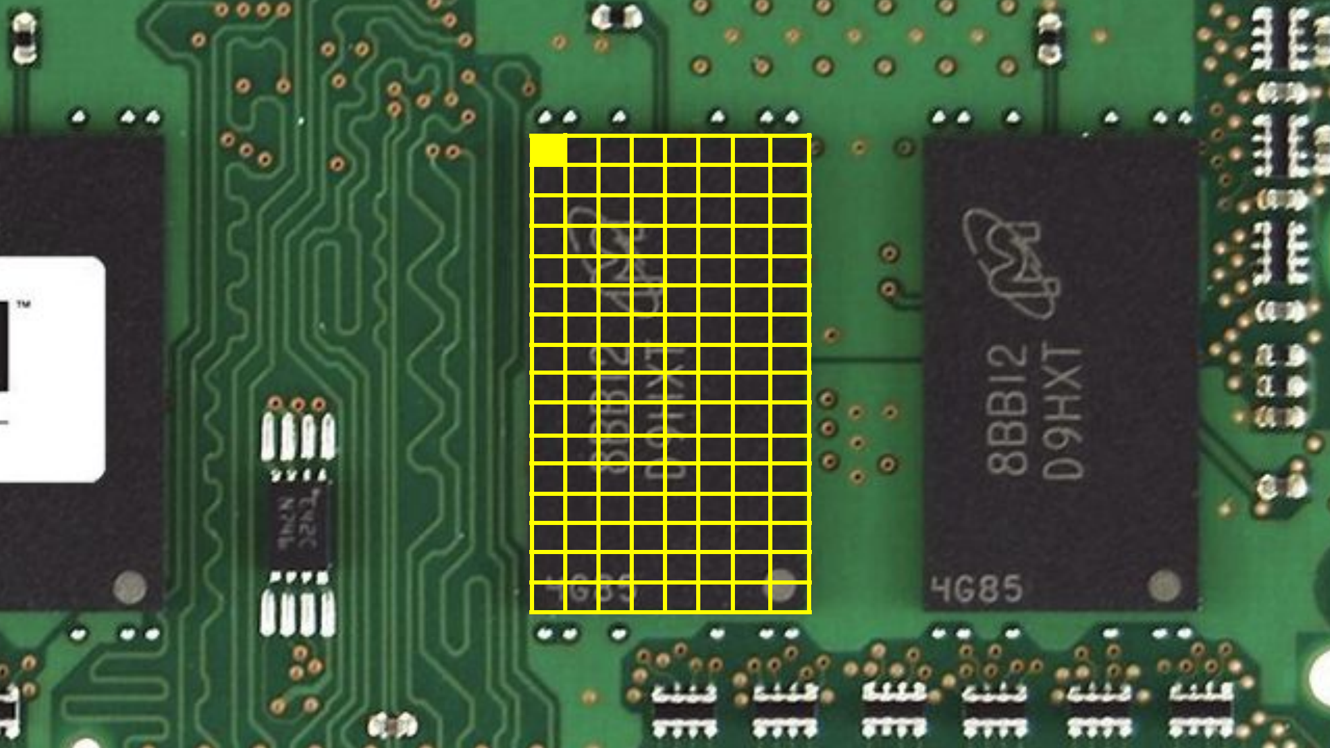
One byte
Conceptual grid: each square represents one byte
16
CS50 Lecture 2
Notes:
Each square in this conceptual CS50 grid represents one byte, and one square is highlighted. It is not a photograph of physical byte boundaries. sizeof(char) is one C byte; CHAR_BIT gives its bit count. The teaching machine has 8 bits per byte.
40–47 minutes | Memory bridge
40–44 / Slides 14–17
DO: Show RAM and one chip, then the conceptual byte grid. Each square represents one byte; it is not a physical map of the chip.
ASK: What does sizeof(char) report?
EXPECT: 1 C byte. CHAR_BIT tells us the number of bits in that byte. Our illustrated environment uses 8.
44–47 / Slide 18
DO: Trace the three slots in first and second. Point to indices 0, 1 and 2.
ASK: Does a three-character array automatically contain a terminator?
EXPECT: No. These arrays contain exactly three characters and no '\0'.
SOURCE
CS50 Lecture 2: Arrays, https://cs50.harvard.edu/x/2026/weeks/2/; original fall 2025 memory slides, https://cdn.cs50.net/2025/fall/lectures/2/lecture2.pdf. Adapted conceptual grid. Photograph credited by CS50 to Amazon.

Slide 19
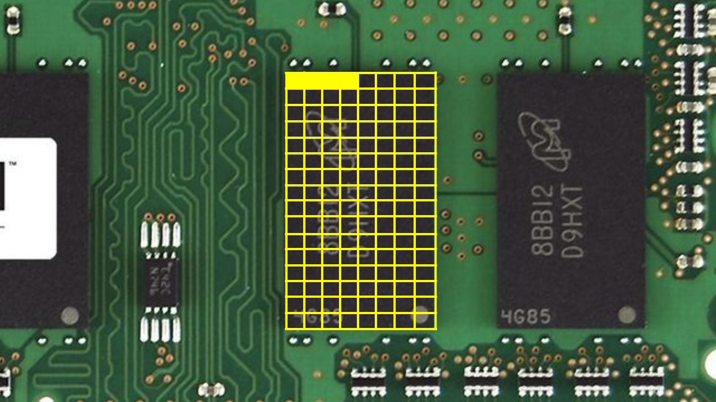
Four bytes
Conceptual grid: each square represents one byte
17
CS50 Lecture 2
Notes:
Four adjacent squares are highlighted, representing four bytes in the conceptual model. This is not a physical map of the memory chip. Four bytes is the measured int size on this teaching machine, not a universal C guarantee.
40–47 minutes | Memory bridge
40–44 / Slides 14–17
DO: Show RAM and one chip, then the conceptual byte grid. Each square represents one byte; it is not a physical map of the chip.
ASK: What does sizeof(char) report?
EXPECT: 1 C byte. CHAR_BIT tells us the number of bits in that byte. Our illustrated environment uses 8.
44–47 / Slide 18
DO: Trace the three slots in first and second. Point to indices 0, 1 and 2.
ASK: Does a three-character array automatically contain a terminator?
EXPECT: No. These arrays contain exactly three characters and no '\0'.
SOURCE
CS50 Lecture 2: Arrays, https://cs50.harvard.edu/x/2026/weeks/2/; original fall 2025 memory slides, https://cdn.cs50.net/2025/fall/lectures/2/lecture2.pdf. Adapted conceptual grid. Photograph credited by CS50 to Amazon.

Slide 20
Character arrays
char first[3] = {'d', 'o', 'g'};
char second[3] = {'c', 'a', 't'};
Index | 0 | 1 | 2
first | d | o | g
second | c | a | t
Indices 0–2 · no '\0' terminator · not C strings
18
Notes:
Both arrays have exactly three char elements. Valid indices are 0, 1 and 2. There is no '\0' terminator, so these arrays are not C strings. Print a known number of characters using %c, not %s. The code uses basic lowercase ASCII letters.
40–47 minutes | Memory bridge
40–44 / Slides 14–17
DO: Show RAM and one chip, then the conceptual byte grid. Each square represents one byte; it is not a physical map of the chip.
ASK: What does sizeof(char) report?
EXPECT: 1 C byte. CHAR_BIT tells us the number of bits in that byte. Our illustrated environment uses 8.
44–47 / Slide 18
DO: Trace the three slots in first and second. Point to indices 0, 1 and 2.
ASK: Does a three-character array automatically contain a terminator?
EXPECT: No. These arrays contain exactly three characters and no '\0'.
SOURCE
Ceri, Mandrioli & Sbattella, The Art and Craft of Computing, Chapters 4–5. Teaching adaptation in C11 with CS50 input helpers.

Slide 21
Alphabetical joining
dog + cat
catdog
Prepared lowercase ASCII letters
Compare the arrays, then copy the earlier one first
19
Notes:
The plus sign is a visual illustration of joining, not a C array operator. Prepared lowercase ASCII arrays dog and cat produce catdog. Compare whole arrays by the first differing character, then copy their elements in that order. Book Example 5.6 already contains the correct && and || bounds guards; our adaptation reduces 50 characters to 3, prepares the input, combines the copy loops and repairs the final output traversal.
47–75 minutes | Alphabetical joining
47–50 / Slide 19, then editor
DO: Create alphabetical_join.c with stdio.h and #define LENGTH 3. Declare first, second and joined[2 * LENGTH].
ASK: Are we sorting individual letters?
EXPECT: No. We compare the two whole arrays and join the earlier one first.
50–54 / Slide 20, then editor
DO: Use car/cat to explain equal prefixes. Type the scan: i < LENGTH && first[i] == second[i].
ASK: At which index do car and cat first differ?
EXPECT: Index 2: r and t. Use prepared lowercase ASCII letters.
54–60 / Slides 21–22, then editor
DO: Ask which bound visits all three elements safely. Trace cat/cat until i becomes LENGTH.
ASK: Why must the bound come before the character access?
EXPECT: && skips its right side when the bound is false. Index 3 is outside either array. Poll answer A.
60–63 / Editor
DO: Type first_earlier = i == LENGTH || first[i] < second[i].
ASK: Why test i == LENGTH first here?
EXPECT: Equal arrays reach the boundary. || skips the invalid character access, and either order gives the same result.
63–70 / Slide 23, then editor
DO: Return to the prepared dog/cat arrays. Reset i. Write the copy loop, using i for the first half and LENGTH + i for the second. Advance i after each pair.
ASK: Where does the second half start? Where does it end?
EXPECT: Indices 3 through 5. Trace i = 0 and i = 2 before running.
70–75 / Slides 24–25, then editor
DO: Trace car/cat through the flowchart, then use the English pseudocode as a checklist. Print all six characters and run the cases below.
ASK: Why is %s unsuitable for this joined array?
EXPECT: There is no final '\0'. Print exactly six characters with %c.
SOURCE
Book Example 5.6, printed pp. 114–116. Three prepared characters instead of 50; final output traversal repaired.

Slide 22
The first different character
Index | 0 | 1 | 2
first | c | a | r
second | c | a | t
Equal? | yes | yes | no
20
Notes:
47–75 minutes | Alphabetical joining
47–50 / Slide 19, then editor
DO: Create alphabetical_join.c with stdio.h and #define LENGTH 3. Declare first, second and joined[2 * LENGTH].
ASK: Are we sorting individual letters?
EXPECT: No. We compare the two whole arrays and join the earlier one first.
50–54 / Slide 20, then editor
DO: Use car/cat to explain equal prefixes. Type the scan: i < LENGTH && first[i] == second[i].
ASK: At which index do car and cat first differ?
EXPECT: Index 2: r and t. Use prepared lowercase ASCII letters.
54–60 / Slides 21–22, then editor
DO: Ask which bound visits all three elements safely. Trace cat/cat until i becomes LENGTH.
ASK: Why must the bound come before the character access?
EXPECT: && skips its right side when the bound is false. Index 3 is outside either array. Poll answer A.
60–63 / Editor
DO: Type first_earlier = i == LENGTH || first[i] < second[i].
ASK: Why test i == LENGTH first here?
EXPECT: Equal arrays reach the boundary. || skips the invalid character access, and either order gives the same result.
63–70 / Slide 23, then editor
DO: Return to the prepared dog/cat arrays. Reset i. Write the copy loop, using i for the first half and LENGTH + i for the second. Advance i after each pair.
ASK: Where does the second half start? Where does it end?
EXPECT: Indices 3 through 5. Trace i = 0 and i = 2 before running.
70–75 / Slides 24–25, then editor
DO: Trace car/cat through the flowchart, then use the English pseudocode as a checklist. Print all six characters and run the cases below.
ASK: Why is %s unsuitable for this joined array?
EXPECT: There is no final '\0'. Print exactly six characters with %c.
SOURCE
Ceri, Mandrioli & Sbattella, The Art and Craft of Computing, Chapters 4–5. Teaching adaptation in C11 with CS50 input helpers.

Slide 23
Which bound visits all three safely?
Prediction 3
i starts at 0 and increases by 1
A
i < 3
B
i <= 3
C
i < 2
D
i > 3
21
Notes:
The requirement is to visit every valid index of a three-element array once, starting at i = 0 and incrementing by one. A visits 0,1,2; B also reaches invalid index 3; C misses index 2; D visits none. Safety alone would not distinguish A from C and D. Poll answer A.
47–75 minutes | Alphabetical joining
47–50 / Slide 19, then editor
DO: Create alphabetical_join.c with stdio.h and #define LENGTH 3. Declare first, second and joined[2 * LENGTH].
ASK: Are we sorting individual letters?
EXPECT: No. We compare the two whole arrays and join the earlier one first.
50–54 / Slide 20, then editor
DO: Use car/cat to explain equal prefixes. Type the scan: i < LENGTH && first[i] == second[i].
ASK: At which index do car and cat first differ?
EXPECT: Index 2: r and t. Use prepared lowercase ASCII letters.
54–60 / Slides 21–22, then editor
DO: Ask which bound visits all three elements safely. Trace cat/cat until i becomes LENGTH.
ASK: Why must the bound come before the character access?
EXPECT: && skips its right side when the bound is false. Index 3 is outside either array. Poll answer A.
60–63 / Editor
DO: Type first_earlier = i == LENGTH || first[i] < second[i].
ASK: Why test i == LENGTH first here?
EXPECT: Equal arrays reach the boundary. || skips the invalid character access, and either order gives the same result.
63–70 / Slide 23, then editor
DO: Return to the prepared dog/cat arrays. Reset i. Write the copy loop, using i for the first half and LENGTH + i for the second. Advance i after each pair.
ASK: Where does the second half start? Where does it end?
EXPECT: Indices 3 through 5. Trace i = 0 and i = 2 before running.
70–75 / Slides 24–25, then editor
DO: Trace car/cat through the flowchart, then use the English pseudocode as a checklist. Print all six characters and run the cases below.
ASK: Why is %s unsuitable for this joined array?
EXPECT: There is no final '\0'. Print exactly six characters with %c.
SOURCE
Ceri, Mandrioli & Sbattella, The Art and Craft of Computing, Chapters 4–5. Teaching adaptation in C11 with CS50 input helpers.

Slide 24
Do not edit
How to change the design
Which condition visits all three elements safely?
The Slido app must be installed on every computer you’re presenting from

Slide 25
Equal arrays reach the boundary
i < LENGTH && first[i] == second[i]
i | i < 3 | Read the characters?
0, 1, 2 | true | yes
3 | false | no
&& skips the right side when the left side is false
22
Notes:
47–75 minutes | Alphabetical joining
47–50 / Slide 19, then editor
DO: Create alphabetical_join.c with stdio.h and #define LENGTH 3. Declare first, second and joined[2 * LENGTH].
ASK: Are we sorting individual letters?
EXPECT: No. We compare the two whole arrays and join the earlier one first.
50–54 / Slide 20, then editor
DO: Use car/cat to explain equal prefixes. Type the scan: i < LENGTH && first[i] == second[i].
ASK: At which index do car and cat first differ?
EXPECT: Index 2: r and t. Use prepared lowercase ASCII letters.
54–60 / Slides 21–22, then editor
DO: Ask which bound visits all three elements safely. Trace cat/cat until i becomes LENGTH.
ASK: Why must the bound come before the character access?
EXPECT: && skips its right side when the bound is false. Index 3 is outside either array. Poll answer A.
60–63 / Editor
DO: Type first_earlier = i == LENGTH || first[i] < second[i].
ASK: Why test i == LENGTH first here?
EXPECT: Equal arrays reach the boundary. || skips the invalid character access, and either order gives the same result.
63–70 / Slide 23, then editor
DO: Return to the prepared dog/cat arrays. Reset i. Write the copy loop, using i for the first half and LENGTH + i for the second. Advance i after each pair.
ASK: Where does the second half start? Where does it end?
EXPECT: Indices 3 through 5. Trace i = 0 and i = 2 before running.
70–75 / Slides 24–25, then editor
DO: Trace car/cat through the flowchart, then use the English pseudocode as a checklist. Print all six characters and run the cases below.
ASK: Why is %s unsuitable for this joined array?
EXPECT: There is no final '\0'. Print exactly six characters with %c.
SOURCE
Ceri, Mandrioli & Sbattella, The Art and Craft of Computing, Chapters 4–5. Teaching adaptation in C11 with CS50 input helpers.

Slide 26
The copy offset
Index | 0 | 1 | 2 | 3 | 4 | 5
joined | c | a | t | d | o | g
i fills 0–2. LENGTH + i fills 3–5.
23
Notes:
Return to the original prepared dog/cat arrays after the car/cat and cat/cat traces. The earlier array cat goes into joined[0..2]; dog goes into joined[3..5]. The second destination offset is LENGTH + i, with i = 0,1,2.
47–75 minutes | Alphabetical joining
47–50 / Slide 19, then editor
DO: Create alphabetical_join.c with stdio.h and #define LENGTH 3. Declare first, second and joined[2 * LENGTH].
ASK: Are we sorting individual letters?
EXPECT: No. We compare the two whole arrays and join the earlier one first.
50–54 / Slide 20, then editor
DO: Use car/cat to explain equal prefixes. Type the scan: i < LENGTH && first[i] == second[i].
ASK: At which index do car and cat first differ?
EXPECT: Index 2: r and t. Use prepared lowercase ASCII letters.
54–60 / Slides 21–22, then editor
DO: Ask which bound visits all three elements safely. Trace cat/cat until i becomes LENGTH.
ASK: Why must the bound come before the character access?
EXPECT: && skips its right side when the bound is false. Index 3 is outside either array. Poll answer A.
60–63 / Editor
DO: Type first_earlier = i == LENGTH || first[i] < second[i].
ASK: Why test i == LENGTH first here?
EXPECT: Equal arrays reach the boundary. || skips the invalid character access, and either order gives the same result.
63–70 / Slide 23, then editor
DO: Return to the prepared dog/cat arrays. Reset i. Write the copy loop, using i for the first half and LENGTH + i for the second. Advance i after each pair.
ASK: Where does the second half start? Where does it end?
EXPECT: Indices 3 through 5. Trace i = 0 and i = 2 before running.
70–75 / Slides 24–25, then editor
DO: Trace car/cat through the flowchart, then use the English pseudocode as a checklist. Print all six characters and run the cases below.
ASK: Why is %s unsuitable for this joined array?
EXPECT: There is no final '\0'. Print exactly six characters with %c.
SOURCE
Ceri, Mandrioli & Sbattella, The Art and Craft of Computing, Chapters 4–5. Teaching adaptation in C11 with CS50 input helpers.

Slide 27
Alphabetical joining
Start at index 0
Inside
both arrays?
false
Keep the
original order
true
Characters
match?
Move to next
character
true
false
Earlier letter’s
array first
Copy both arrays
Print 6 characters
24
Notes:
Check the array bounds before reading a character. Equal characters advance the index and return to the bounds test. Reaching the end keeps the original order. At a difference, choose the array containing the earlier lowercase ASCII letter. Both branches copy complete arrays in that order and print exactly six characters. There is no null terminator.
47–75 minutes | Alphabetical joining
47–50 / Slide 19, then editor
DO: Create alphabetical_join.c with stdio.h and #define LENGTH 3. Declare first, second and joined[2 * LENGTH].
ASK: Are we sorting individual letters?
EXPECT: No. We compare the two whole arrays and join the earlier one first.
50–54 / Slide 20, then editor
DO: Use car/cat to explain equal prefixes. Type the scan: i < LENGTH && first[i] == second[i].
ASK: At which index do car and cat first differ?
EXPECT: Index 2: r and t. Use prepared lowercase ASCII letters.
54–60 / Slides 21–22, then editor
DO: Ask which bound visits all three elements safely. Trace cat/cat until i becomes LENGTH.
ASK: Why must the bound come before the character access?
EXPECT: && skips its right side when the bound is false. Index 3 is outside either array. Poll answer A.
60–63 / Editor
DO: Type first_earlier = i == LENGTH || first[i] < second[i].
ASK: Why test i == LENGTH first here?
EXPECT: Equal arrays reach the boundary. || skips the invalid character access, and either order gives the same result.
63–70 / Slide 23, then editor
DO: Return to the prepared dog/cat arrays. Reset i. Write the copy loop, using i for the first half and LENGTH + i for the second. Advance i after each pair.
ASK: Where does the second half start? Where does it end?
EXPECT: Indices 3 through 5. Trace i = 0 and i = 2 before running.
70–75 / Slides 24–25, then editor
DO: Trace car/cat through the flowchart, then use the English pseudocode as a checklist. Print all six characters and run the cases below.
ASK: Why is %s unsuitable for this joined array?
EXPECT: There is no final '\0'. Print exactly six characters with %c.
SOURCE
Book Example 5.6, printed pp. 114–116.
Visual method: CS50 2025 Lecture 0, slides 103–104 (numbered English pseudocode), https://cdn.cs50.net/2025/fall/lectures/0/lecture0.pdf; Lecture 1, slides 105–109 (flowcharts), https://cdn.cs50.net/2025/fall/lectures/1/lecture1.pdf. Original diagrams and wording for this TashTech lesson; not CS50-authored exercises.

Slide 28
Alphabetical joining
1
Start at the first character of each array
2
While both characters exist and match
3
Move to the next character
4
If all characters matched
5
Keep the original order
6
Else
7
Put the array with the earlier letter first
8
Copy both arrays in that order
9
Print exactly six characters
25
Notes:
Both arrays have three prepared lowercase ASCII characters. “Exist” means the index is below LENGTH. After scanning, all matched means i == LENGTH. Otherwise the first differing characters decide lexicographic order. Copy means the existing element-by-element loop, not C array assignment. No %s: exactly six %c operations. Use car/cat and cat/cat as the key tests.
47–75 minutes | Alphabetical joining
47–50 / Slide 19, then editor
DO: Create alphabetical_join.c with stdio.h and #define LENGTH 3. Declare first, second and joined[2 * LENGTH].
ASK: Are we sorting individual letters?
EXPECT: No. We compare the two whole arrays and join the earlier one first.
50–54 / Slide 20, then editor
DO: Use car/cat to explain equal prefixes. Type the scan: i < LENGTH && first[i] == second[i].
ASK: At which index do car and cat first differ?
EXPECT: Index 2: r and t. Use prepared lowercase ASCII letters.
54–60 / Slides 21–22, then editor
DO: Ask which bound visits all three elements safely. Trace cat/cat until i becomes LENGTH.
ASK: Why must the bound come before the character access?
EXPECT: && skips its right side when the bound is false. Index 3 is outside either array. Poll answer A.
60–63 / Editor
DO: Type first_earlier = i == LENGTH || first[i] < second[i].
ASK: Why test i == LENGTH first here?
EXPECT: Equal arrays reach the boundary. || skips the invalid character access, and either order gives the same result.
63–70 / Slide 23, then editor
DO: Return to the prepared dog/cat arrays. Reset i. Write the copy loop, using i for the first half and LENGTH + i for the second. Advance i after each pair.
ASK: Where does the second half start? Where does it end?
EXPECT: Indices 3 through 5. Trace i = 0 and i = 2 before running.
70–75 / Slides 24–25, then editor
DO: Trace car/cat through the flowchart, then use the English pseudocode as a checklist. Print all six characters and run the cases below.
ASK: Why is %s unsuitable for this joined array?
EXPECT: There is no final '\0'. Print exactly six characters with %c.
SOURCE
Book Example 5.6, printed pp. 114–116.
Visual method: CS50 2025 Lecture 0, slides 103–104 (numbered English pseudocode), https://cdn.cs50.net/2025/fall/lectures/0/lecture0.pdf; Lecture 1, slides 105–109 (flowcharts), https://cdn.cs50.net/2025/fall/lectures/1/lecture1.pdf. Original diagrams and wording for this TashTech lesson; not CS50-authored exercises.

Slide 29
Three exit checks
1
Why does double x = 4 / 3 still lose the fraction?
2
Why is 2100 a common year?
3
Why must i < LENGTH come first in the loop test?
26
Notes:
75–80 minutes | Close
75–78 / Slide 26
DO: Take verbal answers to the three exit checks.
ASK: Integer division? Year 2100? Bound first?
EXPECT: 4 / 3 gives the integer 1 before conversion to double. 2100 is divisible by 100 but not 400, so it is common. The bound must be evaluated first so && can skip an invalid array access.
78–80 / LMS student guide
DO: Open Week 4 → Lab session → Interactive Student Guide.
ASK: What will students build in the separate coding session?
EXPECT: Circle precision and Character processor are the core tasks. Five-character joining is a challenge if time permits.
SOURCE
Ceri, Mandrioli & Sbattella, The Art and Craft of Computing, Chapters 4–5. Teaching adaptation in C11 with CS50 input helpers.

Slide 30
Integer sizes and ranges
Reference · measured on macOS arm64 · 8 bits per byte
Type | Bits | Range
char | 8 | −128 to 127
signed char | 8 | −128 to 127
unsigned char | 8 | 0 to 255
short | 16 | −32,768 to 32,767
unsigned short | 16 | 0 to 65,535
int | 32 | −2,147,483,648 to 2,147,483,647
unsigned int | 32 | 0 to 4,294,967,295
Plain char signedness and integer limits depend on the implementation.
27
Notes:
Measurements shown are from macOS arm64. Use sizeof and limits.h on the teaching machine to confirm. sizeof(char)==1 by definition; the number of bits is CHAR_BIT. Numeric values are implementation-specific. All displayed sizes, signedness, bounds and FLT_DIG/DBL_DIG/LDBL_DIG values were remeasured with C11 on macOS arm64 during this audit. Other implementations may differ.
SOURCE
C11 <limits.h>, <float.h>, sizeof and CHAR_BIT measurements on macOS arm64; https://www.open-std.org/jtc1/sc22/wg14/www/docs/n1570.pdf

Slide 31
Larger integer types
Reference · measured on macOS arm64 · 8 bits per byte
Type | Bits | Range
long | 64 | −9,223,372,036,854,775,808 to 9,223,372,036,854,775,807
unsigned long | 64 | 0 to 18,446,744,073,709,551,615
long long | 64 | −9,223,372,036,854,775,808 to 9,223,372,036,854,775,807
unsigned long long | 64 | 0 to 18,446,744,073,709,551,615
Other environments can use different sizes, especially for long.
signed int = int short int = short long int = long
28
Notes:
Measurements shown are from macOS arm64. long can have another size on another platform. Signed overflow is undefined behaviour. Unsigned arithmetic wraps modulo one more than its maximum value. All displayed sizes, signedness, bounds and FLT_DIG/DBL_DIG/LDBL_DIG values were remeasured with C11 on macOS arm64 during this audit. Other implementations may differ.
SOURCE
C11 <limits.h>, <float.h>, sizeof and CHAR_BIT measurements on macOS arm64; https://www.open-std.org/jtc1/sc22/wg14/www/docs/n1570.pdf

Slide 32
Floating-point sizes and precision
Reference · measured on macOS arm64 · 8 bits per byte
Type | Bits | Decimal precision
float | 32 | 6 significant digits
double | 64 | 15 significant digits
long double | 64 | 15 significant digits
Precision from FLT_DIG, DBL_DIG and LDBL_DIG in <float.h>.
long double has the same precision as double on this platform.
printf precision controls the display, not the stored value.
29
Notes:
Measurements shown are from macOS arm64. float.h describes this implementation. Formatting changes the displayed digits, not stored precision. The table is a reference, not another live program. All displayed sizes, signedness, bounds and FLT_DIG/DBL_DIG/LDBL_DIG values were remeasured with C11 on macOS arm64 during this audit. Other implementations may differ.
SOURCE
C11 <limits.h>, <float.h>, sizeof and CHAR_BIT measurements on macOS arm64; https://www.open-std.org/jtc1/sc22/wg14/www/docs/n1570.pdf

Slide 33
Sources
The Art and Craft of Computing
Examples 5.1, 5.3 and 5.6
CS50 Lectures 0–2
Pseudocode, flowcharts and memory visuals
C11 / CS50 library · Gregorian rule: USNO · BBC News
Full references and adaptations in presenter notes
30
Notes:
Ceri, Mandrioli & Sbattella, The Art and Craft of Computing, supplied course textbook. Example 5.3 p.101, Example 5.1 pp.98–99 with rule repair p.134, Example 5.6 pp.114–116. Exercise 4.3 p.92 and 5.4 p.103 support the separate guided lab. CS50 Lecture 2 Arrays, https://cs50.harvard.edu/x/2026/weeks/2/ and fall 2025 source slides 73–79,82–83,88. CS50 material CC BY-NC-SA 4.0. Original RAM product photograph credited by CS50 to Amazon; separate reuse clearance not established. Type references preserve the supplied Maruza 5 / C tiliga kirish adaptation and measured C11 macOS arm64 values.
C11 types, logical short-circuit evaluation and limits: https://www.open-std.org/jtc1/sc22/wg14/www/docs/n1570.pdf (§§6.2.5, 6.5.13–14, 7.18). CS50 type alias and input API: https://cs50.readthedocs.io/libraries/cs50/c/ and https://github.com/cs50/libcs50/blob/main/src/cs50.h. Pseudocode and flowchart style: CS50 2025 Lectures 0 and 1, https://cdn.cs50.net/2025/fall/lectures/0/lecture0.pdf and https://cdn.cs50.net/2025/fall/lectures/1/lecture1.pdf. Gregorian rule: https://aa.usno.navy.mil/faq/leap_years. User-selected introduction: BBC News, Leap years and why we need them, https://www.youtube.com/watch?v=gvuz0BVy5TM.
SOURCE
Ceri, Mandrioli & Sbattella, The Art and Craft of Computing, Chapters 4–5. Teaching adaptation in C11 with CS50 input helpers.

