Slide 1
Давосда ўтказилаётган Жаҳон иқтисодий форумида 2025 йилги Global Risks Report (https://reports.weforum.org/docs/WEF_Global_Risks_Report_2025.pdf) ҳисоботи эълон қилинди, унда ўрта муддатли истиқболдаги асосий хавфлар аниқланди. 🇺🇿 Ўзбекистон учун улар қуйидагилар: 1. Сув етишмаслиги 2. Энергия танқислиги 3. Ифлосланиш (ҳаво, сув, тупроқ) 4. Давлат қарзи 5. Кадр ва/ёки истеъдоднинг етишмаслиги | 🇰🇿 Қозоғистон учун улар қуйидагилар: 1. Қуролли тўқнашувлар (давлатлараро, давлатлараро, прокси урушлар, давлат тўнтаришлари) 2. Иқтисодий таназзул (рецессия, турғунлик) 3. Сув етишмаслиги 4. Қашшоқлик ва тенгсизлик (бойлик, даромад) 5. Инфляция 🇰🇬Қирғизистон: 1. Энергия танқислиги 2. Сув етишмаслиги 3. Ифлосланиш (ҳаво, сув, тупроқ) 4. Инфляция 5. Давлат қарзи

Slide 2
Formation of Uzbekistan as a republic
Vohid Yusupovich Kholov

Slide 3
Civilization is … .
an advanced state of society
the end of migrations
capitalism
developed economy
Which of the following cultures developed in the deltas of the Amudarya and the Zarafshan?
Jeitun
Hissar
Keltaminar
Chust
Find the place where agriculture developed first in Central Asia.
Jeitun
Hissar
Keltaminar
Chust
Altyndepe, Jarkutan, Namazgadepe are …
Neolithic cultures
Bronze age period sites
Proto-urban settlements
B and c
Zamanbaba culture developed in …
Bukhara region
Tashkent region
Samarkand region
Tashkent region
The nation that migrated to Central Asia in VII-VIII centuries were …
Jews
Indians
Greeks
Arabs

Slide 4
Plan
History of ancient statehood
History of Medieval age statehood
Formation of Uzbek Khanates
Political and territorial changes after Russian conquest
Formation of Nation-building states
Inner division of Uzbekistan
Territorial disputes and delimitation

Slide 5
Questions
What do you understand as a state?
What are the states of development of states?
What do you know about the titles of rulers?
What are the types of state formations?
What are factors that led to the crisis of big and strong countries?

Slide 6
Introduction
The history of statehood indicates the formation of political entities, transformation from adats and tribal forms to certain legally based structures under particular ruler and system.
The tribal forms mostly indicate to control of a particular geographical area under the limited regulation. The transformation to statehood is the combination or alliance of different nations and tribes under more developed legal process.
Module goal. the notion of statehood, in the periods till the VIII century, types of state rulers, structure of state formation in Samanids, Temurid period, division into khanates
Leaning objectives. Factors of statehood, types of state rulers.
Mixture of Islamic and Turkic elements of statehood;
Internal conflicts.

Slide 7
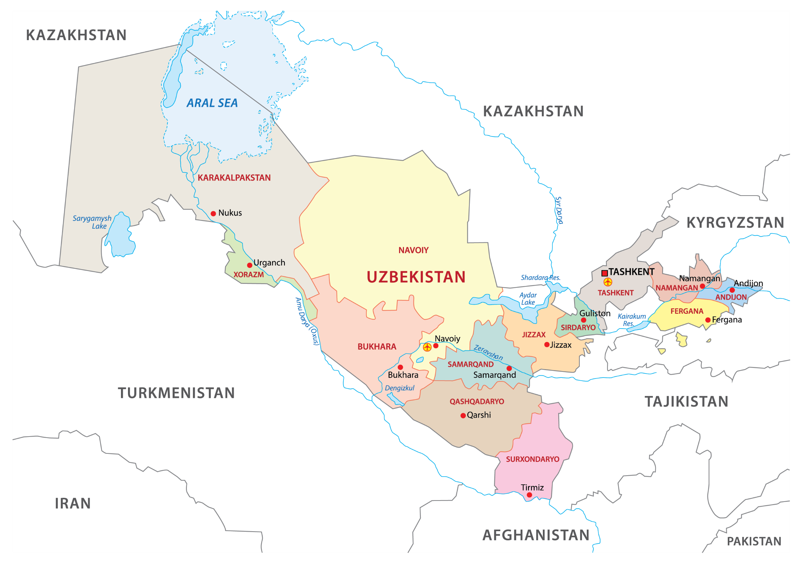

Slide 8
The concept of statehood
Modern statehood - mode of political organization of ‘society’;
The state - the primary agent charged with building the representation of society;
Nation-states – to organize people and territory into formally comparable and sovereign governing units;
The scope of the state now goes beyond traditional activities; the production of laws regulating the exercise of power over territoriality and commerce; to generate forms of subjectivity in people;
One of the major anthropological aspects of states - the deployment of anthropologies: ways of defining and categorizing populations and of systematizing knowledge about them.
The origin of statehood in the world goes back to the period of Charcoalithic period in Egypt and Mesopotamia.

Slide 9
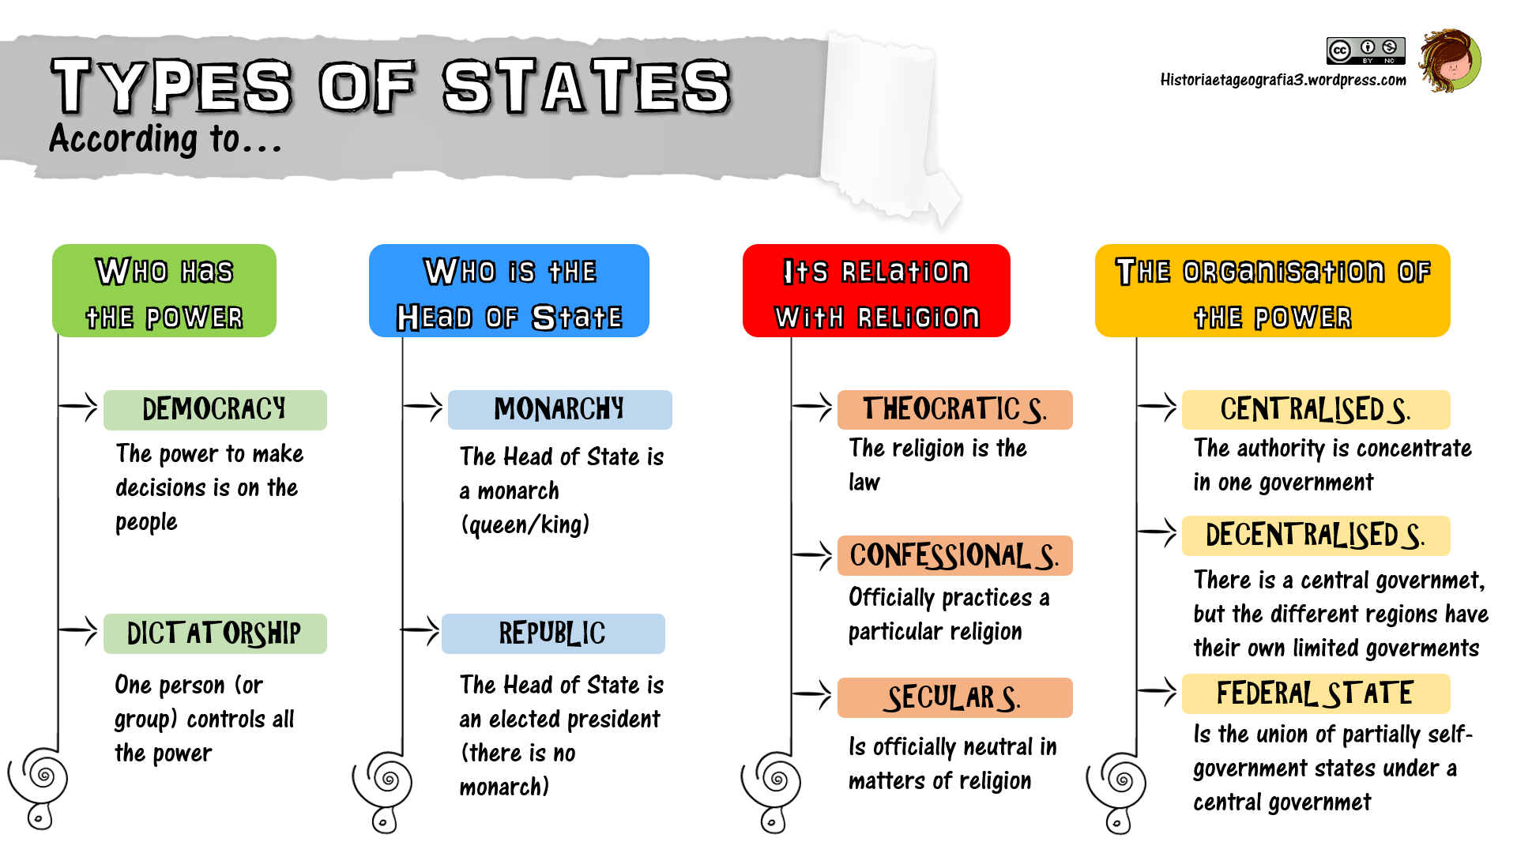

Slide 10
Forms of states and state rulers.
By genetic structure they are divided into Autochthonous ( Qangyu, Korezmia) and foreign-based (Achaemenid Empire, Graeco-Bactrian kingdom)
By their typology-
State type – Kingdom, form of government – absolute monarchy. (Achaemenid Empire, Graeco-Bactrian kingdom).
Theocratic monarchy – Kushan kingdom.
State type – confederative kingdom, form of government – limited monarchy. (Kangju consisting of at least 5 domains and Large Yuezhi).
State type- Domain, type of government – hereditary of tribal leaders, head of clans.

Slide 11
History of ancient statehood
The first state formations in world history – IV-III millennium BC in Egypt and Mesopotamia
In the history of Turkestan, there are different stages of state formation. These stages are because of changes in ruling the country.
1-period. The development of early state-like forms in North Bactria in the second half of the II millennium BC.
2-period. Beginning of the I millennium BC – late VI century BC. The formation of the states of Bactria, Sogdia and Khwarazm.
3-period. Early V century BC – 329 BC. In this period, the area was controlled by Achaemenids.
4-period. The end of the IV century BC – late II century BC. The existence of two types of states. Hellenistic and Khwarazmian and Kangyu states.
5-period. Late II century BC – I century AD. Kushanian kingdom.
6-period. I-III centuries. Development and growth of antient statehood and its final stage in ancient period.

Slide 12
Primary states
Turkestan is a specific historico-geographical and historico-cultural region civilizations had existed over many millenia due to two great rivers (The Amudarya and the Syrdarya).
Bactria. In contemporary Afghanistan, southern Uzbekistan and Tajikistan. The capital was Bactra. In the late II millennium BC, the region saw the emergence of proto-cities, which later consolidated to form the state called the Ancient Bactrian Kingdom. In the VI century it was occupied by Achaemenids, and later by Alexandre Macedonian. After that it was a capital of Greko-Bactrian Knigdom by the time Tokhars succeeded.
Sogdia was established in the in Central Uzbekistan. The capital was present Samarkand. In VI-IV centuries, it was a satrapy of Acheamenids. In 329 BC, it was attacked by A. Macedonian and occupied two years later.
Khoresmia developed in present sites of Khwarazm. In the VII century, it was a centre of Great Khwarazm. In the late VI century BC, it was occupied by Achaemenids. Alexandre Macedonian dd not attack on it since its ruler was smart in foreign policy. It kept its independence by the time Arabs occupied.
Dawan – A state that was developed in Ferghana valley. Zhang Qian noted that there were 70 big and small towns.

Slide 13
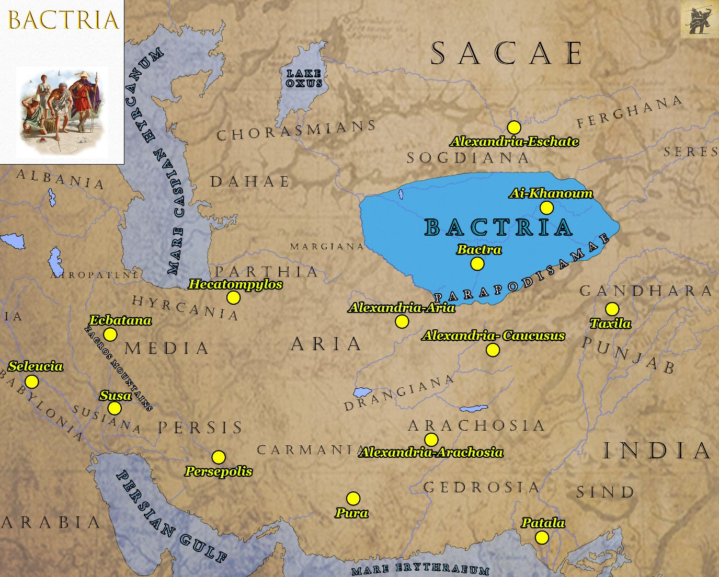
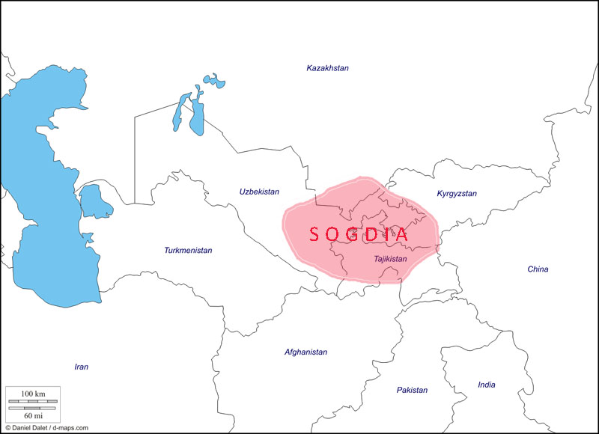

Slide 14
Titles of rulers
Indian factor – Bago pauro (Son of God) in Bactria
Iranianr factor – King of Kings (shahanshah)
Kavi – good princes
Satar –ruler of a region or a country.
Dakhy –pat of all dakhy – lord of all regions
Yabghu – ruler.
Amir;
Sultan;
Khan;
Emperor.

Slide 15
Medieval age statehood history
IV-VI centuries – penetration of Turkic people, migrations;
Military raids of Chionits under Grumbates;
Sogdian coins with the image of an archer on the reverse and the word kydr (Kidara) in the obverse legend;
Hephthalites - From the mid-fifth to the mid-sixth century in Central Asia;
the Hephthalites of Central Asia found themselves squeezed between Sasanian Iran and the Türks;
Assassination of Turkic ambassador in Hephthalite territory;
Joint attacks of Turkic khaganate and Sasanians on Hephthalites and the liquidation of their power;
Formation of Khwarazm as an independent country by Afrigh in the IV century;
VI- early VIII centuries – Period under Turkic khaganate;
704. The start of Arabic attacks on Central Asia and subjugation under Arabic Caliphate.

Slide 16
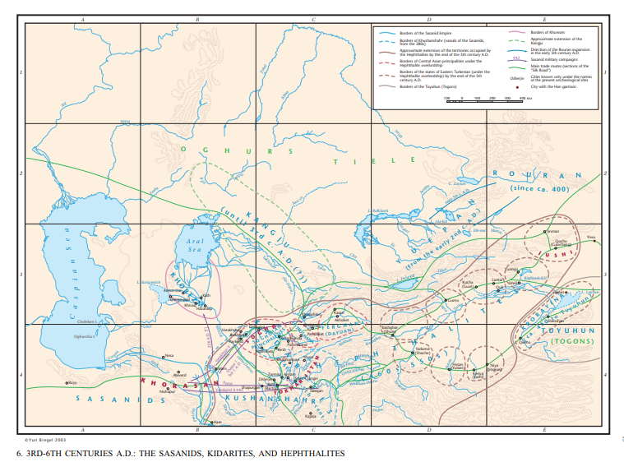

Slide 17
Samanid governance system
the head of state - The Amir;
Provinces were governed by his appointed governors;
Together with the royal court (dargah – responsible for legislation and judicial system), ten centralized military and civilian bureaux (diwans);
The main diwan (the diwan of the vizier) controlled all administrative, political and economic institutions;
Diwan of the mustawfi - financial affairs;
Diwan of amid al-mulk - diplomatic relations and important state papers
Diwan of the sahib al-shurta - the royal guard and military affairs
Diwan of the sahib al-barid - state mail and the clandestine surveillance of local rulers and officials
Diwan of the muhtasib - markets, weights and measures and trade generally, and, later, public morals
Diwan of the mushrif - control over revenue and expenditure and over other state matters
Diwans for juridical affairs, state lands and waqf (pious endowment) lands
Local organs of all the diwans.

Slide 18
Karakhanids
Ghaznavids
Seljuks
Khwarazmshahs
Temurids
Timur besieged Balkh: the fortifications were breached, Amir Husain was defeated and rose to the power on 10 April 1370;
Proclaimation of Chinggisid Soyurghatmish and Sultan Mahmud of titular Khan;
This experience shows the use of limited monarchy, or monarch as a symbol of the unity of the nation;
Emir Temur led military campaigns in order to strengthen his empire. His army occupied 10 million sq.km. It reached from eastern Turkestan to the Mediterranean Sea to the west, from Siberia to the Indian Ocean.
Timur’s last great military undertaking was to have been his projected campaign against China, but this was interrupted by the death of the ‘conqueror of the world’ in 1405, aged 70.

Slide 19
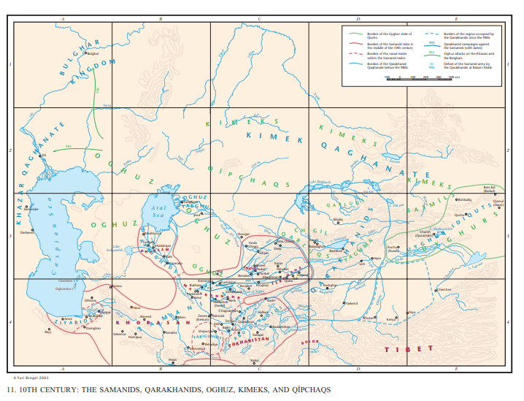

Slide 20
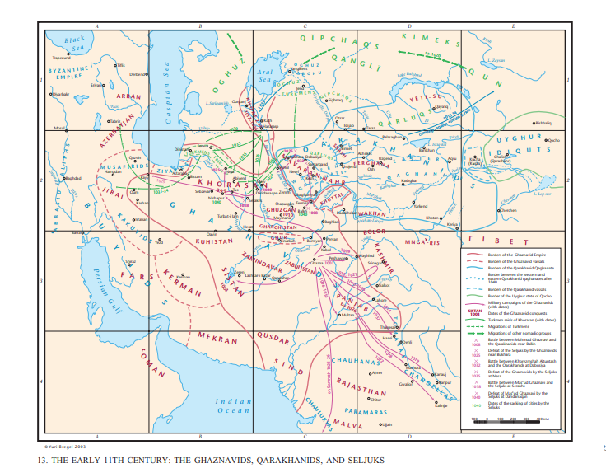

Slide 21
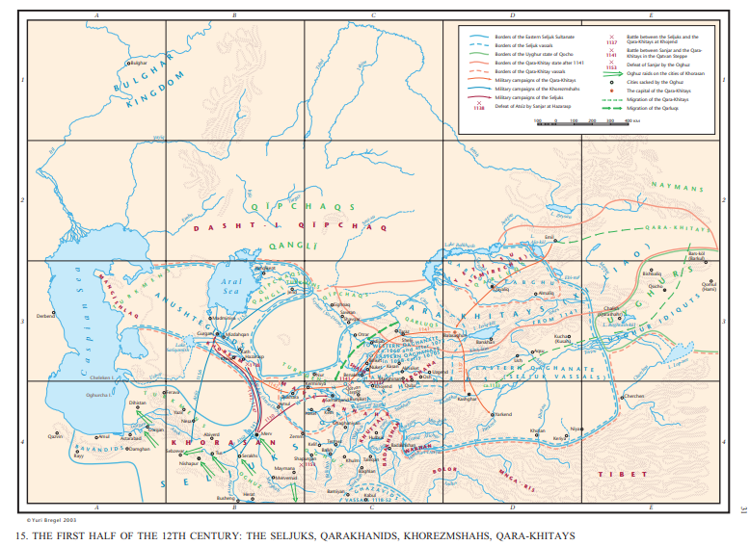

Slide 22
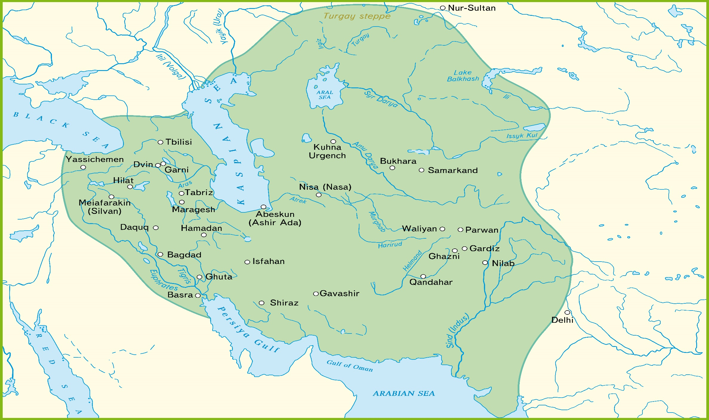
The state of Khwarazmshahs

Slide 23
Division of into small states
Shaybanids
Ashtarkhanids
Bukhara Emirate
Khiva Khanate
Kokand Khanate

Slide 24
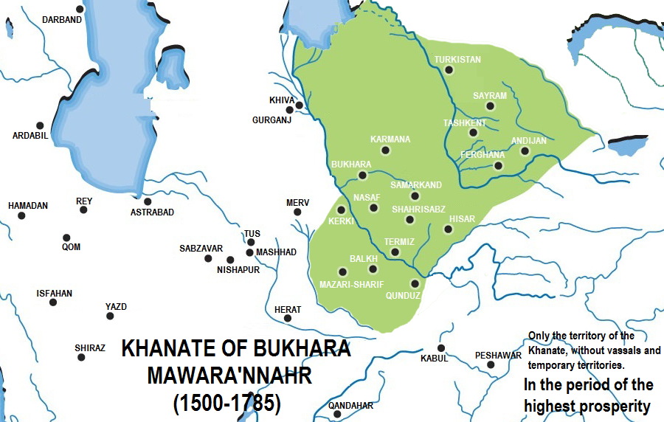

Slide 25
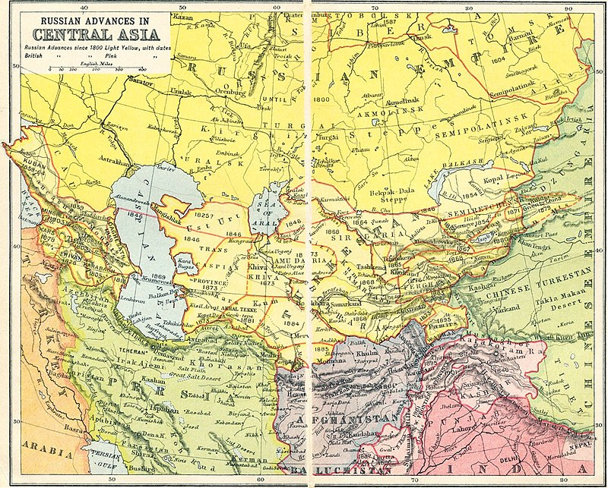

Slide 26
Nation-building states
The set of circumstances altered dramatically in the 1920s in the wake of the world war, revolutions and nationalist movements. It was now the epoch not merely of defining and strategizing, but of deliberate action by states and national movements in nation-building in the whole region.
Soviet state created in stages the five republics of Kazakhstan, Kyrgyzstan, Uzbekistan, Tajikistan and Turkmenistan.
The Jadid Pan-Turkic dream of a single Turkistani state with a single language was fractured into five national states of which four were Turkic-speaking – and one (Tajikistan) Persian-speaking. But the principles of linguistic nationalism were applied, those of defining a territory by language and a supposed common history, and calling the population in it a single people and granting them a single state.
This was the exercise carried out in what is known as national territorial delimitation in 1924.
Either solution would have been unsatisfactory by purely nationalist logic, and it is a measure of how inadequate such nationalist logic necessarily.

Slide 27
Terms commonly used for boundary making - treaty, delimitation, demarcation, delineation.
The meaning of treaty and international agreement under Article 102 of the charter of the United Nations is defined as: “Treaty is a generic term embracing all instruments binding under international law, regardless of their formal designation, concluded between two or more international juridical persons”.
The Vienna Convention (1969) defines a treaty as “an international agreement concluded between States in written form and governed by international law, whether embodied in a single instrument or in two or more related instruments and whatever its particular
designation”

Slide 28
Delimitation is the legal process by which two sovereign nations establish and describe in writing the location of their common boundary, mainly as the output of the decision making on the negotiation table;
Demarcation is a field operation. Its purpose is to mark the position of the boundary on the ground so it is visible to all, and this normally starts by surveying which is the initial stage of demarcation. The objective
of demarcation is to place or adopt physical marks that accurately represent the location of a delimited boundary;
Delineation is the graphical or mathematical representation of the boundary. Frequently, a joint commission undertakes both demarcation and delineation.

Slide 29
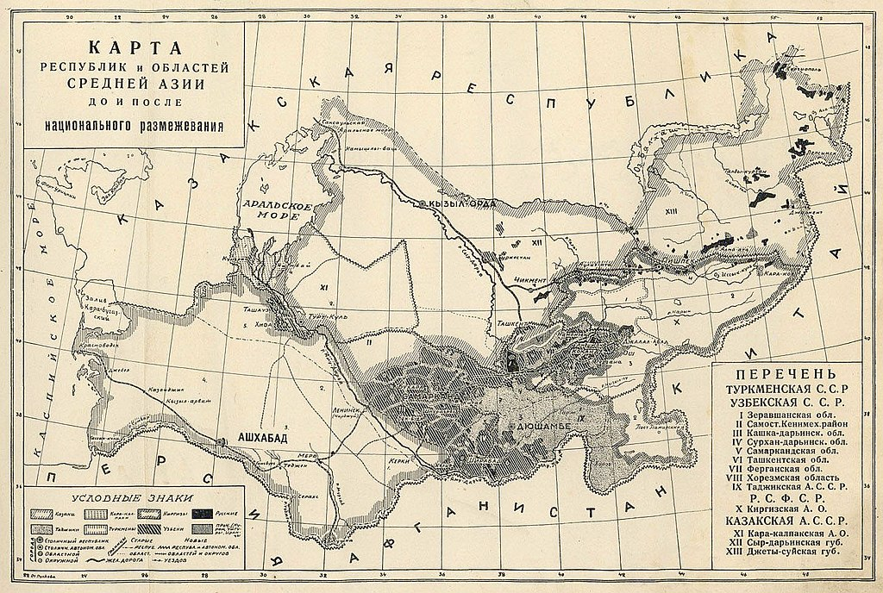

Slide 30
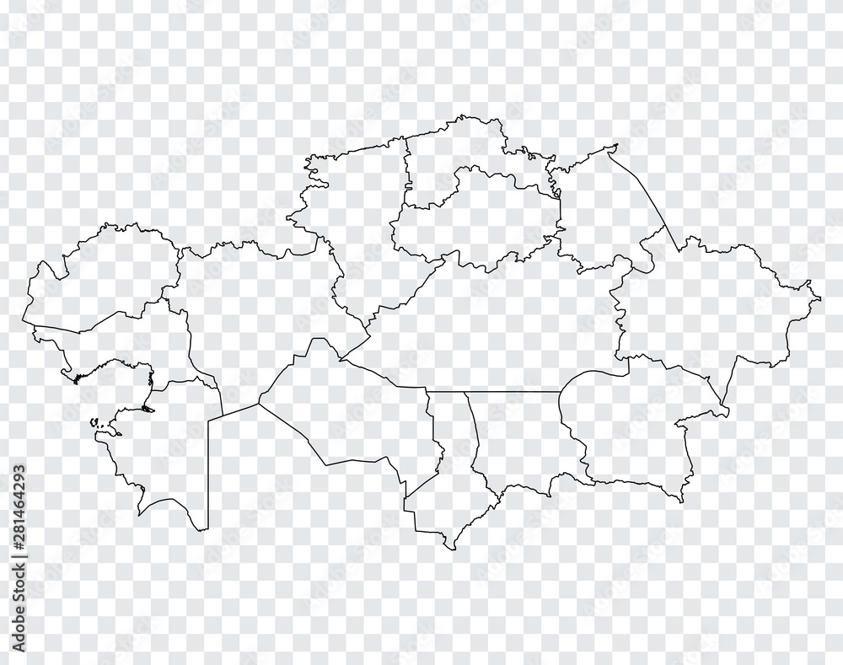
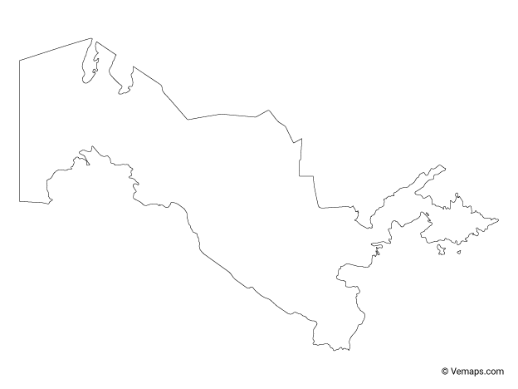
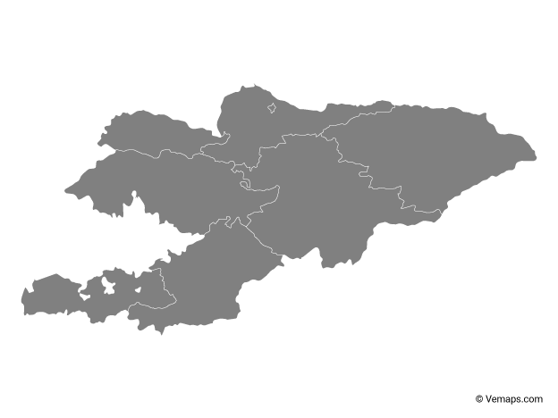
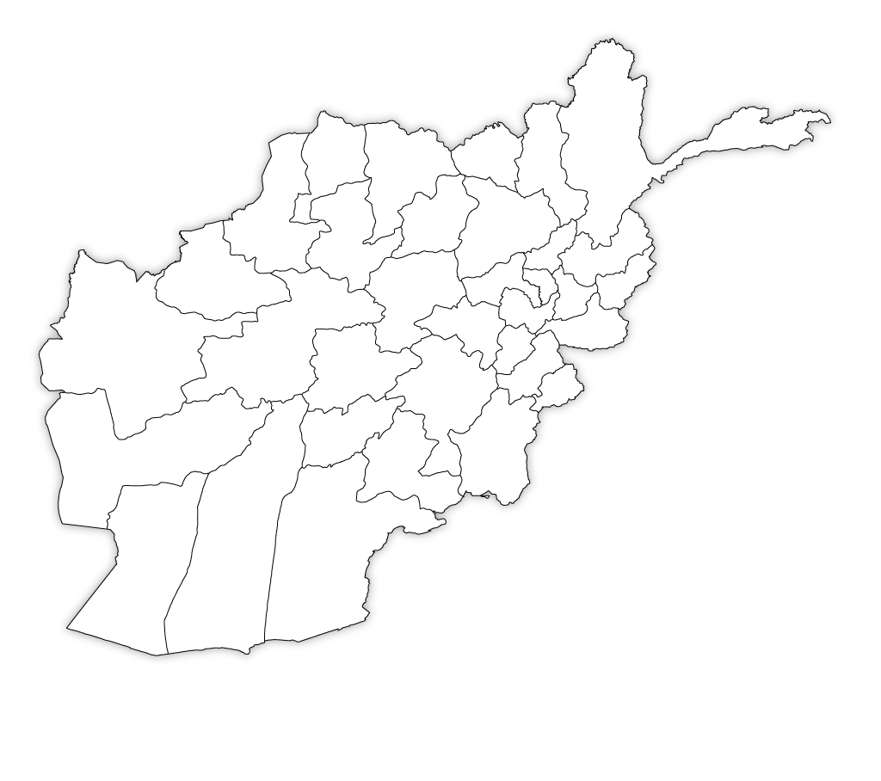
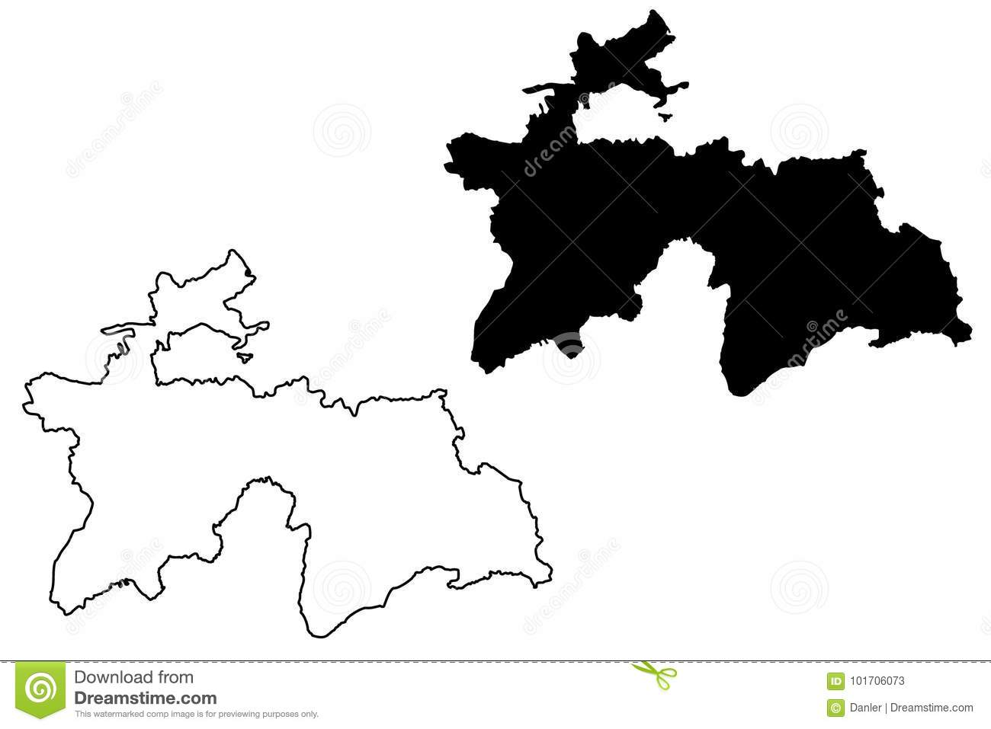
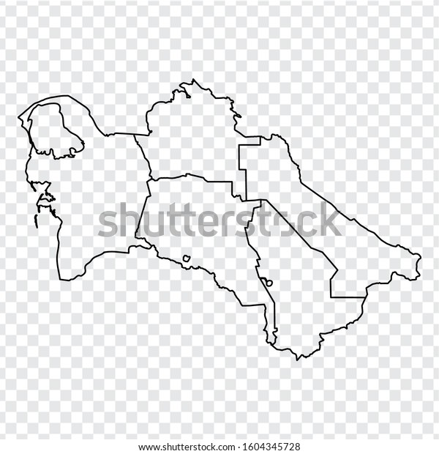

Slide 31
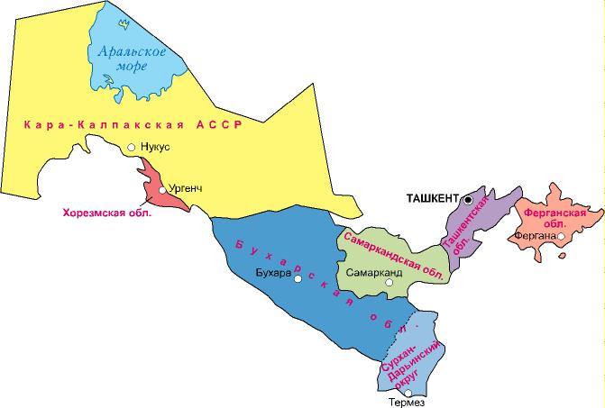
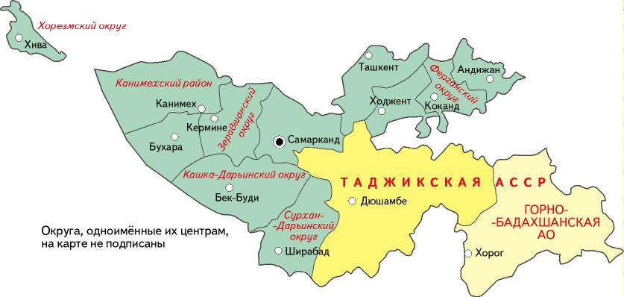
Maps of Uzbekistan in 1927 and 1938

Slide 32
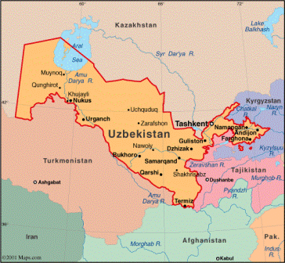
Contemporary map of Uzbekistan

Slide 33
Delimitation talks between Uzbekistan and Kazakhstan
The longest borders between Uzbekistan and other neighbours.
Crossed populated areas having no inviolable area in the north of Tashkent and Syrdarya regions.
Different chosen ways of development (Protectionism (Uzb) and Liberalization (Kaz)

Slide 34
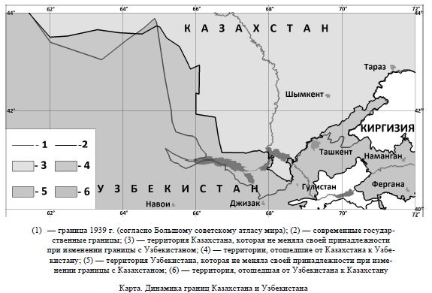

Slide 35
Delimitation discussions with Kyrgyzstan
Borders with most-densly populated areas - Tashkent, Namangan, Andijan and Ferghana regions.
Covers three enclave areas of Uzbekistan.
Disputes and confrontations in the field of water an.

Slide 36
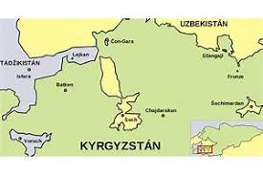
4

Slide 37
Concept. The benefits of the Solution of Delimitation issues
The benefits of the Solution of Delimitation issues for Uzbekistan - to have stable and mutually agreed boundaries with other countries basing on international norms and regulations, development of transiting, partnership in strategic economic sectors, such as the energy sector, agriculture and industry.

Slide 38
Hypotheses
H1: Win – win. Having stable and mutually agreed boundaries with other countries serves for the prosperity of mutual relations.
H2: Reliable boundary policy can make the country to be a centre of discussing problems in international level.

Slide 39
Methods and Data
Methods: policy analysis, discussions on social networks, surveying, comparative analysis, systematic approaches.
The qualitative data come from data distributed by different public bodies and organizations of the republics.

Slide 40
Finding 1: Benefits for not having delimitation issues
Benefits | Obstacles to conducting the research more broadly
Sustainable and reliable relations. | Having problems to use some archive materials since they are considered top secret.
To fight together against different threats.
The solutions of energy peroblems and water disputes.

Slide 41
Suggestions
Establishing joint strategic studies institutions between CAC.
Providing exemptions for the entrepreneurs of other countries joint.
Forming new methods of delimitation policy that could be applied for the solution of much tinier issues related to the problem.
Opening transport corridors.
Supporting one another to provide inviolability of the borders.
Forming funds to promote scientific joint projects in public level to integrate larger number of scholars.

