Slide 1
Gaining the independence of Uzbekistan and further challenges in its state formation
Vohid Yusupovich Kholov

Slide 2
Plan
Uzbekistan under Soviet regime
Perestroika
Adoption of the Declaration of Independence of Uzbekistan
Extraordinary situation in August 1991
Declaring the Independence of Uzbekistan
Referendum on Independence

Slide 3
Summary and Questions
To build homo-sovieticus;
The formation of new states on the basis of nation-building state ideology;
Extracting raw materials or producing agricultural technologies only;
Severe repression policy;
Contributions to the victory over fascism;
No having rights to use income from natural resources.
Questions:
What was main idea of building new countries in Soviet Union?
Why did Soviet Union hold harsh repression policy?
What are main contributions of the people of Uzbekistan during WWII?
How was intellectual and scientific development during Soviet times?
How was the distribution of natural resources of Uzbekistan for Uzbekistanis?
What changes were done during Perestroika?

Slide 4
Soviet Uzbekistan
The USSR Government sought to create a legal basis for the sovereign rights of national republics which was only in concept. The 1924 constitution proclaimed the voluntary principle of the USSR’s federal structure. This principle was also reflected in the constitution of the Uzbek SSR, adopted in March 1927, which declared the republic to be an equal and sovereign component of the USSR.
The government was first headed by Faizullah Khojaev, strove as far as its authority permitted to promote the interests of the local people.
This was reflected principally in the growth of the proportion of Uzbeks in state and economic bodies. This proportion rose in the republic’s central bodies from 23 to 32.3 per cent between 1924 and 1928, and in the lower levels of the state apparatus reached 75 per cent by the end of 1930. At the same time greater use was made of the Uzbek language in administrative work.
However, the USSR methodically pursued a line of reinforcing super centralization. The growing hold of Stalinist radicalism put an end to even the limited area of ‘national independence’. From the end of the 1920s to the mid-1930s, Uzbekistan saw the establishment of the totalitarian administrative model of the Soviet social and state structure based on ideologization of the economy and strict centralization of the system of management.

Slide 5
Collectivization and Industrialization
This period was the beginning of the liquidation of private entrepreneurship, centralized and aimed cotton monoculture.
Curtailment of the New Economic Policy (NEP) and a return to the leadership methods of the ‘war communism’ period created the bureaucratic command system of managing society.
The second half of the 1930s saw the establishment of the dictatorship of Stalin and his entourage.
From that time the soviets (local government bodies) became mere window-dressing for the monopolization of power in the hands of the Communist Party and its leader.
The party and the state were interlocked in a single apparatus and the institutions of civil society were destroyed. They were displaced by pseudo-social organizations whose activities were regulated by the party and the state. The ‘advance of socialism along the whole front’ was accompanied by global coercion whose ideological justification was Stalin’s formula that class struggle would intensify on the road to socialism.

Slide 6
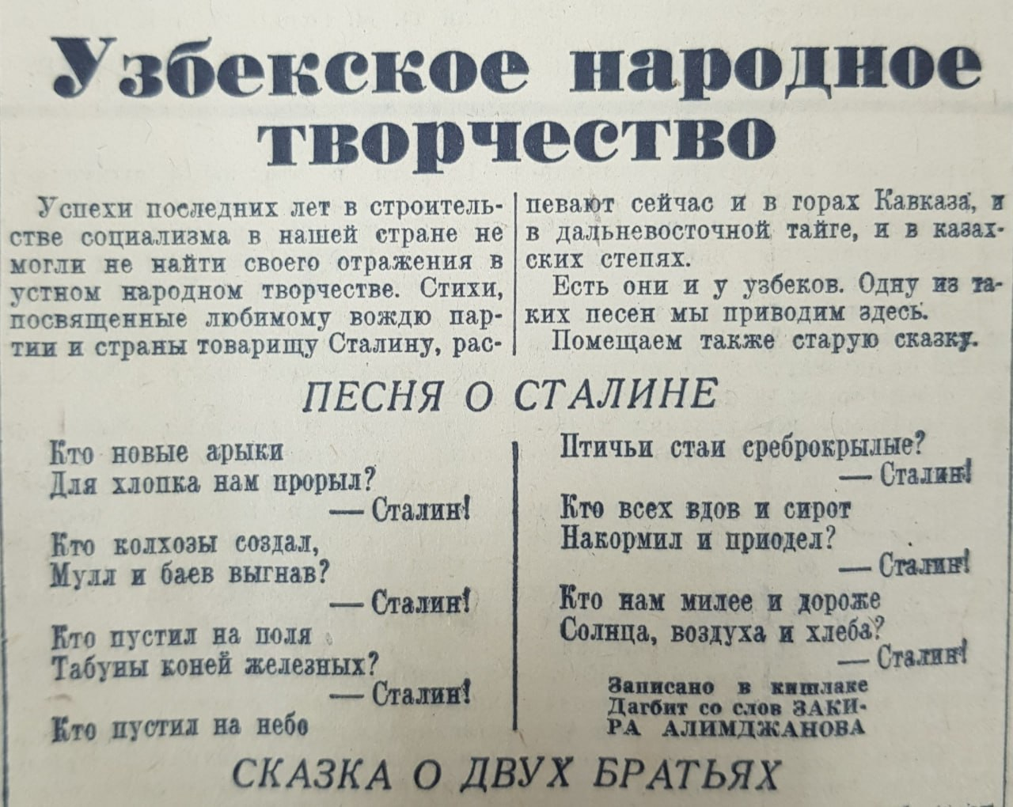

Slide 7
Repressions
There were four phases of Soviet repressions in Uzbekistan.
1920s-beginning of 1930s
1936-1939 (great terror)
1946-1953
1983-1985
The first wave of repression swept through Uzbekistan in the course of the retreat from the NEP. Its victims were the members of the resistance movement, representatives of the national intelligentsia, public figures and politicians who had tried to focus attention on alternative forms of transformation, the rebirth of national culture and the improvement of the people’s life.
In the first half of the 1920s, for instance, statesmen like K. Atabayev, T. Ryskulov, A. Rakhimbayev, N. Tyurakulov, I. Khidiraliyev and S. Khojanov were accused of nationalism. Next came the fabricated cases against Inogamov, the ‘Group of 18’ and Kasymov. The end of 1929 saw the arrest of members of the Milliy Istiqlol (National Independence)

Slide 8
Great terror
Repression had swamped the republican authorities by the mid-1930s. In particular, falsified cases were brought against Faizullah Khojaev, chairman of the republic’s Council of People’s Commissars; A. Ikramov, first secretary of the Central Committee of the Communist Party (Bolsheviks) of Uzbekistan; and other officials including S. Segizbayev, A. Karimov, A. Islamov and M. Tursunkhojayev. They were all executed.
By the spring of 1938, over 70 per cent of the republic’s leaders had been subjected to repression. Uzbekistan was swept by a wave of mass arrests embracing all sections of the population. From 1937 to 1939 alone the People’s Commissariat for Internal Affairs (NKVD) troikas (three-person tribunals for dealing with ‘counter-revolutionaries’) imprisoned more than 41,000 people, of whom 6,920 were executed.
The national intelligentsia was also subjected to persecution. In the 1930s some of the most talented figures in literature and the arts were declared ‘enemies of the people’, including ‘Abdullah Qadiri, ‘Abdulhamid Cholpan, ‘Abdurrauf Fitrat, Shakir Suleyman, Ziya Said, Elbek, Agzam Ayub, Usman Nasir, Qasim Sorokin, Muhammad Hasan, Abdusalom Niyaziy and Atajan Khashimov.
The political oppression of the clergy was intensified. Altogether in the republic between 1937 and 1953 almost 100,000 people were repressed, of whom 13,000 were executed.

Slide 9
Cotton affair
Much-publicized campaigns of ‘exposure’ developed in a number of regions of the USSR to demonstrate the efforts of the new political elite to achieve ‘socialist purification’ and end corruption, whereby the blame for economic failures was placed on local leadership cadres.
One of the regions receiving close attention was Uzbekistan, where the so-called ‘Uzbek’ or ‘cotton’ case was unraveled. Fed from the centre, the USSR mass media began to spread the view widely that the system of corruption in Uzbekistan had embraced the whole nation. This offended national dignity.
Groups of party, local government, law enforcement and economic workers were sent down to the republic. Many of them took their appointment to leadership responsibilities as giving them the right to do as they pleased. They started interfering with people’s customs and culture and increased the artificial restrictions on the Uzbek language.
The situation was aggravated by the investigation teams, headed by Gdlyan and Ivanov, which began ‘purification’ work using the methods of Stalin and Beria. They beat suspects during interrogation and illegally arrested and imprisoned thousands of innocent people. Altogether over 25,000 executives and economic managers from Uzbekistan were arrested.

Slide 10
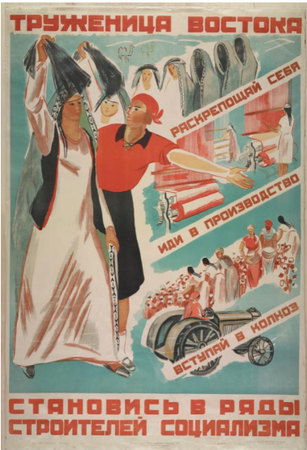
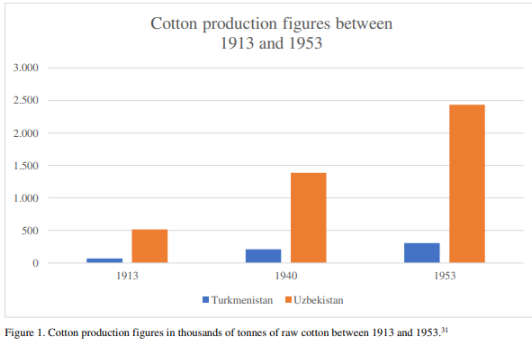

Slide 11
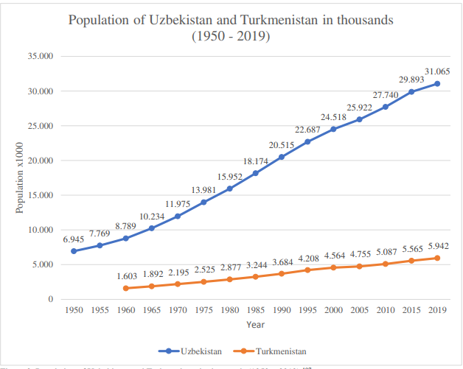
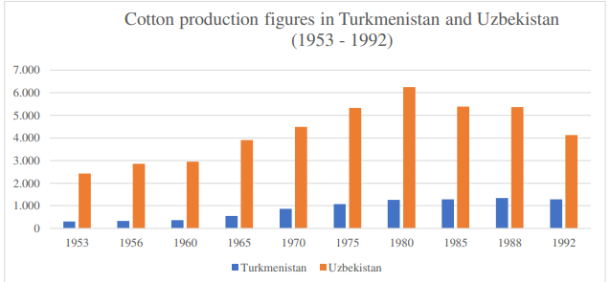

Slide 12
Literacy and Deculturation
Changes of writing scripts that led to high rate of illiteracy;
Establishment of public schools after eliminating private schools;
Increase in the number of specialists;
High level of poetry, playwriting, prose that was inspired by Jadids;
Controversiality in ideological development;
Imprisonment for 10 to 15 years when anything was published in Arabic scripts;
artificially implantention of new Soviet rites and rituals;
Harm to cultural development by the policy of accelerated ‘internationalization’;
Curtailment of the appointment of native cadres and set about the formation of a culture which was ‘socialist in content, internationalist in spirit’ and national in form;
Alienation of the people from the roots of their thousand year-old spiritual heritage and the destruction of their historical memory;
Language policy;

Slide 13
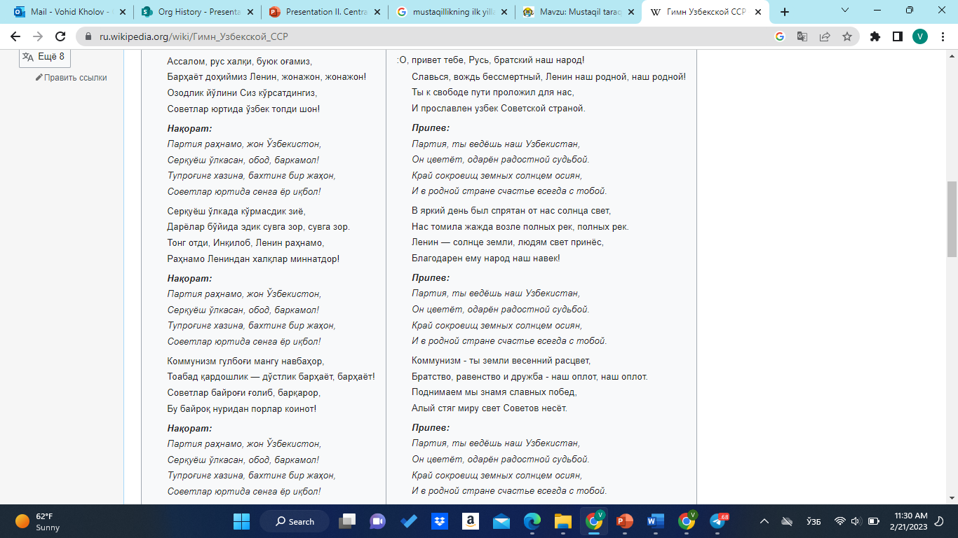

Slide 14
Migrations and Centralization
Policy of artificially increasing the multinational mix of the Union Republics;
Forced migration into the republic as well as voluntary migration, which was uncontrolled;
Compulsory resettlement in the second half of the 1930s;
Koreans from the Soviet Far East, Germans from the Volga basin and Poles from western Ukraine and western Belorussia - the first to be subjected to such population transfers;
Arrival of more than 74,500 Koreans in Uzbekistan between September and December 1937;
A number of political exiles from the northern Caucasus, Georgia and the Crimea in 1943 and 1944;
About 110,000 Meskhetian Turks from Georgia and 151,424 Crimean Tatars from the Crimea to Uzbekistan;

Slide 15
Contribution to the victory over Fascism
Involvement of altogether 1,433,230 people from Uzbekistan in the war – over 40 per cent of the republic’s able-bodied population;
Uzbek soldiers killed - 263,005, missing in action - 132,670, not return - 395,795, and disabled - 60,452;
Awarded Uzbek soldiers for proving the courage and heroism with orders and medals during the war years to around -120,000 soldiers;
Hero of the Soviet Union, awarded to 280 men from the republic, of whom 75 were Uzbeks;
Supplying the front with weapons, ammunition, uniforms and food;
Immediate specializations of local industry in the republic on a war footing and over 100 industrial enterprises evacuated from Russia, Ukraine and Belorussia;
Receiving 1 million citizens arriving in the republic from the occupied areas of Russia, Ukraine, Belorussia, Moldavia and the Baltic region, including 200,000 children;

Slide 16
After Stalin
The policy of de-Stalinization;
Rehabilitation of the victims of political genocide to emerge from prisons and camps and many ‘repressed’ people;
Little change in the general approach to national politics
Withdrawal from the extremes of Stalin’s repressive regime and attempts at a ‘leap into communism’;
solving social problems and boosting agrarian production;
Sharaf Rashidov’s important role;
Opening dozens of big industrial plants from the 1960s to the beginning of the 1980s;
1,549 industrial enterprises, engineering, chemical, construction, light industry and agro-industrial complexes functioning in 1985;
Opening irrigation facilities: irrigation channels - 197,000 km; 23 reservoirs to accumulate 10 billion m3 of water for irrigation;

Slide 17
Losses
From the 1960s to the 1980s the republic’s specialization as a supplier of raw materials;
Deliveries of gas, non-ferrous and rare metals and other minerals intensively;
1980s - the annual deliveries of gas from Uzbekistan over 250 billion m3 and deliveries of gold over 50 tons;
A never-ending stream of cobalt, molybdenum, wolfram, refined copper, uranium;
Minerals worth around $5.5 billion a year;
Revenue from the production and sale of gold, rare and non-ferrous metals, strategic materials and other high-value products in demand on the world market did not go into the treasury of Uzbekistan.
The total value of the minerals delivered to the central regions in the last 15 years – over 75 billion;
Cotton monoculture;
Uncontrolled use of the waters of the rivers Amu Darya and Syr Darya;
Aral Sea disaster;

Slide 18
PERESTROIKA
The ‘restructuring’ proclaimed in April 1985 by M. Gorbachev - hopes of a way out of the systemic crisis;
The proclamation of a ‘new thinking’ in foreign policy in favour of ‘common human values’ and a ‘world without violence and war’;
The birth of national movements which expressed demands for national democratic reform and true sovereignty, rebirth of national consciousness and organization of political movements which focused on the restoration of national statehood;
Arrest of over 25,000 executives and economic managers from Uzbekistan in Cotton case;
A wave of demonstrations swept Ferghana, Kokand, Quvasay, Gulistan, Parkent and Buka in 1989;
The idea of Uzbekistan’s political sovereignty and economic self-dependence as the decisive conditions for independence;
The ‘Declaration of Independence’ adopted at the second session of the Supreme Soviet of Uzbekistan (June 1990);

Slide 19
Adoption of the Declaration of Independence of Uzbekistan
Discussion of the Declaration of Independence
2nd Session of XII Convocation of Supreme Council of SSRUz (18,06,1990-20,06,1990)
12 articles

Slide 20
Extraordinary situation in August 1991
Statement of Soviet Authority (August 19, 1991)
Establishment of GKChP
Isolation of M. Gorbachyov
Termination of I. Karimov’s visit to India

Slide 21
Declaring the Independence of Uzbekistan
Extraordinary 6th Session of XII Convocation
Statement of Supreme Council about the Independence of Uzbekistan
The Law about the Public Independence of the Republic of Uzbekistan

Slide 22
Additional sources to read
1. Sevket Akyildiz. An Introductory History of Soviet Uzbek Academics 1924-1960.
https://www.soas.ac.uk/sites/default/files/2022-06/01%20An%20introductory%20history%20of%20Soviet%20Uzbek%20academics%201924%201960%20file75707.pdf
2. Mirzohid Rahimov & Dr Galina Urazaeva. Central Asian Nations & Border Issues. https://www.files.ethz.ch/isn/92527/05_Apr.pdf

