Slide 1
HAQ OLINUR, BERILMAS

Slide 2
Turkestan (Central Asia) is an integral part of world civilization
Dr Vohid Yusupovich Kholov

Slide 3
What do historians use to examine, interpret, revisit, and reinterpret the past?
Written documents, oral communications
Buildings, artifacts
Photographs, paintings
All are correct
Find the author of the following quotation: History is the subject of learning the causes of our nation’s and past’s prosperity and crisis.
Fitrat
Ibrat
J. Nehru
Rapson
History is a … between the events of the past and progressively emerging future ends.
Lock
Transport
Dialogue
Curtain

Slide 4
Which of the followings is raw material of history?
Thought
Fact
Experience
Books
Which of the followings cannot be a secondary source?
Newspaper
Archival documents
Manuscripts
None of above
What is the subject that learns history by coins?
Ethnology
Numismatics
Archaeology
Chronology
Which of the followings can be studied by numismatics?
History of metallurgy
Names of rulers and their reigning period
Culture of nations
All are correct.

Slide 6
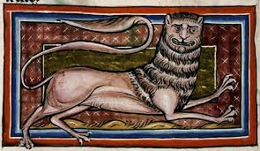
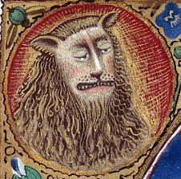
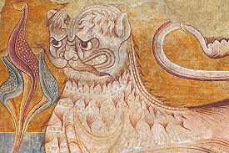
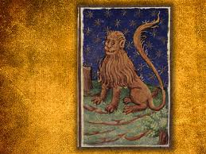

Slide 7
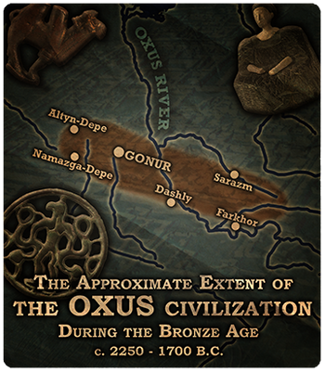
Plan
The concept of Central Asia
Development of Central Asian civilization
The development of Neolithic cultures and their role in further processes
Bronze aga cultures of Central Asia
Migrations and information transmissions
Art in ancient period

Slide 8
The concept of Central Asia
The concept of Central Asia was first used in science by A. von Humboldt in the XIX century while he organized trips across Central Asia. It should not be mixed up with Central Eurasia which occupies bigger geographical territory than Central Asia. (next slide)
Central Asia is a vast territory which is sometimes called Turkestan in the sources. There is very little distinction between them. They both occupy almost the same geographical territories covering the land between Uyghuria and Caspian basin, from south Siberia to Iran. Current geographical location of Central Asia was formerly part of the historic Turkestan also known as Turan.
Politically, Central Asia mostly covers the territories of Uzbekistan, Kazakhstan, Kirgizia, Tajikistan and Turkmenistan. In soviet times, this area was called as Central Asia and Kazakhstan.
After the disintegration of Soviet Union, all these countries started to be called as Central Asia.

Slide 9
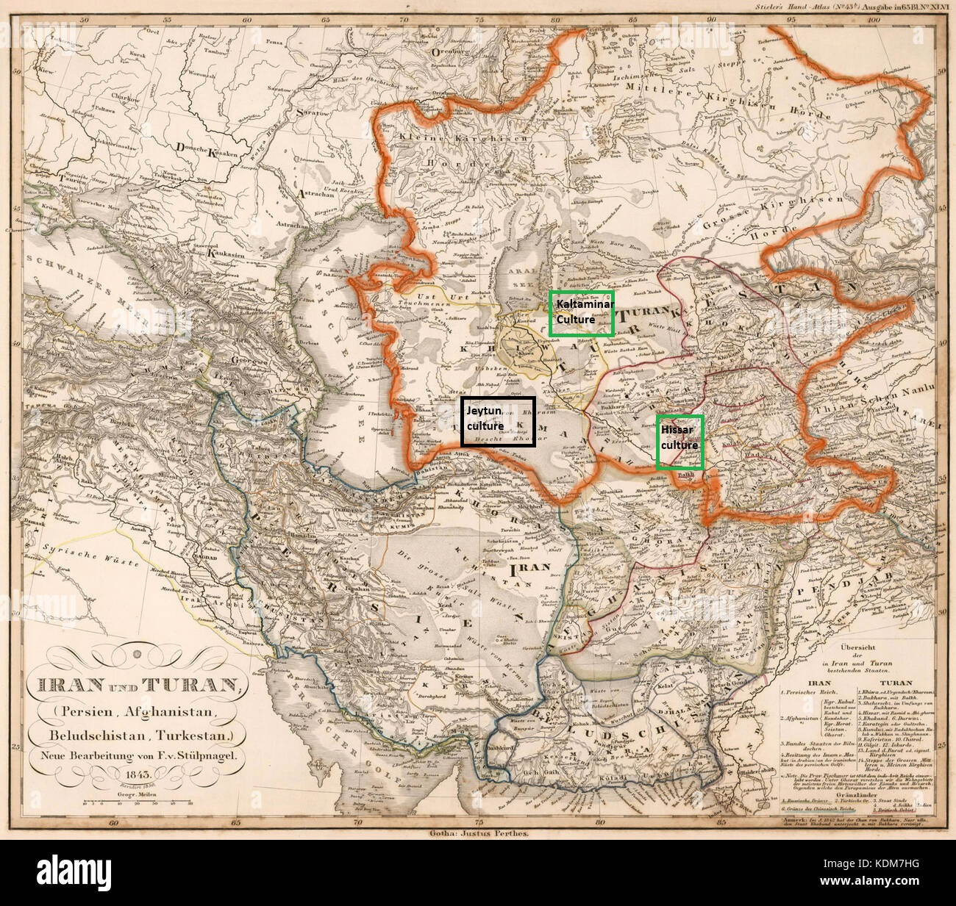

Slide 10
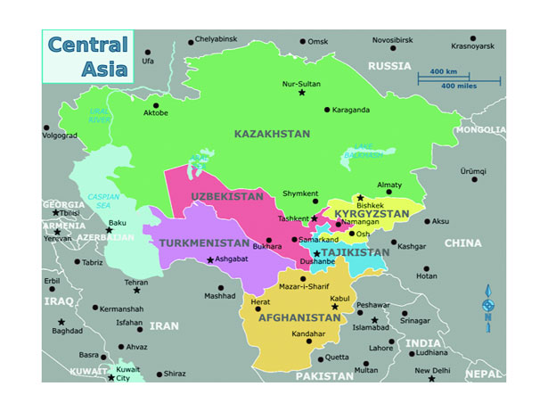
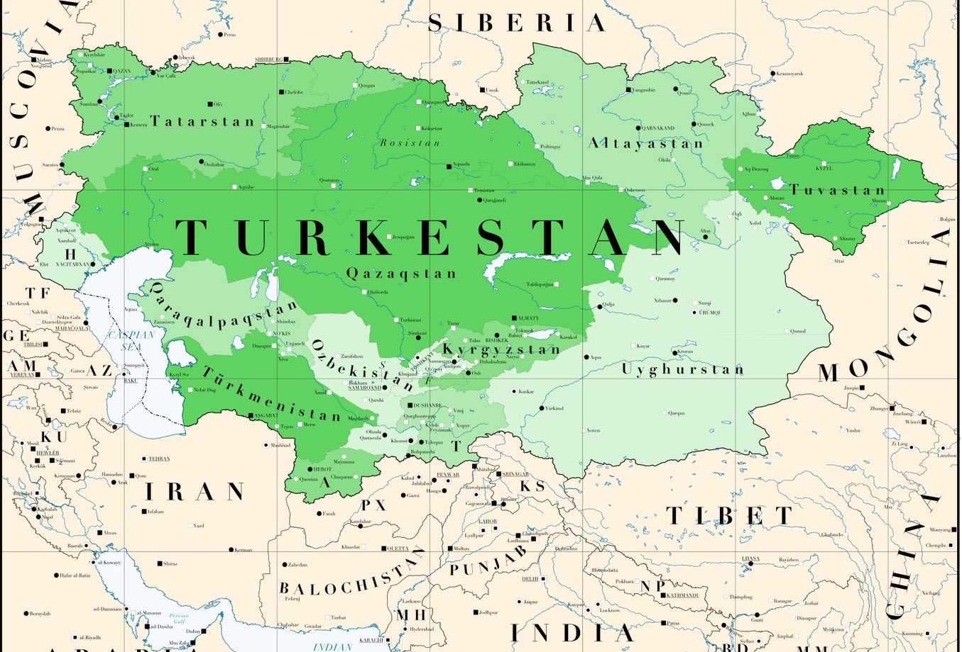

Slide 11
Warm-up questions:
Q.1. What do you understand by civilization?
Q.2. What are the most popular world civilizations?
Q.3. Why is history divided into periods?

Slide 12
Civilization
A civilization is generally defined as an advanced state of human society containing highly developed forms of government, culture, industry, and common social norms. A civilization is a complex human society, usually made up of different cities, with certain characteristics of cultural and technological development. In many parts of the world, early civilizations formed when people began coming together in urban settlements. However, defining what civilization is, and what societies fall under that designation, is a hotly contested argument, even among today’s anthropologists.
The word “civilization” relates to the Latin word “civitas” or “city.” This is why the most basic definition of the word “civilization” is “a society made up of cities.”
The world civilizations among which are Egyptian, Babylonian, Chinese, Indian, Greek-Roman, Arabic were the most popular. However, the recent archeological studies in Central Asia have proven that the advancement in the area is one of world civilizations. As result, well-known world scholars have admitted the ancient development of Central Asia as one of world civilizations centres.

Slide 13
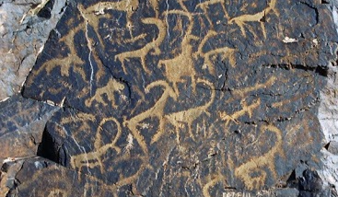
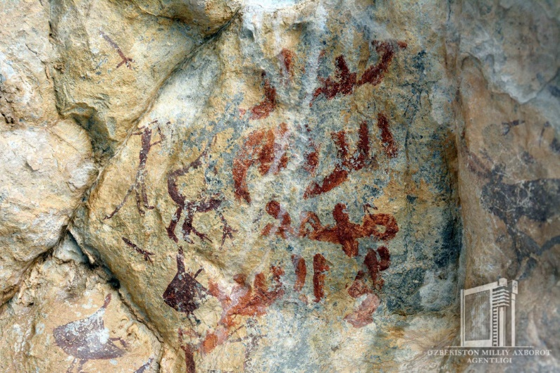
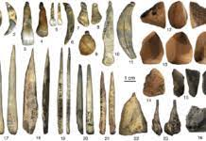
Development of Central Asian civilization
Early life and cultural views
Paleolithic and Mesozoic culture.
Petroglyphs,
Wall paintings
Work tools (made of stone)
Development of arrow and bow in Mesozoic period.

Slide 14
The development of Neolithic cultures and their role in further processes
VI-VI millennium BC (revolution of Humanity)
The development of first settled culture;
Development of new spheres in economy;
Home building;
Early handcraftsmanship;
Settled peasantry;
Settled hunting and fishery;
Sedentary stock-breeding.

Slide 15
Neolithic cultures
Jeytun, Kaltaminar and Hissar cultures.
Jeitun (Djeitun) is an archaeological site of the Neolithic period in southern Turkmenistan. The settlement was occupied from about 7200 to 4500 BC possibly with short interruptions. Jeitun has given its name to the whole Neolithic period in the foothills of the Kopet Dag..
The settlement was occupied from about 7200 to 4500 BC possibly with short interruptions. Jeitun has given its name to the whole Neolithic period in the foothills of the Kopet Dag.
Sheep and goats were already domesticated by the villagers; but they also engaged in hunting to supplement their diet. Sheep and goats were already domesticated by the villagers; but they also engaged in hunting to supplement their diet.

Slide 16
The Kelteminar culture (5500–3500 BC) was a Neolithic archaeological culture of sedentary fishermen occupying the semi-desert and desert areas of the Karakum and Kyzyl Kum deserts and the deltas of the Amu Darya and Zeravshan rivers. It is named after a site of the same name. The Kelteminar culture was replaced by the Tazabagyab culture.
The Kelteminar people lived in huge houses (size 24m x 17m and height 10m), which housed the whole tribal community of about 100-120 people. They adorned themselves with beads made of shells. They manufactured stone axes and miniature trapezoidal flint arrowheads. For cooking, they used clay vessels produced without the potter's wheel.
Hissar Culture an archaeological culture of the Late Neolithic (tentatively 7,000 to 2,000 B.C.) distributed in the Kafirnigan and Vakhsh river valleys. The Hissar culture represents a culture, archaic in appearance, of tribes of the foothills and mountain valleys that evidently developed at the same time as the more developed, settled farming cultures (Anau, Dzheitun)

Slide 17
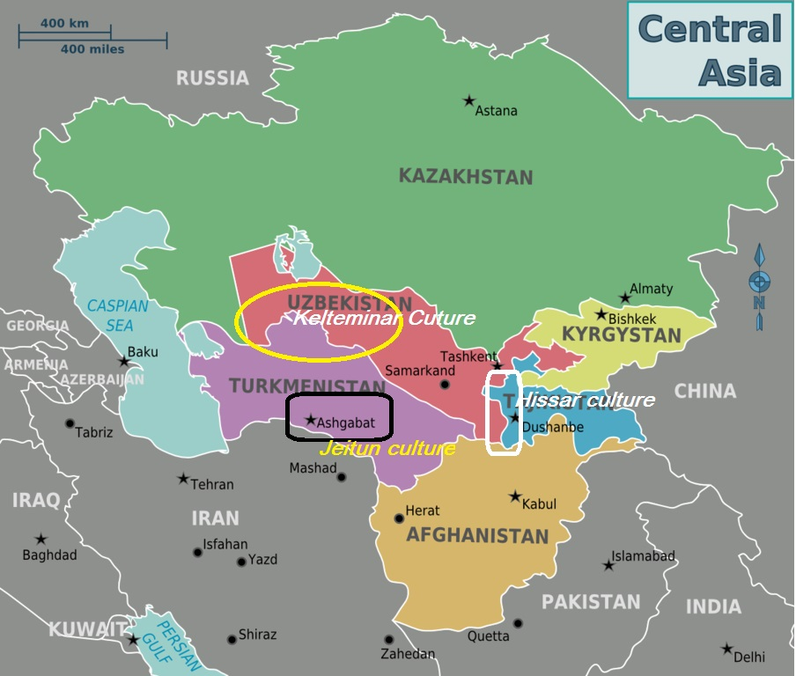

Slide 20
Neolithic revolution.
The culture of Neolithic agricultures and of cattle-breeders of Central Asia shows that a transition to the forms of economy, usually termed the 'Neolithic revolution', took place here almost simultaneously with similar developments in western Asia. A new way of life is clearly represented here by comfortable houses with accurate trimming of interiors, bright ceramics and wide use of ornaments. This qualitative leap in social development prepared the necessary base for the creation of ancient civilizations. At the same time in¬ equalities in the course of historical development become clear: the ancient tribes of Iran and southern Turkmenistan passed to the new forms of economy, while in other areas of Central Asia and northern Afghanistan the transition was delayed. Tribes of hunters, fishers and food-gatherers, maintaining many archaic features in their culture, were contemporary with sedentary communities in oases. The lines of cultural links that emerged during the Palaeolithic epoch not only keep their importance but also become stronger - a fact which played an important role in the diffusion of cultivating cereals and of cattle-breeding.

Slide 21
Bronze age cultures of Central Asia
Bronze age – introduction of metallurgy. Stone tools started to be replaced by metal tools.
Embroidery appeared in economy.
Urban planning appeared.
The Early Eneolithic (fifth and early fourth millennia b.c.) was marked by a growth in the population of the foothill belt at Kopet Dag. Along with smaller settlements 0.5-1 ha in area (Anau, Dashlyji, Yassy-depe), some major centres covering more than 10 ha sprang up (Kara-depe, Namazga-depe). Fanning out over still unsettled areas, the early agrarian tribes wandered eastward as far as the ancient delta of the River Tedzhen (Harirud), the site of the Geoksiur oasis.
The twin pillars of the economy were agriculture and cattle-raising, the latter activity providing over four-fifths of the meat consumed. Along with cattle and sheep, pigs were also domesticated. The soil-working implements of the Anau IA complex include massive stone hoes, while the Namazga I complex contains ring stones once fitted to the ends of digging sticks.
For more, please, visit: https://www.youtube.com/watch?v=LRBwWZs3W0Q

Slide 22
Bronze age settlements:
Namazga I
Altyn-depe
Yalangach-depe, Mullali-depe
Mullali-depe
Kara-depe
Kara-depe
Zamanbaba
Sapalli
Jarqutan

Slide 23
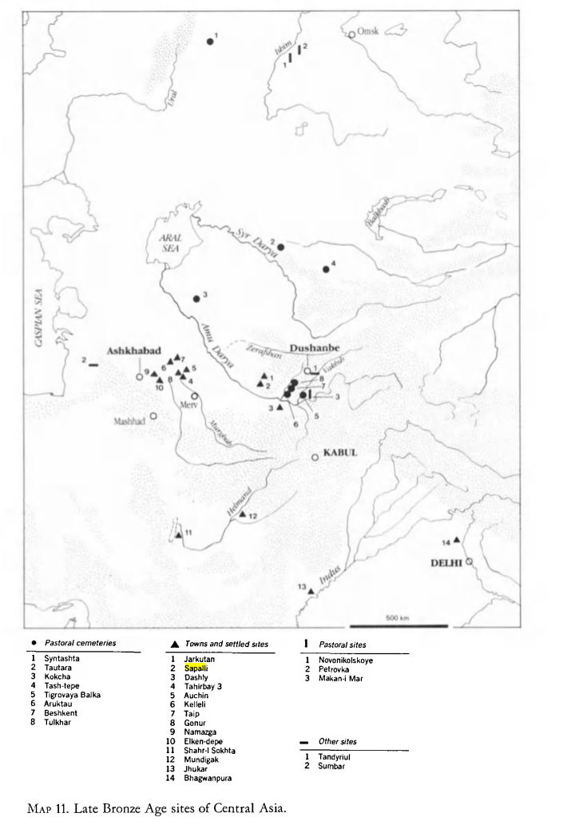

Slide 24
Art in ancient period
The culture of the Early Eneolithic testifies to improved standards of everyday life and well-being. The applied arts underwent considerable development: almost a third of the clay pottery is decorated in black paint against a red or yellowish background. During the Middle Eneolithic dating back to the middle of the fourth millennium B.C., the unitary culture of the early agrarian communities of southern Turkmenistan split into two distinct local variants - the western and the eastern. The western variant is distinguished by its colourful painted pottery vessels dec orated with geometric ornaments subdivided into two colours - red and black (Anau, Kara-depe, Namazga-depe). In the east, on the other hand, the ornaments become simpler and more austere, the dominant motifs being straight parallel lines running along the lips of cups and pots (Altyn-depe and settlements of the Geoksiur oasis).

Slide 25
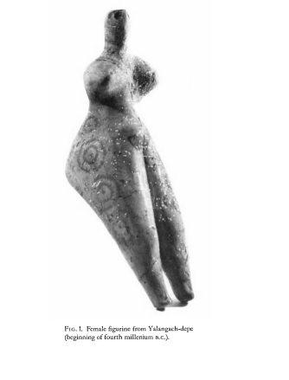
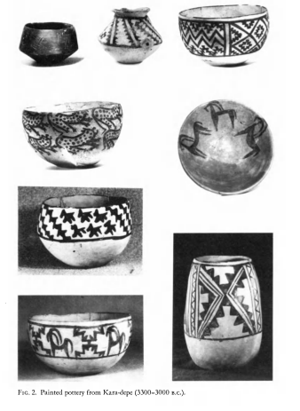

Slide 26
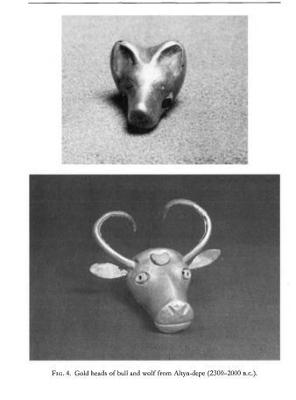
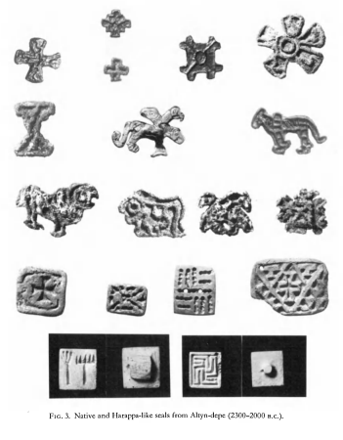
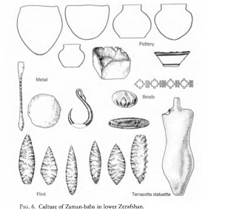
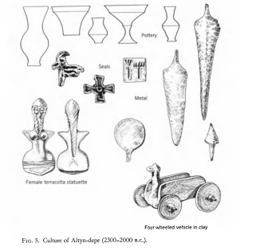

Slide 27
Migrations in Central Asia and information exchange
The migrations of Indo-European people -
Migration of Iranians
Migration of Indians
Migration of Jews
Migration of Turkic people
Migration of Arabs
Migration of Mongols
For further explanation, please, visit: https://www.youtube.com/watch?v=uM1a9OiZMxA&t=293s from 4:43 to the end.

Slide 28
Summary and questions
tendency of intellectual, cultural and art development in the area;
start of settled life with such spheres as peasantry, fishing, stock-breeding, primitive craft such as pottery, house planning and building;
decoration with special patterns, people explored copper, artificial irrigation in the areas of Central Asia;
the mixture of metals, embroidery, proto urban formation;
association of local people with immigrants of various ethnic groups;
formation of diasporas;
tolerance with all in and outside the country.
Questions.
What is civilization?
What are primary sites of Central Asian civilization?
What developments were done in Bronze age?
What are distinctive indicators between Neolithic and Bronze ages?
What do you know about migrations to Central Asai?

