Slide 1
The subject matter of History
Dr Vohid Yusupovich Kholov
History is an argument without end

Slide 2
Requirements
Being on time
Respecting to be respected
Providing presence
No allowance for any electronic devices without permission
Feeling the environment of the lesson
Feeling free to ask lesson related questions

Slide 3
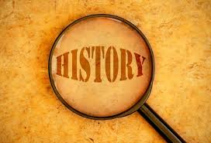
Content
Introduction
Nature of History
Quotations about history
3 key points to understand the essence of the history
Types of sources
Sub subjects of history

Slide 4
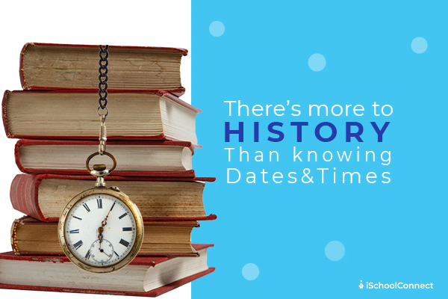
Introduction
History is the study of life in society in the past;
Evidence (fact) is the raw material of history;
History is, or should be an attempt to re-think the past;
History aims at helping students to understand the present existing social, political, religious and economic conditions of the people.
Meaning, nature and scope of history, aims and objectives of teaching history;
Using evidences to examine, interpret, revisit, and reinterpret the past;

Slide 5
Knowing History vs Doing History
Knowing a lot about the past
can puff up people as walking encyclopedias
history enthusiast (those who love to collect tidbits about the past in a knowledge closet)
interrogating the past in order to make meaning of the world that came before them
Historical research
Historical thinking
wrestle with competing accounts and narratives
learn to understand those that are foreign to us (even if not foreign in space, historical actors are foreign in time).

Slide 6
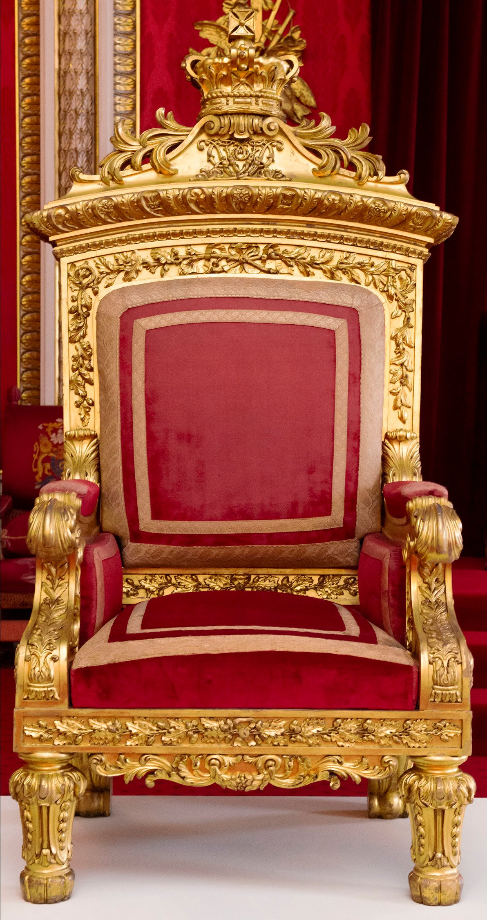

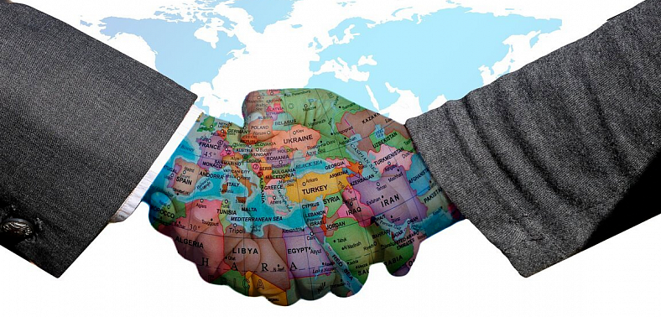
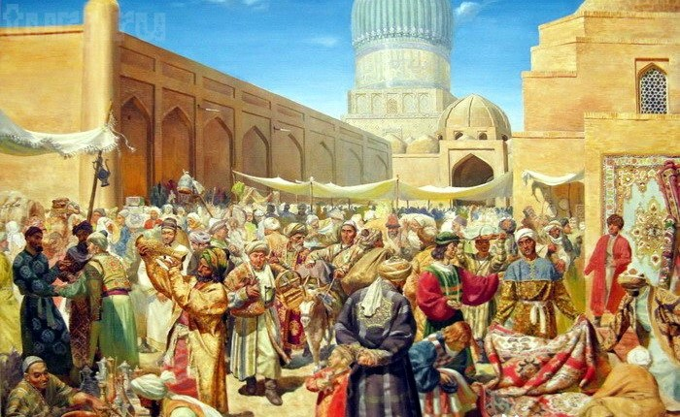

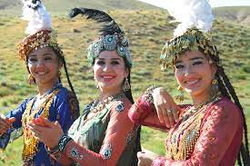
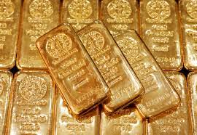
Types of History
Political History
Diplomatic History
Social History
Intellectual History
Cultural History
Economic History

Slide 7
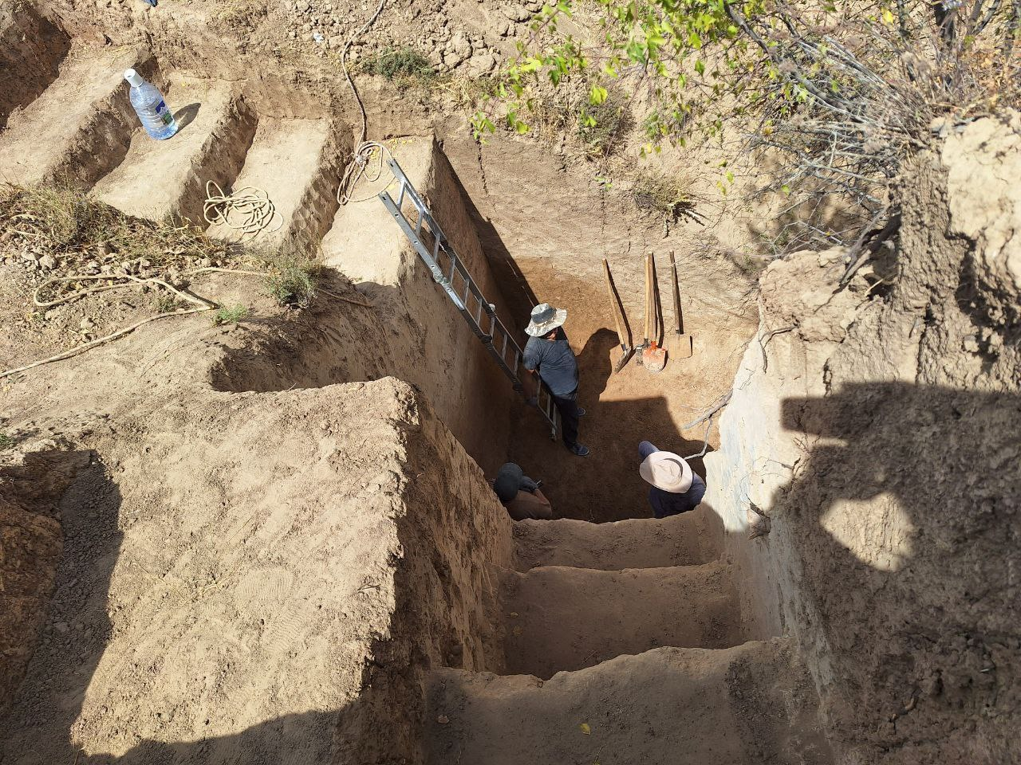

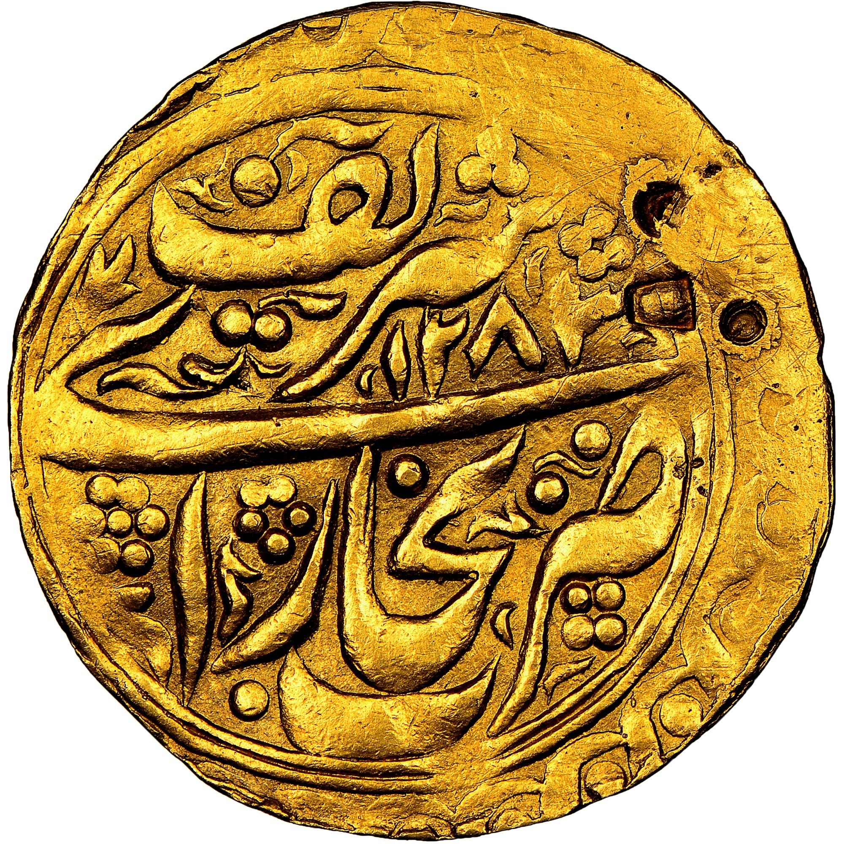

The subjects included in history
Archeology – the study of the past by excavations;
Chronology – the study of time, calendars;
Source studies – the study of historical written sources;
Numismatics – the study of coins;
Ethnology – the study of traditions.

Slide 8
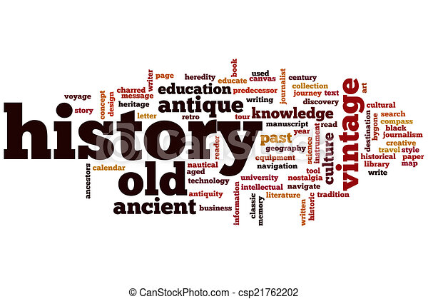
History as a sphere of science
A study of the present in the light of the past;
History is the study of man;
History is concerned with man in time;
History is concerned with man in space;
Objective record of happening;
Multisided;
History is a dialogue between the events of the past and
progressively emerging future ends;
Not only narration but also analysis;
Continuity and coherence are the necessary requisites of history;
Relevant;
Comprehensiveness

Slide 9
Quotations about history
Local thinkers:
Alisher Nawoi: We know from history which ruler was rough and cruel to govern and who kept the flag of justice. What developed in the area, what brought peace and stability to the country. Qualities and lacks of every person is recorded in history.
Ibrat. Knowing the history of homeland in the necessary for every resident.
A.Fitrat: History is the subject of learning the causes of our nation’s and past’s prosperity and crisis.

Slide 10
Quotations about history
Foreign thinkers:
Burckhardt: “History is the record of what one age finds worthy of note in another.”
Henry Johnson: “History, in its broadest sense, is everything that ever happened.”
Smith,V.S: “The value and interest of history depend largely on the degree in which the present is illuminated by the past.”
NCERT: “History is the scientific study of past happenings in all their aspects, in the life of a social group, in the light of present happenings.”
Jawaharlal Nehru: “History is the story of Man’s struggle through the ages against Nature and the elements; against wild beasts and the jungle and some of his own kind who have tried to keep him down and to exploit him for their own benefit.”
Voltaire; “History is the study of all the world’s crime.”
Robert Heinlein: A generation which ignores history has no past and no future.”
Confucius: “Study history, study history. In history lies all the secrets of statecraft.”
Napoleon Bonaparte: “History is a set of lies, agreed upon.”
Richard Paul Evans: “The more I study history the more I realise how little mankind has changed. There are no new scripts, just different actors.”

Slide 11
3 key points to understand the essence of the history
Experience – combination of positive and negative thoughts about a person or historical process, its analyses and interpretation.
Thought – the idea or viewpoint developed by learning many facts. For instance, if tom much negative information and facts are gathered about any person or event, negative thought develops, if vice versa, positive thought develops.
Fact (evidence) - is the raw material of history teaching and learning. It is an Inquiry into what happened in the past, when it happened, and how it happened

Slide 12
Most commonly recognized historical methodologies (a technique of presenting information)
Palaeography (study of historical handwriting),
diplomatics,
the study of documents, records and archives,
chronology (establishing the dates of past events),
the study of publications,
epigraphy (study of ancient inscriptions).
genealogy (study of individuals and families),
historical geography,
heraldry (study of weapons),
codicology (the study of handwritten documents),
numismatics (the study of coins),
sphragistics (study of seals),
the study of new media (historical E-literacy).

Slide 13
Historical methods
  1Source criticism
    1.1Procedures for contradictory sources
    1.2Core principles for determining reliability
    1.3Eyewitness evidence
    1.4Indirect witnesses
    1.5Oral tradition
    1.6Anonymous sources
  2Synthesis: historical reasoning
    2.1Argument to the best explanation
    2.2Statistical inference

Slide 14
Primary & Secondary Sources
Primary sources include documents or artifacts created by a witness to or participant in an event. They can be firsthand testimony or evidence created during the time period that you are studying. Primary sources are personal diaries, letters, correspondences, interviews, oral histories, photographs, newspaper articles, government documents, poems, novels, plays, and music. The collection and analysis of primary sources is central to historical research.
Secondary sources analyze a scholarly question and often use primary sources as evidence. Secondary sources include books and articles about a topic. They may include lists of sources, i.e. bibliographies, that may lead you to other primary or secondary sources.

Slide 15
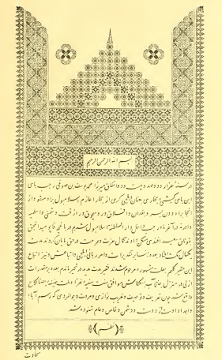
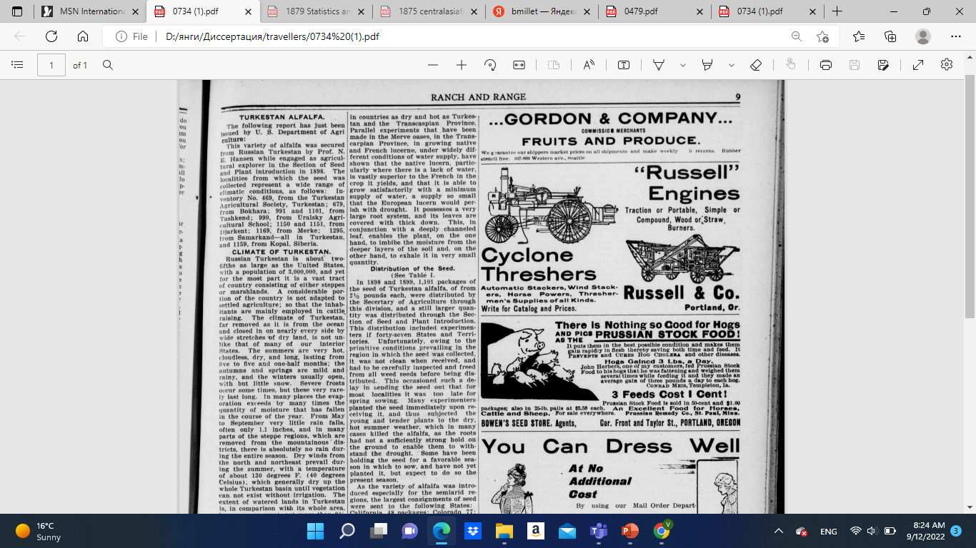
Examples of primary sources
\
https://chroniclingamerica.loc.gov/lccn/2007252185/1900-10-11/ed-1/seq-10/#date1=1777&index=0&rows=20&words=alfalfa+Turkestan&searchType=basic&sequence=0&state=&date2=1963&proxtext=turkestan+alfalfa&y=0&x=0&dateFilterType=yearRange&page=1
The work of Mir Abdulkarim Bukhari. Tarikhi Nadimi. 1818.

Slide 16
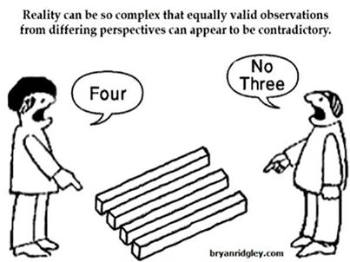

Slide 17
Additional sources to read
Extra reading materials.
Pallavi Talekau, Dr. Jyotrimayee Nayak , Dr.S.Harichandan. History.
R. G. Collingwood https://brocku.ca/MeadProject/Collingwood/1946_5.html
M. V. C. Jeffreys. The subject-matter of history in schools: a case for a new principle of selection // History, December, 1935, new series, Vol. 20, No. 79, pp. 233-242.
Алимова, Дилором Агзамовна. История как история, история как наука. Т. 2008.

