Slide 1

Personal virtual assistant
Asim Sidd

Slide 2


Description
It was a hassle to find the location of a site on the basics of board sign.
So we designed a virtual assistant inside a robot that will provide a hassle-free guide to get to the respective location.
It can also be modified according to the user's needs, making it more user-friendly.

Slide 3
Solution
We are presenting a solution to the limitation of virtual assistants like Siri and Alexa.
These virtual assistants can give us almost any information.
When it comes to personal use for finding location they have a limitation like they can’t tell us the exact location of a room.
So our project solves this problem by giving the user flexibility to add a custom location for personal use.

Slide 4
Who is the end-user?
Visitors and Delicates to the college.
Why is the problem important to solve?
It was a maze to find the location with the help of a board sign.
What is the user’s problem that needs a solution?
For tracking a particular site.

Slide 5
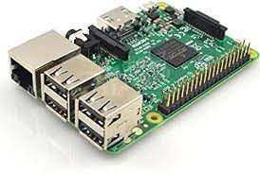


Technology Stacks:
Hardware:
Raspberry PI
Speaker
Microphone
Battery
3D Model
Memory card
Software:
Python
Linux
Speech Recognition

Slide 6
Criteria | Criteria 1 | It is user-friendly.
 | Criteria 2 | It is cost-effective approach.
 | Criteria 3 | Less consumption of electricity.
Constraints | Constraint 1 | Requires internet connection.
 | Constraint 2 | It can communicate only in single language for now.
 | Constraint 3 | It can only guide to a location.

Slide 7


