Slide 1
MOTHERBOARD
BY ASIM ALI

Slide 2
What is motherboard ?
It is the also known as main and system board. It connects all internal components and external peripherals of a computer system.
It facilitates communication among different parts of computer.
It explains the performance and capability of computer.

Slide 3
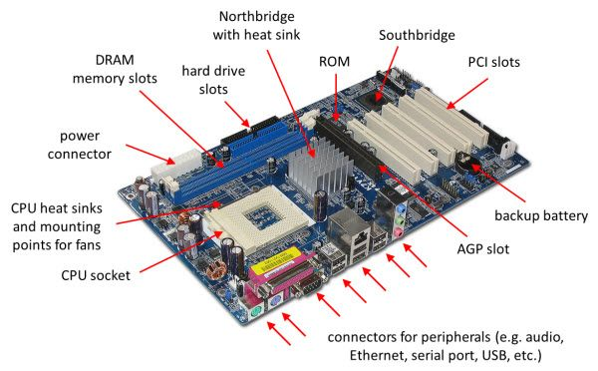
Motherboard with labels

Slide 4
COMPONENTS OF MOTHERBOARD
A typical motherboard contains the following parts
CPU
Memory
Storage
BIOS
South and North Bridge chipset
Cooling fan
Slots

Slide 5
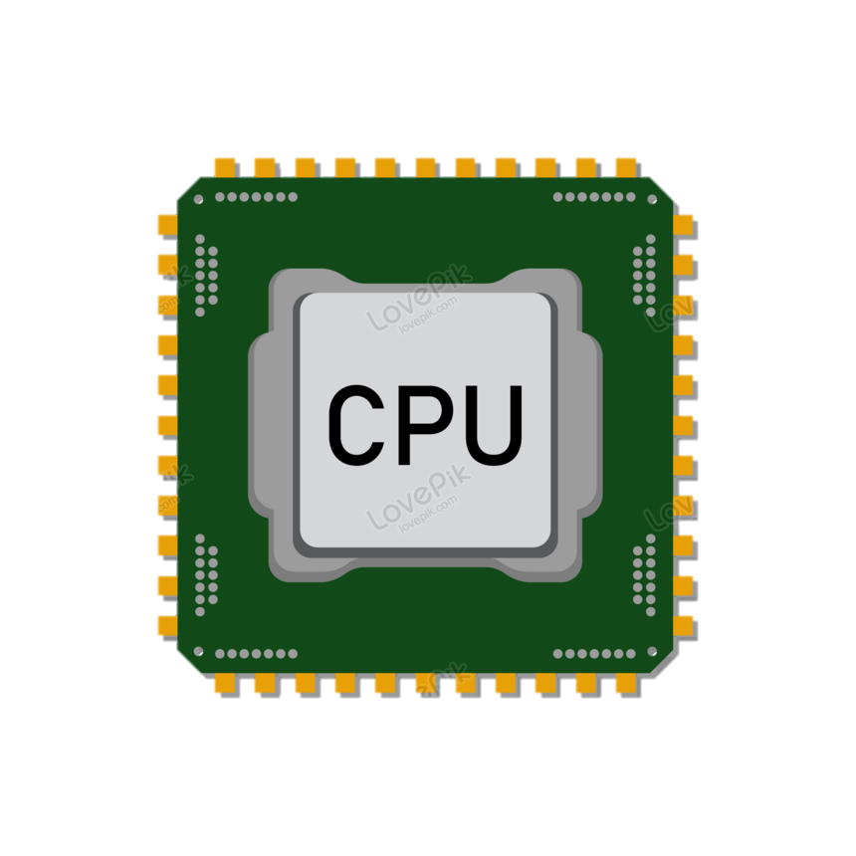
What is CPU?
Central Processing Unit is the brain of computer which executes instructions and performs calculation
Modern CPUs can run multiple tasks at a time and improved the performance
It’s speed is measured in GigaHertz(GHz). It’s speed can from 2 to 5GHz

Slide 6
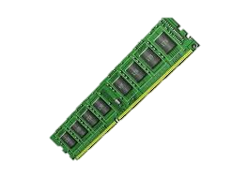
What is memory?
RAM(Random Access Memory) is a volatile memory that stores data for short time when computer needs while performing different tasks.
It’s capacity is from 4GB to 64GB or more.

Slide 7
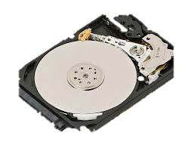
What is storage ?
These are devices which are data and information for a long time.
Hard Disk Drive (HDD) Solid State Drive (SSD) and other external devices which stores date even when computer is off.
The capacity is from 256 GB to 1 TB

Slide 8
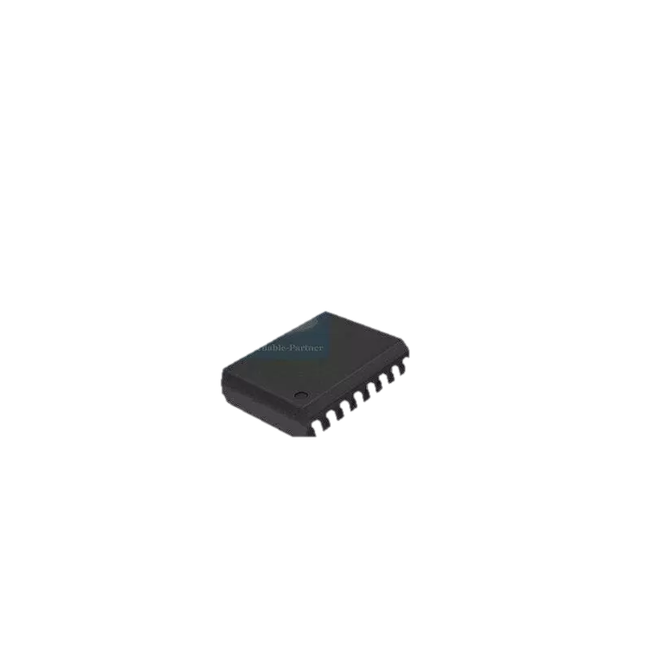
What is BIOS
BIOS (Basic Input/Output Software) is a firmware installed on ROM. It checks hardware when turning on computer
it is source of communication between operating system and hardware.

Slide 9
South and North Bridge Chipset
NORTH BRIDGE
North Bridge manages communication between RAM, CPU and Graphic card.
It is connected to south bridge through bus.
SOUTH BRIDGE
It manages communication between low speed peripherals.
It helps in transferring date to and from storage devices.

Slide 10
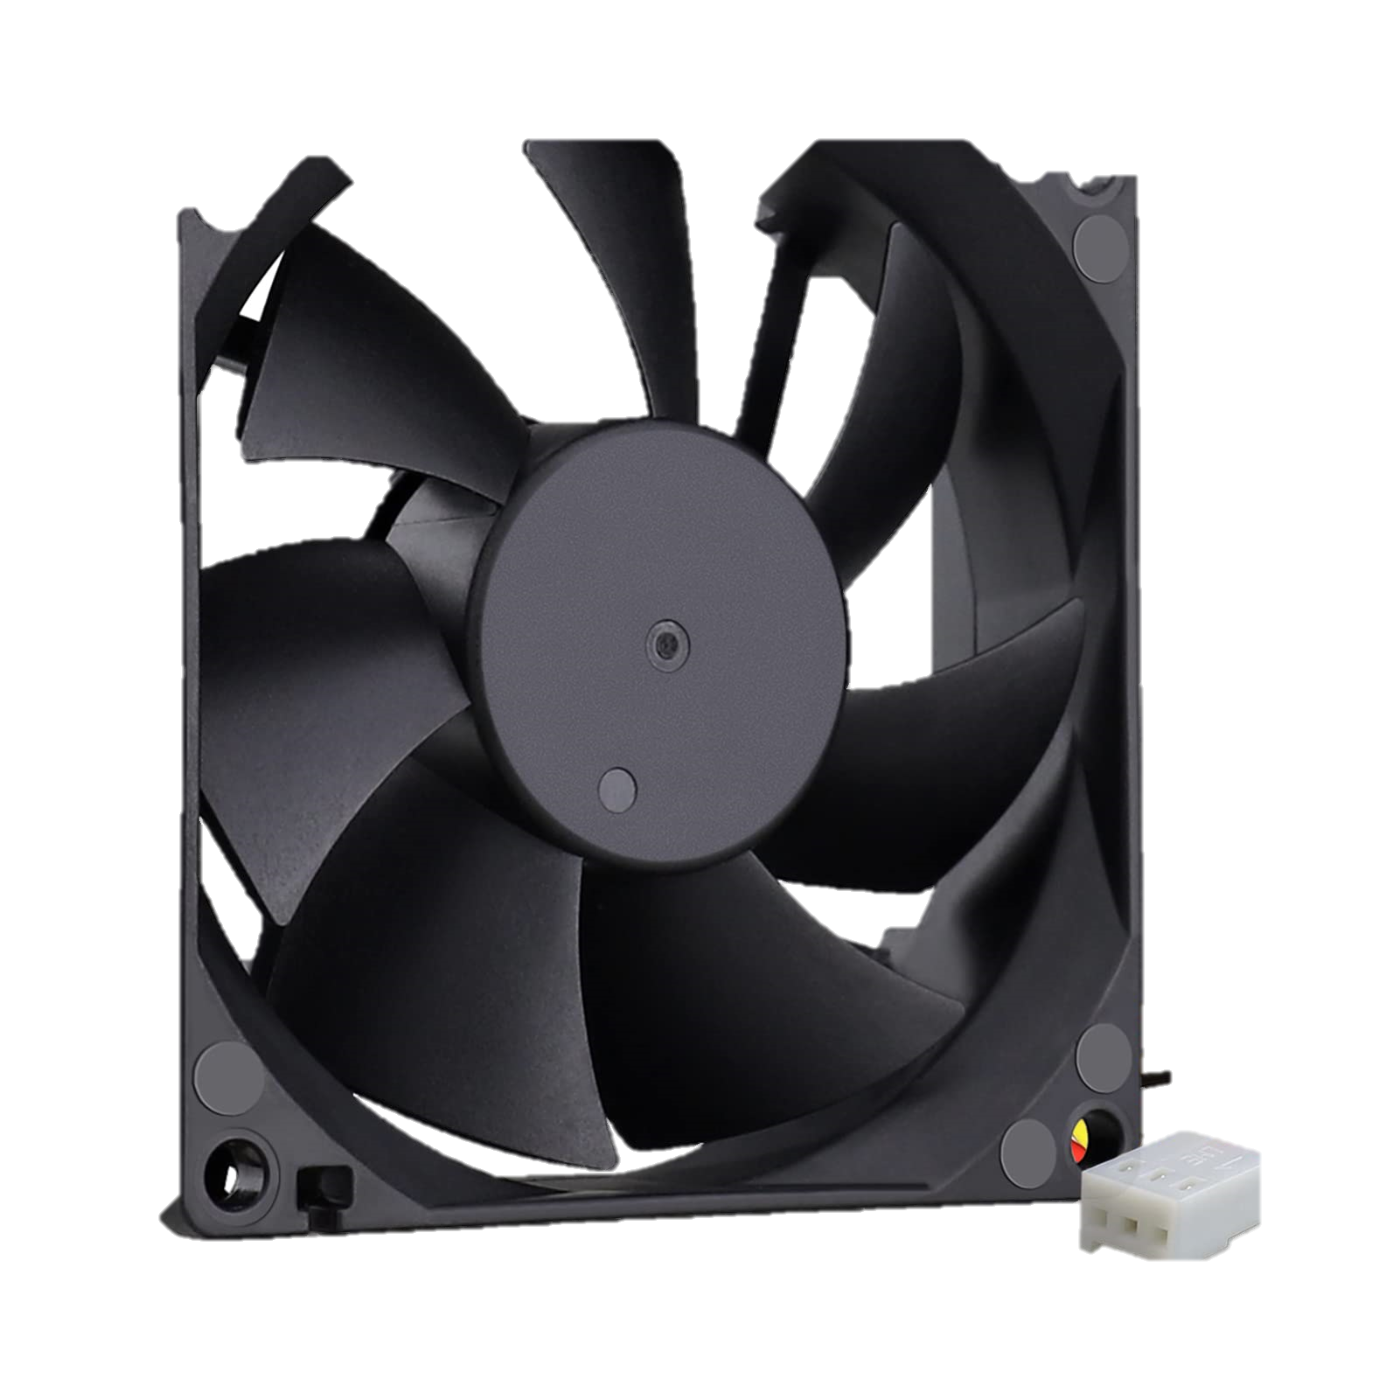
What is Cooling Fan ?
Cooling fan is used to disperse heat produced by components of computer and maintains temperature normal also keeps computer safe from overheated.
These are designed to intake cool air from outside and take hot air outside from case.

Slide 11
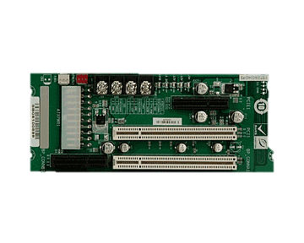
What are Slots ?
These are physical connector on motherboard where we can insert
internal hardware.
Slots can upgrade the system performance capabilities.

