Slide 1
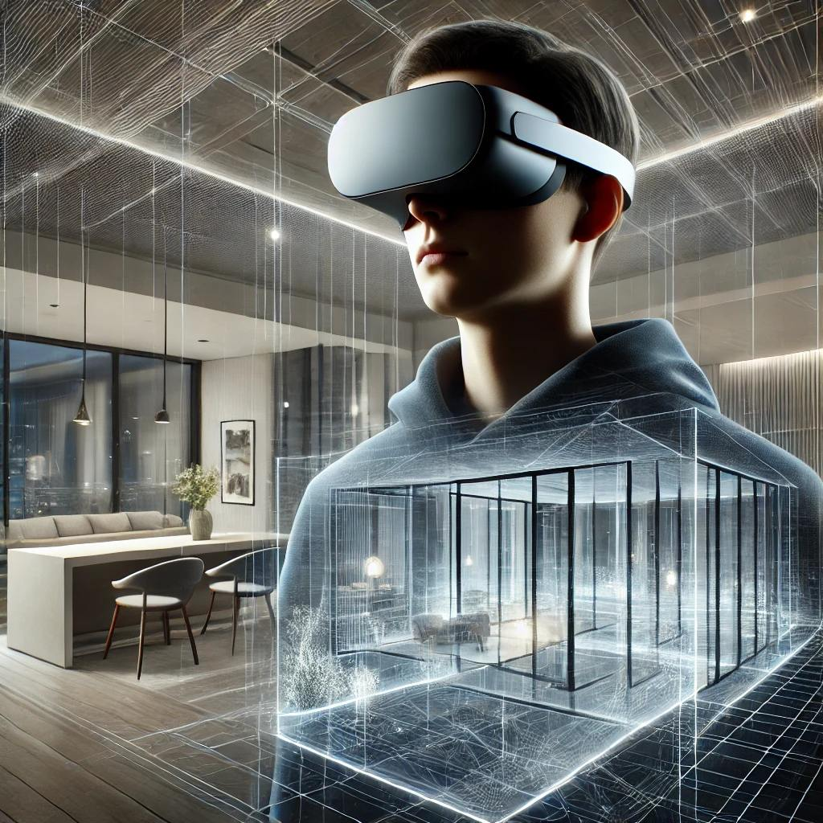

brickrat
Visualization: Immersive and Interactive

Slide 2
Take aways
brickrat
  What
  How
  Why
Marketing Strategy
Future Plans

Slide 3
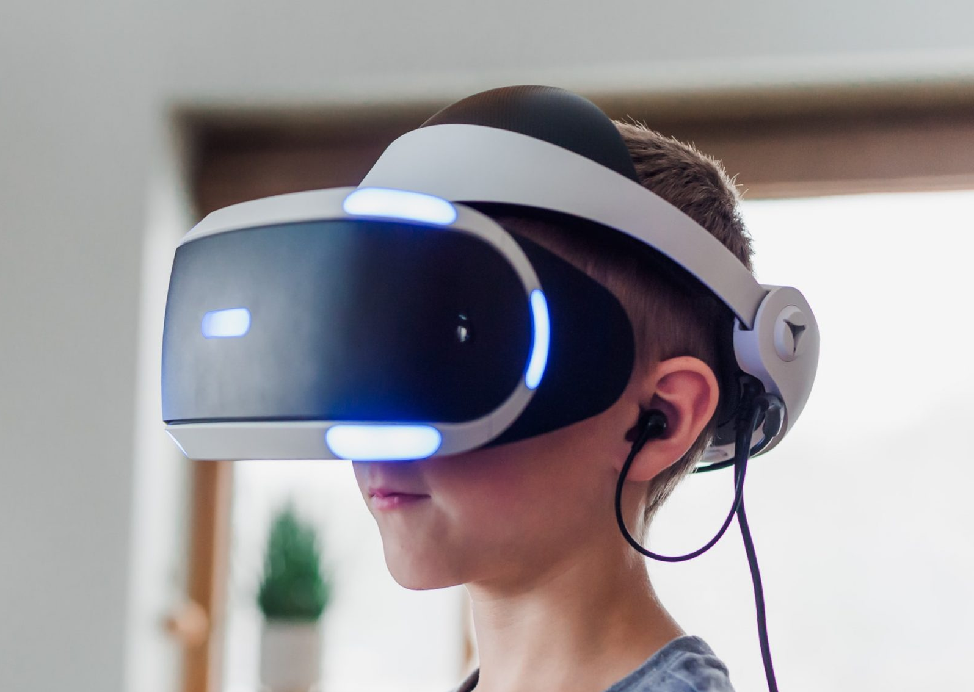
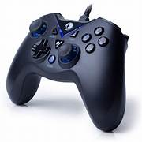
What is brickrat?
Future of architectural visualization
Immersive and interactive way to perceive space.
Team: Tech savvys from complementary fields, integrating Meta and architecture to bring in future to your hands

Slide 4
brickrat in Action
Interactive 3D walkthroughs bring properties to life.
Seamless transitions between outdoor and indoor environments.
Detailed exploration of spaces including a unique 18-story structure.
State-of-the-art realism through advanced technology and VR support.

Slide 5



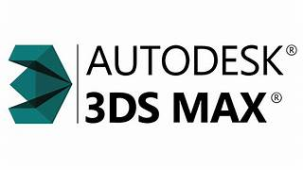
How it Works
How it’s made:
  Architectural models made in 3d modeling software like SketchUp, 3dsMax .etc
  Using game engines like Unreal Engine and Unity to make interactive experience

Slide 6
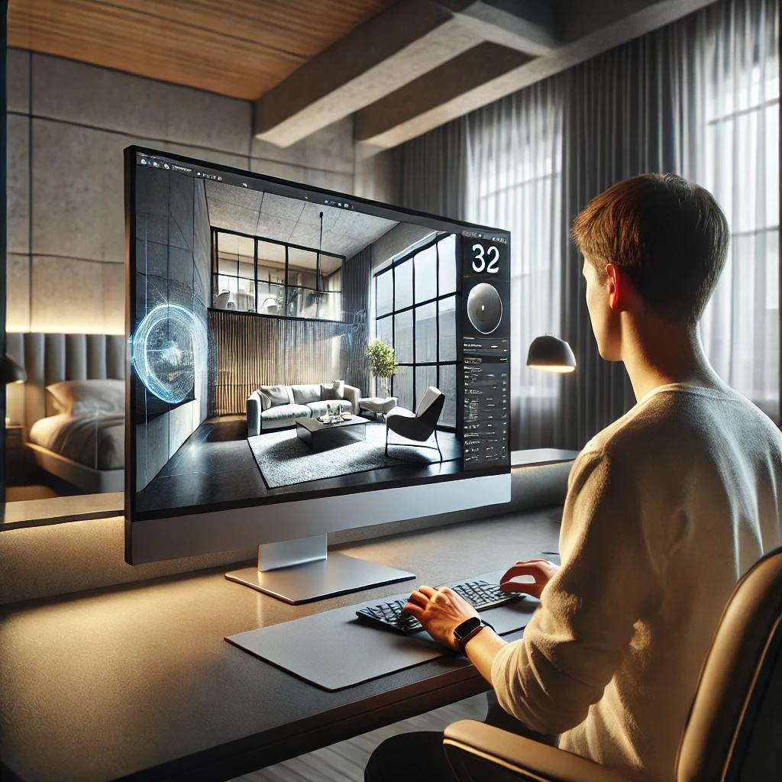
How it Works
How to use it:
  Interactive model for
    Windows computers
    MacOS computers
    VR headsets
  Input devices
    Keyboard
    Mouse
    Joysticks

Slide 7
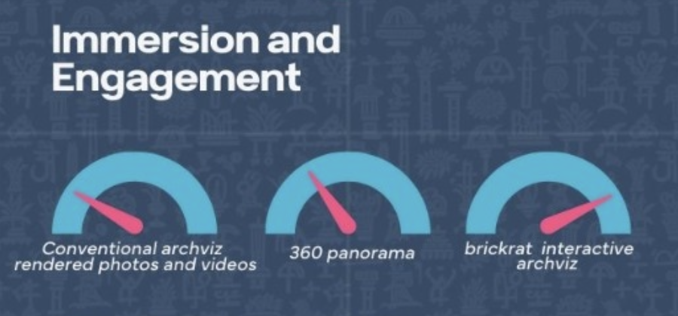
Why brickrat
Unlike traditional 2D imagery, brickrat delivers a 3D model with natural sense of depth and realism.
Our solutions increase buyers’ confidence to make faster decisions thereby boosting sales.
Establish new way of marketing in the real estate industry.

Slide 8
One City Project
A high-profile project with One City.
Showcasing a township project.
An immersive interactive model enabling full-site walkthroughs and interior explorations.
Demonstrates brickrat’s capability to revolutionize property visualization.

Slide 9
Business Model & Marketing Strategy
brickrat opens new avenues in design visualization and marketing.
Revolutionizes property presentations by creating immersive customer experiences.
Positioned to lead the future of interactive architectural visualization.
Opportunities for expansion into diverse property types and interactive solutions.

Slide 10
Conclusion & Future Prospects
brickrat transforms the way properties are visualized and marketed.
Our pilot project with One City validates its impact on design and customer engagement.
Join us in building a future where design is intuitive, interactive, and inspiring.
Thank you – Let's build the future together!

