Slide 1

Machine Vision & Intelligence Lab | NIT Jamshedpur
Digital Image Processing — CS1664
Academic Year 2025–26
Multilingual Abuse and Slang Detection
Aditya Raj | Roll No: 2023UGCS051
Asim Kumar Mahata | Roll No: 2023UGCS050
Apoorva Singh | Roll No: 2023UGCS025
Mihir Kumar | Roll No: 2023UGCS049
Abhishek Kumar | Roll No: 2023UGCS089
Guided by : Dr Koushlendra Kumar Singh | MVI Lab, Dept. of Computer Science & Engineering

Slide 2
Problem Statement
02 Problem Statement
To detect and flag abuse/toxic/hate language in code-switched multi-lingual text input. ​
Lack of datasets of regional languages, different semantic meaning of some words in different language.​
Some people show toxic behaviour in live chats/ social media comments/ different forums.​
People in online platform get cyber-bullied / abused by others, sometimes even the minors, which has mental health effect, specially on teenager and young people. ​
Current chat moderations mostly are targeted towards english based comments/text, they failed to capture semantics of mixed language abuse, and thus allows harmful content to avoid detection.
MVI Lab | NIT Jamshedpur | DIP - CS1664
2 / 11

Slide 3
Objectives
03 Objectives
Primary Goal: Develop a system which will able to detect hate , toxic ,cyberbully etc. in multilingual and code-switched text support for real time moderation .
Secondary Goal:
- Handle Informal spelling , transliteration, emoji , abbreviation , detect language
- build a REST API Interface with onxx model for fast query processing
- Provide confidence score , along with lime token and attention explanation
Inside Scope : Multilingual and code-switched text processing , detect text based hate content .
Outside Scope : Audio ,Video , Image based hate detection , User behaviors analysis. Detection of hate which relies on prior context/reference or sarcasm.
Expected Output: Trained Model, Processed Dataset, Evaluation metrices, Interface to test the model.
MVI Lab | NIT Jamshedpur | DIP - CS1664
3 / 11

Slide 4
Background / Literature Review
04 Background / Literature Review
SemEval-2019 Task 5 (Basile et al.) 2019
Hindi-English Code-Mixed Detection (Sreelakshmi et al.) 2020
International NLP competition focused on multilingual hate speech detection on Twitter
Dataset provided in two languages — English and Spanish
Two subtasks: binary hate/not-hate classification, and fine-grained target identification (individual vs. group)
Fine-grained target classification (Subtask B) proved significantly harder than binary detection
Focused on hate speech in Hinglish — the most prevalent code-mixed language on Indian social media
Dataset of 10,000 samples collected from platforms like X (Twitter)
Three feature extraction methods compared: fastText, Word2Vec, and Doc2Vec
fastText with SVM (RBF kernel) achieved the best accuracy of 85.81%
MVI Lab | NIT Jamshedpur | DIP - CS1664
4 / 11

Slide 5
Proposed Solution / Idea
05 Proposed Solution / Idea
A single XLM-Roberta-Large model(which is trained on 100+ languages, covering most of the English language) is trained over major Indian languages to detect offensive text content. It is doing both outputting offensive verdict and language detection.
Code mixed languages such as Hinglish, Banglish, etc does not come under monolingual classification, the model is trained on code-switched languages (which is generally used in chats) to detect hate/toxicity without any need of translation or transliteration.
Most of the work focuses on English language natively, sometime translate everything to English, which loose cultural context. This model processes all the languages simultaneously, with a balanced dataset.
Offensive detection and language detection are done by single backbone, language ID forces the model to stay language aware, which helps the model to understand the context better.
Good macro F1 score across all the languages, with minimal performance gap in their performance.
The system returns a binary verdict of offensive or not based on the confidence score, word level attention map, language detection.
MVI Lab | NIT Jamshedpur | DIP - CS1664
5 / 11

Slide 6
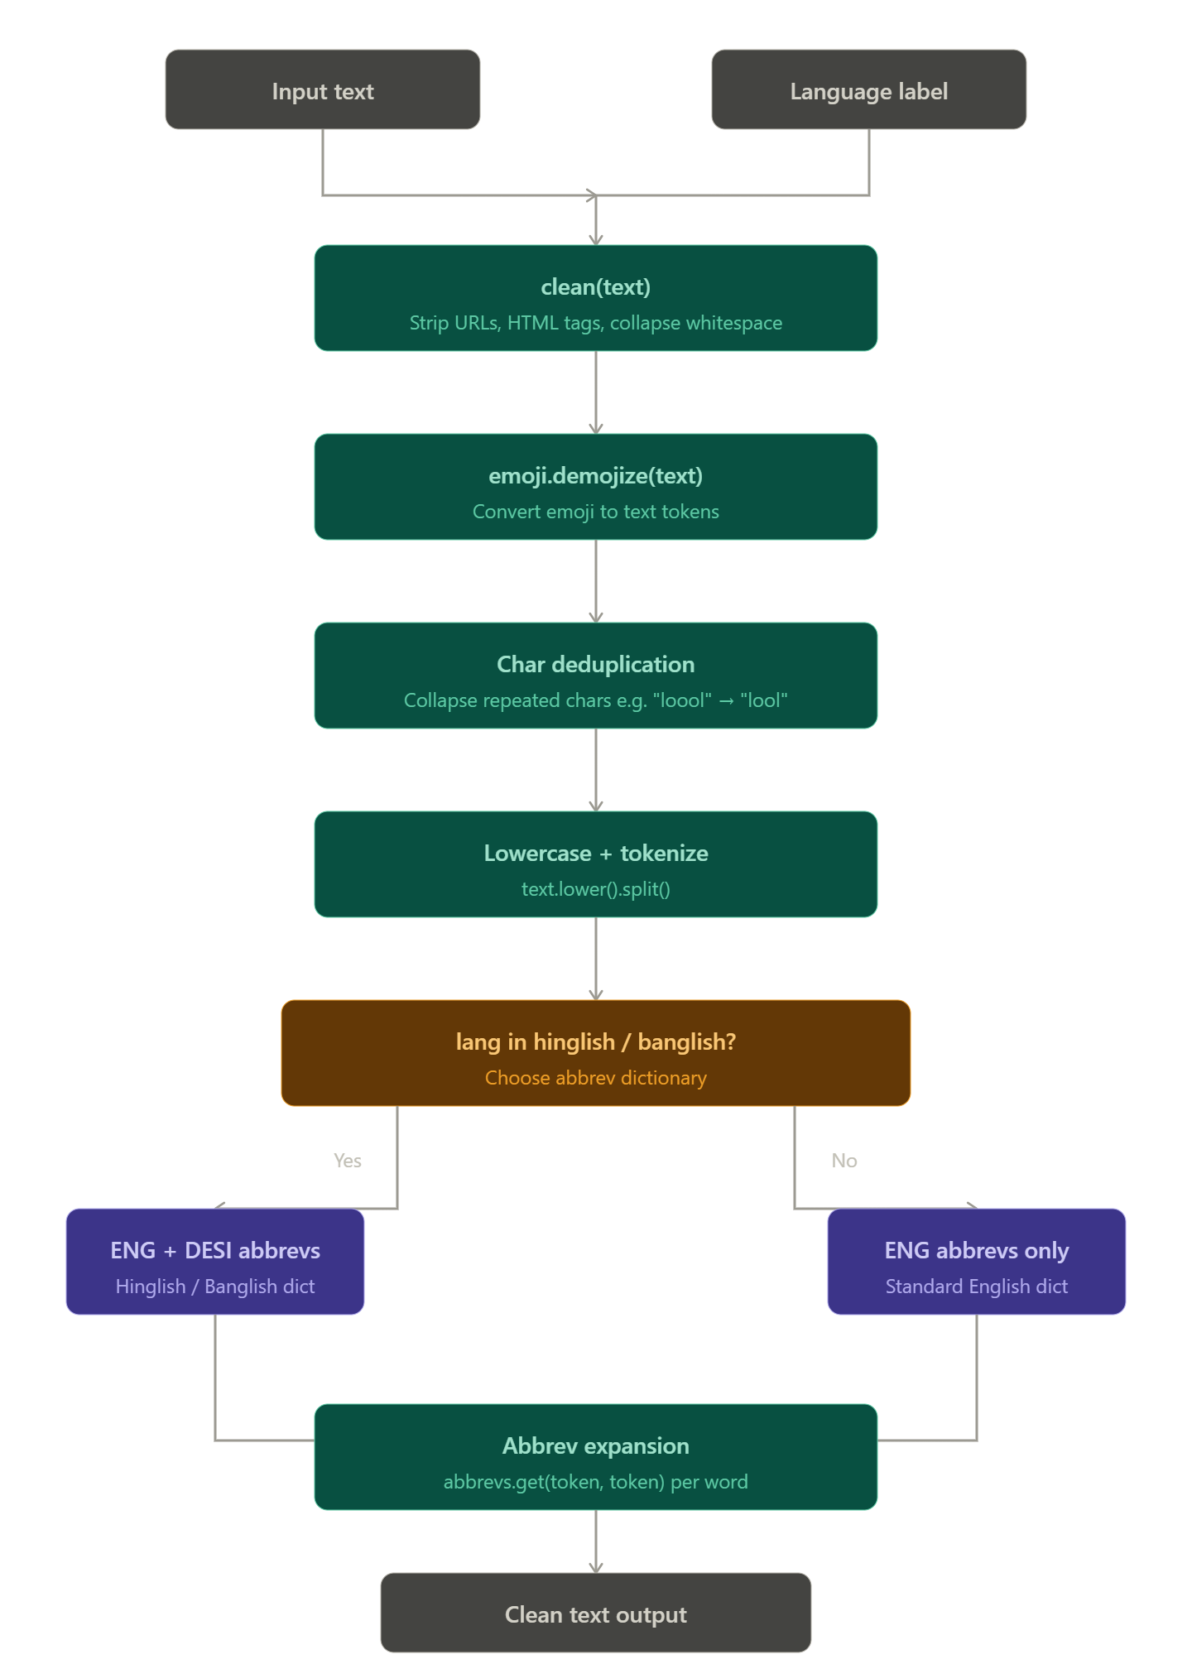
Methodology
06 Methodology
Step-by-Step Approach
Step 1: Data Collection / Dataset Preparation:
collect different language dataset, convert them to have same columns, mix them uniformly
Step 2: Data Preprocessing:
Remove URL , Handle abbriviation, handle emoji
Step 3: Model Design:
XlmBerta-Large For multilingual detection
MVI Lab | NIT Jamshedpur | DIP - CS1664
6 / 11

Slide 7
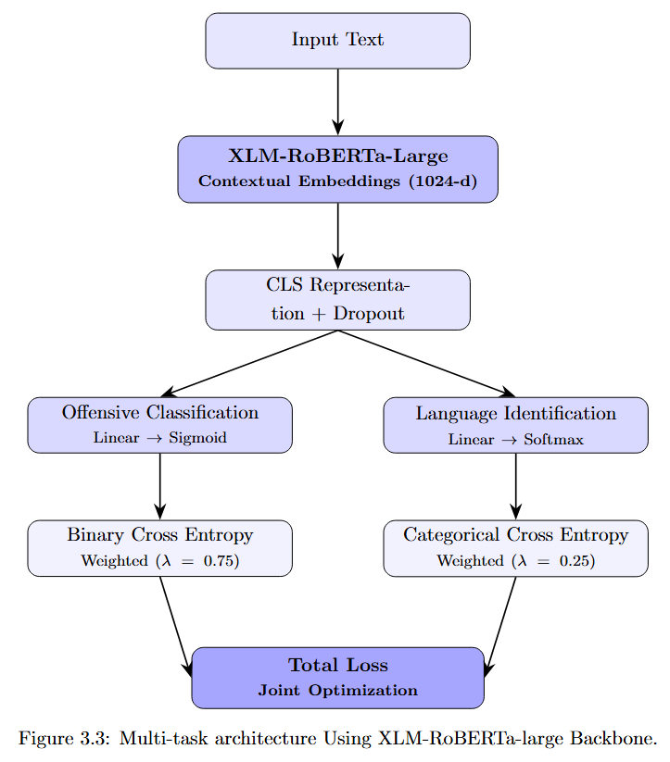
Methodology
06 Methodology
Step-by-Step Approach
Step 4: Training & Optimization:
Trained for 10 epoch with batch size of 8 and early stopping of 5
Used Adam optimizer
Best model is validated by f1 score
Step 5: Evaluation & Testing:
Model Is evaluated using accuracy, precision , recall , f1 score for all different language separately as well as overall.
For testing used Onxx model and built API .
MVI Lab | NIT Jamshedpur | DIP - CS1664
7/ 11

Slide 8
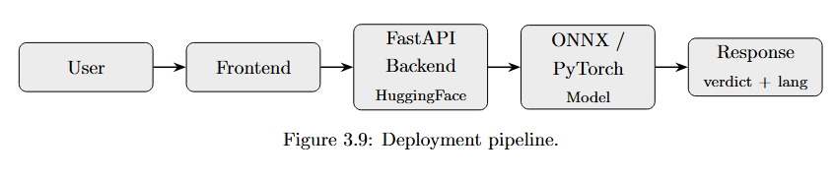
Implementation
07 Implementation
Tools & Technologies
Language: Python
Libraries: Pytorch , Hugginface transformer, Scikit-learn,pandas,numpy,matplotlib,seaborn
Dataset: Custom TSV dataset by mixing various dataset, such as - hasoc 2019, Kaggle jigsaw, Dravidian code-mix etc.
IDE / Environment: Goggle Colab
Version Control: GitHub
MVI Lab | NIT Jamshedpur | DIP - CS1664
8 / 11

Slide 9
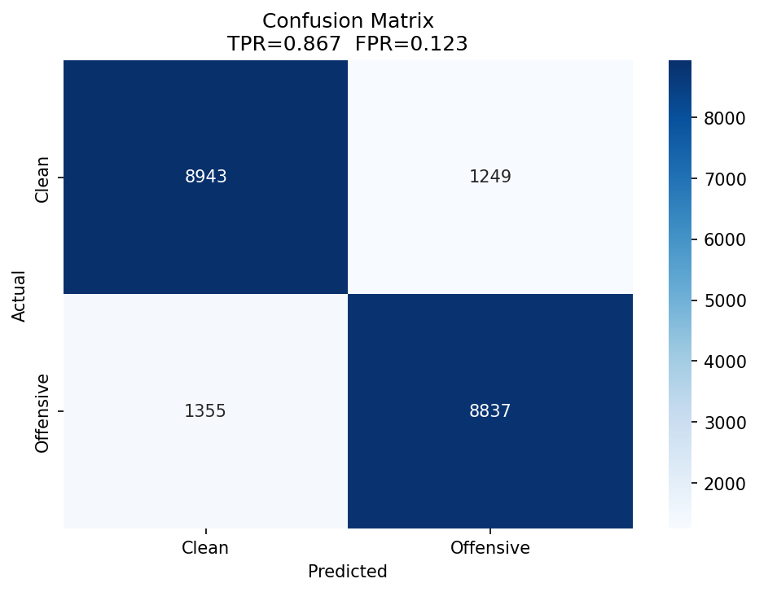
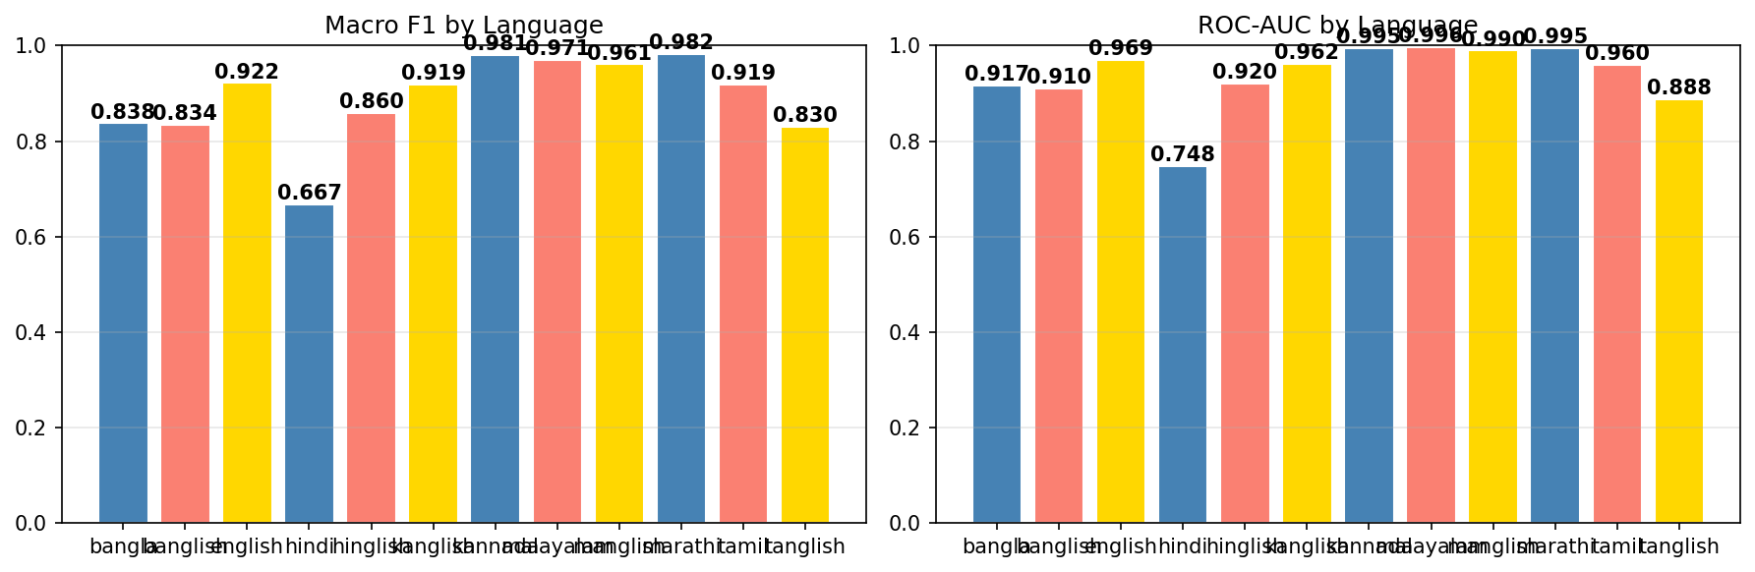
Results / Output
08 Results / Output
Key Observations
Model achieved 87.23% accuracy and 94.05% precision on the test dataset
Key finding or pattern observed in the output
MVI Lab | NIT Jamshedpur | DIP - CS1664
9 / 11

Slide 10
Applications & Future Work
09 Applications & Future Work
Real-World Applications
Possible Improvements / Extensions
Social media sites moderation: Make public places like social media safe , and non toxic so people can browse them freely
Live chat moderation: Use Model to help moderators easily catch misbehavior of chatters while streaming making it easy for them
Prevent Cyber bulling: Prevent cyber bulling of peoples, especially kinds on social spaces of the internet.
Currently the model is only telling whether a message is toxic or not expand it to have multiclass classification like , toxic, identity hate, rasism etc.
Handle sarcasm or context dependent toxicity.
Add more Indian languages.
Make it integratable with Live chats.
MVI Lab | NIT Jamshedpur | DIP - CS1664
10 / 11

Slide 11
Conclusion
Thank You!
Summary of Work
Detecting abusive/toxic comment is for multilingual and cod-mixed text is still a problem, specialy for Indian languages.​
A XLM-Roberta-Large model is fine tuned to detect toxic content and also language detection.​
Model is detecting abusive content fairly good in all languages.
MVI Lab | NIT Jamshedpur | DIP - CS1664
11/ 11

