Slide 1
Student Profile Management System
Asim Nath Pant, Michelle Shrestha, Pragya Ghimire

Slide 2
Overview
Student Profile Management System
Simplifies academic data storage and retrieval
Built using Python and pandas library
Features include add, view, and update
Enhances student information accessibility and security
User-friendly interface with structured data flow
Supports future scalability and improvements

Slide 3
Objectives and Significance
Design a clear structure for student profile
Automate repetitive profile management tasks
Ensure secure and organised data handling
Allow smooth retrieval and editing of records
Build a scalable and modular codebase
Encourage teamwork and logical thinking
Support future improvements and add-ons

Slide 4
Features and Functionalities
Provides a menu-driven interface for both roles (ie. admin and student)
Secure login for student/admin roles (use of passwords)
Uses file handling for persistent storage
Implements OOP principles (inheritance, methods)
Admin can add, edit, delete students
Students can update profile info
View marks in five key subjects
ECA activities tracked for each student
Password change available for all users
Admin dashboard with charts and alerts

Slide 5
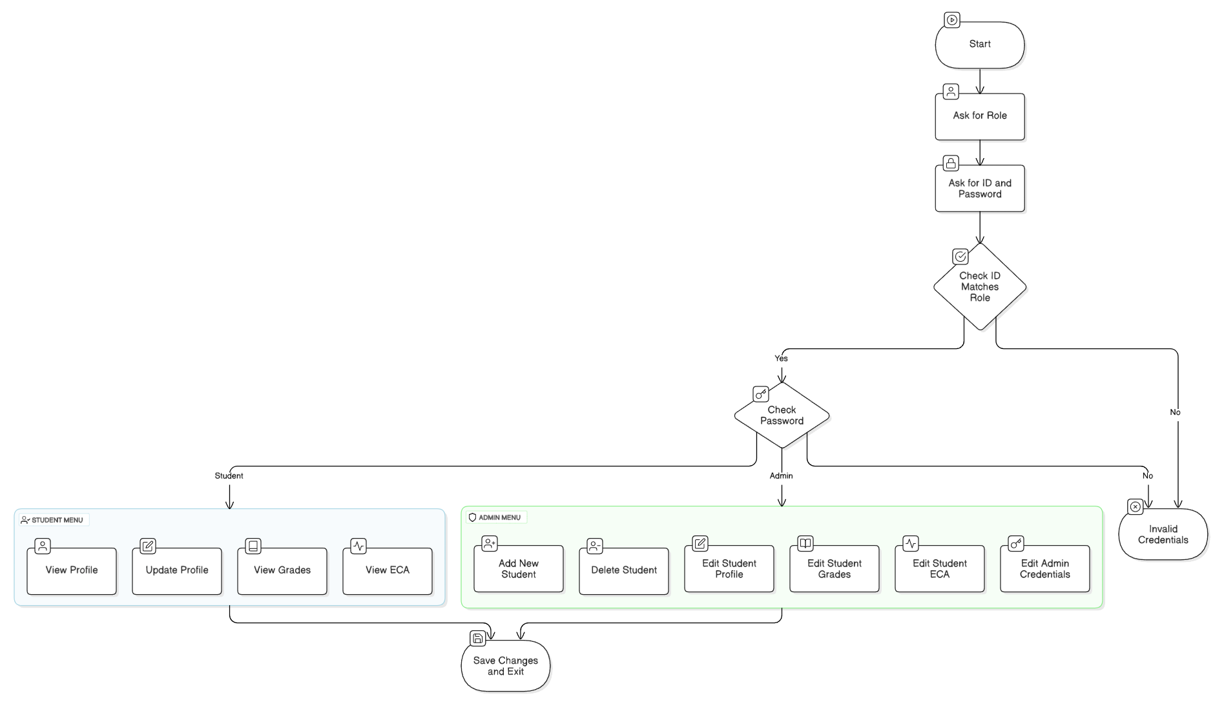
Design Structure

Slide 6
System Components and Implementation
Classes:
Student class: student-related methods
Admin class: student+admin methods
Admin Class Methods:
admin_menu()
add_student()
delete_student()
update_student_profile()
update_student_grades()
update_student_eca()
update_admin_credintials()
show_analytics()
Other Functions:
main()
login_screen()
load_user()
load_password()
Student Class Methods:
student_menu()
view_profile()
update_profile()
view_grades()
view_eca()
change_password()
Text Files:
users.txt
passwords.txt
grades.txt
eca.txt

Slide 7
Team Contributions
We discussed the program structure, content and layout in college. After the examination, we stayed at college to do the project. More than dividing and doing individually, we collectively did it together by distributing the same methods and functions, checking, refining and formatting it. The methods which were executed properly without any errors, we combined it and formatted it similarly in visual studio code. Asim offered more valuable insights to us, Michelle and myself in the field which were lacking. Overall, the collaboration and team synergy played a key role in completing the project efficiently. We shared insights, learned from each other, and ensured consistent formatting and functionality overall the code.

Slide 8
Conclusion
We built an OOP-driven system for streamlined academic data management
Secured role-based access with persistent storage via text file operations
Empowered admins with dynamic analytics (grades, ECA trends, alerts)
Prioritized data security, modular code, and scalable architecture
This helped as we strengthened teamwork, problem-solving, and adherence to coding best practices

Slide 9
Thank You

