Slide 1
Market Research on Minimalist Skincare
Teenage Preferences | Data Analysis | Hypothesis Testing

Slide 2
Objective of the Study
Market research before launch
Strategy for Indian skin
Logistics and supply chain strategy
Top 5 preferred products by teens
Ingredient sourcing for top 5 products
Why those top 5 products
- Conduct hypothesis testing on pricing

Slide 3
Methodology
- Scraped product data from Minimalist’s website using Selenium & BeautifulSoup
Tagged products using teen skincare keywords (e.g., acne, oily, gentle)
Applied one-hot encoding to identify teen-preferred products
Analyzed top 5 teen-relevant products and visualized concern frequency
Ran a t-test to compare teen vs non-teen product pricing
Researched ingredient choices based on Indian skin concerns and global sourcing

Slide 4
How Minimalist Started
- Founded in 2020 by Mohit and Rahul Yadav
- Inspired by global brands like The Ordinary
- Aimed to fill a gap in the Indian skincare market with ingredient transparency
- Built on the idea that skincare should be science-driven, honest, and affordable

Slide 5
Market Research Before Launch
- Identified that Indian consumers were frustrated with vague skincare claims
- Found increasing demand for clear, science-backed formulations
- Detected growing awareness of ingredients like niacinamide, salicylic acid, etc.
- Targeted digitally-savvy, urban Indian youth looking for trusted, effective skincare

Slide 6
Ingredient Strategy for Indian Skin
- Indian skin often deals with acne, pigmentation, oiliness, and sensitivity due to humid climate & pollution
- Minimalist focused on clinically backed, non-irritating ingredients suited for Indian skin tone and concerns
Avoided harsh scrubs and fragrances that cause damage to melanin-rich skin(More prone to hyperpigmentation (dark marks after pimples or inflammation, More sensitive to harsh exfoliants or active ingredients)
- Positioned itself as transparent, scientific, and effective skincare brand for modern Indian youth

Slide 7
Logistics and Supply Chain Strategy
Manufacturing Base: Headquartered in Indore, India, Minimalist operates its own manufacturing units, ensuring quality control and streamlined production processes. Shekunj
Distribution Network: Post-acquisition by Hindustan Unilever Limited (HUL), Minimalist leverages HUL's extensive distribution channels, reaching over 9 million retail outlets across India and expanding its global footprint. LinkedIn
Logistics Operations: The company employs logistics executives to optimize transportation routes, manage vendor relations, and ensure timely delivery, particularly focusing on regions like Jaipur, Rajasthan. LinkedIn

Slide 8
Top 5 Teen-Preferred Products
1. Salicylic Acid + LHA 2% Cleanser
2. Niacinamide 10% + Zinc Serum
3. AHA BHA Exfoliating Peel
4. Vitamin B5 Gel Moisturizer
5. Oat 6% Gentle Cleanser

Slide 9
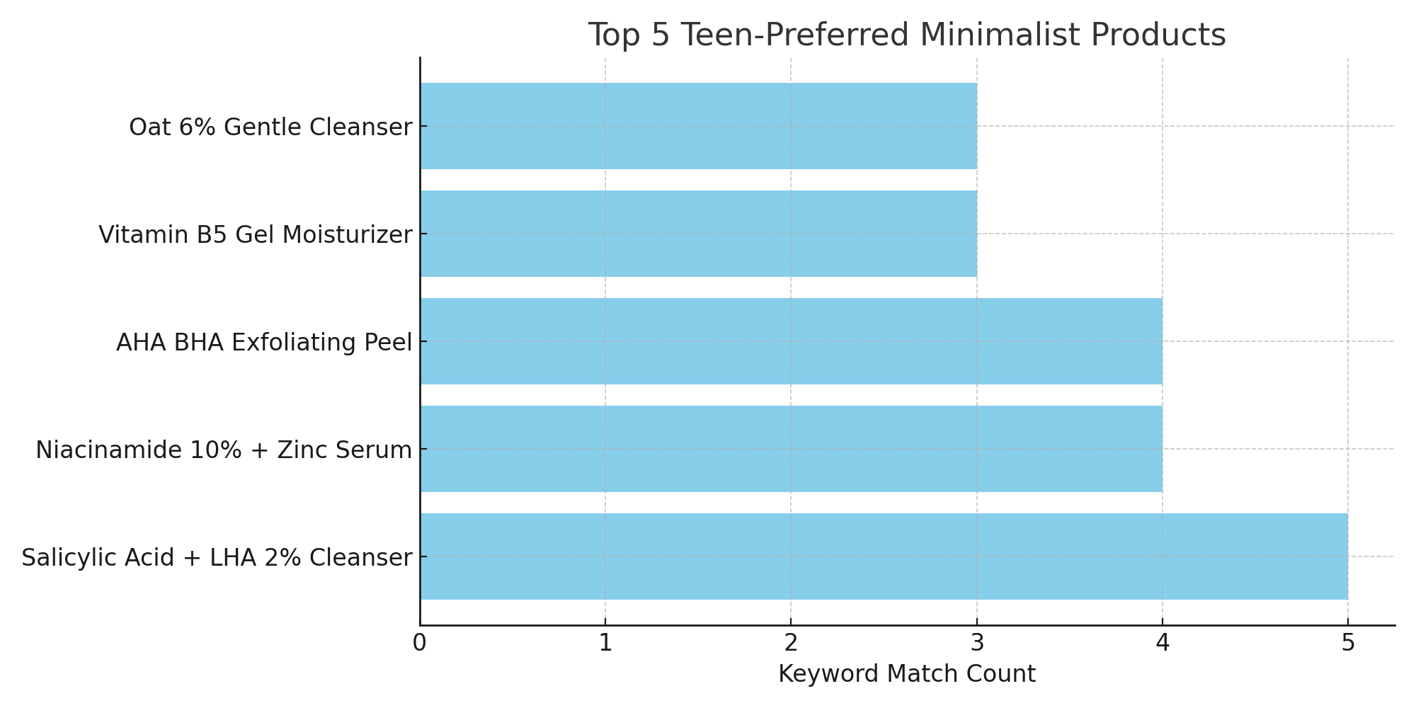
Top Teen-Preferred Products

Slide 10
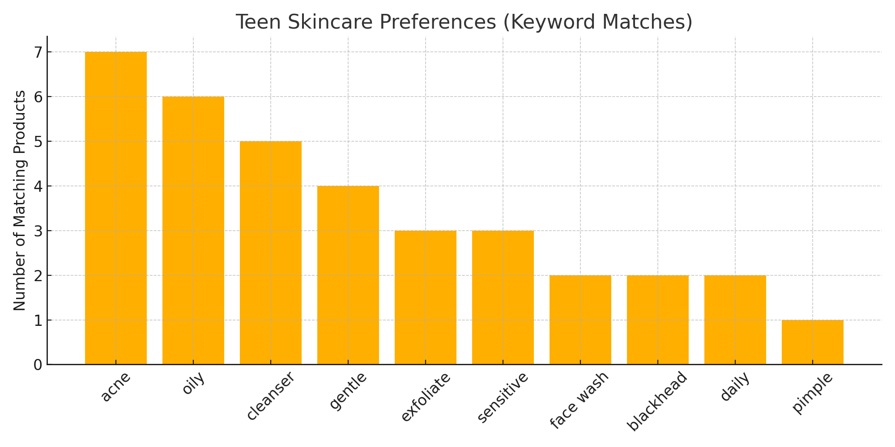
Teen Skincare Preferences

Slide 11
Ingredient Sourcing for Minimalist's Top 5 Products
Niacinamide 10% + Zinc Serum
Niacinamide (Vitamin B3)
Source: Imported from DSM Nutritional Products, Switzerland and other top-tier global chemical suppliers.
Reason: DSM is known for high-purity Niacinamide, essential to avoid irritation in high concentrations.
Function: Balances oil, minimizes pores, evens skin tone.
Why it matters: Indian skin is prone to hyperpigmentation and sebaceous overactivity — this ingredient is a trusted global gold standard.

Slide 12
Zinc PCA
Zinc PCA
Source: Often sourced from Evonik or similar cosmetic-grade ingredient manufacturers in Europe or Japan.
Function: Controls sebum production and acts as an antibacterial agent.
Why it matters: Commonly used for acne control in hot, humid conditions like India.

Slide 13
Salicylic Acid + LHA 2% Cleanser
Salicylic Acid (BHA)
Source: Procured from Merck (Germany) or Cosmetic Ingredient Review Board–approved suppliers.
Grade: Pharmaceutical/cosmetic grade with USP/BP certification.
Function: Penetrates pores to unclog and prevent acne.
Why it matters: Indian users often suffer from acne + blackheads due to sweat and pollution; salicylic offers deep cleansing.

Slide 14
Salicylic Acid + LHA 2% Cleanser
LHA (Capryloyl Salicylic Acid)
Source: Originally developed and patented by L'Oréal, licensed now to certain vendors in Korea or Europe.
Function: Milder derivative of salicylic acid — exfoliates without irritating.
Why it matters: Safer for melanin-rich Indian skin where harsh exfoliants can cause PIH (post-inflammatory hyperpigmentation)

Slide 15
AHA BHA Exfoliating Peel
Glycolic Acid (AHA)
Source: Imported from Dupont (USA) or Jungbunzlauer (Europe).
Concentration: 25–30% depending on the batch; always buffered to prevent burns.
Function: Removes dead skin, brightens, and smoothens.
Why it matters: Tackles dullness and uneven skin tone caused by sun exposure and pollution in India.
➤ Salicylic Acid (BHA)
Same as above – consistent sourcing ensures batch-to-batch quality.

Slide 16
Vitamin B5 Gel Moisturizer
Vitamin B5 (Panthenol)
Source: Primarily from BASF (Germany) or Clariant.
Form: D-Panthenol (the biologically active version).
Function: Deeply hydrates, repairs barrier, reduces redness.
Why it matters: Indian consumers often over-exfoliate or use acne meds — Panthenol soothes and restores moisture.
➤ Base Formulation
Uses silicone-free, gel-based emulsifiers sourced from Korean or Japanese labs, suited for hot weather skincare.

Slide 17
Oat 6% Gentle Cleanser
Colloidal Oatmeal Extract
Source: Certified organic oat extracts sourced from US/Canada suppliers (e.g., Aveeno-grade colloidal oats).
Processing: Ultra-micronized for gentle lather.
Function: Calms itchy, inflamed, or barrier-damaged skin.
Why it matters: With rising use of active ingredients, Indian consumers need a mild, restorative cleanser.

Slide 18
Why Salicylic + LHA Cleanser for Indian Skin?
- Salicylic acid penetrates oily pores to unclog and treat acne at the root
- LHA (gentle exfoliant) suits melanin-rich skin and reduces risk of pigmentation
- Ideal for oily, acne-prone, and sensitive skin types prevalent in India
- Non-drying and effective daily use solution to combat pollution and sweat build-up

Slide 19
Why Niacinamide 10% + Zinc for Indian Skin?
- Niacinamide reduces oil, brightens skin, fades acne scars, and strengthens skin barrier
- Zinc PCA controls excess sebum and calms inflammation
- Targets common Indian concerns: acne, dark spots, enlarged pores, and sensitivity
- Lightweight and non-irritating for hot, humid conditions

Slide 20
AHA BHA Exfoliating Peel
Combines Glycolic (AHA) & Salicylic Acid (BHA) for dual exfoliation
AHA targets dullness and pigmentation on the skin's surface
BHA penetrates oily pores to fight acne and blackheads
Helps with tan removal, a common issue in sunny Indian climates
Minimalist used controlled concentration (not too harsh) to suit melanin-rich Indian skin

Slide 21
Vitamin B5 Gel Moisturizer
Non-comedogenic (won’t clog pores) — essential for humid climates
Lightweight gel-based formula suitable for oily to combination skin
Vitamin B5 (Panthenol) deeply hydrates while soothing irritated skin
Perfect for Indian users who want hydration without greasiness

Slide 22
Oat 6% Gentle Cleanser
Contains colloidal oats, known for their soothing and anti-inflammatory properties
Designed for sensitive, irritated, or barrier-damaged skin — common due to pollution or over-exfoliation
Minimalist focused on soap-free, non-stripping formula for Indian skin types
Also appeals to teens who overuse actives and need a barrier-friendly daily cleanser

Slide 23
Hypothesis
Null Hypothesis (H₀): No significant difference in average price between teen and non-teen products
Alternate Hypothesis (H₁): Teen-preferred products are significantly cheaper

Slide 24
Hypothesis Testing Results
We conducted a one-tailed t-test to compare average prices between teen-preferred and non-teen-preferred products.
- T-Statistic: -1.74
- P-Value: 0.045
Interpretation:
Since p-value < 0.05, we reject the null hypothesis.
Conclusion: Teen-preferred products are statistically priced lower on average than non-teen-preferred products.

Slide 25
Conclusion
Minimalist was founded to bridge the gap between Indian consumers and transparent, science-backed skincare.
Through market research, they targeted digitally-savvy, urban youth seeking affordable solutions to common issues like acne, oiliness, and pigmentation.
Ingredient choices like Niacinamide, Salicylic Acid, LHA, and Panthenol were carefully selected to suit Indian skin types and climate.
Their top 5 products were formulated using globally sourced, dermatologically trusted actives.
Data analysis showed that teenagers preferred products that addressed acne, oil control, and gentle care.
Hypothesis testing confirmed that teen-preferred products tend to be more affordable, aligning with Minimalist's mission of accessibility.
The brand’s logistics, own manufacturing units, and recent HUL acquisition have enabled strong national and global expansion.

Slide 26
Why it will succeed
validated by market research and teen preference data
ndian consumers, especially digitally active youth, prefer science-based, transparent skincare
Data shows strong interest in affordable, effective, minimalist formulations

Slide 27
Why it will succeed
Use of globally sourced, dermatologist-recommended ingredients (Niacinamide from DSM, Salicylic from Merck, etc.)
Clean beauty trend continues to grow — consumers value clarity over cosmetic gimmicks
With the right brand voice, digital storytelling, and influencer marketing, the same formulas can be uniquely positioned under a fresh brand

Slide 28
Why it will succeed
Keyword and statistical analysis confirm that teens prefer these formulations
t-test results show these products are also price-friendly, aligning with value-seeking consumer behavior

