Slide 1
Boot Block

Slide 2
Introduction
Disk Management is one of the functions of Operating System
Boot Block & Bad Block are the 2 features of disk management
Boot block is an important component of an operating system
  resides in a region of a hard disk or any other storage device
  contains all crucial data and instructions required for initiating the booting process.
Bad block is a region or sector of a data storage device which is damaged or malfunctioned
  is not reliable to store data.

Slide 3
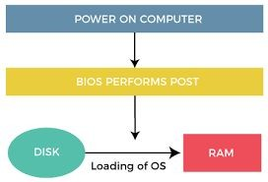
Booting in OS

Slide 4
What are Boot Block?
Contains all the data and instructions required for starting the booting process of the system is referred to as boot block
also known as boot sector
as it is a sector in the memory device which contains all the instructions
designed in a standard format required to boot the system by which BIOS can understand and execute

Slide 5
Components of Boot Block
MBR – Master Boot Record
  is a first part of a storage device that contains the boot block, boot code, partition table, and other required data and instructions
  is an essential part, helps to understand how the storage device is organized and which partition is required to boot.
Bootloader is a computer program
  responsible for starting the system and loading the operating system into the main memory
  executes all the essential steps required to initiate the booting process.

Slide 6
Components of Boot Block
Boot code, also called bootstrap code,
  is another important component of boot block.
  Bootstrap code consists of all the essential instructions written in low-level language like machine language or assembly language.
  Bootstrap code - performs important functions, including configuration of system components, initialization of hardware parts, loading of operating system into the main memory, etc.
Partition Table is another important component of the boot block.
  It is basically a data table that contains information about the different partition of the data storage device.
  It helps in identifying the active partition on the disk from which the operating system is to be loaded into the main memory.

Slide 7
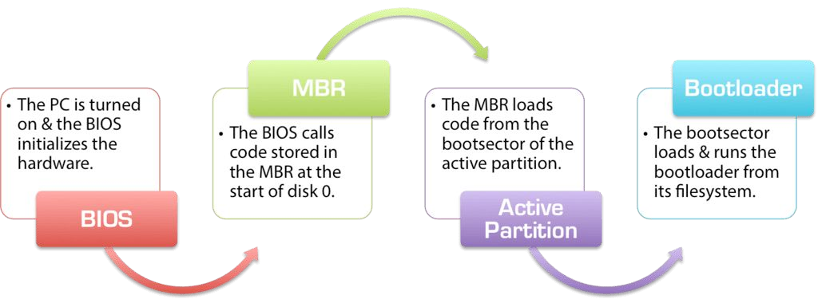
Components of Boot Block - Flow

Slide 8
Some important terms
the initialization program known as the bootstrap program which initialises all the components of the computer system:
  The CPU registers, device controllers, and main memory before starting the operating system.
  Next, the bootstrap program loads the kernel into the main memory.
  it jumps to the initial address and starts the operating-system execution.
an outline of the booting process in Windows 2000.
  The hard disk is divided into a number of partitions and one of these is the boot partition, which contains the operating system as well as the device drivers.
  The booting process starts by running the code placed in the ROM.
  This code that was placed in the ROM allows the system to read code directly from the master boot record or MBR.
  A table that lists the hard disk partitions and a flag indicating the partition to be booted is also contained in the MBR.
  After identifying the boot partition, the system reads the boot sector (first sector from
memory). The process continues with the remaining boot process that includes loading of other system services.

