Slide 1
Kernel

Slide 2
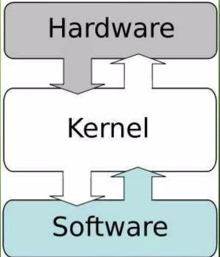
Introduction
The kernel is the central component of computer's operating system.
It act as an interface between user applications and the
actual data processing at the hardware level.
It is the core that provides basic services for all other parts of the OS.
Helps with management, networking.
tasks such as file systems,
process and memory device control and
When a process makes request of a kernel, the request is called a system call

Slide 3
Responsibilities of Kernel
Central Processing Unit
  Kernel take responsibility for deciding which program should be allocated to which processors all the time.
Random Access Memory
  Kernel is responsible for deciding which memory each process can use.
Input/Output Devices
  Kernel allocate request from applications to perform I/O task with the connection with appropriate device.

Slide 4
Responsibilities of Kernel
Memory Management
  Kernel has full access to the system memory and allow processes to safely access the memory whenever required.
Device Management
  Kernel must maintain list of available devices in advance by the user (called plug and play)

Slide 5
Features of Kernel
Scheduling of Process (Dispatching)
Interprocess Communication
Process Synchronization
Context Switching
Manipulation of Process Control Blocks
Interrupt handling
Process Creation and Destruction
Process Suspension and Resumption

Slide 6
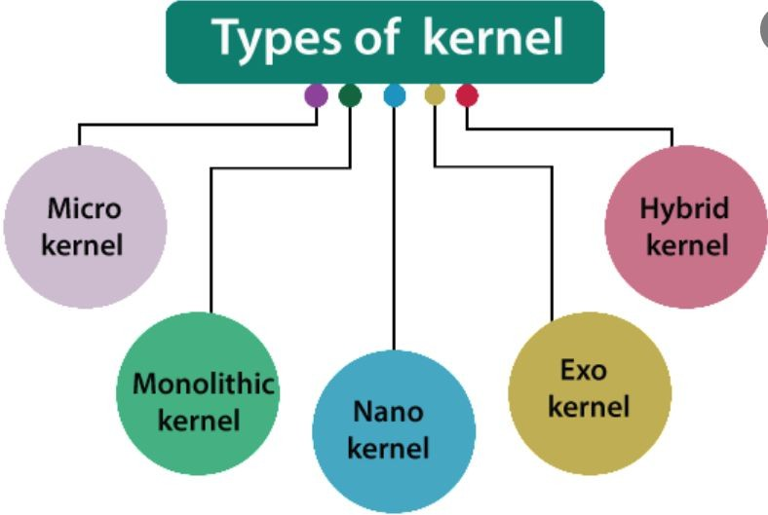

Slide 7
Micro Kernel
Kernel is broken down into separate processes known as server.
Some server processes runs in kernel space and some other runs in user space
All the servers are kept separate and runs in different address space
Communication is done by message passing
Parts like IPC, basic schedular, basic memory handling, basic I/O primitives are placed in kernel.

Slide 8
Advantage & Disadvantage
Easier to maintain
But large number of system calls and context switch must slow down the system because they typically generate more overhead then plain function calls.
Crash resistant - if one server fails , other servers can still work efficiently
Portable
Smaller in Size
Slower processing because of additional message passing

Slide 9
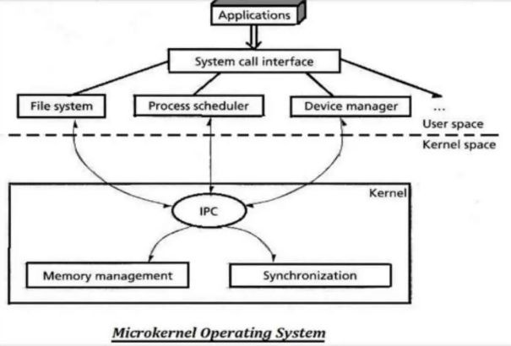
Micro Kernel

Slide 10
Monolithic Kernel
Runs every basic system services like process and memory management, Interrupt handling and I/O Communication and filesystem in kernel space.
Used by Unix, Linux Operating Systems
By using simple function call, the kernel can directly communicate with each other
Provides rich and powerful hardware access

Slide 11
Advantage & Disadvantage
Smaller in source and compiled form
Less code with less bugs and security problems
System calls are used to do operation in monolithic kernel
Execution is fast
Kernel will have all, it does not need any extra mechanism for handling I/O and process at the time of application making
Coding in kernel is hard, since common libraries cannot be used
Debugging is harder, rebooting is needed frequently
Bugs in one part of kernel produce strong side effect
Kernel is become very huge and difficult to maintain
Not portable one
  Monolithic kernels must be rewritten for each new architecture

Slide 12
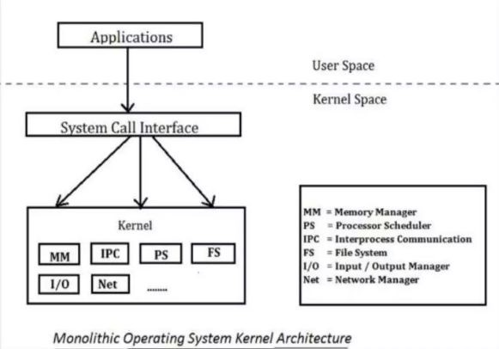
Monolithic Kernel system Architecture

Slide 13
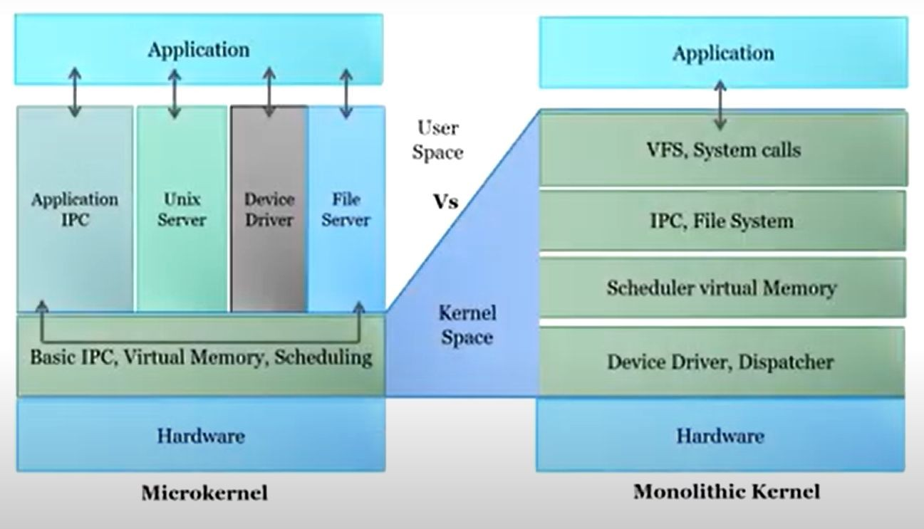
Microkernel & Monolithic kernel

Slide 14
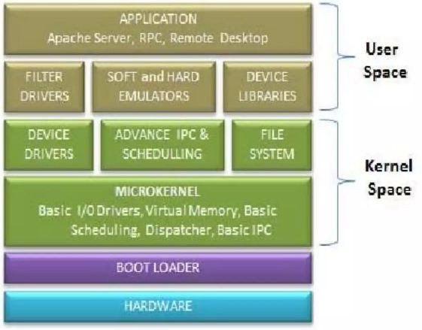
Hybrid Kernel
It is a combination of Monolithic and Micro kernel

