Slide 1






Heart Failure
predictor

Slide 2
Model Construction

Slide 3



Data cleaning performed
Checked for duplicate entries
Checked for NULLs within entries
Checked for outliers within entries
*didn’t find any*
*didn’t find any*
*decided to remove them*

Slide 4


Feature scaling
Standard
Scalar
x_train
x_test
*independently*

Slide 5
Finding a model
Decision tree
LOGR
?
Random forest
Adaboost
?
?
SVM
KNN
?
?

Slide 6


Best fitting model
Accuracy
≈
84%
Logistic regression

Slide 7
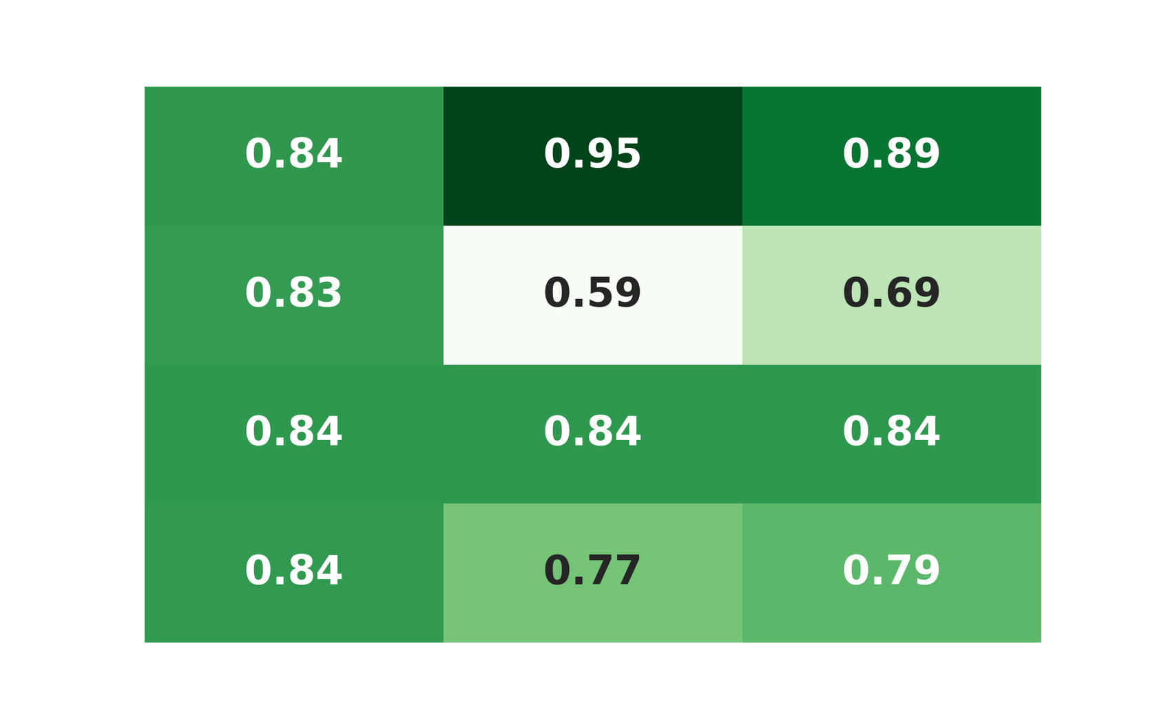
Classification report
Precision
Recall
F1 score
“Not at risk”
“At risk”
Accuracy
Macro avg

Slide 8
Gradio App

Slide 9
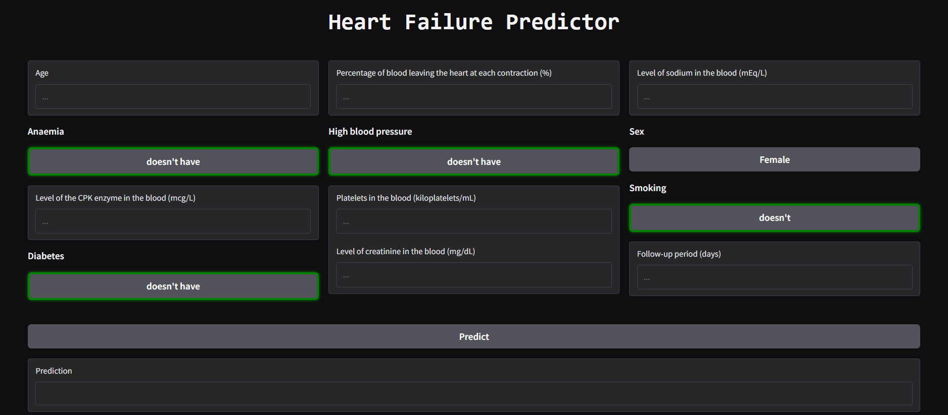
Interface

Slide 10
Readable Input fields
*map*
Feature name
Input field name
(in the dataset)
(in the app)
*more technical*
*more intuitive*
*more brief*
*more descriptive*

Slide 11
Readable Input fields
*some examples*
*map*
time
Follow-up period
(days)
*map*
Level of sodium in the blood (mEq/L)
serum_sodium

Slide 12
Binary toggles
Binary feature
*map*
A Button
(in the dataset)
(in the app)
*shows what each binary option represents*

Slide 13
Binary toggles
*some examples*
smoking
*map*
A Button
(in the dataset)
(in the app)
doesn’t
does
(0)
(1)

Slide 14
Binary toggles
*some examples*
diabetes
*map*
A Button
(in the dataset)
(in the app)
doesn’t have
has
(0)
(1)

Slide 15
Obstacles

Slide 16

Obstacles
Gradio’s docummentation

Slide 17
Future work

Slide 18


Future work
UI

Slide 19
Thank you
=)

