Slide 1
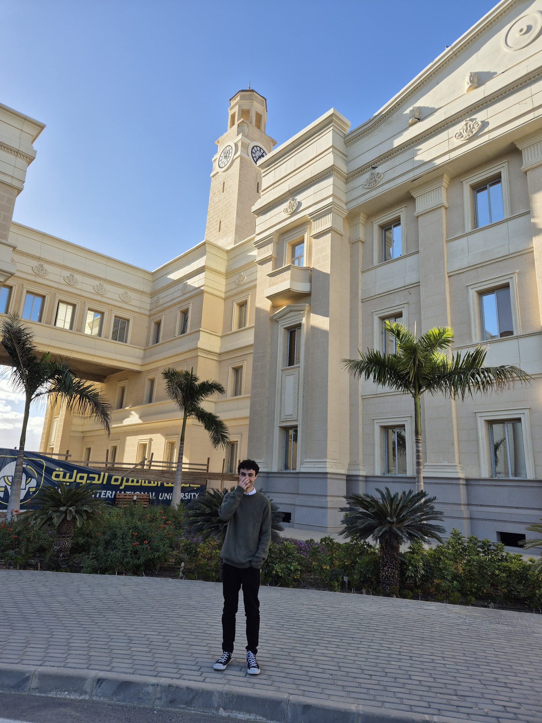
Asser
ML engineer/
Data visializer
Page | 01

Slide 2

About Asser
I’m a Computer Science undergraduate.
I found Machine Learning intriguing. Which is why I took a summer course to explore it, and have since built and deployed two ML models =)
I found it fulfilling to be able to visualize new concpets that I learn, so I decided to learn manim and have created several animations, one of which is on YouTube
Page | 02

Slide 3
Education
Cairo University
Faculty of Computers and Artificial Intelligence
(2023 - present)
Page | 02

Slide 4
My skills
Version
Control
CSS
Python
Manim
JS
Gradio
Page | 02

Slide 5
Work experience
Place A
Place B
*did*
*did*
Page | 02

Slide 6
My Services
01
02
Visualizing insights from your data via animations
Building ML models with interfaces
Page | 02

Slide 7
Previous Projects

Slide 8
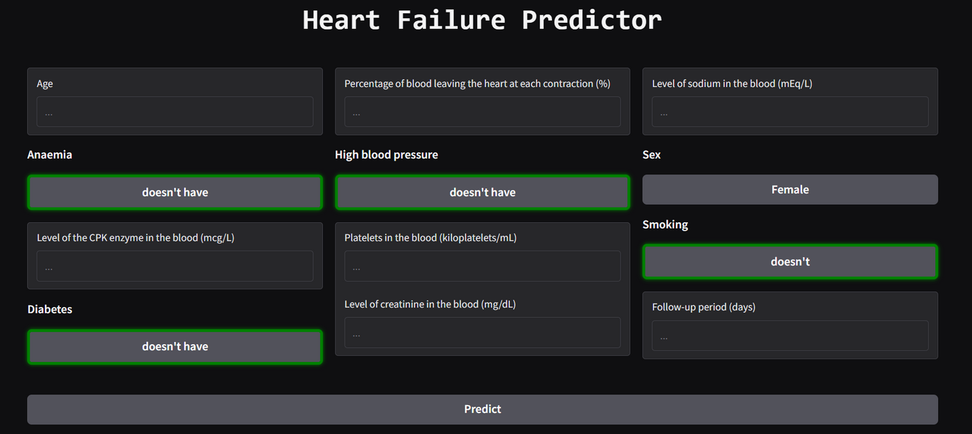
Heart Failure Predictor app
It’s here
It was cooked here

Slide 9
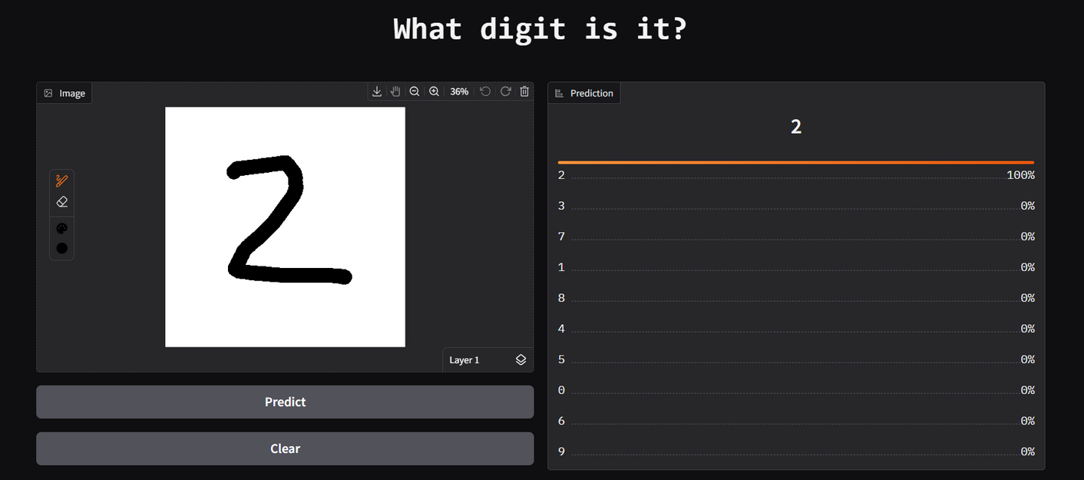
Digit classifier app
It’s here
It was cooked here

Slide 10
Achievements
01
02
*reward name*
*reward name*
*details*
*details*
Page | 02

Slide 11
Testimonials
*name*
*name*
*quoted words*
*quoted words*
Page | 02

Slide 12



Contact me
call me to collaborate
Cairo, eg
This is where all my code gets cooked up.
Page | 02

Slide 13
Thank you =)
Page | 02

