Slide 1
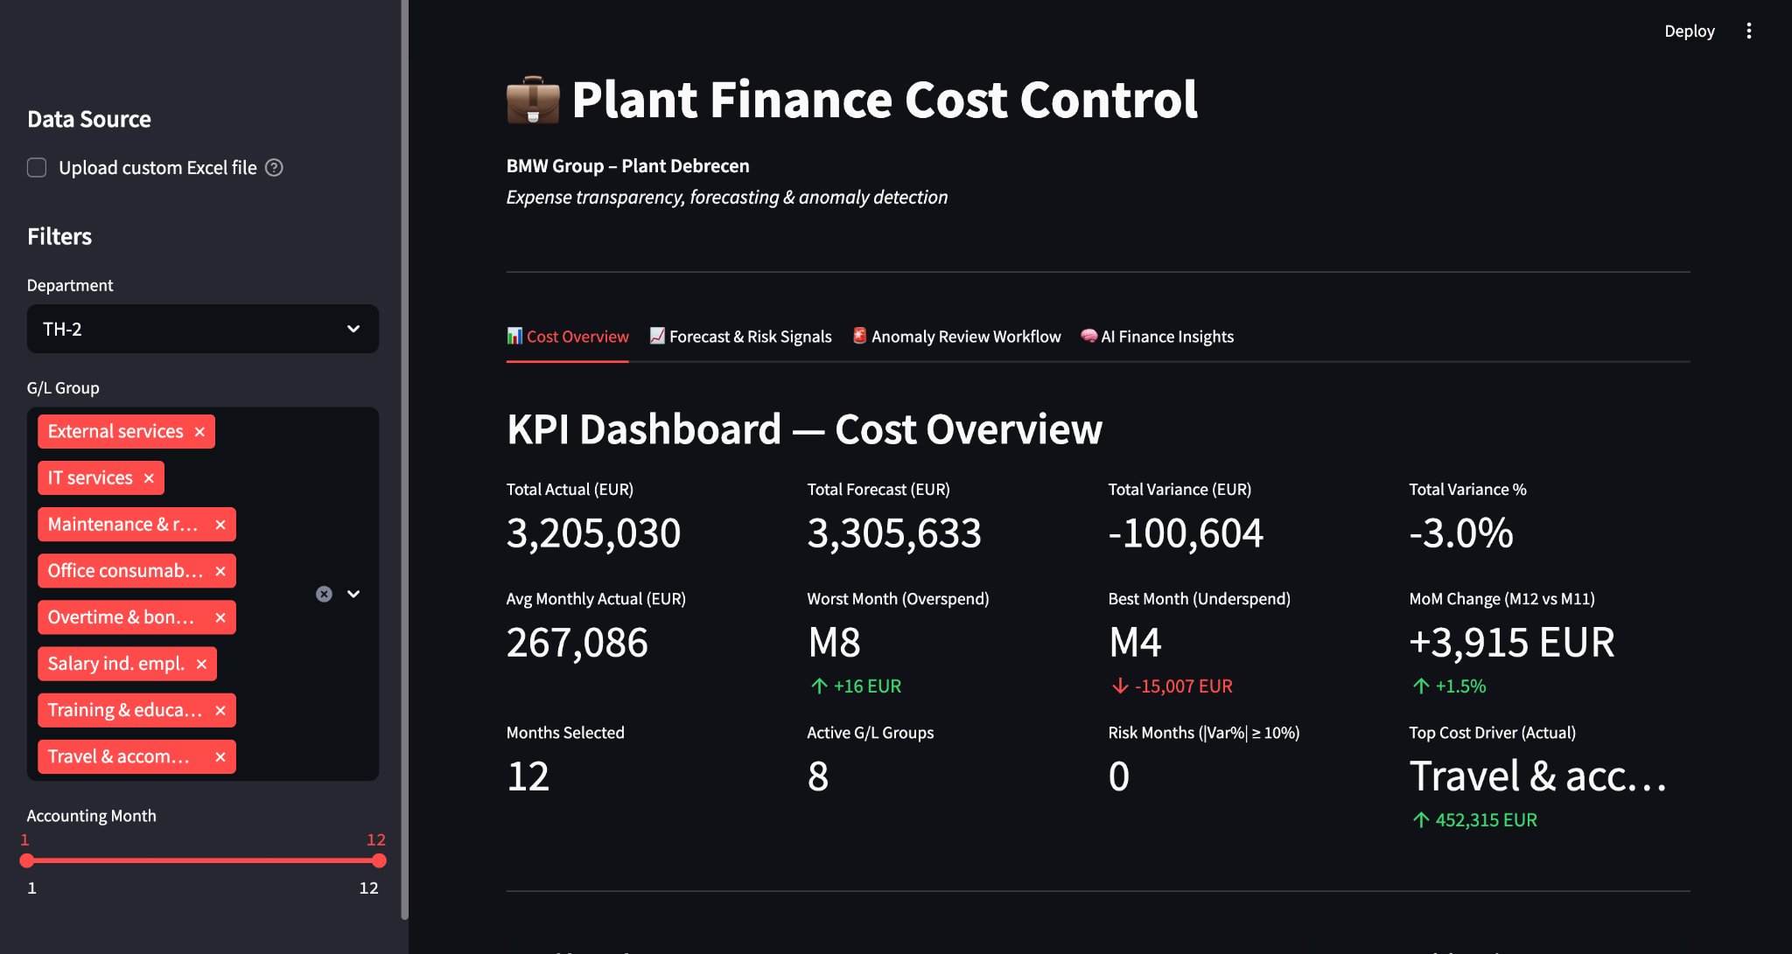
BMW Plant Finance Cost Control Dashboard
Actual vs Forecast • MoM anomaly workflow • Executive AI summary
Built on Case study (EUR-only dataset)
Notes:
[Sources] - Screenshots are from the user’s local Streamlit app. [/Sources]

Slide 2
Why This Dashboard?
Make monthly cost steering faster, clearer, and auditable without living in Excel.
Key Benefits
What the app delivers
One place to answer the finance close questions fast: Are we on plan? What changed? Why? What do we do next?
Replaces manual Excel hunting: instead of scanning rows, the dashboard summarizes totals
Focuses attention on what matters: flags big MoM spikes/drops so you review only the months that need investigation.
Turns analysis into action: ends with prioritized risks + suggested next checks, so it supports decisions, not just reporting.
KPI dashboard: totals, variance, risk months, top cost driver
Budget compliance: Actual vs Forecast + variance bridge
MoM anomaly signals + review status, reasons, notes
AI summary for executives (guardrails + short format)
Outcome: Less time preparing reports, more time explaining drivers and taking action.
Notes:
[Sources] - Content describes the user-built app features and logic. [/Sources]

Slide 3
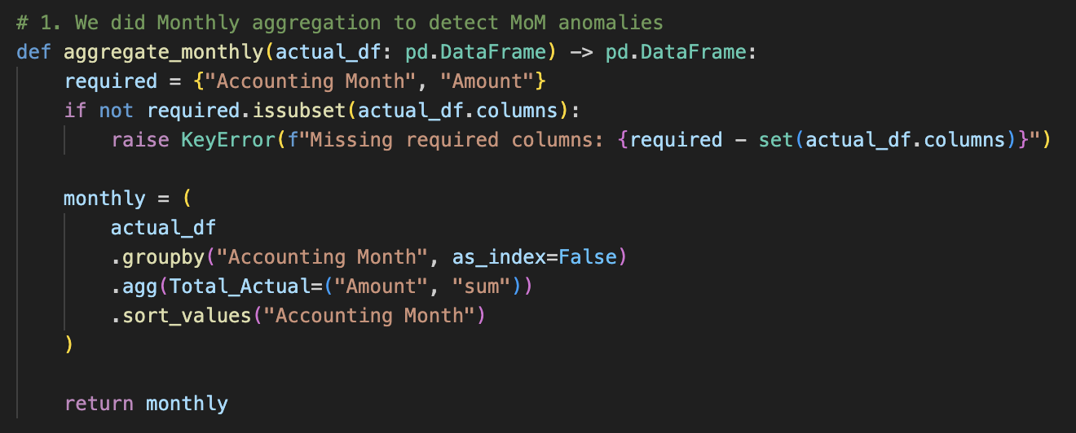
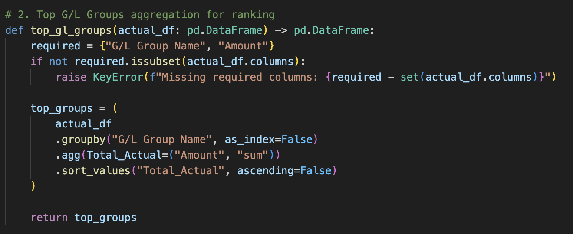
Detection Approach (Finance-Friendly)
Logic is rule-based and fully reproducible, enabling audit-ready outputs and consistent month-end steering.
Approach & Method
Key formulas
Budget compliance stays visible: Actual vs Forecast shown every month
Anomalies are driven by MoM movements in Actuals (spike/drop)
Flags are simple and explainable:
Anomaly: ≥ 50% MoM change, or ≥ 10k EUR + ≥ 25%
Variance = Actual − Forecast (negative = under budget)
Variance % = Variance / Forecast (when Forecast ≠ 0)
MoM Change = Actual(M) − Actual(M−1)
MoM Change (EUR) = Actual(M) − Actual(M−1)
Notes:
[Sources] - Definitions reflect the implemented logic in the user’s code (aggregations.py and anomaly_detection.py). [/Sources]

Slide 4
How The App Is Structured
Built for monthly reviews: fast scan → exceptions → explanation → action.
Excel
(Actual + Forecast)
Data Loader
(clean types)
Aggregations
(month / group)
Signals
(MoM thresholds)
Workflow + AI
(summary)
Same granularity keys (Month + Dept + G/L) so comparisons are valid.
Cleans dates/month types and standardizes EUR-only inputs.
Roll-ups: month totals + group totals + month × group comparisons.
Exceptions are based on MoM volatility in Actuals (Forecast is context only).
AI turns the top exceptions into an exec-ready narrative.
Automatic exception detection (MoM spikes/drops) so you don’t hunt manually
Notes:
[Sources] - Diagram describes the user-built components and data flow. [/Sources]

Slide 5
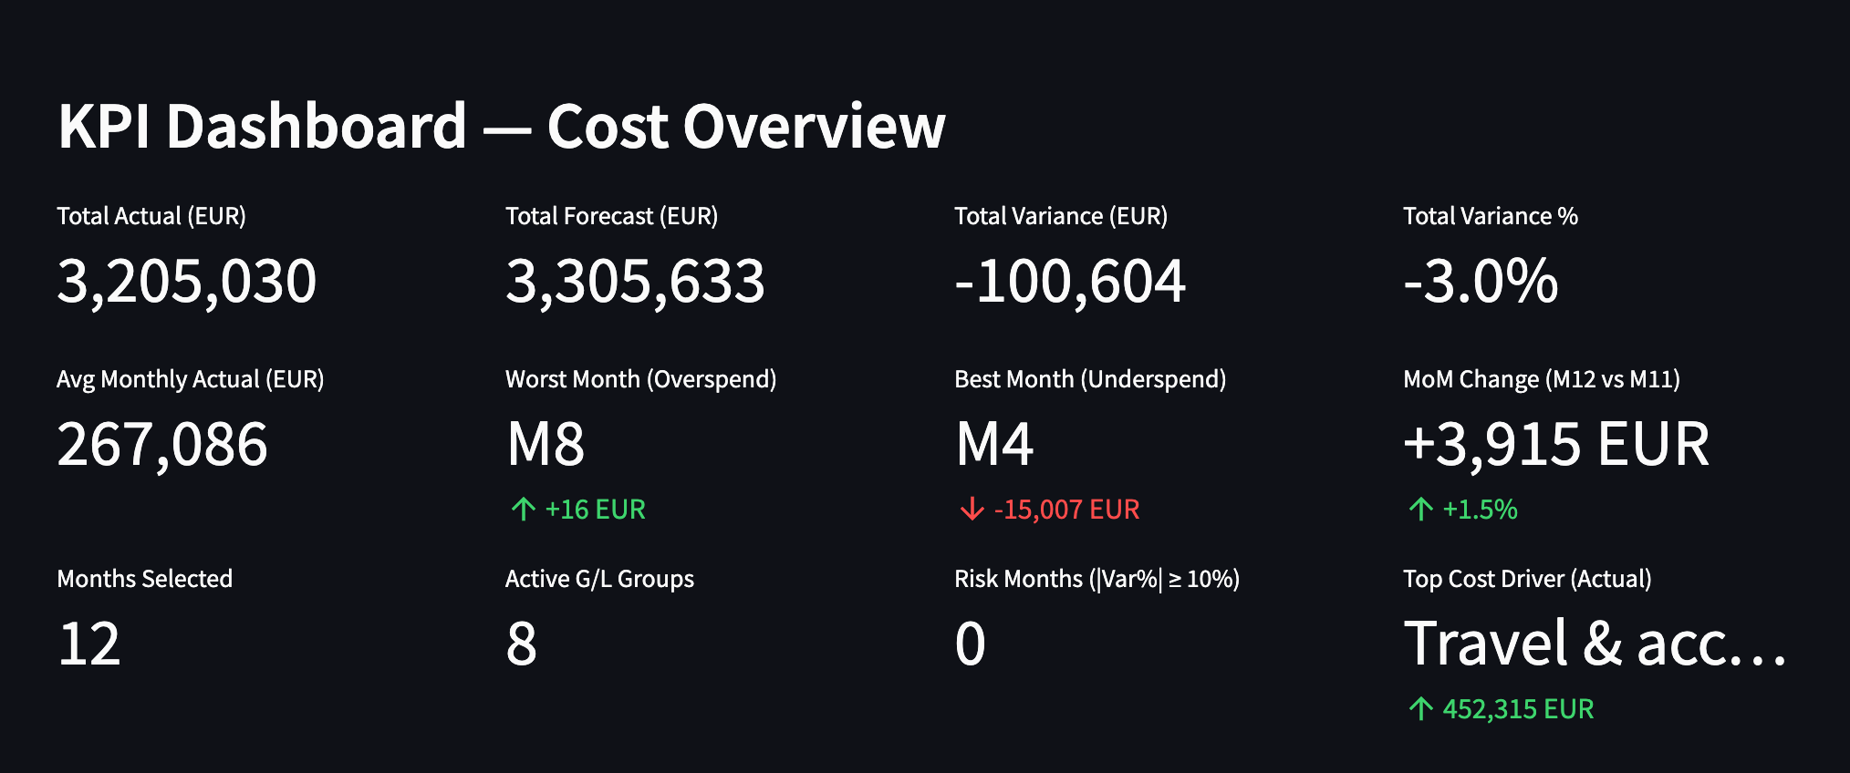
KPI Dashboard — Cost Overview
Are we on plan? What is driving cost?
Demo Callouts
Totals: Actual, Forecast, Variance
Worst/Best month (variance)
Risk months by variance %
Top cost driver (Actual)
Data Analysis
Under budget: -100,604 EUR (-3.0%) YTD variance.
Steering-ready: worst/best month + MoM change for quick month-end review.
Focus: highlights the top cost driver to start investigation immediately.
Notes:
[Sources] - Screenshot from the user’s app (Tab 1 KPI dashboard). [/Sources]

Slide 6
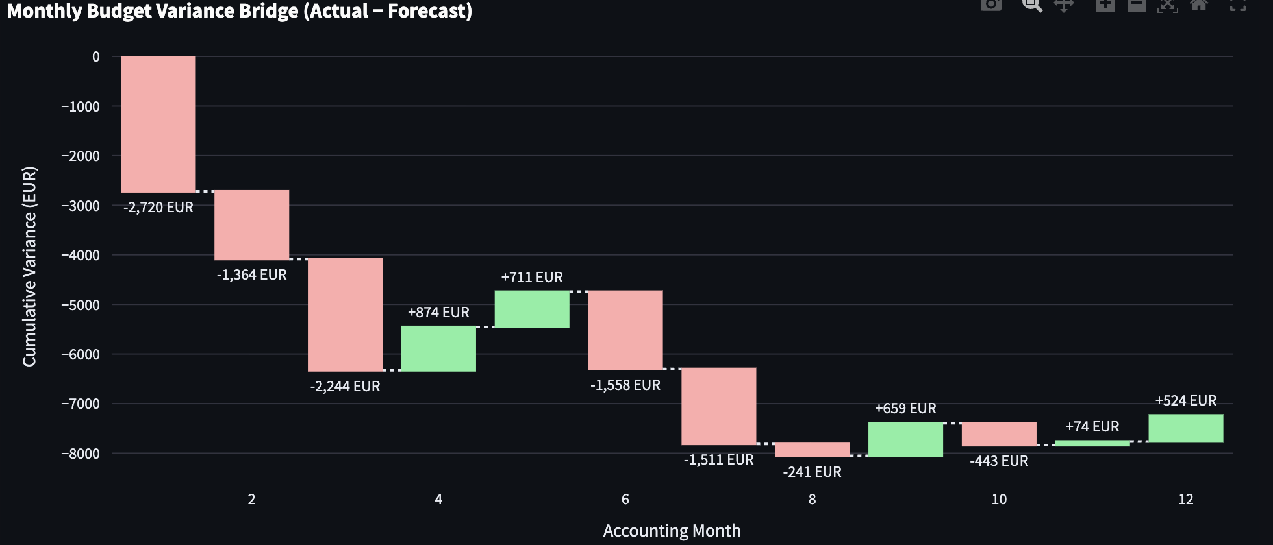
Forecast & Dynamic Risk Signals
Highlights the months driving variance so finance can validate drivers and take action.
Overtime & Bonuses
How to read
Variance = Actual − Forecast
Negative = under budget
Bridge shows monthly + cumulative impact
Scope = selected G/L group(Overtime & Bonuses)
Findings
Holiday / peak-period effect is visible: overspend increases show up in the later months (notably Month 9 and Month 12), which fits a story of holiday coverage / peak workload / shift fill driving more OT payouts.
Net under budget over the year: the cumulative bridge stays negative and ends around ~−7–8k EUR, meaning overall Actual < Forecast.
Notes:
[Sources] - Screenshot from the user’s app (variance waterfall chart). [/Sources]

Slide 7
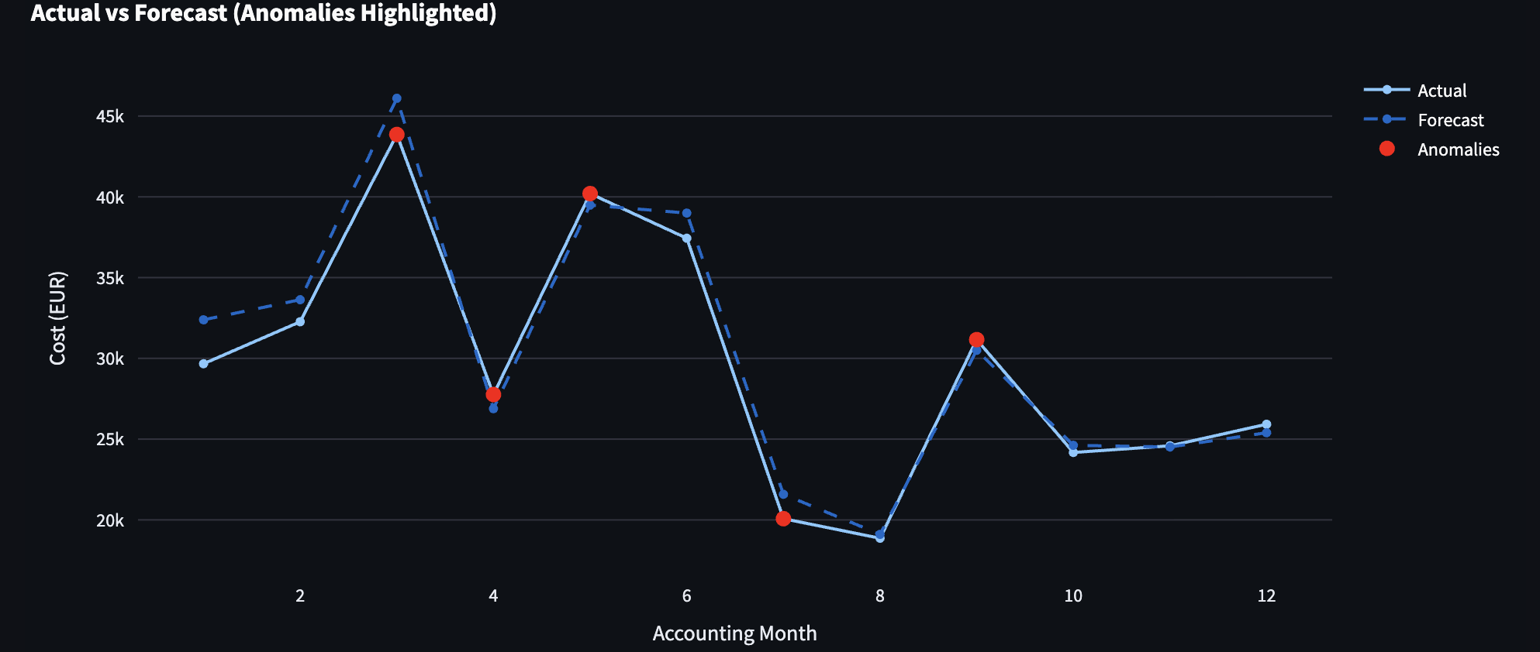
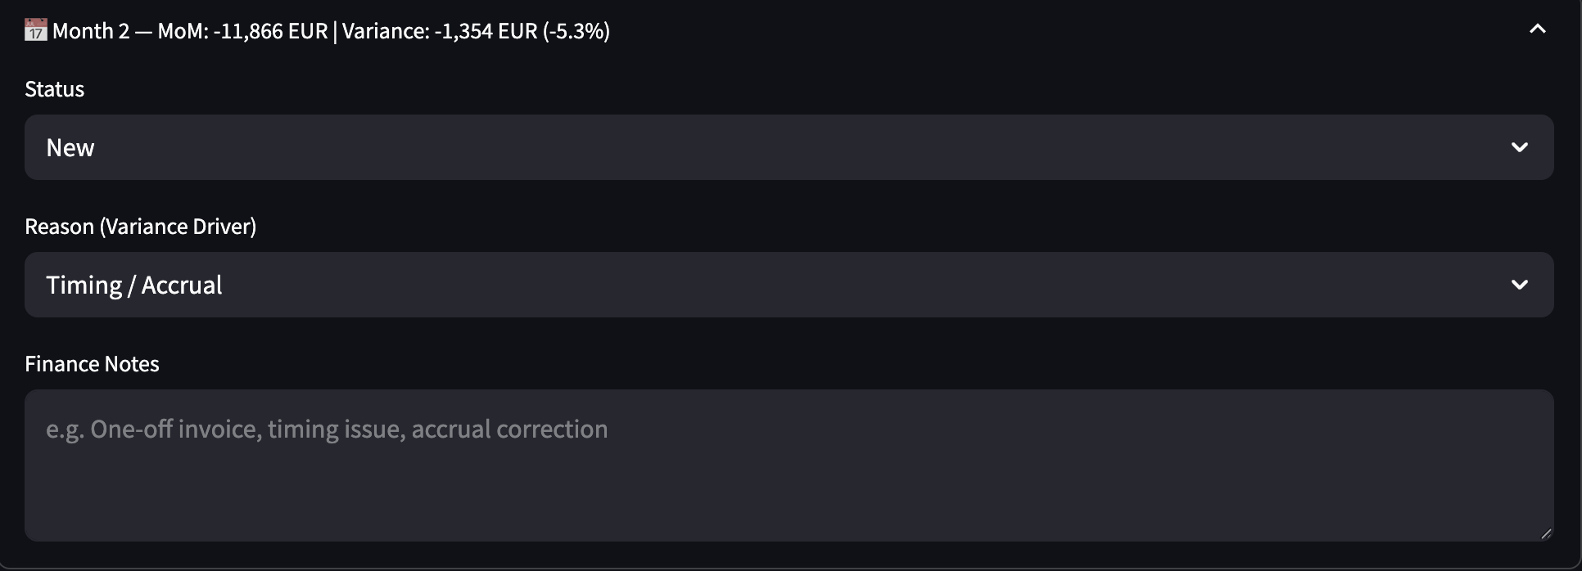
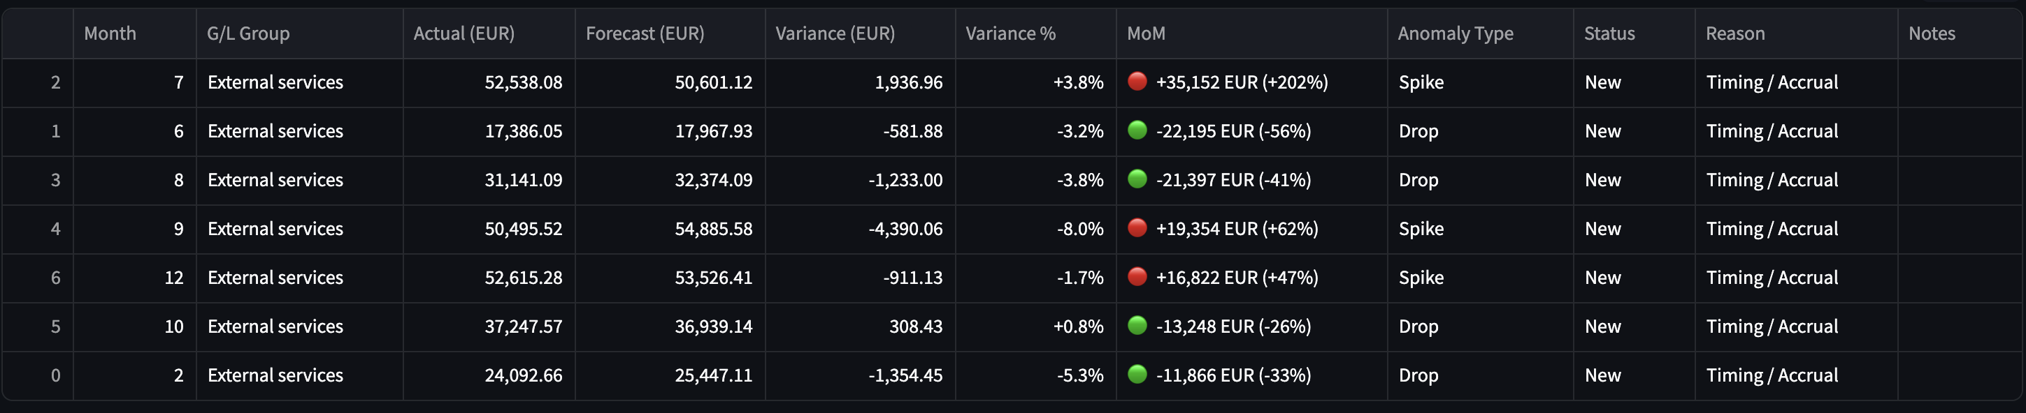
Anomaly Review Workflow
MoM signals trigger review with status, reason, and notes.
Multiple MoM spikes/drops indicate a volatile spend profile, consistent with invoice timing, milestone billing, or reclassification.
If the MoM change is huge but the budget variance is small, it’s mostly phasing; if both are large, it may be scope/volume or price.
KEY FINDINGS
Notes:
[Sources] - Screenshots from the user’s app (MoM chart + anomaly summary table). [/Sources]

Slide 8
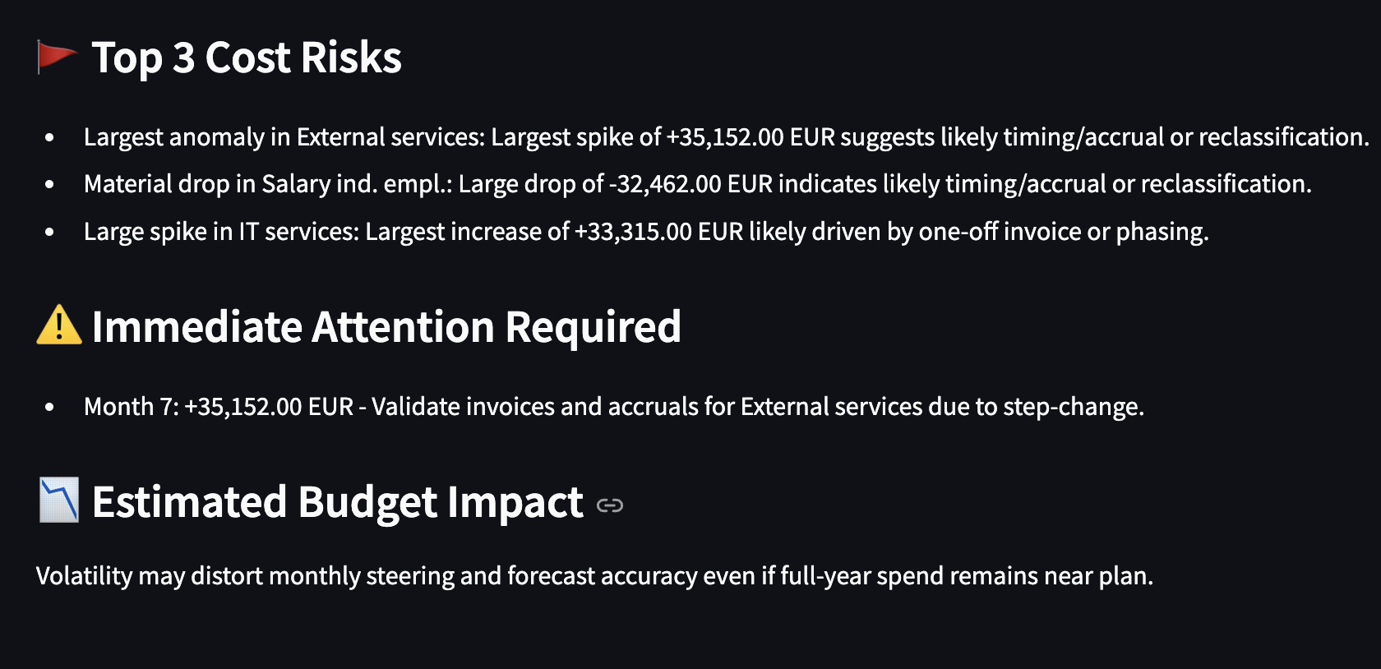
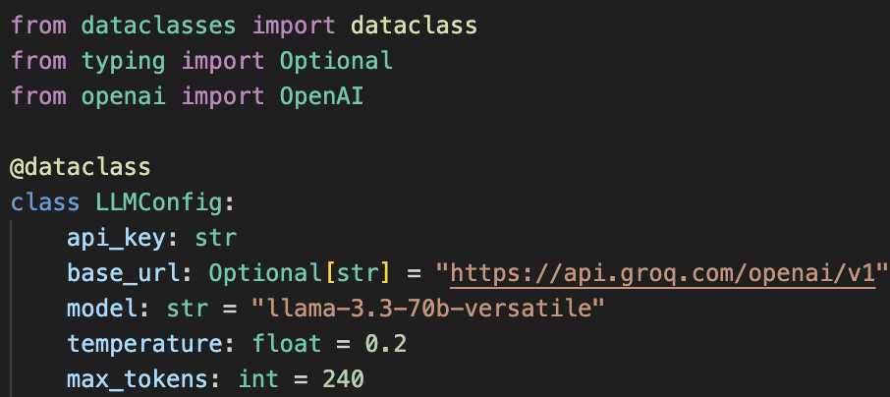
AI Finance Insights — Controlled Executive Summary
LLM turns signals into a short executive brief—without inventing data.
Why AI is safe + what value it adds
Uses only aggregated outputs from the app (MoM + variance tables)
Fixed format: Risks → Action → Budget impact
Hard limits: ≤130 words, consistent EUR formatting
If data is missing returns “Not enough data” (no guessing)
Budget context (variance impact, not confused with MoM)
Source: anomaly table + forecast comparison (shown in tabs 2–3)
Audit trail
Inputs used: MoM movers + forecast variance (aggregated tables only)
Traceability: each EUR value maps to a specific Month + G/L row
Reproducible: same filters → same summary (no randomness in logic)
Notes:
[Sources] - Sample reflects the app’s prompt design and typical outputs from user testing. [/Sources]

Slide 9
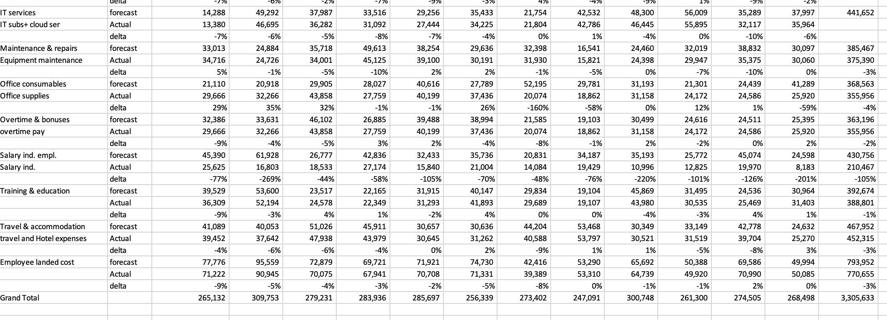
From Findings to Features
Controller notes translated into concrete features to improve steering, forecast quality, and cost control.
Additional Findings
Forecast allocation G/L accounts must match Actual G/L accounts, otherwise variances can be misleading.
IT services & subscriptions should behave as fixed/contracted costs (stable pattern).
Startup costs after holidays should be planned into forecast (ramp-up effect).
Set consumables targets based on industry benchmarks and monitor deviations.
Reduce training costs by shifting to AI-based internal training modules and internal degree-style programs.
Employee cost should be more consistent, driven by salary increases + controlled OT.
Notes:
[Sources] - Screenshot contains stakeholder notes provided by the user. [/Sources]

Slide 10
A Short Live Demo:
▶ Start Demo
A crisp demo path that mirrors a finance review conversation.
Conclusion:
Are we on plan? (Total variance / variance %)
What’s driving it? (Top driver + bridge months)
What changed vs last month? (MoM spike/drop)
What’s the action? (workflow notes + AI brief)
Thank you, Questions?
Notes:
[Sources] - Demo script is derived from the app’s tab structure and workflow. [/Sources]

