Slide 1
Industrial Training
K.M.A.A.Karunanayaka
150297K

Slide 2


Slide 3
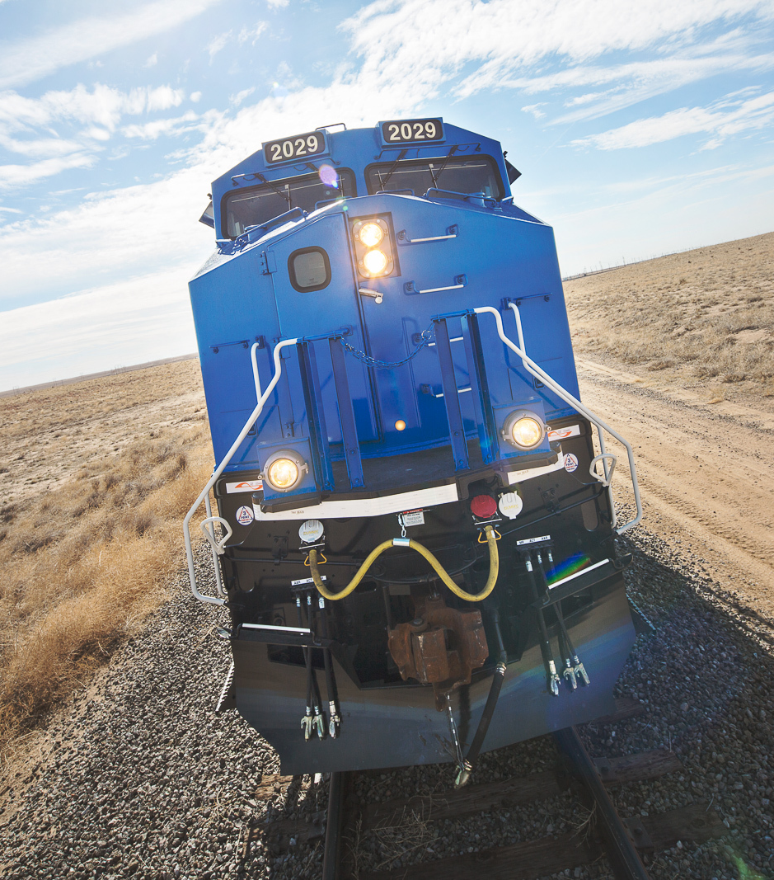
What is ShipXpress?
ShipXpress was founded in Jacksonville Beach, Florida in 2000 to create web-delivered services that simplify rail logistics and reduce costs for rail carriers, railcar owners and rail shippers.
GE-Transportation acquired ShipXpress in 2016

Slide 4
Products of ShipXpress
Portal
Trax
EBol
Yard
Command
Control
Rates
Concur

Slide 5
ShipX-Rates
ShipX-Rates is a freight management system used to make decisions about how to ship product
RailSync Concur allows you to manage all aspects freight revenue interline, junction settlement of your railroad.

Slide 6
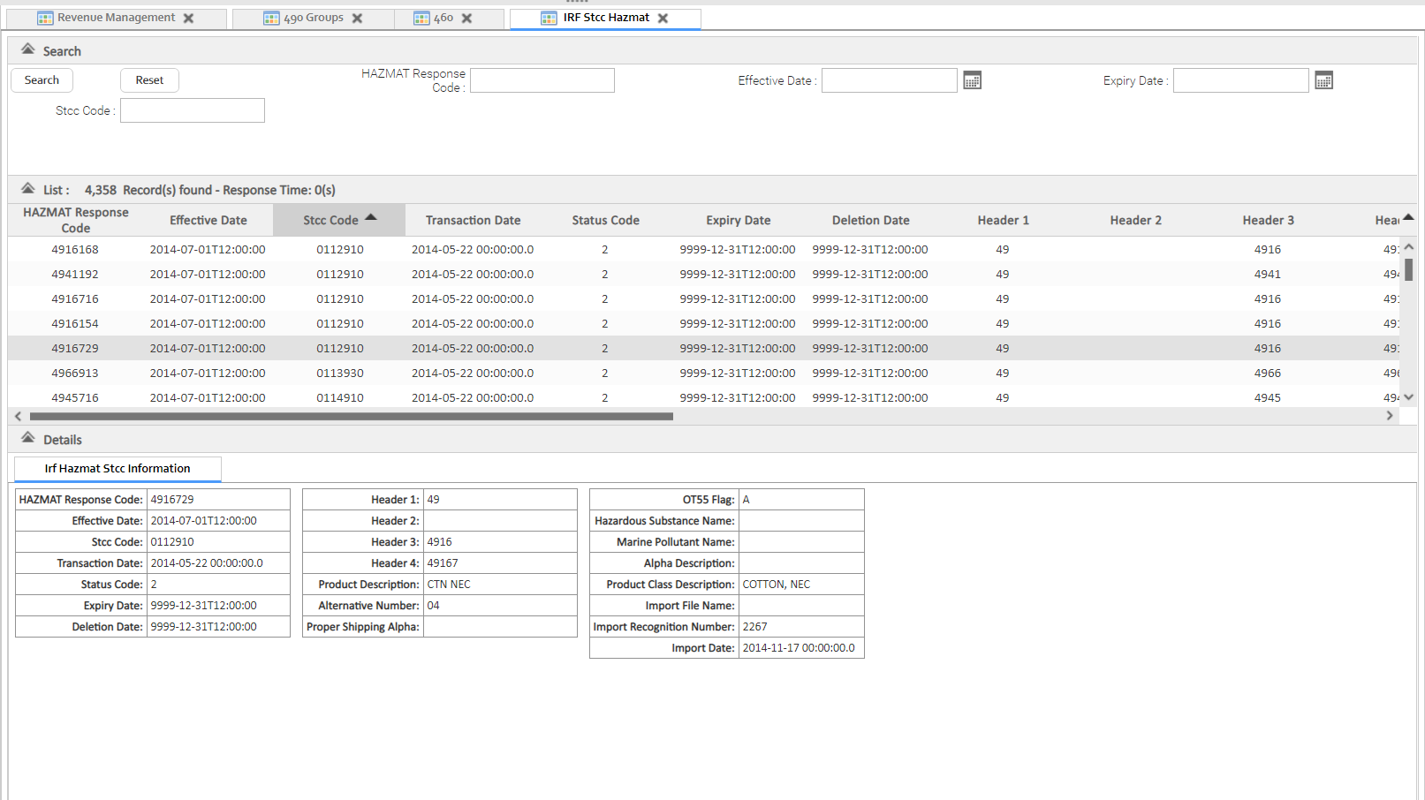
Technical Training Assignment
Creating a View Panal from Smart Gwt

Slide 7
Technologies Used
Smart GWT
Spring
Struts2
Hibernate

Slide 8
Autosuggestion API for search text fields
Return most favorite searches for a given text item.
User centered design

Slide 9
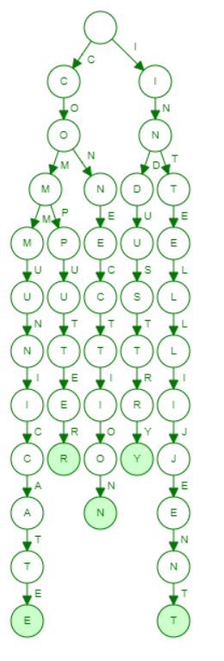
Autosuggestion
Research about data analysis
Trie Tree data structure has been used.
User Input will save new database
Fetch data from both Oracle and new database

Slide 10
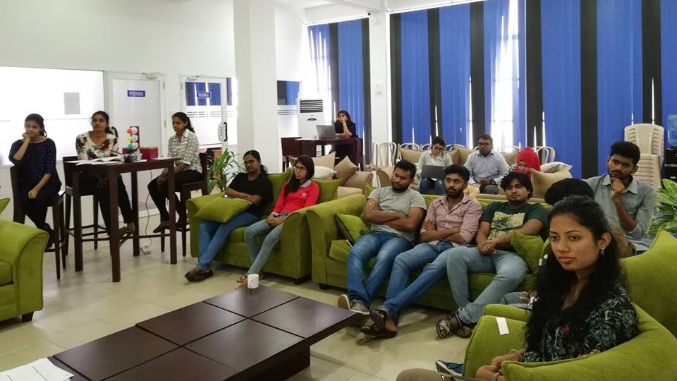
ShipXpress life
ShipX Toastmasters club
Annual year end party
Blood donation campaign

Slide 11
Learning Outcomes
Work as a team with team effort with professional practices like Sprint.
Get a knowledge about what are the leading technologies in the industry.
How to adapt to new environment with short period of time.
Technologies and best practices in the industry

Slide 12
Thank You!

