Slide 1
JIRA Training
JIRA Sprint Planning/ Anomaly Training

Slide 2
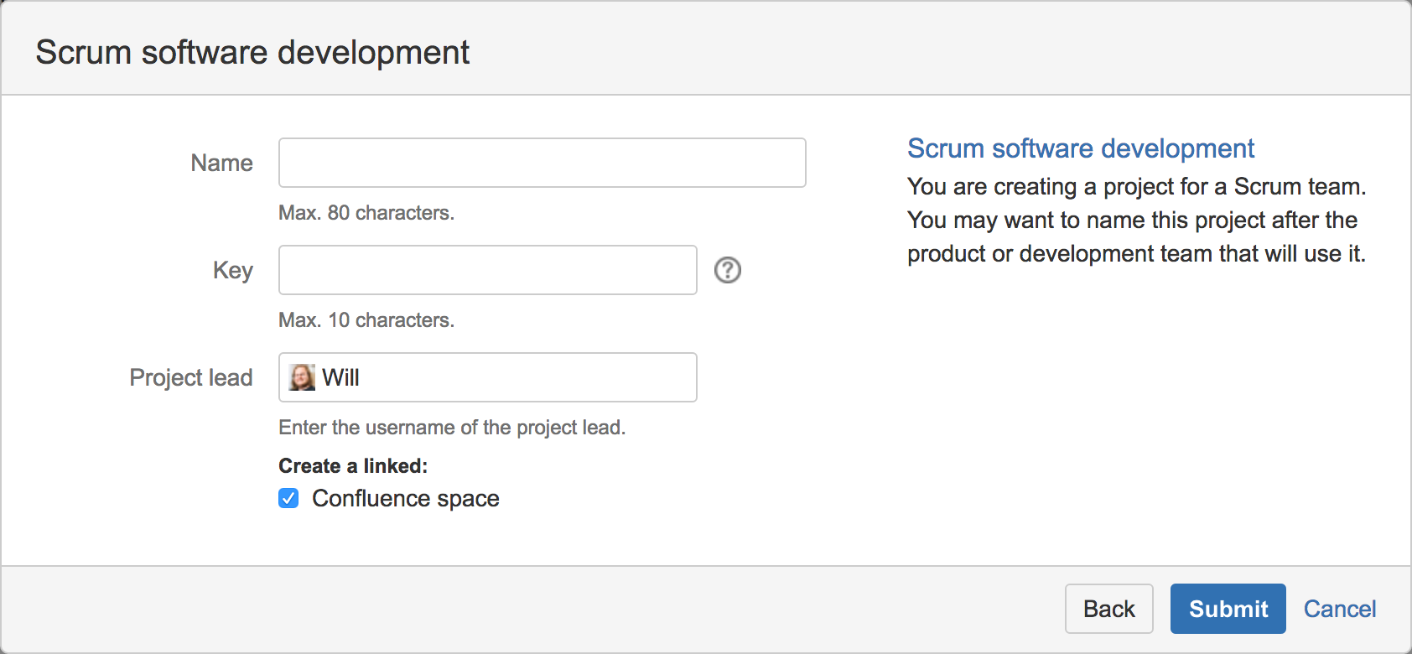
Creating a New Project
Note :- Only Jira admins can create new projects.

Slide 3
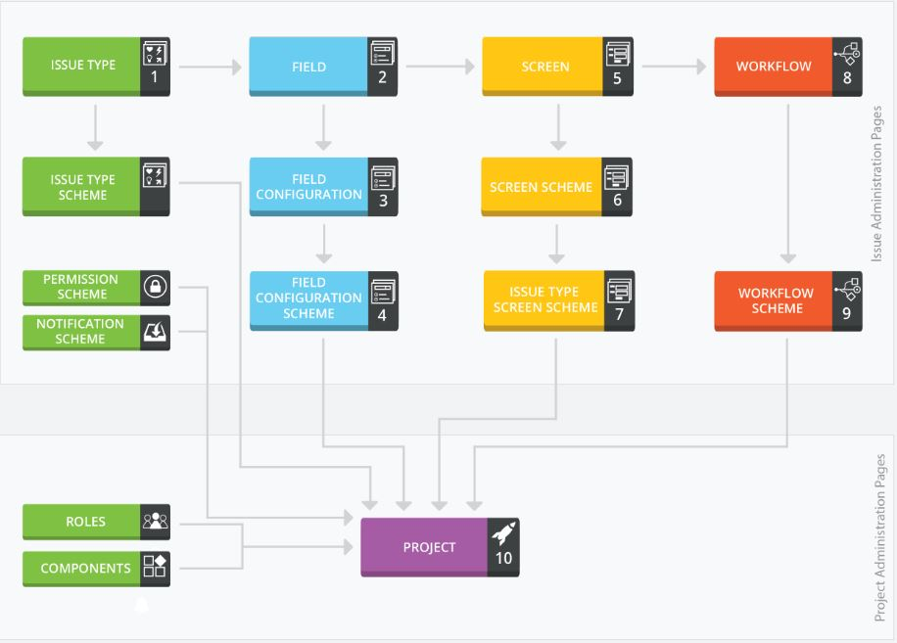
JIRA Project Setup

Slide 4
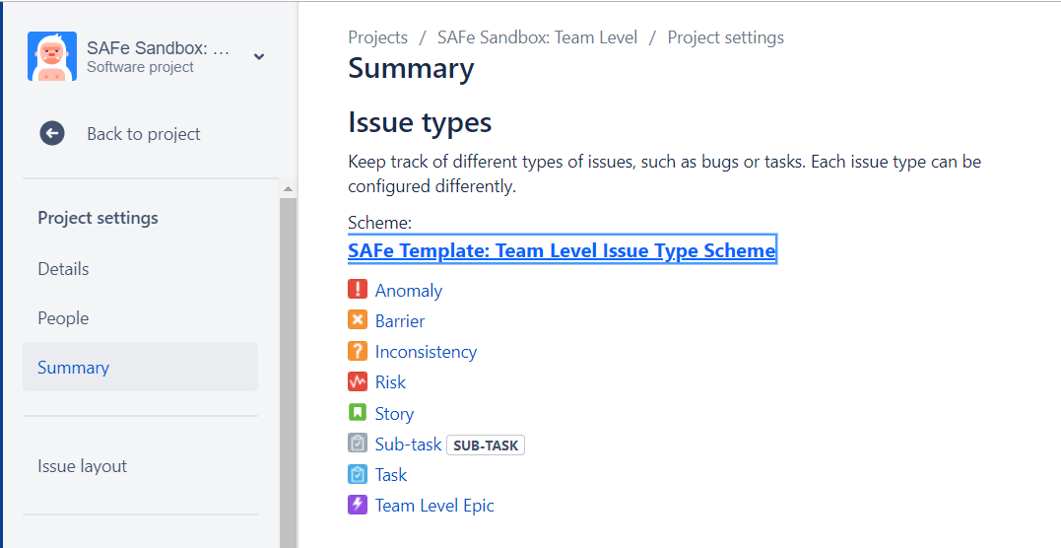
Projects that share configuration share:
Issue types

Slide 5
Issue types
SCHEME_NAME | OPTIONS | PROJECTS
SAFe Template: Team Level Issue Type Scheme | Story Anomaly Task Team Level Epic Risk Inconsistency Barrier Subtask | SAFe Sandbox: Team Level CAT: Security Toolkit
Product Marketing Scheme | Anomaly Task Risk | Security Infrastructure & Automation Support, Services & Contracts
Framework Scheme | Story Task Team Level Epic Risk Subtask | SSCB Test Framework

Slide 6
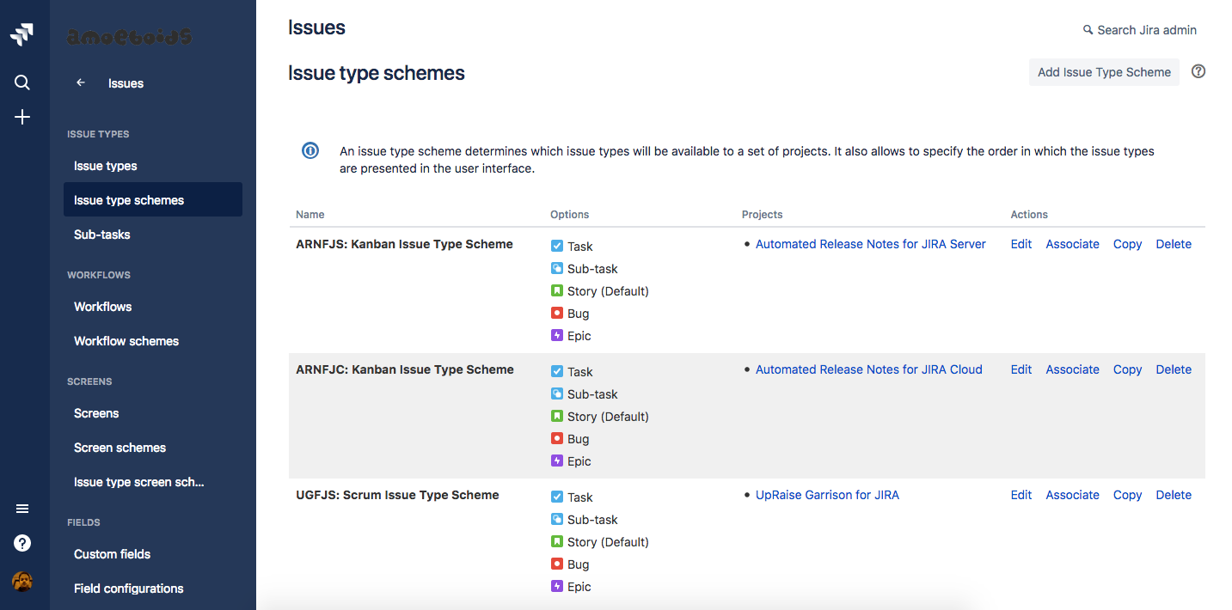
Issue types

Slide 7
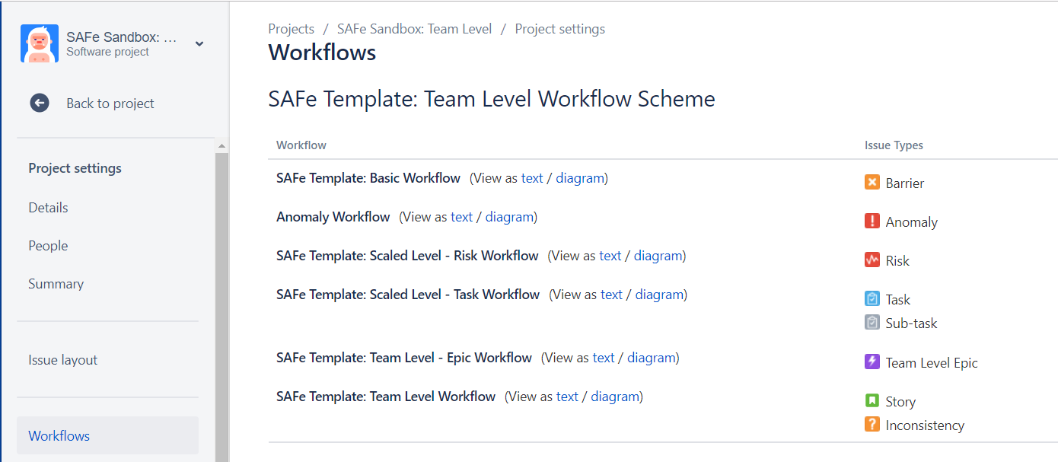
Workflows
A workflow defines the sequence of steps that an issue will follow.

Slide 8
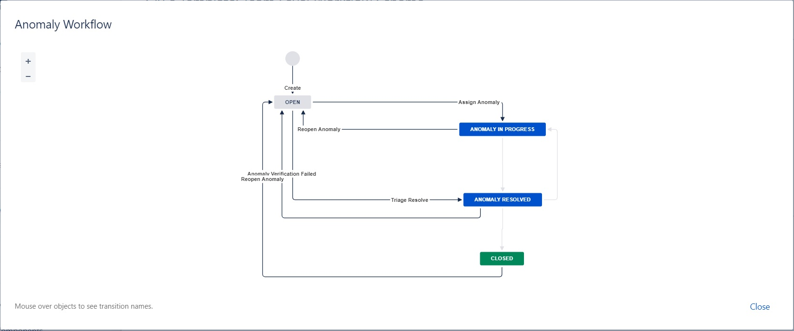

Slide 9
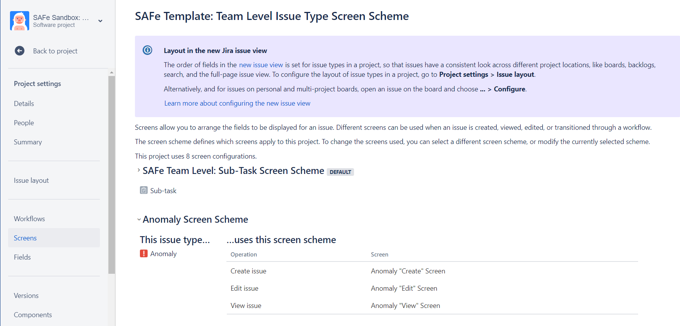
Screens
Screens allow you to arrange the fields to be displayed for an issue. Different screens can be used when an issue is created, viewed, edited, or transitioned through a workflow.

Slide 10
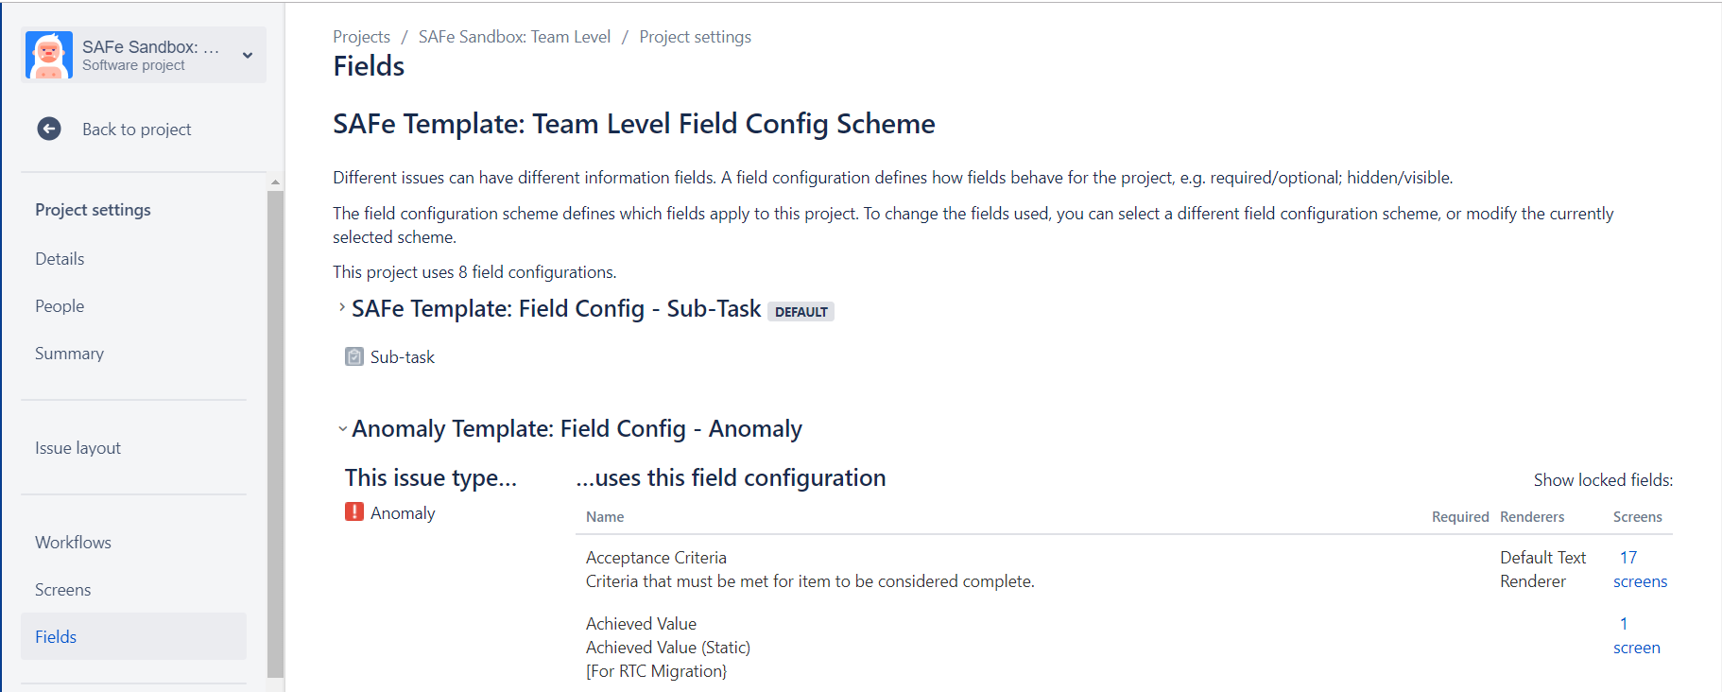
Fields
Different issues can have different information fields. A field configuration defines how fields behave for the project, e.g. required/optional; hidden/visible.

Slide 11
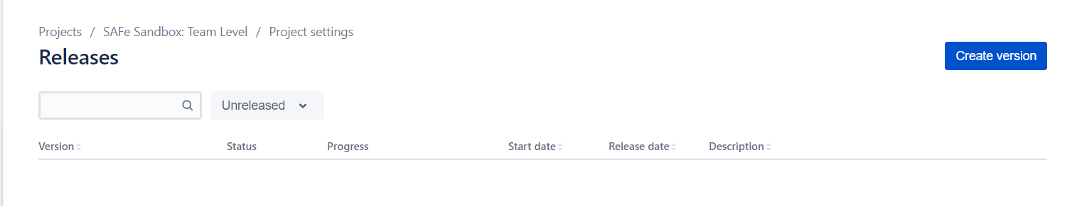
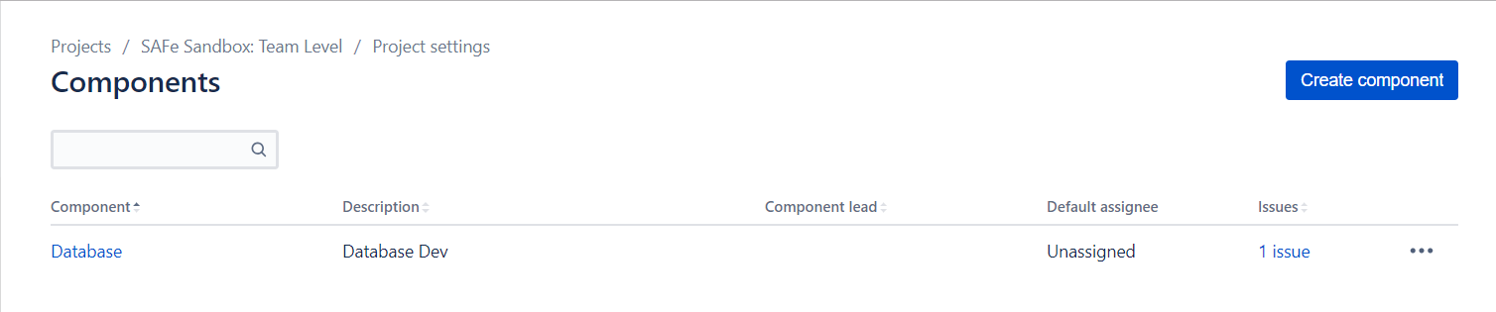
Versions
Components

Slide 12
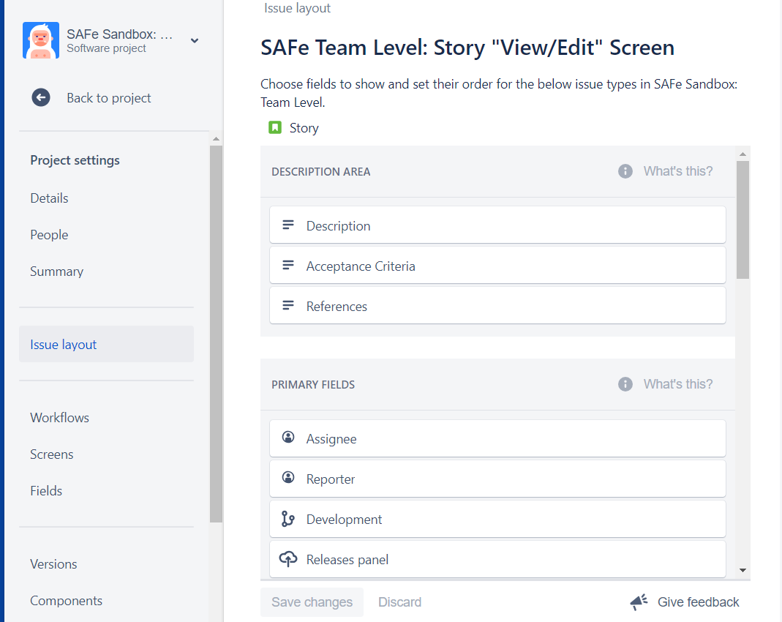
Issue layouts
This page lets you set the visibility and order of fields for this project's issue types

Slide 13
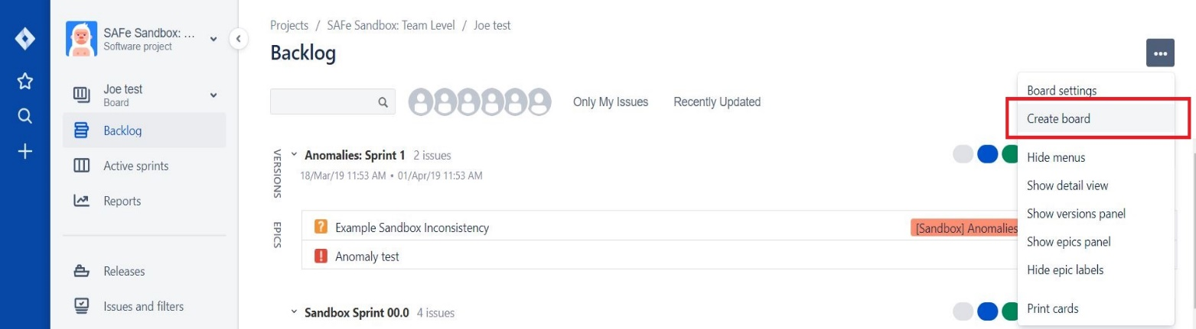
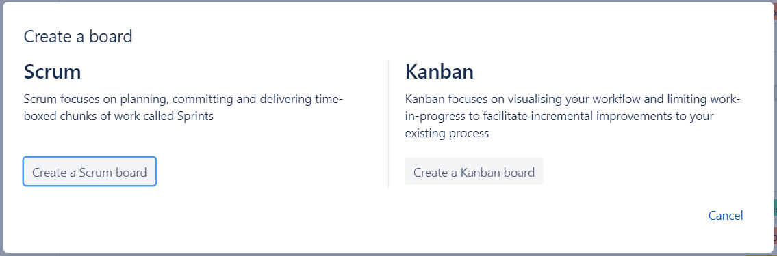
Creating a New Jira Board
Click Create board at the top-right of the page
Choose whether to create an agility board, Scrum board, or Kanban board, as described below.

Slide 14
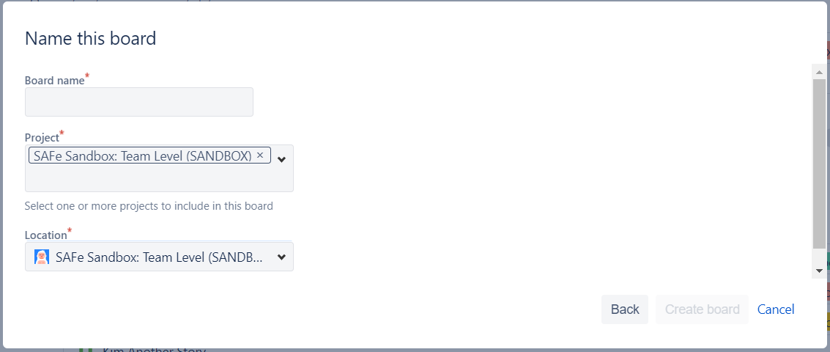
Enter a new Board name and click Create

Slide 15
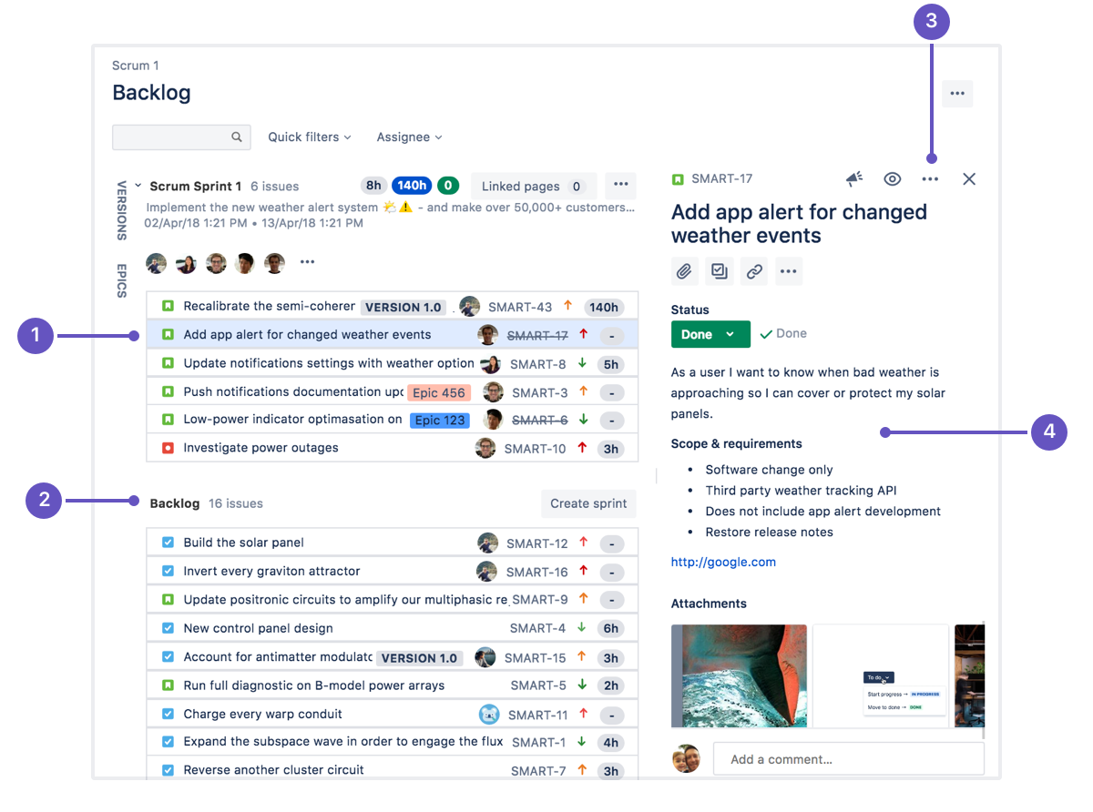
Backlog
A backlog is a list of outstanding work. Before starting new work (newsprint), you will build a new backlog or groom an existing backlog.
Selected Jira tickets for the sprint
Backlog: Jira tickets that needs to take for the sprints.
3. Issue actions: Move an issue, clone it, log time spent working on it, and perform other actions.
4. Issue details: See the assignee and description, make comments, and add content to the issue.

Slide 16
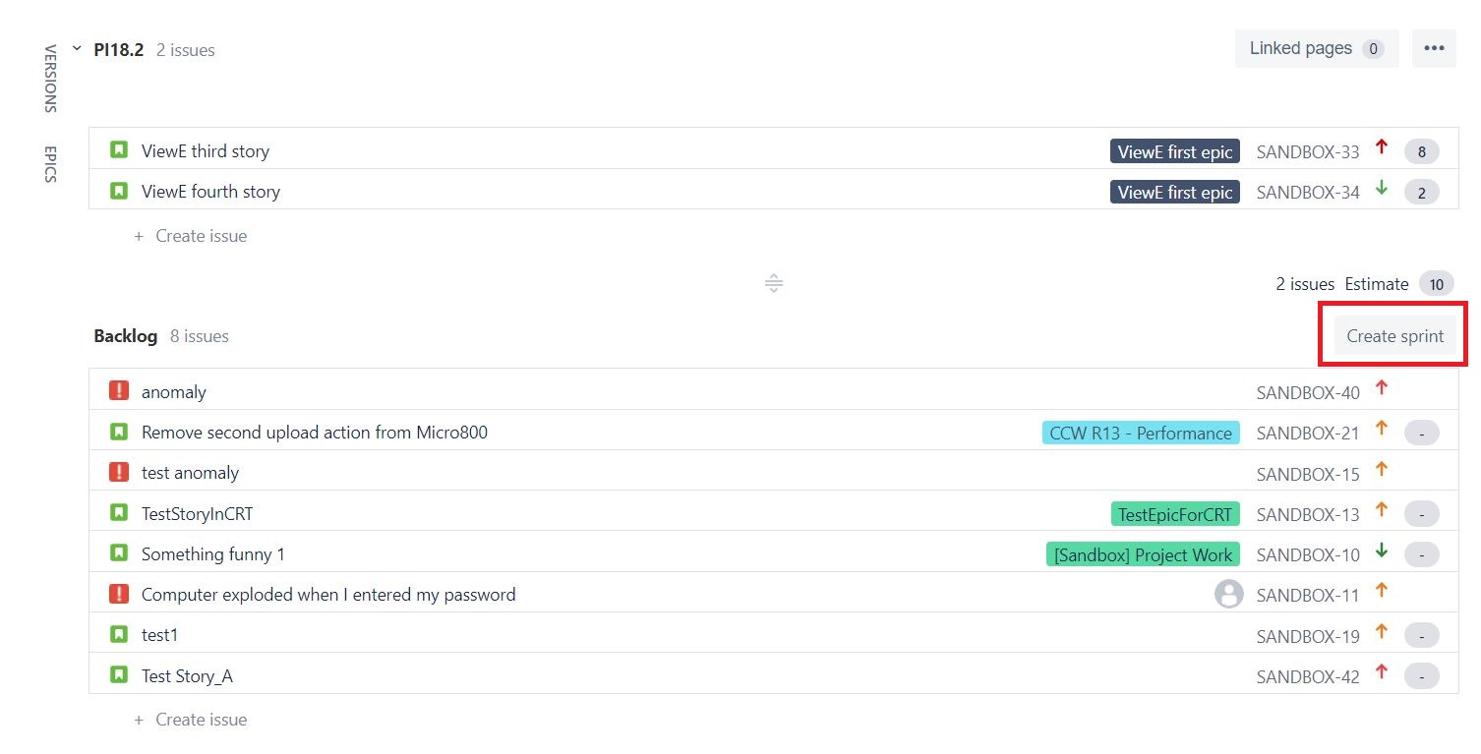
Planning and Creating sprints
Every sprint starts with a planning meeting.

Slide 17
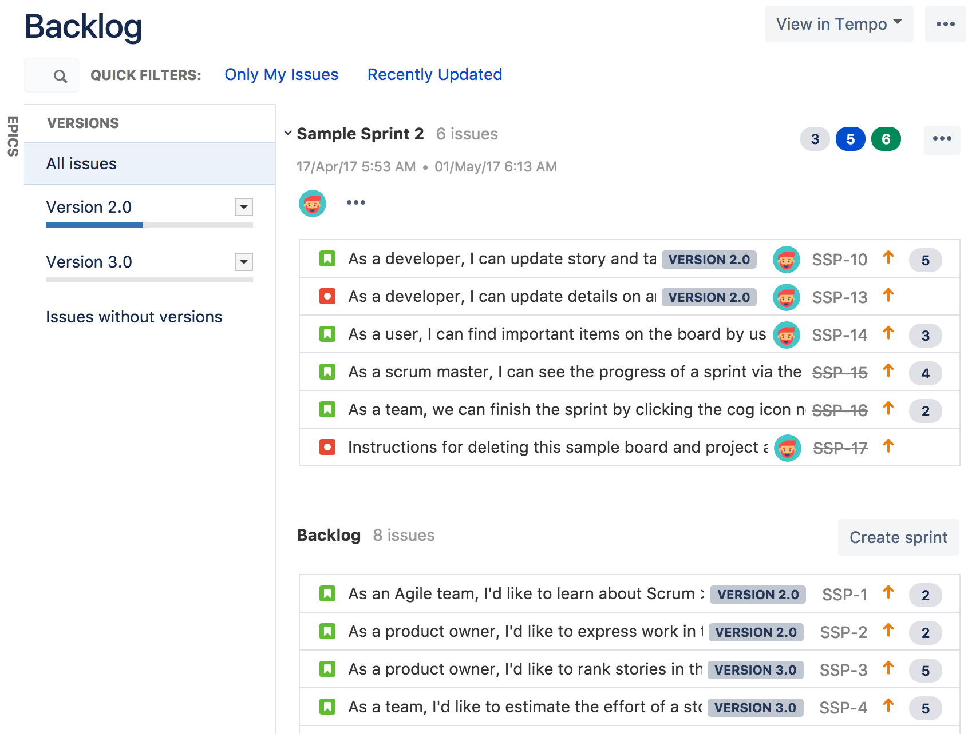
Version
A version is a set of features and fixes released together as a single update to your application. Assigning issues to versions helps you plan the order in which new features (stories) for your application will be released to your customers.
Note :- Once a version has been created for a project, the 'Affects version' and 'Fix version' fields will become available for your issues.

Slide 18
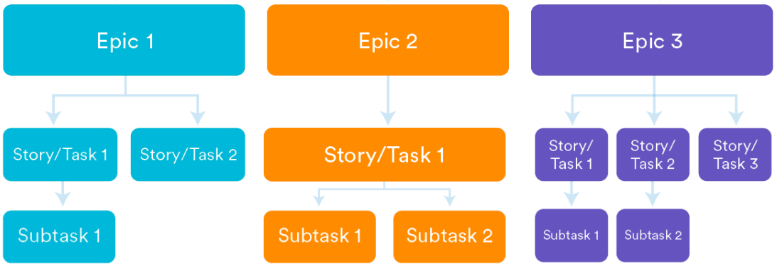
Epics
An epic captures a large body of work—performance-related work, for example—in a release. It's essentially a large user story that can be broken down into several smaller stories. An epic can span more than one project.

Slide 19
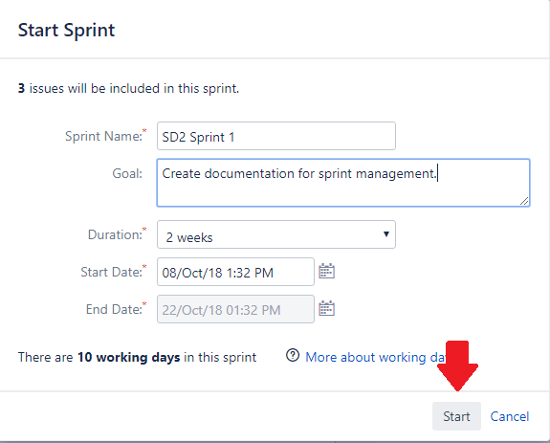
Starting a Sprint
You can only start a sprint, if:
You haven't started one already.

Slide 20
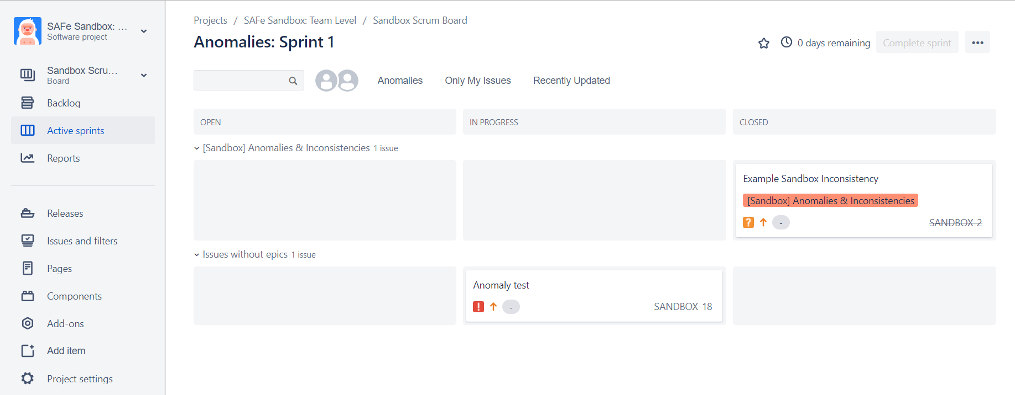
Active Sprints
An issue will only be visible in Active sprints if:
The issue's status maps to one of the board's columns
The issue is in an active sprint (for Scrum boards), and
The issue matches the board's saved filter.
Each column maps to one or more Jira statuses.
Subtasks are shown slightly indented, with their parent issue key shown above.

Slide 21
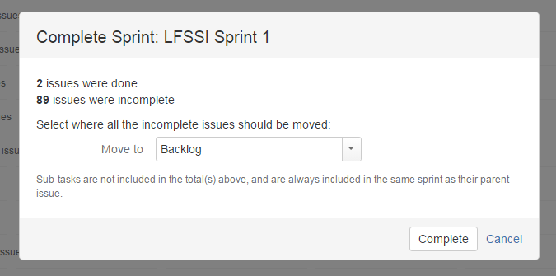
Completing a Sprint
1. Go to the Active sprints of your Scrum board.
2. If necessary, select the sprint you want to complete from the sprint drop-down.
3. Click Complete Sprint. All completed issues will move out of Active sprints.
4. If the sprint has incomplete issues, select from one of the following:
• Backlog, to move the issues to the backlog
• Any future sprint, to move the issues to any future sprint that's already created
• New sprint, to create a new sprint and then move the issues to the new sprint

Slide 22
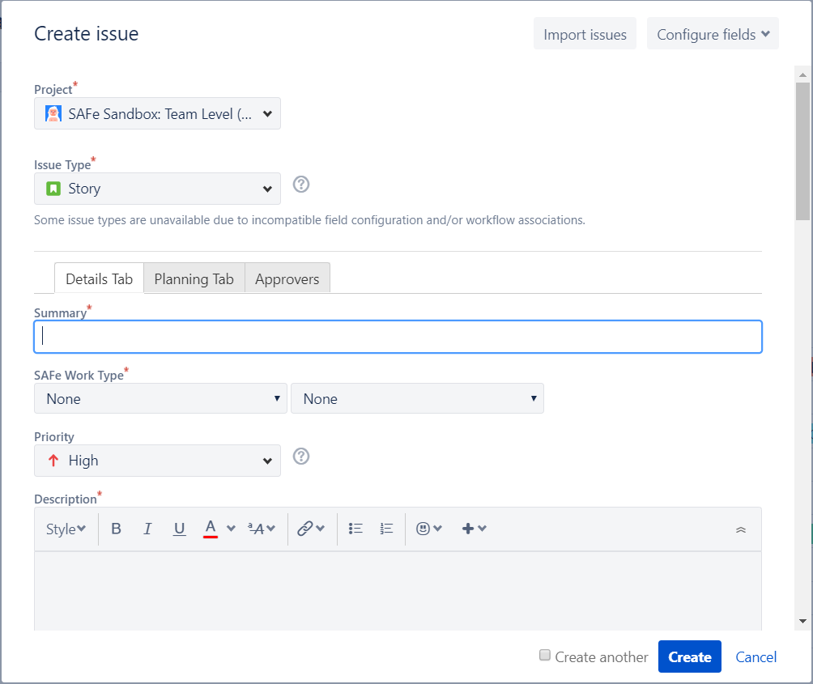
JIRA Anomalies
Creating an issue,
1. Click Create at the top of the screen to open the Create Issue dialog box.
2. Select the relevant Project and Issue Type in the Create Issue dialog box.
3. Type a Summary for the issue and complete any appropriate fields — at least the required ones that are marked by an asterisk.

Slide 23
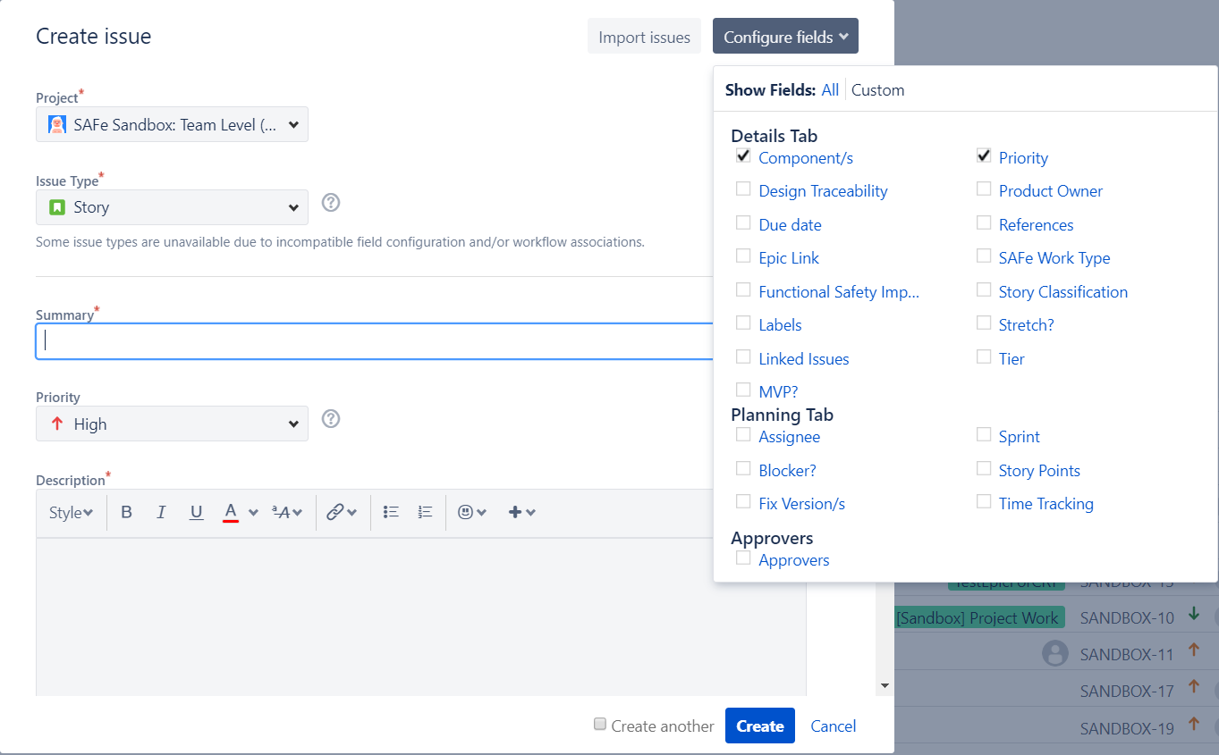
4. If you want to access fields that are not shown in this dialog box, or you want to hide existing fields:
Click the Configure Fields button at the top right of the screen.
Click Custom and select the fields you want to show or hide by selecting or clearing the relevant check boxes respectively or click All to show all fields.
Note: When you next create an issue, these selected fields will be displayed.

Slide 24
When creating an issue
Best practices,
Summary | A brief, one-line summary of the issue. Here we need to follow better format when we summarize the issue. Story: - [REQ_PRIORITY] [REQ_ID] [COMPONENT] – summary Ex: - [HIGH] [RQ-009] [GATEWAY] – Create File Gateway engine in application node. Issue: - [ISSUE_PRIORITY] [TEST_CASE_ID] [ENV] [PHASE] [COMPONENT] – summary Ex: - [HIGH] [TC-002,005] [QA] [REGRESSION] [GATEWAY] – File gateway engine is crashed.
Description | A detailed description of the issue. SUMMARY STEPS TO REPRODUCE: EXPECTED RESULT: ACTUAL RESULT: ENVIRONMENT: AFFECTS VERSION: OTHER: (logs location, etc.)

Slide 25
Labels | Begin typing to find and create labels or press down to select a suggested label. Ex: - specific label type
A proper Jira issue(anomaly) must have,
A proper summary (meaningful)
Priority and Severity status
Description with clear steps, actual output and expected output.
Screenshots – Issue area
Logs, reports or any other sources to identify the issue.
Environment and Affects versions
Requirement documents or Story ID link to the issue.

Slide 26
Anomaly life cycle
New
Assigned
Deferred
Open
Rejected
Fixed
Duplicate
Pending Retest
Reopened
Retest
Verified
Closed

Slide 27
NEW (OPEN) | RESOLVED | CLOSED
Reporter: A proper summary Priority and Severity Description with clear steps, actual output and expected output. Screenshots Logs, reports or any other sources to identify the issue. Environment and Affects versions Requirement documents or Story ID link to the issue. Test case IDs. | Developer: RCA (Root Cause Analysis) for the issue. Component/s that fix made. Screenshots of the fix. A separate code branch for the fix. (with the Jira ID) Merge request to Development code base. (with the Approval comments) Binary version for each component. Release version. Unit tests. | Tester: Tested binary version for each component. Tested release version. Tested environment version. Screenshots. Passed test case IDs. Passed report. (Automation report)

Slide 28
Reports
Burndown chart
A burndown chart shows the amount of work that has been completed in a sprint, and the total work remaining.
Subtask behavior when remaining estimate and time spent is enabled | Subtask behavior when remaining estimate and time spent is disabled
If you add a subtask to an issue that's already in an active sprint, the subtask is treated as scope change. The scope change is also indicated in the Burndown Chart. | If you add a subtask to an issue that's already in an active sprint, the subtask is also treated as scope change. However, scope change is not indicated in the Burndown Chart for the subtask.
Time estimates of subtasks are rolled up to the parent task. This means that the parent task will have the total sum of all remaining estimates of the subtasks. | Time estimates are tracked individually across the subtasks and the parent task itself.

Slide 29
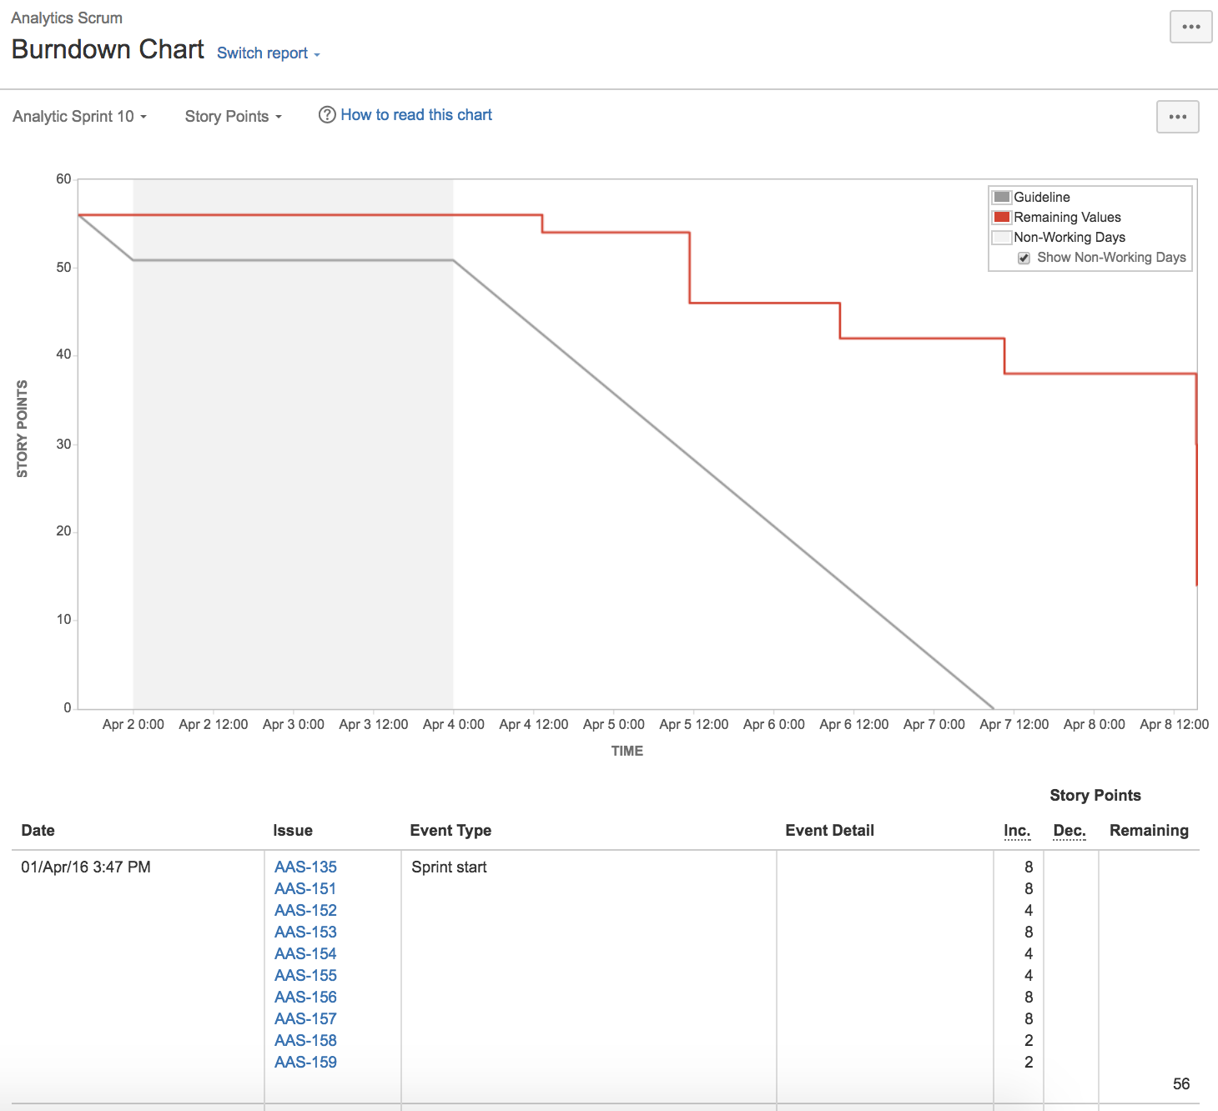
The Grey Line shows an approximation of where the team should be, assuming linear progress. How suppose to burn the story. If the red line is below this line, sprint team's on track to completing all their work by the end of the sprint.
The Red Line represents the total amount of work left in the sprint, according to team's estimates.

Slide 30
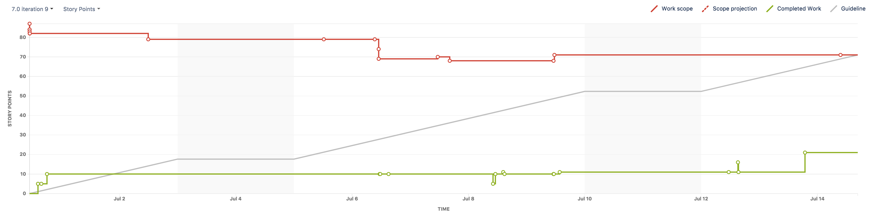
Burnup chart
The Burnup Chart provides a visual representation of a sprint's completed work compared with its total scope. Burnup Chart for individual sprints in a project, meaning can see the amount of work completed vs the amount of work remaining (project scope) on a day-to-day basis.
The vertical axis represents the amount of work and can be measured in different ways such as story points, issue count, or estimates. The horizontal axis represents time in days.
The distance between the lines on the chart is the amount of work remaining. When the project has been completed, the lines will meet.

Slide 31
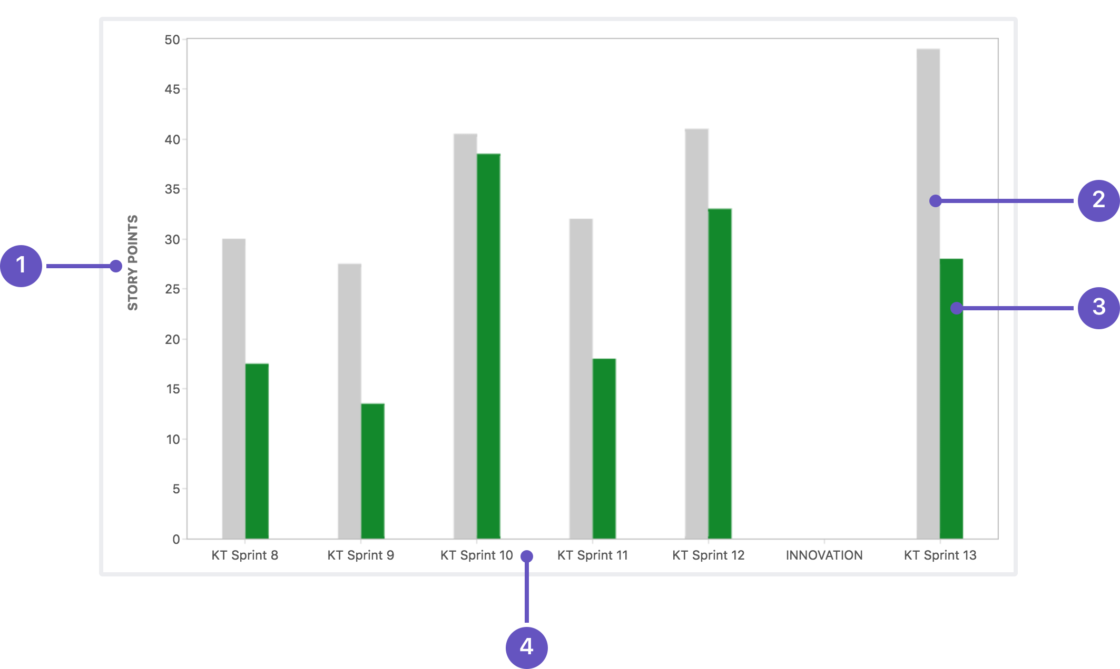
Velocity chart
The Velocity Chart shows the amount of value delivered in each sprint, enabling you to predict the amount of work the team can get done in future sprints.
1 - Estimation statistic: The y-axis displays the statistic used for estimating stories
2 - Commitment: The gray bar for each sprint shows the total estimate of all issues in the sprint when it begins.
3 - Completed: The green bar in each sprint shows the total completed estimates when the sprint ends.
4 - Sprints: The x-axis displays the last 7 sprints completed by the team.

Slide 32
Calculating team velocity
A team's recent velocity can be useful in helping to predict how much work can be completed by the team in a future sprint. Velocity is calculated by taking the average of the total completed estimates over the last several sprints.
Ex: - So in the chart above, the team's velocity is (17.5 + 13.5 + 38.5 + 18 + 33 + 28) / 6 = 24.75. This means that the team can be expected to complete around 24.75 story points worth of work in the next sprint.
NOTE: Estimates from sub-tasks are not included in the Velocity Chart's calculation. (Only estimates from parent tasks are included.)

