Slide 1






A
IVP 2026 // CHALLENGE #1 — USER-FIRST OR USER-FAIL?
ASIRIVE
CORTEX
Hands-free navigation for the visually impaired — one voice, no screen, cane still in hand.
HAZIQ SHAH · MUHAMMAD IRFAN NUAFAL · ERYNA NATASHA — ADMIRALTY SECONDARY SCHOOL
WITH SAVH

Slide 2

A
// CONTENTS
WHAT'S
AHEAD
01
THE CHALLENGE
user-first, and the CARE test
02
STAGE 1 — EMPATHIZE
who we design for
Design thinking is a loop, not a line. We followed six stages — and doubled back whenever testing proved us wrong.
03
STAGE 2 — DEFINE
the problem we chose
04
STAGE 3 — MARKET RESEARCH
what exists, what misses
05
STAGE 4 — IDEATE
three design rules
06
STAGE 5 — PROTOTYPE
what we built & how it works
07
STAGE 6 — TEST
the failure that fixed it
08
REFLECTION
what comes next

Slide 3
A
// THE CHALLENGE WE CHOSE
USER-FIRST,
NEVER USER-FAIL.
OUR YARDSTICK — THE CARE TEST
CARE FOR THE USER
does it meet real needs, values, preferences?
ACHIEVE ITS GOAL
does it solve the problem better than what exists?
IvP 2026 Challenge #1 asks one question: does your design keep the user at the heart of everything? assistive tech has a long history of user-fail — powerful devices nobody actually uses. we held Cortex to that standard from day one.
RESPECT BROADER IMPACT
is it responsible to society and cost?
ENHANCE LIVES
does daily life get genuinely better?

Slide 4

A
01
STAGE 01 // DESIGN THINKING
EMPATHIZE
Who are we designing for — and what does getting around actually feel like for them?
01
02
03
04
05
06
EVERY TEST LOOPS BACK — WE ITERATE

Slide 5




A
// STAGE 01 EMPATHIZE — THE SCALE
2.2 BILLION
people worldwide live with some form of vision impairment.
9 IN 10
1
■ LIVE IN LOW- AND MIDDLE-INCOME COUNTRIES
□ HIGH-INCOME COUNTRIES
Yet most assistive technology is designed — and priced — for the 1 in 10 who can pay. that mismatch is where our project begins.
SOURCES: WORLD HEALTH ORGANIZATION FACT SHEET (2023) // IAPB VISION ATLAS

Slide 6

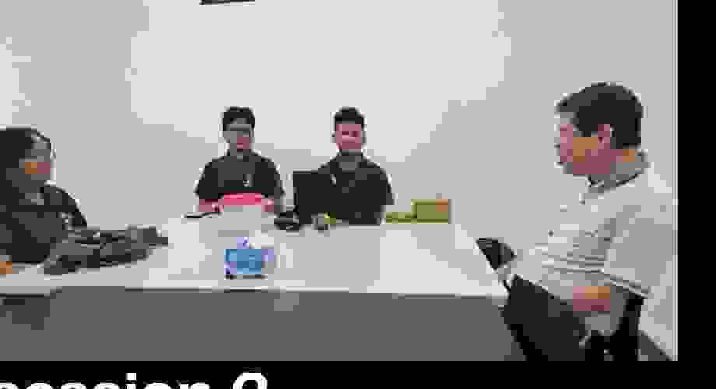
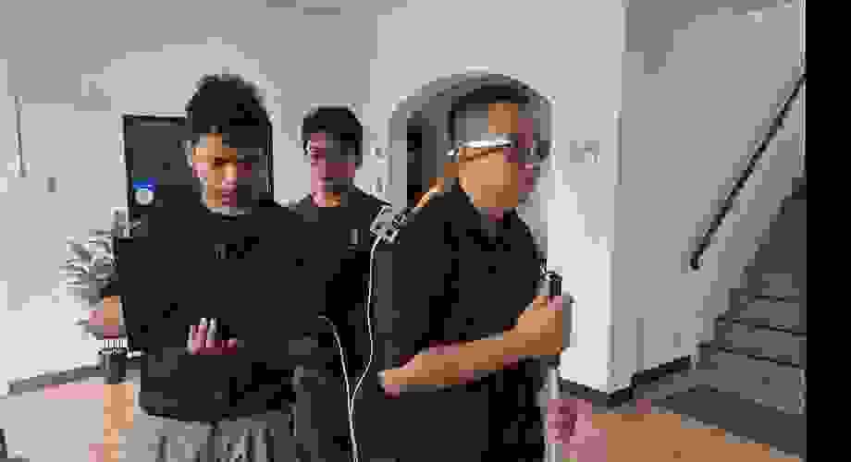
A
// STAGE 01 EMPATHIZE — PRIMARY RESEARCH
WE DID NOT JUST RESEARCH ONLINE.
> SESSION 01 — ONLINE INTERVIEW
> SESSION 02 — SAVH CENTRE VISIT
> SESSION 03 — NAVIGATION WALK
daily routines & pain points
guided interviews with members
we followed, they led
PRIMARY RESEARCH // SAVH — SINGAPORE ASSOCIATION OF THE VISUALLY HANDICAPPED, 2026

Slide 7
A
// STAGE 01 EMPATHIZE — WHAT WE OBSERVED
THE DAILY TRADE-OFF
THE CANE
THE PHONE
+Feels the ground — trusted, always ready
+Maps, bus arrivals, information
+Leaves hands and hearing free
−Stops you mid-pavement to check
−Cannot feel overhead signs or barriers
−Occupies the hands and attention you need for safety
−Cannot read bus numbers or give directions
STOP-AND-CHECK
every route decision costs half a minute of stillness — a pause in the middle of a footpath. safety or knowledge: never both.

Slide 8
A
02
STAGE 02 // DESIGN THINKING
DEFINE
After three sessions with SAVH, one problem kept surfacing. We made it ours.
01
02
03
04
05
06
EVERY TEST LOOPS BACK — WE ITERATE

Slide 9

A
// STAGE 02 DEFINE — OUR PROBLEM STATEMENT
HOW MIGHT A VISUALLY IMPAIRED PERSON TRAVEL INDEPENDENTLY — WITHOUT PUTTING DOWN THE CANE, WITHOUT STOPPING TO CHECK A PHONE, AND WITHOUT WAITING FOR SOMEONE TO HELP?
our yardstick, agreed with users: if a solution costs hands, attention or dignity — it fails the user-first test.

Slide 10
A
03
STAGE 03 // DESIGN THINKING
RESEARCH
What already exists — and why isn't it enough for the person holding a cane?
01
02
03
04
05
06
EVERY TEST LOOPS BACK — WE ITERATE

Slide 11
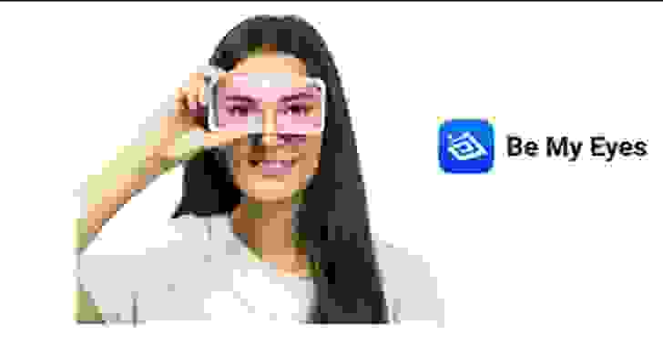
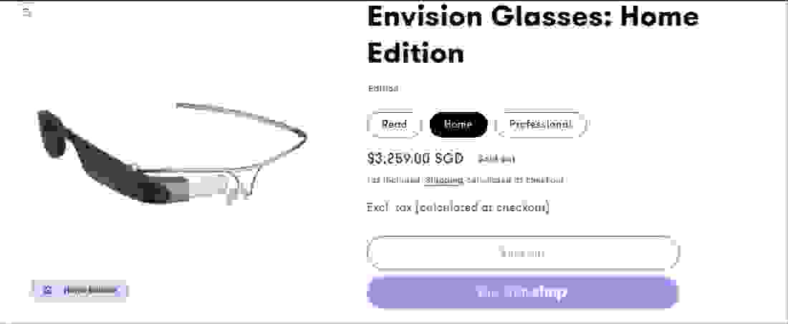
A
// STAGE 03 MARKET RESEARCH — EXISTING SOLUTIONS
GOOD TOOLS. WRONG JOB.
PRODUCT
SNAPSHOT
WHAT IT IS
PROS
CONS — WHY IT MISSES
BE MY EYES
free app connecting users to sighted volunteers over video call
free · human judgement · handles almost any task
needs a phone in hand · depends on volunteer availability · not built for continuous navigation
ENVISION GLASSES
AI glasses (built on Google Glass) that read text and identify objects
hands-free reading · recognises objects & people
≈ US$2,500 (S$3,259 list) · reading-first, not navigation-first · screen and camera up front all day
ORCAM MYEYE
discreet clip-on camera that reads text aloud
small & discreet · strong text reading
US$2,500–4,250 · reads text — it does not guide you anywhere
SOURCES: OFFICIAL PRODUCT PAGES & PUBLISHED PRICING, 2026 // PROS AND CONS VERIFIED AGAINST USER FEEDBACK FROM SAVH SESSIONS

Slide 12
A
// STAGE 03 MARKET RESEARCH — THE GAP
NOTHING WALKS YOU THERE.
01
02
03
COST
INDEPENDENCE
DIGNITY
US$2,500+ price tags put existing assistive glasses out of reach for most families.
every alternative still needs a phone in hand, a volunteer on call — or simply stops at reading.
keeping dignity intact: no stopping, no staring at a screen, no needing a guide everywhere you go.
the gap is navigation: genuinely hands-free, genuinely affordable, built around the journey — not around reading.

Slide 13
A
04
STAGE 04 // DESIGN THINKING
IDEATE
What should this device be — and, just as important, what should it never be?
01
02
03
04
05
06
EVERY TEST LOOPS BACK — WE ITERATE

Slide 14
A
// STAGE 04 IDEATE — THE DECISION
NOT A SMARTER CANE — A GUIDE FOR THE JOURNEY.
RULE 01
AUDIO-FIRST
one clear voice in the ear. eyes, hands and hearing stay exactly where they belong — on the world.
RULE 02
CANE-AWARE
the cane stays the ground sensor. we detect only what it cannot feel — head-height and beyond.
RULE 03
NAVIGATION-FIRST
directions, bus arrivals, arrival alerts — the whole journey end to end, not another reading gadget.

Slide 15
A
05
STAGE 05 // DESIGN THINKING
PROTOTYPE
Three iterations later, here is what we actually built — and the engineering underneath it.
01
02
03
04
05
06
EVERY TEST LOOPS BACK — WE ITERATE

Slide 16
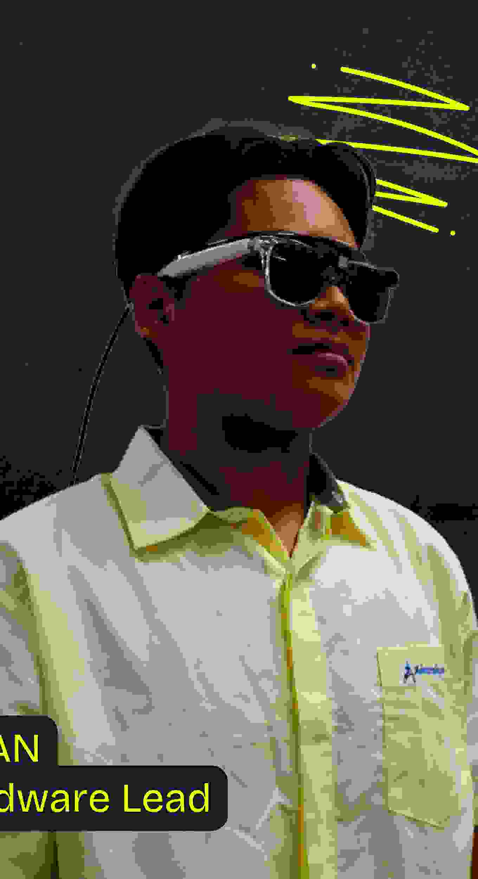
A
// STAGE 05 PROTOTYPE — WHAT IT IS
GLASSES THAT TALK YOU THROUGH THE JOURNEY
open-ear audio — you hear Cortex and the traffic. a dual camera watches ahead; a Raspberry Pi 5 with an AI accelerator does the thinking. your phone stays in your pocket.
01
GET THERE
spoken turn-by-turn directions and bus routes
02
DON'T STOP
head-height hazards called out before you reach them
03
RIDE THE BUS
live arrival times and a wake-me-up at your stop
PROTOTYPE V3 // OPEN-EAR AUDIO · DUAL CAMERA · PI 5 + NPU

Slide 17
A
// STAGE 05 PROTOTYPE — HOW IT THINKS
FIVE SPECIALISTS, ONE VOICE
Cortex runs five cooperating layers — four on the glasses, one in the cloud.
L0
L1
L2
L3
L4
GUARDIAN
LEARNER
THINKER
GUIDE
MEMORY
spots hazards and warns in under 100 ms — before cloud could even wake up
recognises places and things, from the bus stop to the kopitiam
a conversational AI brain you can just ask
directions, bus arrivals and the route state machine
remembers your frequently visited locations
ONE RULE: SAFETY NEVER LEAVES THE DEVICE.

Slide 18
A
// TECHNICAL ARCHITECTURE 1 OF 3
FAST REFLEXES LOCAL, BIG BRAINS ON CALL
ON-DEVICE
ON-DEMAND
REACTS < 100 MS
CLOUD
//YOLO vision (runs offline on the NPU)
//Gemini Live — the conversational brain
//depth sensing + ToF laser
//Google Maps routing
//safety fusion & alert engine
//LTA bus arrival times
//navigation state machine
//memory sync to the cloud
//offline route following
CONNECTIVITY MONITOR — walking into an MRT underpass with no signal? safety alerts and route-following keep running on-device. the journey does not stop when the network does.

Slide 19
A
// TECHNICAL ARCHITECTURE 2 OF 3
ONE VOICE IN. ONE VOICE OUT.
no buttons to find, no screen to unlock — talk like you would to a friend.
→
→
→
→
01
02
03
04
05
EARS
UNDERSTAND
DECIDE
ACT
SPEAK
bluetooth mic + voice activity detection
speech-to-text + the Gemini Live brain
intent router — 97.7% accuracy on 14 intents
tool calls: navigate, bus times, find places
a natural voice answers in your ear
⟲CONTINUOUS CONVERSATION — INTERRUPT ANYTIME, LIKE A HUMAN COMPANION
FALLBACK CHAIN: CARTESIA VOICE → LOCAL ENGINE — THE VOICE NEVER DIES MID-JOURNEY

Slide 20
A
// TECHNICAL ARCHITECTURE 3 OF 3
IT KNOWS WHERE YOU ARE IN THE JOURNEY
a navigation engine moves through six states — so the right help arrives at the right moment, without being asked.
INACTIVE
LOADING ROUTE
NAVIGATING
WAITING FOR BUS
ON VEHICLE
ARRIVED
FIVE MODES THAT SWITCH AUTOMATICALLY
OUTDOOR
INDOOR
BUS STOP
TRANSIT
IDLE
full hazard watch
cane-aware mode
bus-number vision
stops & interchanges
conversation only
GPS, CAMERA AND CONTEXT DECIDE THE MODE — THE USER NEVER TOUCHES A SETTING

Slide 21
A
// PROTOTYPE — CANE-AWARE BY DESIGN
THE CANE STAYS THE CANE. AI FILLS THE BLIND SPOTS.
HAZARD
WHITE CANE
CORTEX
WHY
GROUND-LEVEL OBSTACLES
DETECTED
STAYS QUIET
the cane already owns the ground
OVERHEAD BARRIERS & BRANCHES
MISSED
ALERT < 100 MS
the classic head-height blind spot
STAIRS GOING UP
TOO LATE
ALERT < 100 MS
spotted before the first step
FAST-APPROACHING VEHICLES
MISSED
ALERT + HAPTIC
speed measured, not guessed
indoors, Cortex stays quiet about walls and curbs the cane already handles — less noise, more trust. that single decision came straight from user testing.

Slide 22
A
06
STAGE 06 // DESIGN THINKING
TEST
Does it work for real users — and what did we get wrong the first time?
01
02
03
04
05
06
EVERY TEST LOOPS BACK — WE ITERATE

Slide 23





A
// STAGE 06 TEST — THE MOMENT WE LISTENED
“
THE SPATIAL AUDIO WAS OVERWHELMING — WE COULDN'T HEAR OUR SURROUNDINGS.
— SAVH USER, AFTER TESTING PROTOTYPE V1
our first version poured 3D sound effects over everything. the test said: for a blind user, your ears are a safety system — never drown them. we stripped it back to one clear voice and rebuilt around the cane. failing here is what made V2 work.

Slide 24
A
// STAGE 06 TEST → ITERATE → REPEAT
THREE ROUNDS OF LISTENING
V1
V2
V3
FIRST BUILD
REBUILT AROUND THE CANE
FIELD-READY
+spatial 3D audio everywhere
→
+one clear voice, cane-aware alerts
→
+outdoor & indoor auto-switching
+single camera, monocular depth
ITERATE
+dual camera + ToF laser depth
ITERATE
+live bus navigation end to end
+alerts for every obstacle
+navigation made the core feature
+lighter, wearable, open-ear
FAILED THE TEST — too noisy, too distracting
TESTED WITH SAVH — "finally, something we can live with"
VALIDATED — three sessions and counting
each loop back through design thinking made the product simpler, quieter and more trusted — the opposite of what we assumed on day one.

Slide 25

A
// REFLECTION — WHAT THE NUMBERS SAY
1/10 THE PRICE. PROVEN WITH REAL USERS.
US$186
<100 MS
parts cost — about 1/10 of existing AI glasses (US$2,500+)
local hazard reaction — faster than a blink, no network needed
97.7%
3
intent-routing accuracy across 14 spoken commands
documented SAVH user sessions shaped every major decision
COST COMPARISON: PUBLISHED PRICING OF ENVISION GLASSES / ORCAM MYEYE, 2026 // INTENT ACCURACY: INTERNAL TEST SET, 14 INTENTS

Slide 26
A
// ROOMS FOR IMPROVEMENT
THIS IS A
PROTOTYPE.
THE ROADMAP
01
a custom single-board computer — smaller, lighter, cooler
Cortex is a working prototype — not a finished product. it took student tools, student budgets and student hours. with the right resources, partners and time, Cortex gets better.
02
longer battery life for a full school day
03
fully local navigation, no cloud needed
04
more testing with more SAVH users
SUBMISSION // 25 SEP
YOUNG INNOVATORS' FAIR // 6 NOV

Slide 27






A
// THE WHOLE LOOP, IN ONE SENTENCE
CORTEX FILLS WHAT THE CANE CANNOT FEEL — NAVIGATION THAT IS HANDS-FREE, AFFORDABLE AND DIGNIFIED.
01
02
03
04
05
06
EVERY TEST LOOPS BACK — WE ITERATE
ASIRIVE // CORTEX
HAZIQ SHAH · MUHAMMAD IRFAN NUAFAL · ERYNA NATASHA — ADMIRALTY SECONDARY SCHOOL
ASIRIVE.COM

