Slide 1
Analyzing Gym quality and Distribution in New York City
Asis Sotelo

Slide 2
Gym quality and Distribution is important for people Moving to New York and Those in Fitness INdustry
People moving to a New York with a very active lifestyle may have questions about how to continue said lifestyle in the big city. In comparison to cities like Los Angeles, they might wonder what New York City has to offer. This project hopes to answer those questions and highlight the areas of New York City most attractive to a healthy lifestyle individuals
Many lifestyle companies who seek to find the best borough in New York City to base their business from may have questions of where to begin. This project hopes to answer questions of fitness industry hopefuls.

Slide 3
Data Acquisition / exploratory Data Analysis
NYC Open Data
Provided the Borough Boundaries as a GEOJSON file
GEOPY
Provided individual coordinates for borough centers.
Foursquare API
Provided up to 99,500 Regular Calls, and 500 Premium Calls
Was mainly used for gym name, latitude, longitude, and ratings
Featured data set contained 239 rows with 18 features. Dropped 12 and used only 6 features. Duplicated rows were eliminated and gyms located within our range but outside of the geographical location of our boroughs were removed.
NULL values from the Ratings column where replaced with average of the column.

Slide 4
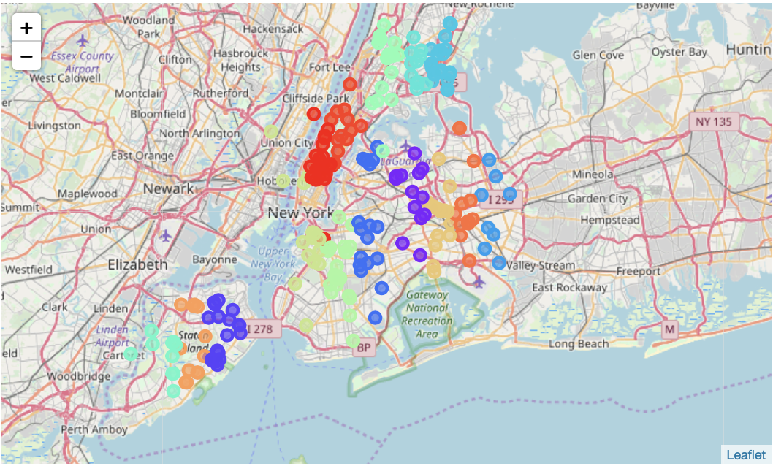
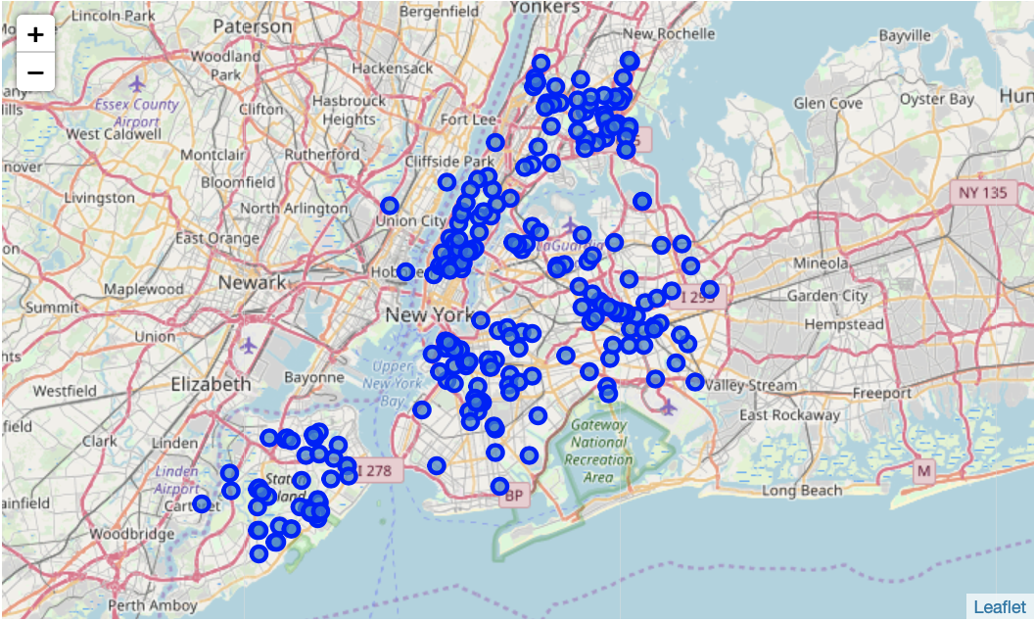
Grouping gym Locations To Respective Boroughs
K-Means Clustering k= 15
Original Distribution
In order to attribute each gym to the correct borough we had to cluster them accordingly. Each gym would be given a label according to its cartesian distance to the borough
We changed the latitude/longitude features to x-y cartesian coordinates to facilitate analysis. The machine learning we utilized was the K-Means algorithm, which clusters observed points with the nearest mean.
Euclidean distance is used which required transformation of points

Slide 5
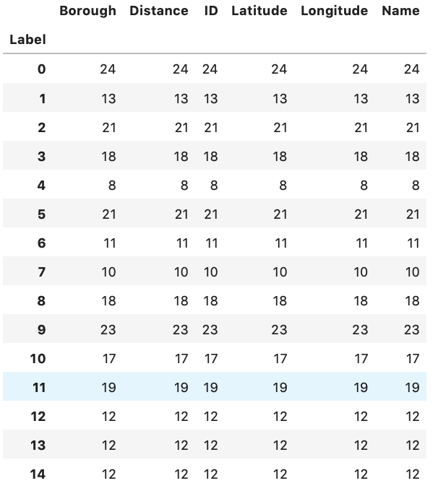
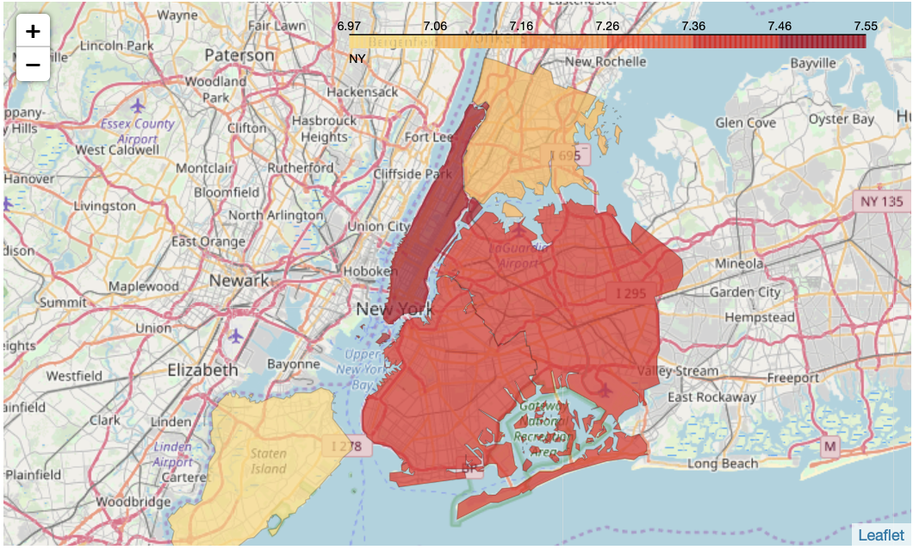
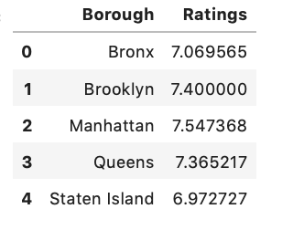
Using User Ratings In order to Compare Boroughs
Once we had given each observed gym a label we assigned each label to a borough then grouped the labels by borough and took an averaged of the ratings.
The ratings of each borough where within 6.97 – 7.55
We created a map comparing the values of the ratings corresponding to the borough on the map. The darker color indicates a larger rating value.
Our results indicate that the borough of Manhattan has the highest quality gyms.

Slide 6
Conclusion and Future Directions
The gym life of New York City seems to have the best quality of fitness institutions clustered around Manhattan
For anyone looking to enter the lifestyle industry or someone moving to New York City and looking for the best workout borough Manhattan would be it.
For future analysis I would like to narrow the scope. To find the density of gyms to every neighborhood in New York City. This would require us to partition each borough into their respective Neighborhoods and make distinct Fourquare API request. This might very well exceed our daily limit per account, however.
We had quite a few gyms not have ratings provided by Foursquare we could find a different source for rating gyms.
Equipment availability is also a concern and could be identified with “trending” attributed provided by Foursquare
Cost of gym is also a factor. Weighing this into our analysis may sway one borough over another.

