Slide 1
Credit Card Fraud Detection
Asis A Sotelo
Part of Coursera Capstone

Slide 2
Use Case
Credit Card Fraud is the most common form of identity theft with 133,015 reports last year alone according to a survey conducted by Experian, a credit bureau.
In order to minimize exposure of credit card consumers we can various feature data from credit card consumers as well as transaction information in order to identify fraudulent transactions.
Is it possible to create algorithms to identify a fraudulent credit card transaction

Slide 3
Data Set & QA
Dataset in a CSV form from Kaggle
Made up of credit card transaction from two unspecified days in September 2013 by European Cardholders
284,807 non-fraudulent transactions and 492 fraudulent transactions, an imbalanced dataset
Dataset has 30 features: “Time”, “Amount”, “V1”-”V28”
Dataset has one target variable: “Class” with 1 signifiying fraudulent transaction and 0 signyfing non-fraudulent
”V1”-”V28” are a result of PCA transformation, we can assume that these features have been normalized and scaled.
There are no NULL values, empty rows, values are all unique dataset is very clean

Slide 4
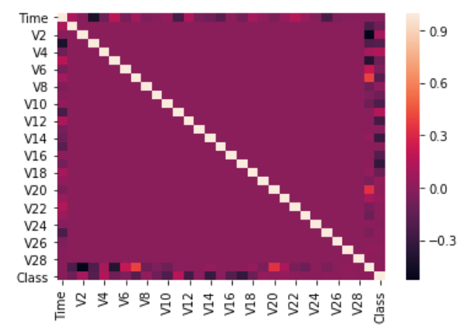
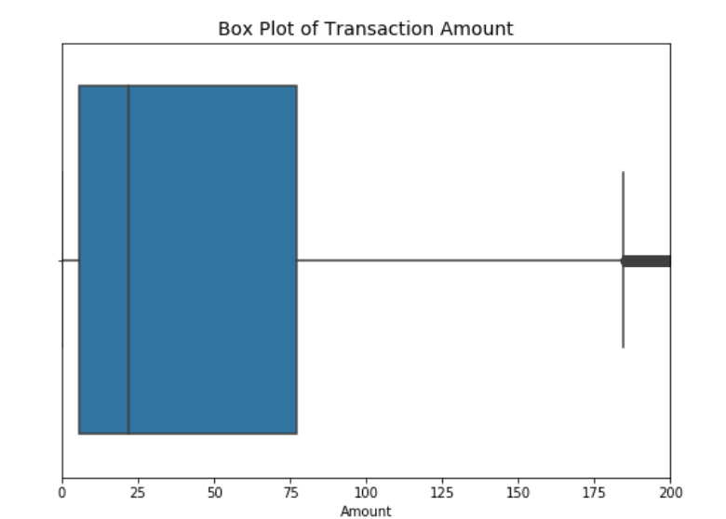
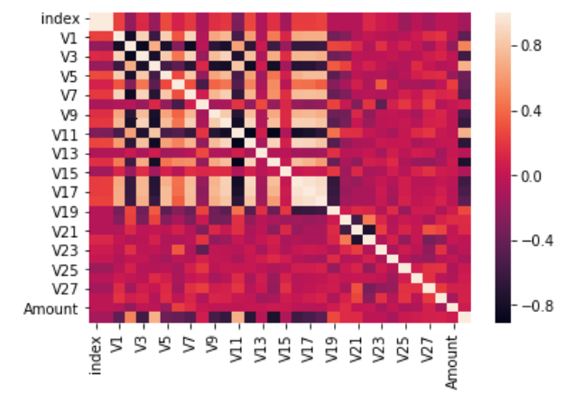
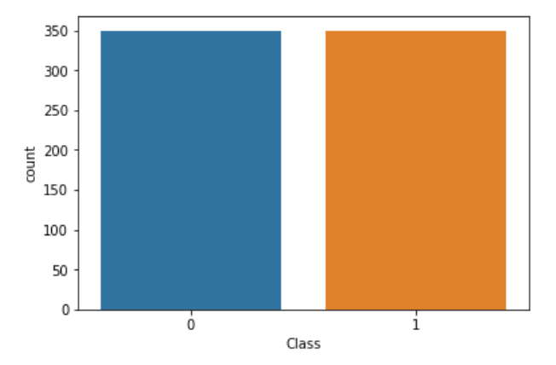
Data Exploration and Visualization
Using correlation heatmap there is very little correlation when utilizing the entire datseta
Under sampling the non-fraudulent data then having a 1:1 ration of fraudulent data to fraud data reveals correlations between features and target variable

Slide 5
Methodology
Three separate model definitions
One local scikit-learn based logistic regression model.
Two Apache Spark based models: one a logistic regression model and one an autoencoder deep learning model
Feature Engineering
Created Pipeline consisting of
Normalization/Scaling
Specifically on ‘time’ and ‘amount’ features
Renamed ‘class’ to ‘label’
Vector Assembler
PCA Transformation

Slide 6
Model I : Logistic Regression
Logistic Regression Implementation Local Machine
To have a base target implemented logistic regression on dataset
Trained model on subsample of data set
Took 1:1 ratio of fraudulent to fraud samples 350 samples of each
Only predicted and evaluated on 2,000 samples
Logistic Regression Implementation Apache Spark
Pyspark implementation
Utilized a subset equal to local machine implementation to train model
Fit model to entire dataset

Slide 7
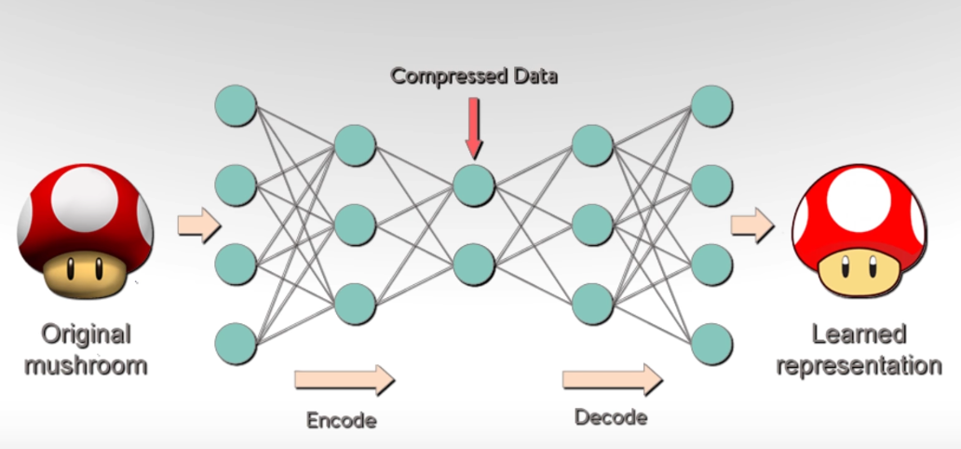
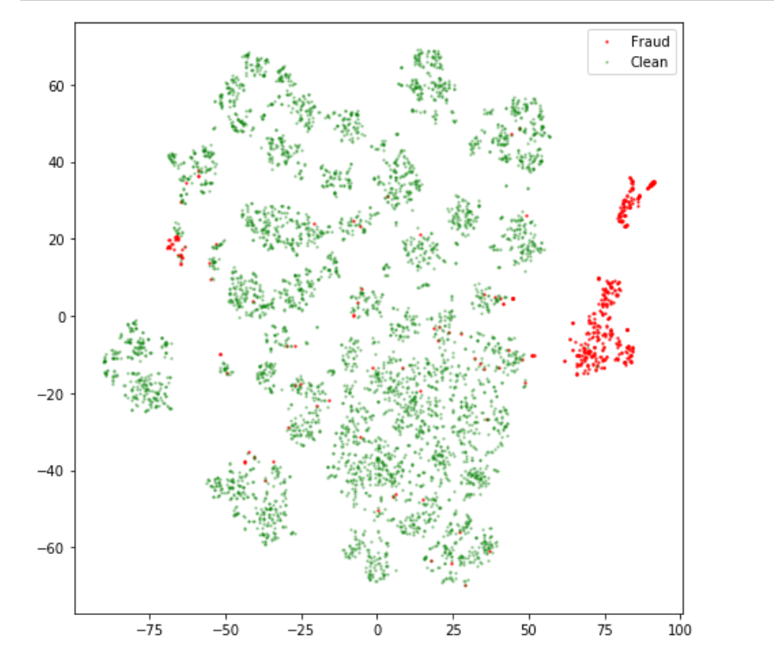
Model II : Autoencoder
Autoencoder implementation
Utilized a 3 Denser Layer Sequential model
Trained only on a sub sample of the dataset 5,000 samples of only non-fraudulent data
Autoencoder was trained to be able to reconstruct non-fraud data
Take weights from encode part then feed to decode and see the error deviation of the learned representation
I large error between input and output on never before seen data probability of it being fraudulent is high
2 – Dimensional grouping using TNSE of latent representation of fraud/non-fraud datapoints

Slide 8
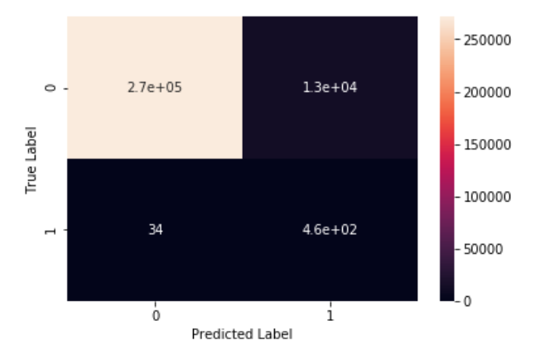
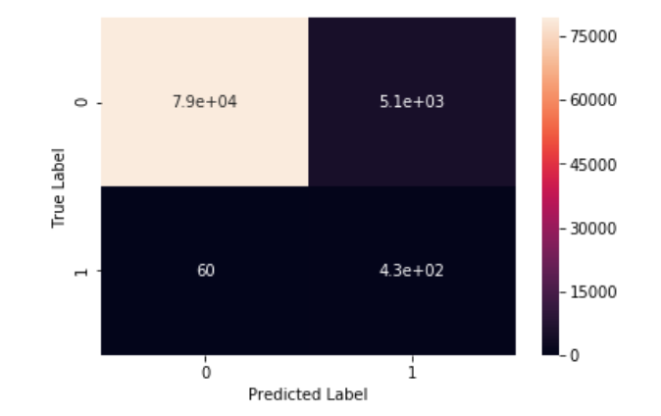
Model Evaluation
Utilized confusion matrix and overall accuracy only on non-fraud subset of data as this would be the best indication on which model can identify a fraudulent transaction
Logistic Regression
Accuracy on Fraudulent transaction 93.1% detection rate
F1-Score: .93
Autoencoder
Accuracy on Fraudulent Transactions 87.8% detection rate
F1-Score: .91
Logistic Regression Confusion Matrix
Autoencoder Confusion Matrix

Slide 9
Results/Conclusion
The logistic regression was a ~5% better in detecting fraudulent transactions
We might have a better result with more layers and to limit the compression layer of the network to only have of the features as opposed to only 2.
We eliminated the features of “time” and “amount” as they seemed to have no correlation with the “label” class and only got a tenth of a percentage increase in accuracy in both models.

