Slide 1
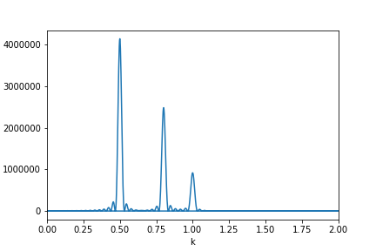
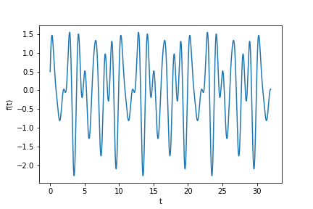
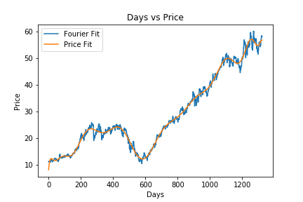
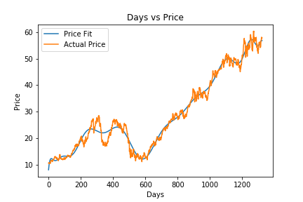
The Fourier Transform and Computational Analysis
Utilizing the Fourier Transform we can analyze any given signal regardless of noise
Any time series data can be transformed due to it being analytic at any point just like we learned in class
This ability to pull out underlying frequency allows one to remove unwanted frequencies or noise from a set of data minimizing error
This type of data analysis can be translated to any scientific field not only physics.
Asis A Sotelo

