Slide 1
BUKD-X500 · AGENTIC AI SYSTEMS · DESIGN STUDIO
NorthStar
Property Investment Consulting
“Should I buy this property?”
Answered with auditable numbers and current local rules.
Team 5 · Ashish Nath · Justin Kretschman
github.com/AsisNath/Real-Estate-Investment-Decision-Support
Notes:
[0:00-0:20] Two-sentence hook.
NorthStar answers one question for a small real-estate investor: should I buy this property? The numbers are deterministic Python. The local rules come from AI research that runs itself and cites every source.

Slide 2
THE PROBLEM
The same question, two answers, two ZIP codes apart
A small investor decides with a spreadsheet plus whatever Google returns.
Rental rules are hyper-local, change often, and the top search results are property-management blogs that go stale silently.
Model short-term-rental income on a property where STR is illegal and every number downstream is wrong - IRR, cash flow, the recommendation.
We found this in our own test data:
63043 · Maryland Heights, MO
STR allowed for investors owner OR manager within 1 hour
63021 · Ballwin, MO
STR closed to investors owner must live there 180 days/yr
Same state. Same county. Same statutes. Opposite conclusions.
No static dataset catches that. It has to be researched, per address, and kept fresh.
Notes:
[0:20-1:10] Lead with the proof, not the premise.
Maryland Heights lets an investor run an STR if the owner OR a manager is within an hour. Ballwin, two ZIPs away, requires the owner to live there 180 days a year - so a pure investment property cannot do it at all. Same county, same state law, opposite answers. If you underwrite Ballwin using Maryland Heights' rule, your entire revenue model is fiction. That is the gap we built for.

Slide 3
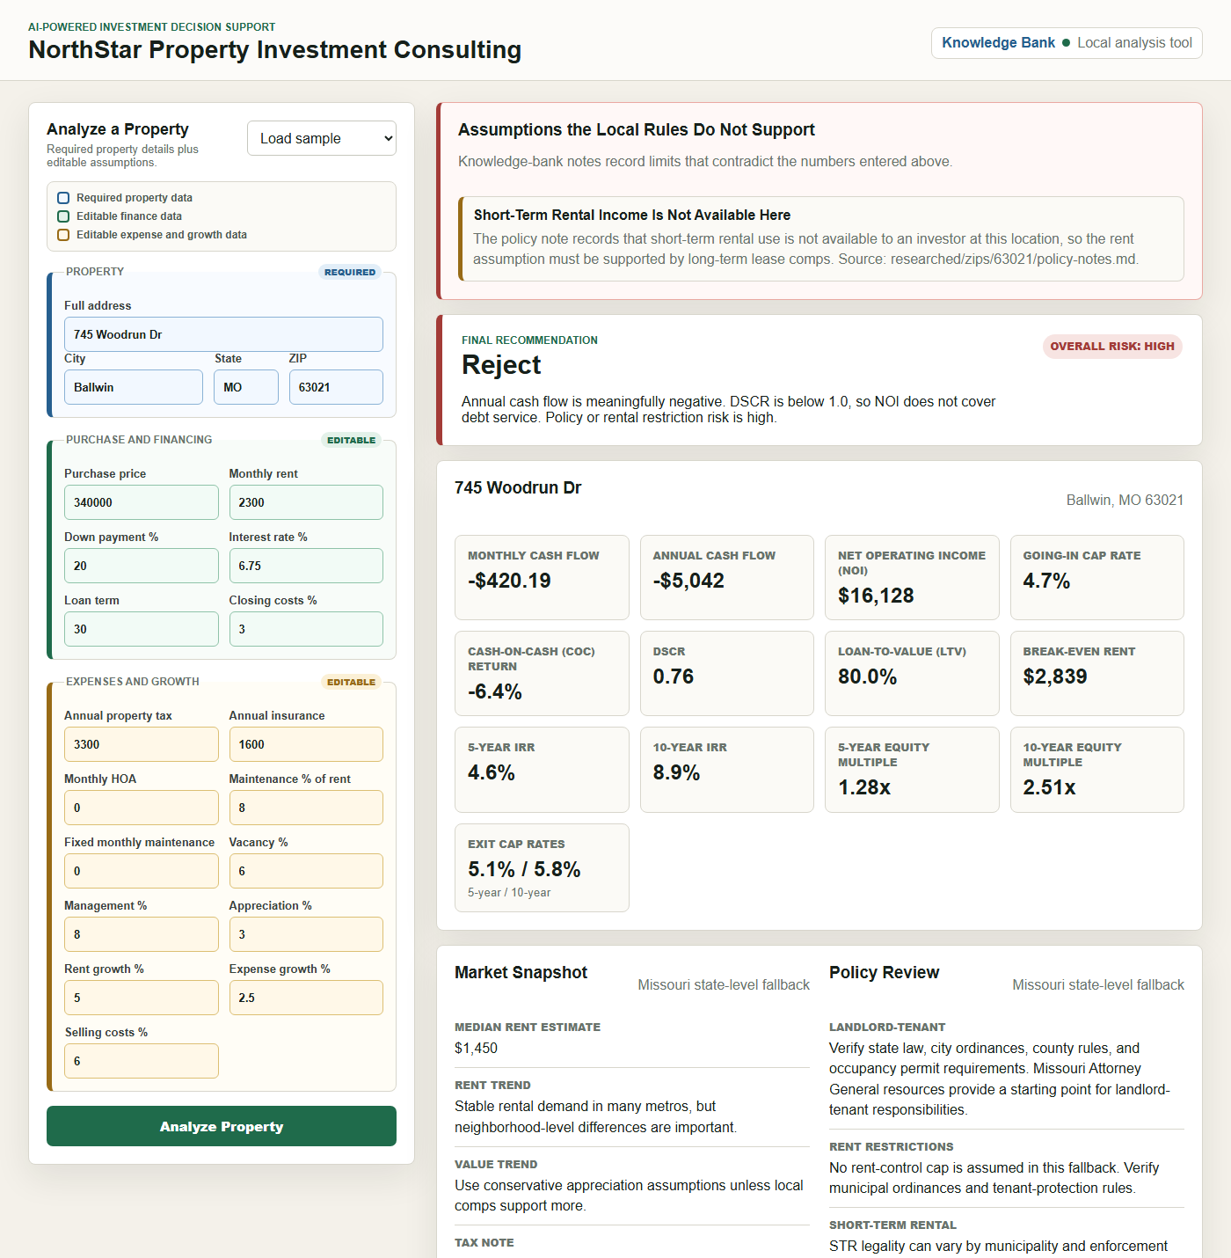
WHAT WE BUILT
Two layers that never mix
1 · The math
Plain Python. Unit-tested. No model touches a number.
2 · The rules
An Agent Skill researches local law with live web search and cites every source.
They meet at the decision
Findings become risk flags, diligence items, and conflicts with your own assumptions.
Research never blocks the report.
Notes:
[1:10-1:55] The one-sentence architecture. The screenshot is the point - let them look.
Two layers that never mix. The financial model is ordinary Python - we deliberately kept the LLM out of the arithmetic, because a hallucinated IRR is worse than no IRR. The AI does the part it is actually good at: reading the web and citing sources. They meet only at the decision layer.

Slide 4
DESIGN & APPROACH
Four decisions we would defend
1
Keep the LLM out of the arithmetic
A hallucinated IRR is worse than none
2
Provenance enforced in code
AI-written and human-written notes cannot mix
3
Use the agent the user already signed into
Zero credential setup, no key stored
4
State missing data, never fill the gap
“Confirm with the agency”, not a blog
Notes:
[1:55-2:25] Only 30 seconds. Say TWO of the four out loud - 1 and 3 land best - and let the slide carry the others.
Decision 3 is the one we are proudest of. Our first build made the app call an API directly, which meant every user needed their own key. We realised the Skill is just instructions - so we run it inside a CLI the user is already logged into. Setup went from 'get an API key' to nothing at all.

Slide 5
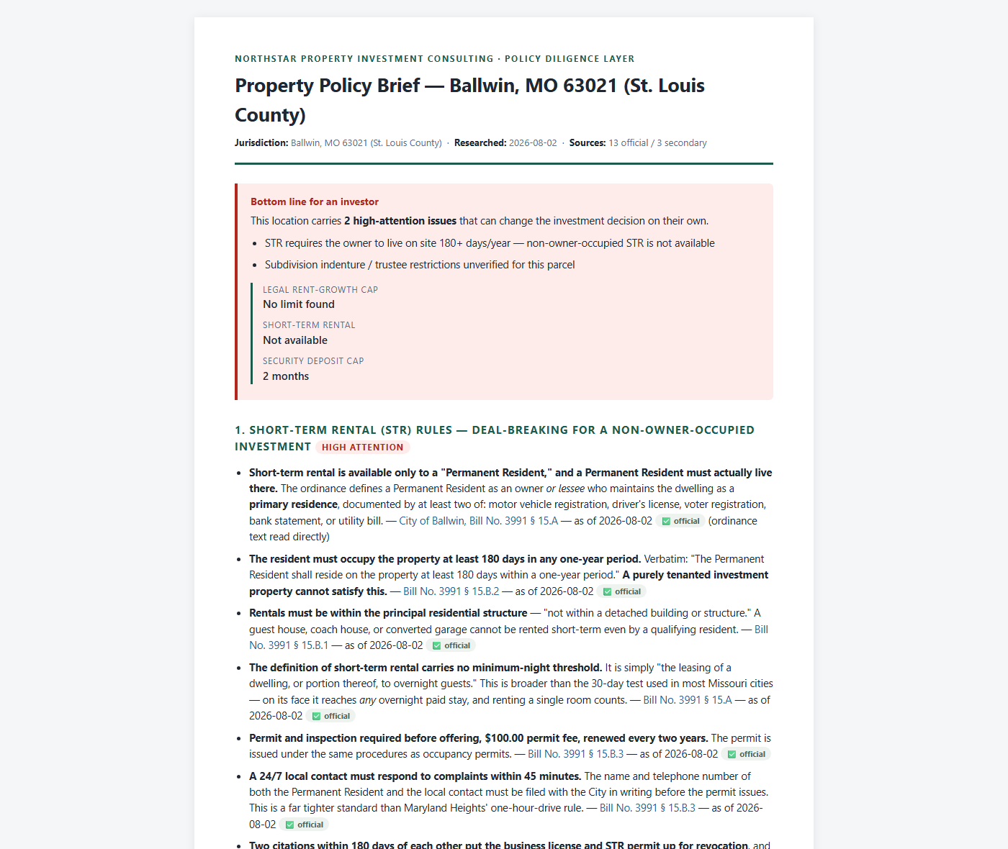
WORKING PROTOTYPE
Live demo
Same property, before and after research
BEFORE
STR income: assumed viable
Policy risk: medium
2 high-attention risks
AFTER
STR income: unavailable
Policy risk: HIGH
5 high-attention risks
Demo path
Analyze → report is instant and complete
New ZIP → research starts itself, unprompted
Saved note → every fact sourced, dated, tagged
One click → printable Policy Brief for a client
Notes:
[2:25-4:15] The longest block - 110 seconds. Pre-load the app; do not set up on stage, and have the recorded backup queued.
Say the before/after out loud: before research the model assumed short-term rental income; after, the app flags it unavailable, policy risk goes medium to HIGH, and high-attention risks go from two to five.
Do NOT say research flipped the recommendation - on this property it was already Reject on cash flow. The honest claim is that the reasoning changed, and on a marginal deal it would flip the decision.
If time is short, cut the Policy Brief step and keep the research-runs-itself moment.
Worth 15 seconds if it fits: a note in our repo for Wildwood 63038 was researched by the app unattended, 20 official citations, nobody triggered it by hand.

Slide 6
QUALITY & SECURITY
Tested and hardened, not just working
138
automated tests
41,488
US ZIPs bundled for offline checks
10
cited policy notes
0
secrets in the repo
How we tested
Financial model unit-tested against hand-computed values.
Two near-opposite jurisdictions used as the research test: Austin and Los Angeles.
Tests force research off, so running the suite can never spend real money.
Bugs the tests caught: a lock deadlock that hung the server, and a stale note that blocked its own refresh.
Security decisions
Path traversal blocked - notes cannot escape the knowledge bank.
Note text is escaped before rendering, so a document cannot inject markup into a brief a client opens.
The research agent runs read-only; the app decides what reaches disk, so a reply that is not a policy note is never saved.
Secrets live in a git-ignored .env; the app runs fully offline without one.
Notes:
[4:15-4:45] Do not read the cards; point at them.
Threat model: this is a local app, so the realistic risk is not a remote attacker - it is untrusted text. Policy notes come from the open web and from PDFs a user drops in, and those get rendered into a document handed to a client. So we escape everything and validate before saving.

Slide 7
REFLECTIONS
What we learned
Worked
Writing standards instead of steps. The Skill says what good research looks like; the agent works out how.
Making provenance a code boundary rather than a naming convention.
Keeping the AI out of the numbers.
Did not
First research design needed an API key per user. Wrong shape - the Skill already ran inside tools people had.
A stale server made fixed code look broken for an hour.
Documents users supply are often scans; the parser silently ignored them until we surfaced it.
Next
Real market data: Redfin Data Center for ZIP-level history, a rent API for per-property estimates. Today's figures are a state-level sample, and the report says so.
OCR so scanned HOA declarations parse themselves.
Scheduled re-research so notes refresh before they age out.
github.com/AsisNath/Real-Estate-Investment-Decision-Support · Team 5 · Ashish Nath · Justin Kretschman
Notes:
[4:45-5:00] Close on the lesson, not a summary.
If asked what you would build next, or about data sources, lead with the market-data item: policy is researched live, but rent and comps are still a bundled state-level sample, and the report labels that low confidence rather than hiding it. Owning that gap is stronger than being caught by it.
If Redfin comes up specifically: they publish no public API, so the plan is their Data Center bulk files - free, aggregated, ZIP-level history - refreshed by a script, exactly the pattern we already use for the 41,488-ZIP GeoNames dataset. Scraping their internal endpoints would breach their terms and break on any frontend change, so it is not on the table. Per-property rent estimates would come from a rental-data API with real developer access.
The biggest shift: we spent our time writing standards - what counts as a verified fact, when to say 'unverified' - rather than wiring steps together. The agent handled the how, including recovering when a government site blocked it. That is a different job from programming a pipeline.

