Slide 1

PLC BASED AUTOMATIC SORTING CONVEYOR
Project ID: 17304
Project ID:
By
Asish Maharana
Under the guidance of
Dr Swagat Kumar Samantray
Notes:
B-TECH PROJECT MID-SEM PRESENTATION 2011
BY KHUSHBU KHAN & ISAN SAHOO

Slide 2
Contents
Introduction
Objective
Components
Flow chart of the system
Implementation of the system
Outcome of the system
Importance
Innovativeness
Conclusion
Reference

Slide 3
Introduction
In this project, Automation System for sorting metal objects conveyor is developed in Programmable Logic Controller.
The project mainly focuses on sorting metallic and non metallic objects using PLC.
Thus it become necessary to develop low cost automation for sorting these products in accurate manner.

Slide 4
Objective
Develop an algorithm for Sorting metal and non metal products.
Design a conveyor belt system which operate using DC motor.
Algorithm to detect metal & Non metal object.
Algorithm to sorting metal and non metal object.

Slide 5
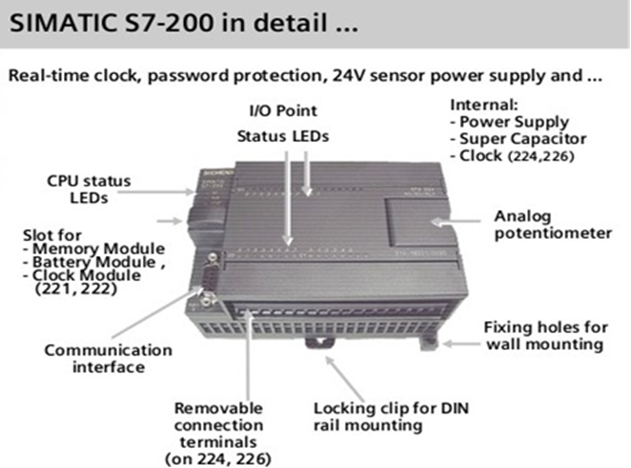
Components
PLC : The system is powered by a programmable logic controller (Siemens S7 200) to control the sorting system.

Slide 6
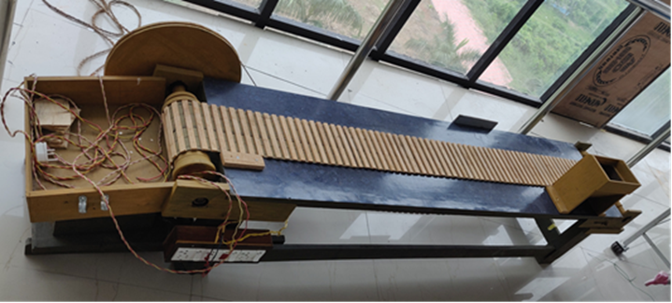
Components
Conveyor System : The system consists of conveyor belt which takes the objects like bottles, small boxes or packages in front of sensors and thus sorting logic is decided by PLC .

Slide 7
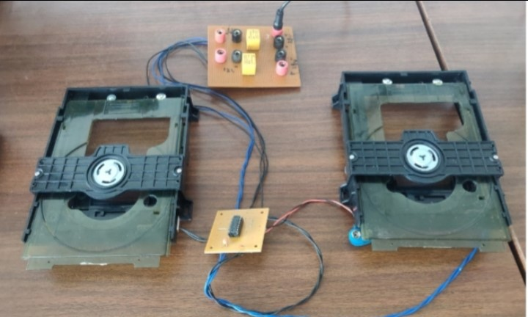
Components
Piston Driver : The conveyor system carries the piston drivers and it pushes the product in the collection bin the sensor sense them accordingly.

Slide 8
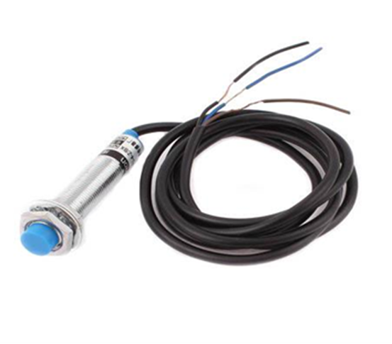
Components
Proximity Sensor : This sensor is used to distinguish between metals and non-metals. It utilizes the inductive effect for the detection of metals.

Slide 9
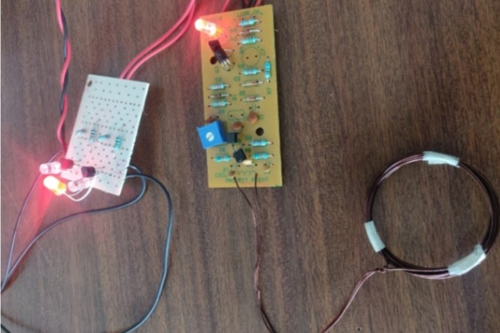
Components
Metal Detector Sensor : A metal detector is an electronic instrument that detects the presence of metal nearby. when electricity flows through the transmitter coil, it creates a magnetic field all around it. The magnetic field makes an electric current flow inside the metal object.

Slide 10
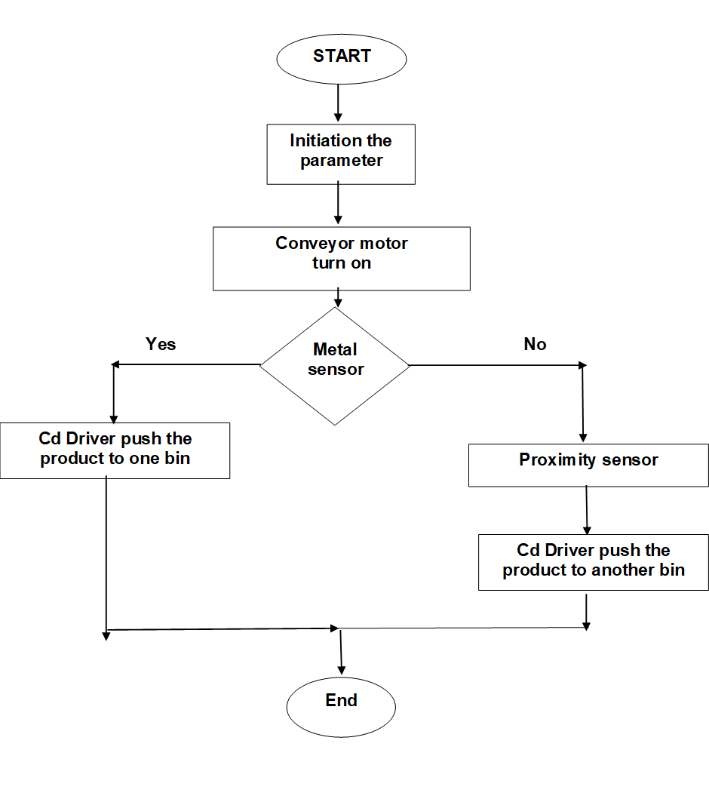
Flow Chart Of the System

Slide 11
Implementation Of The System
In the system, there are two parts: hardware section and software section.
The hardware section will be construction of the system using s7-200 PLC and other electronic components.
And the software is developed for to control and work the system correctly.

Slide 12
Outcome of the system
By this system it is very helpful in industries for sorting easily metal and non metal products & also decrease human effort, avoid risk, improve accuracy, increase speed of production and reduce the cycle time.

Slide 13
Importance
Increase speed of production and reduce the cycle time.
Avoid risk and improve accuracy.
Reduce a lot of time and labor.
Developing an automation system which having low-cost, low maintenance, long durability and to make system user friendly as possible.

Slide 14
Innovativeness
Designing a real time application which helps in sorting the objects using PLC.
And helps to achieving effective communication between objects using multiple sensor to monitor parameters.

Slide 15
Results
From the work by which, we made a simple sorting system using the Programmable Logic Controller (PLC).
The sorting system is based on the height of the object that is coming through the conveyor system.
The System works during normal operation and greatly improved by the automation processes with the use of the PLC ladder diagram using step7 Micro win.

Slide 16
Conclusion
The project presents an overview of hardware and software implementation with PLC.
Developed an algorithm to separate metal and non metal products by using PLC programming.

Slide 17
Reference
N.Keerthipriya, “PLC Based Industrial Conveyor Automation and Monitoring,”, IJRASET 2015, Volume 3 Issue III, March, 2015.ISSN: 2321-965
Bargal, Nilima, et al. "PLC based object sorting automation." Int Res J Eng Technol (IRJET) 3.07 (2016)
Shukat N, PLC Based Automated Object Sorting Machine, Multi Topic Conference 2001, IEEE publication.
Notes:
B-TECH PROJECT MID-SEM PRESENTATION 2011
BY KHUSHBU KHAN & ISAN SAHOO
17

Slide 18
Thank you ..

