Slide 1
8-Puzzle Intelligent Solver
Comparison of BFS, DFS, and A* (Misplaced & Manhattan)
Team members:
1.Aaquib Alam
2.Ashraf Ali
3. Asish Sharma
4. Pratap Singh

Slide 2
Introduction
The 8-puzzle problem
- A sliding-tile puzzle on a 3x3 board
- Search problem: state space, moves, path cost
Platforms & Tools
Development environment
- SWI-Prolog for implementation and execution
- VS Code for editing and running tasks

Slide 3
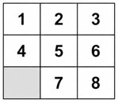
Template Design Overview
Key components
- State representation: list of 9 integers (0 = blank)
- Move generation: up/down/left/right swaps
- Algorithms implemented: BFS, DFS, A*
- Heuristics: Misplaced tiles, Manhattan distance

Slide 4
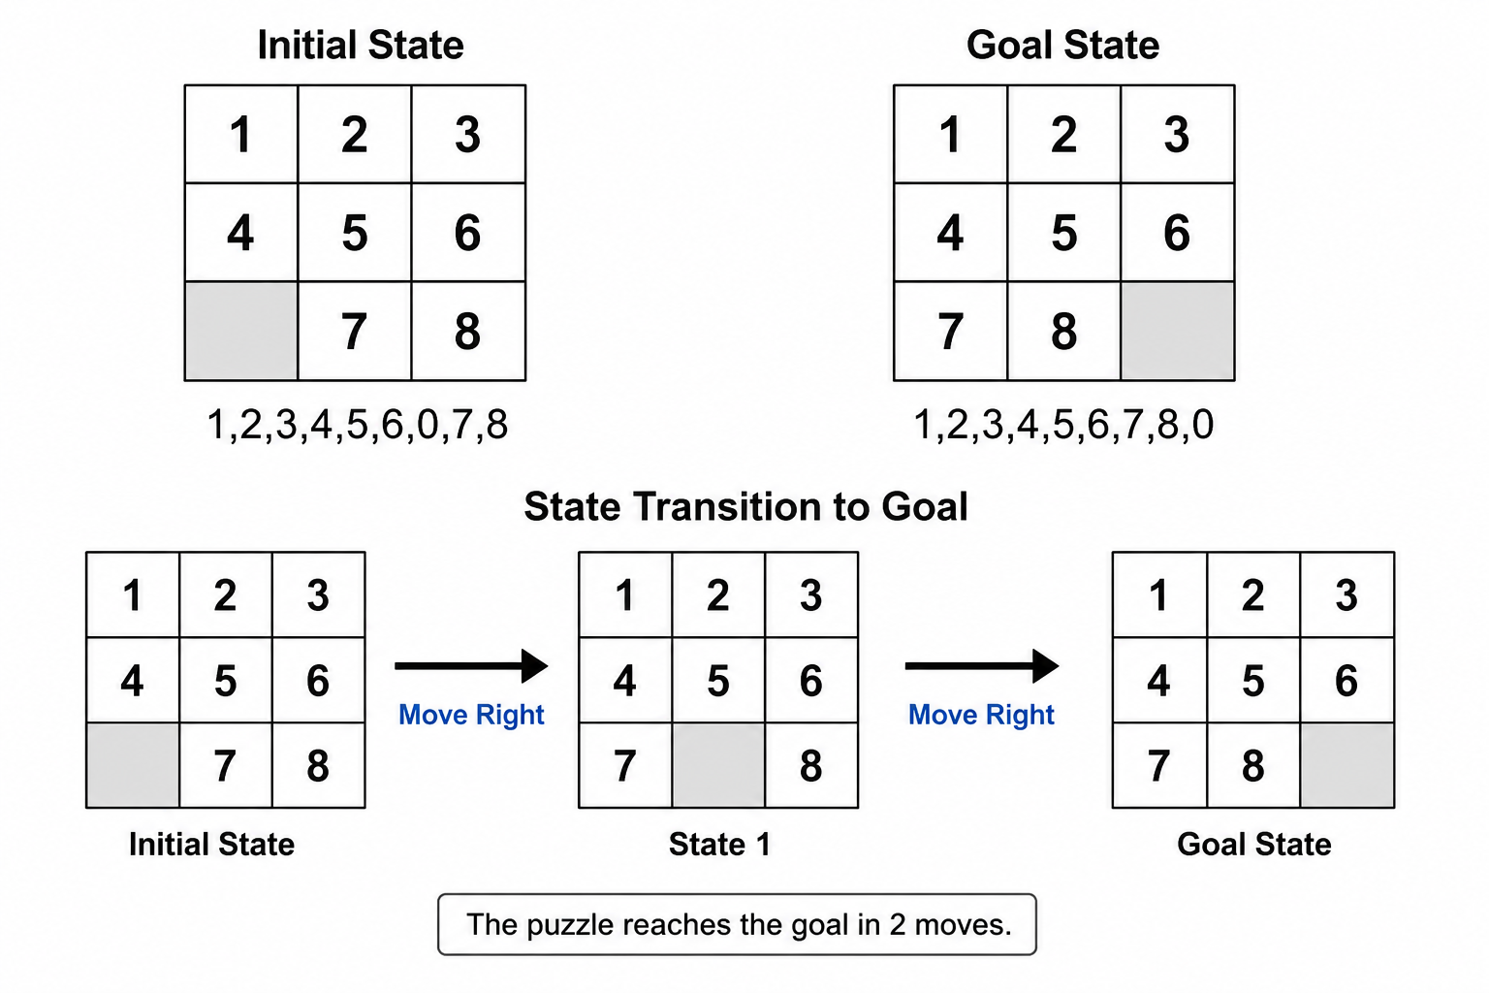
Results (Example)
Sample run (start: [1,2,3,4,5,6,0,7,8])
- A* (Manhattan): moves = 2, expanded = 6
- BFS: moves = 2, expanded = (depends on ordering)
- DFS: may find a solution but not guaranteed shortest

Slide 5
Queries and Outputs
Executed queries and their outputs
- A* (Manhattan): goal_state(Goal), solve_astar([1,2,3,4,5,6,0,7,8], Goal, manhattan, Results)
Output: result{path:[[1,2,3,4,5,6,0,7,8],[1,2,3,4,5,6,7,0,8],[1,2,3,4,5,6,7,8,0]],stats:stats{expanded:6,moves:2,runtime_ms:0}}
- A* (Misplaced): goal_state(Goal), solve_astar([1,2,3,4,5,6,0,7,8], Goal, misplaced, Results)
Output: result{path:[[1,2,3,4,5,6,0,7,8],[1,2,3,4,5,6,7,0,8],[1,2,3,4,5,6,7,8,0]],stats:stats{expanded:6,moves:2,runtime_ms:0}}

Slide 6
Queries and Outputs
- BFS: goal_state(Goal), solve_bfs([1,2,3,4,5,6,0,7,8], Goal, Results)
Output: result{path:[[1,2,3,4,5,6,0,7,8],[1,2,3,4,5,6,7,0,8],[1,2,3,4,5,6,7,8,0]],stats:stats{expanded:19,moves:2,runtime_ms:0}}
- DFS: goal_state(Goal), solve_dfs([1,2,3,4,5,6,0,7,8], Goal, Results)
Output: result{path:[[1,2,3,4,5,6,0,7,8],[1,2,3,0,5,6,4,7,8],[0,2,3,1,5,6,4,7,8],[2,0,3,1,5,6,4,7,8],[2,5,3,1,0,6,4,7,8],[2,5,3,1,7,6,4,0,8],[2,5,3,1,7,6,0,4,8],[2,5,3,0,7,6,1,4,8],[0,5,3,2,7,6,1,4,8],[5,0,3,2,7,6,1,4,8],[5,7,3,2,0,6,1,4,8],[5,7,3,2,4,6,1,0,8],[5,7,3,2,4,6,0,1,8],[5,7,3,0,4,6,2,1,8],[0,7,3,5,4,6,2,1,8],[7,0,3,5,4,6,2,1,8],[7,4,3,5,0,6,2,1,8],[7,4,3,5,1,6,2,0,8],[7,4,3,5,1,6,0,2,8],[7,4,3,….

Slide 7
Queries and Outputs
- Compare All: compare_strategies([1,2,3,4,5,6,0,7,8], Results)
Output: comparison{astar_manhattan:result{path:[[1,2,3,4,5,6,0,7,8],[1,2,3,4,5,6,7,0,8],[1,2,3,4,5,6,7,8,0]],stats:stats{expanded:6,moves:2,runtime_ms:0}},astar_misplaced:result{path:[[1,2,3,4,5,6,0,7,8],[1,2,3,4,5,6,7,0,8],[1,2,3,4,5,6,7,8,0]],stats:stats{expanded:6,moves:2,runtime_ms:0}},bfs:result{path:[[1,2,3,4,5,6,0,7,8],[1,2,3,4,5,6,7,0,8],[1,2,3,4,5,6,7,8,0]],stats:stats{expanded:19,moves:2,runtime
- Heuristic: Manhattan distance: manhattan_distance([1,2,3,4,5,6,0,7,8], Results)
Output: 2

Slide 8
Queries and Outputs
- Heuristic: Misplaced tiles: misplaced_tiles([1,2,3,4,5,6,0,7,8], Results)
Output: 2
- Solvability check: solvable_pair([1,2,3,4,5,6,0,7,8],[1,2,3,4,5,6,7,8,0]), Results = solvable
Output: ERROR: ERROR: [Thread main] -g solvable_pair([1,2,3,4,5,6,0,7,8],[1,2,3,4,5,6,7,8,0]), Results = solvable, writeq(Results), nl, halt.: '<meta-call>'/1: Unknown procedure: solvable_pair/2

Slide 9
Future Improvements
Possible extensions
- Add more heuristics (linear conflict, pattern DB)
- Optimize performance and memory usage
- Visualize solution steps and interactive UI
- Benchmark against randomized test sets

Slide 10
Thank You

