Slide 1

Character Modelling Pipeline
Design & Implementation
29/03/2018 – Sam Nicholas

Slide 2
Contents
Before you start
Design
Orthographics
Modelling
UV Unwrapping
Prepare for rigging

Slide 3
Before you start
Everybody’s character will be set up differently.
As you are designing your character, remember Form Follows Function.
How it looks, and how it is made will depend on what it needs to do.

Slide 4
Before you start
To keep things simple, this tutorial will be using a parent-bind method for attaching the mesh to the bones.
If you are choosing to do a skin weighted bind, know that you may encounter complications not supported by these course resources.

Slide 5
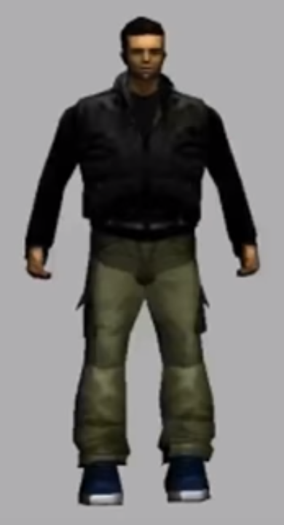
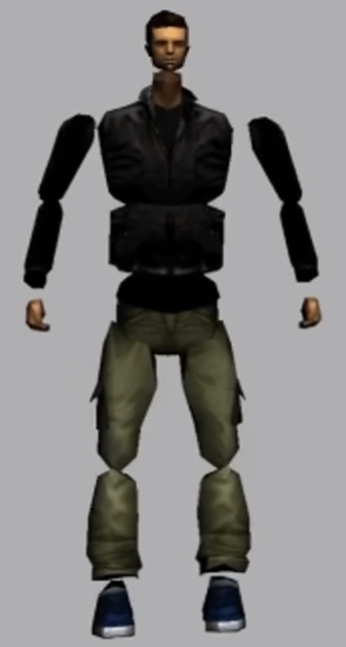
Before you start
In the parent-bind method, you will make your model out of individual pieces.
Look at your concept… How can you break this into individual pieces?

Slide 6
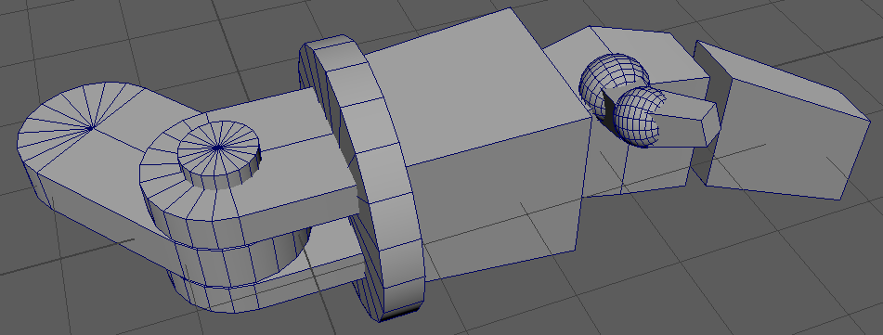
Design
Try work out if you can make the design work with the different pieces.
Swivel Joints
Overlapping sleeves
Hinges
Ball Joints
Floating Geometry

Slide 7
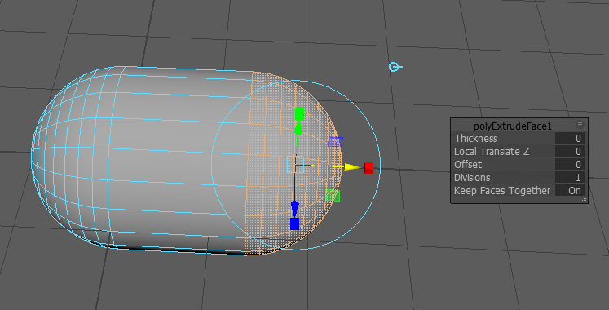
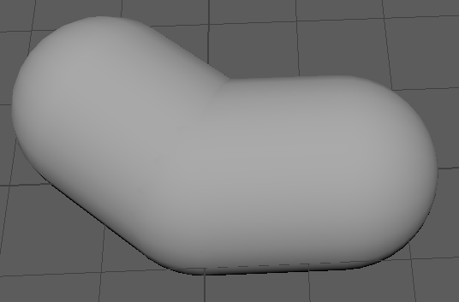
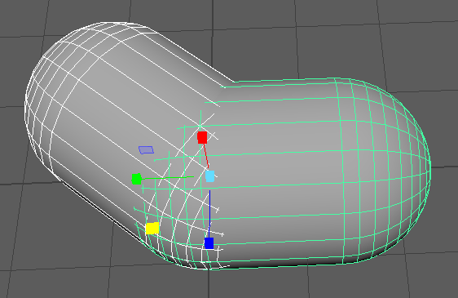
Design
Global direction toggle
For more organic forms you can make a capsule shape by extruding half a sphere (in a global direction to stop it from splaying out).
Two overlapping capsules can hide an elbow joint very well.
The capsules don’t have to be perfectly spherical, but the rounder they are, the more seamless the joint.

Slide 8
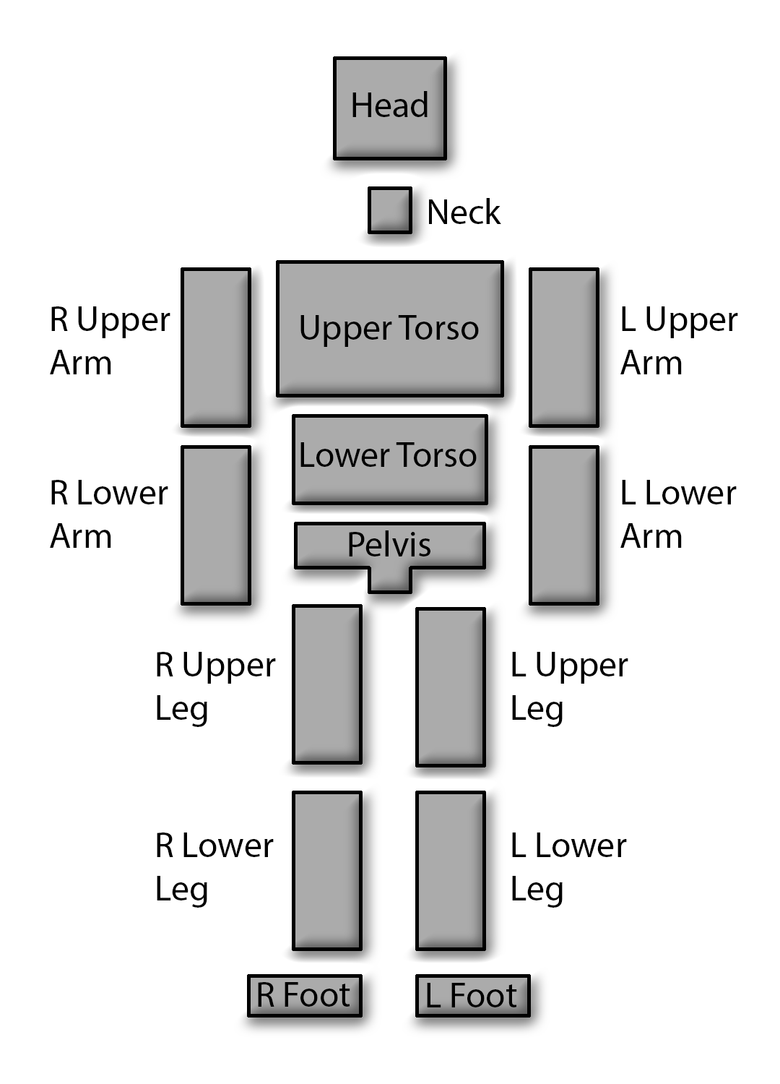
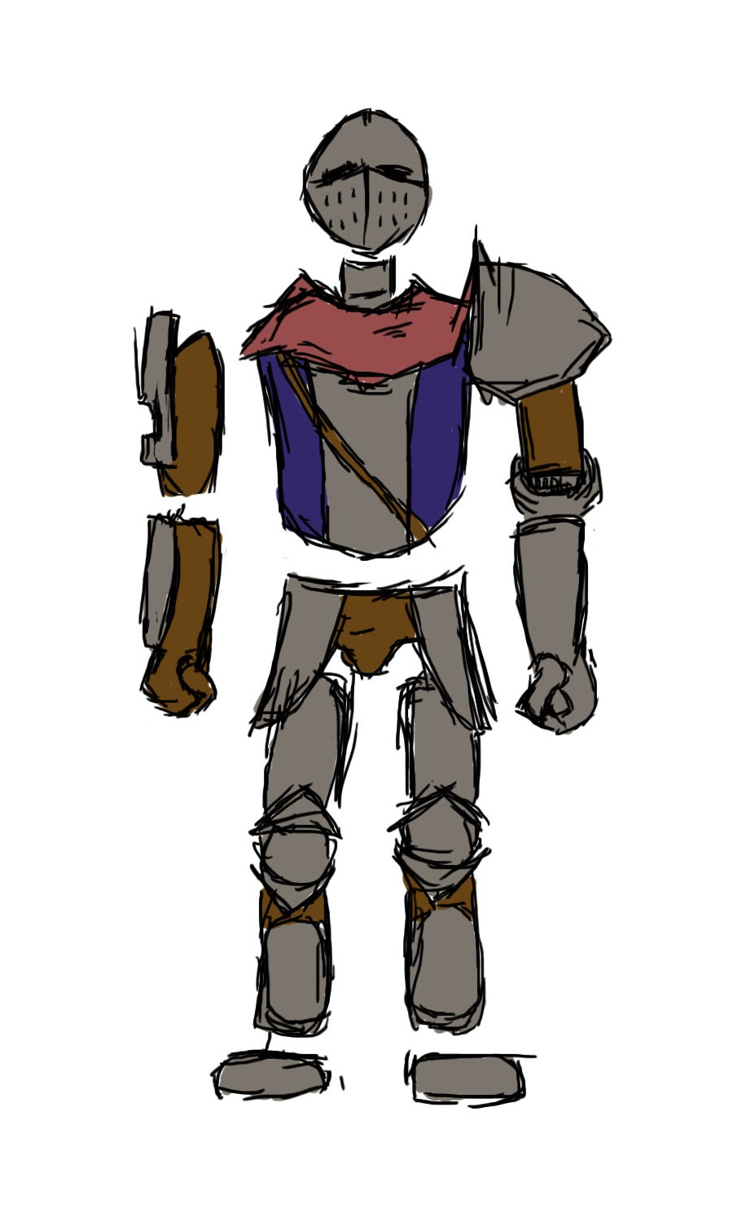
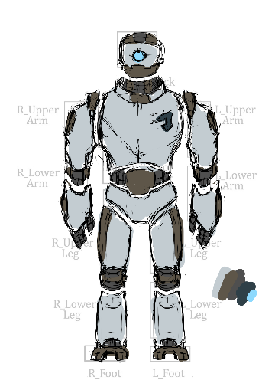
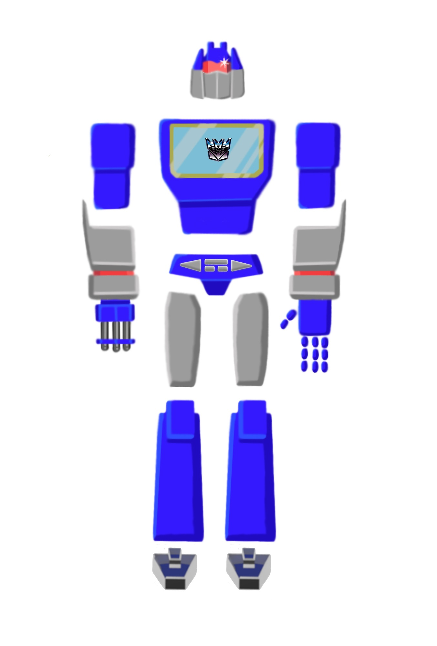
Design
This template provided in the GameConcept.pptx file will give you a good idea of the pieces you’ll need for a humanoid.

Slide 9
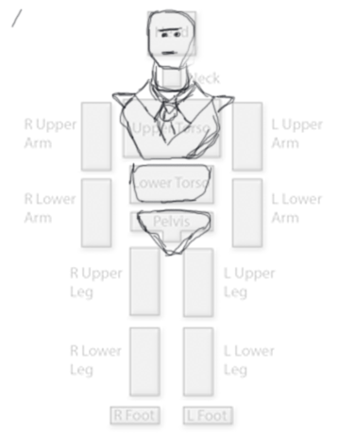
Orthographics
Copying the template into photoshop can help you plan out the parts for your character.
Remember to work on multiple layers when you do this!

Slide 10
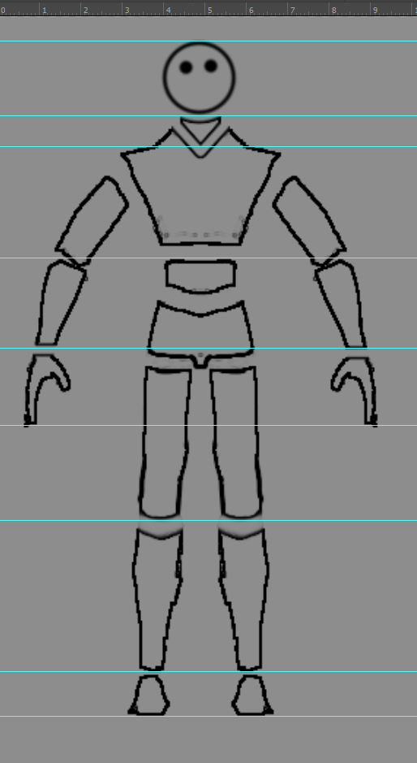
Orthographics
Once you’ve completed the front view, press Ctrl +R to display the rulers.
Drag off of the top ruler to leave a horizontal line on key points on the model (shoulders, horns, head, feet, hands, buttons, etc).
You can move an existing ruler by holding control as you click and drag on it.
Use these rulers as a guide for drawing a side view of your character

Slide 11
Modelling
When you export both the front and side views from Photoshop, ensure that they are identically sized (if they’re not exported in the same image).
If you don’t, it might be difficult to line up your geometry to the images.

Slide 12
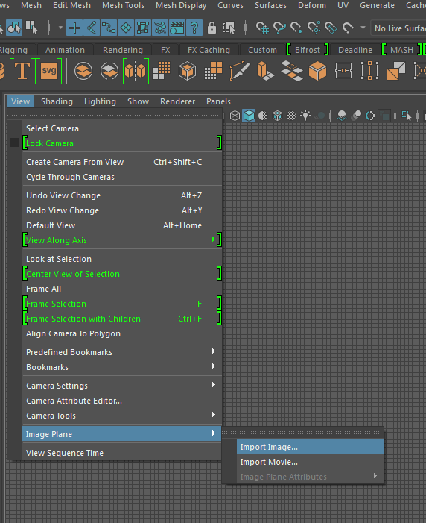
Modelling
To bring the orthographics into Maya:
In the front (Z) and side (X) views of Maya, import your image planes.
You can select the image planes in the Outliner if you wish to move/scale them.

Slide 13
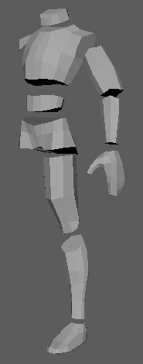
Modelling
Think of each piece of your model like its own asset. You may make each piece out of several smaller pieces (Like an armguard that sits over the forearm).
In the case of symmetrical models
select all pieces to be mirrored
pressing Ctrl + g
setting the ScaleX of the group to -1
select Edit > Ungroup.
This will mirror the geometry without adding transform history.

Slide 14
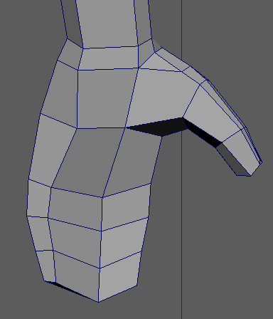
Modelling
Don’t stress about small details! (a block-hand is just fine!)
You can make up many of the fine details by using a diffuse texture and normal map.
Avoid nGons (polygons with 5+ sides) wherever possible. Try to divert the flow of the topology in complete loops.

Slide 15
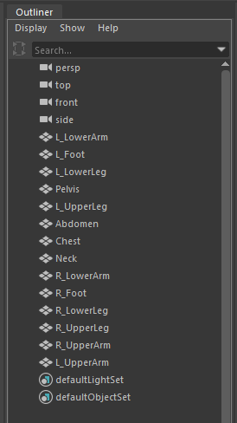
Modelling
Once you’ve completed your model, go through each item in your outliner and either:
Give it an appropriate and identifiable name
OR
Delete it if it’s no longer required (like the image planes).

Slide 16
UV Unwrapping
Here’s some tips for UV Unwrapping your character:
Be patient. Put on some music and try not to rush yourself.
Cut the UV shells into smaller, more manageable pieces, but be careful; too many seams can spoil the appearance of your model.
If you are able, get the Maya Bonus tools. There’s a great UV Unwrapping tool in there that simplifies the process.

Slide 17
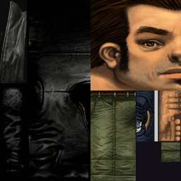
UV Unwrapping
Have as few texture files as possible.
In our example from earlier, Claude is made up of many individual pieces. However, his only texture file contains the information for every piece of the model.
By positioning the UV shells so they don’t overlap (you can check by selecting all pieces at once), you can designate different parts of the texture file to different pieces.

Slide 18
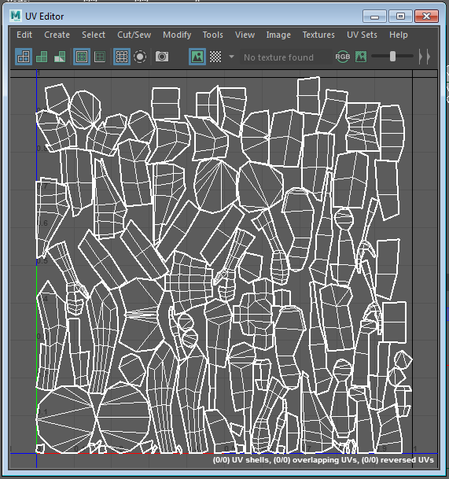
UV Unwrapping
UVs like this are not complete. (automatic unwrap, followed by Modify > Layout).
There’s no rhyme or reason to where the shells are… This will make texturing in Photoshop difficult.
Many of the seams could be eliminated or better hidden from view.
From this stage, you will need to use the Cut/Sew tools to complete the UV Shells.

Slide 19
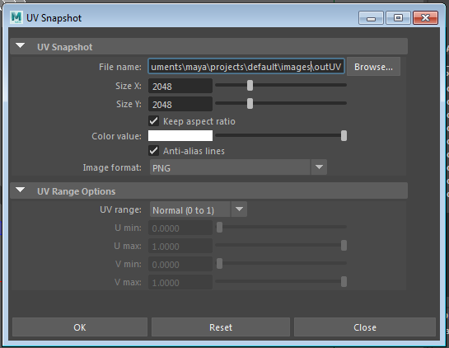
UV Unwrapping
Once you’ve unwrapped your objects, you can select Image > UV Snapshot to create a PNG image of your UVs.
I like to make this a 2048x2048 image, because it’s much easier to downsample than it is to add more detail later.
Keep the colour value as white
Set the Image Format to PNG, and make sure you note where it will be saving the output to (in your Maya Project’s images folder, by default)

Slide 20
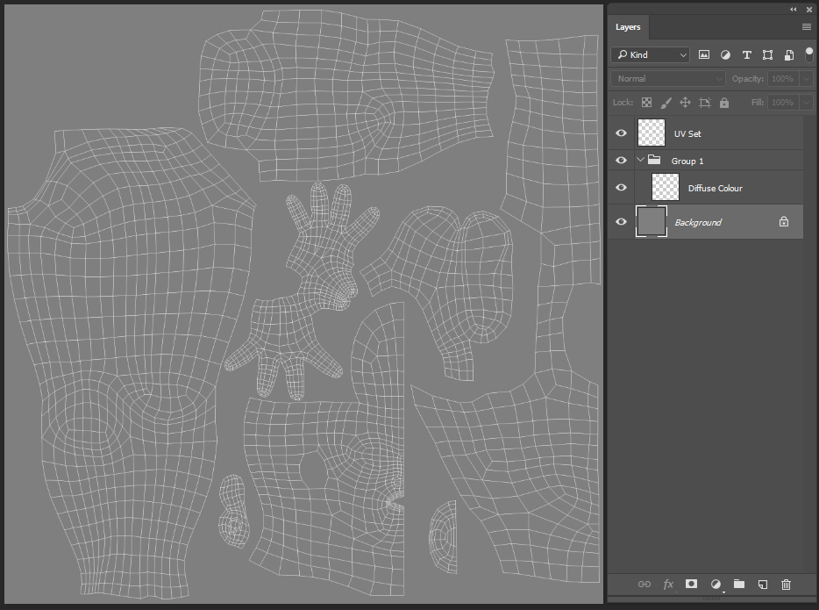
UV Unwrapping
Paste the UV set into a photoshop document of the same dimensions. Ensure that they are on the top layer.
Set the background to an appropriate colour (you should be able to see the Uvs AND the details you’re adding).
Create a group and a new layer between the UV set and the background. This will be where you draw in your details.
You can make a layer and/or group for each part of your texture map.

Slide 21
Prepare for Rigging
Now we need to centre up the model, delete the history, and freeze the transformations on the geometry. If we don’t, we can get some nasty skewing as the pieces are rotated and scaled.
Group all the pieces of your model, then move the group so that the character stands centred above the origin (0,0,0 point). Ungroup.
Select every piece of geometry in your scene go to Modify > Freeze Transformations, and then go to Edit > Delete by Type > History.
Save a backup of your project now. It’ll be a great idea to get some feedback from your teacher now, too!

