Slide 1

Character Rigging
Pipeline
Design & Implementation
18/05/2018 – Sam Nicholas

Slide 2
Contents
Before you start
Prepare for rigging
Rigging
Rigging - Troubleshooting
Finishing the rig
Saving for animations

Slide 3
Before you start
Everybody’s character will be set up differently.
As you are designing your character, remember Form Follows Function.
How it looks, and how it is made will depend on what it needs to do.

Slide 4
Before you start
To keep things simple, this tutorial will be using a
parent-bind method for attaching the mesh to the bones.
If you are choosing to do a skin weighted bind, know that you may encounter complications not supported by the course resources.

Slide 5
Prepare for Rigging
If you haven’t already, centre up the model, delete the history, and freeze the transformations on the geometry.
If we don’t, we can get some nasty skewing as the pieces are rotated and scaled.
Group all the pieces of your model, then move the group so that the character stands centred above the origin (0,0,0 point). Ungroup.
Select every piece of geometry in your scene go to Modify > Freeze Transformations, and then go to Edit > Delete by Type > History.

Slide 6
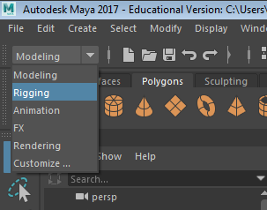
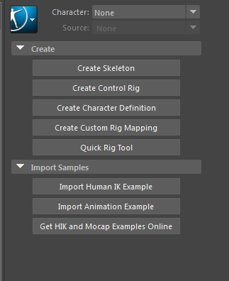
Rigging
There are several ways you can rig a character. For this assessment, we’re going to use the HumanIK tool.
The HumanIK tool can be found in the Rigging toolset, then selecting Skeleton > HumanIK. You’ll get a new interface on the right: hit Create Skeleton to create the base rig.
Chances are the rig won’t perfectly fit the character you’ve made, so you’ll need to resize the rig… We’ll do that in a moment.

Slide 7
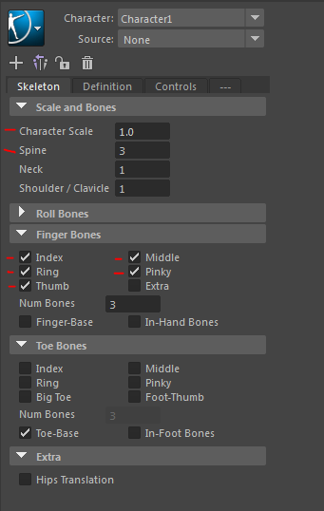
Rigging
We first want to adjust which bones are going to be included in our rig.
Most importantly, we want to change the number of spine joints (probably to 2, depending on your character design).
You can probably turn off all the finger bones, too. If you must have hand control, try to limit it to just a Middle Finger and Thumb with Num Bones set to 2.
Lastly, use the Character Scale to resize the bones so that the pelvis is sitting in the right location.

Slide 8
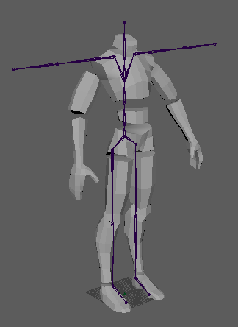
Rigging
From here you’ll likely find that the bones don’t line up perfectly with your character.
You can make the joints easier to see by going to the top left of the viewport, and selecting Shading > X-Ray Joints.
Reposition the bones by using the move tool (Not the rotate tool and not the scale tool!).

Slide 9
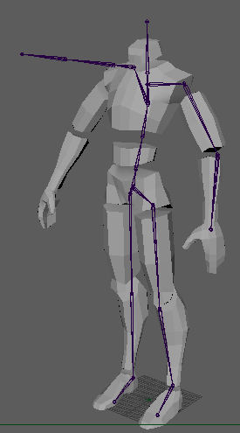
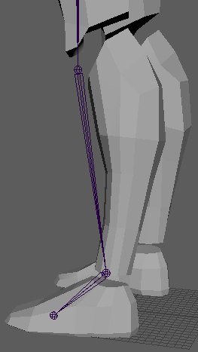
Rigging
Start with the left side only (based on the rig’s left). To move one single joint and not its children, press the ‘d’ key to toggle the isolation mode.
Remember that the bones are going to be the pivot point of the geometry. If the pivot point is not in the right location, your model will start to go off-kilter when it moves.
The bones don’t necessarily need to be inside the geometry: The pivot point of each bone is much more important!

Slide 10
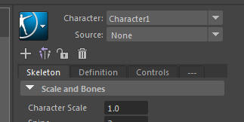
Rigging
Once you have positioned all the bones on the left side of the rig look to the IK Panel.
There is a button that will mirror the position of the joints from the left side to the right side of the rig.
If you have an asymmetric rig, you may need to re-adjust the right side of the rig, or position them entirely manually.
Once ALL the bones are in position (on both sides), select the highest bone in the hierarchy and select Modify > Freeze Transformations.

Slide 11
Rigging
It’s a good idea to save another copy now.
To attach the geometry to your rig, perform the following steps in this exact order:
Select the piece of geometry. It, and only it should be highlighted green.
Hold shift and click on the matching bone. The bone should now be green and the geometry should have a white wireframe.
Press ‘p’. The geometry should be highlighted green, and the bone should be deselected. When the bone is selected, both it and the geometry should be green.
If at any point the highlighted selection looks different to what is described here, undo, check the steps, and try again.

Slide 12
Rigging – Troubleshooting
If you don’t get the parenting order right, you’ll detach the bone from the skeleton and parent it to the geometry.
To fix this, select the detached bone (not the geometry), then the bone it should be attached to, and then press ‘p’.
Keep an eye on the Output line (lower right corner). If it turns yellow or red after you try do something, see if it gives you any hints about what you may have done wrong.

Slide 13
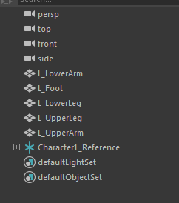
Finishing the Rig
With all the bones in place, and the character attached to the bones, we can check if any geometry has been left behind in the outliner.
If there is any geometry that is not parented under the Character1_Reference, you should check to see what it is, and where it should be attached (or if it should be deleted).

Slide 14
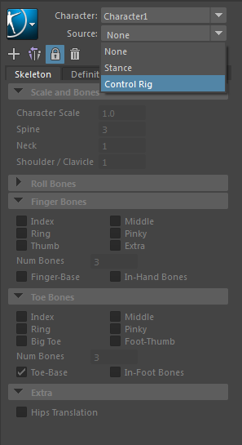
Finishing the Rig
To implement the control rig, select the root of the skeleton, then on the right hand side select Source > Control Rig.
Test to see that your joints work ok. Sometimes the setup can cause issues. Eg. If the knees bend backward the default bend of the knee is not facing forward. You can Go back to the Source > Stance and adjust the base pose of the rig so that the default pose has the knees bending forward very slightly.
If everything goes missing when you click on Control Rig, undo, select the character root, select the blue icon at the top of the HumanIK panel, and select Edit Control Rig > Delete Control Rig, and then try create the control rig again.

Slide 15
Saving for animations
Phew! All done!
Save your character as “CharacterName_SkeletalMesh.”
Going forward, when you go to create your animations, make a copy of this file (Make sure you don’t overwrite it!) and use the naming convention: CharacterName_AnimationName.

