Slide 1
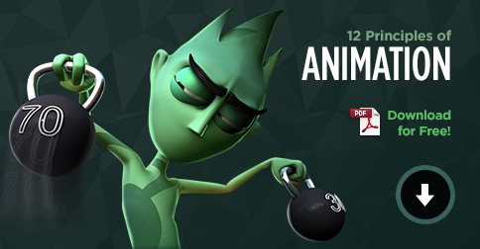
12 Principles of animation
Asish Sharma
Notes:
NOTE:
To change the image on this slide, select the picture and delete it. Then click the Pictures icon in the placeholder to insert your own image.

Slide 2
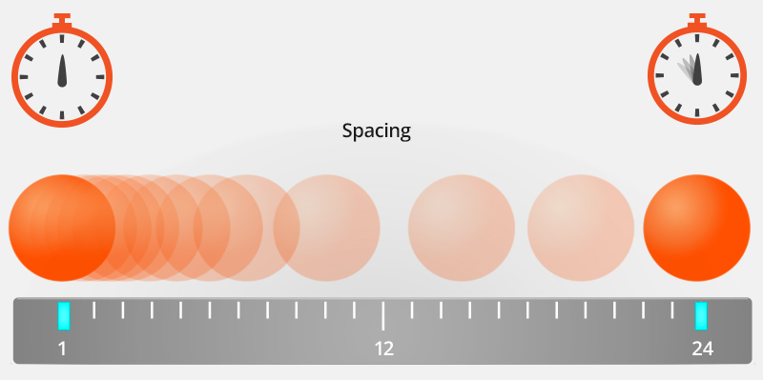
Timing and Spacing
Timing and spacing in animation is what gives objects and characters the illusion of moving within the laws of physics. Timing refers to the number of frames between two poses.

Slide 3
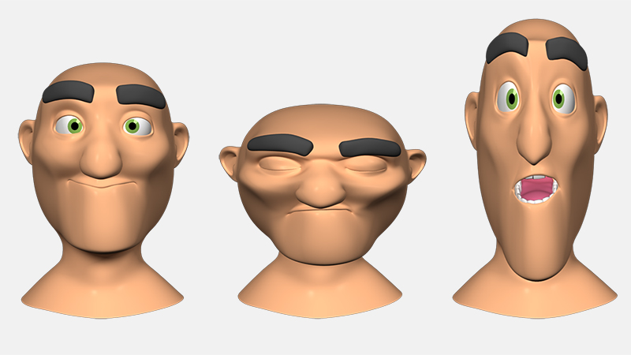
SQUASH AND STRETCH
Squash and stretch action gives the illusion of weight and volume to a character as it moves. There’s lot of squash and stretch happening in real life that may not notice; in animation this can be exaggerated.

Slide 4
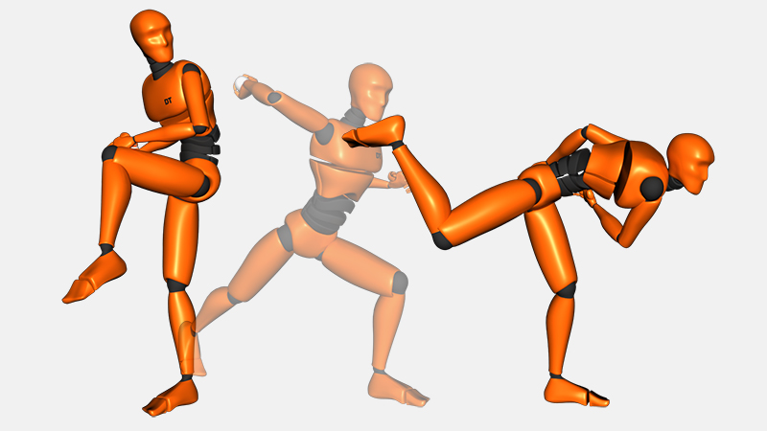
ANTICIPATION
Anticipation is used in animation to set the audience up for an action that is about to happen. An easy way to think about this is that if a person needs to move forward, they first must move back. For example, if a character is about to walk forward, they might move back slightly, this not only gets their momentum up, but it also lets the audience know this person is about to move.

Slide 5
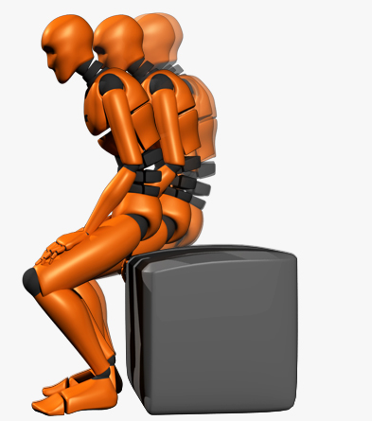
Ease in Ease Out
As any object or person moves or comes to a stop there needs to be a time for acceleration and deceleration. Without ease in and ease out (or slow in slow out), movements become very unnatural and robotic.

Slide 6
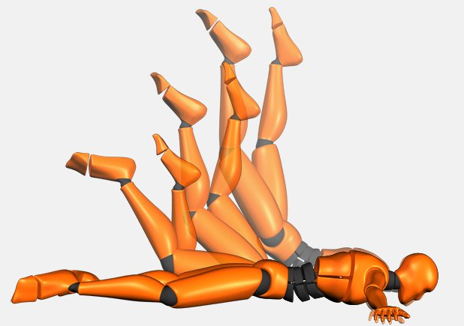
Follow Through and Overlapping Action
Follow through and overlapping action can be considered two different principles, but they're still closely related. Follow through is the idea that separate parts of the body will continue moving after the character has come to a stop.

Slide 7
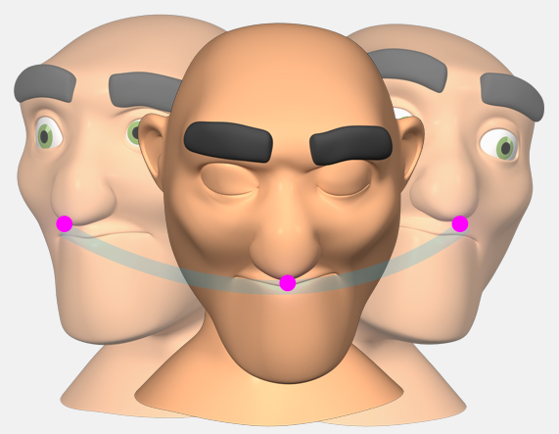
Arcs
Everything in real-life typically moves in some type of arcing motion, and in animation you should obey this principle of arcs to ensure your animation is smooth and moves in a realistic way. The only time something would move in a perfectly straight line is if you're trying to animate a robot, because it's unnatural for people to move in straight lines.

Slide 8
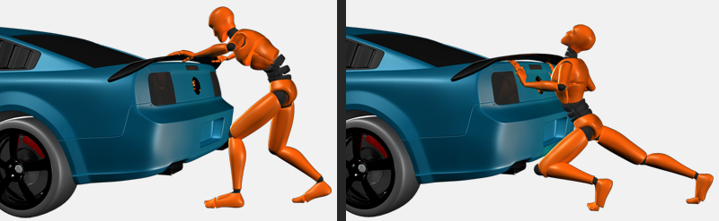
Exaggeration
Exaggeration is used to push movements further to add more appeal to an action. Exaggeration can be used to create extremely cartoony movements, or incorporated with a little more restrain to more realistic actions. Whether it's for a stylized animation or realistic, exaggeration should be implemented to some degree.

Slide 9
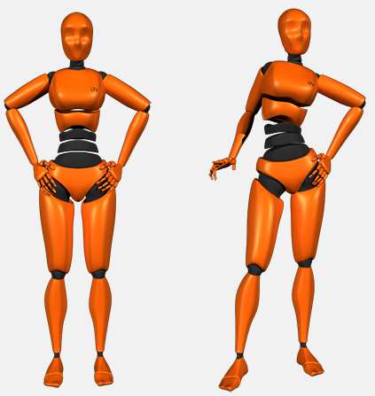
Solid Drawing
Solid drawing is about creating an accurate drawing with volume and weight, and thinking about balance, and the anatomy in a pose. With 3D animation, animators are less likely to rely on their drawings, but the idea of solid drawing is just as important.

Slide 10
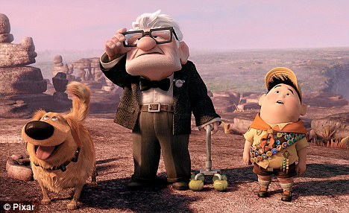
Appeal
This principle can really come down to adding more appeal in many different areas of your animation, such as appeal in posing. However, the most obvious example is appeal in the character design, you want to have a character that the audience can connect to or relate to.

Slide 11
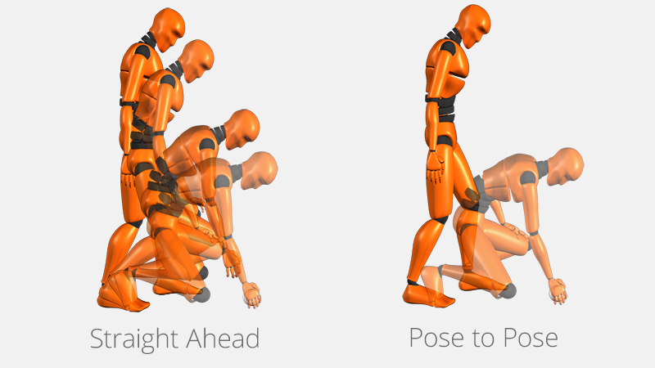
Straight Ahead Pose to Pose
Straight ahead and pose to pose refers to the two different techniques for how you go about animating. With straight ahead it's a very spontaneous and more of a linear approach. You'll create each pose or drawing of the animation one after the other.

Slide 12
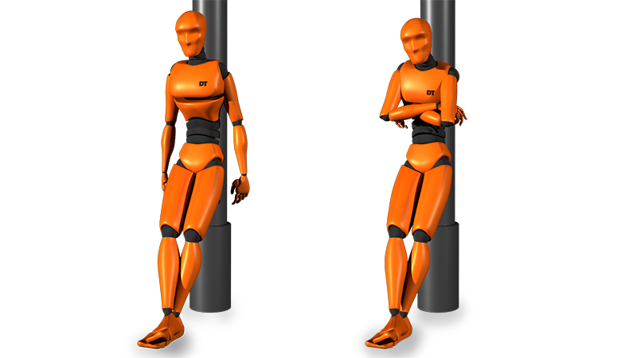
Secondary Action
Secondary action refers to creating actions that emphasize or support the main action of the animation; it can breathe more life into an animation and create a more convincing performance.

Slide 13
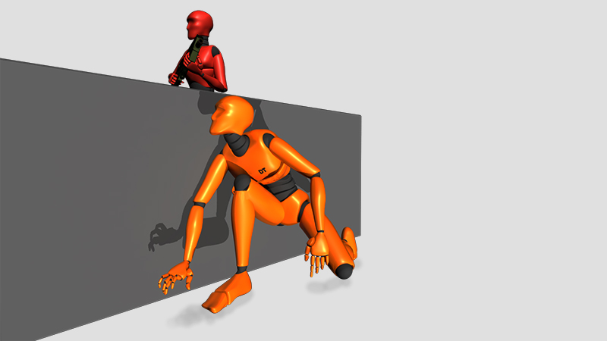
Staging is how you go about setting up your scene, from the placement of the characters to the background and foreground elements and how the camera angle is set up. The purpose of staging is to make the purpose of the animation unmistakably clear to the viewer.

Slide 14
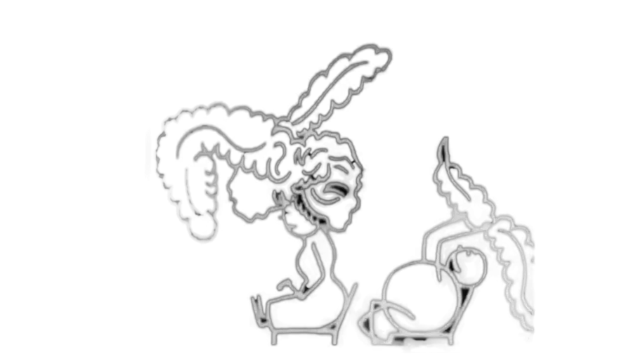
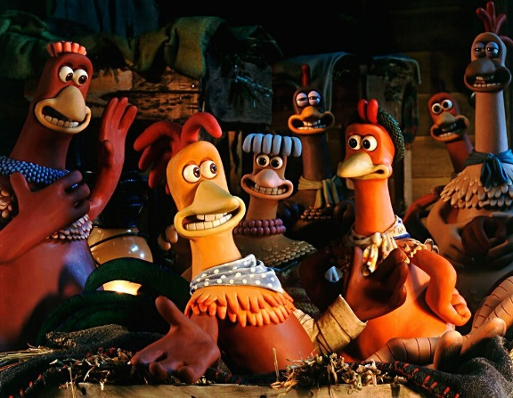
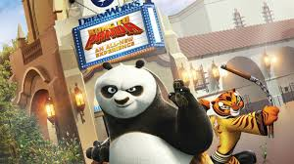
History of animation
1900 – 1930 2000 2018
The early 20th century marks the beginning of theatrical showings of cartoons, especially in the United States and France. Many animators form studios, with Bray Studios in New York proving the most successful of Mighty Mouse, Betty Boop, and Woody Woodpecker. The first animated film using hand-drawn animation.
Animation has gotten very better than before as new animation features VFX, color grading and there are heaps of software which helps creators a lot when creating animation as in the past everything was hand drawn.
During 2000 technology got better allowed us to create some more realistic model and animation. Colors were also introduced which made a huge change in animation industry.

