Slide 1
concepting
Asish Sharma

Slide 2
Art Bible Contents
This Art Bible will be used to gather evidence for assessment. The following work will need to be updated and completed for submission…
Level Design
Level Description
Top down map design
Colour and Gameplay
Character
Description
Colour Palette
Concept Image
Mechanics
List of mechanics
How they will be used

Slide 3
Level design
Note: Feel free to expand upon the scope of this template. If you have more ideas and create extra work, duplicate the slides.

Slide 4
Level description
Description/scenario:
Hal-09 is a third person game set in a modern robot factory where futuristic robots are build. A robot named Hal-09 needs to escape the factory which has high security system including guards, security cameras, lasers. Hal-09 must escape the high security building using the tools that can be found inside the building such as a key to unlock a door, turning off power to disable cameras.
Art Style:
Note: Describe what your game is about? What is the setting/mood? What art style will you be trying to create? Also remember, we are making a 3rd person game using limited mechanics, and your scope should reflect this.

Slide 5
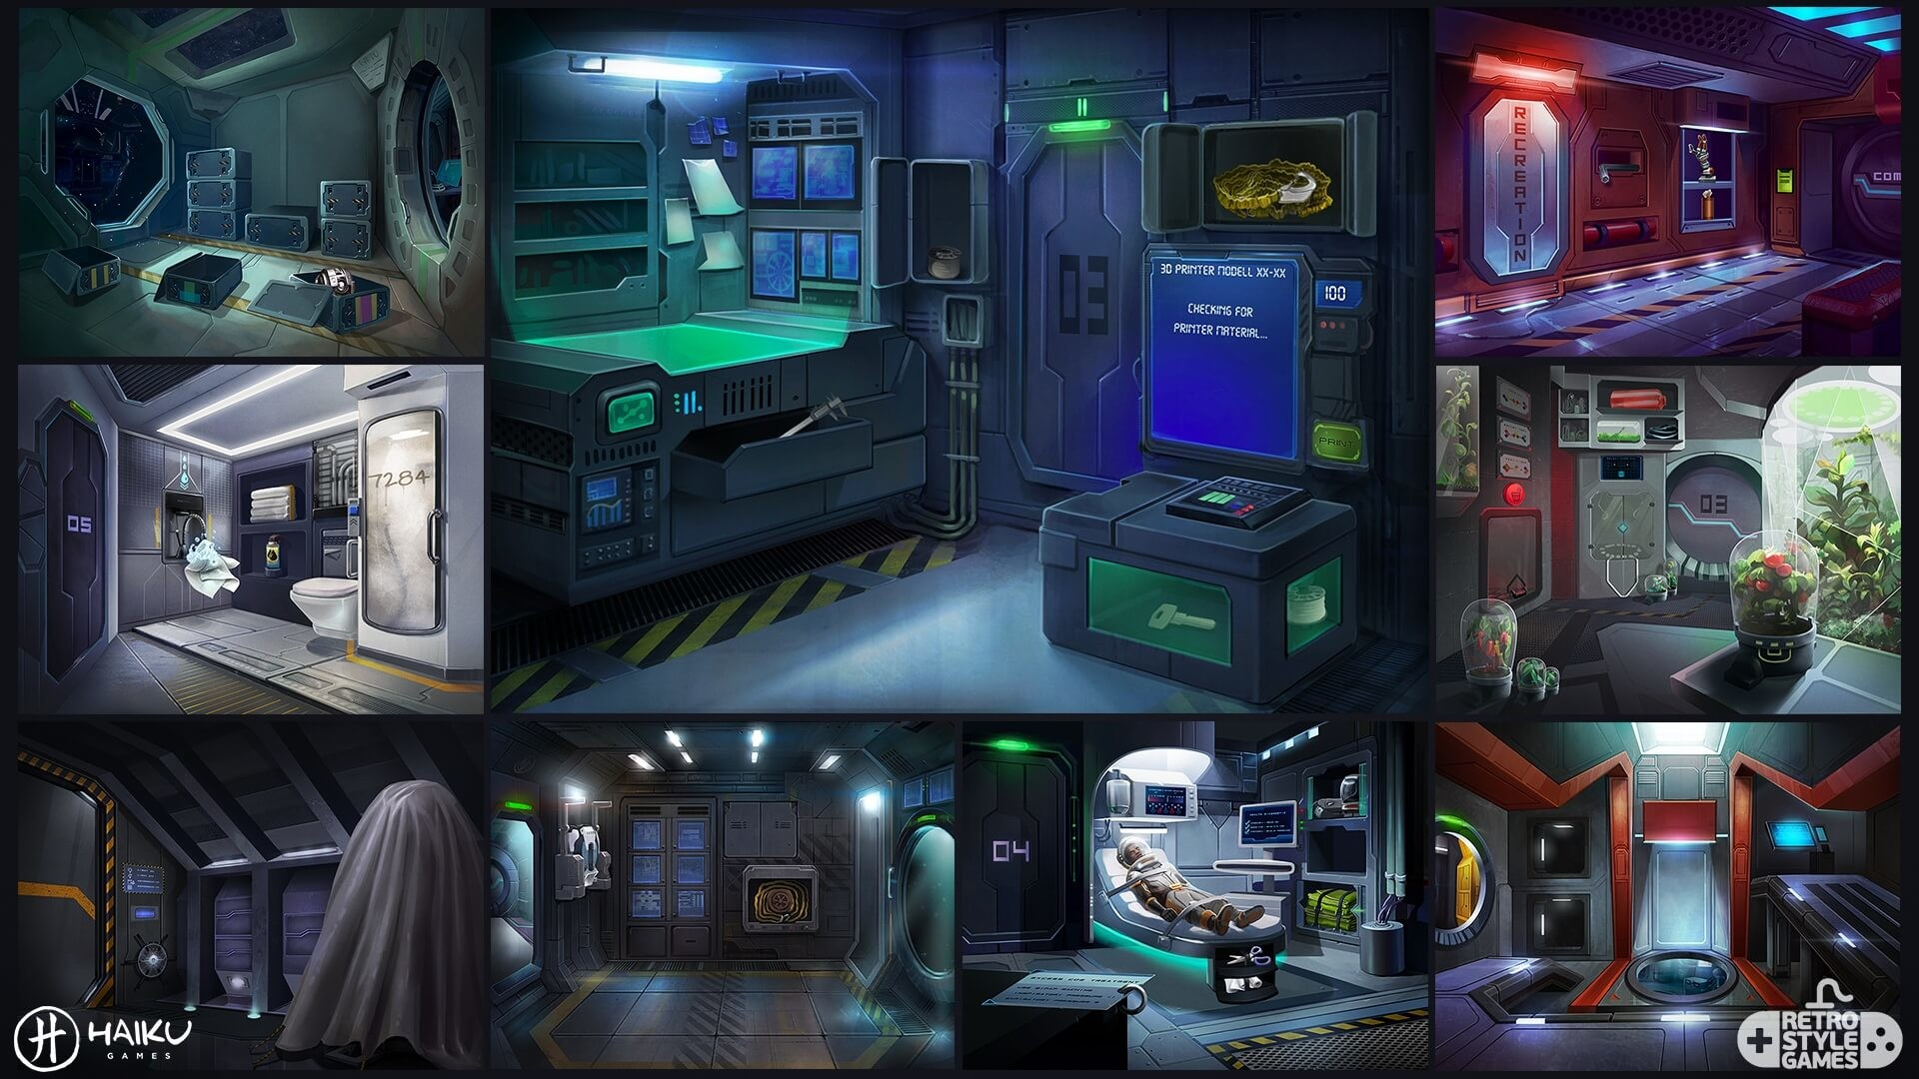
Art style Reference images
Find at least 5 reference images that illustrate the style/type of game level you will create.

Slide 6
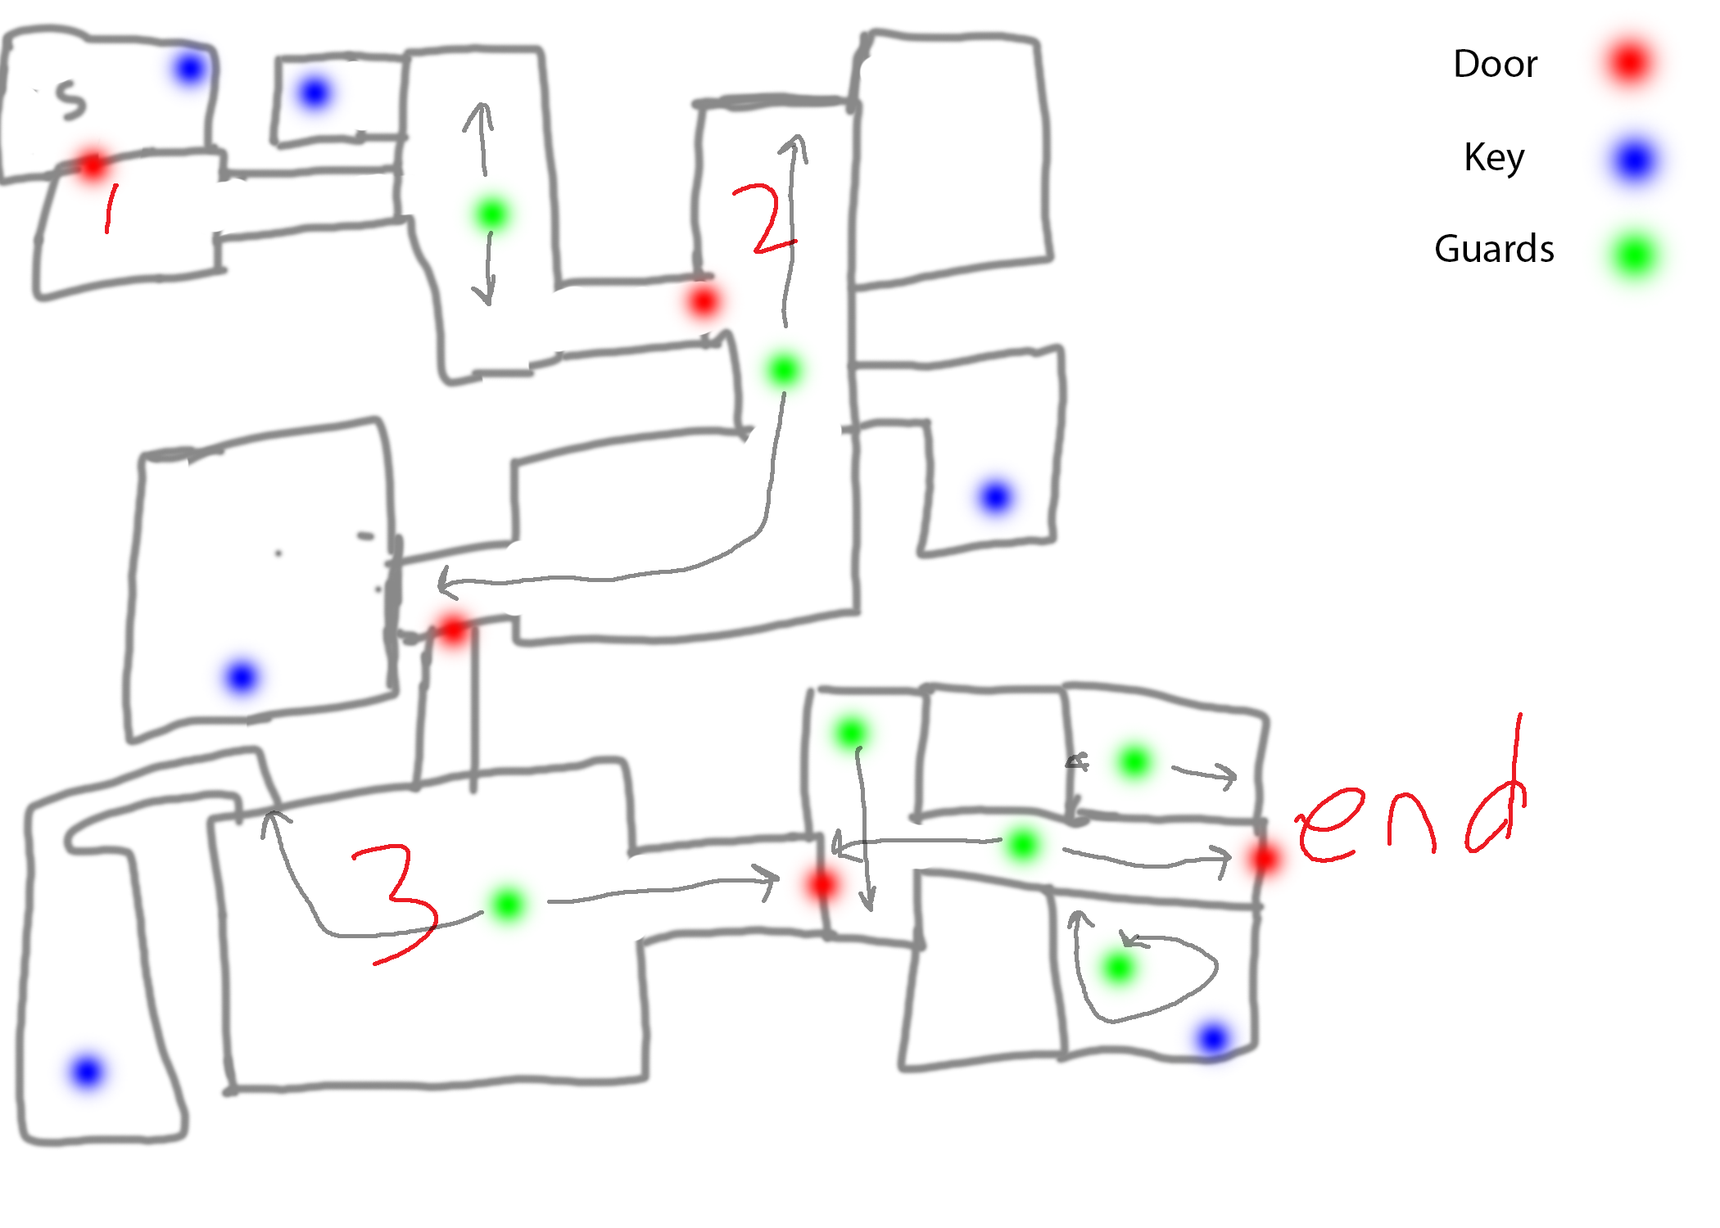
Environment sketches
Create some concept sketches for your environment ideas.

Slide 7
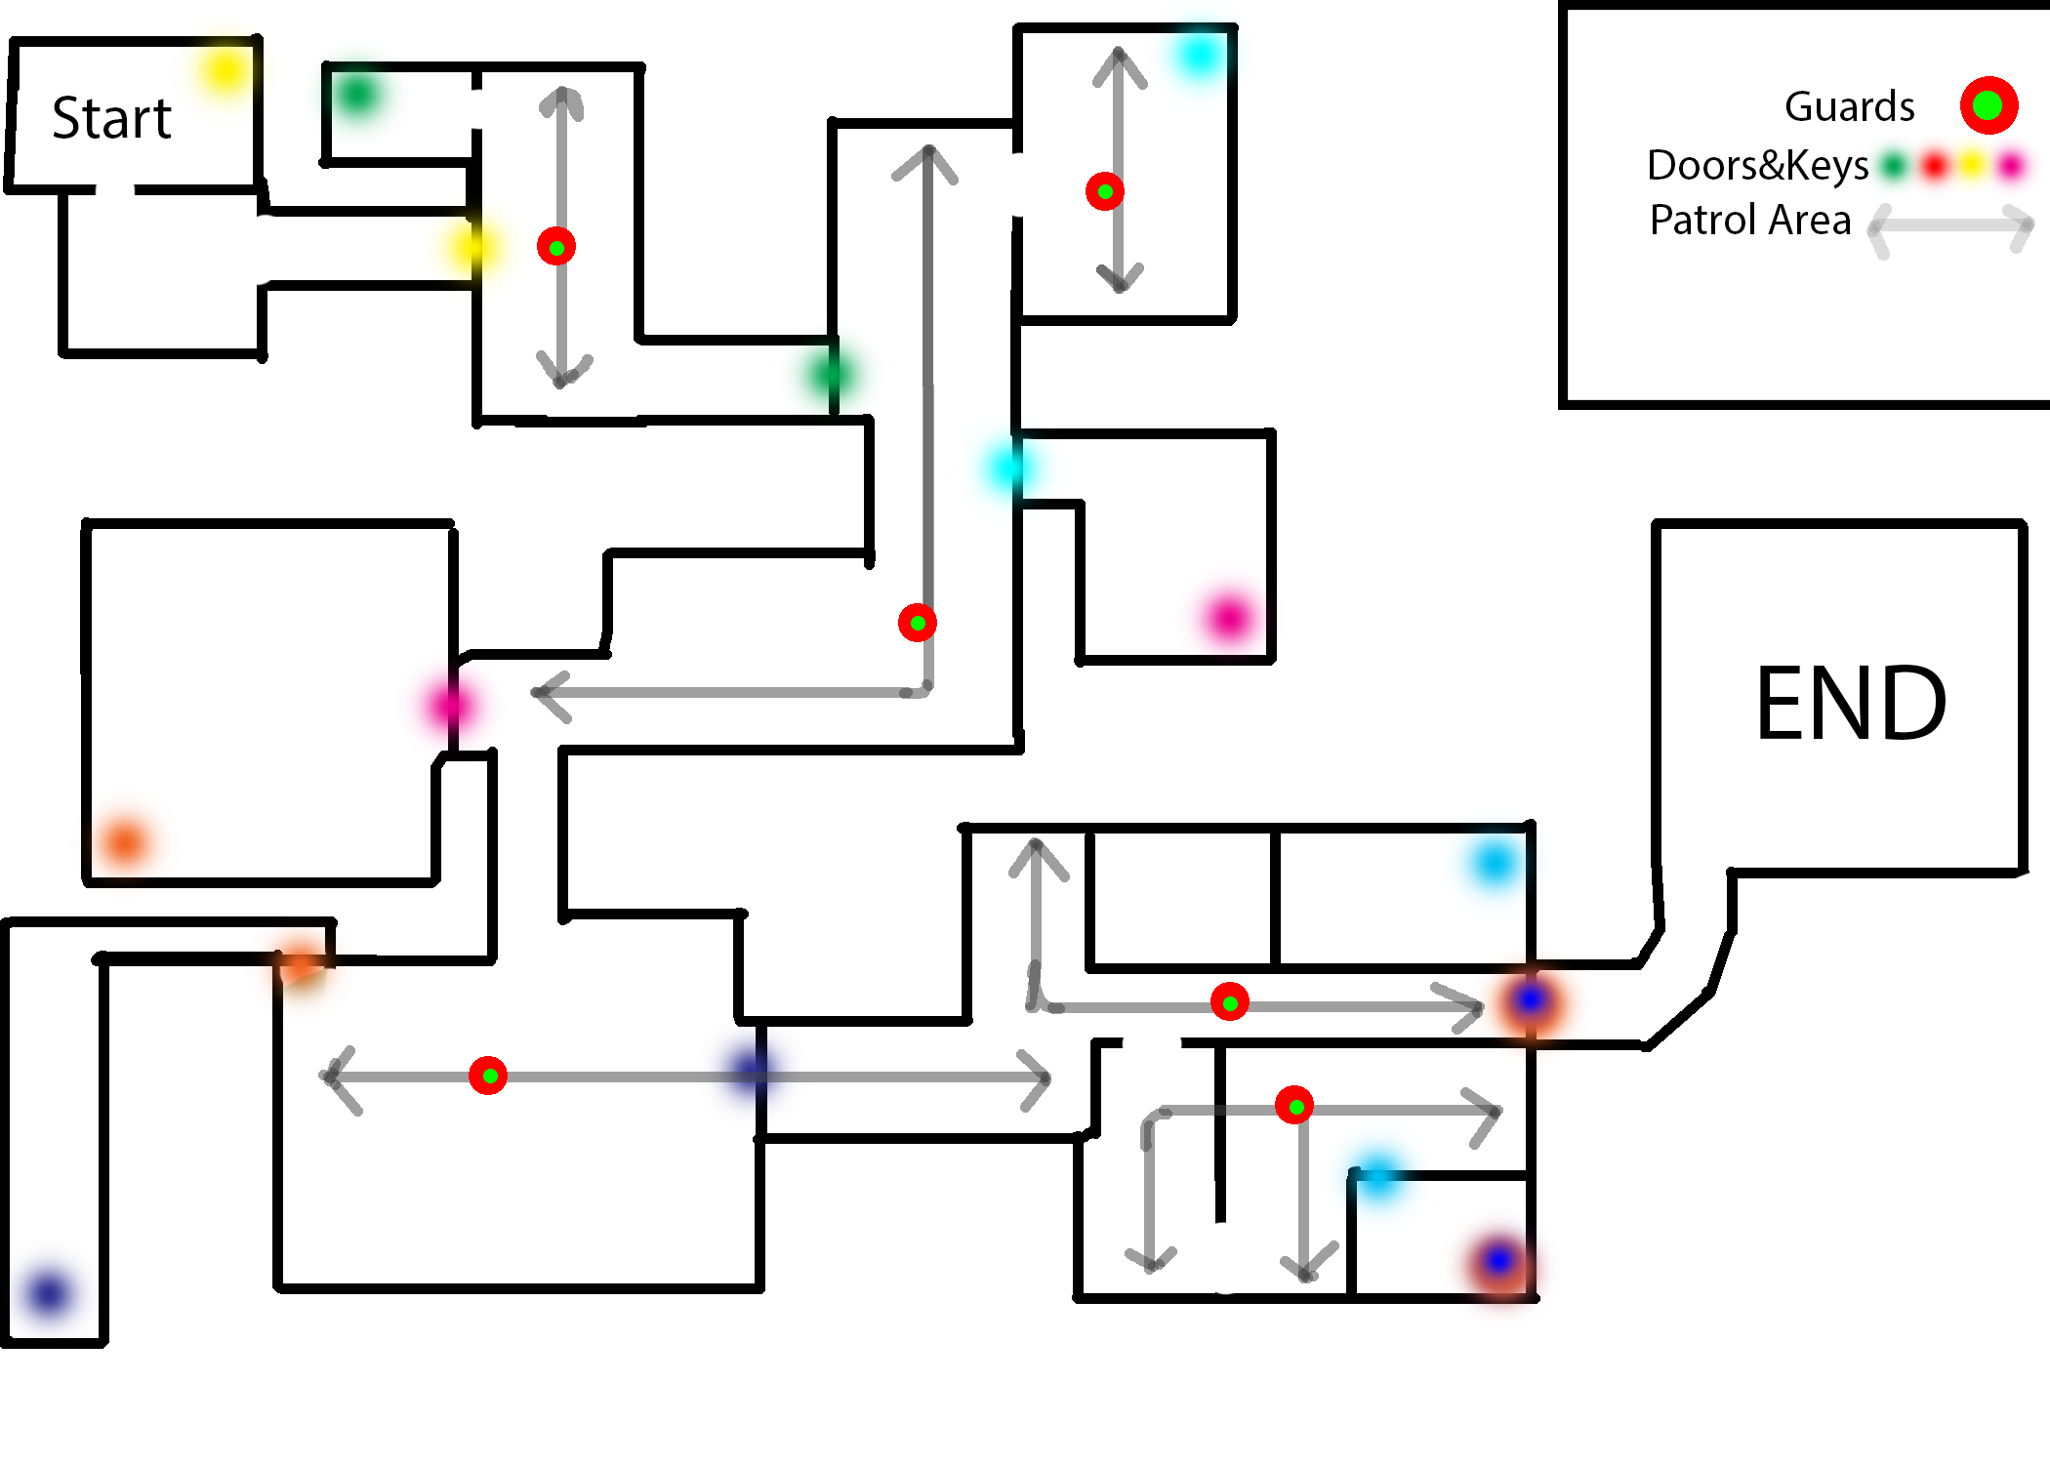
Top down level design
Note: Add key points of interest, such as player start location, level end, pickups etc.. Remember, this should be specific enough that you could hand it to an environment artist and they would create your exact vision.

Slide 8


Colour palette
Colour: The colours I have chosen represent a red earth and gritty aesthetic. I want the environment to feel alien and worn, while contrasting with the brighter colours of the character and the pickups.
Colour and Gameplay: I will be using colour to guide the player. Subtle green lighting will be used at points of interest, and a series of purple flags will draw attention to things in the distance. There will also be a bread crumb trail of glowing pickups to encourage players to explore.
Create a colour palette for your environment, and describe how the colours will influence gameplay.

Slide 9

Environment Colour palette
Colour: I picked these colours because it represents a factory and robotic atmosphere. I want the environment to feel more like a modern interior with lower grey and white balance and brighter red and green colours.
Colour and Gameplay:
Create a colour palette for your environment, and describe how the colours will influence gameplay.

Slide 10
Character design

Slide 11
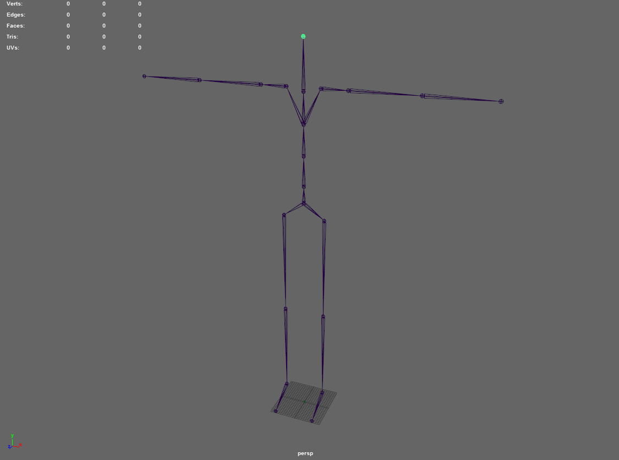
Character description
Human IK rig:
Description: The character is going to be a robot with a Head it contains two motion sensor cameras(Eyes), two hands without fingers, torso, and two legs without fingers. The character is going to be a simple robotic robot which will act as a main character in the game.
Describe the type of character you want to create. We will all be using the same Human IK rig in Maya, so you should design your character with this in mind.

Slide 12
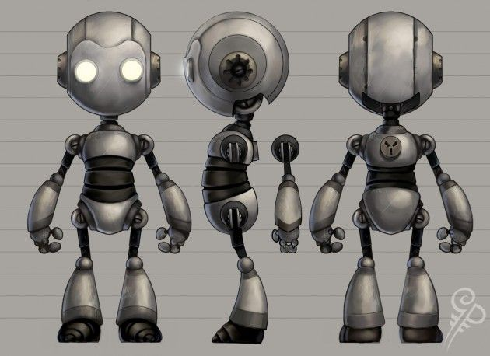
Character reference
Find reference images for your character. Remember, your character will be a biped (walks on 2 legs).

Slide 13
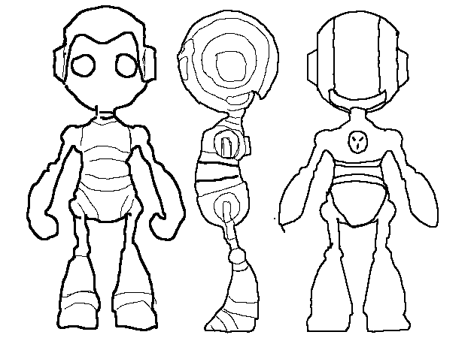
Character sketches
Sketch different ideas for your character. This is your chance to experiment. Remember, your character will be a biped (walks on 2 legs).

Slide 14

Character Colour palette
Colour theory applied:
Create a colour palette for your character using colour theory. Explain the colour theory you have used.

Slide 15
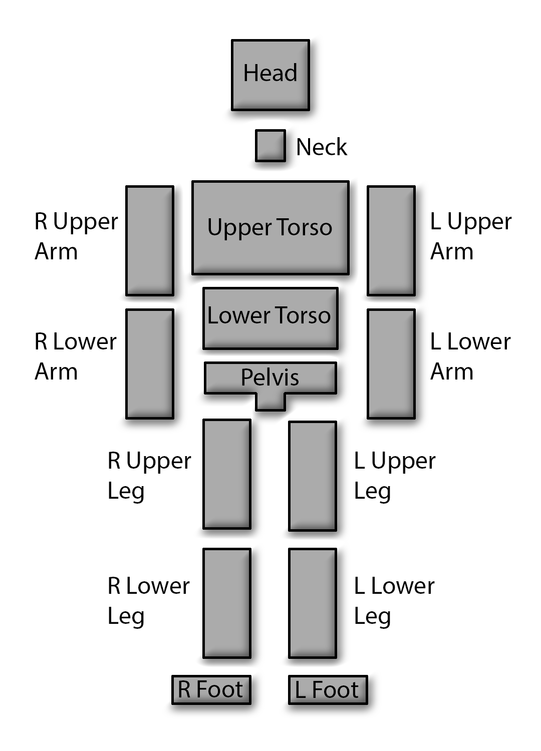
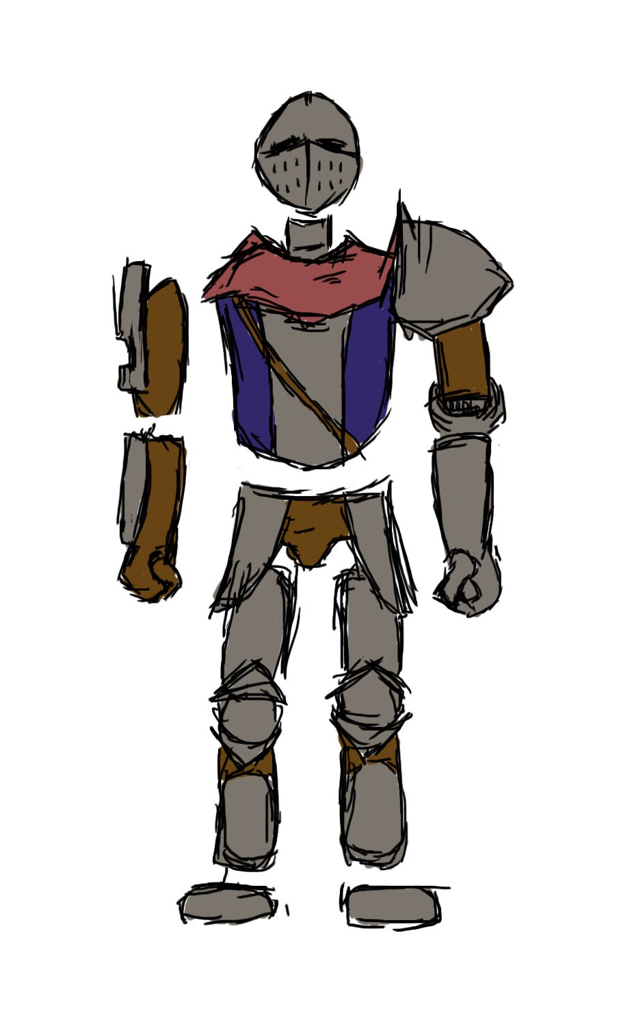
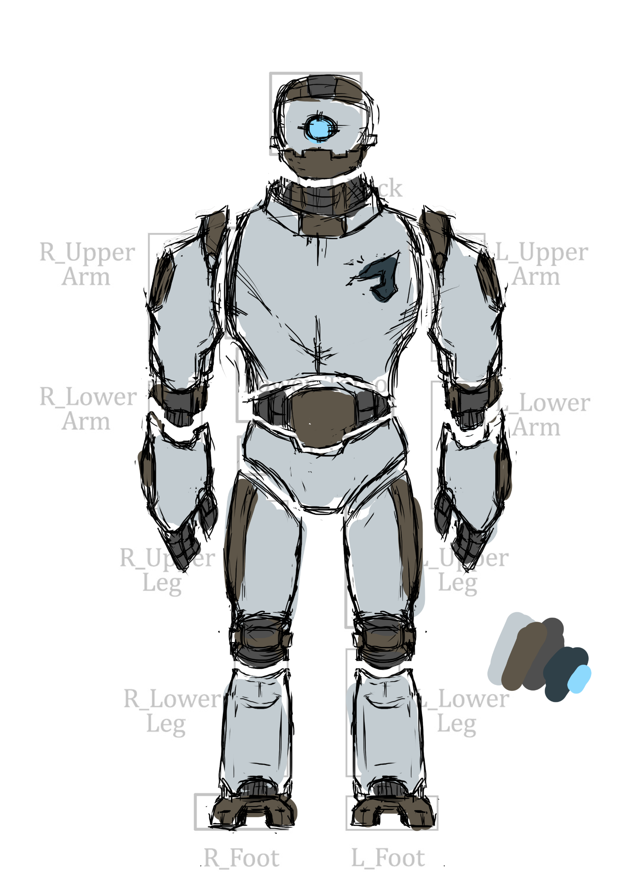
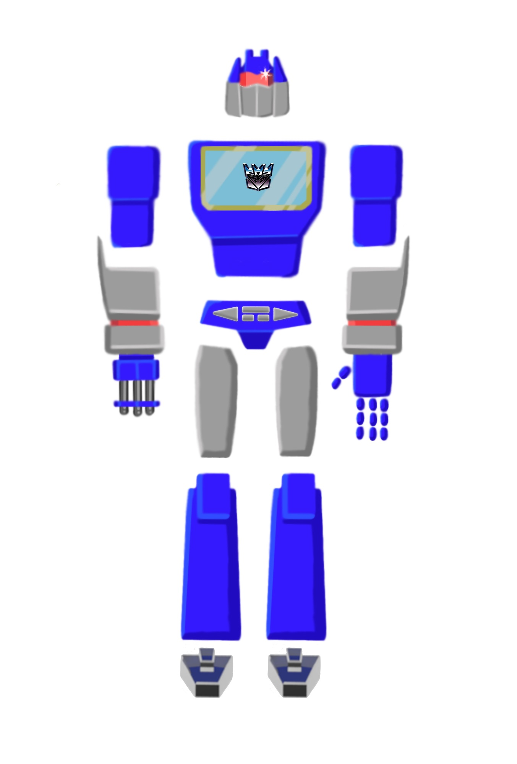
Character concept
Character Template:
Character Design examples:
This is your final Character concept image. Use the template as a guide and clearly show the individual sections you will create to match the animation rig (human IK).

Slide 16
Character concept
Character Template:
Character Design:
This is your final Character concept image. Use the template as a guide and clearly show the individual sections you will create to match the animation rig (human IK).

Slide 17
mechanics

Slide 18
Game mechanics
Description: We will be choosing our game mechanics from a limited list on canvas. Remember, having more mechanics doesn’t necessarily mean the game will be better. Your creativity in designing the way the mechanics are used, is what will determine the quality of gameplay.
Choose 3 mechanics and discuss how each will be used to create the player experience. Think of ways you can combine the mechanics together to create interesting challenges for the player.
Canvas link to mechanics: https://aie.instructure.com/courses/131/pages/blueprint-tutorials
Note: Use the following slides to describe how each game mechanic will be used in your game. You can use more than 3 mechanics, but you will need to justify their inclusion.

Slide 19
Mechanic 1
Mechanic:
Unlockable door
How will this mechanic influence gameplay?
This mechanic will influence gameplay as player must find the key to pass each level therefore implementing unlockable door in each level will encourage player to explore the building and find the tools that unlocks the door which changes the level.
Try and come up with interesting scenarios for the player using each mechanic. Combining mechanics can also create complex and engaging gameplay.

Slide 20
Mechanic 2
Mechanic:
Security Cameras and lasers
How will this mechanic influence gameplay?
Security cameras and lasers mechanic will influence the gameplay because this mechanics are used to challenge player to pass the level as these security cameras and lasers will make it hard for a player to move around the environment and being careful that they don’t trigger the cameras and lasers which would restart the level. Therefore to avoid the security system of the building you could turn off the electricity which disables cameras and lasers.
Try and come up with interesting scenarios for the player using each mechanic. Combining mechanics can also create complex and engaging gameplay.

Slide 21
Mechanic 3
Mechanic:
Patrolling Guards
How will this mechanic influence gameplay?
This mechanic will influence gameplay as player have to be very careful of their surrounding to avoid getting in the radius of guards eyesight. If you get inside the guard’s eyesight radius guard will come towards you and black screen will pop up with a mission failed sound effect and the level will be restarted.
Try and come up with interesting scenarios for the player using each mechanic. Combining mechanics can also create complex and engaging gameplay.

Slide 22
Mechanic 4
Mechanic:
Robot battery life
How will this mechanic influence gameplay?
This mechanic will influence gameplay as player must finish the level within certain time frame as main character contains a battery that drains every seconds. Player has 2.5 mins to complete the level if exceeded the time the level will be restarted.
Try and come up with interesting scenarios for the player using each mechanic. Combining mechanics can also create complex and engaging gameplay.

