Slide 1
CLOINT FUSION
A python package
Problem Statement-4
Develop a BOT using ClointFusion to extract rows from one spreadsheet based on conditions and copy the data to another spreadsheet.

Slide 2
To Run This Python File
You should have python 3.8 or 3.9 version installed in your pc.
You should install ClointFusion package and sign in dost.
It is better to have only one version of python in your pc.
An IDE to run python code (Vs code).

Slide 3

Step-1:
When you run the program, the first message u will get is this.

Slide 4
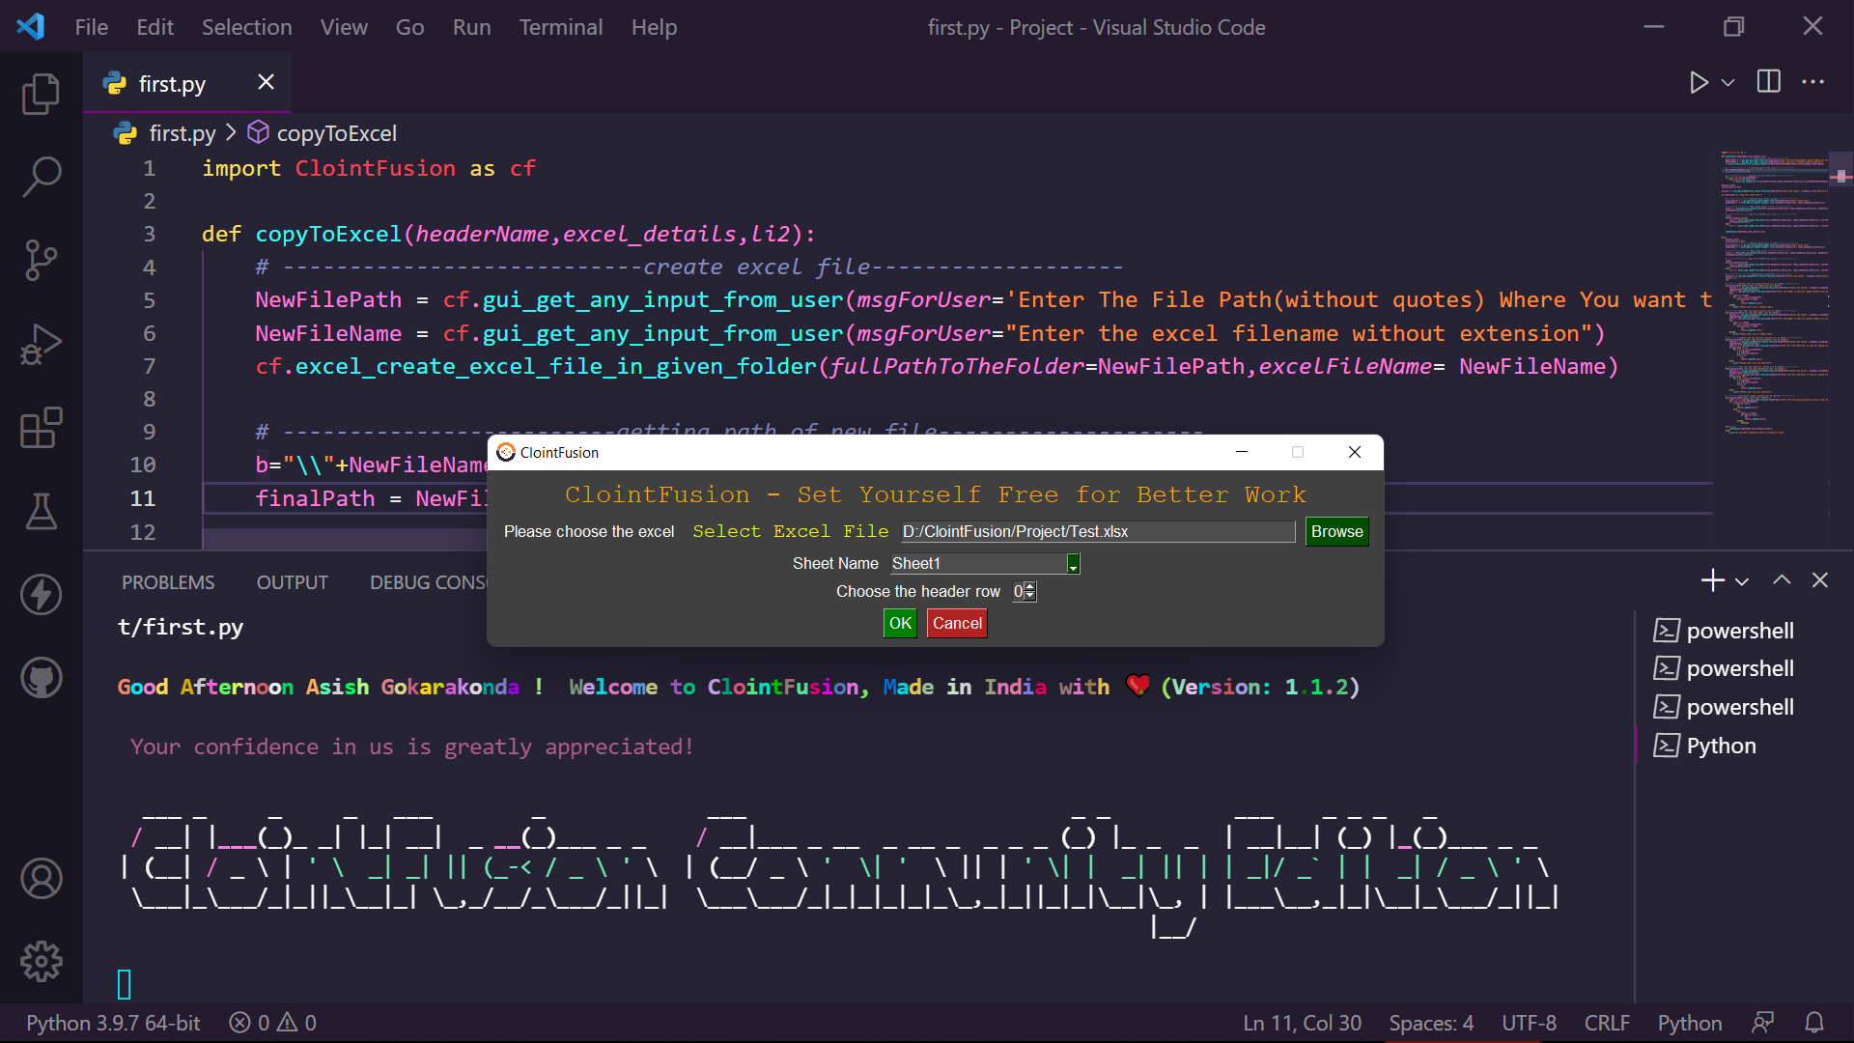
Step-1:
Click the first option “Copy Full Excel File”. This option means, you can copy the full excel file.
After that, you should give the file you want to copy and the sheet name and header row.
You can change header
row if you want.
And the main point here
is, the header row will
be copied even if you
don’t keep header
row=0.

Slide 5
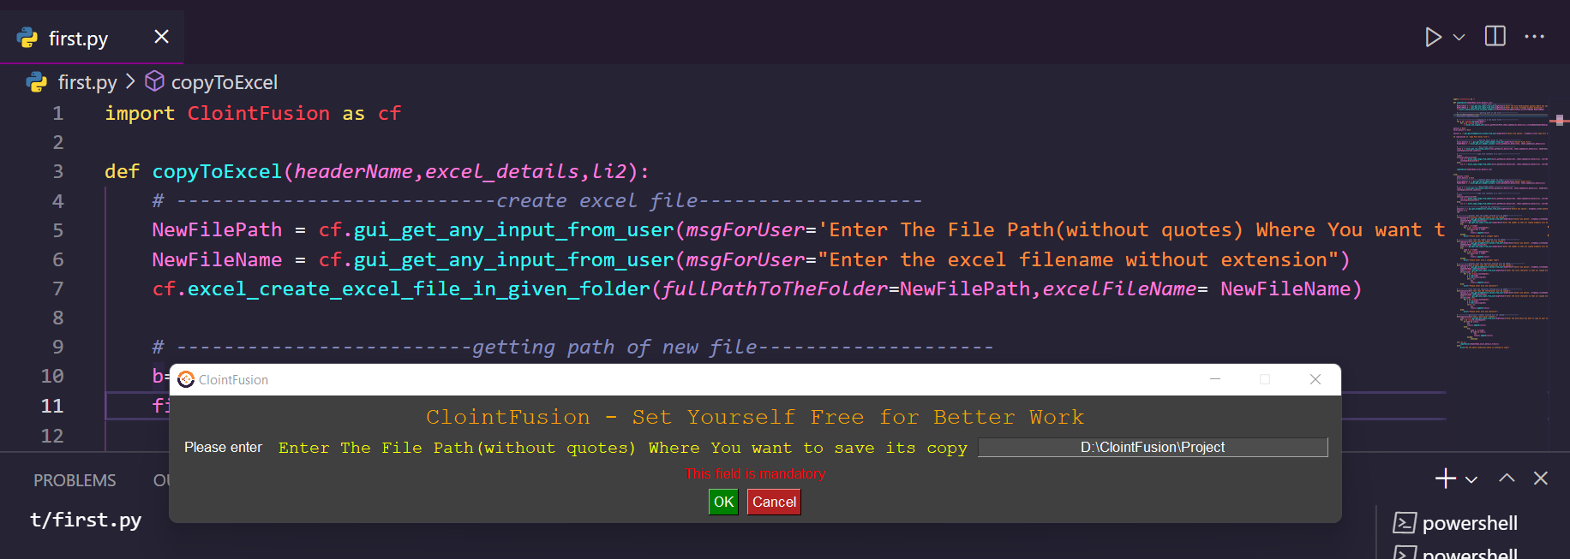
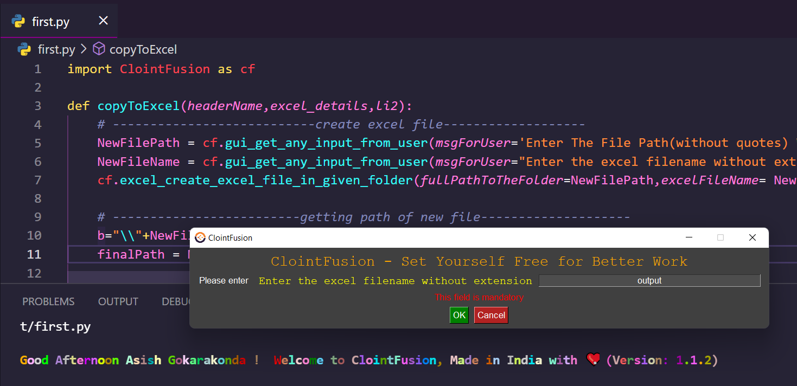
Step-2:
Now you should give the file path(without quotes) where you want to save the copied excel file.
And after that you should give file name without extension (.xlsx will be added by default).

Slide 6
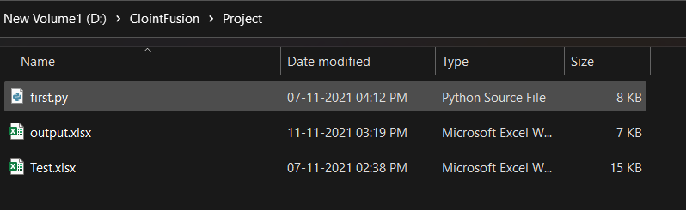
Step-3:
Yeah, it is done!
You just need to go to the file location you have given and search for that file and check !
For the inputs, I have given
in the previous pictures, it
made this output.xlsx file
automatically which is copied
version of Test.xlsx.

Slide 7
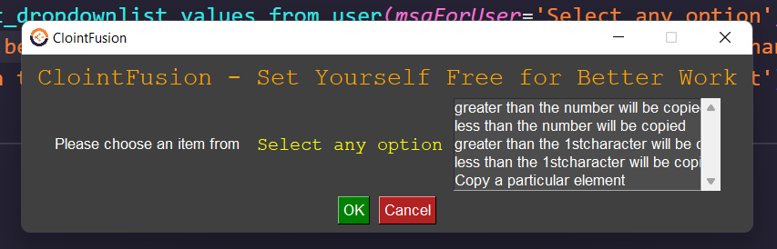
Step-4:
Now, we will click on “Other Operations” instead of “Copy Full Excel file”.
Same Step-1 should be repeated here also because we want an excel file to copy.
Now we will get 5 options. They are:
Greater than the number will be copied
Less than the number will be copied
Greater than the 1st character will be copied
Less the an the 1st character will be copied
Copy a particular element

Slide 8
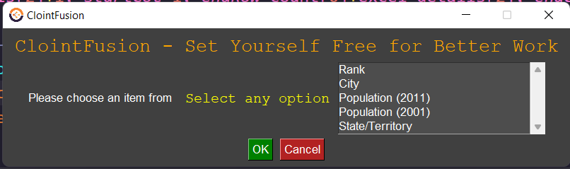
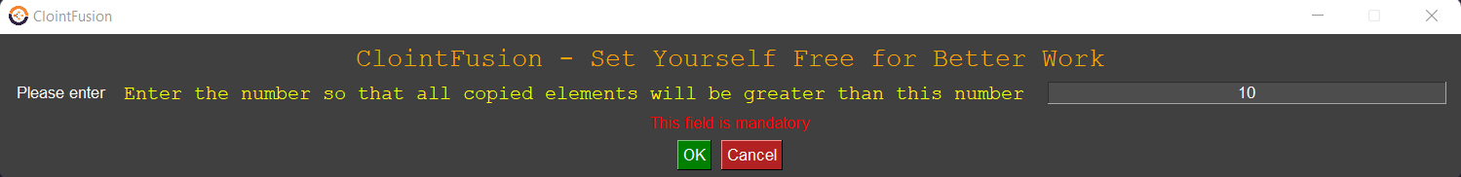
Step-5:
We will select “Greater than the number will be copied”now.
Then you will get all the headers (header row) in the excel you have given in Step-1.
You should select one header file. For example, I will select Rank column.
Then you should give a number.

Slide 9
Step-6:
Here what happens is it will check for the number greater than the number you have given in the column you have given (I gave Rank column, number 10) and copy that whole row to the new excel file.
In the example, the rows corresponding to the numbers greater than 10 in Rank column will be added to new excel file.
And now it will ask for the new excel file location. Repeat Step-2.

Slide 10
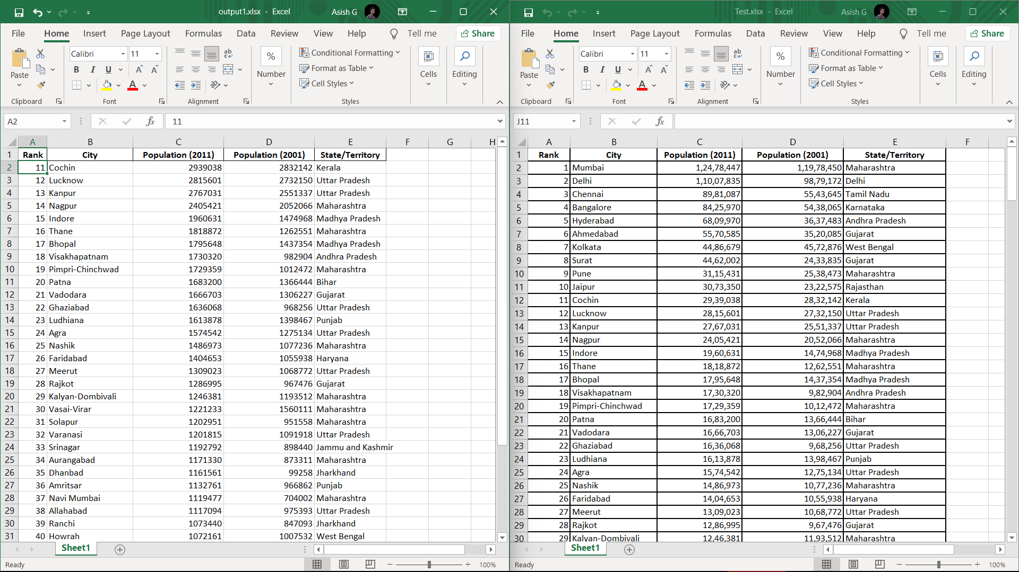
Here if you follow my example, it will be very clear for you.
Only from Rank 11 rows are added.

Slide 11
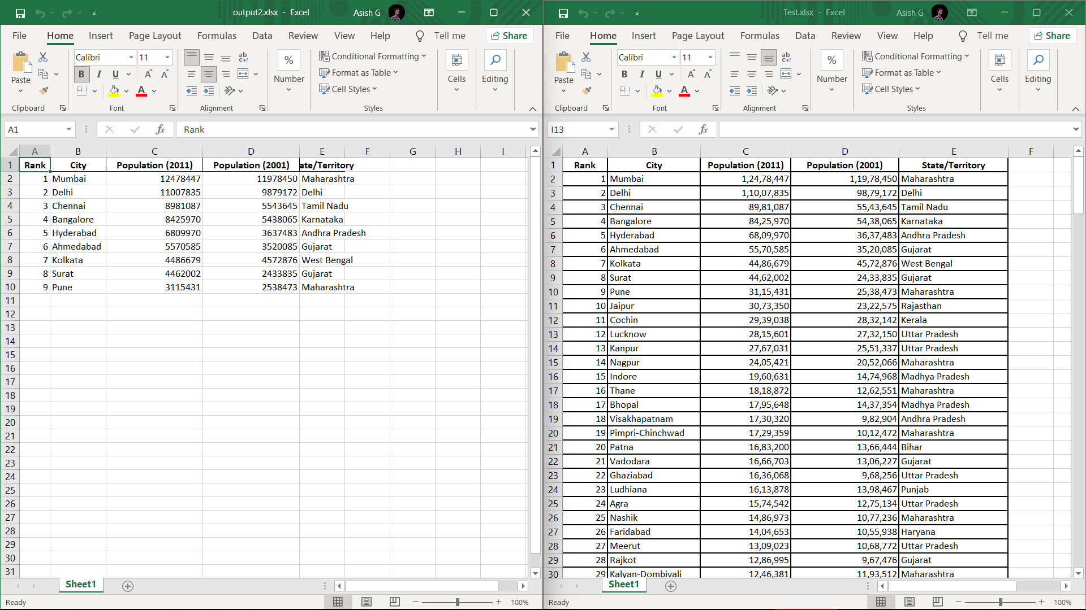
Step-7:
Same like the previous one, in the option “less than the number will be copied” only the numbers less the number you entered in a particular column corresponding rows will be copied. I am taking previous example, but
this time the option I
selected is “less than the
number will be copied”.
Only below 10 are copied

Slide 12
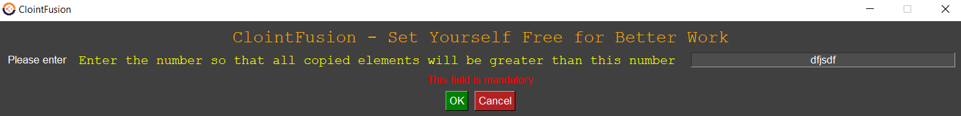
Exception Handling:
If you enter some weird text instead of a number, the program wont be crashed. It will show you a message, “Please enter only a integer type” in terminal. As nothing is copied, it will show “By the above conditions,there is nothing to copy”.

Slide 13
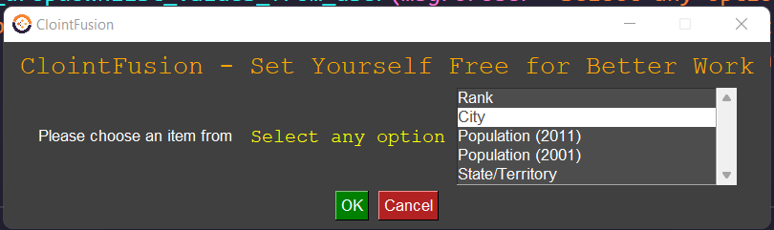
Step-8:
We will select “Greater than the 1stcharacter will be copied” now.
Then you will get all the headers (header row) in the excel you have given in Step-1
You should select one header file. For example, I will select City column.
Then you should give a character.
It is case sensitive. By ASCII code
c>C.

Slide 14
Step-9:
For example, I gave letter M. Then what this function does is, it will check for the 1st character greater than letter M in the given column (I gave City column). And copy the rows of those columns to new excel file.
And now it will ask for the new excel file location. Repeat Step-2.
You will get the file in the path you entered.

Slide 15
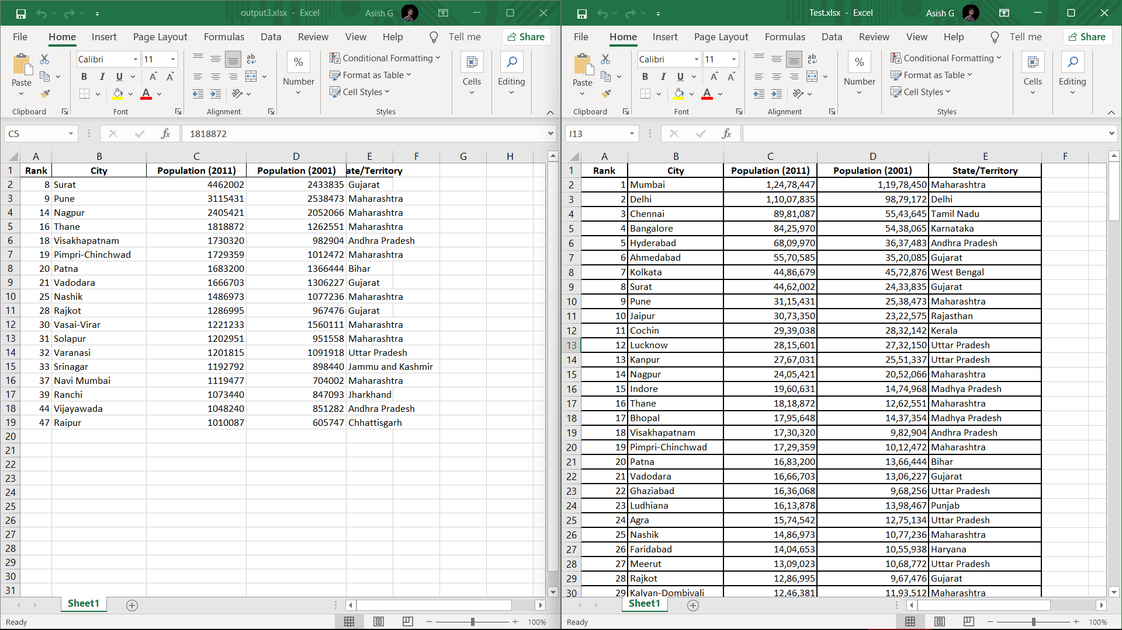
Step-10:
Here if you follow my example, it will be very clear for you.
Here after the letter M, that is N,O,P,Q,R,S,T,U,V,W,X,Y,Z. The rows, in which the word in City column starting with these letters will be copied.
It is case sensitive, that is
c>C. If you enter c, then
then all the letters after c
and all the uppercase
letter words will be copied

Slide 16
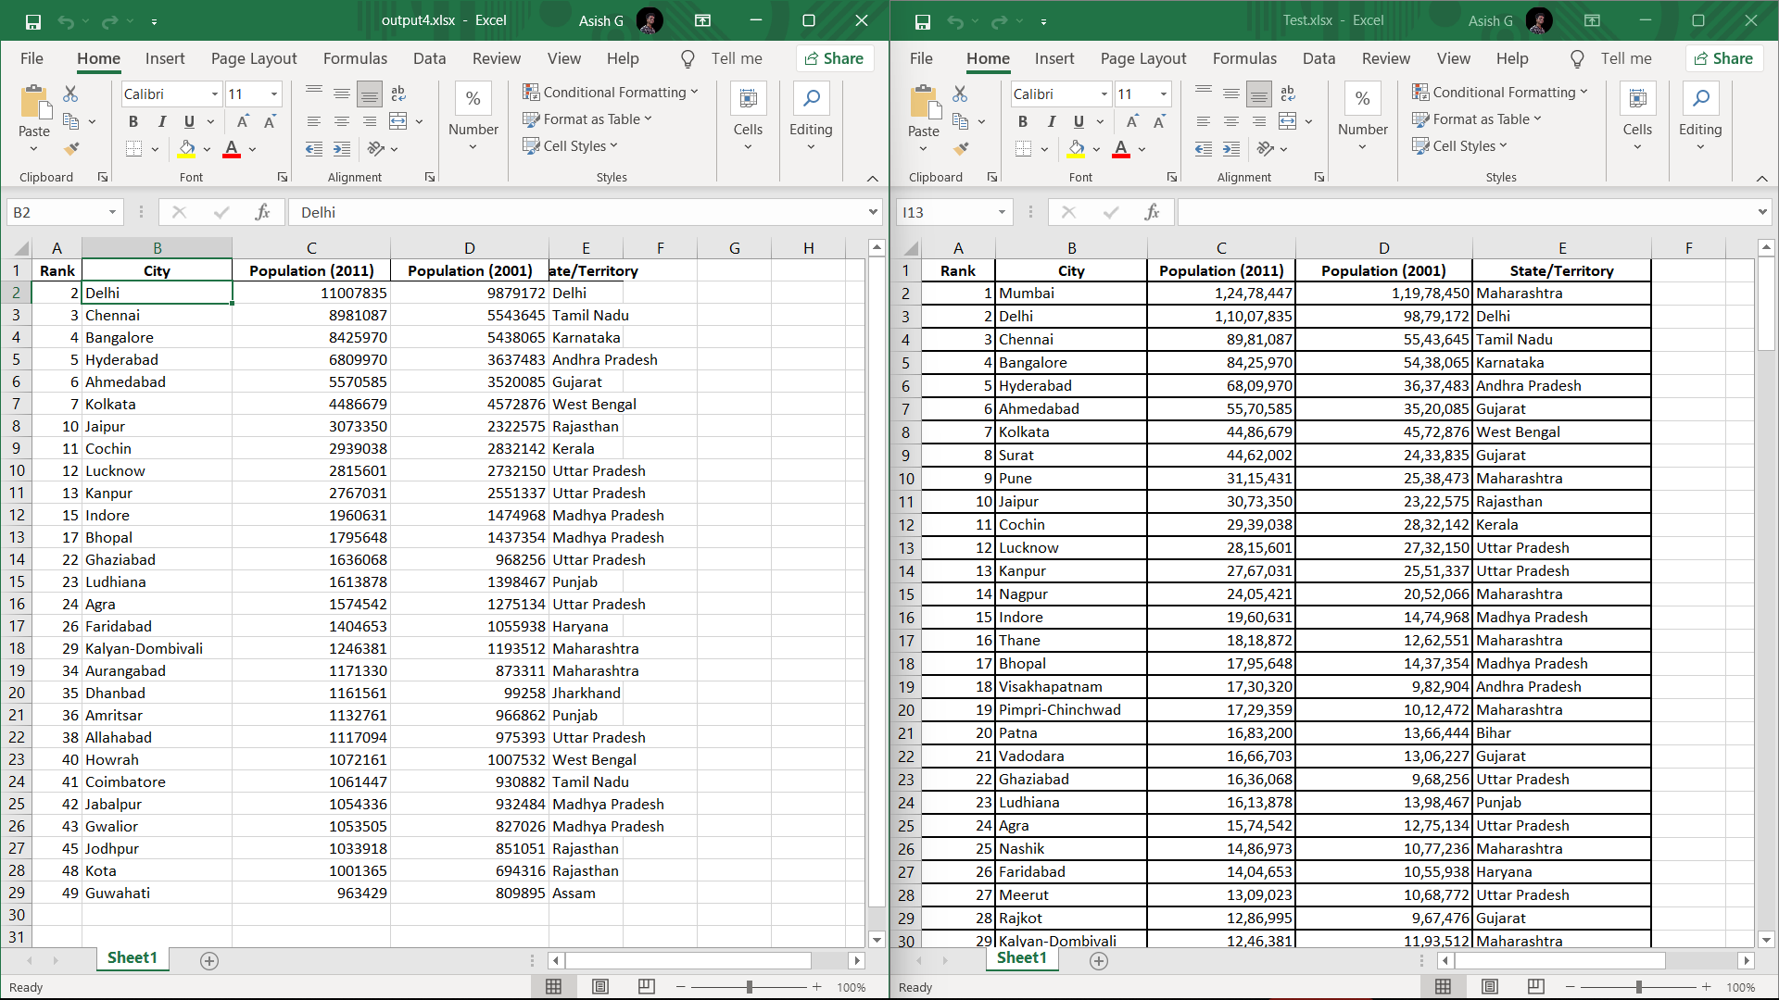
Step-11:
Same like the previous one, in the option “less than the 1st character will be copied”, the starting letter less than the entered letter in a particular column will be copied to the new excel file.
Here Letter M is given as
input.

Slide 17
Exception Handling:
If you enter some weird text instead of a single character, the program wont be crashed. It will show you a message, “Please enter only one character” in terminal. As nothing is copied, it will show “By the above conditions,there is nothing to copy”.

Slide 18
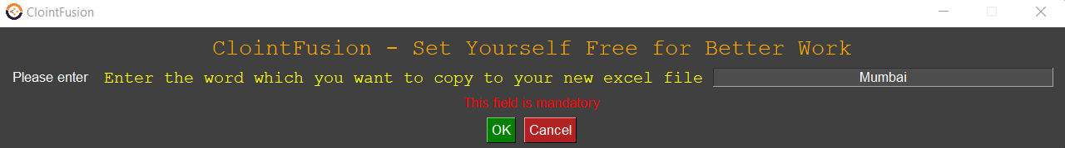
Step-12:
We will select “Copy a particular element” now.
Here you wont get any headers as previous options. It will search the word you have entered in the whole excel file and copy that rows.
For example, Here I have entered Mumbai. So, the rows which contains the word Mumbai will be copied to new excel file.

Slide 19
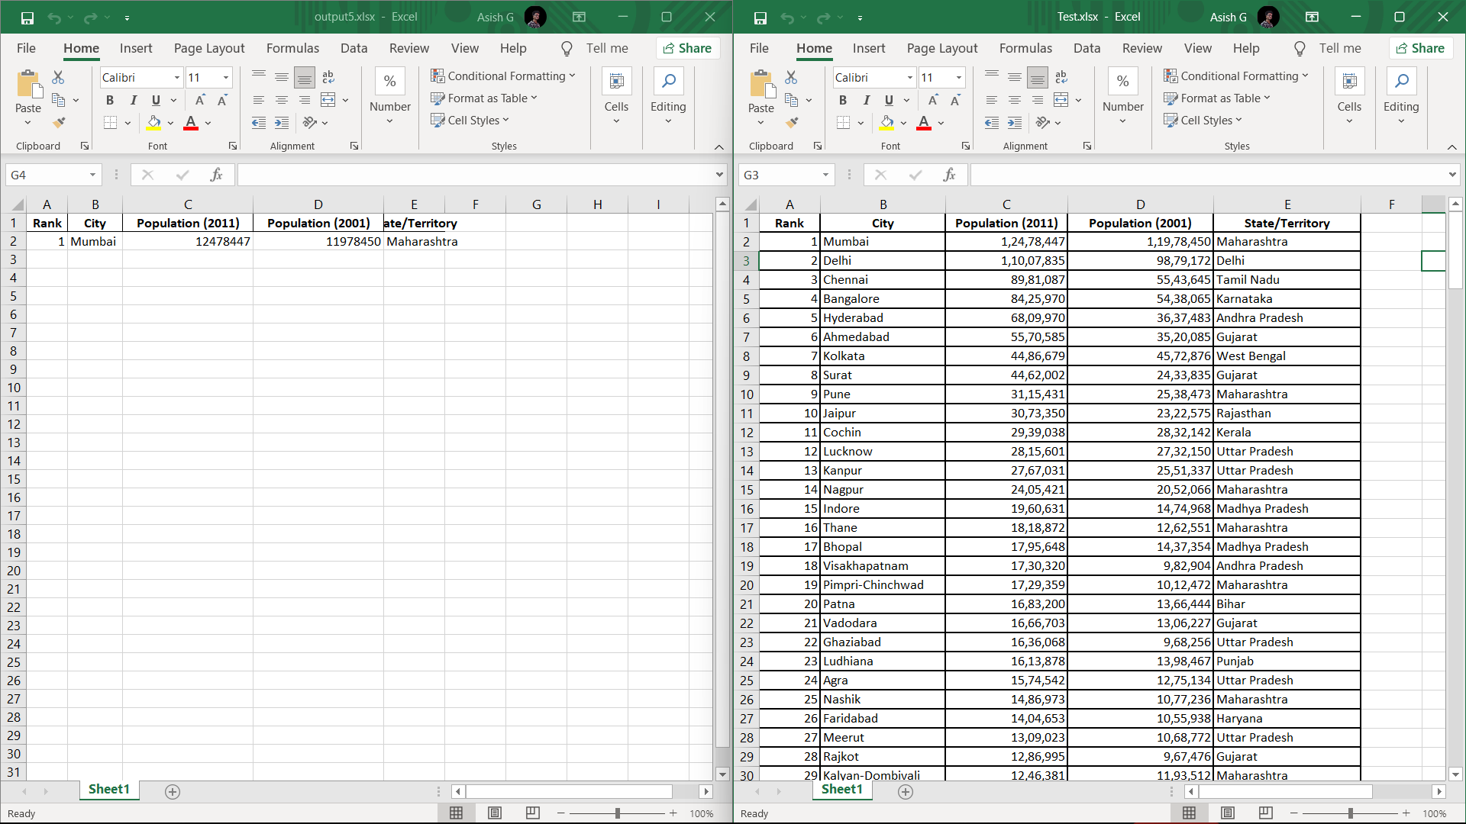
Step-13:
Here I have only one Mumbai word in the whole excel sheet, So only one row added.

Slide 20
Thank you for giving me this opportunity!!

