Slide 1

Face Recognition System Using CNN
Subtitle: A Project Presentation
Team Name: Innovators United
Team Members:
Asit Kumar
Dheeraj Kumar

Slide 2


Introduction
Overview of Face Recognition:
Biometric technology that identifies individuals using facial features.
Key applications:
Security and surveillance
User authentication
Social media
Applications:
Security systems (e.g., airport security, surveillance cameras)
Unlocking devices (e.g., smartphones)
Social media tagging (e.g., Facebook, Instagram)

Slide 3
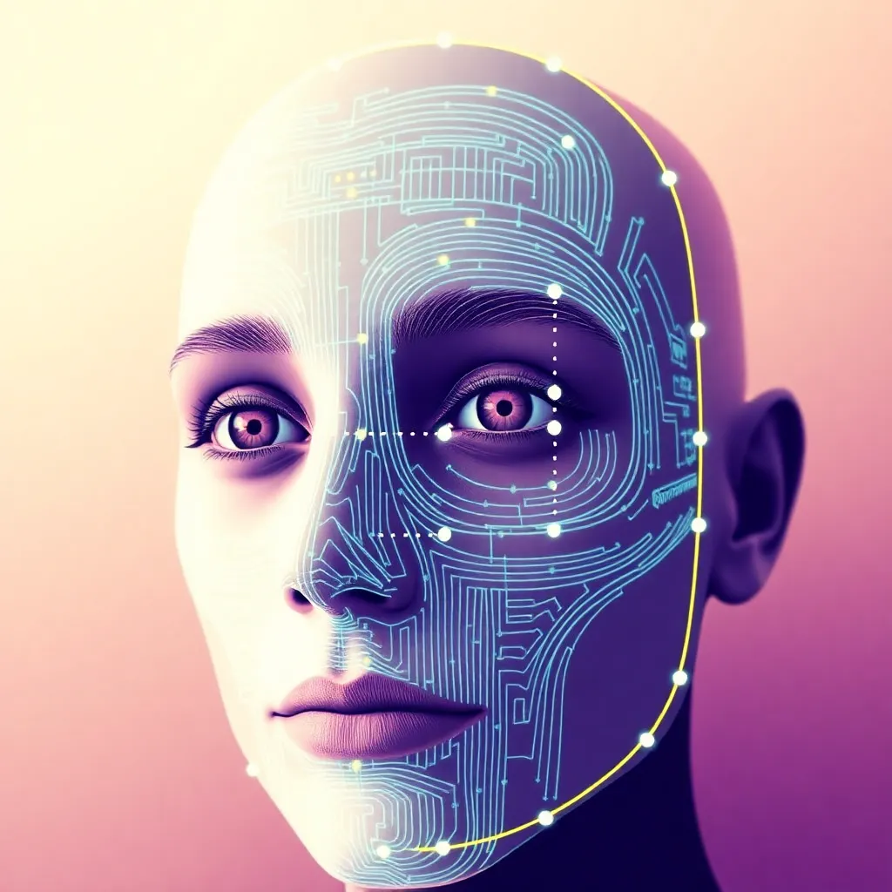
Objective
Main Objectives:
Develop a real-time face recognition system using CNN techniques.
Achieve high accuracy in recognizing faces from a live video feed.
Implement additional features such as age estimation.
Significance:
Enhance user experience in security and social applications.

Slide 4
Technology Stack
Programming Language: Python
Libraries Used:
OpenCV: For image processing and video capturing.
face_recognition: For face detection and encoding.
DeepFace: For additional analysis like age estimation.

Slide 5
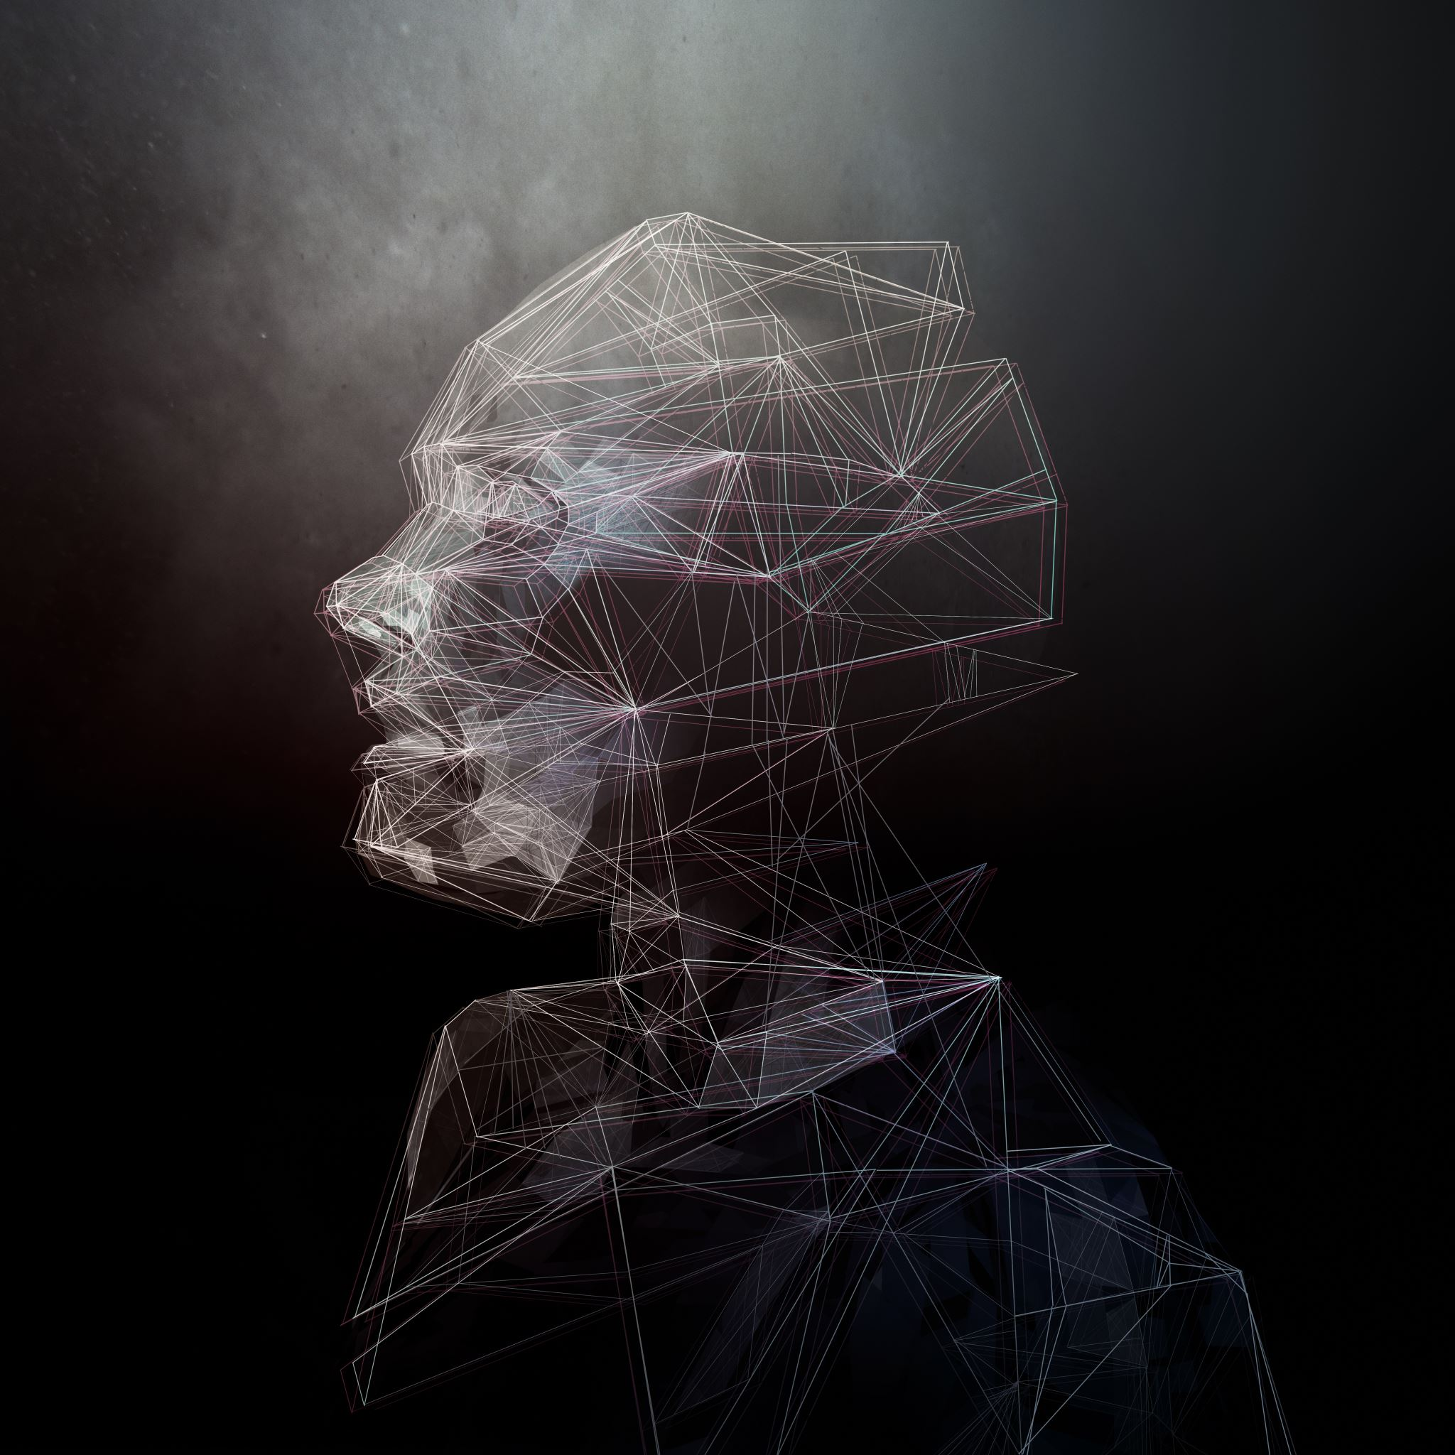
Convolutional Neural Networks (CNN)
Convolutional Neural Networks (CNNs) are a class of deep learning algorithms commonly used in face recognition due to their ability to automatically learn hierarchical features from images

Slide 6
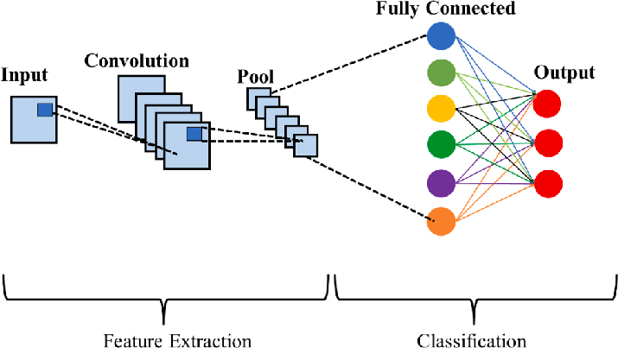
CNN Architecture
Convolutional Layers:-
Detect patterns like edges, textures, or more complex features in higher layers.
Pooling Layers:-
Reduce spatial dimensions of the representation to decrease computation
Fully Connected Layers:-
Flatten the output from previous layers and connect every neuron to every other neuron.

Slide 7

Data Preparation
Loading Images:
Use face_recognition.load_image_file() to load images of known individuals.
Encoding Faces:
Generate face encodings using face_recognition.face_encodings(), which converts images into numerical representations.
Known Faces:
List the known individuals whose faces are encoded (e.g., Asit, Dheeraj, etc.).

Slide 8
Implementation
Key Code Snippets:
Display the main logic of the code, focusing on:
Loading and encoding faces
Capturing video and detecting faces
Recognizing faces and displaying results

Slide 9

Thank You
Thank you for your time and attention today.
I appreciate the opportunity to speak with you about Face Recognition System.
I’m now happy to answer any questions you may have.
If you need any further information, please feel free to reach out to me at
Github:- asitshakya789
LinkedIn:- Asit kumar
Email:- asitshakya789@gmail.com
Contacts:- +91-6398174441
I look forward to hearing from you!

