Slide 1


The Team Deatails
Project : Fee Status Manager
Group - 1
Mentor : Benumadhaba Rath
Team Leader Name : Asit Kumar Raut
Team Member 1: Akash Kumar Swain
Team Member 2 : Aditya Kumar Sahoo
Team Member 3 : Bishwa Prakash Rout

Slide 2
Project Overview
ABSTRACT:
The Core Objective: A secure, automated desktop application designed to streamline student fee collection, tracking, and receipt generation, replacing manual, error-prone paperwork.
Technical Foundation: Developed using Python (Tkinter) for a modern, responsive user interface and MySQL for a secure, relational database backend.
Role-Based Access: Features a secure three-tier login system:
Admin: For system approvals, fee controls, and feedback monitoring.
Counselor: For searching students, entering payments (Online/Offline), and tracking collections.
Student: For viewing fee summaries, checking payment history, and generating receipts.
Key Innovation: Incorporates real-time financial tracking, UTR transaction verification for online payments, and automated ledger balance calculations.

Slide 3


INTRODUCTION & PROBLEM STATEMENT
Manual Challenge:
Calculation Errors
Lack of Transparency & Long Queues
Difficult Revenue Tracking
Data Security & Loss Risks
The Proposed Solution:
Three-Tier Role-Based Access (RBAC)
Automated Fee Logic
Dual-Mode Payment Processing
Real-Time Collection Reports
Digital Receipt & Feedback Management
Technology stack here:

Slide 4
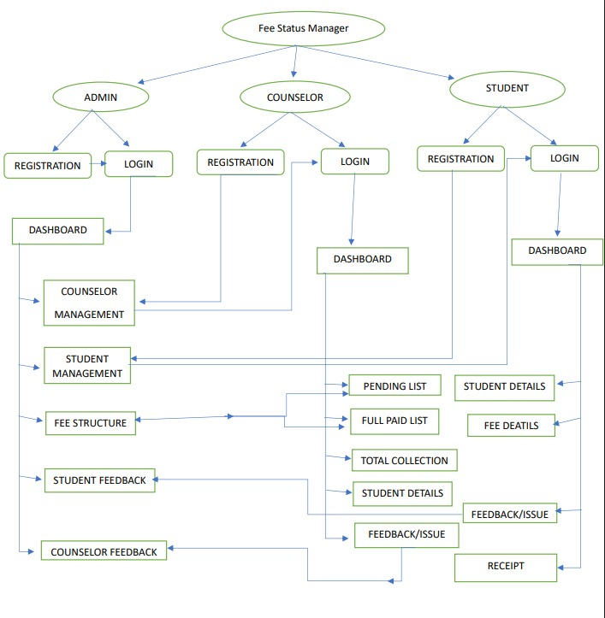
Three-Tier User Architecture (Roles):
Admin (Superuser):
Authorization
Verification
Monitor and control
Review
Rewrite
2. Counselor (Operator):
Record maintenance
Payment maintenance
Filters and views
3. Student (End-User):
Monitors real-time fee summary
Views and exports payment history & receipt logs.
Submits feedback/grievances to the admin.

Slide 5


