Slide 1
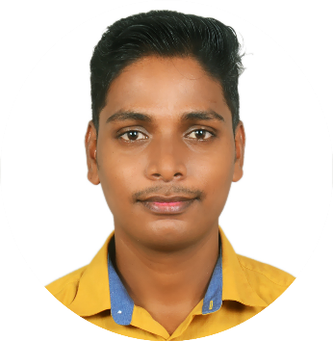




Asit Kumar Das
Education and certificates
Synergy Institute of Technology, Bhubaneswar
Computer Science Engineering
2017-2021
Analyst/Software Engineer
Base Location: Mumbai
Skills
Email ID: asit-kumar.das@capgemini.com
Java | Java Basics, OOPS, Generics, Collections, Arrays.
Framework | Spring Core, Spring Boot, Spring Data JPA, Spring Data REST.
Spring REST | REST Controller, Implementation of GET, POST, PUT, and DELETE. Controller and Repository layer
Database | PostgreSQL, MongoDB
Tools | Git, Eclipse, Spring Tool Suite, Intellij IDEA, Postman, Visual Studio Code, PgAdmin 4.
UI Tech | HTML 5, CSS 3, Bootstrap JavaScript, React
React | Components, Hooks, Event Handling, Redux, Reducer.
Mobile No: +91 6370455565
Grade: A4
Strengths
Achievement
Full Stack Developer trained on Java Hands on experience on
Shopping Cart
Case study at Shopping Cart System using Microservice along with Swagger, Junit, JWT. Responsive UI using HTML5, CSS3, Bootstrap, and React.
Git and GitHub.
Proficient in creating Single Page Web application in React.
Hands on experience in developing webpages using HTML 5, CSS 3, Bootstrap, JavaScript.
Currently improving skills on Itranform-platform.
Ready to learn new technologies and implement them for the future knowledge improvement.
Cricket Management System
Cricket Management System is develop to automate all the activities of adding coaches, adding managers through an application. Here, we can create a system where we can manage all the information in a single place.
Note Making System
This application is built to help customer to keep their note updated. User can save and delete the note. It is easy to use.
.

