Slide 2
Football: Player Recognition and Analysis
Submitted to:
Department of Computer Science and Engineering

Slide 3
Supervised by: Prof.Preeti Shukla
Team Members
1.Asit Joshi(0827CS201045)
2.Ayush Choudhary(0827CS201052)
3.Deepakshi Choudhary(0827CS201064)
4.Deependra Singh Parihar(0827CS201065)

Slide 4
Project Presentation Outline
Abstract
Introduction
Problem Statement
Survey of Existing Systems
Project Objectives
Requirement Analysis
Solution Proposed
The Outcome Discussion
Conclusions and Limitations

Slide 5

Abstract
To increase the interest of people so that people get to know more about football and the game can get its actual value as it has in other parts of world.
Player recognition technology which will classify the player on the basis of a photograph or name and provide all the details and statistics about that player.
In addition the user can find out the all the leagues and clubs present currently.

Slide 6
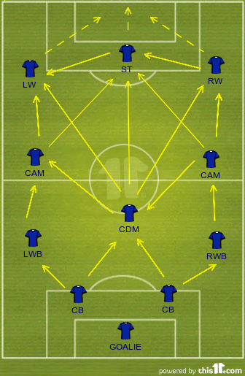
Introduction
The main idea behind this project is to make people aware about football and its various aspects.
With the rapid development of computer vision technology, detection of players is more and more popular in identifying characteristics of athletes and its existence helps in gaining the knowledge in the field of football.
The key steps are player recognition and providing the detailed information of player as well as the game football on which our predictions are based on.

Slide 7
The Problem Statement
In our country football is getting popular but most of the people didn't properly understand the game so it is hard for them to connect with the game.
For example people doesn't know about different leagues and the clubs that play on these leagues so it is difficult to keep track of things.
They are not fully aware of rules and regulations of the game and most of the times just know about one or two clubs and very limited no. of players.
As a result of these they are not aware of the full potential, passion and joy of this game.

Slide 8





Survey of Existing Systems
OneFootball
Gives live and latest scores, news and statistics of various leagues.
Quick access, has lots of content, great layout and easy to navigate.
Some of the apps are available on the play store.

Slide 9

Survey of Existing Systems
Limited to some clubs and leagues only.
Shows lots of advertisements.
Do not include rules and basic knowledge of football.
Do not cover small leagues and focuses on main players and their activity.

Slide 10
Objectives
Promoting the football sport related activities and will give the information about all the leagues and clubs present in football.
To develop a model by which user can identify the player and its statistics based on the past data.
A system capable of providing strategic indications to coaches with the techniques of Machine learning.
Easiest platform for all football fans through which user can search and identify the player, find out the best ones and all the rules and positions present in football.

Slide 11



Requirement Analysis
FUNCTIONAL REQUIREMENTS -
Computational Power
Upload and Download Permission
Dataset Testing and Model Training
Operating System windows 10 or above.
PyCharm and Jupyter Notebook
NON FUNCTIONAL REQUIREMENTS -
Website should load quickly
The information provided must be up to date
Website should be portable
Consistency should be maintained
Reliability of information.

Slide 12
Technologies Required
HTML/CSS
JavaScript/Bootstrap
Flask – for server and backend development
MySQL – for database preparation
Python
NumPy/Pandas/Matplotlib
Tableau – for analysis part of project
Open CV – for model preparation
scikit-learn – for model training and classification
Haar Cascade Classifier – to image detection

Slide 13
Solution Proposed
The proposed system intend to provide everything about the sport football in a well-informative way through a web application.
Our website will be covering current leagues, clubs, players, identification, statistics, rules etc.
Through the search bar, the user can search a player and from the dataset which we have made by taking the reference from Kaggle, the user will get the information of the player and its statistics based on the past data.
Identification of the player by the photograph is done by open CV and Haar Cascade Classifier and user will get detailed information about it.

Slide 14
The Outcome Discussion
Gives accurate information of the player by identifying him through a photograph.
Gives information about various leagues and clubs present currently.
Provides statistics in different forms.
Easiest platform for searching the player.
Gives knowledge about football in brief like rules, formations, positions etc.

Slide 15
Conclusion and Limitation
Limitations: The acquired results during experiments are limited to some extent and may much vary depending on the experiment settings. One of its major demerits is it does not provide real time score of ongoing matches.
Conclusion: Our results shows that the model can perform well on the dataset obtained from Kaggle, indicating the wide applications of this algorithm. Detection is just the beginning. Now we can really take it to the next level!

Slide 16
THANKS

