Slide 1


Retail Sales Forecasting using EDA and Time Series in Python
Team:-
Dev Anand -25070123039
Asit Srivastav-25070123026
Rohan kumbhar-25070123141
Dolly Dalal-25070123044
Year:2025-29
Course: B.Tech Electronics & Telecommunication Engineering
MINI PROJECT PRESENTATION
Institute: Symbiosis Institute of Technology, Pune

Slide 2

Introduction
Retail sales analysis is the systematic examination of transactional data to uncover patterns, trends, and insights that drive smarter business decisions. In today's competitive market, data-driven strategies are no longer optional — they are essential for survival and growth.
What is Retail Sales Analysis?
The process of collecting, processing, and interpreting sales data to understand customer behavior, product performance, and market dynamics over time.
Why Python & EDA?
Python offers powerful libraries for data manipulation and visualization. Exploratory Data Analysis (EDA) helps uncover hidden patterns before building predictive models.

Slide 3
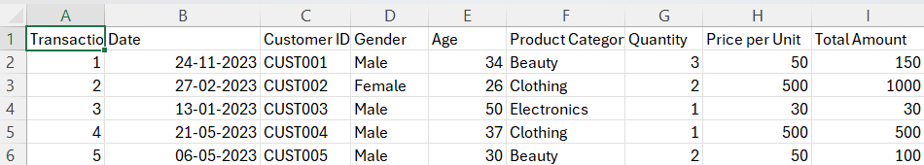
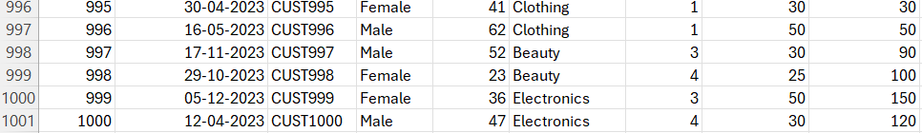
Background & Project Objectives
Dataset Overview
Project Objectives
The project uses a retail transaction dataset containing approximately 1,000 entries. Each record captures customer demographics, product categories, sales amounts, quantities, and transaction dates — providing a rich foundation for analysis.
1
Analyze Sales Performance
Understand which categories and segments drive the most revenue.
Customer demographics (age, gender)
Product categories and pricing
Sales amounts and quantities
Transaction dates for time-series analysis
2
Understand Customer Behavior
Segment customers by demographics and purchasing patterns.
3
Identify Trends Over Time
Use time series analysis to detect seasonal and cyclical patterns.
4
Predict Future Sales
Build a forecasting model to estimate upcoming sales figures.

Slide 4





Tools & Technologies Used
This project uses Python's rich ecosystem of data science libraries, each serving a distinct role in the analytical pipeline — from data ingestion to model deployment.
Python
Core programming language for all data processing, analysis, and modeling tasks.
Pandas & NumPy
Data manipulation, transformation, and numerical computation at scale.
Matplotlib & Seaborn
Statistical visualization for histograms, boxplots, line charts, and heatmaps.
Scikit-learn
Machine learning framework used for building the Linear Regression forecasting model.

Slide 5

Data Preprocessing & Feature Engineering
Data Preprocessing Steps
Feature Engineering
Before any analysis, raw data must be cleaned and standardized to ensure accuracy and consistency throughout the pipeline.
New derived features were created to enrich the dataset and enable deeper analytical insights.
Handling Missing Values
Temporal Features
Age Groups
Identified and imputed or removed null entries across key columns to prevent skewing results.
Customer ages were binned into categorical groups (e.g., 18–25, 26–35) for demographic segmentation.
Extracted Month, Day, and Year from the Date column to support monthly and seasonal trend analysis.
Removing Duplicates
Duplicate transaction records were detected and eliminated to maintain data integrity.
Datetime Conversion
Price per Item
The Date column was converted to proper datetime format to enable time-based operations and indexing.
Computed as Sales ÷ Quantity to analyze unit pricing trends across product categories.

Slide 6
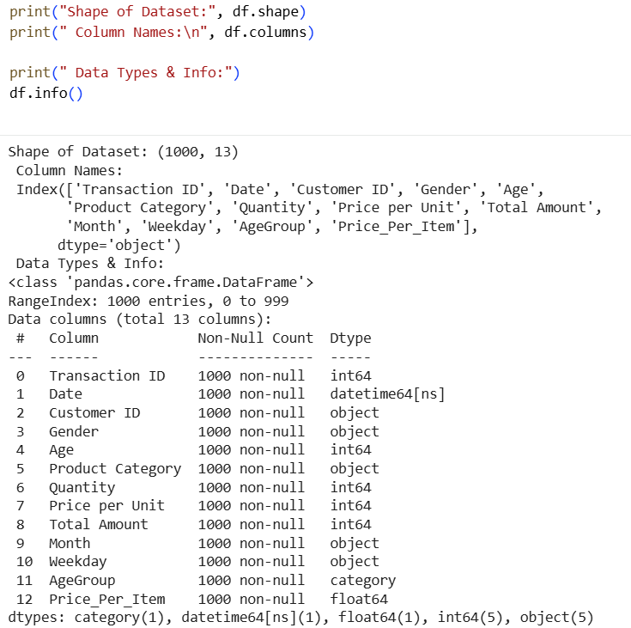
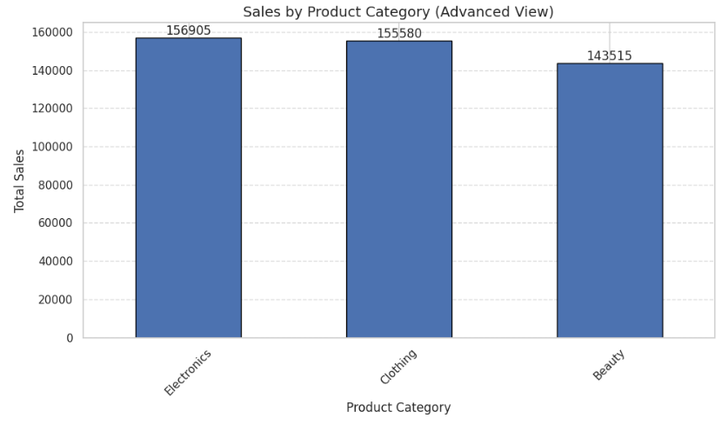
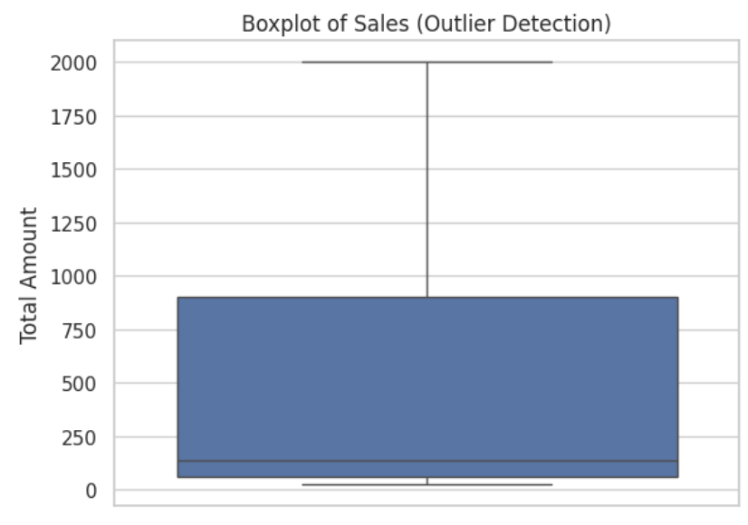
Exploratory Data Analysis (EDA)
EDA is the critical first step in understanding the structure, quality, and distribution of data before drawing conclusions or building models.
Distribution of Sales
Outlier Detection
A histogram of sales values reveals the distribution pattern — typically right-skewed in retail data, with most transactions clustered at lower values and a few high-value outliers.
Boxplots were used to identify statistical outliers in sales and total amount columns. Outliers were investigated to determine if they represented genuine high-value transactions or data errors.
Dataset Summary
Using info() and describe(), we examined data types, non-null counts, and statistical summaries (mean, std, min, max) to assess overall data quality.

Slide 7
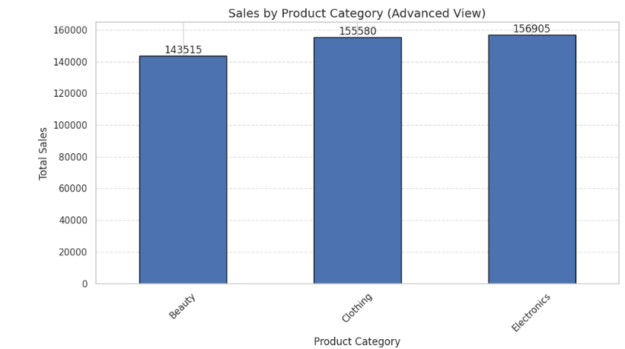
Category Sales - Bar Chart)

Slide 8
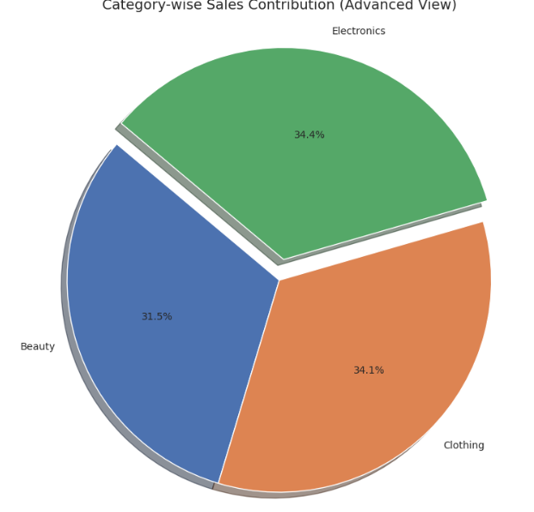
Category Contribution (Pie Chart)

Slide 9
Time Series Analysis & Moving Average
Daily Sales & Quantity Trends
Moving Average Smoothing
Plotting daily sales and quantity over time reveals inherent patterns — including weekly cycles, random fluctuations, and potential seasonal effects. Raw daily data is often noisy, making underlying trends difficult to discern visually.
A 7-day rolling moving average was applied to smooth out short-term noise and highlight the underlying trend in daily sales data.
Reduces day-to-day volatility
Reveals clearer directional trends
Helps identify gradual increases or declines
Foundation for more advanced forecasting
Daily Sales Trend
Shows revenue fluctuation day-by-day, highlighting peak and low-performing days.
Smoothing transforms a jagged, hard-to-interpret series into a clean, readable trend line — essential for both analysis and stakeholder communication.
Daily Quantity Trend
Tracks units sold per day, useful for inventory and demand planning.

Slide 10
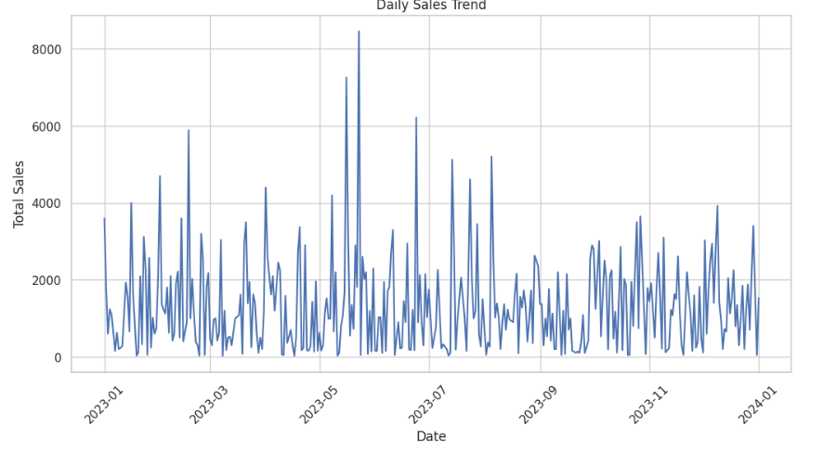
Daily Sales Trend Over Time

Slide 11
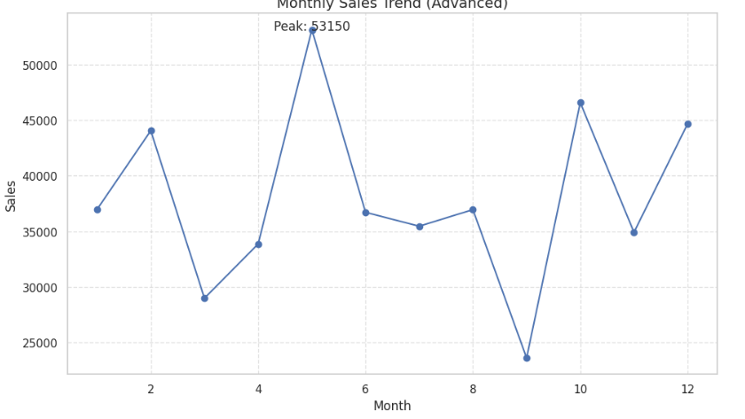
Monthly Sales Trend (Time Series)

Slide 12
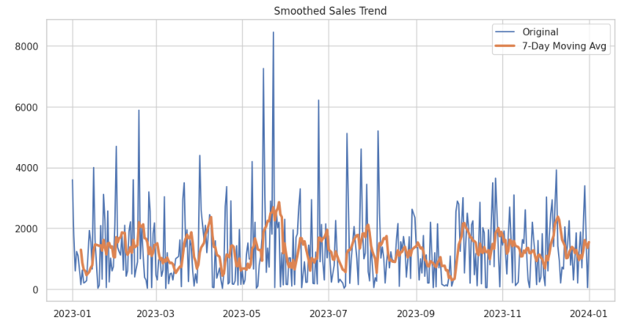
Smoothed Trend (Moving Average)

Slide 13
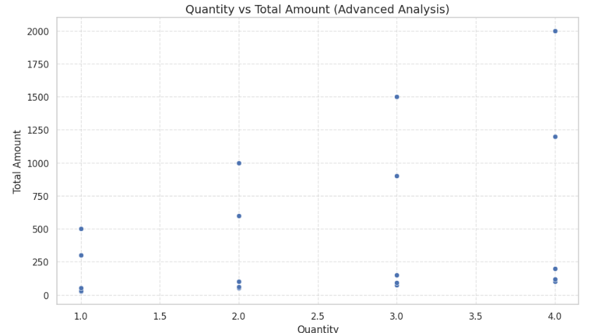
Quantity vs Sales (Scatter Plot)

Slide 14
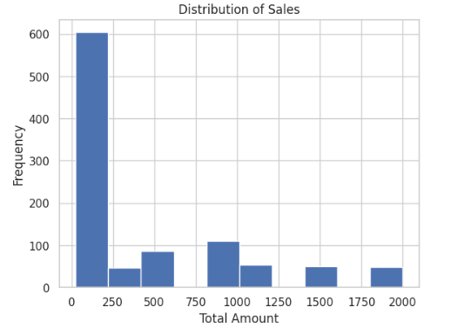
Distribution of Total Sales Amount

Slide 15
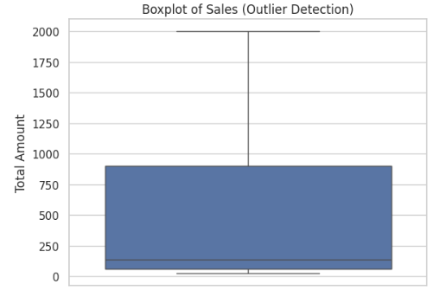
Outlier Detection in Sales Data

Slide 16
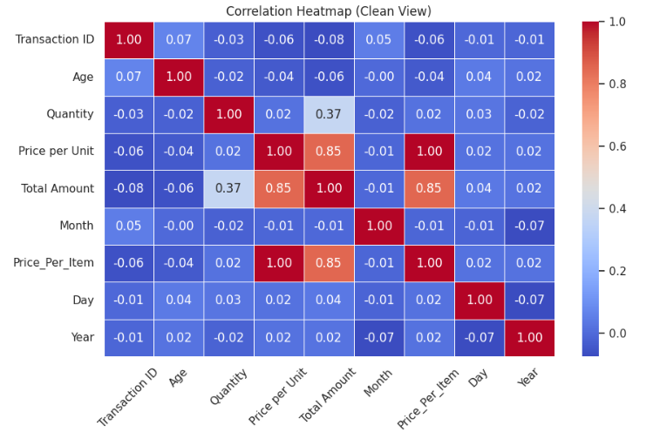
Correlation Between Numerical Features

Slide 17


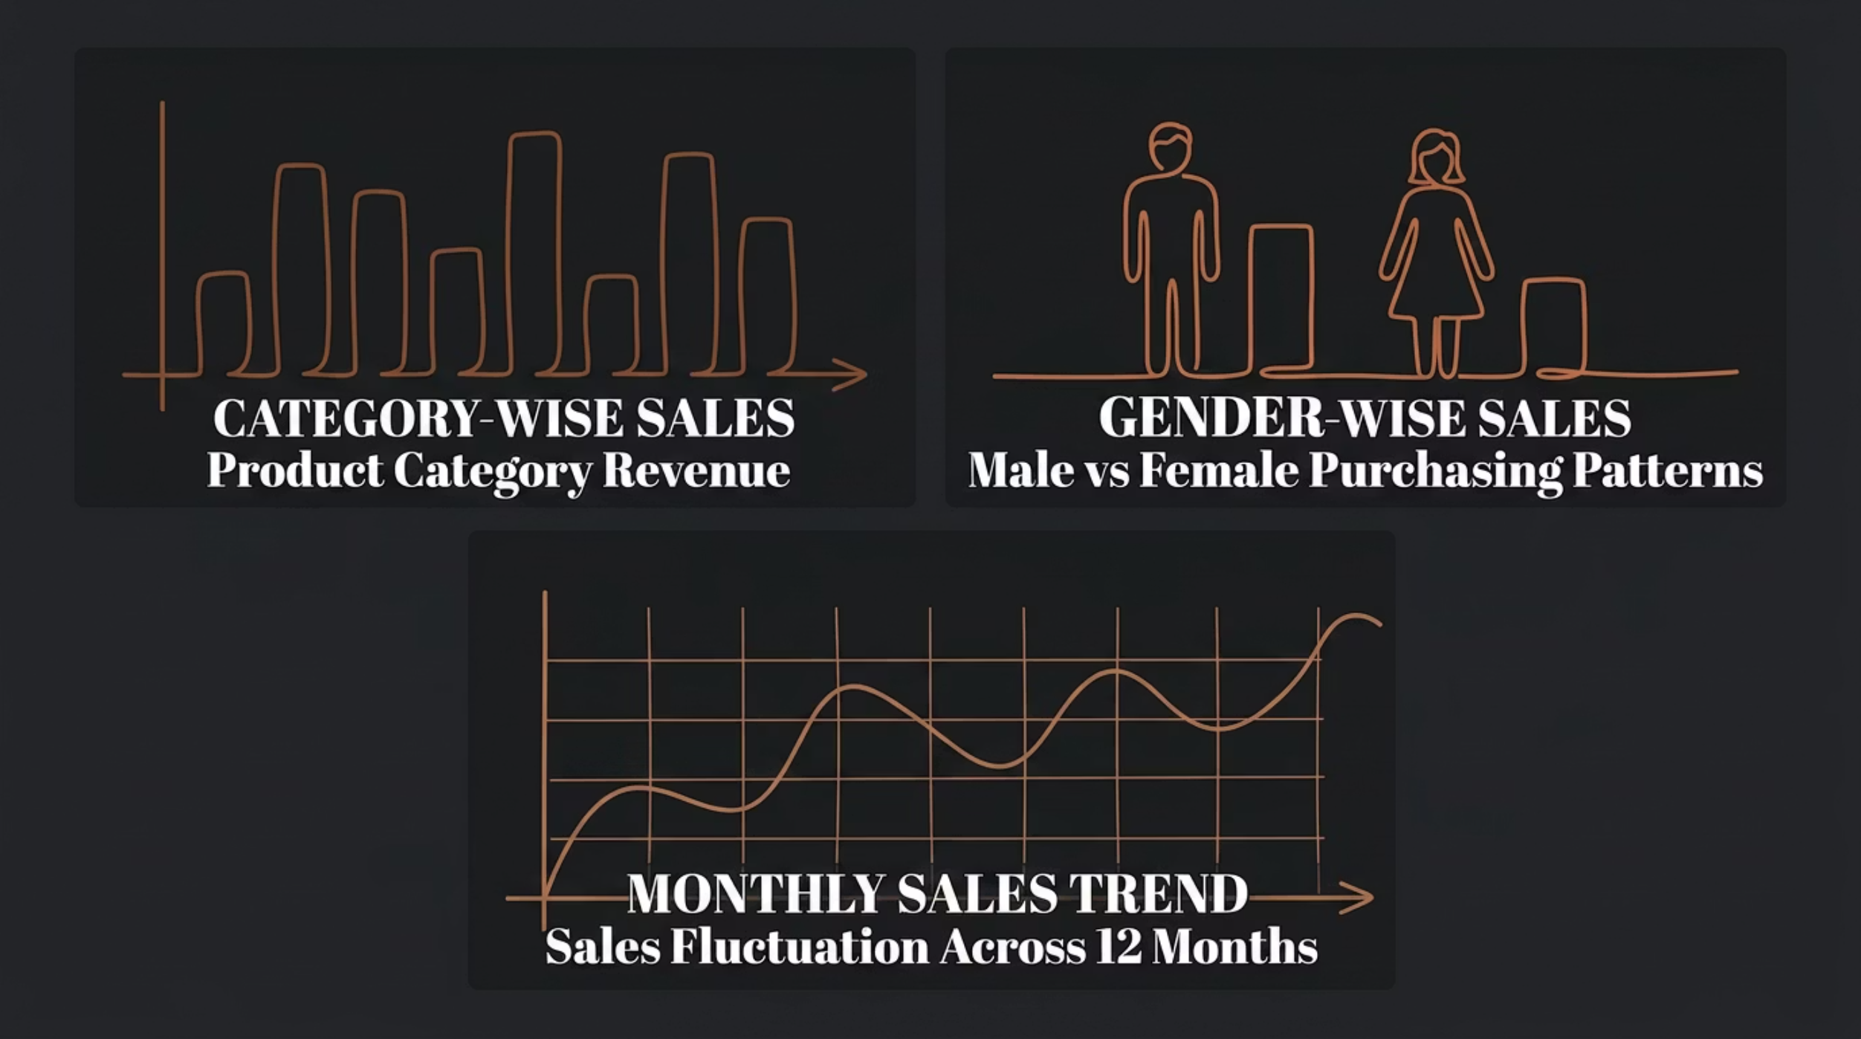

Sales Analysis — Visual Insights
Visual analysis of sales data across categories, demographics, and time reveals actionable patterns that inform business strategy and forecasting.
Category-Wise Sales
Gender-Wise & Monthly Trends
Bar charts highlight which product categories contribute most to total revenue, enabling inventory and marketing prioritization.
Gender-based segmentation reveals purchasing preferences, while monthly line charts expose seasonality and growth trajectories across the year.
Top-performing categories typically include Electronics, Clothing, and Home Goods in retail datasets.
Monthly trends often show peaks during festive seasons and dips in off-peak months.

Slide 18
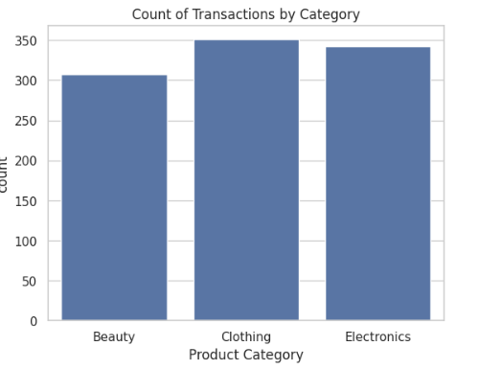
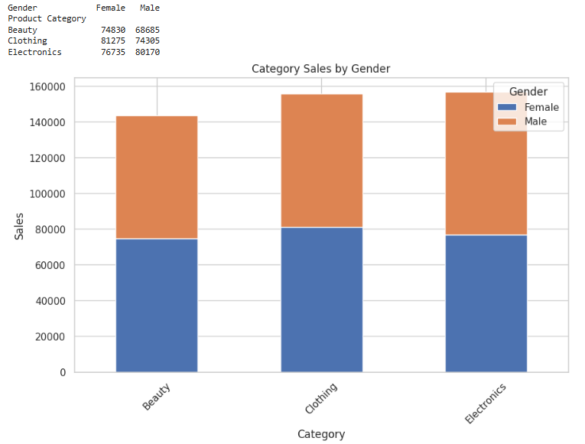

Slide 19
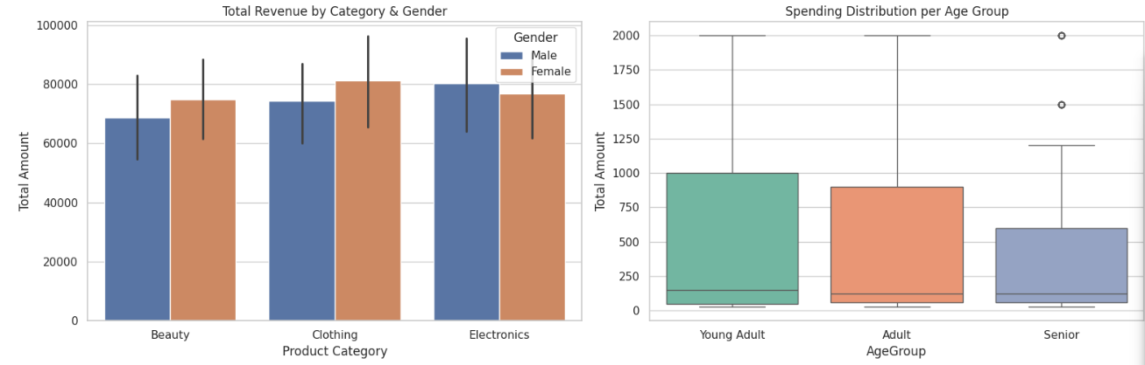

Slide 20
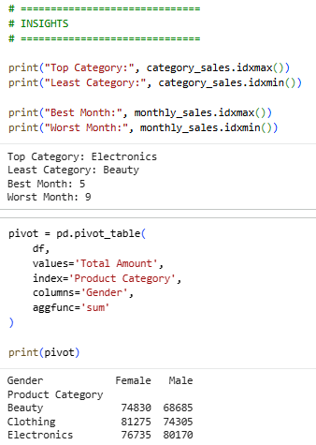
Insights:
We wrote the code and got some final conclusions about the top category ,Least category.
The Total amount sold of different categories decided by gender Male and Female.

Slide 21
Key Insights, Conclusion & Future Scope
Key Insights
Top-Selling Category
One product category consistently dominated revenue, signaling strong market demand.
Sales Patterns
Clear monthly seasonality and weekly fluctuations were observed across the time series.
Customer Behavior
Demographic segmentation revealed distinct purchasing preferences by age group and gender.

Slide 22
Conclusion
This project demonstrated that EDA uncovers hidden data patterns, time series analysis reveals temporal trends, and forecasting enables proactive business planning. Together, they form a complete analytical framework for data-driven retail decision-making.
Future Scope
Implement ARIMA/SARIMA models for more accurate seasonal forecasting
Build real-time prediction pipelines integrated with live sales data
Integrate with business intelligence dashboards for operational use
Explore ensemble models (Random Forest, XGBoost) for improved accuracy

