Slide 1
Data-Driven Quality Improvement in Beverage Manufacturing A Lean Six Sigma Approach Using Control Charts and Root Cause Analysis

Slide 2
Introduction to the Process & Problem Context

Slide 3
The production runs across two shifts daily (Morning and Evening), managed by a team of four trained operators using three different machines (PX1, PX2, PX3).
It produces three product lines Aloe Juice, Energy Drink, and Protein Shake using automated filling and packaging machines
The company operates in the fast-moving consumer goods (FMCG) sector, specifically in non-carbonated beverage production
Each unit must meet a strict net weight specification of 500g ±5g, which ensures compliance with quality standards and customer expectations.

Slide 4
The company operates in the fast-moving consumer goods (FMCG) sector, specifically in non-carbonated beverage production
Each unit must meet a strict net weight specification of 500g ±5g, which ensures compliance with quality standards and customer expectations.
It produces three product lines Aloe Juice, Energy Drink, and Protein Shake using automated filling and packaging machines
The production runs across two shifts daily (Morning and Evening), managed by a team of four trained operators using three different machines (PX1, PX2, PX3).

Slide 5
The company operates in the fast-moving consumer goods (FMCG) sector, specifically in non-carbonated beverage production
It produces three product lines Aloe Juice, Energy Drink, and Protein Shake using automated filling and packaging machines
Each unit must meet a strict net weight specification of 500g ±5g, which ensures compliance with quality standards and customer expectations.
The production runs across two shifts daily (Morning and Evening), managed by a team of four trained operators using three different machines (PX1, PX2, PX3).

Slide 6
The company operates in the fast-moving consumer goods (FMCG) sector, specifically in non-carbonated beverage production
It produces three product lines Aloe Juice, Energy Drink, and Protein Shake using automated filling and packaging machines
The production runs across two shifts daily (Morning and Evening), managed by a team of four trained operators using three different machines (PX1, PX2, PX3)
Each unit must meet a strict net weight specification of 500g ±5g, which ensures compliance with quality standards and customer expectations.

Slide 7
Problem Context
Recent data shows a significant increase in defects,
especially in the Energy Drink and Protein Shake lines.

Slide 8
Problem Context
Recent data shows a significant increase in defects,
especially in the Energy Drink and Protein Shake lines.
Main defect types identified Underfilled bottles (less than 495g)

Slide 9
Six Sigma & Lean Six Sigma
Approach

Slide 10

What is Six Sigma?
A quality management method

Slide 11
What is Six Sigma?
A quality management method
Focused on process improvement

Slide 12
What is Six Sigma?
A quality management method
Focused on process improvement
Uses data and statistics to reduce errors

Slide 13
What is Six Sigma?
A quality management method
Focused on process improvement
Uses data and statistics to reduce errors
Metrics :- DPMO, Sigma Level, Higher Sigma

Slide 14
Objective of Six Sigma
Reduce defects in processes

Slide 15
Objective of Six Sigma
Reduce defects in processes
Minimize variation

Slide 16
Objective of Six Sigma
Reduce defects in processes
Minimize variation
Improve consistency and quality

Slide 17
What is Lean Six Sigma?
Combines Lean (removing waste) + Six Sigma (controlling variation)

Slide 18
What is Lean Six Sigma?
Combines Lean (removing waste) + Six Sigma (controlling variation)
Focuses on efficiency + quality

Slide 19
Key Benefits of Lean Six Sigma
Faster processes with fewer delays

Slide 20
Key Benefits of Lean Six Sigma
Faster processes with fewer delays
Higher product or service quality

Slide 21
Key Benefits of Lean Six Sigma
Faster processes with fewer delays
Higher product or service quality
Better customer satisfaction

Slide 22
Key Benefits of Lean Six Sigma
Faster processes with fewer delays
Higher product or service quality
Better customer satisfaction
Cost savings

Slide 23
Six Sigma Problem-Solving Approach: DMAIC, DMADC

Slide 24

What is DMAIC
CONTROL
MEASURE
IMPROVE
ANALYSE
DMAIC stands for Define, Measure, Analyze, Improve, Control. It is a structured problem-solving approach used in Six Sigma projects for continuous improvement

Slide 25
I
C
D
M
A
Measure
Collects data to measure current performance
Analyze
Identifies root causes of the problem
Improve
Develops solutions to improve the process
Control
Ensures the improvements are sustained
Define
Clearly defines the problem and
sets project goals

Slide 26
What is DMAIC
VERIFY
MEASURE
DESIGN
ANALYSE
DMADV stands for Define, Measure, Analyze, Design, Verify. It is a structured methodology used in Six Sigma for designing new processes or products.

Slide 27
D
V
D
M
A
Define
Clearly define the problem and project goals
Measure
Collect data to understand the
current process
Analyze
Identify root causes and analyze potential solutions
Design
Design the new process or product to meet customer needs
Verify
Validate the new design by testing and ensuring it meets specifications

Slide 28
Control Charts Overview

Slide 29
What is a Control Chart?
Variable data
X bar and R chart
When to Use the Basic Control Charts
X bar and S chart
Defects
P chart
Attribute Data
nP chart
Defectives
U chart
C chart

Slide 30
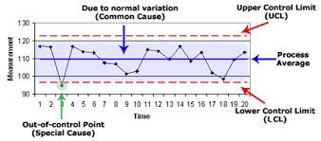
Control vs. Out of Control
In Control
When the process data points consistently fall within the control limits (UCL and LCL), the process is said to be "In Control”
Out of Control
When data points fall outside the control limits or exhibit non-random patterns, the process is "Out of Control"

Slide 31
Fishborn Diagram Overview

Slide 32
Fishbone Diagram
Material
Measurement
Machine
Quality of Raw Materials
Human Error
Poor Maintenance
Inaccurate Instruments
Machine Calibration
Contamination
Problem
Process Complexity
Temperature and Humidity
Lack of Training
Process Complexity
Air Quality
Skill Level
Method
Environment
Employee

Slide 33
Sampling Technique Overview
Select the Sample

Slide 34
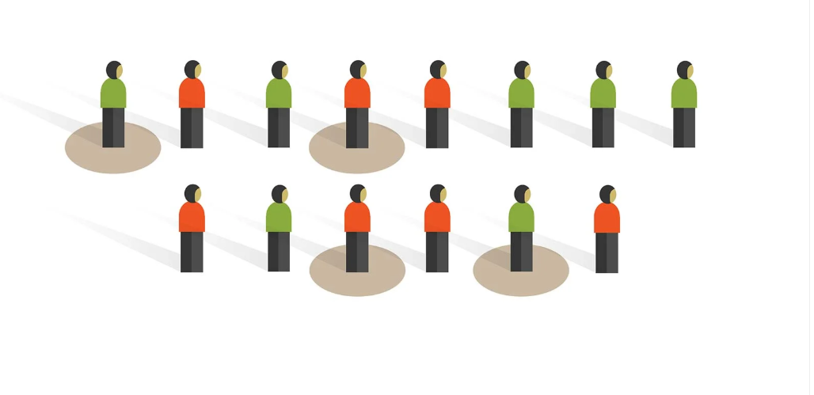
Random Sampling
Commonly used in surveys, experiments and observational studies
Ensure unbiased representation
Helps collect reliable data

Slide 35
Random Sampling
Allows for the generalisation of results to the larger population
Increases the validity of the findings
Straightforward to implement
Applications
Commonly used in surveys, experiments and
observational studies
Ensure unbiased representation
Helps collect reliable data

Slide 36
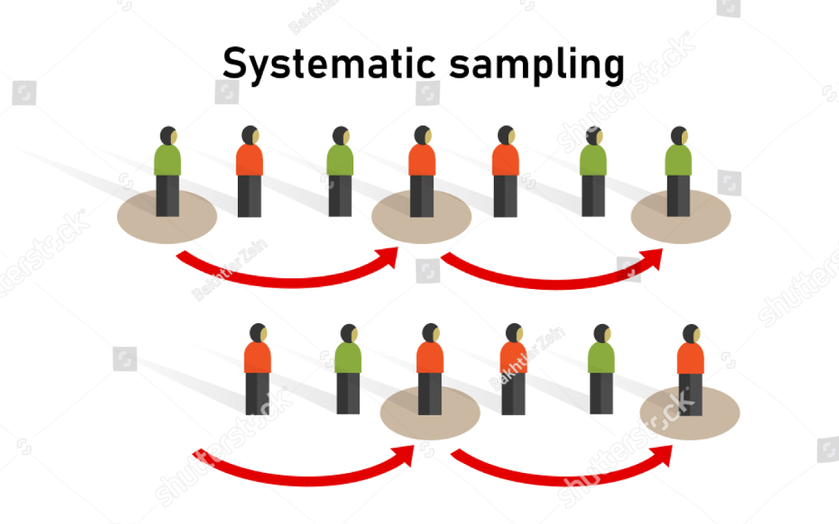
Systematic Sampling
Ensures good population coverage
More convenient than random sampling

Slide 37
Systematic Sampling
Ensures good population coverage
More convenient than random sampling
Applications
Commonly used in quality control processes
Often applied to ordered populations, such as
Time series data
Sequential production outputs

Slide 38
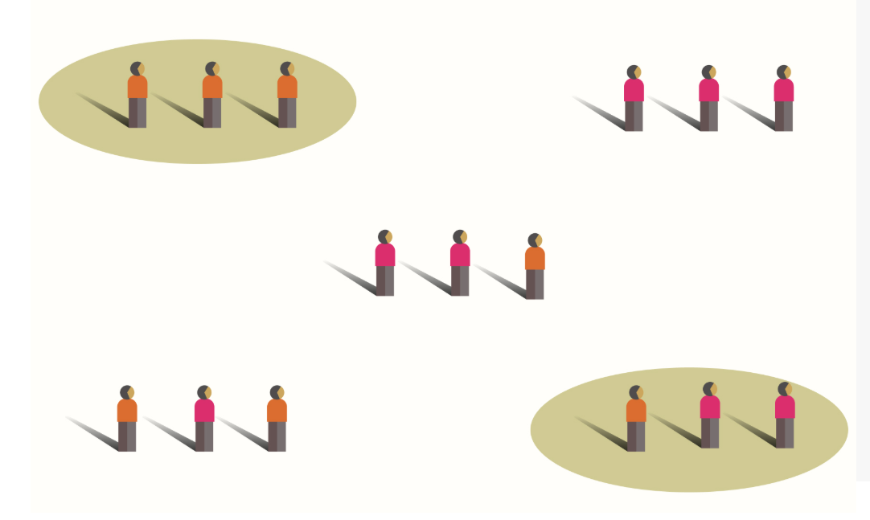
Cluster Sampling
Cost-effective
Time-saving
Especially beneficial for large populations by:
Reducing travel costs
Lowering logistic expenses

Slide 39
Cluster Sampling
Cost-effective
Time-saving
Especially beneficial for large populations by:
Reducing travel costs
Lowering logistic expenses
Application
Widely used in:
Educational research
Public health studies
Involves sampling entire groups such as:
Classrooms
Neighborhoods

Slide 40
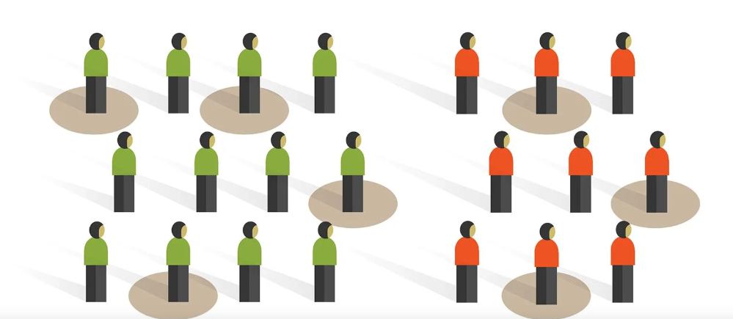
Stratified Sampling
Enhances sampling precision for accurate results.

Slide 41
Stratified Sampling
Enhances sampling precision for accurate results.
Applications
Used in social science
market research

Slide 42
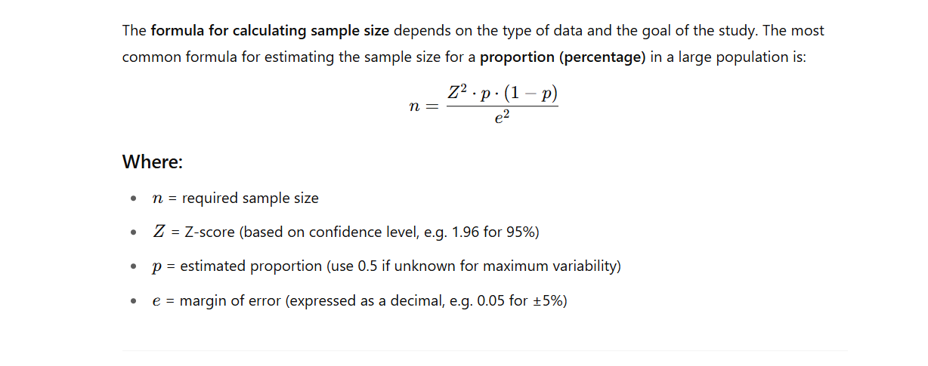
Sample Size Determination

Slide 43
Exploratory Data Analysis (EDA)
in RStudio

Slide 44
Descriptive Statistics
Define Variables
Date | Date of production (from 2025-04-01 onward)
Shift | Work shift during production (Morning or Evening)
Product | Beverage type: Aloe Juice, Energy Drink, or Protein Shake
Operator | The staff member responsible for operating the machine (e.g., Kevin, Mark)
Weight_g | Net weight of the filled bottle, measured in grams
Temperature_C | Temperature in degrees Celsius at the time of filling
Machine_ID | Machine used for filling the bottle (PX1, PX2, or PX3)
Defect | Whether the unit had a defect: 0 = No, 1 = Yes

Slide 45
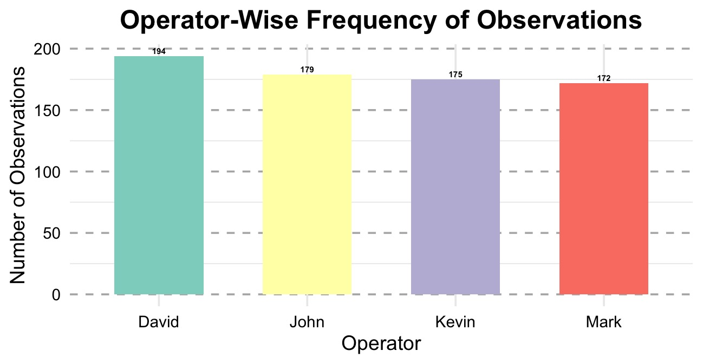
Qualitative Data Analysis : Shift, Product, Operator Factors, Machine

Slide 46
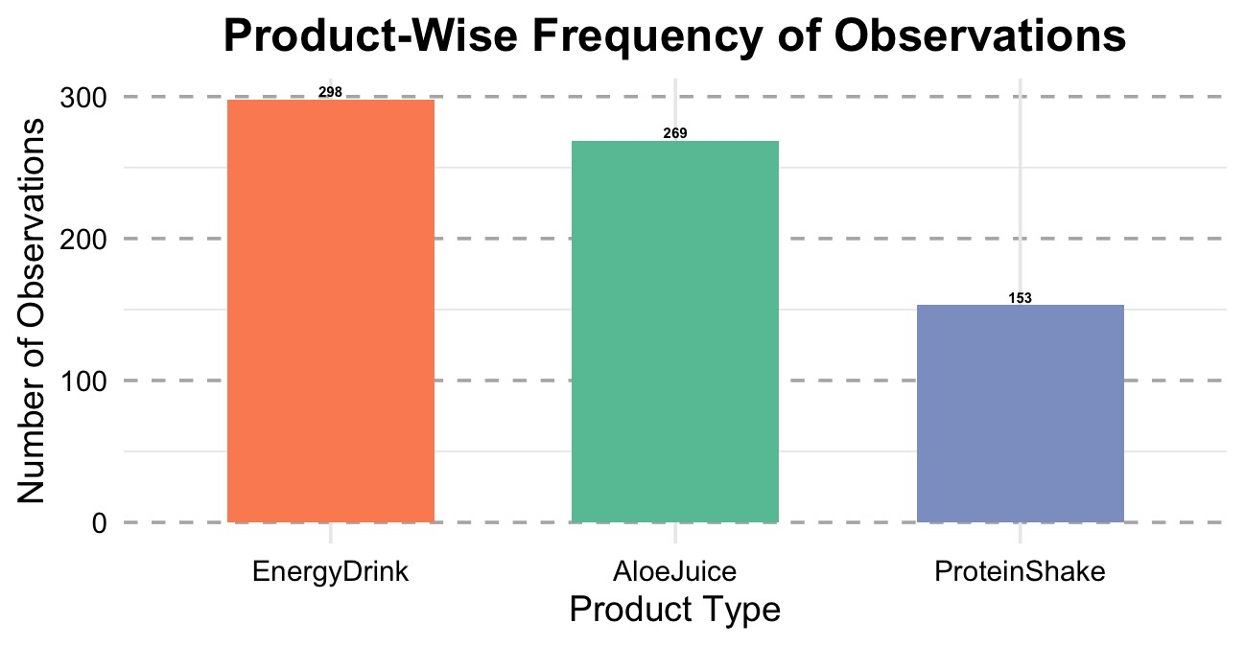
Qualitative Data Analysis : Shift, Product, Operator Factors, Machine

Slide 47
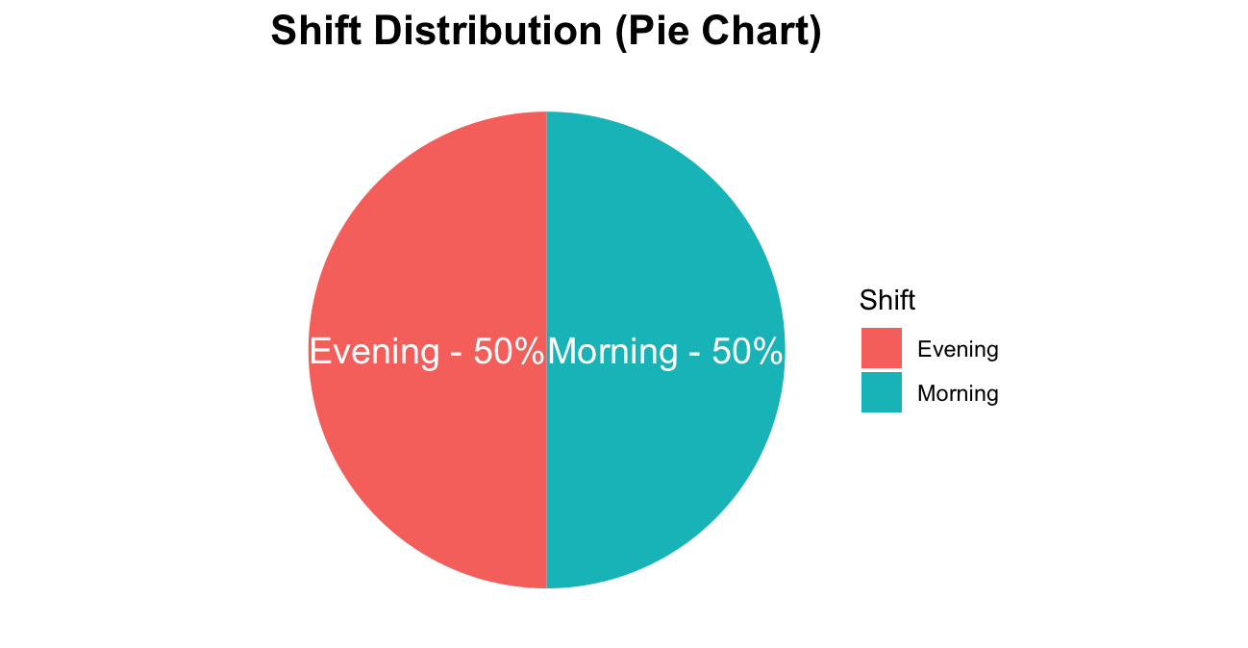
Qualitative Data Analysis : Shift, Product, Operator Factors, Machine

Slide 48
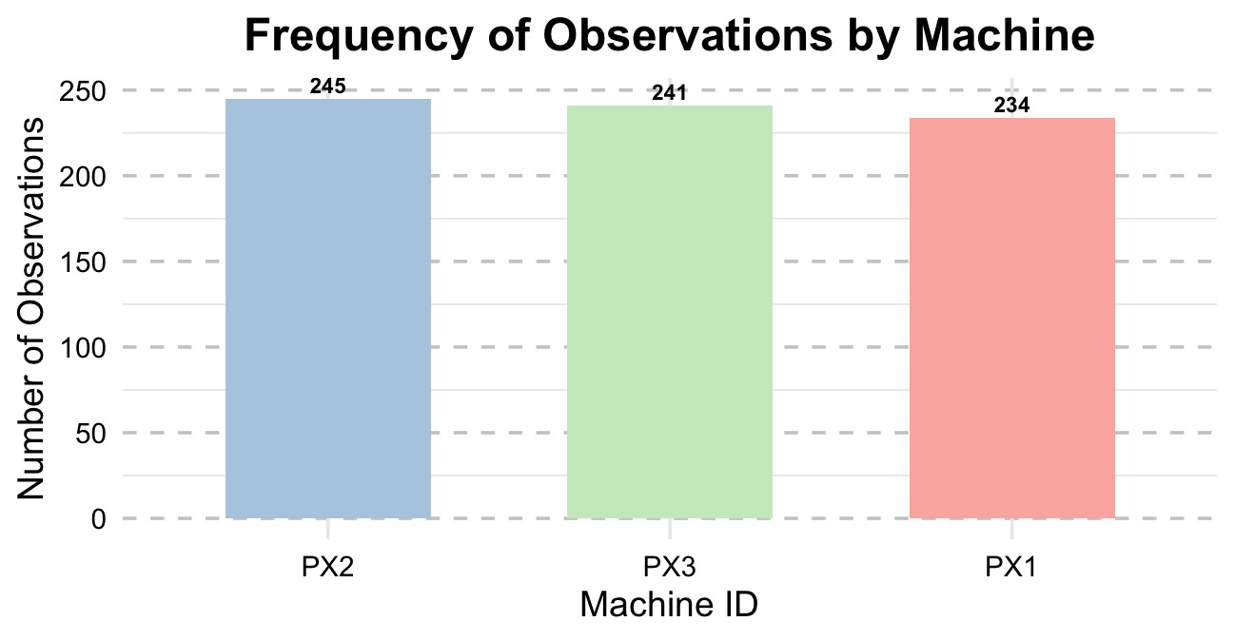
Qualitative Data Analysis : Shift, Product, Operator Factors, Machine

Slide 49
Qualitative Data Analysis : Weight
Central Tendency
Statistic | Value
Mean | 499.7431 g
Median | 499.0250 g
Mode | 499.4500

Slide 50
Qualitative Data Analysis : Weight
Central Tendency
Statistic | Value
Mean | 499.7431 g
Median | 499.0250 g
Mode | 499.4500
Spread of Data
Statistic | Value
Minimum | 481.3700 g
Maximum | 529.2000 g
Range | 47.8300 g
Variance | 46.6801
Standard Deviation | 6.8323 g
1st Quartile (Q1) | 495.4775 g
3rd Quartile (Q3) | 502.4475 g
Interquartile Range (IQR) | 6.9700 g
Skewness | 0.81
Kurtosis | 1.31

Slide 51
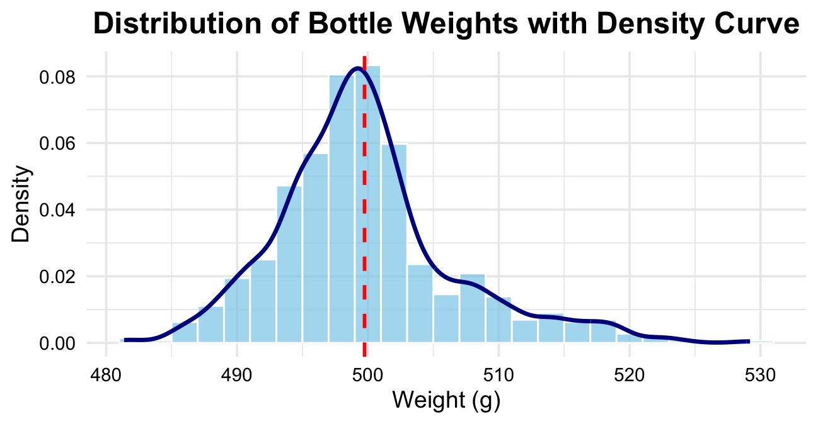
Qualitative Data Analysis : Weight
Central Tendency
Statistic | Value
Mean | 499.7431 g
Median | 499.0250 g
Mode | 499.4500
Spread of Data
Statistic | Value
Minimum | 481.3700 g
Maximum | 529.2000 g
Range | 47.8300 g
Variance | 46.6801
Standard Deviation | 6.8323 g
1st Quartile (Q1) | 495.4775 g
3rd Quartile (Q3) | 502.4475 g
Interquartile Range (IQR) | 6.9700 g
Skewness | 0.81
Kurtosis | 1.31

Slide 52
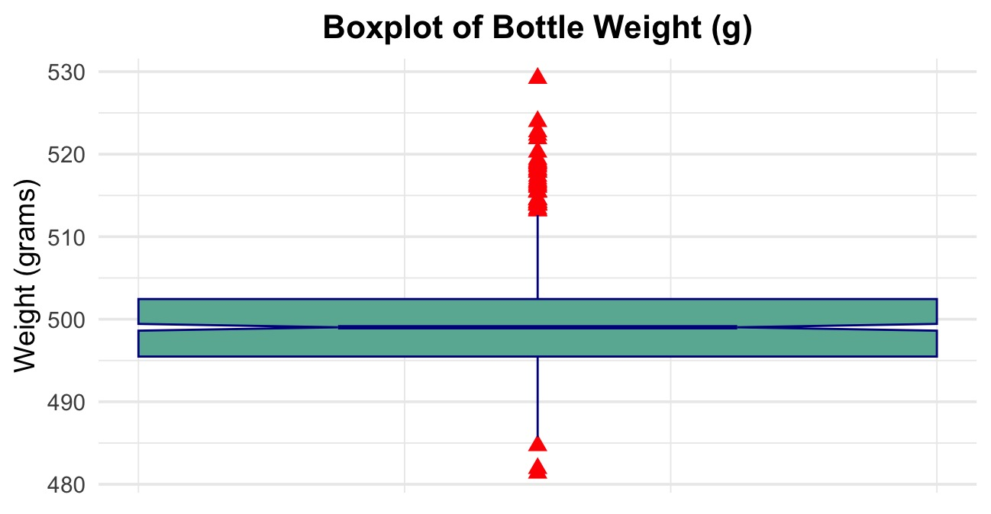
Qualitative Data Analysis : Weight
Central Tendency
Statistic | Value
Mean | 499.7431 g
Median | 499.0250 g
Mode | 499.4500
Spread of Data
Statistic | Value
Minimum | 481.3700 g
Maximum | 529.2000 g
Range | 47.8300 g
Variance | 46.6801
Standard Deviation | 6.8323 g
1st Quartile (Q1) | 495.4775 g
3rd Quartile (Q3) | 502.4475 g
Interquartile Range (IQR) | 6.9700 g
Skewness | 0.81
Kurtosis | 1.31
Number of Outliers 44

Slide 53
Qualitative Data Analysis : Temperature
Central Tendency
Statistic | Value
Mean | 23.51 °C
Median | 23.50 °C
Mode | 23.90 °C

Slide 54
Qualitative Data Analysis : Temperature
Central Tendency
Statistic | Value
Mean | 23.51 °C
Median | 23.50 °C
Mode | 23.90 °C
Spread of Data
Statistic | Value
Minimum | 20.30 °C
Maximum | 26.30 °C
Range | 6.00 °C
Variance | 0.98
Standard Deviation | 0.99 °C
1st Quartile (Q1) | 22.88 °C
3rd Quartile (Q3) | 24.20 °C
Interquartile Range | 1.33 °C
Skewness | -0.08
Kurtosis | -0.11

Slide 55
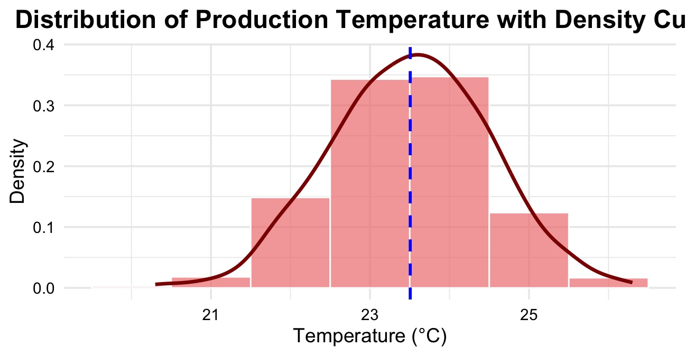
Qualitative Data Analysis : Temperature
Central Tendency
Statistic | Value
Mean | 23.51 °C
Median | 23.50 °C
Mode | 23.90 °C
Spread of Data
Statistic | Value
Minimum | 20.30 °C
Maximum | 26.30 °C
Range | 6.00 °C
Variance | 0.98
Standard Deviation | 0.99 °C
1st Quartile (Q1) | 22.88 °C
3rd Quartile (Q3) | 24.20 °C
Interquartile Range | 1.33 °C
Skewness | -0.08
Kurtosis | -0.11

Slide 56
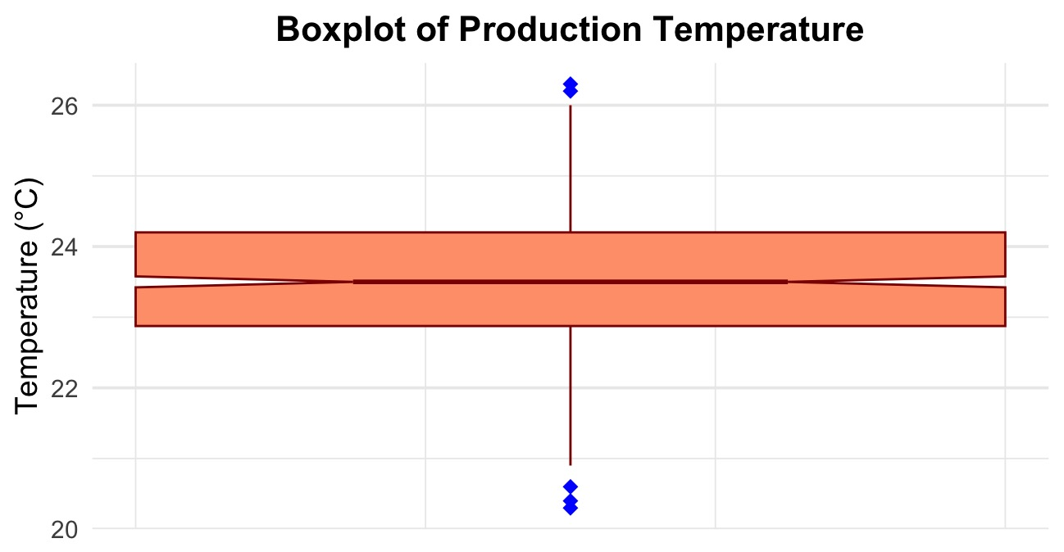
Qualitative Data Analysis : Temperature
Central Tendency
Statistic | Value
Mean | 23.51 °C
Median | 23.50 °C
Mode | 23.90 °C
Spread of Data
Statistic | Value
Minimum | 20.30 °C
Maximum | 26.30 °C
Range | 6.00 °C
Variance | 0.98
Standard Deviation | 0.99 °C
1st Quartile (Q1) | 22.88 °C
3rd Quartile (Q3) | 24.20 °C
Interquartile Range | 1.33 °C
Skewness | -0.08
Kurtosis | -0.11
Number of Outliers 5

Slide 57
Qualitative Data Analysis : Temperature

Slide 58
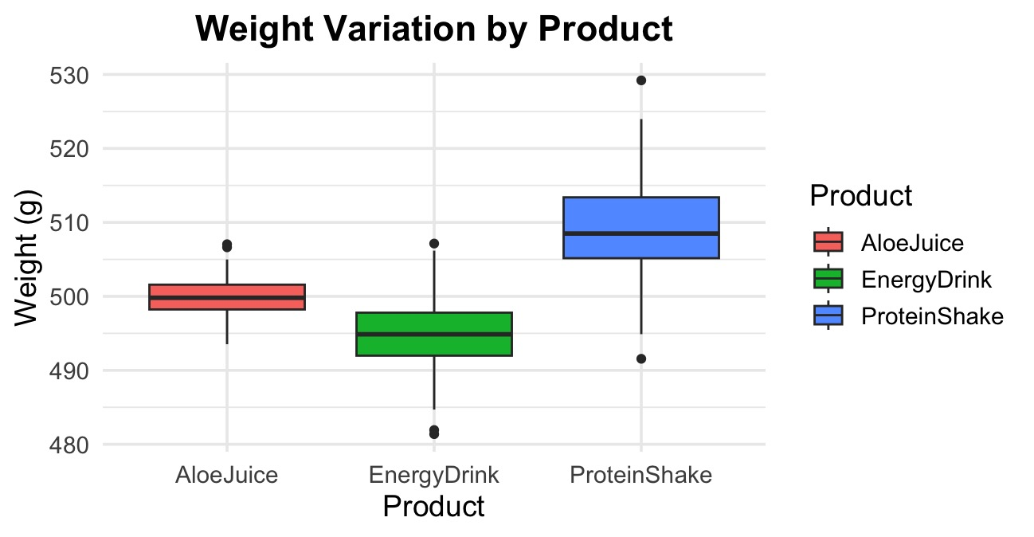
Weight Variation Across Operational Factors

Slide 59
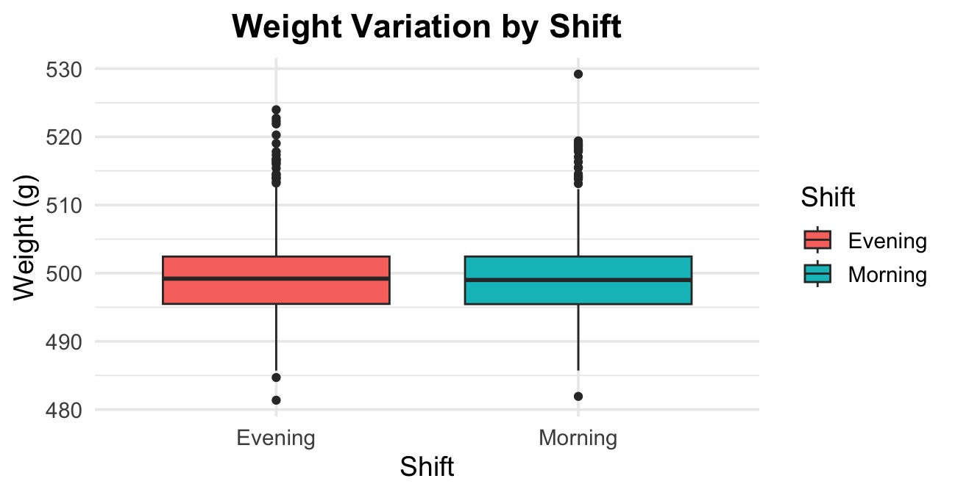
Weight Variation Across Operational Factors

Slide 60
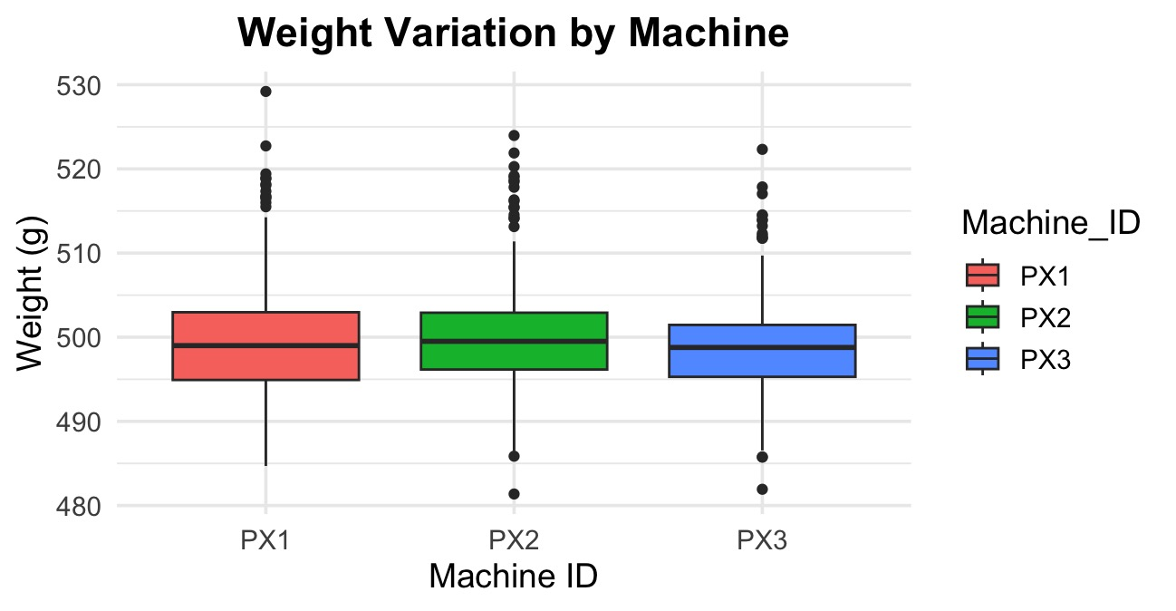
Weight Variation Across Operational Factors

Slide 61
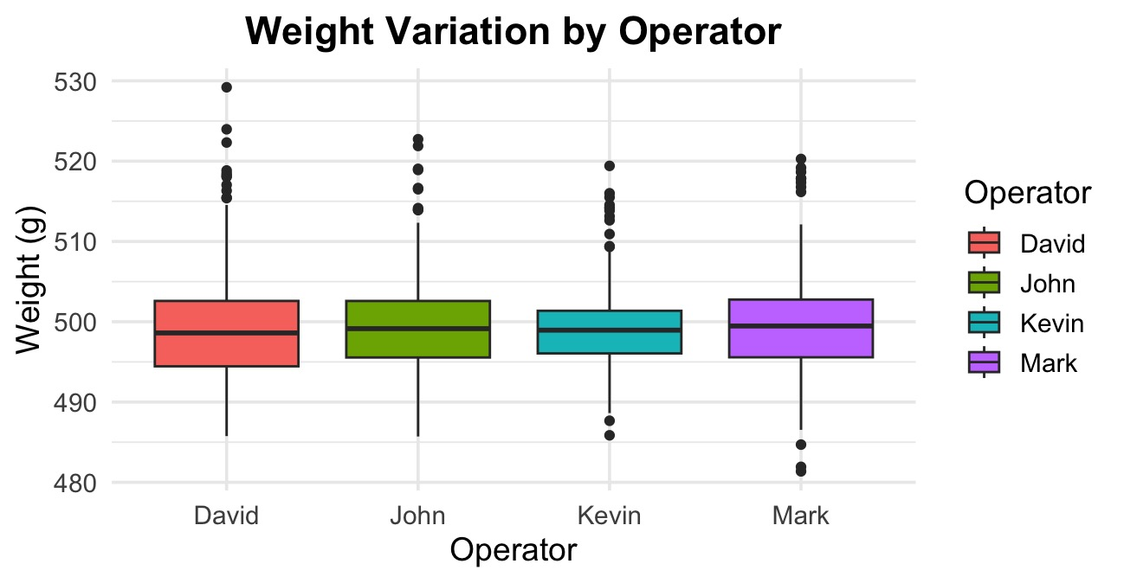
Weight Variation Across Operational Factors

Slide 62
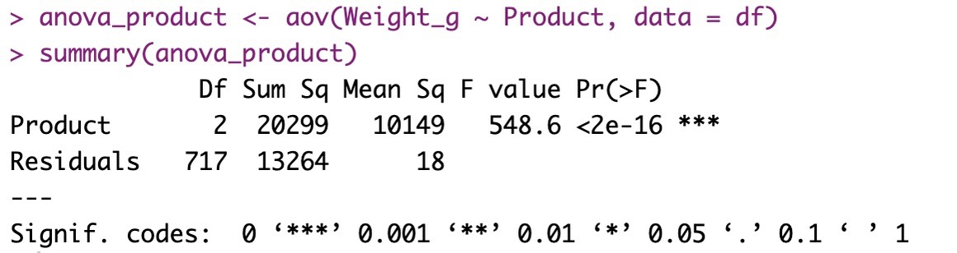
Factor-Wise Impact on Bottle Weight: ANOVA Analysis
Mean Weight Variation Across Product Types

Slide 63
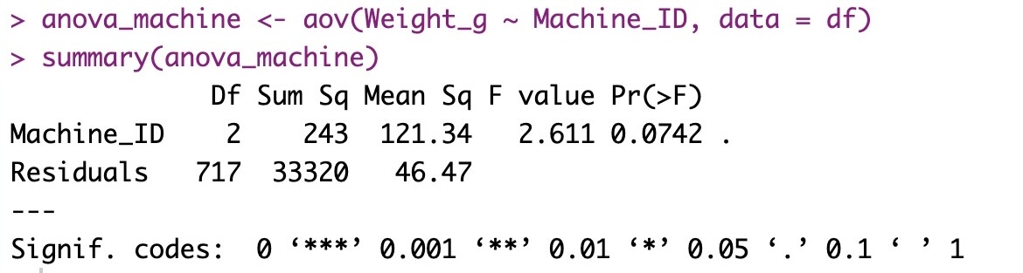
Factor-Wise Impact on Bottle Weight: ANOVA Analysis
Mean Weight Variation Across Product Types
Mean Weight Variation Across Product Types

Slide 64
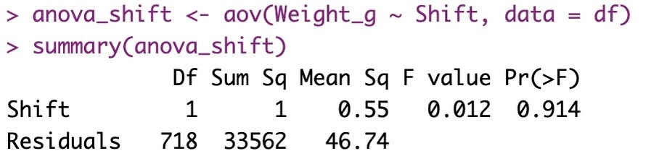
Factor-Wise Impact on Bottle Weight: ANOVA Analysis
Mean Weight Variation Across Product Types
Mean Weight Variation Across Product Types
Mean Weight Variation Across Product Types

Slide 65
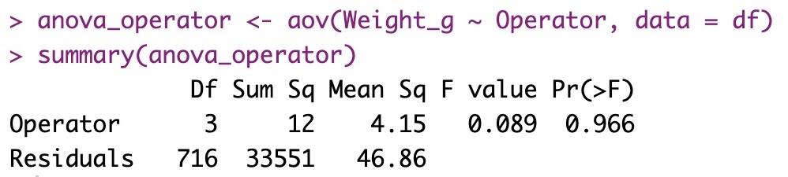
Factor-Wise Impact on Bottle Weight: ANOVA Analysis
Mean Weight Variation Across Product Types
Mean Weight Variation Across Product Types
Mean Weight Variation Across Product Types
Mean Weight Variation Across Product Types

Slide 66
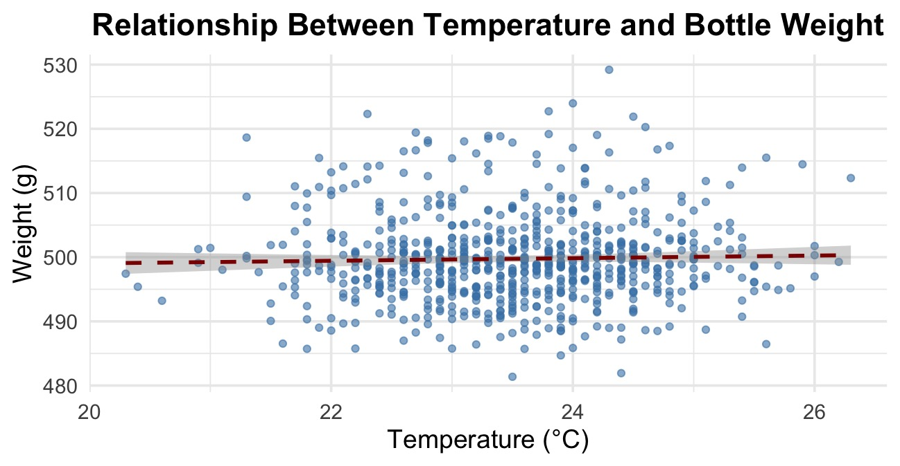
Factor-Wise Impact on Bottle Weight: Correlation and Regression Analysis

Slide 67
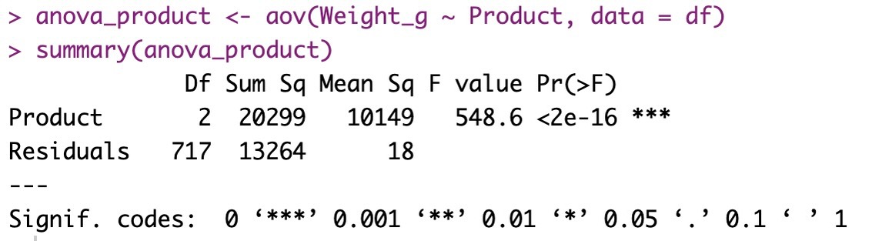
Factor-Wise Impact on Bottle Weight: Correlation and Regression Analysis

Slide 68
Factor-Wise Impact on Bottle Weight: Correlation and Regression Analysis

Slide 70
Fishbone Diagram for Identifying
Causes of Underfilled Bottles

Slide 71
Fishbone Diagram
Material
Measurement
Machine
Law quality Raw Ingredients
Control chart misinterpreted
Machine PX2 Inconsistency
Data collection errors
Filling nozzle misalignment
Packaging defects
Faulty weighing equipment
Low maintenance
Incorrect mixing ratios
Defects in underfilled bottles in production line
Lack of standard operating procedure
High ambient
temperature
Lack of Training
Humidity
fluctuations
Insufficient supervision
in evening shift
Poor maintenance schedule
Method
Environment
Employee

Slide 72
Lean Six Sigma Application for
Process Optimization

Slide 73
Waste identification (7 Wastes)
Our analysis revealed several types of waste impacting quality and efficiency.
Defects

Slide 74
Waste identification (7 Wastes)
Our analysis revealed several types of waste impacting quality and efficiency.
Defects
Waiting

Slide 75
Waste identification (7 Wastes)
Our analysis revealed several types of waste impacting quality and efficiency.
Defects
Waiting
Overproduction

Slide 76
Waste identification (7 Wastes)
Our analysis revealed several types of waste impacting quality and efficiency.
Defects
Waiting
Overproduction
Over processing

Slide 77
Waste identification (7 Wastes)
Our analysis revealed several types of waste impacting quality and efficiency.
Defects
Waiting
Overproduction
Over processing
Motion

Slide 78
Waste identification (7 Wastes)
Our analysis revealed several types of waste impacting quality and efficiency.
Defects
Waiting
Overproduction
Over processing
Motion
Inventory

Slide 79
Waste identification (7 Wastes)
Our analysis revealed several types of waste impacting quality and efficiency.
Defects
Waiting
Overproduction
Over processing
Motion
Inventory
Transportation

Slide 80
Our process have these wastes
Defects: 1.3% (29/2237), underfilled (<495g), sealing issues.

Slide 81
Our process have these wastes
Defects: 1.3% (29/2237), underfilled (<495g), sealing issues.
Overproduction: Excess Energy Drink/Protein Shake output.

Slide 82
Our process have these wastes
Defects: 1.3% (29/2237), underfilled (<495g), sealing issues.
Overproduction: Excess Energy Drink/Protein Shake output.
Waiting: Delays from Machine PX2 inconsistency

Slide 83
Process Bottlenecks
Process Bottlenecks Affecting Flow and Quality.
Frequent
sealing errors
Operator
Higher defect rate
Filling
PX2 MACHINE
Sealing
Packaging
Evening Shift
Delays
Spike

Slide 84
Bottlenecks
Machine PX2: 37.9% defects (11/29)

Slide 85
Bottlenecks
Machine PX2: 37.9% defects (11/29)
Evening Shifts: 62.1% defects (18/29)

Slide 86
Bottlenecks
Machine PX2: 37.9% defects (11/29)
Evening Shifts: 62.1% defects (18/29)
Underfilling: EnergyDrink (55.2%)

Slide 87
Findings & Root Causes
Root Causes of Defects
Findings:
Defect Rate: 1.3% (DPMO ≈ 13,000)
PX2: 37.9% defects, SD 4.5g (Energy Drink)
Evening Shifts: 62.1% defects
Machine
PX2 Variability

Slide 88
Findings & Root Causes
Root Causes of Defects
Findings:
Defect Rate: 1.3% (DPMO ≈ 13,000)
PX2: 37.9% defects, SD 4.5g (Energy Drink)
Evening Shifts: 62.1% defects
Machine
PX2 Variability
Method
Evining Process

Slide 89
Findings & Root Causes
Root Causes of Defects
Findings:
Defect Rate: 1.3% (DPMO ≈ 13,000)
PX2: 37.9% defects, SD 4.5g (Energy Drink)
Evening Shifts: 62.1% defects
Machine
PX2 Variability
Method
Evining Process
Method
Operator Training

Slide 90
Findings & Root Causes
Root Causes of Defects
Findings:
Defect Rate: 1.3% (DPMO ≈ 13,000)
PX2: 37.9% defects, SD 4.5g (Energy Drink)
Evening Shifts: 62.1% defects
Machine
PX2 Variability
Method
Evining Process
Method
Operator Training
Method
Bottle fill issue

Slide 91
How we reduced variation and improved process

Slide 92
Used the DMAIC Method
PX2 inconsistency Hourly checks +maintenance

Slide 93
Used the DMAIC Method
PX2 inconsistency Hourly checks +maintenance
Sealing issues (Evening) SOP for cleaning & pressure

Slide 94
Used the DMAIC Method
PX2 inconsistency Hourly checks +maintenance
Sealing issues (Evening) SOP for cleaning & pressure
Operator variation Retrain with visual guides

Slide 95
Used the DMAIC Method
PX2 inconsistency Hourly checks +maintenance
Sealing issues (Evening) SOP for cleaning & pressure
Operator variation Retrain with visual guides
Manual weight checks Sensor based feedback loop

