Slide 1

Environment Pollution
P.G. Asitha Kanchana
S23010526

Slide 2

Topic
The detrimental effects of environmental pollution on human health and ecosystems.

Slide 3
Pollution
Air Pollution
Water Pollution
Soil Pollution
Noise Pollution

Slide 4
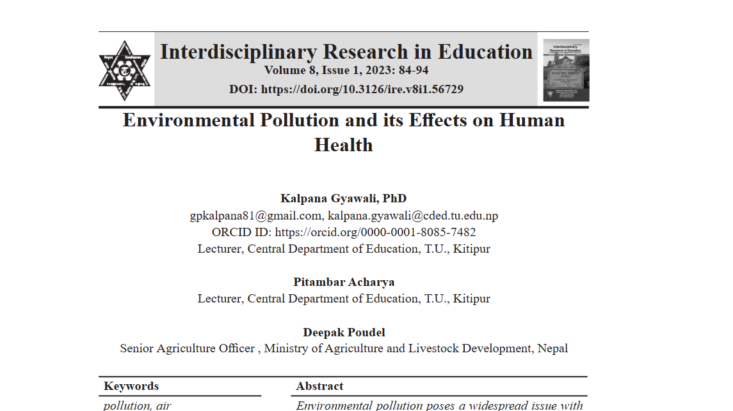
Research About Environmental Pollution and its Effects on Human Health
Notes:
https://www.researchgate.net/publication/372991318_Environmental_pollution_and_its_effect_on_human_health

Slide 5

C o nc lusion
Environmental pollution poses a significant threat to our health and the planet.
Immediate and collective action is essential to mitigate its effects.
Preserve our environment for future generations.

