Slide 1

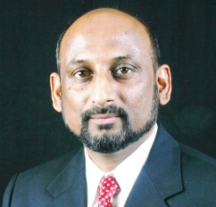

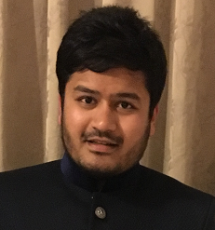

Team 4
Secure Messaging: Click2Text
Dr Muhammad S Ahmed | Mohammad Ibrahim | Aman Patel | Robert Boose Aaron Parmar Sundeep Nagumalli
As of April 5st 2016 RUNNING TOTAL: 30
Scheduled : none

Slide 2


What We Thought?
Original Business Thesis
  Educationist need a simpler tool to engage students, to prevent phone-related distraction and gauge class participation
  Clicker devices are cumbersome, costly and not par with the current technology
Educationist = University – Colleges – High School teachers and administrators (users and buyers)

Slide 3
What we did?
Develop interview questions
  Initially focused on students engagement and participation in classroom
  Modified questions to investigate more on issues/problems and distractions faced by instructors in their classroom
  Rewrote questions to investigate customer “pain” and differentiate between symptoms , root causes & affects
Created Teams for interview
Conducted Interviews
  University Professors& administrators
  Under grad and Grad Professors with large class size
  STEM and non STEM under grad and Grad Professors
  Community Colleges
Documented interview
Analyze thesis/ modify model and Eco Diagrams

Slide 4
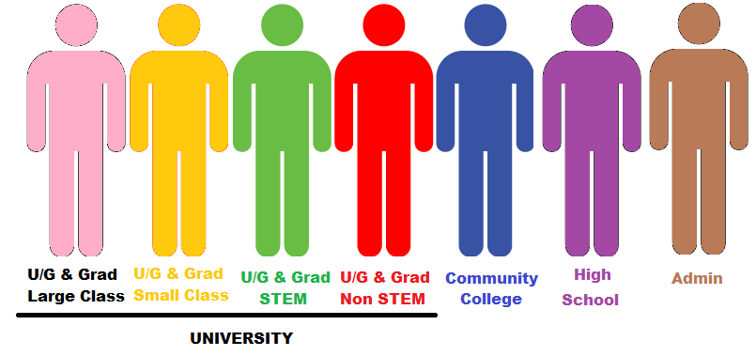
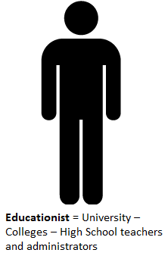
What we found:
Who is our customer?
?
?

Slide 5
What we found?
MAJOR ISSUES IN CLASSROOM
Common
Assurance that learning have occurred Seeking students attention and interest in the class Nonhomogeneous participation Grading assignments / class participation
UG & G - Large Class Size | UG & G - Small Class Size | UG & G - STEM | UG & G – Non STEM | Community Colleges
Attentiveness/ Distraction/ Participation | Evaluation participation is time consuming | Meaningful participation | Detail participation rather Y/N responses | Students not prepared for college education
Communication/ interaction | Hesitance to openly express point of view |  |  | Lack of confidence
Engaging and Evaluating engagement quickly | Young students often get distracted |  |  | Engaging and Evaluating engagement quickly
Accountability
Notes:
Class participation and engagement are two different things

Slide 6

What we found?
Participation
Class participation can take many forms. Plan and assign responsibility
Engagement
Class engagement requires a well-planned lesson plan
Distractions
Students not prepared for class . Use of Computer/electronic devices/ Cellphone. Too much participation from few

Slide 7
What we found?
How is this problem solved today?
CURRENTLY TESTED SOLUTIONS
Non Technical Solutions | Solutions Using Technology
Ask questions at random Mock interviews/discussion/ presentation/ project/ exercises /quizzes/ debate/ Index card / one minute paper/ team work/ peer evaluation Grading class participation create motivation Evaluating students class participation is time consuming | Clicker is commonly used to engage Costly and difficult maintenance Useful in asking FAQs Beneficial for large class & quick responses. Requires lot of time and effort Not useful for in-depth participation Setting up clickers is time consuming Cellphone can be a best way to engage students in classroom Cellphones are used for survey in class Canvas discussion on cellphone

Slide 8
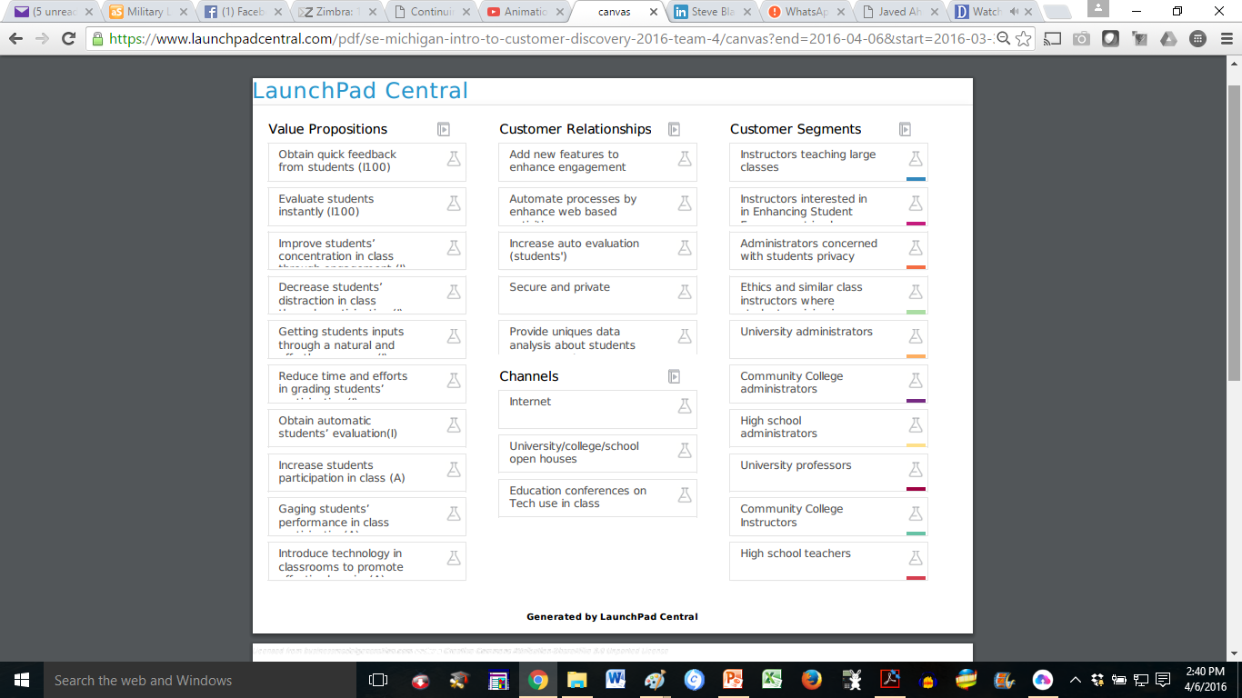
Business Canvas Model
Potential SOLUTION - TIME Saving
Outside Class Room = (40 + 20 ) min /class
Inside Class Room = 30 to 40 min/class
Target is 50% saving
CURRENT SOLUTION
PAINS / GOALS
SURPRISE
FERPA – Evaluation in Privacy
We are now starting to understand this better and are working on validating and invalidating hypothesis

Slide 9
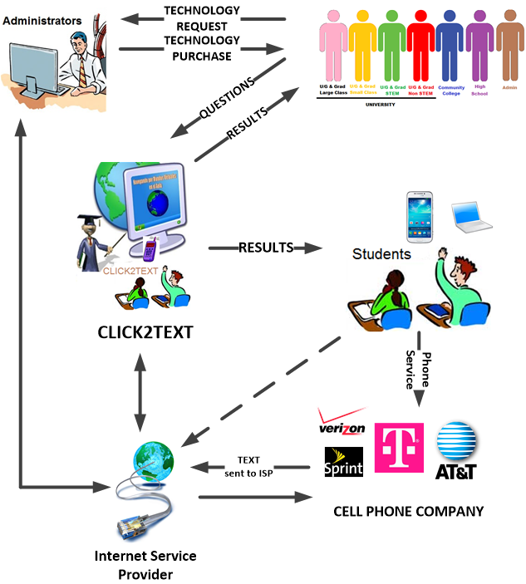
Ecosystem Diagram
Instructors
Large Class Size
Small Class Size
STEM Education
Other Education

Slide 10
What’s next?
Customer discovery has completely changed our point-of-view about our product.
Further investigate customer type and pains
Back to the drawing board – Modify CLICK2TEXT architecture
  Change /add features in CLICK2TEXT

