Slide 1

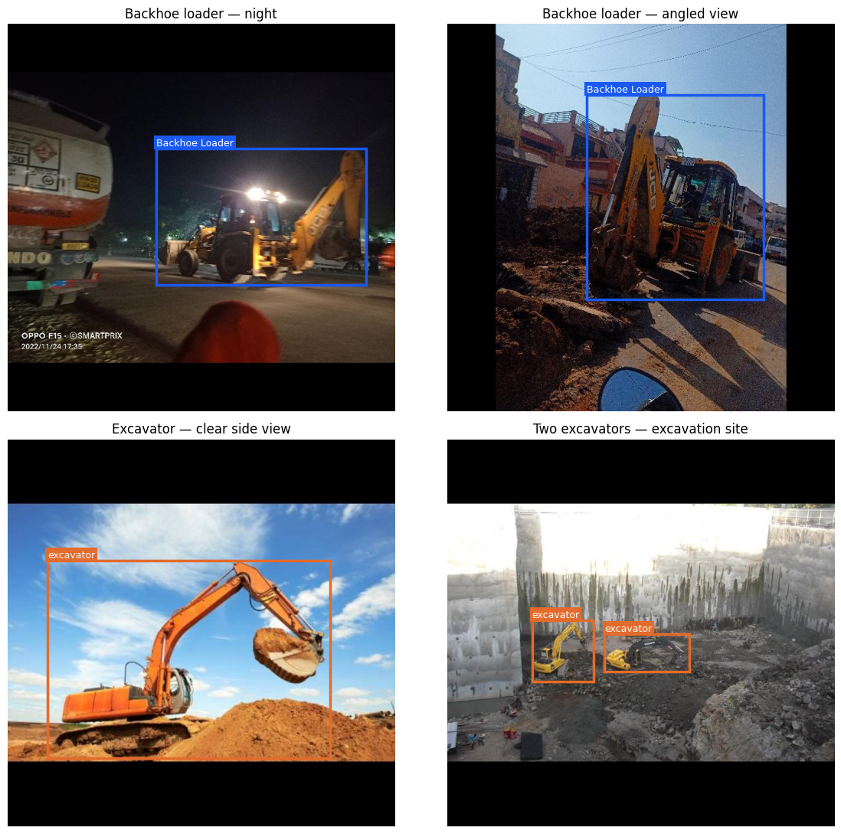
M4U3 COMPUTER VISION
Backhoe Loader and Excavator Detection
in Construction Images
Asiya Begum | Submitted to Pablo Aumente Gallego | 27 September 2026
PROJECT QUESTION
Can a model locate and identify backhoe loaders and excavators in construction site photos?
A supervisor reviewing equipment costs can compare the machine types detected in dated site photos with hire records when checking the equipment cost sheet. Hire duration and use come from those records.
Evaluation aim: grouped 80/20 split, precision and mAP reporting, plus a provisional recall target of at least 0.70.
ASIYA BEGUM / M4U3 COMPUTER VISION
01 / 07

Slide 2
DATASET AND ANNOTATIONS
Dataset cloning and annotation review
Two target classes: Backhoe Loader and excavator. Images without either class remain negatives.
DataCluster Labs: Backhoe Loaders
Mohamed Sabek: Excavators
Selected source images labeled “excavator” were visually identified as backhoe loaders and relabeled.
Actual excavator photos were cloned from a second source to complete the two-class task.
105
13
13
11
Training
Validation
Testing
Negatives
80.2% of 131 images
Held out for selection
Untouched final check
Across all three splits
Frozen version 3: about 80% train and 20% held out (validation + test). Related views were grouped before export. Auto-orient, 640 × 640 black-edge fit and exclusion-tag filtering were applied; export augmentation was off.
Photo sources: DataCluster Labs and Mohamed Sabek on Roboflow Universe; CC BY 4.0 as listed by each source.
ASIYA BEGUM / M4U3 COMPUTER VISION
02 / 07
Notes:
Source projects: https://universe.roboflow.com/datacluster-labs-agryi/excavator-construction-vehicle and https://universe.roboflow.com/mohamed-sabek-6zmr6/excavators-cwlh0

Slide 3
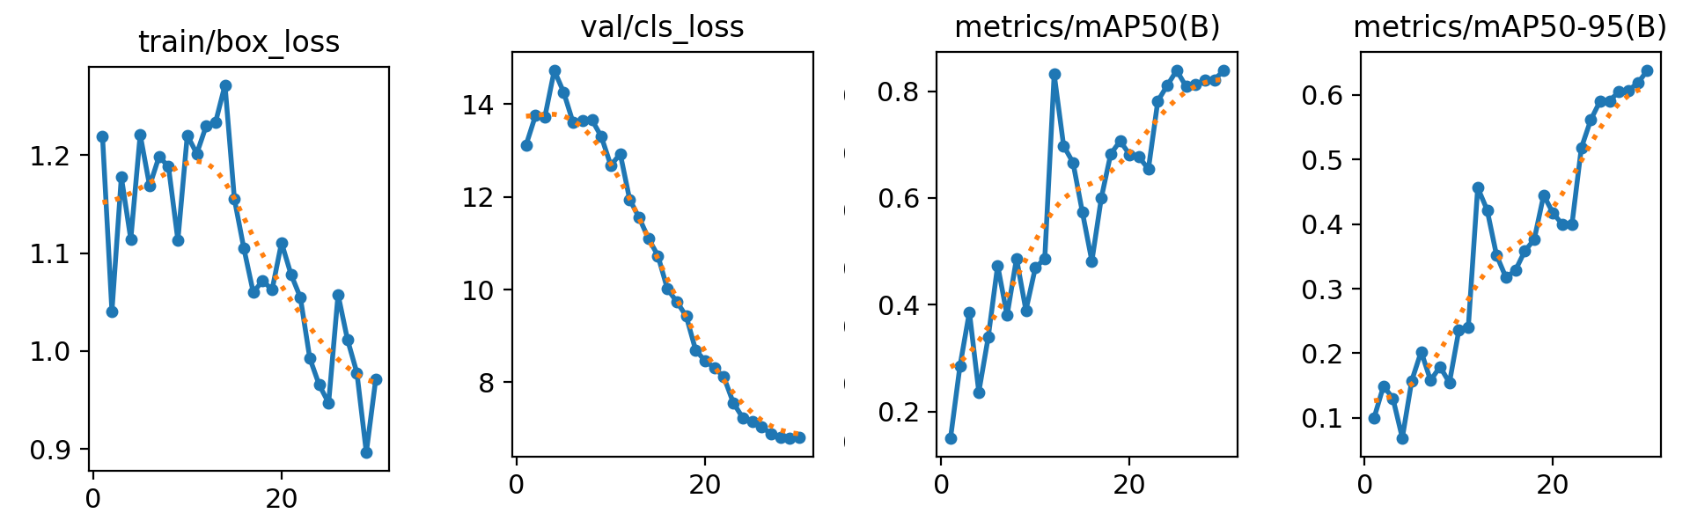
WORKFLOW AND TRAINING EVIDENCE
From Roboflow versions to the trained detector
Related views were grouped before the frozen version 3 export.
V1 review
Group views
Freeze V3
Train + test
Labels and split inspected
→
Related photos kept together
→
131 images and SHA256 ZIP
→
YOLO26n, 30 epochs; 13 test photos
Selected YOLO curves: training box loss and validation class loss fell overall; validation mAP50 and mAP50–95 rose. The full results.png is in the report and repository.
ASIYA BEGUM / M4U3 COMPUTER VISION
03 / 07

Slide 4
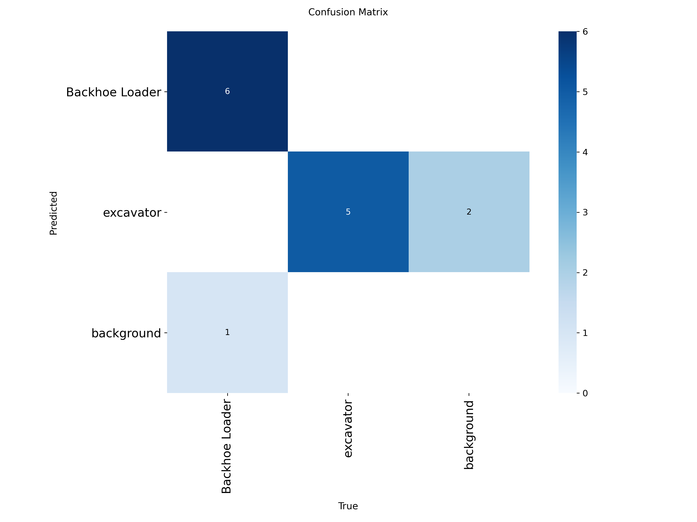
HELD-OUT TEST
Test results on 13 held-out images
Twelve labeled objects; the 0.70 provisional recall aim was exceeded in this small test.
0.812
0.904
Precision
Recall
Predicted box correctness
Provisional aim: 0.70
0.938
0.677
mAP50
mAP50–95
IoU threshold 0.50
Across stricter overlaps
“Background” records unmatched labels or predictions during evaluation. It is not a third class.
With only 12 labeled test objects, each miss or extra box can change the summary scores noticeably.
ASIYA BEGUM / M4U3 COMPUTER VISION
04 / 07

Slide 5
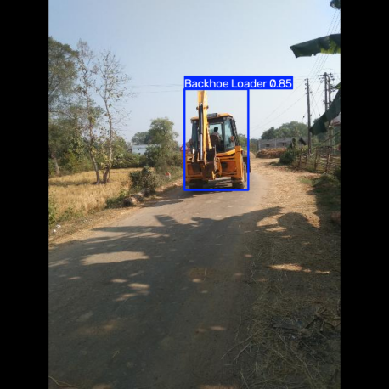
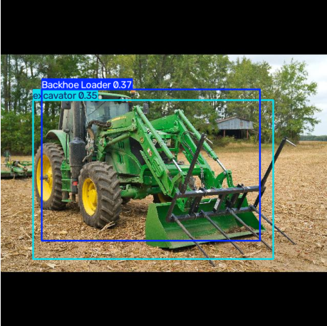
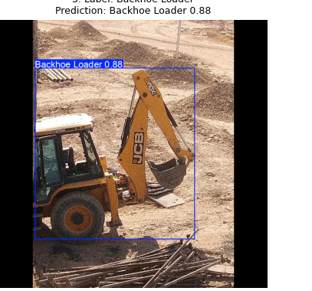
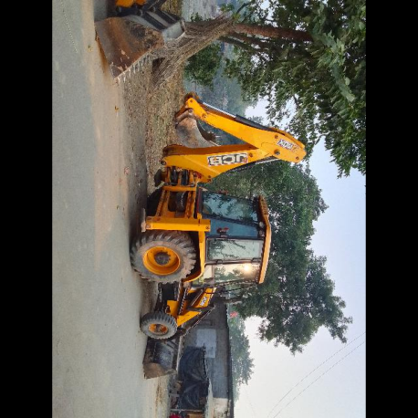
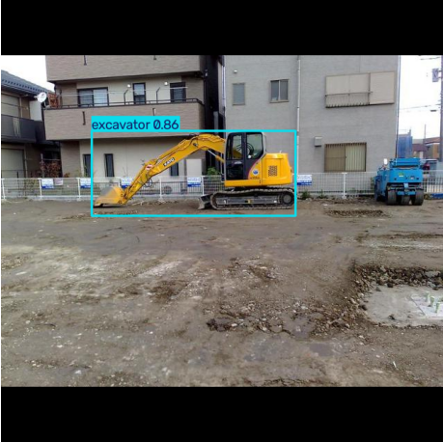
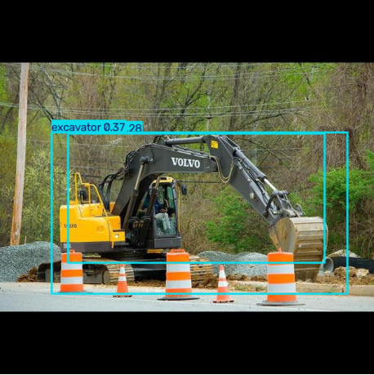
QUALITATIVE EVIDENCE
Correct detections and error cases
Selected predictions at confidence 0.25; the repository documents three FP detections and three FN examples.
WHAT WORKED
WHAT FAILED
Rear-view backhoe
Two False Positives
Backhoe Loader 0.85
Negative tractor: Backhoe Loader 0.37; excavator 0.35.
Partial backhoe
False negative
Backhoe Loader 0.88
Sideways backhoe loader: no detection.
Site excavator
Duplicate False Positive
excavator 0.86
One excavator: two overlapping boxes.
ASIYA BEGUM / M4U3 COMPUTER VISION
05 / 07

Slide 6
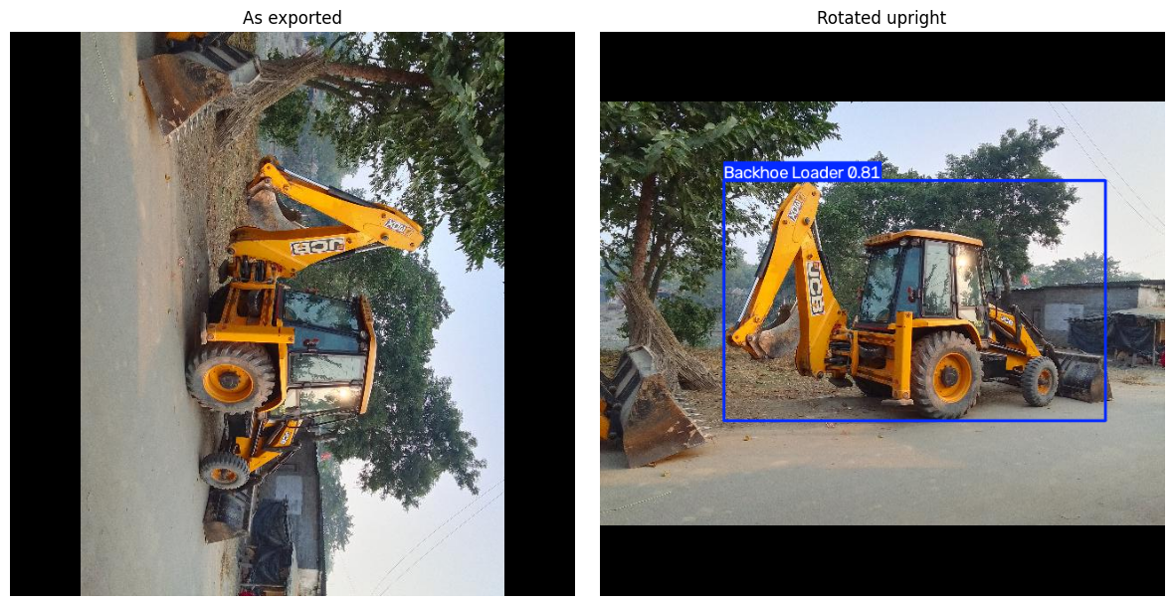
FALSE NEGATIVE INVESTIGATION
Investigation of a missed backhoe loader
The labeled target received no box. Auto-orient was enabled, but this exported photo remained sideways.
As exported: no detection at confidence 0.25. Rotated upright: Backhoe Loader 0.81 with the same checkpoint. Check image orientation during data cleaning and add realistic tilted views. This diagnostic does not change the original test score.
ASIYA BEGUM / M4U3 COMPUTER VISION
06 / 07

Slide 7
CONCLUSION AND HANDOVER
Workable Detection Prototype
The model detects equipment presence in individual images, with known limits.
Three data improvements tied to the observed errors:
1 Correct orientation and broaden views
USE WITH HUMAN REVIEW
Sideways and transported targets were missed. Verify upright files; add labeled tilted, partial and transport views.
A supervisor can compare per-photo detections with dated hire records. These images alone do not establish the hours hired or used.
2 Strengthen hard negatives
A tractor received two target boxes. Add unboxed tractors and similar loaders in comparable scenes.
HANDOVER
The public release holds the frozen dataset and best.pt; the repository has notebooks, evidence and source attribution.
3 Review boxes and diversify scenes
An excavator drew a duplicate box. Audit box consistency and expand the small independent test set.
Conclusion: The model can help screen individual site photos for these two machine types. Human review and wider testing remain essential before using detections in a cost review.
github.com/Asiya0555/Backhoe-Excavator-Site-Detection
ASIYA BEGUM / M4U3 COMPUTER VISION
07 / 07

