Slide 1
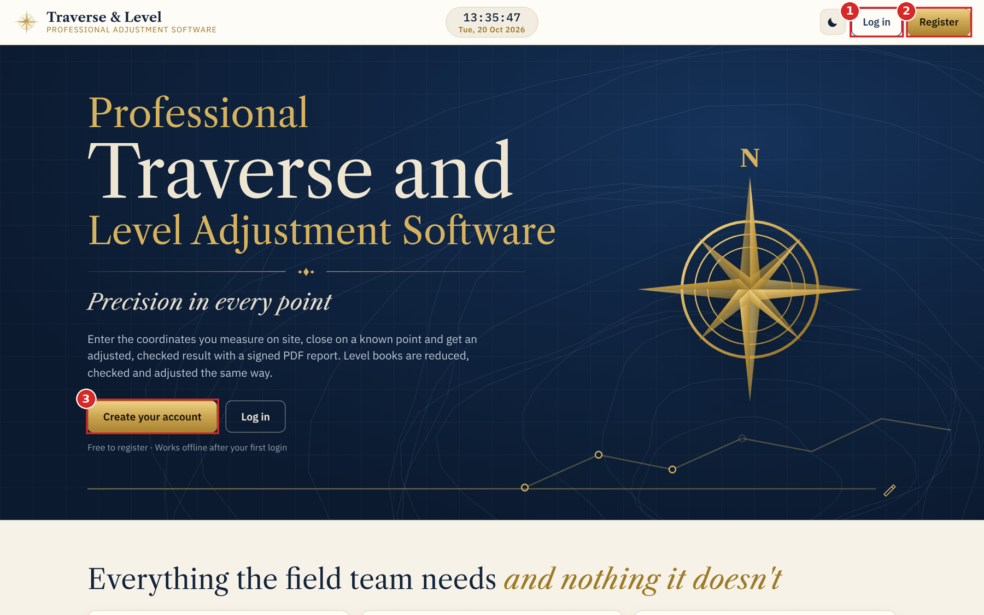
USER MANUAL
Traverse & Level Adjustment
Closed and open traverses, levelling, simulator, saved jobs and PDF reports, explained screen by screen.
Version with open-traverse closing point | October 2026
Notes:
Welcome slide. The red numbered squares on every screenshot match the numbered notes beside it.

Slide 2
INTRODUCTION
How to use this manual
Every screenshot carries red numbered boxes. Find the number on the picture, then read the note with the same number beside it.
1
2
3
4
5
Getting started
Closed traverse
Open traverse (new)
Levelling
Simulator, jobs and tips
Account, top bar and navigation
Known points, readings, adjustment, results
Optional closing point for checking and adjusting
Benchmarks, staff readings, reduced levels
Practice tool, dashboard, sharing, quick reference
Slides 4-6
Slides 7-15
Slides 16-21
Slides 22-26
Slides 27-32
TIP Results update as you type, so there is no Calculate button. Fix anything shown in red and the answer appears by itself.
Notes:
Sections: 1 Getting started, 2 Closed traverse, 3 Open traverse (new), 4 Levelling, 5 Simulator, jobs and tips.

Slide 3







INTRODUCTION
What the software does
Traverse adjustment
Levelling
Traverse simulator
Enter known and measured coordinates. The app finds the misclosure, checks the precision you require, and adjusts the points by Bowditch, Transit or Equal distribution.
Reduce staff readings by Rise & Fall or Height of Instrument. It checks the arithmetic, compares the misclosure with the allowable value and adjusts the levels.
Watch a total station observe a traverse with realistic random errors, then send the result to the Traverse tool to practise adjusting it.
PDF reports and CSV
Saved jobs and offline use
Share jobs with colleagues
Light and dark themes
NEW Open traverses can now be checked on a closing point (section 3). Without one they are shown as measured, exactly as before.
Notes:
Overview of the three tools and the common features.

Slide 4
1 GETTING STARTED
The home screen
1
Log in
For returning users. Enter your e-mail and password. After the first login the app also works offline.
2
Register
Opens the account form on the next slide. Registration is free.
3
Create your account
The same as Register, as the large button in the banner. Scroll down for a tour of every tool.
NOTE A yellow "Demo mode" bar means the account server is not connected. Accounts and jobs are then kept only on this computer.
Notes:
Home screen. Demo mode: the site is not connected to the account server, so accounts and jobs are stored in this browser only.

Slide 5
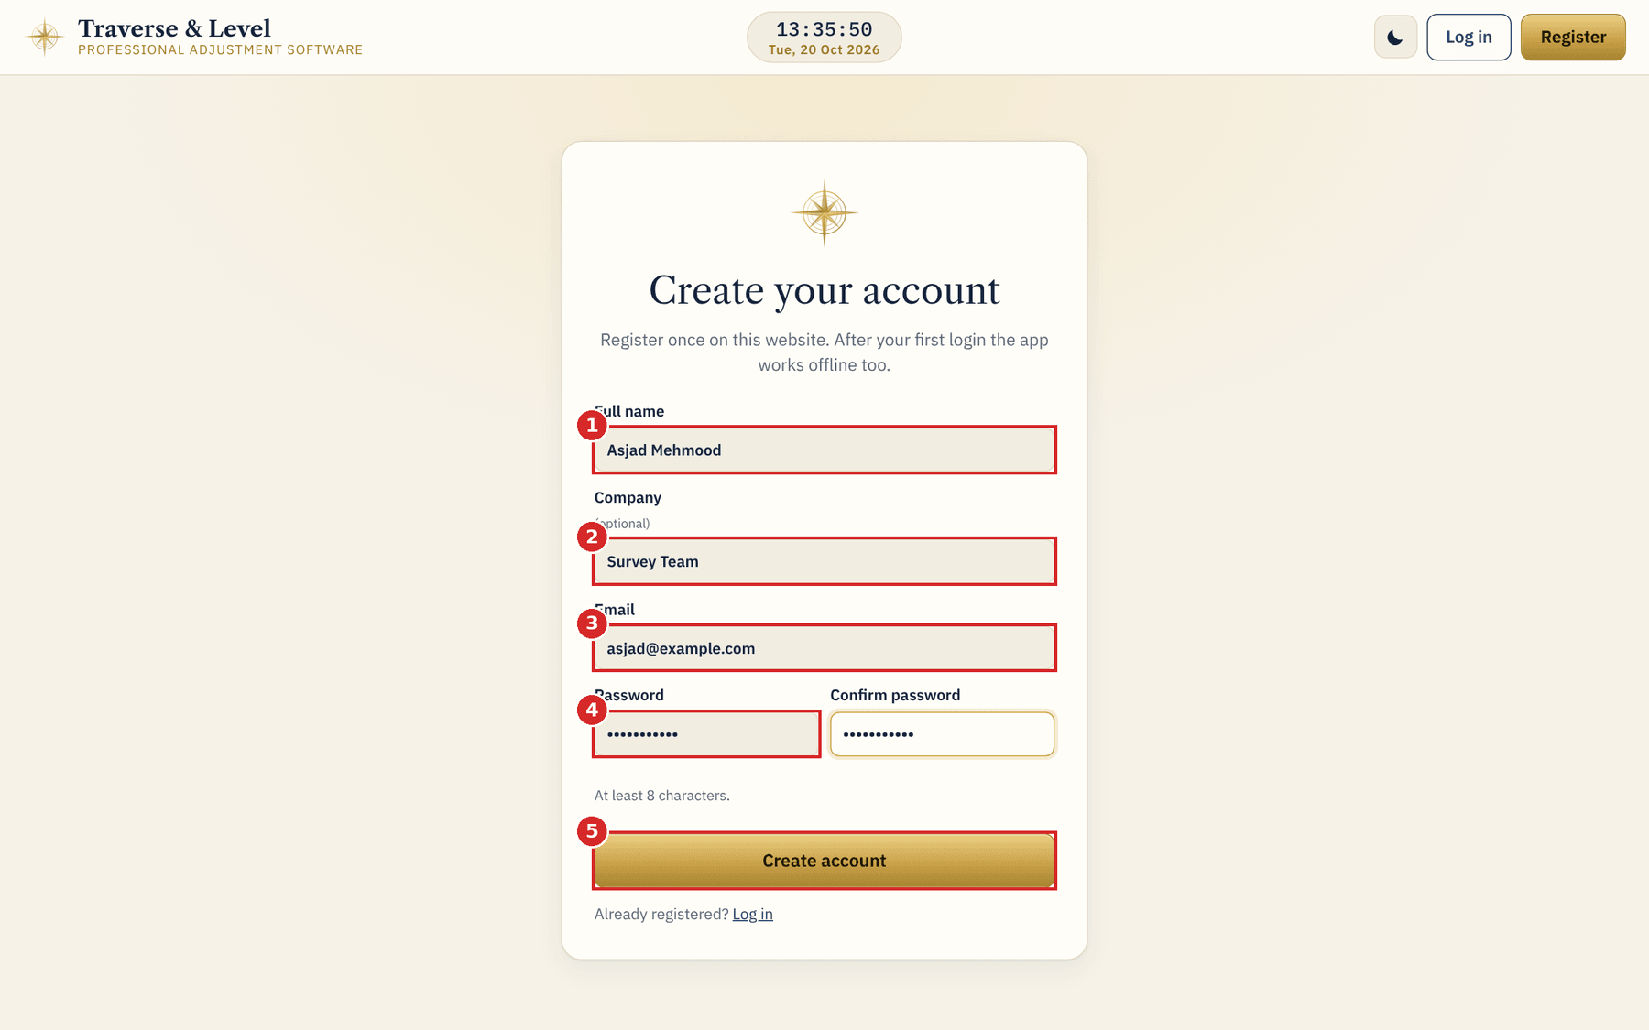
1 GETTING STARTED
Create your account
1
Full name
Shown in the dashboard greeting and used as the Surveyor on reports.
2
Company (optional)
Free text for your organisation.
3
E-mail
Your login name. Colleagues also use it to share jobs with you.
4
Password and confirm
At least 8 characters. Both boxes must match or an error appears.
5
Create account
Takes you to your dashboard with a welcome message.
Notes:
Fill all fields, press Create account. You are logged in straight away.

Slide 6
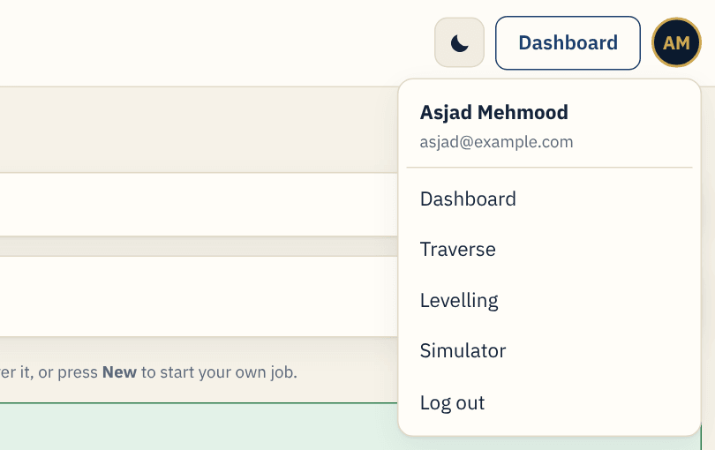
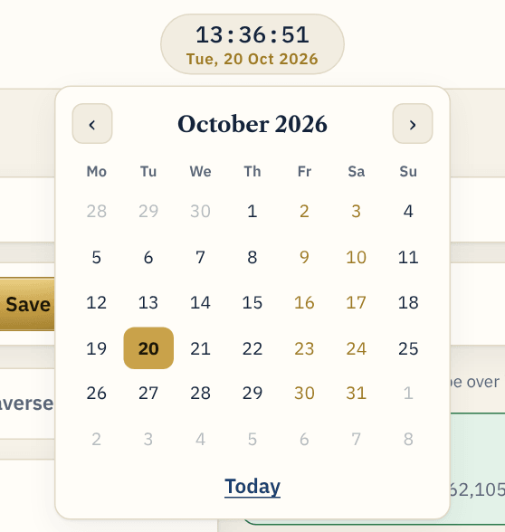
1 GETTING STARTED
Top bar and navigation
1
App name
Click to return to the home page.
2
Clock
Live date and time. Click it to open a calendar.
3
Light / dark
Switches the colour theme. Your choice is remembered.
4
Dashboard
Your saved jobs and summary. Visible after login.
Account menu
Calendar
5
Account button
Shows your name and e-mail, links to every tool, and Log out.
Navigation tabs, numbered left to right: Dashboard, Traverse, Levelling, Simulator. The tab you are on is dark.
Notes:
Top bar controls 1 to 5, the account menu and the navigation tabs.

Slide 7
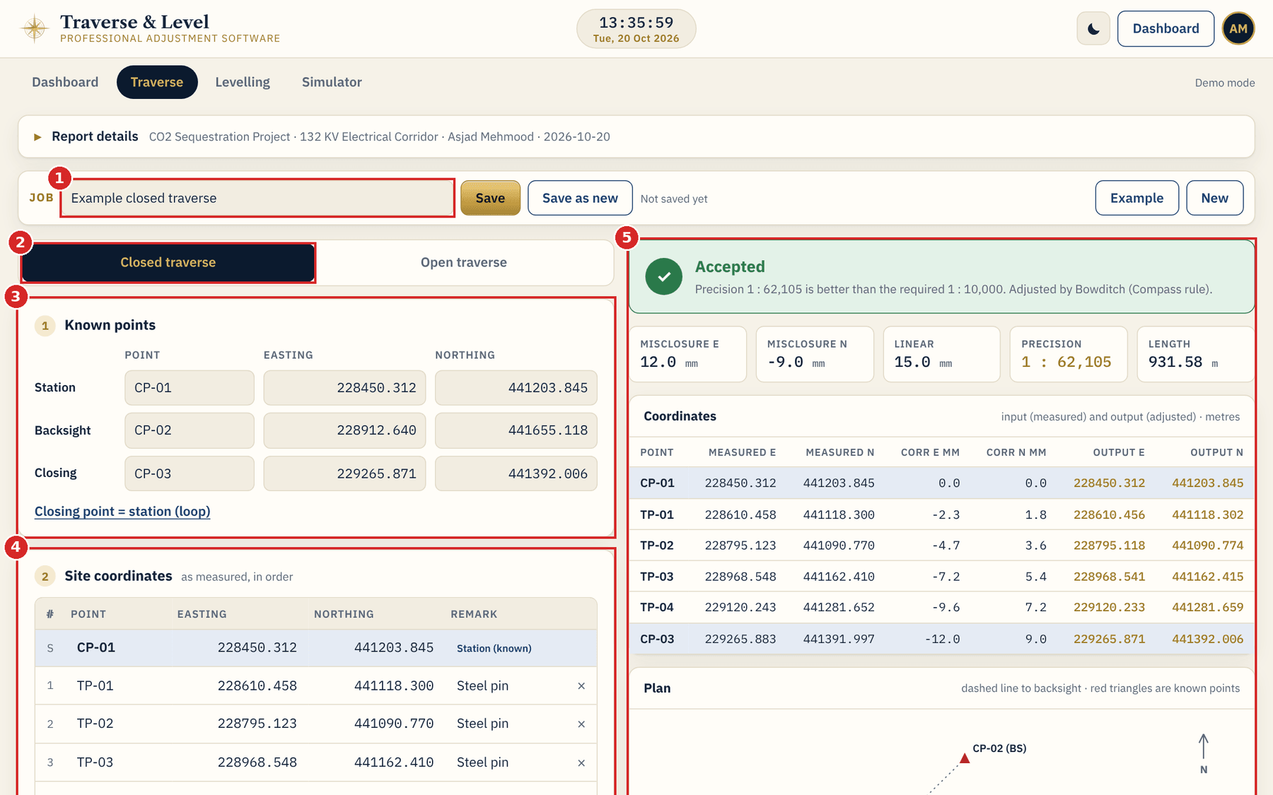
2 CLOSED TRAVERSE
The Traverse screen
1
Job bar
Name, save, example and new.
2
Traverse type
Closed checks on a known point. Open is in section 3.
3
1 Known points
Station, backsight and closing point.
4
2 Site coordinates
Points as measured, in order observed.
5
Result panel
Updates live as you type.
TIP Your entries are saved on this device as you type, so closing the app does not lose work.
Notes:
The Traverse screen has an input column on the left and a result column on the right.

Slide 8
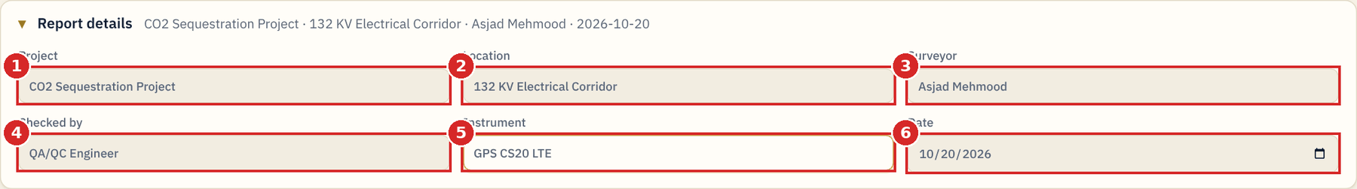
2 CLOSED TRAVERSE
Report details
1
Project
Printed at the top of every PDF report.
2
Location
Site or corridor name.
3
Surveyor
Your account name. Edit it if needed.
4
Checked by
Checker or QA/QC engineer.
5
Instrument
Total station or GPS model.
6
Date
Today by default. Change with the calendar button.
TIP Click the "Report details" bar to open or close it. The same details are used on traverse and levelling reports.
Notes:
Report details are shared between the Traverse and Levelling tools.

Slide 9
2 CLOSED TRAVERSE
Job bar: name, save, example, new
1
Job name
2
Save
3
Save as new
4
Example
5
New
Type a name such as "Al Khor TP loop 1". If you leave it empty, one is made from the project and date.
Stores the job under My jobs on the Dashboard. The text beside it shows Not saved yet, Unsaved changes or Saved.
Makes a separate copy with "(copy)" added, so you can try a variation.
Loads sample data for the traverse type you have selected, closed or open.
Clears the screen after you confirm with Start new. Unsaved changes are lost.
Traverse type switch. Choose Closed traverse or Open traverse. Your known points and readings stay when you switch.
Notes:
Job bar controls and the traverse type switch.

Slide 10
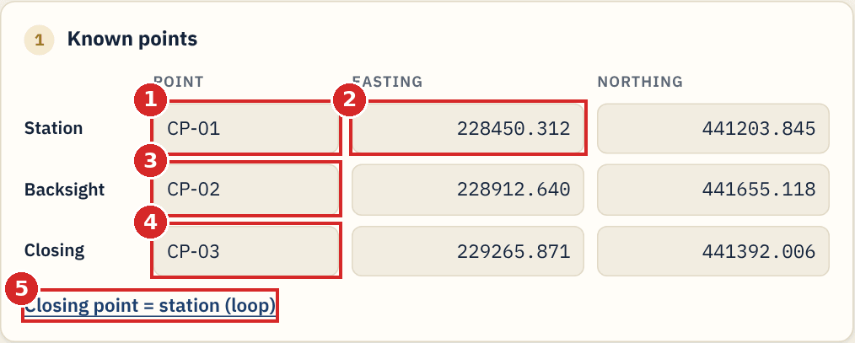
2 CLOSED TRAVERSE
Step 1: Known points
1
Station name
The known point where the traverse starts, for example CP-01.
2
Station Easting and Northing
Known coordinates in metres. Commas and spaces are accepted. A box turns red if it is not a number.
3
Backsight name
A second known point that gives the starting direction. It must not have the same coordinates as the station.
4
Closing name
The known point where the traverse ends. It is used for the closure check.
5
Closing point = station (loop)
One click copies the station into the closing point for a loop that returns to the start.
Notes:
Enter the three known points. Coordinates are Easting then Northing in metres.

Slide 11
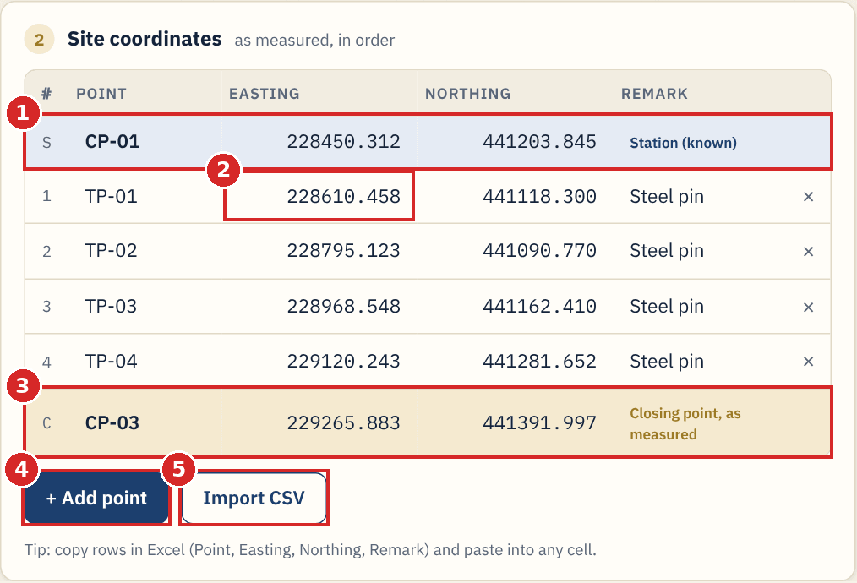
2 CLOSED TRAVERSE
Step 2: Site coordinates
1
Row S: station
Known station coordinates from step 1. Not editable here.
2
Traverse rows
One row per point, in order. The x deletes a row.
3
Row C: closing point
Coordinates as measured on site, not the known values.
4
+ Add point
Adds an empty row at the bottom.
5
Import CSV
Loads Point, Easting, Northing, Remark.
TIP Copy rows in Excel (Point, Easting, Northing, Remark) and paste into any cell. The rows fill automatically.
Notes:
Row C only appears for closed traverses and for open traverses with a closing point.

Slide 12
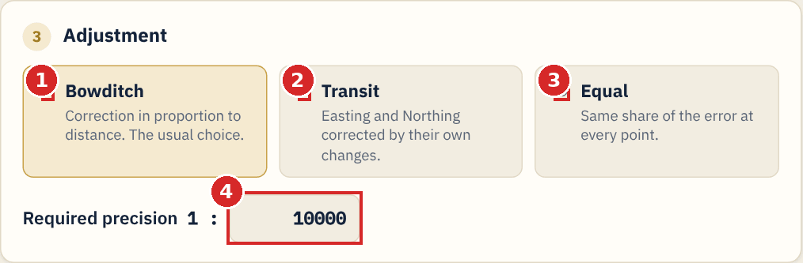
2 CLOSED TRAVERSE
Step 3: Adjustment method and precision
1
Bowditch (compass rule)
The usual choice. Each correction is in proportion to the distance travelled.
2
Transit
Easting and Northing are corrected in proportion to their own changes. It needs some change in both directions.
3
Equal
Every point receives the same share of the error.
4
Required precision 1 : N
Type N only, for example 10000 for 1:10,000. The result is accepted when the achieved precision is equal or better.
TIP Use the method your specification asks for. The default is Bowditch.
Notes:
Misclosure is measured closing coordinates minus known closing coordinates. Corrections have the opposite sign.

Slide 13
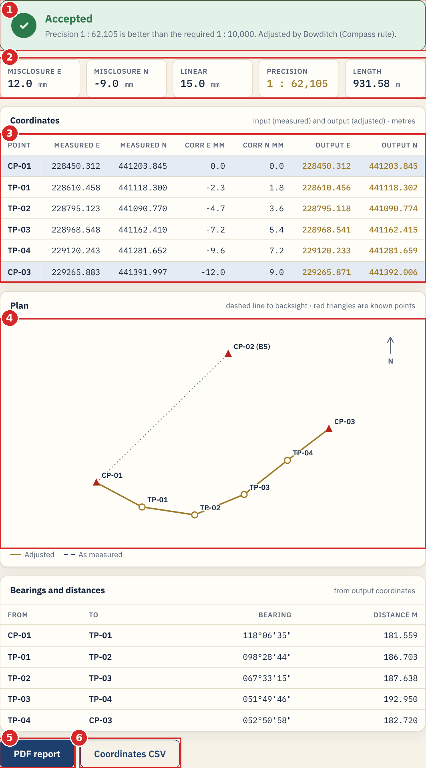
2 CLOSED TRAVERSE
Reading the result
1
Status banner
Green Accepted when the achieved precision is equal to or better than required, for example 1 : 62,105 against 1 : 10,000.
2
Misclosure tiles
Misclosure E and N and the linear misclosure in millimetres, the precision achieved, and the total traverse length.
3
Coordinates table
Measured E and N, the corrections in millimetres, and the Output E and N. Use the Output (adjusted) columns.
4
Plan sketch
Gold line is adjusted, dashed line is as measured, red triangles are known points, dotted line goes to the backsight.
5
PDF report
Creates the signed-off report for the job.
6
Coordinates CSV
Exports the table for Excel or CAD.
Notes:
A Bearings and distances table below the plan lists each leg computed from the output coordinates.

Slide 14
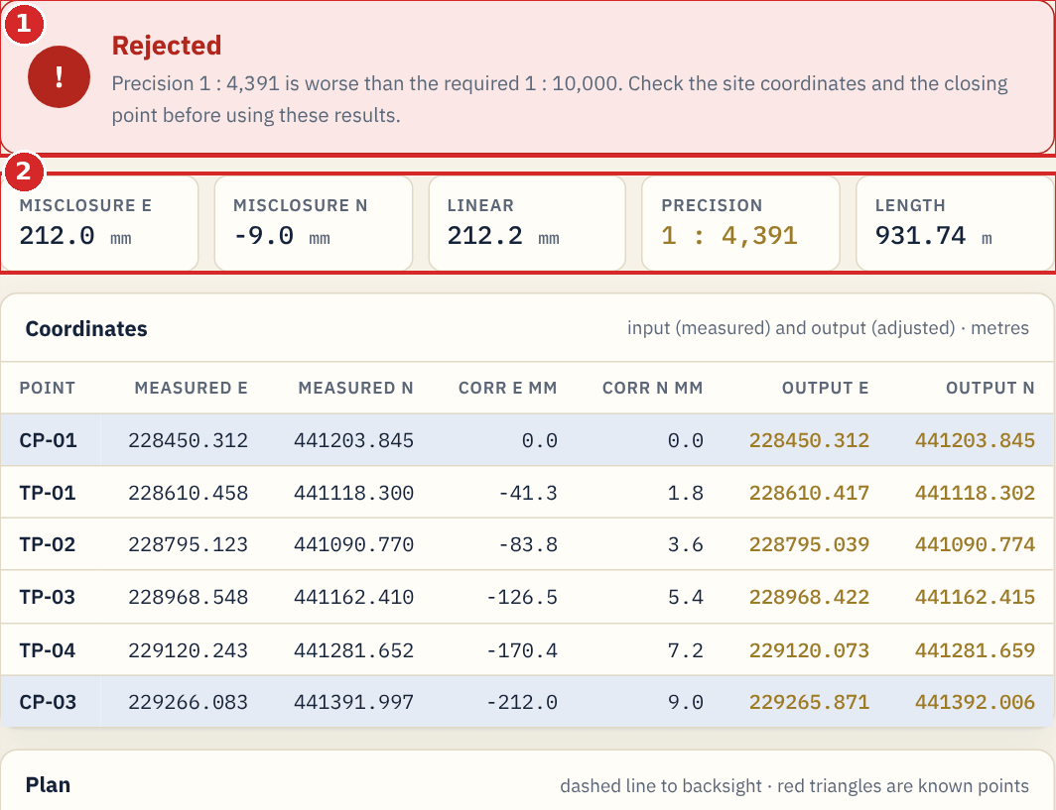
2 CLOSED TRAVERSE
When the result is rejected
1
Red Rejected banner
The achieved precision is worse than required. Here 1 : 4,391 against 1 : 10,000.
2
Misclosure tiles
Show how large the error is. Linear misclosure 212.0 mm on 931.74 m is too large for 1 : 10,000.
NOTE Do not use rejected results. Check that known and measured closing values are not swapped, re-check typed coordinates, then re-observe if needed.
Notes:
The app still shows the corrections so you can see where the error sits, but the job should not be issued until the misclosure is explained.

Slide 15
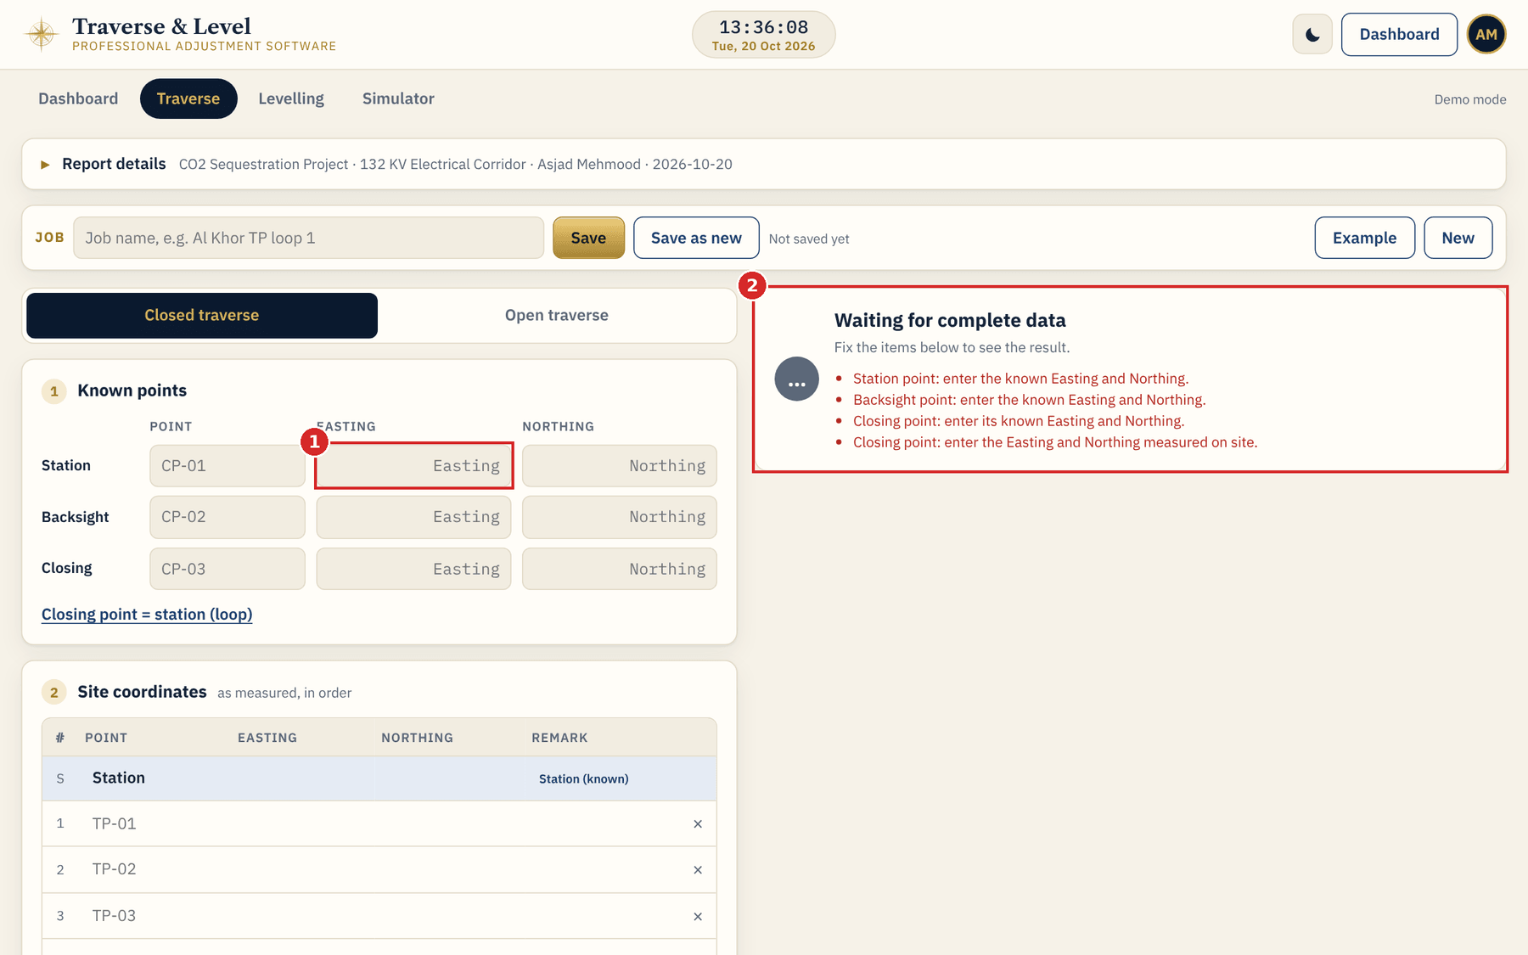
2 CLOSED TRAVERSE
Waiting for complete data
1
Empty or invalid box
A box with a red outline is missing or is not a number.
2
Status list
Lists exactly what to fix, one line each. The result appears when the list is empty.
TIP Typical messages: enter known Easting and Northing; row N is missing a number; backsight has the same coordinates as the station; precision must be positive.
Notes:
Warnings also appear when two points are less than 0.5 mm apart.

Slide 16
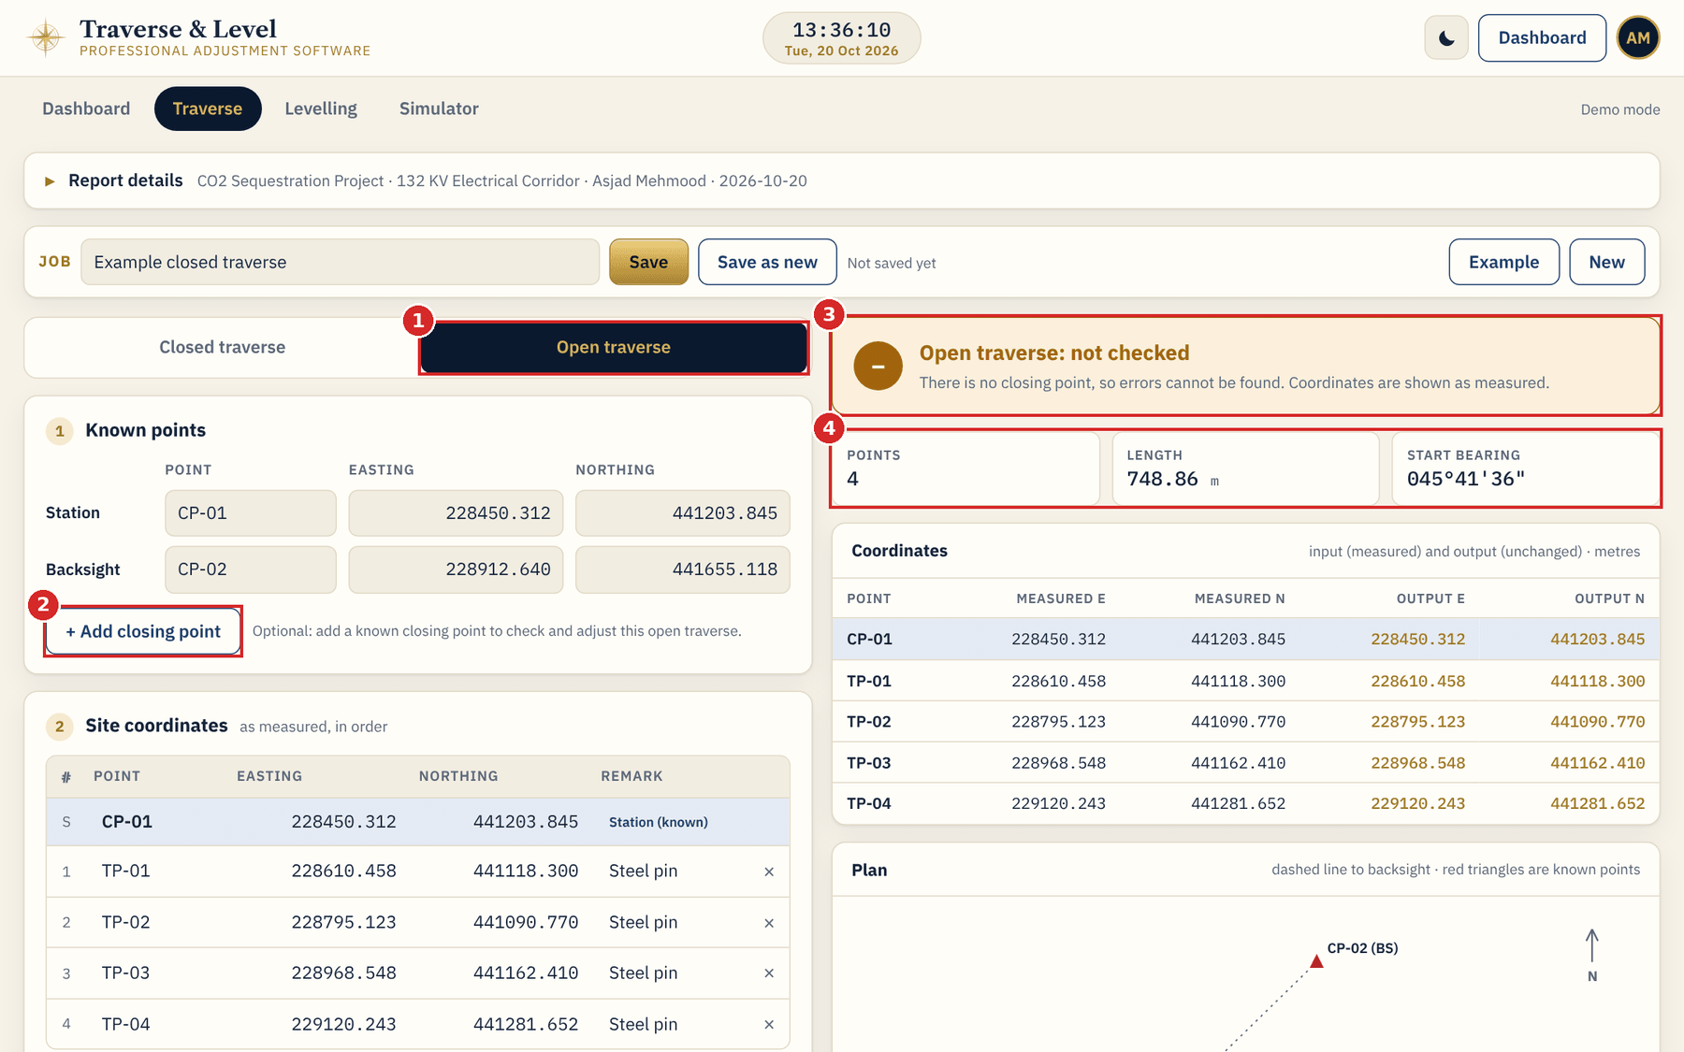
3 OPEN TRAVERSE
Open traverse: as measured
1
Open traverse
Select it to run a traverse that does not end on a known point.
2
Add closing point
New button. It is optional and is explained on the next slide.
3
Not checked banner
Without a closing point errors cannot be found, so coordinates are shown exactly as measured.
4
Summary tiles
Number of points, length and the starting bearing.
TIP Choose Example while Open traverse is selected to load an open sample.
Notes:
Without a closing point there is no adjustment, as in the previous version.

Slide 17
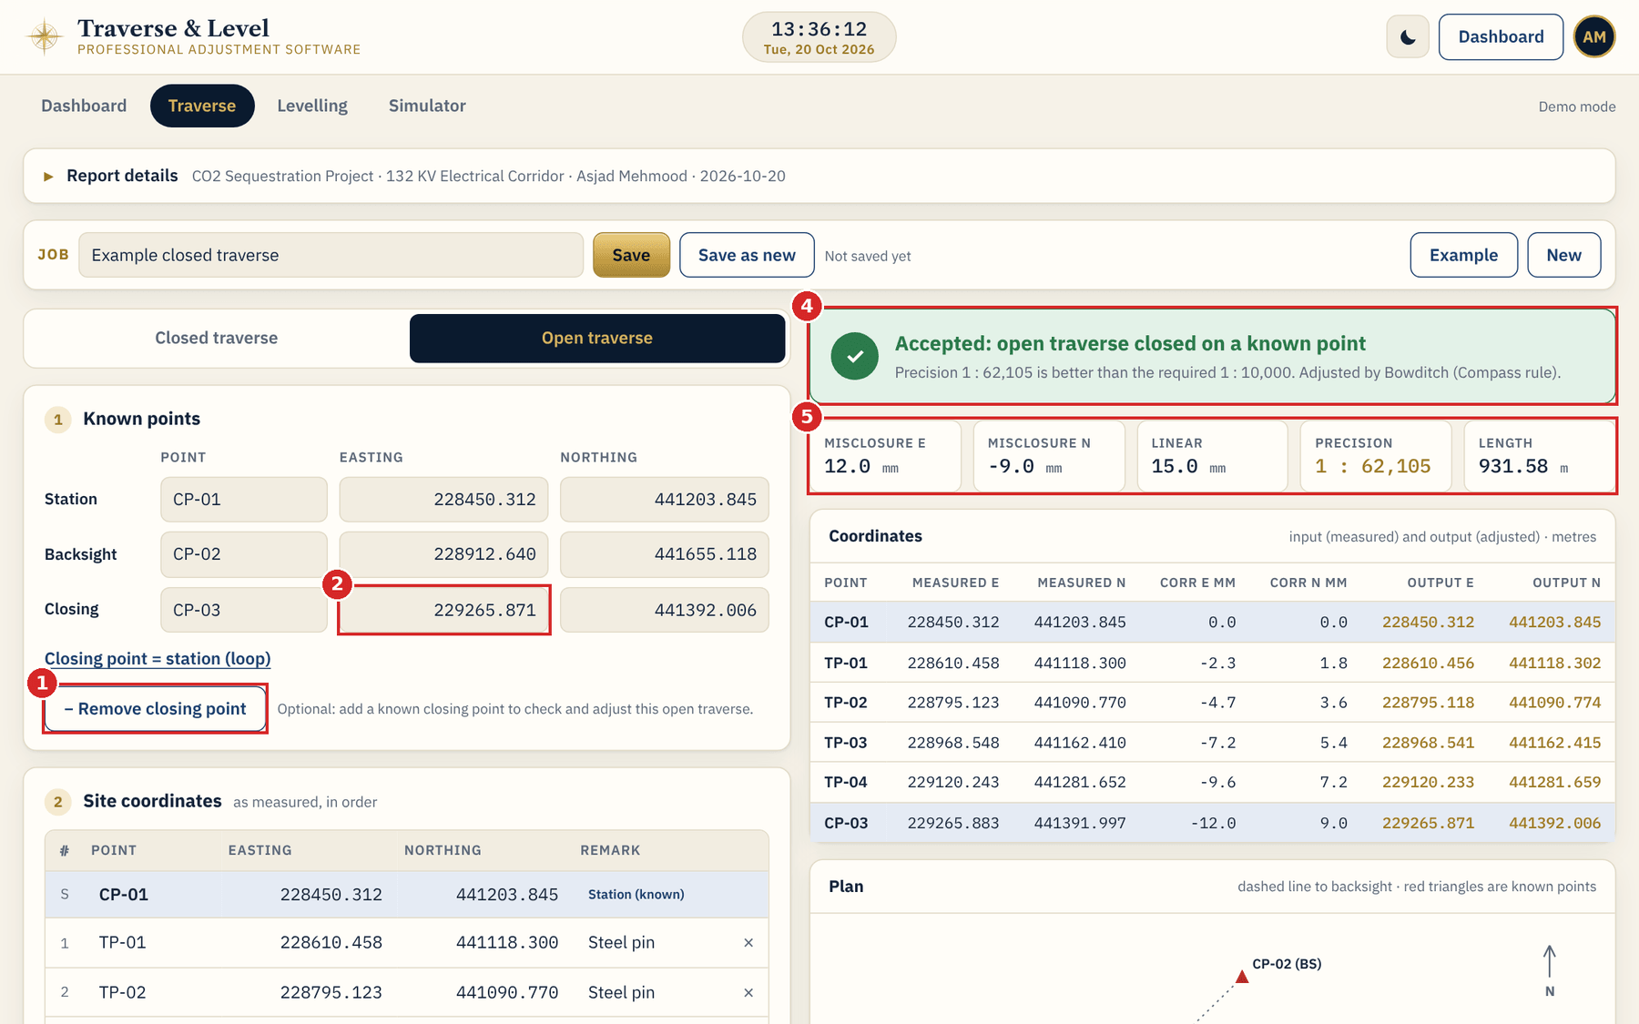
3 OPEN TRAVERSE
New: add a closing point
1
+ Add closing point
Press it under Known points. The button then reads Remove closing point.
2
Closing point known coordinates
Type the name, Easting and Northing of the known point you finish on.
3
Adjustment card
Appears now: choose Bowditch, Transit or Equal and the required precision.
4
Status banner
Reads "Accepted: open traverse closed on a known point" or Rejected.
5
Misclosure tiles
Misclosure E and N, linear misclosure, precision and length.
Notes:
The open traverse now behaves like a closed one for checking and adjustment, but it ends on a different known point.

Slide 18
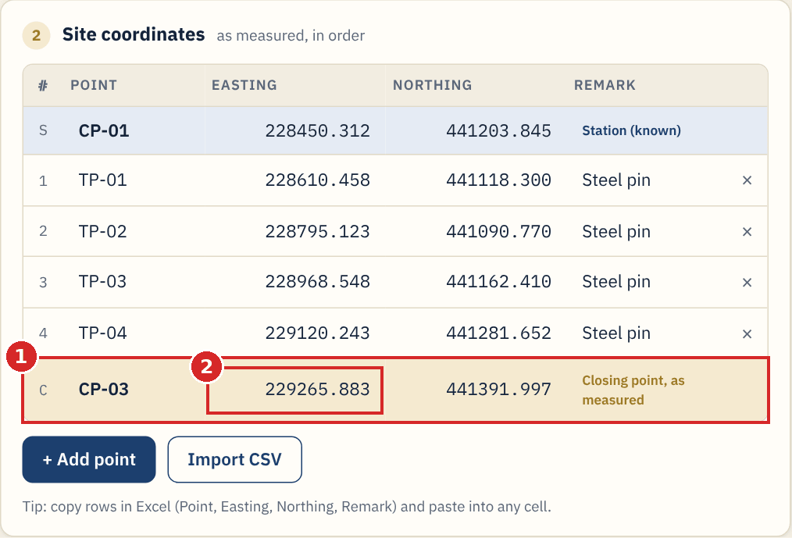
3 OPEN TRAVERSE
Enter the measured closing point
1
Row C appears
A new row at the bottom of Site coordinates, tagged "Closing point, as measured".
2
Measured Easting and Northing
Type what you observed on site for the closing point. The known values stay in Known points.
NOTE Both the known and the measured closing coordinates are needed. The status shows what is missing until both are complete.
Notes:
Misclosure = measured closing coordinates minus known closing coordinates.

Slide 19
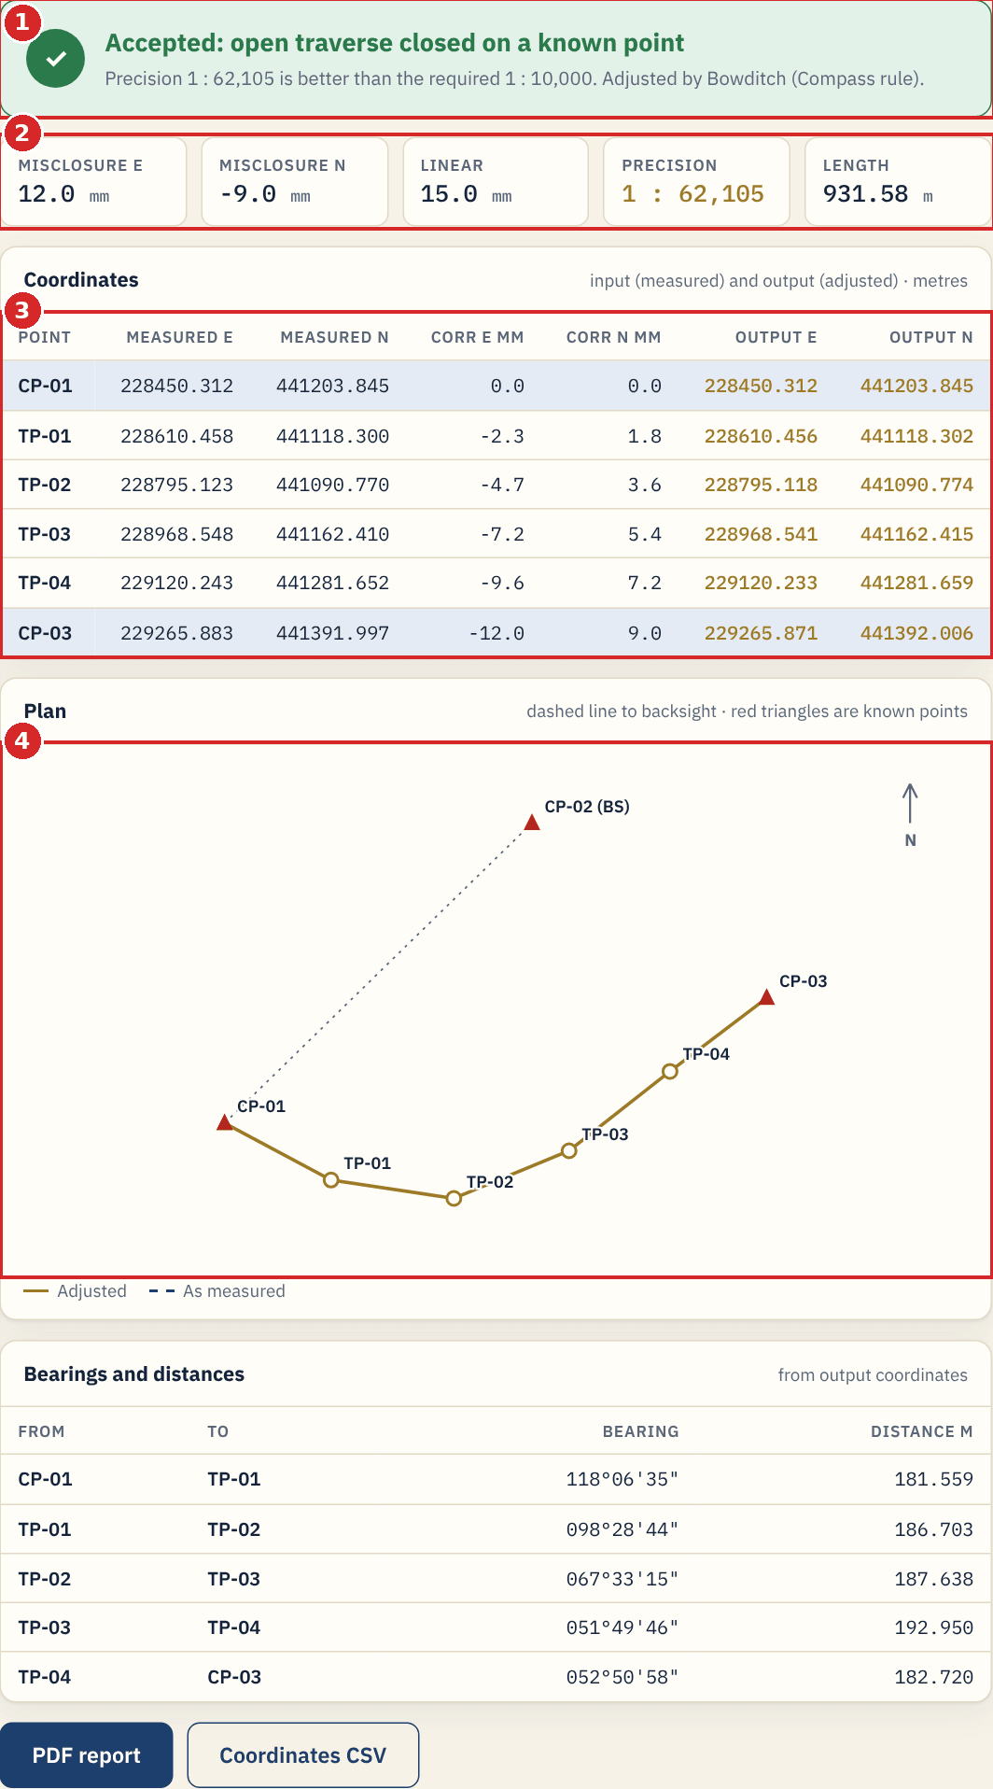
3 OPEN TRAVERSE
Open traverse result
1
Accepted banner
Precision 1 : 62,105 is better than the required 1 : 10,000, adjusted by Bowditch.
2
Misclosure tiles
12.0 mm East and -9.0 mm North, linear 15.0 mm, over 931.58 m.
3
Coordinates table
Corrections grow along the traverse. The closing point ends on its known coordinates.
4
Plan sketch
Dashed line shows as measured and the gold line adjusted. The red triangle at the end is the known closing point.
Notes:
With the example data the open traverse with a closing point gives the same numbers as the closed example.

Slide 20
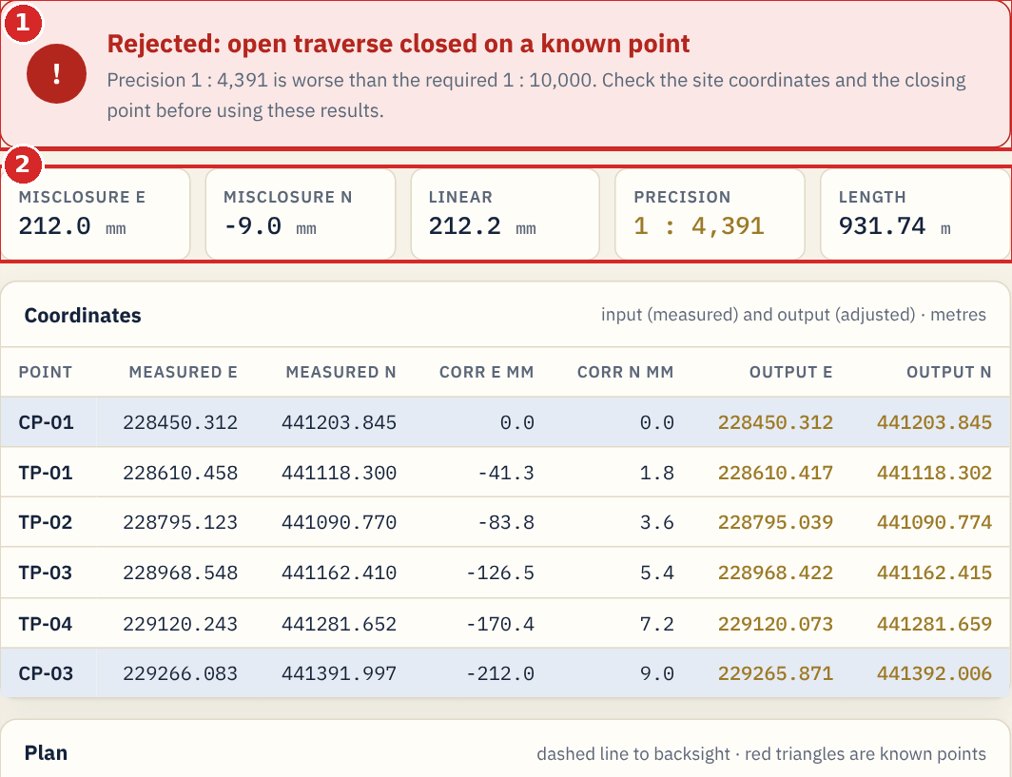
3 OPEN TRAVERSE
Rejected, or remove the closing point
1
Rejected: open traverse closed on a known point
The misclosure is too large for the required precision. Check the closing coordinates and re-observe if needed.
2
Remove closing point
Press the button again to go back to the unchecked open traverse. Your typed values are kept.
NEW Closed traverse and open traverse without a closing point behave exactly as before.
Notes:
Removing the closing point hides row C and the adjustment card.

Slide 21
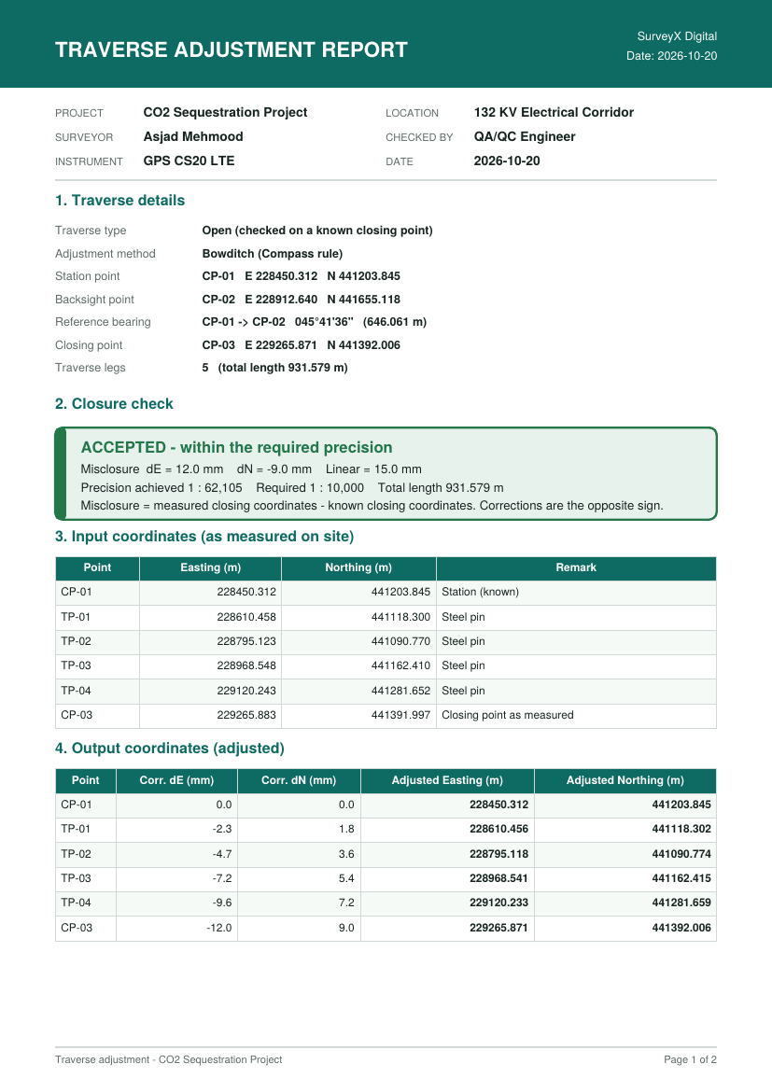
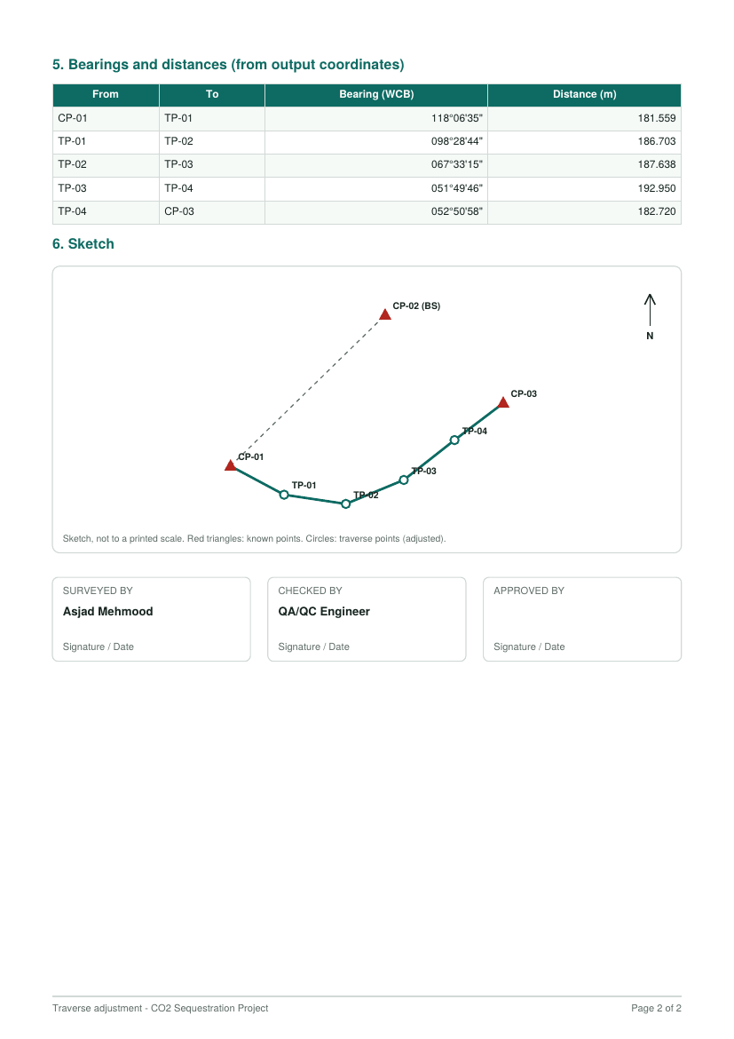
3 OPEN TRAVERSE
PDF report and CSV export
PDF report
Press PDF report under the results. It contains: 1 Traverse details, 2 Closure check, 3 Input coordinates, 4 Output coordinates, 5 Bearings and distances, 6 Sketch.
Type line in the report
Reads Closed, Open (checked on a known closing point) or Open (no closing check).
Coordinates CSV
Press Coordinates CSV for Point, Measured E and N, Corr dE and dN, Output E and N, Remark.
TIP The PDF uses your Report details (project, location, surveyor, checker, instrument, date). Fill them in first.
Notes:
Page 1 and 2 of the PDF produced for the open traverse with a closing point.

Slide 22
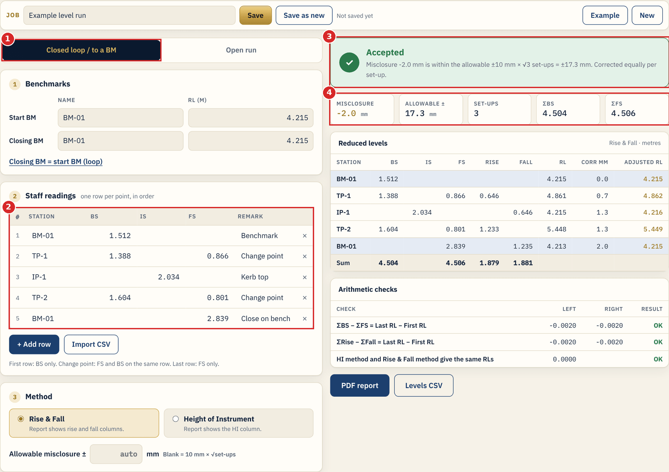
4 LEVELLING
The Levelling screen
1
Run type
Closed loop / to a BM checks on a known benchmark. Open run is not checked.
2
Benchmarks and staff readings
Start BM with its RL, closing BM, then one row per staff reading.
3
Status banner
Accepted when the misclosure is within the allowable value, here -2.0 mm against 17.3 mm.
4
Summary tiles
Misclosure, allowable, number of set-ups, total BS and total FS.
Notes:
Job bar and report details work exactly as in the Traverse tool.

Slide 23
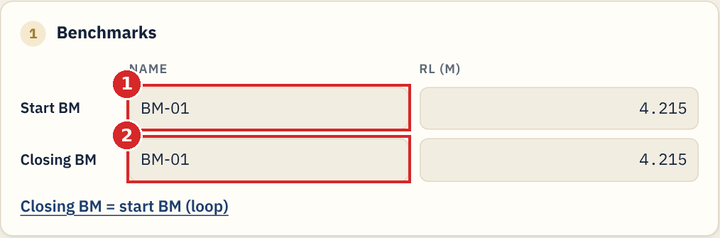
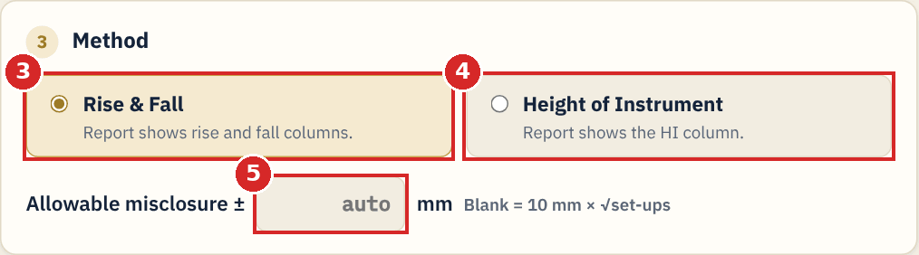
4 LEVELLING
Benchmarks and method
1
Start BM
Name and known RL of the benchmark you start on.
2
Closing BM
Benchmark you finish on. For a loop press "Closing BM = start BM".
3
Rise & Fall
Report shows rise and fall columns.
4
Height of Instrument
Report shows the HI column. Both methods give the same levels.
5
Allowable misclosure
Leave blank for 10 mm x sqrt(set-ups), or type your own value in mm.
Notes:
Marks 1 and 2 are on the Benchmarks card and 3 to 5 on the Method card.

Slide 24
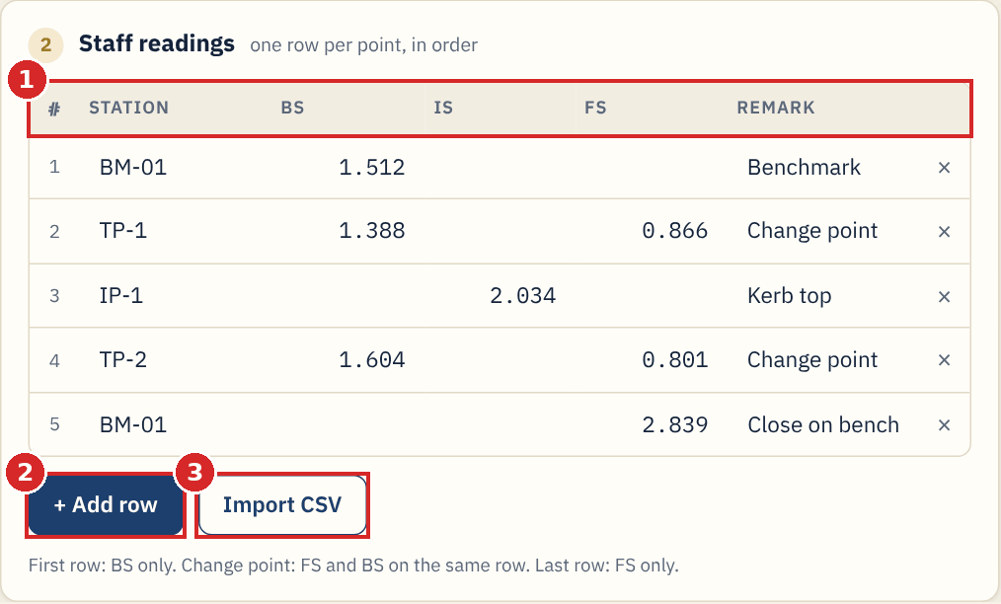
4 LEVELLING
Staff readings
1
Readings table
One row per reading: Station, BS, IS, FS, Remark.
2
+ Add row
Adds an empty row.
3
Import CSV
Loads Station, BS, IS, FS, Remark from a file.
TIP First row: BS only. Change point: FS and BS on the same row. Intermediate sight: IS alone. Last row: FS only.
Notes:
A reading outside -0.5 m to 6 m produces a warning because it looks unusual for a staff reading.

Slide 25
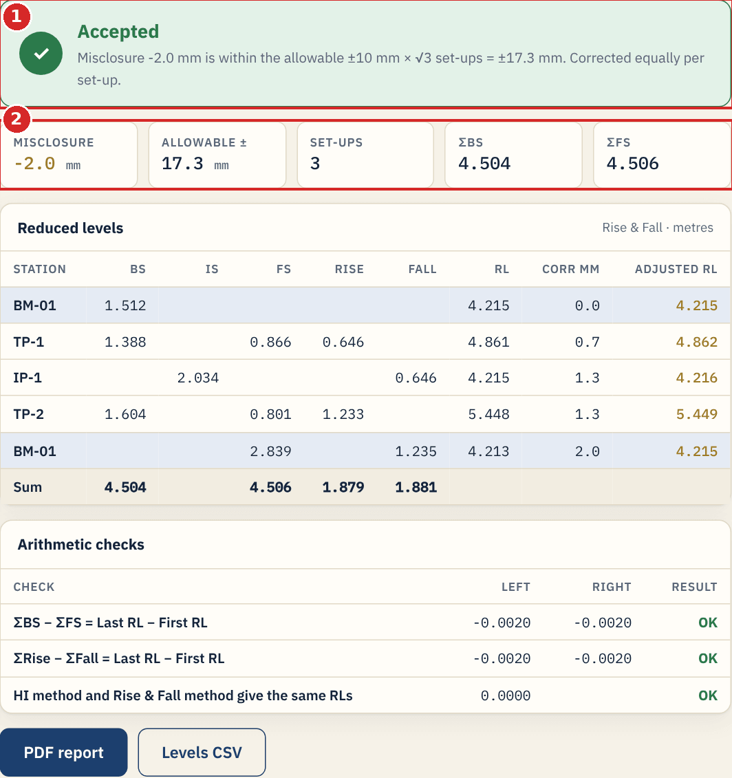
4 LEVELLING
Reading the levelling result
1
Status and tiles
Accepted or Rejected, with the misclosure, allowable value, set-ups and sums of BS and FS.
2
Reduced levels table
BS, IS, FS, Rise, Fall, RL, correction in mm and the adjusted RL. Correction is shared equally per set-up.
3
Arithmetic checks
Sum BS - Sum FS and Sum Rise - Sum Fall must equal last RL - first RL. All checks show OK.
4
PDF report and Levels CSV
Buttons at the bottom of the result column.
Notes:
The checks also confirm that the Height of Instrument and Rise & Fall methods give the same RLs.

Slide 26
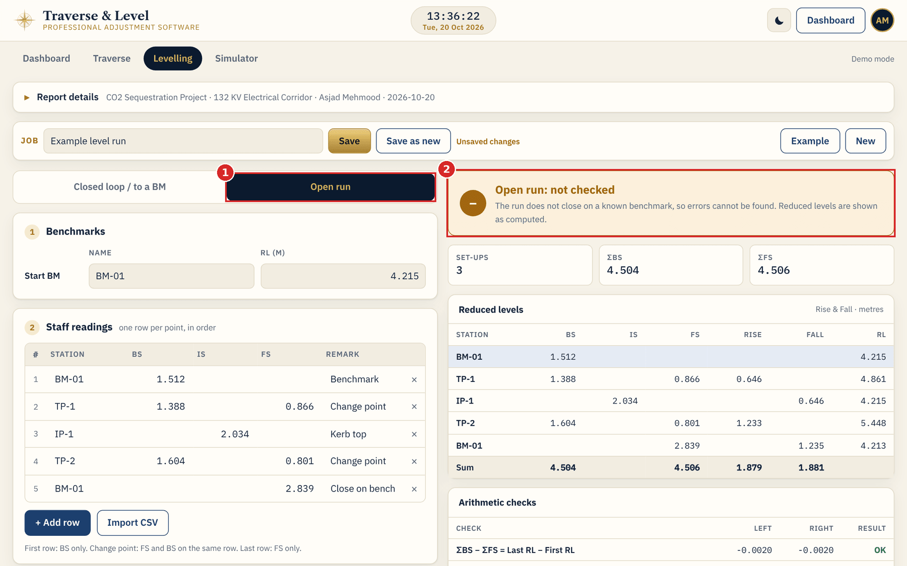
4 LEVELLING
Open run
1
Open run
Select it when you do not close on a benchmark.
2
Not checked banner
Errors cannot be found. Reduced levels are shown as computed and no correction is applied.
TIP The Closing BM boxes are hidden for an open run. Switch back to Closed loop to use them.
Notes:
Open runs have no adjustment.

Slide 27
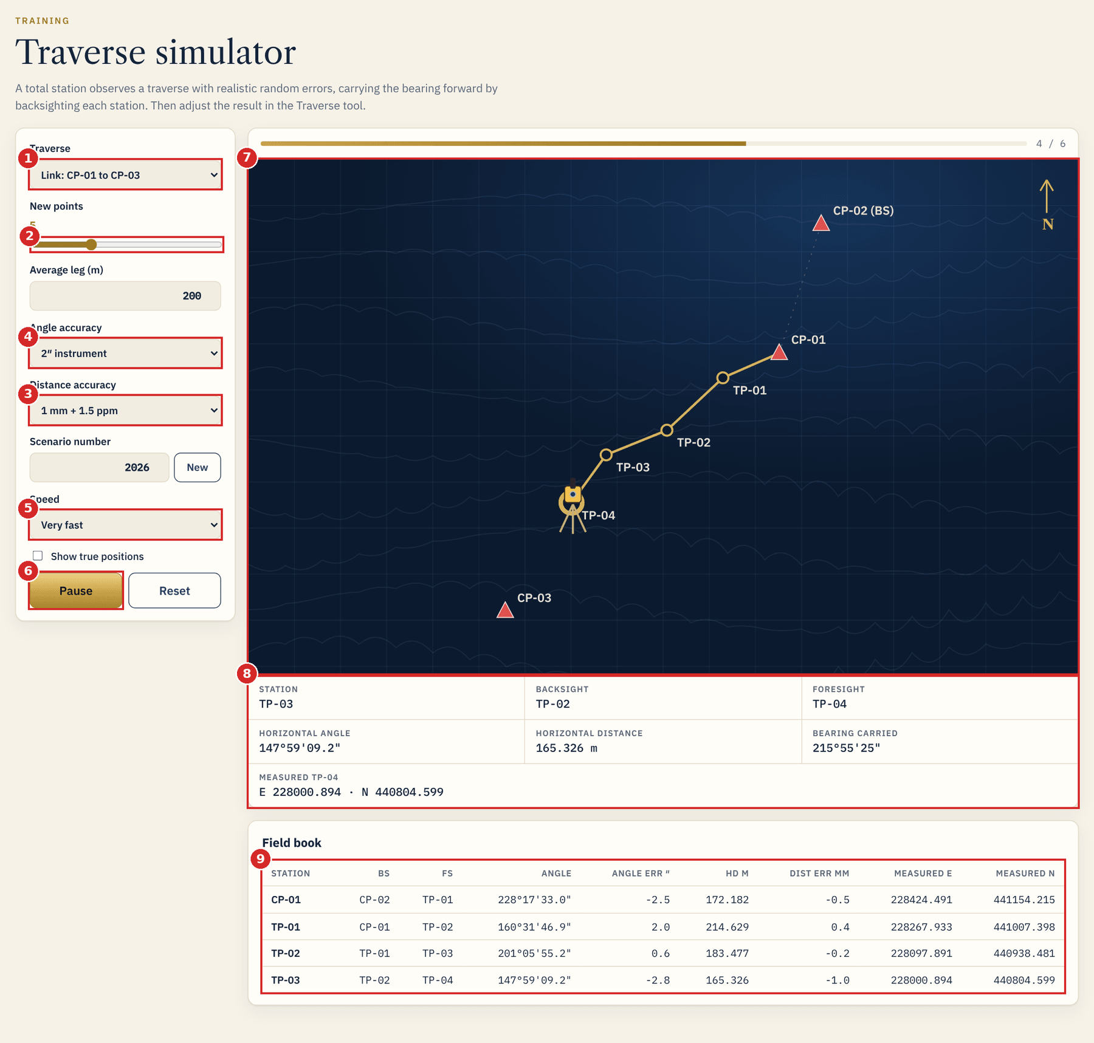
5 SIMULATOR, JOBS AND TIPS
Traverse simulator
1
Traverse Link CP-01 to CP-03, or loop back.
2
New points Slider for the number of points.
3
Distance accuracy For example 1 mm + 1.5 ppm.
4
Angle accuracy 1 second up to a poor 30 second set-up.
5
Speed Slow to very fast.
6
Run / Pause Starts or pauses. Reset clears.
7
Stage Plan view with the moving instrument.
8
Current reading Station, backsight, angle, distance.
9
Field book Each reading with its errors.
Notes:
Numbers 3 and 4 are Distance accuracy and Angle accuracy as they appear on the screen. Also on the left panel: Average leg (m), Scenario number with a New button, and Show true positions.

Slide 28
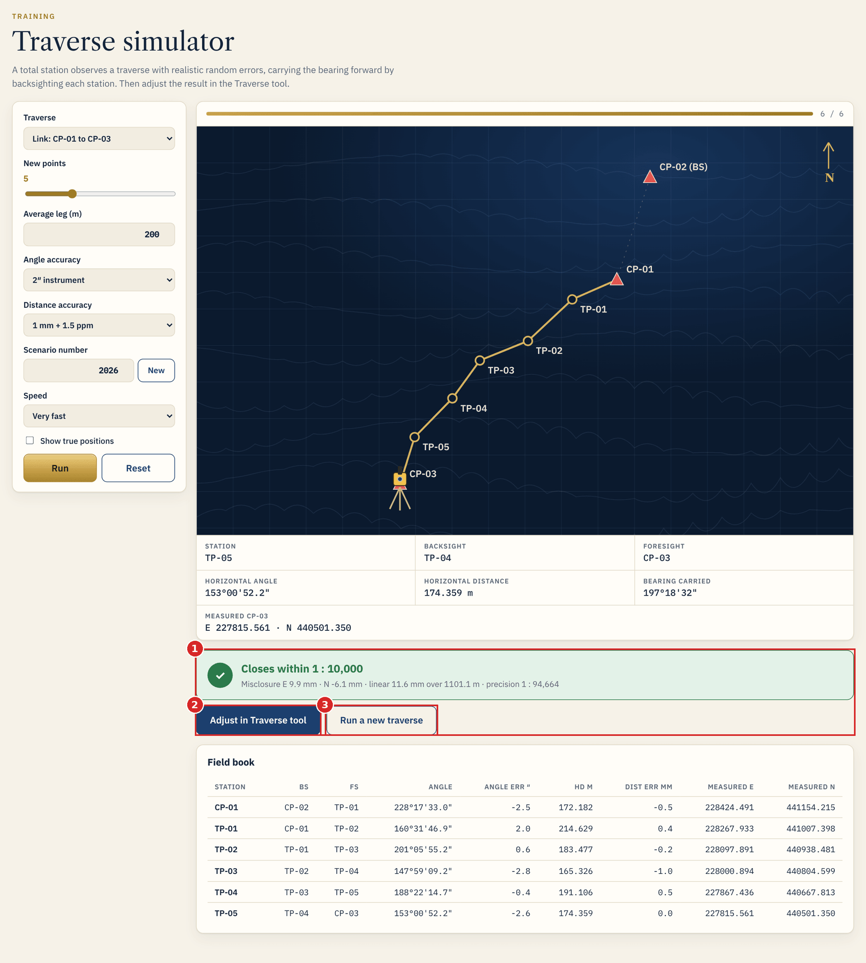
5 SIMULATOR, JOBS AND TIPS
Finish and adjust the simulated traverse
1
Result message
Tells how the simulated traverse closed, for example "Closes within 1 : 10,000" with the misclosure.
2
Adjust in Traverse tool
Sends the simulated points to the Traverse screen so you can adjust them.
3
Run a new traverse
Starts again with a new scenario number.
TIP Use the simulator for training. Try poor angle accuracy to see a traverse that gets rejected.
Notes:
The simulator is a training tool and does not change your saved jobs.

Slide 29
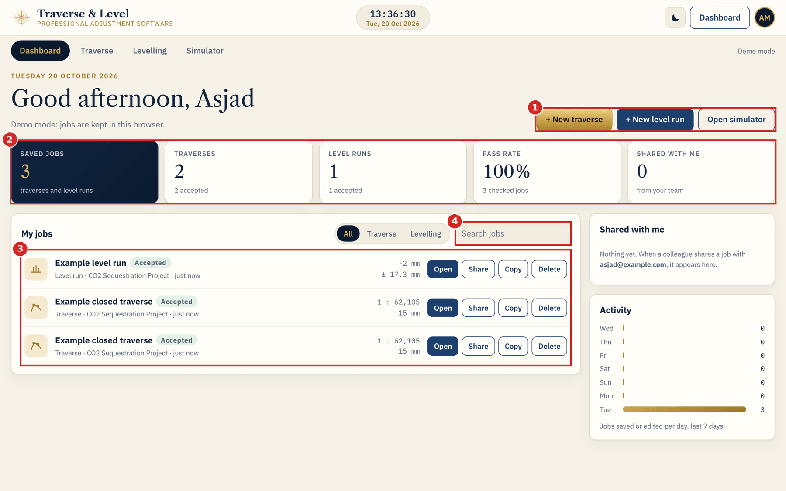
5 SIMULATOR, JOBS AND TIPS
Dashboard and saved jobs
1
Quick buttons
Start a new traverse, a new level run, or open the simulator.
2
Summary tiles
Saved jobs, traverses, level runs, pass rate and jobs shared with you.
3
My jobs
Filter All, Traverse or Levelling. Each job has Open, Share, Copy and Delete.
4
Search jobs
Type part of a name to find a job.
TIP Shared with me lists jobs from colleagues. Activity shows jobs saved or edited per day over the last 7 days.
Notes:
Delete asks for confirmation before removing a job.

Slide 30
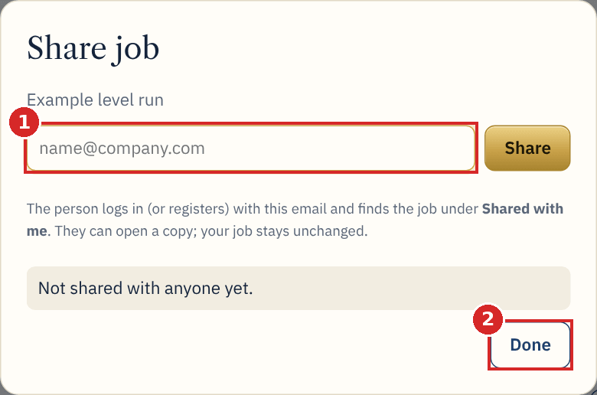
5 SIMULATOR, JOBS AND TIPS
Share a job
1
E-mail address
Type the colleague's e-mail and press Share. They find the job under Shared with me.
2
Done
Closes the dialog. The people you shared with are listed in it.
TIP The person can open a copy. Your job stays unchanged.
Notes:
Press Share on a job card on the Dashboard to open this dialog.

Slide 31
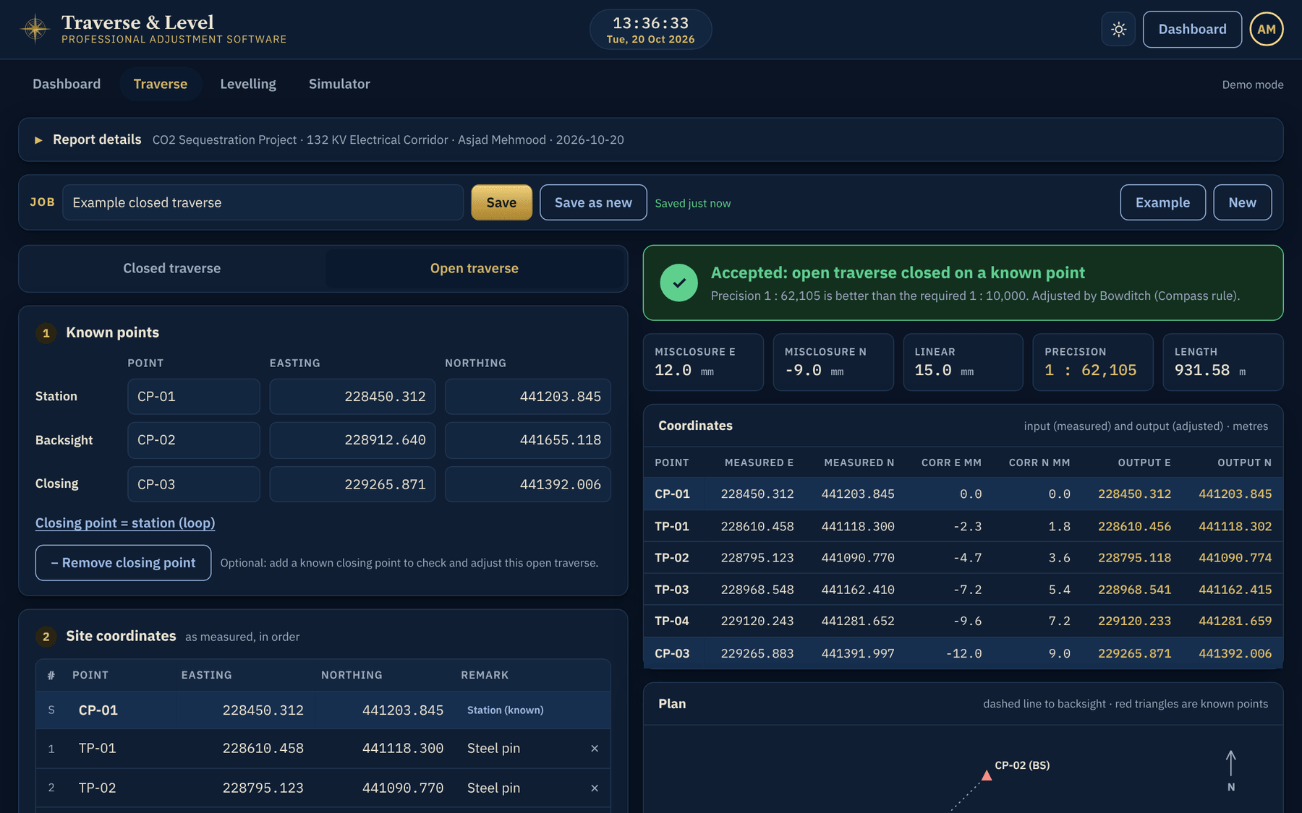
5 SIMULATOR, JOBS AND TIPS
Dark mode and good practice
Dark mode
Use the moon button in the top bar. It suits low light and is remembered.
Save often
Press Save after the first complete result and again after edits.
Check inputs first
Known and measured closing values are the most common mix-up.
Report details
Fill them before the PDF so it is ready to issue.
Keep the original data
Use Save as new before trying another method.
Notes:
General tips.

Slide 32
QUICK REFERENCE
Which mode should I use?
 | Closed traverse | Open traverse | Open + closing point (new)
Ends on | A known point | No known point | A known point
Closing point needed | Yes | No | Yes: known and measured
Misclosure and precision | Shown | Not shown | Shown
Adjustment | Bowditch, Transit or Equal | None | Bowditch, Transit or Equal
Status banner | Accepted or Rejected | Not checked | Accepted or Rejected
Output coordinates | Adjusted | As measured | Adjusted
Levelling follows the same idea: a closed loop or run to a BM is checked and adjusted, an open run is not checked.
Notes:
Summary table for choosing a mode.

