Slide 1
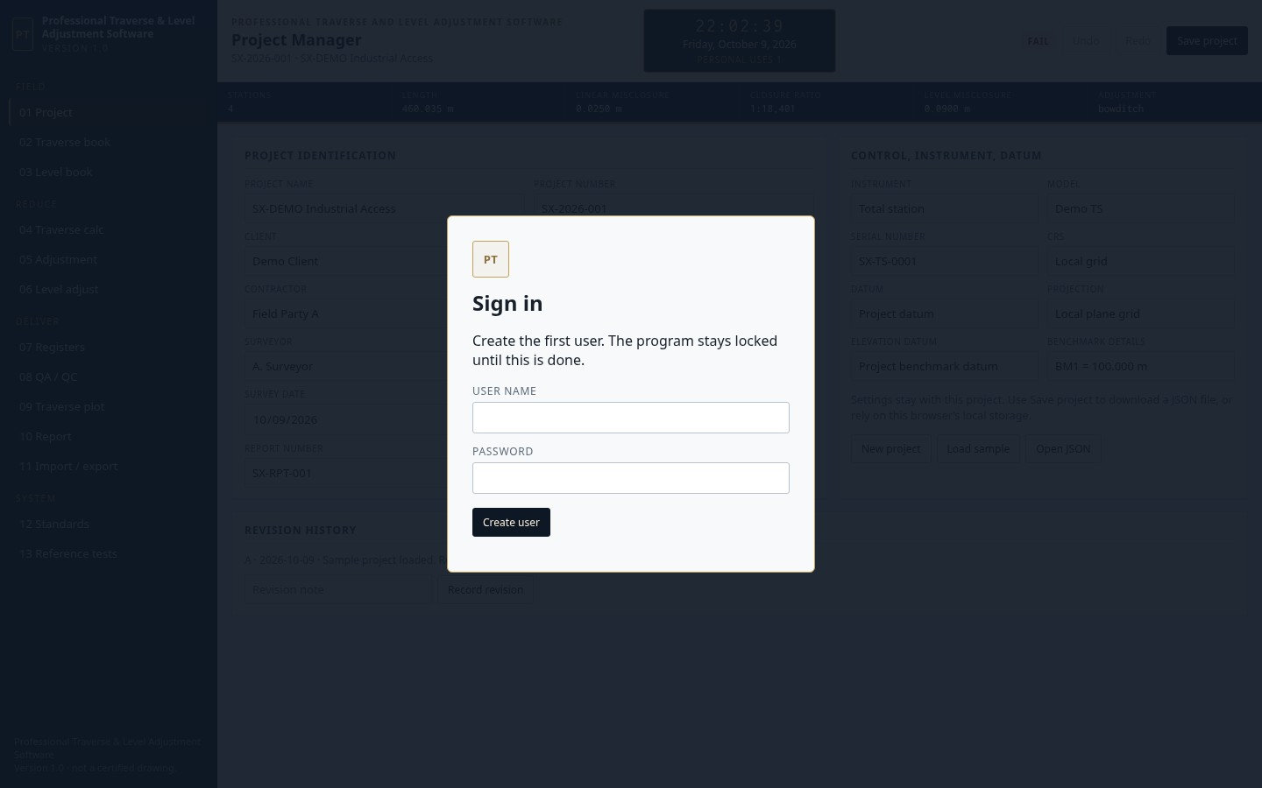
Install and sign in
Run the setup file and open the shortcut. Create a user. The program does not open without a sign-in.

Slide 2
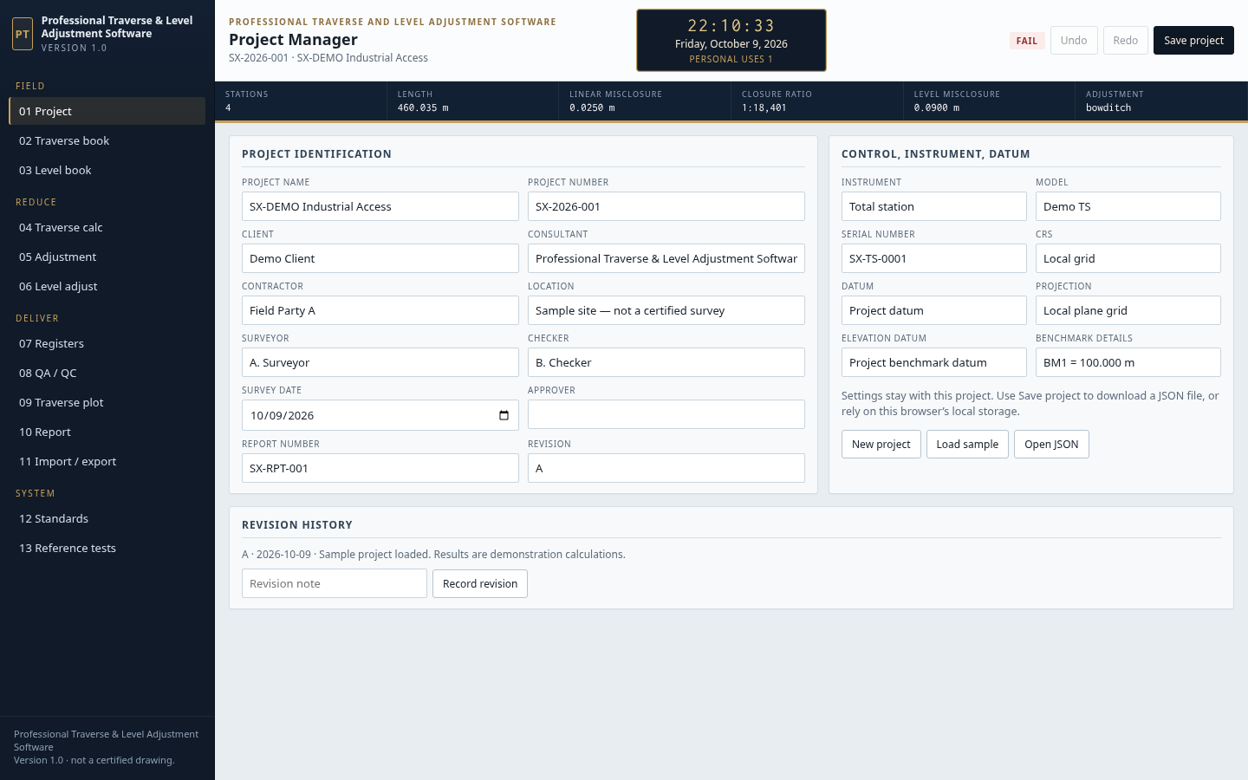
Project Manager
Enter the project, client, surveyor, instrument and datum. Load sample, open a JSON file, or save the project.

Slide 3
Clock and personal use
The gold clock and calendar stay at the top centre. Personal uses counts once each time this computer opens the program.

Slide 4
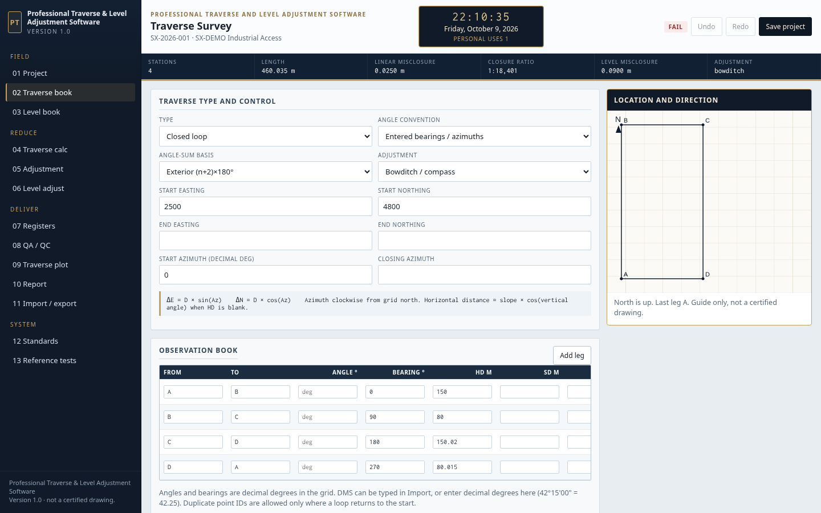
Traverse book
Enter the start coordinates and each leg. The location window updates on the right. North is up.

Slide 5
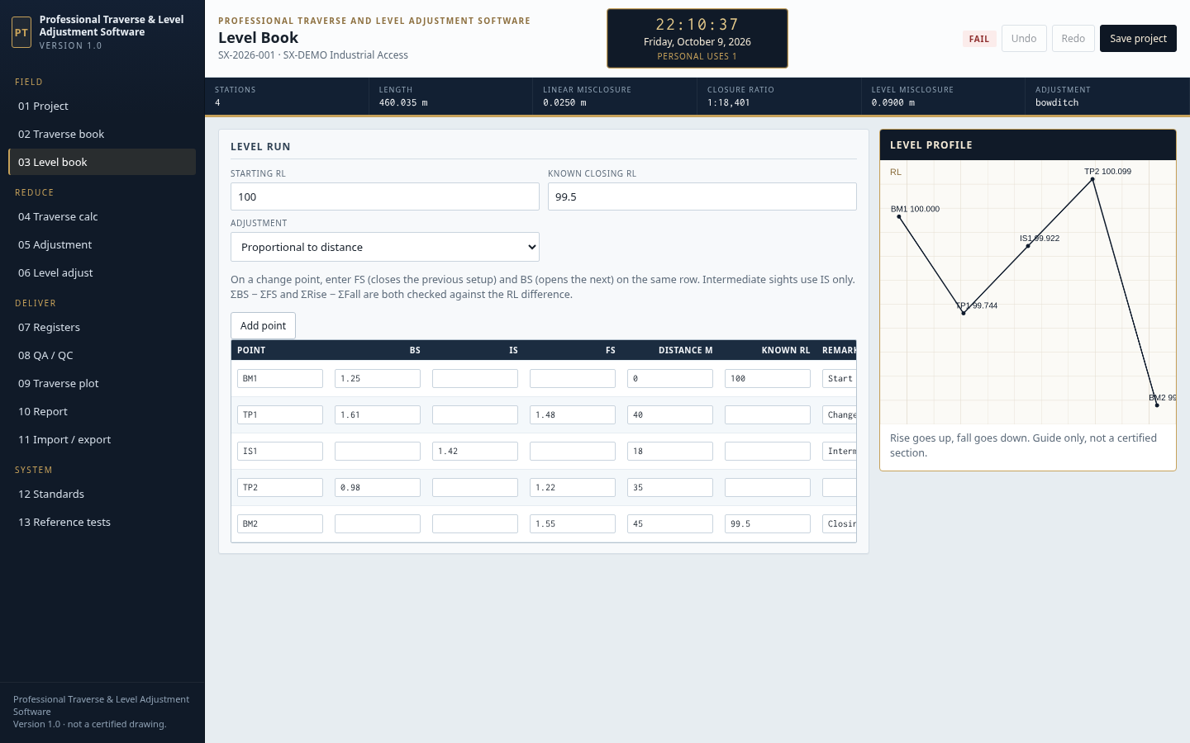
Level book
Enter BS, IS, FS and distance. The profile shows rise and fall.

Slide 6
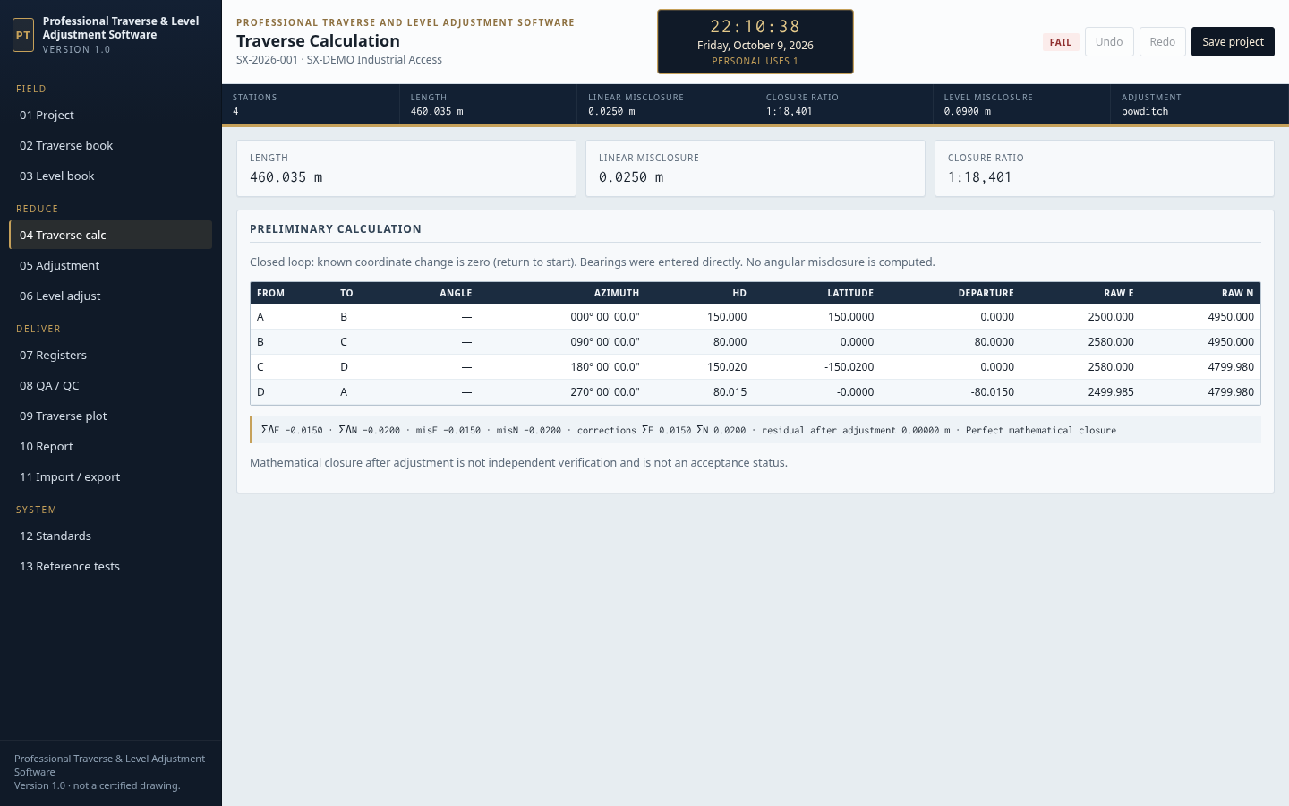
Traverse calculation
Check azimuth, latitude, departure and raw coordinates before adjustment.

Slide 7
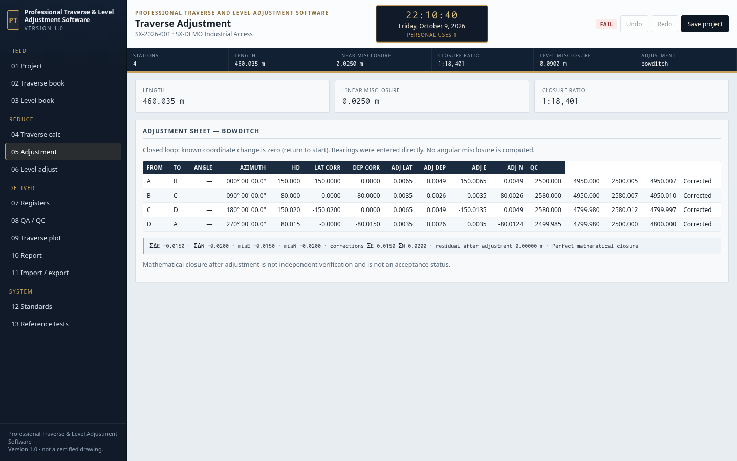
Traverse adjustment
Bowditch, Transit, least squares or none. Corrections and adjusted coordinates are listed by leg.

Slide 8
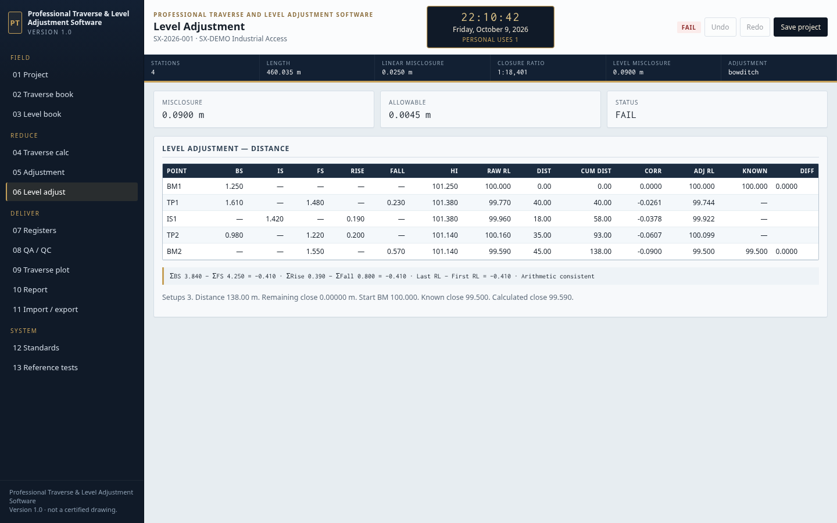
Level adjustment
Closing error, allowable tolerance, corrections and adjusted reduced levels.

Slide 9
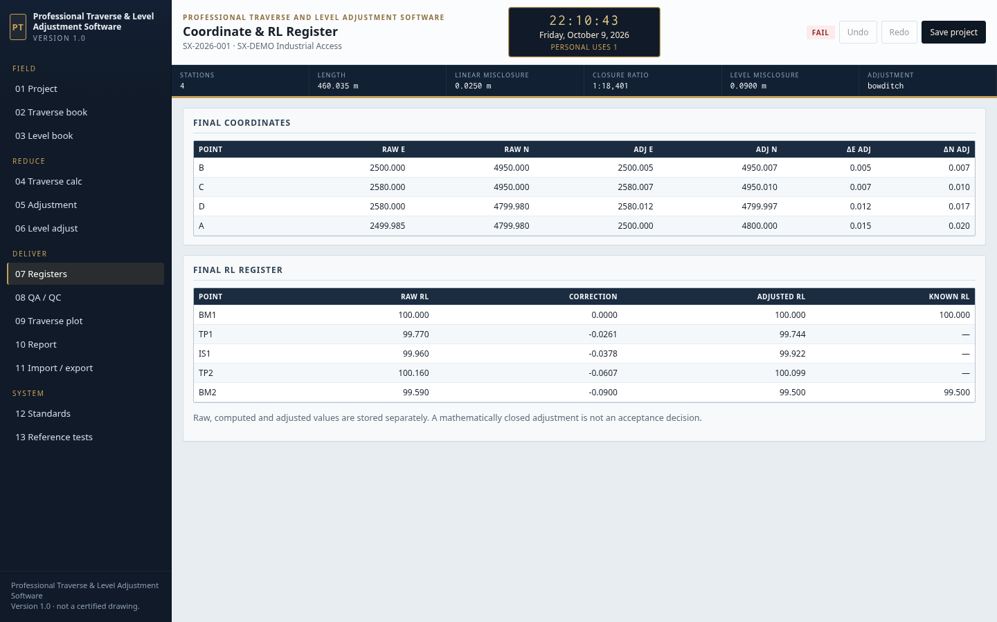
Registers
Raw and adjusted coordinates, and raw and adjusted reduced levels.

Slide 10
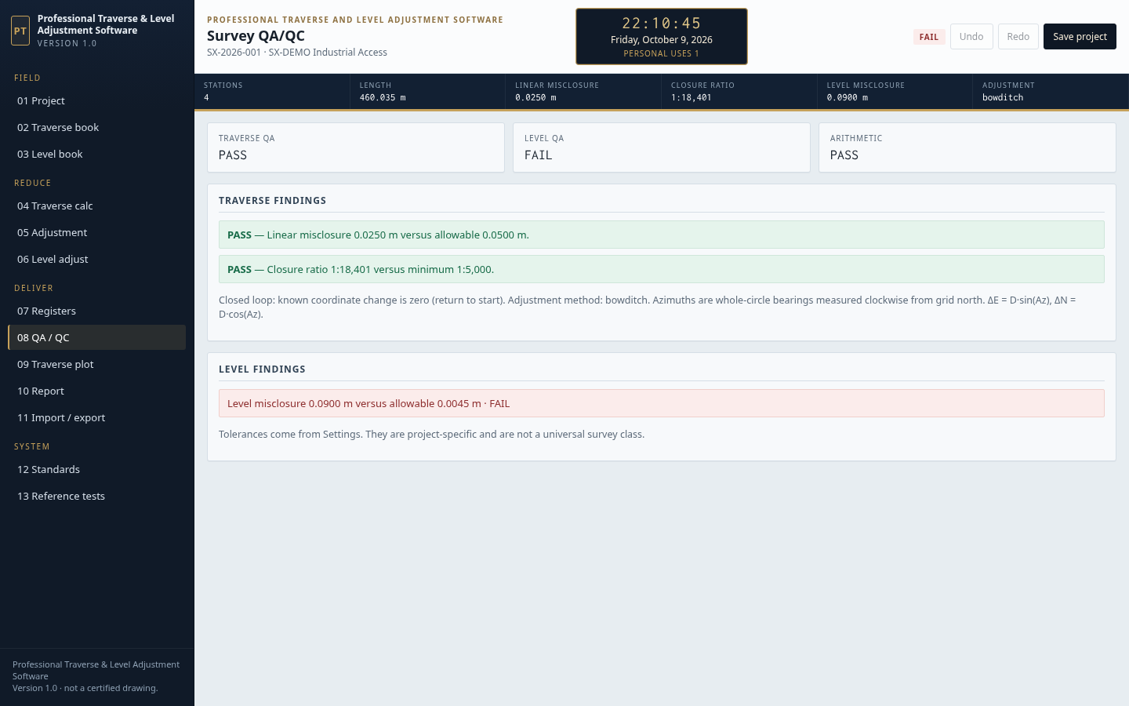
QA / QC
Pass, warning or fail against the limits set in Standards.

Slide 11
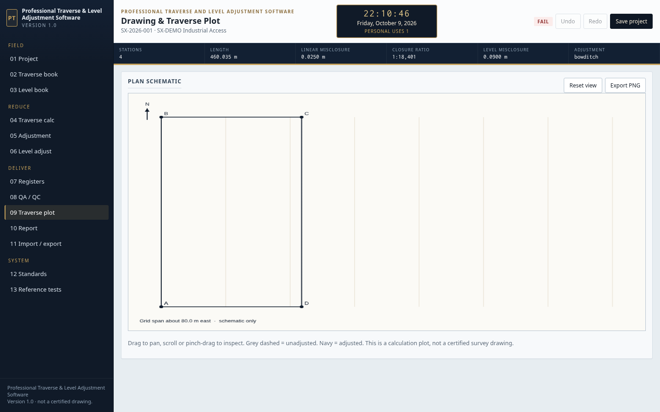
Traverse plot
Full plan with north, station names, and drag and zoom.

Slide 12
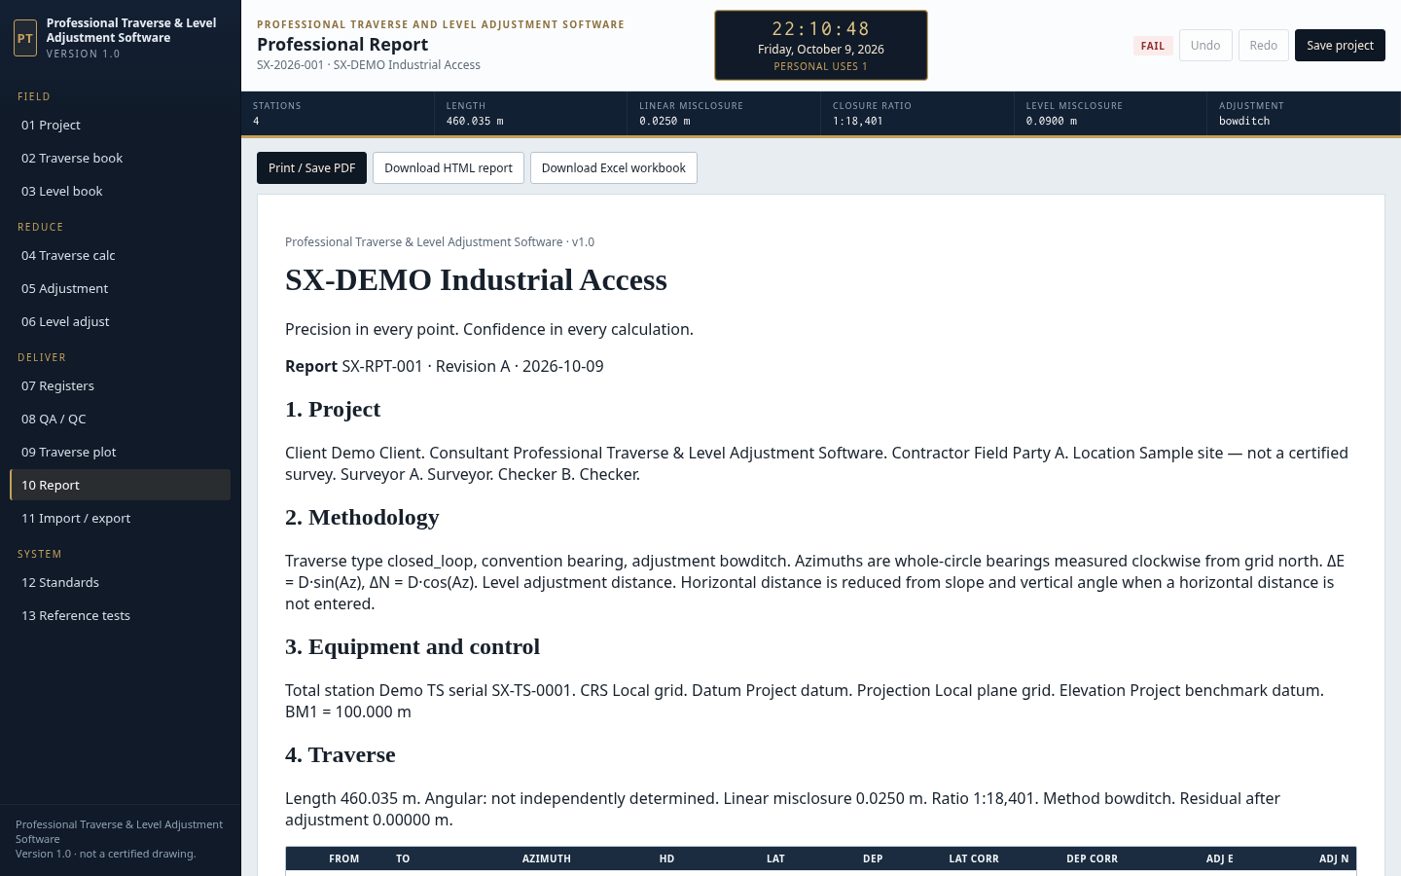
Report
Review and print the professional report.

Slide 13
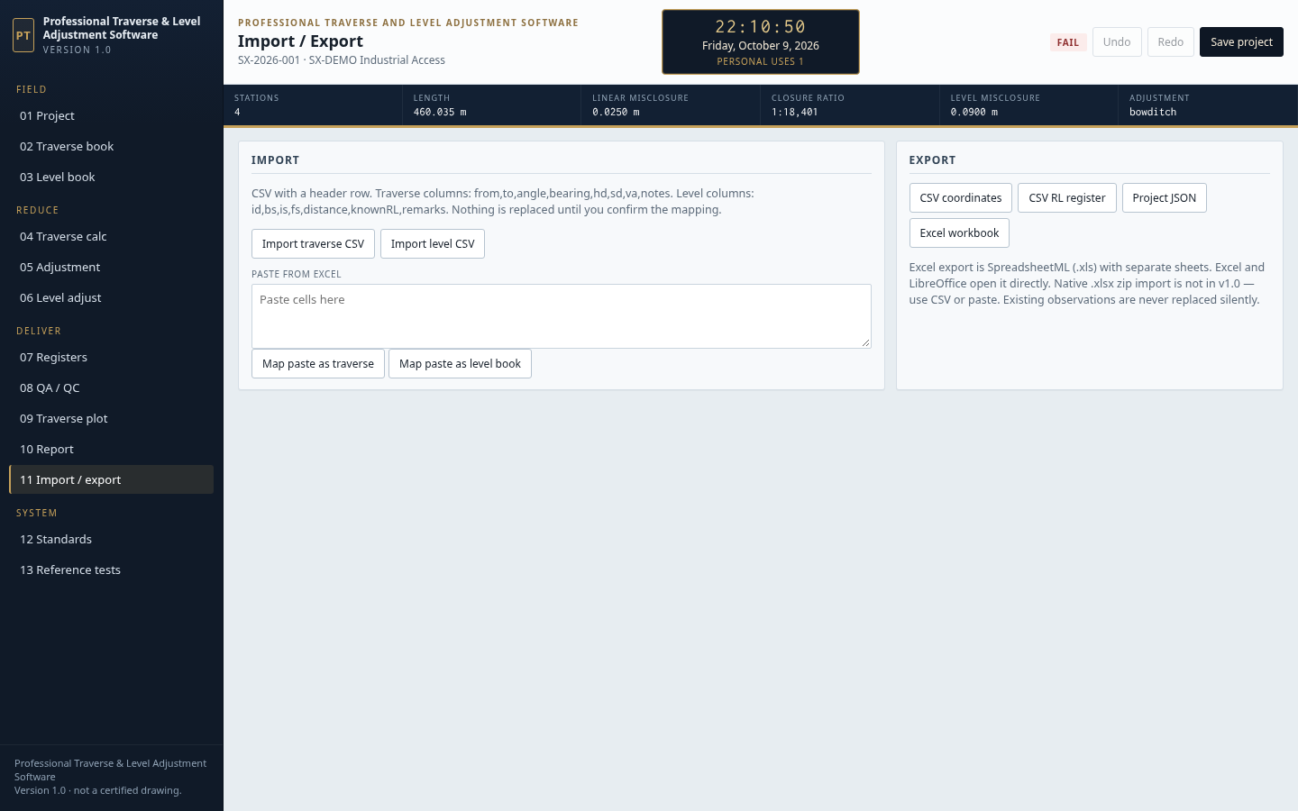
Import / export
Import a CSV traverse or level book, and export the workbook.

Slide 14
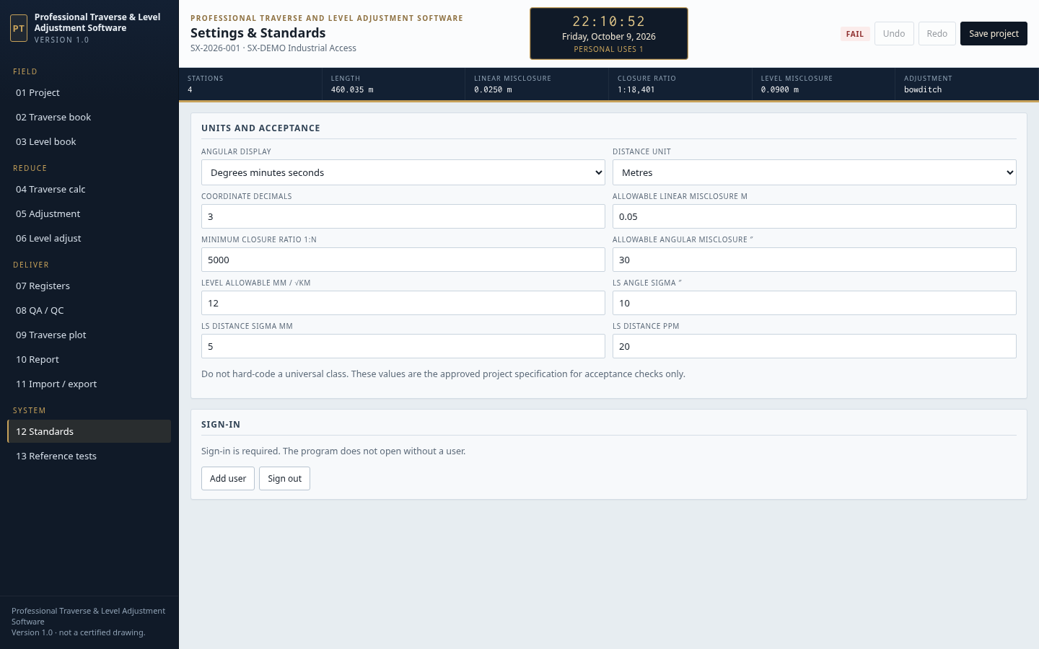
Standards
Units, tolerances, add user and sign out.

Slide 15
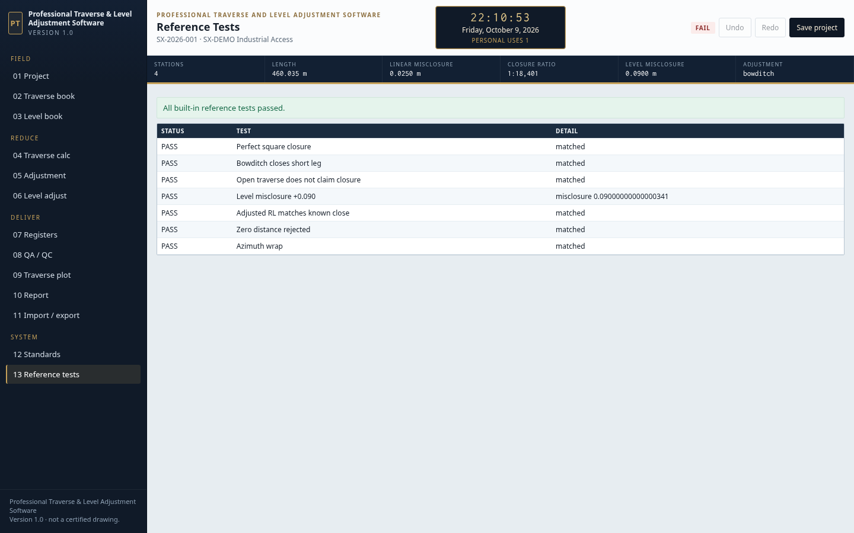
Reference tests
Built-in arithmetic checks. A pass confirms the engine, not the field work.

