Slide 1


Heart Attack Prediction
Introduction to heart attack analysis and prediction
Understand the problem and its importance

Slide 2


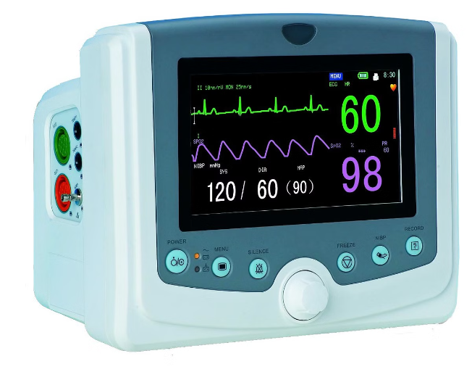


Group Members
537
Asjad Ali
585
Assad Naeem
646
Mutahir Sohail
475
Humail Aslam

Slide 3
Data Collection
Gather relevant patient data
Preprocess and clean the data
Demographics
Medical History
Lifestyle Factors
Age, gender, ethnicity
Previous conditions, medications
Smoking, diet, exercise

Slide 4
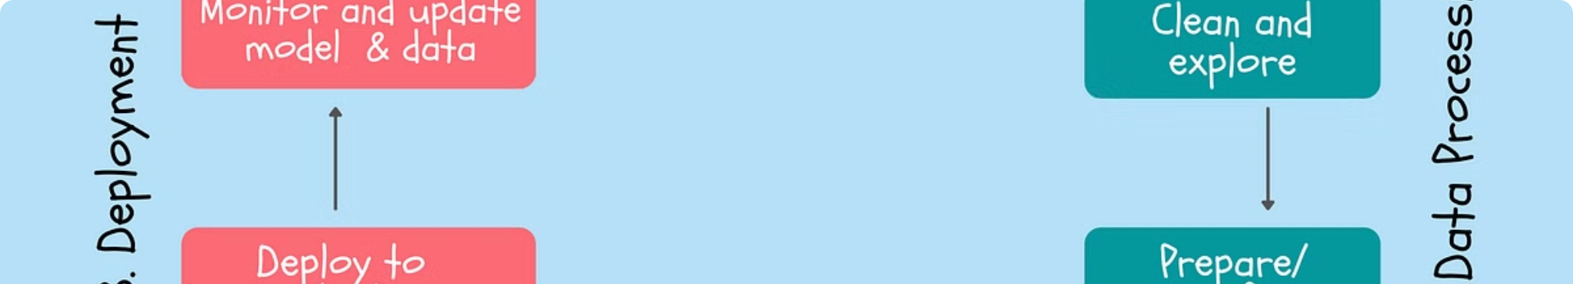
Random Forest Model
A powerful classification algorithm
Trains multiple decision trees
1
Ensemble Learning
2
Feature Importance
Combines predictions from multiple trees
Identifies key risk factors
3
Robustness
4
Scalability
Resistant to overfitting
Handles large datasets

Slide 5
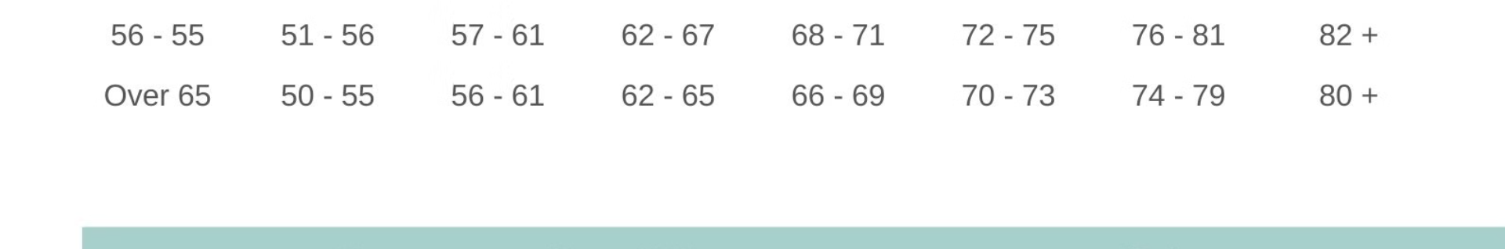
Model Evaluation
Assess model performance
Measure accuracy and reliability
Metric
Description
Accuracy
Percentage of correct predictions
Precision
Fraction of true positives
Recall
Fraction of actual positives correctly identified
F1-score
Harmonic mean of precision and recall

Slide 6
Future Improvements
Explore advanced techniques
Incorporate real-time data
Deep Learning
Neural networks for complex patterns
Wearable Sensors
Continuous monitoring for early detection
Personalized Predictions
Tailored models for individual patients

Slide 7
Lets Talks
about
The Code

