Slide 1
Final Project : DengAI: Predicting Disease Spread HOSTED BY DRIVENDATA
Asjad Ali
18101144
MS-DATA SCIENCE

Slide 2
Implementation Model
Load Data Set
Preprocessing
Check for the Missing Value in the Columns
Dropping the Column which have too many Missing values
Drop the Two Columns because the do not had any affect of chance on data and are not Changed in whole data set i.e. that are Constant, So removed to keep the model simple
Convert the Categorical features into Numerical
Filled missing Values with mean Value
Normalized the Data to scale it

Slide 3
Implementation Model
3 : Feature Selection
Feature Selection is done using Linear Support Vector Classification to Pick K BEST Features and to reduce Dimension
4: Algorithm
Linear Regression
Polynomial regression
Random Forest Regressor
Keras: Regression-based neural networks

Slide 4
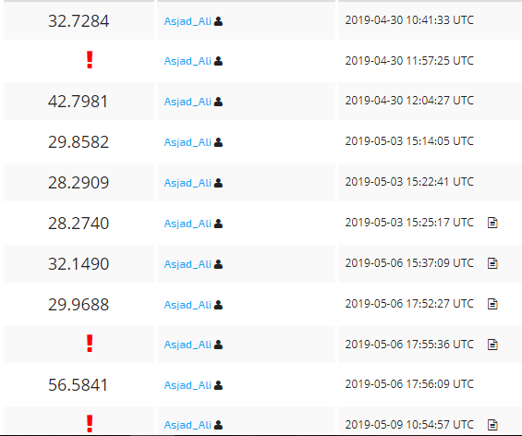
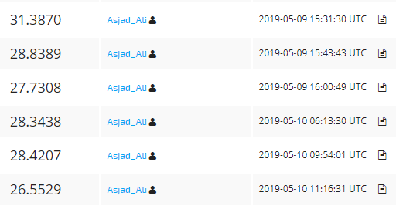
Submissions

Slide 5
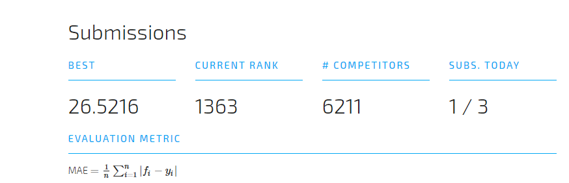
Best Score Submissions

Slide 6
Github Link
https://github.com/Asjadali121/DengAI-Predicting-Disease-Spread/upload/master

Slide 7
THANKS..!!

