Slide 1

CoreChain
B2B Inventory & Supply Chain
Management System
Muhammad Asjad · Hamza Sheikh · M. Abuzar Rizwan
FAST-NUCES Lahore · FSE · May 2026

Slide 2
CoreChain
a) Project Introduction
What is CoreChain?
Technology Stack
A centralized, multi-tenant B2B platform for:
• Warehouse inventory management
• Purchase & sale order automation
• Real-time stock visibility
• Full audit trail of all actions
• Role-based access control (RBAC)
Backend
Node.js, Express.js (MVC)
Frontend
React (Vite), Shadcn
Database
MySQL — 20-table schema
Auth
JWT + bcrypt
Dev Tools
Trello, GitHub, Postman

Slide 3
CoreChain
b) Advantages & Constraints
Real-Time Stock Updates
Constraints
Inventory updates instantly when POs are received or SOs confirmed — no manual entry needed.
No mobile app — web only
Local MySQL only (no cloud DB yet)
No real-time push notifications
Single-currency support ($) only
No barcode/QR code scanning
Manual CSV import not supported
Multi-Tenant Isolation
BusinessID from JWT enforced server-side on every query — zero cross-tenant data leaks.
Full Audit Trail
Every action logged with actor, timestamp, and details. Filterable and CSV-exportable.
Role-Based Access
Owners, Managers, and Staff have distinct permissions enforced at the API layer.

Slide 4


CoreChain
c) Non-Functional Requirements
NFR-1: Security
Multi-tenant isolation enforced server-side via BusinessID extracted from JWT on every protected route. Passwords hashed with bcrypt. JWT tokens expire and are validated on all routes. Role-based access control (RBAC) restricts module access by staff role (Owner vs Manager).
NFR-2: Performance
Standard CRUD operations execute in under 1.5 seconds under normal load. Order listing queries use indexed columns (BusinessID, WarehouseID, SupplierID, Status) for efficient filtering. Paginated responses returned for large datasets to maintain UI responsiveness. SQL Views centralize complex joins at the database layer.

Slide 5
d) Design
UML Diagrams — Use Case · Class · Activity · Sequence

Slide 6
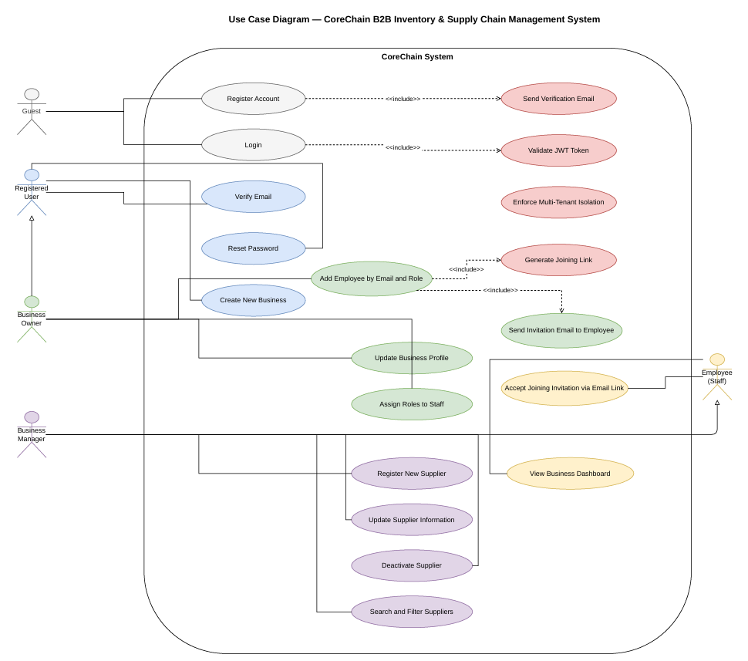
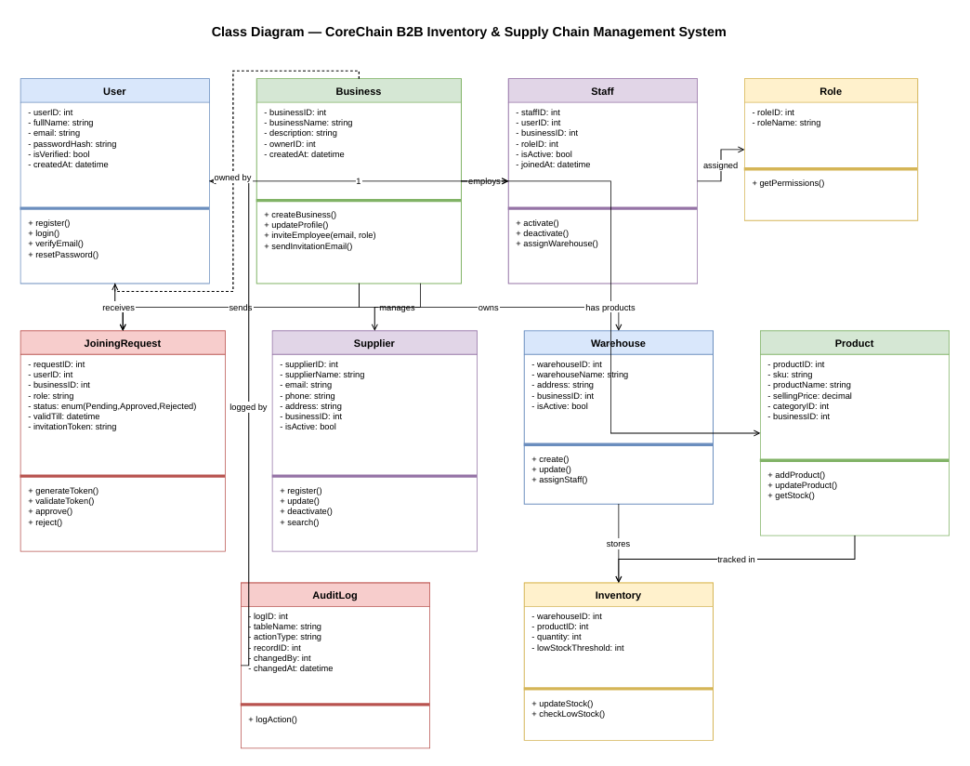
CoreChain
d) Design — Use Case & Class Diagrams
Use Case Diagram
Class Diagram

Slide 7
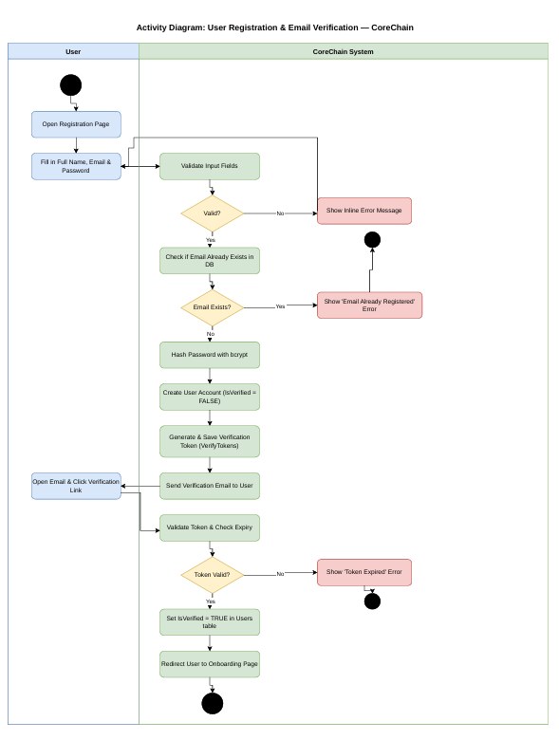
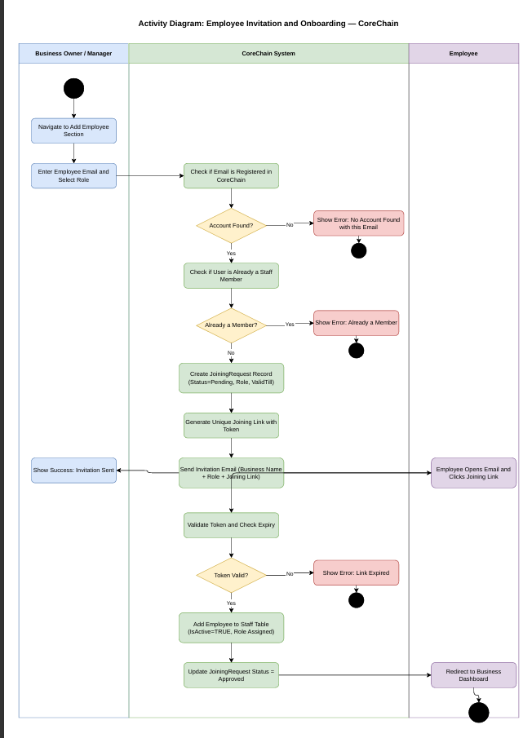
CoreChain
d) Design — Activity Diagrams
User Registration & Email Verification
Employee Invitation & Onboarding

Slide 8
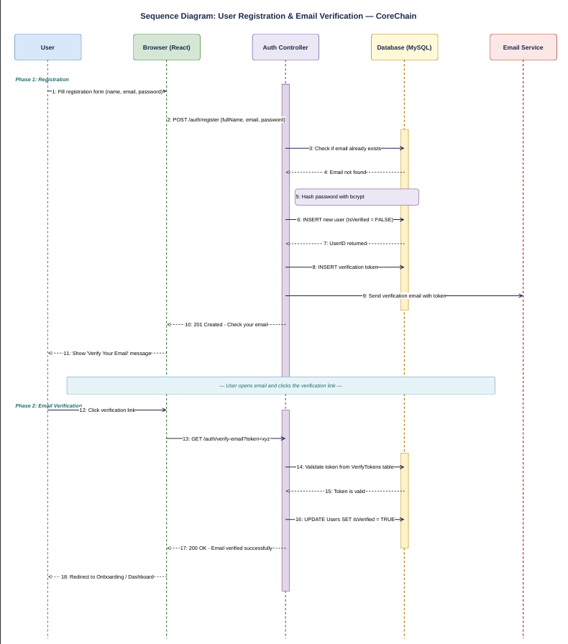
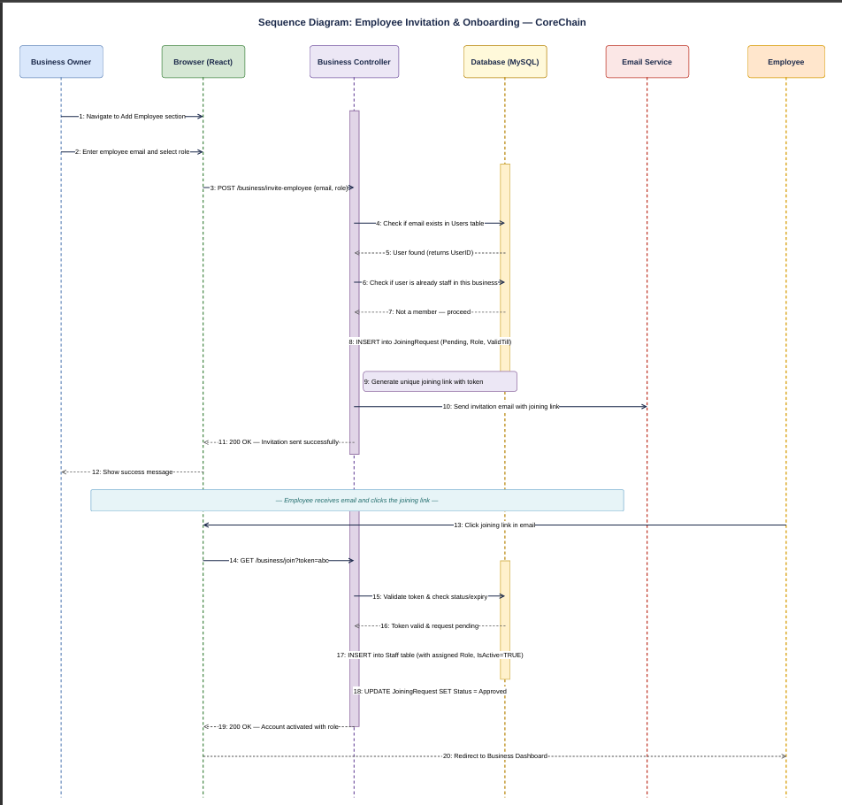
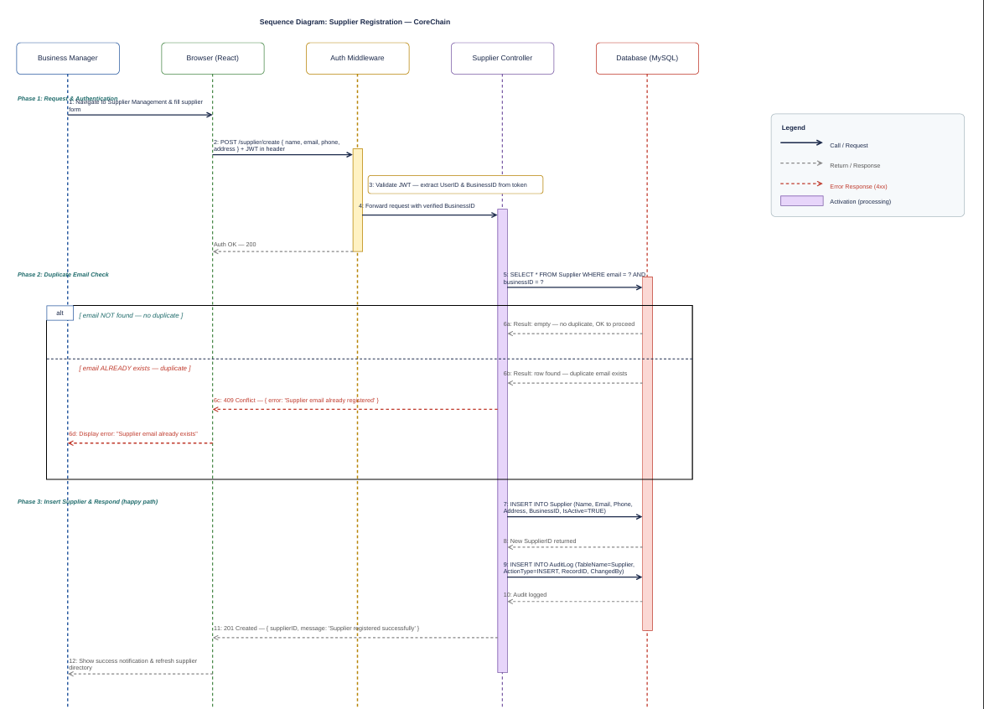
CoreChain
d) Design — Sequence Diagrams
User Registration
Employee Onboarding
Supplier Registration

Slide 9
e) Architecture
MVC Pattern — React · Node.js/Express · MySQL

Slide 10
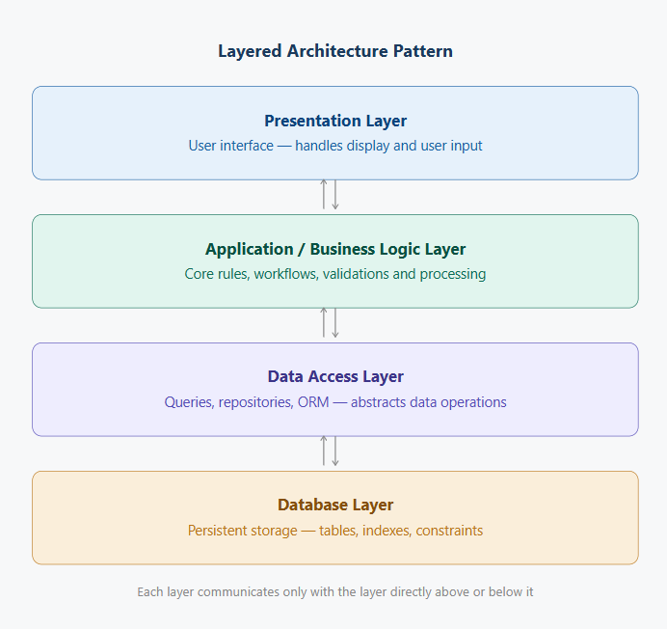
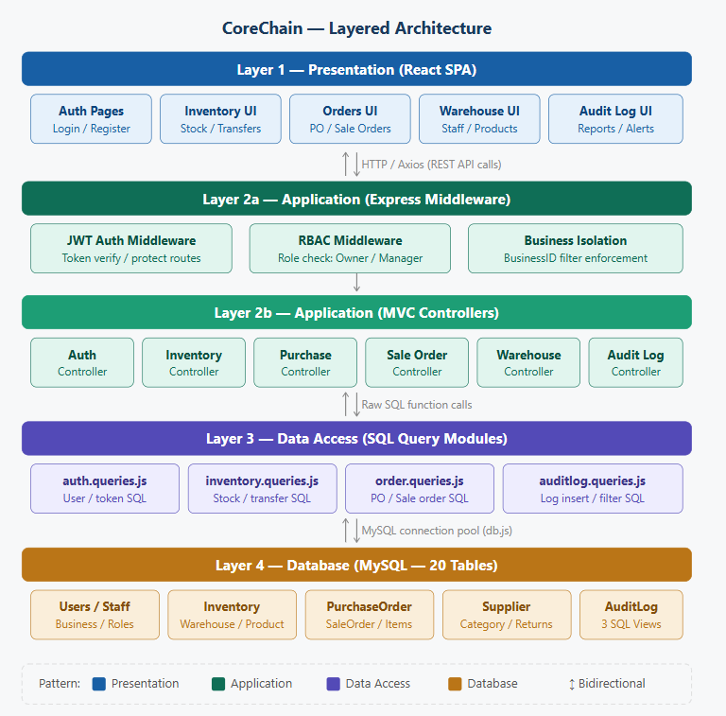
CoreChain
e) Architecture — MVC Pattern
Architecture Overview
Architecture — Detailed View

Slide 11
CoreChain
e) Architecture — Three-Tier MVC
Frontend
React (Vite) SPA · React Router · Protected routes · Role-based UI rendering
▼
Backend
Node.js · Express MVC · controllers / queries / routes · JWT middleware · BusinessID isolation
▼
Database
MySQL · 20-table normalized schema · Soft-deletes · ENUM status fields · SQL Views (vw_CurrentStock, vw_LowStockAlerts, vw_ProfitLoss)

Slide 12
f) Actual Implementation Screenshots
CoreChain — Working System

Slide 13
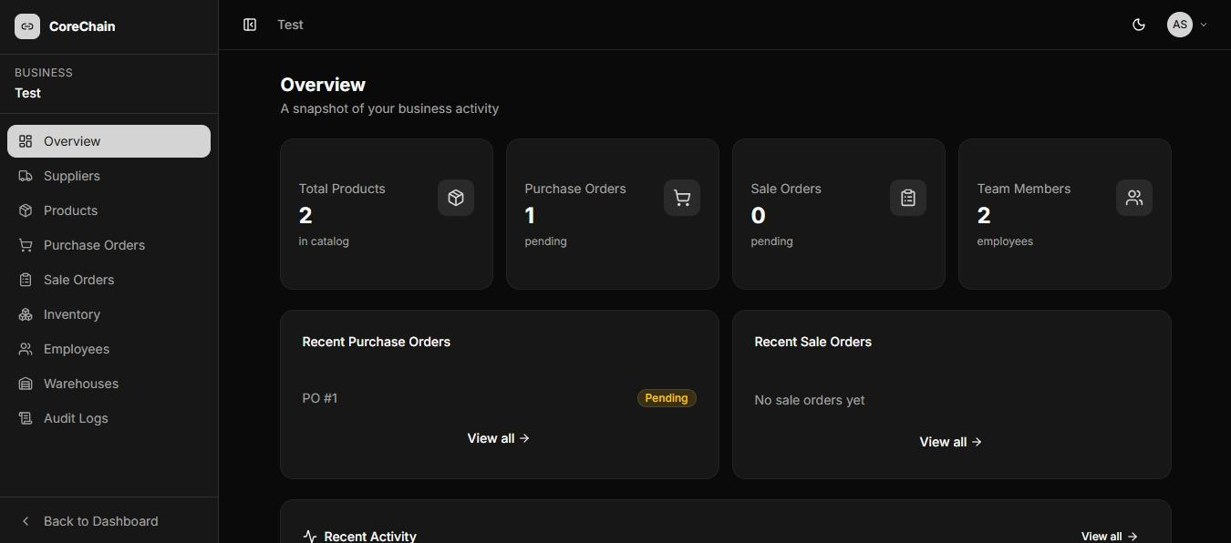
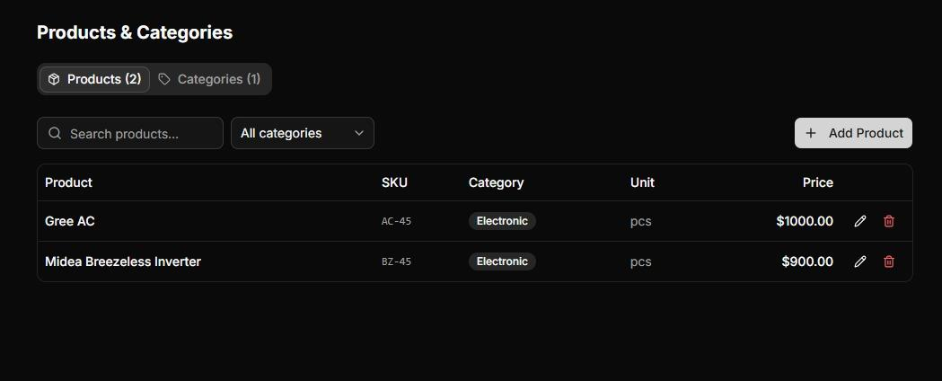
CoreChain
f) Implementation — Dashboard & Products
Overview Dashboard — real-time business snapshot
Products & Categories — catalog with SKU and pricing

Slide 14
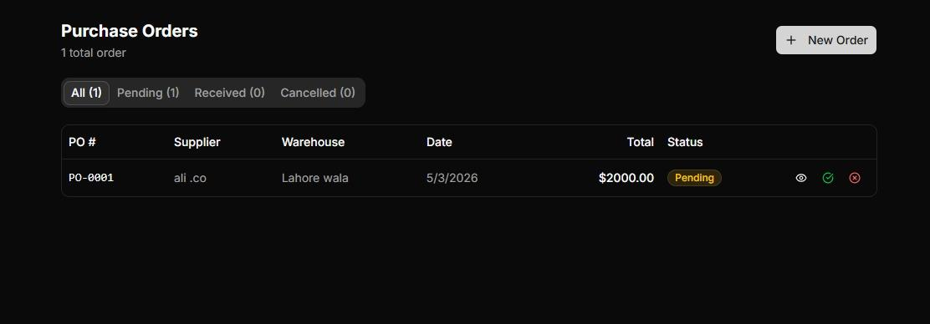
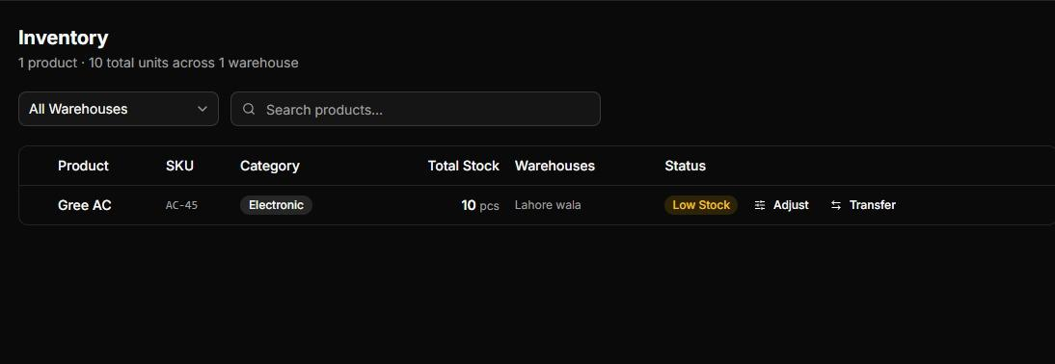
CoreChain
f) Implementation — Purchase Orders & Inventory
Purchase Orders — PO-0001 pending, status/filter tabs
Inventory — Low Stock badge, Adjust & Transfer actions

Slide 15
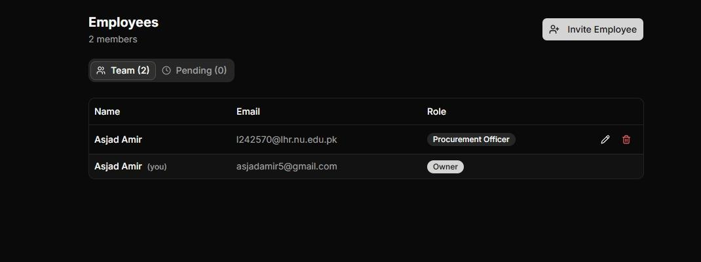
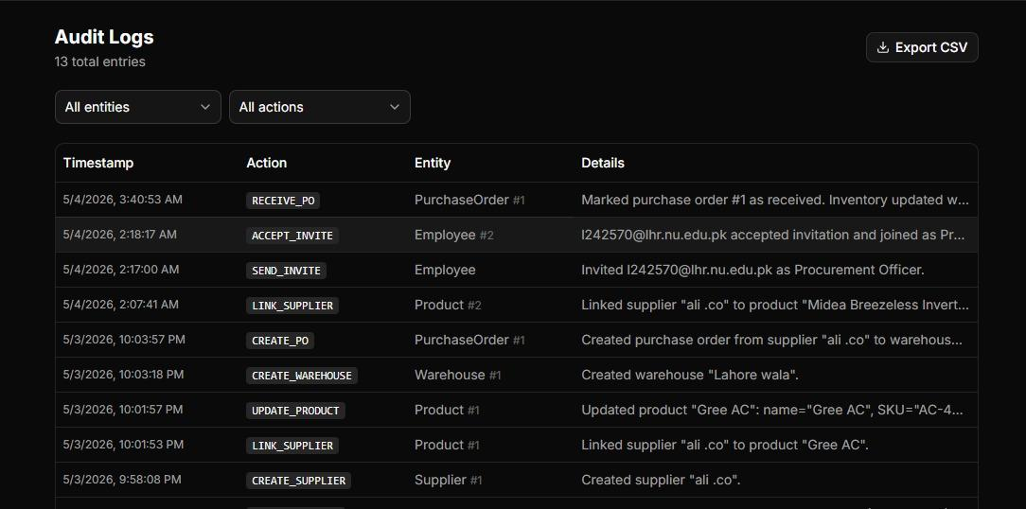
CoreChain
f) Implementation — Employees & Audit Logs
Employees — team with Owner & Procurement Officer roles
Audit Logs — 13 entries, full activity trail, CSV export

Slide 16
CoreChain
g) Work Division Between Group Members
Hamza Sheikh
Muhammad Asjad
M. Abuzar Rizwan
L24-2500 · Backend Lead
L24-2570 · Frontend Lead & QA
L24-2535 · Scrum Manager & Docs
20-table database schema & ERD design
Major backend structure & API architecture
SQL Views: vw_CurrentStock, vw_LowStockAlerts, vw_ProfitLoss
Core module backend implementation
Inventory backend (Sprint 3)
Major frontend (all modules — React)
System testing & quality improvement
Bug fixing & UX polish
Auth bug resolution
Products, Warehouses, Inventory, Employees, Orders UI
Documentation & final report
Scrum management & Trello board
Requirement engineering (all sprints)
User stories & structured specifications
Supporting backend development

Slide 17
CoreChain
h) Lessons Learnt
Server-Side Isolation
Atomic Inventory Updates
Soft-Deletes Over Hard
BusinessID must come from JWT, never from client. Enforced on every query — zero cross-tenant leaks.
PO Received = stock up. SO Confirmed = stock down. Must succeed or fail together — no partial updates.
IsActive=FALSE preserves historical PO, supplier & staff records. Hard-deletes would break audit trails.
SQL Views Save Frontend
Sprint Planning Works
Test Earlier Next Time
vw_CurrentStock and vw_LowStockAlerts centralized complex joins — cleaner code, faster dashboard loads.
Product module slipped Sprint 1 → Sprint 2. Identified early, replanned, delivered without disrupting velocity.
Integration tests in Sprint 3 caught bugs that Sprint 2 unit tests missed. Earlier = cheaper to fix.

Slide 18
Thank You
CoreChain — B2B Inventory & Supply Chain Management
Muhammad Asjad · Hamza Sheikh · M. Abuzar Rizwan

