Slide 1
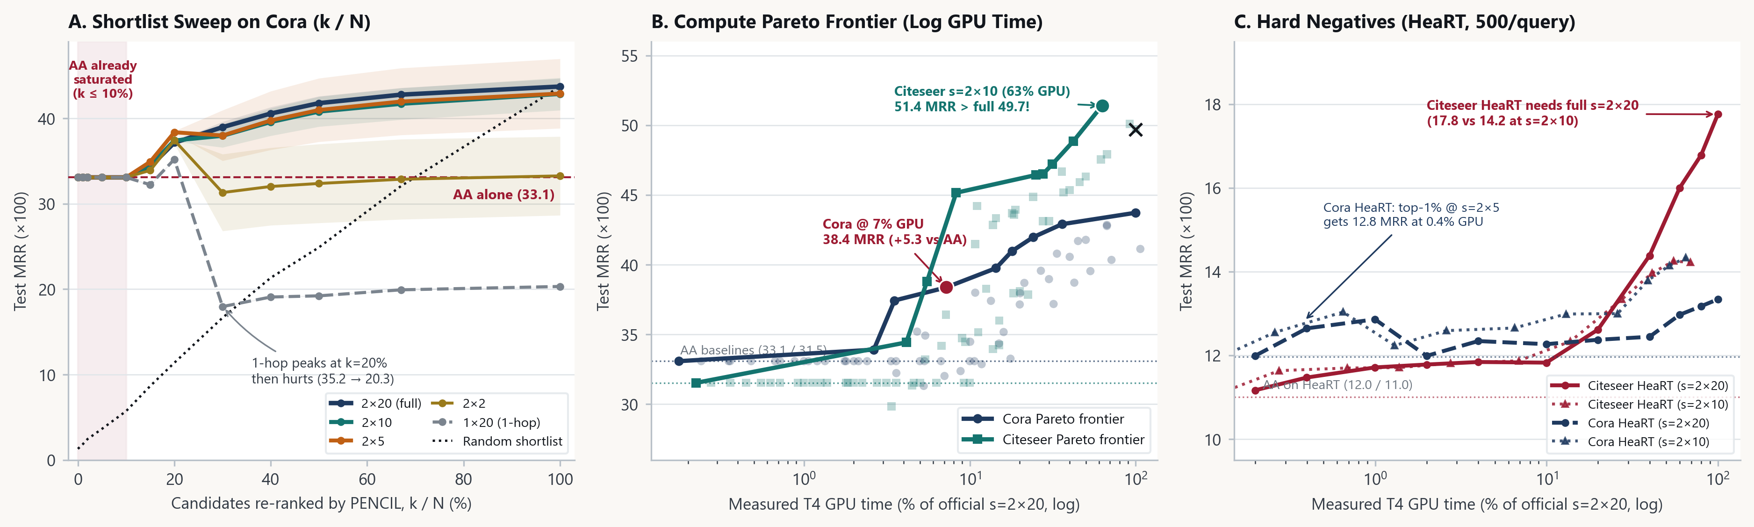
DA4022 MID-PROJECT REPORT · SELF-PROPOSED PENCIL EXTENSION · 15 OCT 2026
TEAM
Amit Kumar · Ashmit Satpute · Arnav Kshirsagar · Pranav Shalya · Atharv Wankhede
How Much PENCIL Can You Afford?
Compute-allocation laws for link prediction · choosing shortlist k and context budget s without retraining
WHAT WE ARE DOING
RESULTS FROM THE BUDGET SWEEP
BUDGET SWEEPS
We rank every candidate link with Adamic–Adar, run PENCIL only on the top-k candidates, and vary PENCIL's sampled subgraph budget s. The (k, s) sweep measures how much accuracy remains at each GPU budget. The model is not retrained.
01
Half fanout is enough in 3 of 4 regimes
At s=2×10 (~65% GPU), PENCIL matches Cora Pool (42.9 vs 43.7) and beats full s=2×20 on Citeseer Pool (51.4 vs 49.7) and Cora HeaRT (14.3 vs 13.3). Citeseer HeaRT is the exception: 14.2 vs 17.8.
1 AA rank
→
2 top-k
→
3 PENCIL
CPU <1 ms
shortlist 0–100%
re-rank with s
02
A ≤10% GPU hybrid beats heuristics everywhere
Validation-selected (k, s) improves over Adamic–Adar in all four tests: 33.1→38.4 on Cora Pool, 31.5→34.7 on Citeseer Pool, 12.0→12.8 on Cora HeaRT, and 11.0→13.8 on Citeseer HeaRT.
Shortlist saturation · compute Pareto frontiers · HeaRT hard-negative stress test
FREE-GPU REPRODUCTION · PAPER USED 4–8× A100
44.00
50.46
112
VALIDATION-SELECTED OPERATING POINTS · TEST MRR ×100
Cora test
Citeseer test
score dumps
Policy
Cora
Pool
Citeseer
Pool
Cora
HeaRT
Citeseer
HeaRT
paper 42.23
paper 47.51
4 regimes
PENCIL pays off where graph structure is blind
03
Chance
1.3
1.5
1.4
1.4
EXPERIMENT SETUP
Re-ranking only the top 10% changes almost nothing because AA already ranks easy links highly. The useful compute lies in the zero-common-neighbour tail: 57.3% of true Cora test links have zero shared neighbours.
AA · 0% GPU
33.1
31.5
12.0
11.0
Data
Cora and Citeseer
Hybrid · ≤10%
38.4 · 7%
34.7 · 9%
12.8 · 0.4%
13.8 · 8%
Tests
shared negative pool and HeaRT hard negatives
Half · s=2×10
42.9 · 67%
51.4 · 63%
14.3 · 65%
14.2 · 69%
Selection
choose (k, s) on validation under fixed compute caps
04
Cross-graph rules can beat noisy local selection
Full · s=2×20
43.7
49.7
13.3
17.8
Checks
corrected score-precision and shortlist tie bias
Applying Cora's validation-chosen rule unchanged to Citeseer beats Citeseer's own validation pick at every cap ≤50%; at the 25% cap, transferred MRR is 44.9 versus 37.9 from local selection.
ADDITIONAL RESULTS
WHAT WE MEASURE
Cora → Citeseer At the 25% cap, the transferred rule reaches 44.9 MRR, beating Citeseer's own noisy validation pick (37.9).
Peak VRAM · Cora HeaRT 2,219 MB (2×20) → 1,347 MB (2×10) → 558 MB (2×2).
Test MRR ×100 · measured T4 GPU time · peak VRAM · three random seeds per budget
Main result: reducing fanout is usually safer than shortening the candidate list.
All operating points are selected on validation data; test data are used only for the reported results.

