Slide 1

COMPILER DESIGN
UNIT - I
B.Tech (CSE) -VI SEM

Slide 2
Syllabus
UNIT-I: Introduction: Language Processors, the Structure of a Compiler. Lexical Analysis: The Role of the Lexical Analyzer, Specification of Tokens, Recognition of Tokens and the Lexical-Analyzer Generator Lex.
UNIT-II: Syntax Analysis: Definition of CFG, Lexical Versus Syntactic Analysis, Writing a Grammar- Elimination of Left Recursion, Left Factoring. Top Down Parsing: Recursive Descent Parsing, First and Follow, LL(1) Grammars, Non recursive Predictive Parsing, Error Recovery in Predictive Parsing.
UNIT-III: Bottom-Up Parsing: Bottom Up Parser Classification, Reductions, Handle Pruning, Shift-Reducing, Conflicts During Shift Reduce Parsing. Introduction to LR Parsing: Difference between LR and LL Parsers, Why LR Parsers?, Items and the LR(0) automaton, The LR-Parsing Algorithm, Constructing SLR Parsing Tables

Slide 3
UNIT-IV: More powerful LR parsers: construction of CLR (1), LALR Parsing tables, Comparison of all Bottom Up approaches. Semantic Analysis: Syntax Directed Definitions, Evaluation Orders for SDD’s, Applications of SDT.
UNIT-V: Intermediate Code Generation: Variants of Syntax Trees, Three-Address Code, Control Flow, Back-patching. Run-Time Environments: Storage Organization, Stack Allocation of Space, Heap Management.
UNIT-VI: Code Generation: Basic Blocks and Flow Graphs, Optimization of Basic Blocks, Peephole Optimization, Register Allocation and Assignment. Machine-Independent optimizations: The Principal Sources of Optimizations, Introduction to Data-Flow Analysis. .
TEXT BOOKS: 1. Compilers, Principles Techniques and Tools- Alfred V Aho, Monica S Lam, Ravi Sethi, Jeffrey D. Ullman,2nded, Pearson,2007
REFERENCE BOOKS: 1. Principles of compiler design, V. Raghavan, 2nd ed, TMH, 2011 2. Compiler Design, K. Muneeswaran, Oxford

Slide 4
S.No. | COURSE OUTCOMES (After completion of the course, The Learner is able to) | KNOWLEDGE LEVEL
CO1 | Describe the compilation process and lexical analyzer | K2
CO2 | Construct top down parsing Techniques | K3
CO3 | Construct bottom up parsing techniques | K3
CO4 | Construct syntax directed translation | K3
CO5 | Produce intermediate code generation process and run time environments | K3
CO6 | Explain the code generation process. | K2

Slide 5
UNIT-I: Introduction:
Language Processors
The Structure of a Compiler
Lexical Analysis: The Role of the Lexical Analyzer
Specification of Tokens
Recognition of Tokens
The Lexical-Analyzer Generator Lex.

Slide 6
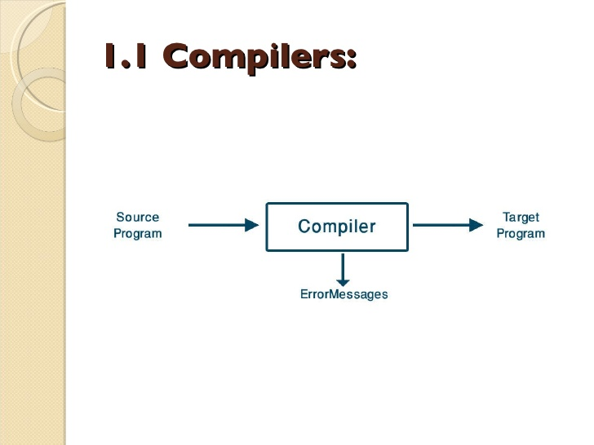
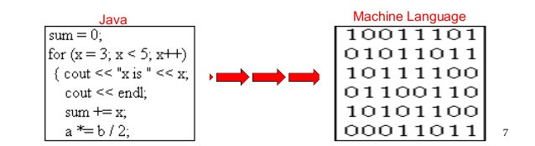
Compiler :
A compiler is a program that can read a program in one language i.e. source language and translate it into an equivalent program in another language i.e. target language

Slide 7
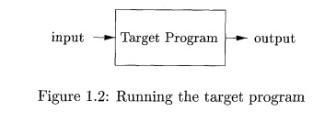
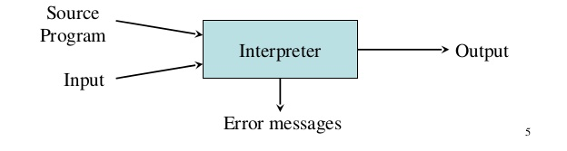
If the target program is an executable machine-language program, it can then be called by the user to process inputs and produce outputs
Interpreter :
An interpreter is another common kind of language processor. Instead of producing a target program as a translation, an interpreter appears to directly execute the operations specified in the source program on inputs supplied by the user

Slide 8
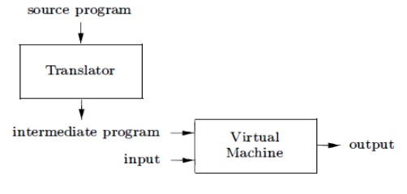
For example Java language processors combine compilation and interpretation A Java source program may first be compiled into an intermediate form called bytecodes. The bytecodes are then interpreted by a virtual machine.
A benefit of this arrangement is that bytecodes compiled on one machine can be interpreted on another machine, perhaps across a network. In order to achieve faster processing of inputs to outputs.

Slide 9
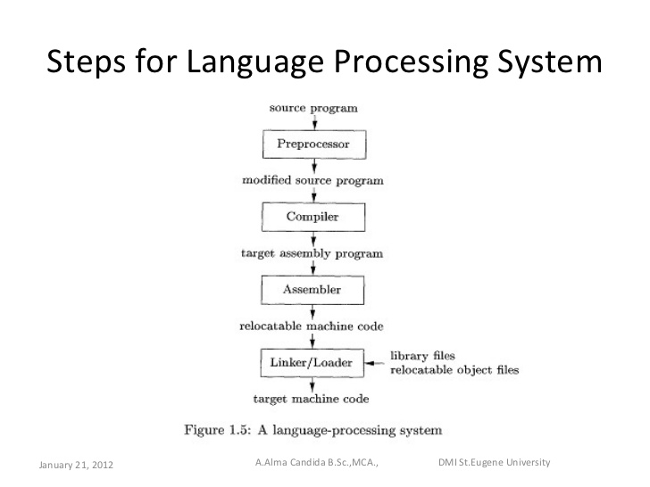
Language Processors:
In addition to a compiler, several other programs may be required to create an executable target program as shown in Fig

Slide 10
Preprocessor :
The preprocessor may also expand shorthands, called macros, into source language statements. The modified source program is then fed to a compiler.
Compiler :
The compiler may produce an assembly-language program as its output, because assembly language is easier to produce as output and is easier to debug.
Assembler :
The assembly language is then processed by a program called an assembler that
produces relocatable machine code as its output.
Linkers and Loaders :
Large programs are often compiled in pieces, so the relocatable machine code may have to be linked together with other relocatable object files and library files into the code that actually runs on the machine.
The linker resolves external memory addresses, where the code in one file may refer to a location in another file.
The loader then puts together all of the executable object files into memory for execution.

Slide 11
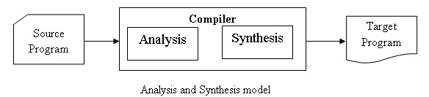
Structure of a compiler :
There are two major parts of a compiler:
Analysis
Synthesis
In analysis phase, an intermediate representation is created from the given source program.
Lexical Analyzer ,Syntax Analyzer and Semantic Analyzer are the parts of this phase.
In synthesis phase, the equivalent target program is created from this intermediate representation.
Intermediate Code Generator, Code Generator, and Code Optimizer are the parts of this phase.

Slide 12
Phases of a compiler:
Compiler consists of 6 phases
Each phase transforms the source program from one representation
into another representation.
They communicate with error handlers.
They communicate with the symbol table.

Slide 13
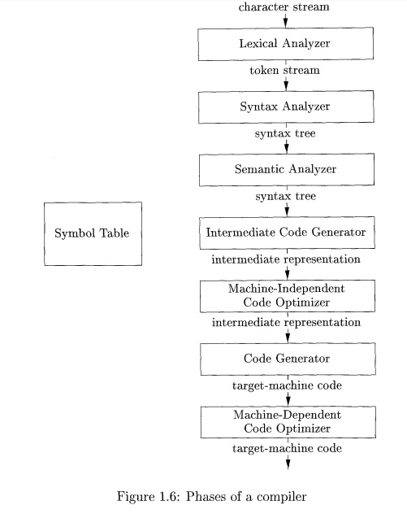

Slide 14
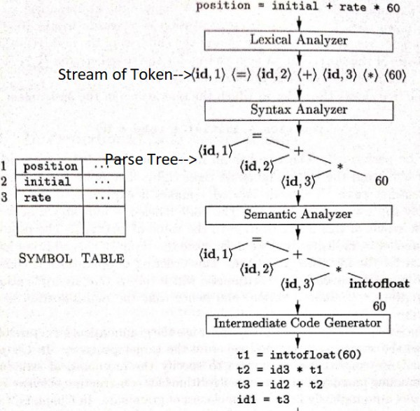
Lexical Analysis :
Lexical analyzer phase is the first phase of compilation process.
Lexical Analyzer reads the stream of characters making up the source program and group the characters into meaningful sequences called Lexeme
For each lexeme, the lexical analyzer produces a token of the form that it passes on to the subsequent phase, syntax analysis
<token-name, attribute-value>
Token-name: an abstract symbol is used during syntax analysis, an
attribute-value: points to an entry in the symbol table for this token
Puts information about identifiers into the symbol table.
Example: position =initial + rate * 60

Slide 15
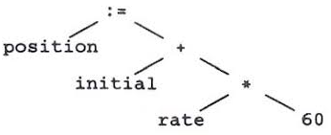
Syntax analysis :
Syntax analysis is the second phase of compilation process.
It takes tokens as input and generates a parse tree as output. In syntax analysis phase, the parser checks that the expression made by the tokens is syntactically correct or not.
A typical representation is a syntax tree in which each interior node represents an operation and the children of the node represent the arguments of the operation

Slide 16
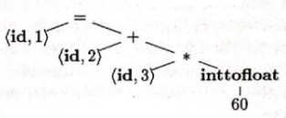
Semantic analysis :
Semantic analysis is the third phase of compilation process.
It checks whether the parse tree follows the rules of language.
Semantic analyzer keeps track of identifiers, their types and expressions.
The output of semantic analysis phase is the annotated tree syntax.

Slide 17

Intermediate Code Generation :
In the intermediate code generation, compiler generates the source code into the intermediate code.
Intermediate code is generated between the high-level language and the machine language.
The intermediate code should be generated in such a way that you can easily translate it into the target machine code.

Slide 18


Code Optimization :
Code optimization is used to improve the intermediate code so that the output of the program could run faster and take less space.
It removes the unnecessary lines of the code and arranges the sequence of statements in order to speed up the program execution.
Code Generation :
Code generation is the final stage of the compilation process. It takes the optimized intermediate code as input and maps it to the target machine language.
Code generator translates the intermediate code into the machine code of the specified computer.

Slide 19
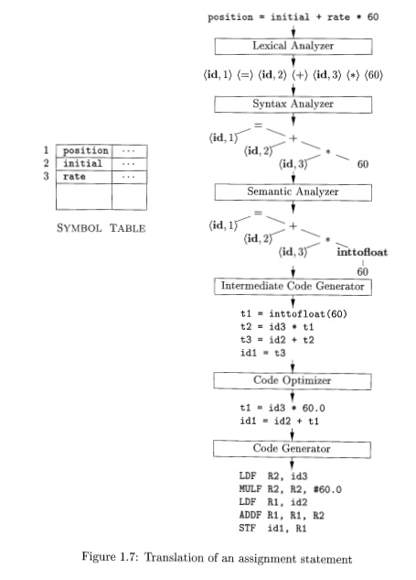

Slide 20
Lexical Analysis :
The first phase of a compiler
The main task of the lexical analyzer is to read the input characters of the source program, group them into lexemes , and produce as output a sequence of tokens for each lexeme in the source program.
The stream of tokens is sent to the parser for syntax analysis
The lexical analyzer to interact with the symbol table
One such task is stripping out comments and whitespace (blank, newline, tab, and perhaps other characters that are used to separate tokens in the input).

Slide 21
The role of lexical analyzer :
token
Source
program
Lexical Analyzer
Parser
Parse
tree
getNextToken
Symbol
table

Slide 22
Lexical Analysis Versus Parsing
Simplicity of design is the most important consideration.
Compiler efficiency is improved
Compiler portability is enhanced.

Slide 23
Tokens, Patterns and Lexemes
A token is a pair a token name and an optional token value
A pattern is a description of the form that the lexemes of a token may take
A lexeme is a sequence of characters in the source program that matches the pattern for a token

Slide 24
Example: In many programming languages, the following classes cover most or all of the tokens:
Token
Informal description
Sample lexemes
if
Characters i, f
if
else
Characters e, l, s, e
else
comparison
< or > or <= or >= or == or !=
<=, !=
id
Letter followed by letter and digits
pi, score, D2
number
Any numeric constant
3.14159, 0, 6.02e23
literal
Anything but “ sorrounded by “
“core dumped”
printf(“total = %d\n”, score);

Slide 25
Attributes for tokens
E = M * C ** 2
<id, pointer to symbol table entry for E>
<assign-op>
<id, pointer to symbol table entry for M>
<mult-op>
<id, pointer to symbol table entry for C>
<exp-op>
<number, integer value 2>

Slide 26
Lexical errors
Some errors are out of power of lexical analyzer to recognize:
fi (a == b) …
However it may be able to recognize errors like:
d = 2r
Such errors are recognized when no pattern for tokens matches a character sequence

Slide 27
Error recovery
Panic mode: successive characters are ignored until we reach to a well formed token
Delete one character from the remaining input
Insert a missing character into the remaining input
Replace a character by another character
Transpose two adjacent characters

Slide 28
Specification of tokens
In theory of compilation regular expressions are used to formalize the specification of tokens
Regular expressions are means for specifying regular languages
Example:
Letter(letter | digit)*
Each regular expression is a pattern specifying the form of strings

Slide 29
Regular expressions
Ɛ is a regular expression, L(Ɛ) = {Ɛ}
If a is a symbol in ∑then a is a regular expression, L(a) = {a}
(r) | (s) is a regular expression denoting the language L(r) ∪ L(s)
(r)(s) is a regular expression denoting the language L(r)L(s)
(r)* is a regular expression denoting (L(r))*
(r) is a regular expression denoting L(r)

Slide 30
Regular definitions
d1 -> r1
d2 -> r2
…
dn -> rn
Example:
letter -> A | B | … | Z | a | b | … | Z |
digit -> 0 | 1 | … | 9
id -> letter (letter| digit)*

Slide 31
Extensions
One or more instances: (r)+
Zero of one instances: r?
Character classes: [abc]
Example:
letter_ -> [A-Za-z_]
digit -> [0-9]
id -> letter(letter|digit)*

Slide 32
Recognition of tokens
Starting point is the language grammar to understand the tokens:
stmt -> if expr then stmt
| if expr then stmt else stmt
| Ɛ
expr -> term relop term
| term
term -> id
| number

Slide 33
Recognition of tokens (cont.)
The next step is to formalize the patterns:
digit -> [0-9]
digits -> digit+
number -> digit(.digits)? (E[+-]? digit)?
letter -> [A-Za-z_]
id -> letter (letter|digit)*
If -> if
Then -> then
Else -> else
Relop -> < | > | <= | >= | = | <>
We also need to handle whitespaces:
ws -> (blank | tab | newline)+

Slide 34
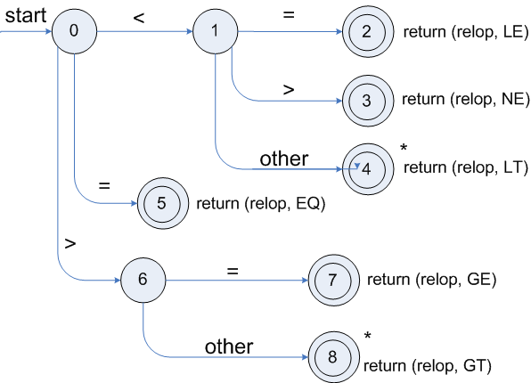
Transition diagrams
Transition diagram for relop
Relop -> < | > | <= | >= | = | <>

Slide 35
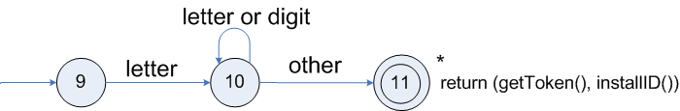
Transition diagrams (cont.)
Transition diagram for reserved words and identifiers
id -> letter (letter|digit)*

Slide 36
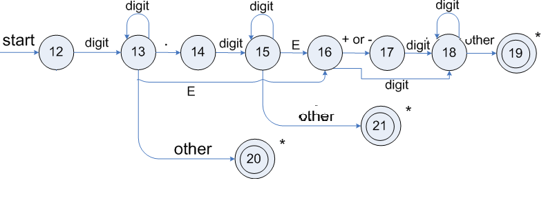
Transition diagrams (cont.)
Transition diagram for unsigned numbers
number -> digit(.digits)? (E[+-]? digit)?

Slide 37
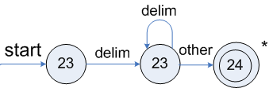
Transition diagrams (cont.)
Transition diagram for whitespace
ws -> (blank | tab | newline)+

Slide 38
Lexical Analyzer Generator - Lex
LEX is a tool that allows one to specify a Lexical Analyzer by specifying RE to describe patterns for tokens.
Input Notation-Lex language(Specification)
Lex Compiler-Transforms Input patterns into a Transition diagram and generates code in a file called lex.yy.c

Slide 39
Lexical analyzer with LEX
Lex Source program
lex.l
Lexical Compiler
lex.yy.c
C
compiler
lex.yy.c
a.out
a.out
Sequence of tokens
Input stream

Slide 40
Structure of Lex programs :
Lex program has the following form:
declarations
%%
translation rules
%%
auxiliary functions
The translation rules each have the form
Pattern {Action}

Slide 41
The declarations section includes declarations of variables, manifest constants (identifiers declared to stand for a constant, e.g., the name of a token), and regular definitions.
The translation rules each have the form
Pattern { Action }
pattern is a regular expression
Action-Fragment of code written in C.
Third Section-holds whatever additional functions are used in the actions.
Alternatively, these functions can be compiled separately and loaded with the lexical analyser

Slide 42
Conflict Resolution in Lex
There are two rules that Lex uses to decide on the proper lexeme to select, when several prefixes of the input match one or more patterns:
1. Always prefer a longer prefix to a shorter prefix.
2. If the longest possible prefix matches two or more patterns, prefer the pattern listed first in the Lex program.

Slide 43
The Lookahead Operator
Lex automatically reads one character ahead of the last character that forms the selected lexeme, and then retracts the input so only the lexeme itself is consumed from the input.
However, sometimes, we want a certain pattern to be matched to the input only when it is followed by a certain other characters. If so, we may use the slash in a pattern to indicate the end of the part of the pattern that matches the lexeme.
What follows / is additional pattern that must be matched before we can decide that the token in question was seen, but what matches this second pattern is not part of the lexeme.

Slide 44
Thank you

