Slide 1

Machine Learning By David Raju kuppala - VI SEM CSE A&B S Kumar Reddy M - VI SEM CSE C&D Department of CSE Sri vasavi Engineering College, Tadepalligudem

Slide 2
Course Otline:
Academic Year : 2020-21
Programme & Branch : B.Tech & CSE
Semester : VI
Sections : A, B, C, & D
Course Name : Machine Learning (PE-II)
Course Code : V18CST25
L-T-P : 3-0-0
Credits : 3

Slide 3
Course Outcomes:
S.No. | CO No. | Course Outcome | BTL
1 | 1 | Demonstrate basics of Machine Learning | K2
2 | 2 | Explain Various Classification Techniques | K2
3 | 3 | Explain Tree Based Learning and Ensemble Learning | K2
4 | 4 | Demonstrate Neural Networks and Multi Layer Perceptrons | K2
5 | 5 | Explain Dimensionality Reduction techniques | K2
6 | 6 | Demonstrate clustering algorithms | K2

Slide 4
Text Books:
1. Machine Learning: An Algorithmic Approach.Stephen Marsland, 2nd Edition, CRC press.
2. A First Course in Machine Learning; Volume in Machine Learning and Pattern Recognition Series – CRC-Taylor & Francis-Chapman & Hall Rogers S., Girolami M.,(2011)
Reference Books:
1.Machine Learning: The art and Science of Algorithms that Make sense of Data. Peter Flach, Cambridge.
2.Machine Learning: Tom Mitchel, McGraw Hill Learning, 1997

Slide 5
CO - 1: INTRODUCTION

Slide 6
S.No | Course Outcome | Intended Learning Outcomes (ILO) | Knowledge Level of ILO | No. of Hours
1 | CO 1 | Dissemination of Vision, Mission of the Dept. and PEOs, Pos, & PSOs of the Programme |  | 1
2 |  | Introduction to Machine Learning and Types of Machine Learning | K1 | 1
3 |  | Supervised Learning :Regression and Classification | K1 | 1
4 |  | The Machine Learning Process | K2 | 1
5 |  | Terminology of ML: Weight Space, The Curse Of Dimensionality | K1 | 1
6 |  | Knowing What You Know: Testing Machine Learning Algorithms | K2 | 2
7 |  | Some Basic Statistics. Averages Variance And Covariance. The Bias-Variance Trade-off | K2 | 2

Slide 7
What is Machine learning?
Machine learning is a field of artificial intelligence (AI).
Machine learning is about making computers modify or adapt their actions so that these actions get more accurate, where accuracy is measured by how well the chosen actions reflect the correct ones.
In simple terms, machine learning means making the machines learn from their experiences like humans and other animals.
Notes:
Machine learning is the science of getting computers to act without being explicitly programmed.
Machine learning is the concept that a computer program can learn and adapt to new data without human intervention.
Machine learning is a method of data analysis that automates analytical model building.
Machine learning is the use and development of computer systems that are able to learn and adapt without following explicit instructions by using algorithms and statistical models to analyze and draw inferences from patterns in data.
Learning is what gives us flexibility in our lives; we can adjust and adapt to new circumstances and learn new tricks, no matter how old we are.

Slide 8
What is Machine learning?
The important parts of animal learning are remembering, adapting, and generalizing.
There are plenty of other bits to intelligence, such as reasoning and logical deduction.
Machine learning deals with learning and adopting, whereas AI makes computers reason and deduce facts.
Notes:
Remembering and adapting is recognizing that last time we were in a similar situation, what we tried, what actions we performed, and if it worked, so we'll try it again, or it didn't work, so we'll try something different.
The last word, generalizing, is about recognizing the similarity between different situations so that things that are applied in one place can be used in another.

Slide 9
Definition:
The sub field of computer science that “gives computers the ability to learn without being explicitly programmed”
- Artur samuel(1959)
A computer program is said to learn fom experience E with respect to some class of tasks T and performance measure P if ita performance at tasks T, as measured by P, improves with experience E.
-Tom Mitchell(1997)

Slide 10
ML: Types
A machine learning algorithm takes data (With labels or without labels) as input and produces a generalized model that can be used on similar new data.
Machine learning is basically classified into
Supervised Learning
Unsupervised Learning
Reinforcement Learning
Evolutionary Learning.

Slide 11
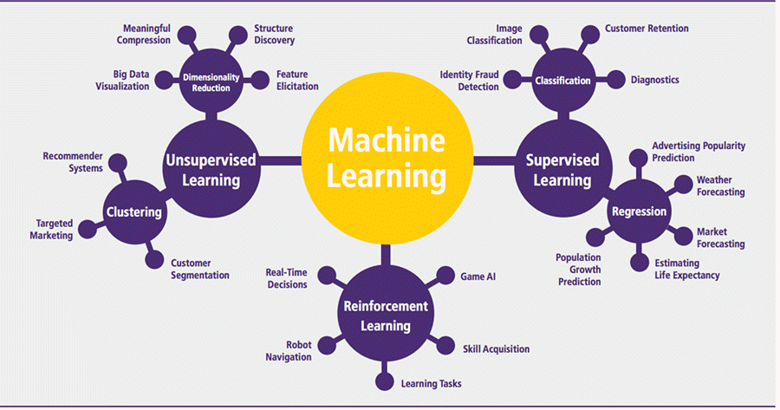

Slide 12
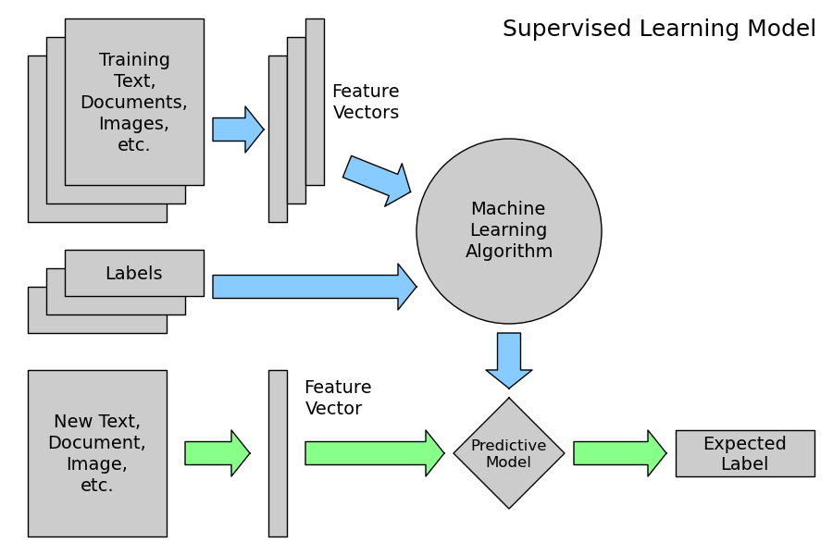
ML: Supervised Learning
Targets/labels will be provided along with features in training set.
Objective: Predicting the labels of a new object when features are given.
This is also called learning from exemplars.

Slide 13
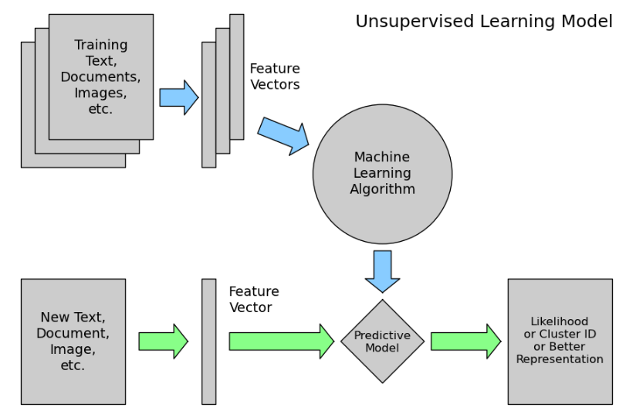
ML: Unsupervised Learning
Targets/labels will not be provided along with features in training set.
Objective: Categorizing the object based on similarities and finding out whether a new object belongs to which category.
The statistical approach to unsupervised learning is known as density estimation.

Slide 14
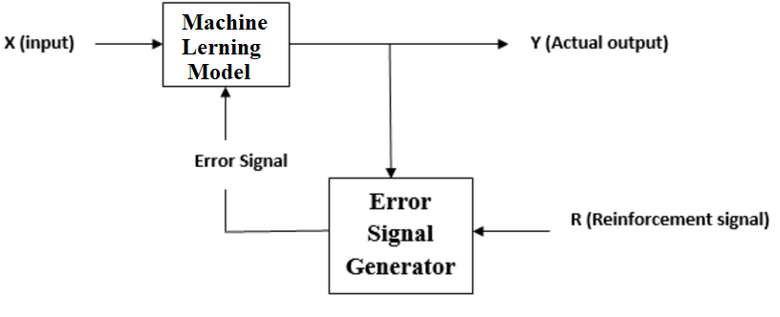

ML: Reinforcement Learning
Somewhere between supervised and unsupervised learning
Objective: Learning from interaction to achieve a goal.
Reinforcement learning is sometimes called learning with a critic because of the monitor that scores the answer but does not suggest improvements.
Notes:
The algorithm gets told when the answer is wrong but does not get told how to correct it. It has to explore and try out different possibilities until it works out "how to get the answer right".
The learner and decision-maker is called the agent. The thing it interacts with, comprising everything outside the agent, is called the environment. These interact continually, the agent selecting actions and the environment responding to those actions and presenting new situations to the agent

Slide 15
ML: Evolutionary Learning
Similar but different then reinforcement learning.
Biological evolution can be seen as a learning process: biological organisms adapt to improve their survival rates and the chance of having offspring in their environment.
Objective: Using an idea of fitness, which corresponds to a score for how good the current solution is? And updating the solution accordingly.
In evolutionary algorithms, they usually start with many "agents" and only the "strong ones survive“.
Notes:
The algorithm gets told when the answer is wrong but does not get told how to correct it. It has to explore and try out different possibilities until it works out "how to get the answer right".
The learner and decision-maker is called the agent. The thing it interacts with, comprising everything outside the agent, is called the environment. These interact continually, the agent selecting actions and the environment responding to those actions and presenting new situations to the agent

Slide 16
ML: Supervised learning

Slide 17
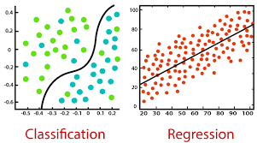
Supervised learning
As discussed earlier, supervised learning is the machine learning task of learning a function that maps an input to an output based on example input-output pairs.
It infers a function from labeled traininAg data consisting of a set of training examples.
There are two types of Supervised Learning techniques:
Regression: Fits the data.
Classification: Separates the data.

Slide 18
Supervised Learning: Regression
Regression models are used to predict a continuous value. Predicting prices of a house given the features of house like size, price etc is one of the common examples of Regression. It is a supervised technique
It predicts continuous/real values such as temperature, age, salary, price, etc.

Slide 19
Example:
Suppose there is a marketing company A, who does various advertisement every year and get sales on that. The below list shows the advertisement made by the company in the last 5 years and the corresponding sales
Now, the company wants to do the advertisement of $200 in the year 2021 and wants to know the prediction
about the sales for this year.
So to solve such type of prediction
problems in machine learning,
we need regression analysis.

Slide 20
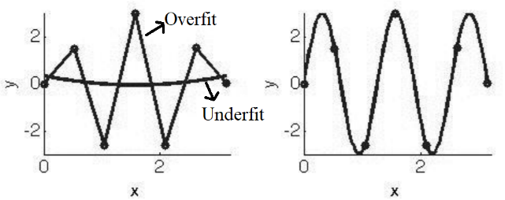
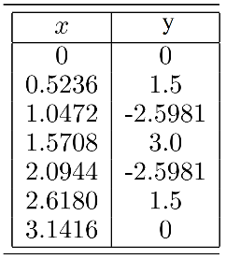
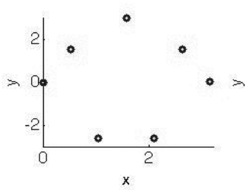
Supervised Learning: Regression
Fits a mathematical function describing a multi dimensional curve/plane so that the curve/plane passes as close as possible to all the data points.
Suppose that given the following data points (a) and asked to find the output's value, when x = 0.44.
The distribution of the data points on a 2D-XY plane is shown in (b).
Regression seems easy when the data has fewer dimensions, but it will become harder and harder as the number of dimensions increases.
(a)
(b)
(c)
(d)
Notes:
There can be an infinite number of models that can fit the given data points. The problem is how to work out what function to choose. An Overfit model and an underfit model were shown in (c). The straight-line approximation (Overfit) probably isn't what we want since it doesn't tell us much about the data. A cubic function (something that can be written as ax³ + bx² + cx + d = 0) (underfit) is nowhere near the data points. In fact, the data were made with the sine function plotted(d), so that is the correct answer in this case.

Slide 21
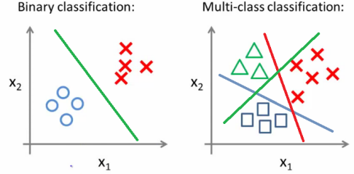
Supervised Learning: Classification
Grouping examples into different classes, i.e., taking input vectors and deciding which of N classes they belong to, based on training from exemplars of each class.
The most important point about the classification problem is that it is discrete.
Many real-world problems use classification.
Notes:
For example, heart disease detection can be identified as a classification problem. This is a binary classification since there can be only two classes, i.e., has heart disease or does not have heart disease. The classifier, in this case, needs training data to understand how the given input variables are related to the class. And once the classifier is trained accurately, it can be used to detect whether heart disease is there or not for a particular patient. Another most common applications of classification are for filtering emails into "spam" or "non-spam," as used by today's top email service providers. An example of multi-class classification is the classification of fruits or classification of animals, etc. Classification algorithms can be better understood using the below diagram.

Slide 22
One of the most common applications of classification is for filtering emails into “spam” or “non-spam”, as used by today’s top email service providers.
In short, classification is a form of “pattern recognition,”. Here, classification algorithms applied to the training data find the same pattern in future data sets.

Slide 23
ML: Process
There are seven steps to machine learning, and each step revolves around data.
Data Collection
Data Pre-processing/ Preparation
Feature Selection
Algorithm Choice
Parameter and Model selection
Training
Ealuation
Notes:
Data Collection: The first step of any machine learning process is gathering data. This step is crucial as the quality and quantity of data gathered will determine how good the predictive model will be. The data collected is then tabulated and called Training Data.
Data Preprocessing/ Preparation: Even though so much care has been taken during data collection, the raw data alone is not very useful. The data may contain duplicates, missing values, outliers, etc. All these issues will be addressed in data pre-processing. Also, feature selection may be made at this stage if the data contains unwanted or duplicate features. Data with fewer features will lead to underfitting, and on the other hand, data with unnecessary features may lead to overfitting.
Model Selection: The third step consists of selecting the right model. Many models can be used for many different purposes. The knowledge of the ML algorithm's underlying principles and the background knowledge of the data is needed for this.
Training: Training your model is the bulk of machine learning. The objective is to use your training data and incrementally improve the predictions of the model. Given the dataset, algorithm, and parameters, training should be simply the use of computational resources in order to build a model of the data in order to predict the outputs on new data.
Evaluation: Before a system can be deployed, it needs to be tested and evaluated for accuracy on data that it was not trained on. This can often include a comparison with human experts in the field and the selection of appropriate metrics for this comparison. Evaluation allows testing the model against data that has never been seen and used for training and is meant to represent how the model might perform when in the real world.
Parameter Tuning: Once the evaluation is over, any further improvement in your training can be possible by tuning the parameters. This is an experimental process.
Prediction: Once the model was tuned and considered the most suitable generalized model, it can be used to make predictions on new data from the real world.

Slide 24
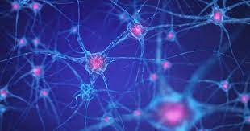
Artificial Neural Network (ANN)
An artificial neural network (ANN) is the piece of a computing system designed to simulate the way the human brain analyzes and processes information.
While the brain is an impressively powerful and complicated system, the basic building blocks that it is made up of are fairly simple and easy to understand.
The animal mainly a human brain has hundreds of billions of cells called neurons.

Slide 25
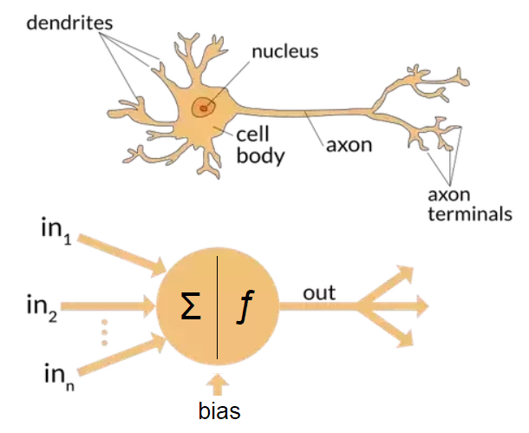
Artificial Neural Network (ANN)
Each neuron comprises
a cell body responsible for processing information.
Dendrites take input from the other neurons.
Axon terminals gives processed output to other neurons.

Slide 26
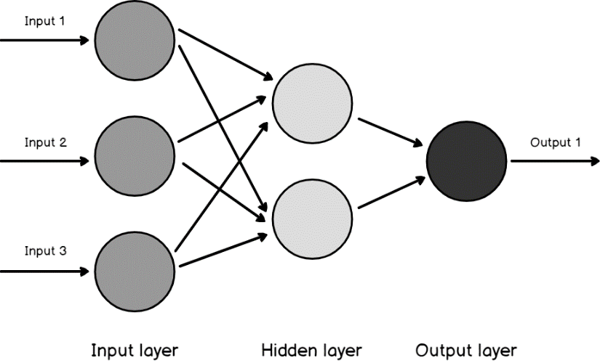
Artificial Neural Network (ANN)
An ANN has hundreds or thousands of artificial neurons called processing units, which are interconnected by nodes.
These processing units are made up of input and output units.
The input units receive various forms and structures of information based on an internal weighting system.
The neural network attempts to learn about the information presented to produce one output report.
Just like humans need rules and guidelines to come up with a result or output, ANNs also use a set of learning rules called backpropagation, an abbreviation for backward propagation of error, to perfect their output results.

Slide 27
ML: Terminology
Inputs: An input vector is the data given as one input to the algorithm and written as x, with elements x_{i}, where i runs from 1 to the number of input dimensions, m.
Weights: w_{ij}, are the weighted connections between nodes i and j. For neural networks, these weights are analogous to the synapses in the brain. They are arranged into a matrix W.
Outputs: The output vector is y, with elements y_{j}, where j runs from 1 to the number of output dimensions, n. We can write y(x, W) to remind ourselves that the output depends on the inputs to the algorithm and the network's current set of weights.

Slide 28
ML: Terminology
Targets: The target vector t, with elements t_{j}, where j runs from 1 to the number of output dimensions, n, are the extra data that we need for supervised learning since they provide the 'correct' answers that the algorithm is learning about.
Activation Function: For neural networks, g(·) is a mathematical function that describes the firing of the neuron as a response to the weighted inputs.
Error (E): a function that computes the inaccuracies of the network as a function of the outputs y and targets t.

Slide 29
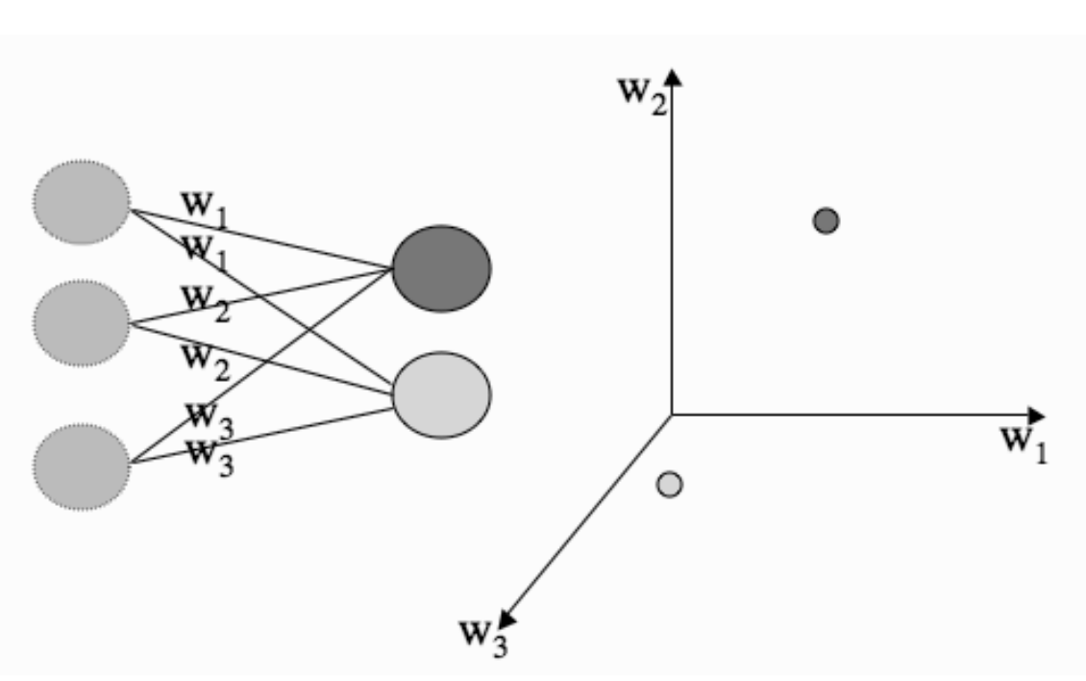
Weight Space
When working with data, it is often useful to plot it and look at it.
As well as plotting data points, we can also plot anything else that we feel like.
This is useful for neural networks since a neural network's parameters are the values of a set of weights that connect the neurons to the inputs.
Notes:
A neural network schematic on the left of the figure below shows the left and the neurons' inputs on the right. If we treat the weights fed into one of the neurons as a set of coordinates in what is known as weight space, we can plot them. We think about the weights that connect into a particular neuron, and plot the strengths of the weights by using one axis for each weight that comes into the neuron, and plotting the position of the neuron as the location, using the value of w1 as the position on the 1st axis, the value of w2 on the 2nd axis, etc. This is shown on the right of the figure. So we can use the idea of neurons and inputs being 'close together in order to decide when a neuron should fire and when it shouldn't. If the neuron is close to the input in this space, it should fire, and if it is not close, it shouldn't.

Slide 30
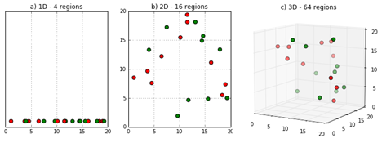
The Curse of Dimensionality
The curse of dimensionality will apply to our machine learning algorithms.
Unnecessary and redundant features increases the complexity of model and may even reduce the performance of model if enough training data is not there.
As the number of input dimensions gets larger, we will need more data to enable the algorithm to generalize sufficiently well.
Our algorithms try to separate data into classes based on the features; therefore, as the number of features increases, the number of data points we need increases.

Slide 31

Testing Machine Learning Algorithms
How to know whether the trained ML model will perform well?
Data set used for training the model can’t be used testing the model as the data was already seen by the model.
Solution: Divide the dataset into training and testing datasets.
The ML model will be trained using training set and then the model will be tested using the unseen testing dataset to check how well it is performing.

Slide 32
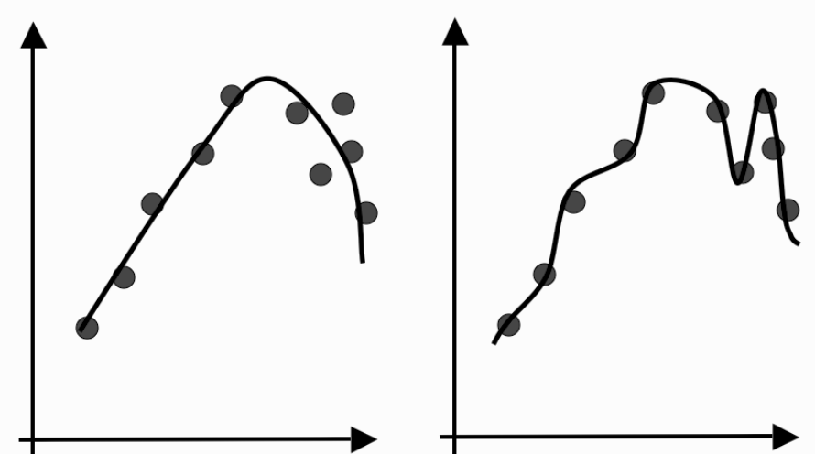
ML: Overfitting
How well the algorithm is generalizing as it learns?
There is at least as much danger in over-training as there is in under-training.
If we train for too short, we may underfit the data on the other hand if we train for too long, we may overfit the data.
Overfitting means instead of constructing a generalized model, the model learns about the noise and inaccuracies in the data.

Slide 33
ML: Overfitting
An overfitted model will surely give a small error during traininging but will give large errors during testing.
We want to stop the learning process before the algorithm overfits, which means that we need to know how well it generalizes at each timestep.
We can't use the training data because we wouldn't detect overfitting, but we can't use the testing data either because we're saving that for the final tests.
Solution: We need a third set of data to use for this purpose, which is called the validation set because we're using it to validate the learning so far.
Also known as cross-validation in statistics.

Slide 34
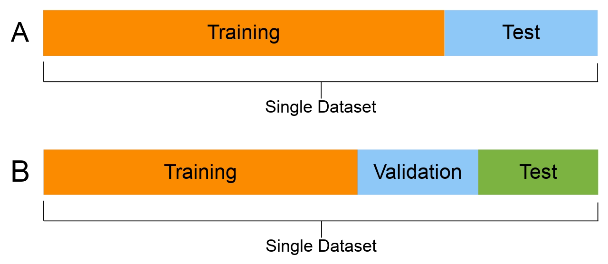
ML: Overfitting
We now need three sets of data: the training set to actually train the algorithm, the validation set to keep track of how well it is doing as it learns, and the test set to produce the final results.
The general proportions used for splitting the data sets are 50:25:25 or 60:20:20.
It is also recommended to randomize the dataset before splitting.

Slide 35
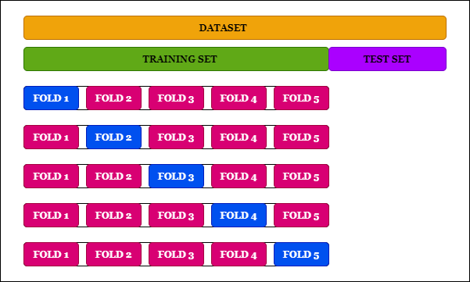
ML: Overfitting
If you are really short of training data so that if you have a separate validation set, there is a worry that the algorithm won't be sufficiently trained.
Solution is possible to perform leave-some-out, multi-fold cross-validation.
The dataset is randomly partitioned into K subsets, and one subset is used as a validation set, while the algorithm is trained on all of the others.

Slide 36
ML: Underfitting
Underfitting refers to a model that can neither model the training data nor generalize to new data.
An underfit machine learning model is not a suitable model and will be obvious as it will have poor performance on the training data.
Underfitting is often not discussed as it is easy to detect given a good performance metric. The remedy is to move on and try alternate machine learning algorithms. Nevertheless, it does provide a good contrast to the problem of overfitting.
Note: Ideally, you want to select a model at the sweet spot between underfitting and overfitting.This is the goal, but is very difficult to do in practice.

Slide 37

Some Basic Statistics
Averages: The mean is easy. It is the most commonly used average of a set of data and is the value that is found by adding up all the points in the dataset and dividing by the number of points. Two other averages are used: the median and the mode. The median is the middle value. The mode is the most common value.
Variance: The variance of the set of numbers is a measure of how spread out the values are. It is computed as the sum of the squared distances between each element in the set and the set's expected value (the mean, µ). The square root of the variance, σ, is known as the standard deviation. The variance looks at the variation in one variable compared to its mean. Here, µ is the mean of set {xi}.

Slide 38

Some Basic Statistics
Covariance: Covariance is a measure of how dependent the two variables are. It is measured as shown above, where ν is the mean of set {yi}. If two variables are independent, then the covariance is 0 (the variables are then known as uncorrelated), while if they both increase and decrease at the same time, then the covariance is positive, and if one goes up while the other goes down, then the covariance is negative.

Slide 39
The Bias-Variance Trade-off
Whenever we train any machine learning algorithm, we are making some choices about a model to use and fit that model's parameters. The more degrees of freedom the algorithm has, the more complicated the model that can be fitted.
A model can be bad for two different reasons. Either it is not accurate and doesn’t match the data well, or it is not very precise (bias) and there is a lot of variation (variance) in the results.
More complex classifiers will tend to improve the bias, but the cost of this is higher variance. While making the model more specific by reducing the variance will increase the bias.
There must be a trade-off between these two, which is called as the bias-variance tradeoff, also known as the bias-variance dilemma.

