Slide 1

Machine Learning
Unit 2: Classification

Slide 2
S.No | Course Outcome | Intended Learning Outcomes (ILO) | Knowledge Level of ILO | No. of Hours
1 | CO 2 | The General Problem, Probabilistic Classifiers: Bayes Classifier | K2 | 2
2 |  | Probabilistic Classifiers: Logistic Regression | K2 | 2
3 |  | Non-Probabilistic Classifiers: K-Nearest Neighbor | K2 | 3
4 |  | Non-Probabilistic Classifiers:Support Vector Machines | K2 | 3
5 |  | Assessing classification performance | K2 | 2

Slide 3
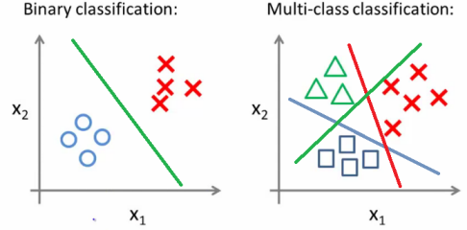
Classification
Grouping examples into different classes, i.e., taking input vectors and deciding which of N classes they belong to, based on training from exemplars of each class.
The most important point about the classification problem is that it is discrete.
Many real-world problems use classification.

Slide 4
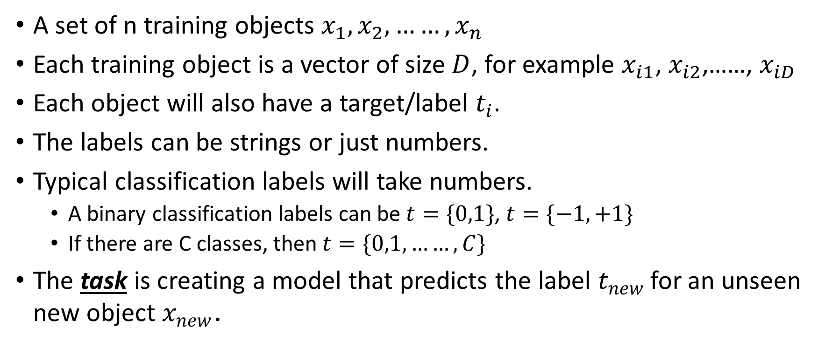
Classification: The General Problem
A set of n training objects $x_{1},x_{2},……,x_{n}$
Each training object is a vector of size $D$, for example $x_{i1}$, $x_{i2}$,……, $x_{iD}$
Each object will also have a target/label $t_{i}$.
The labels can be strings or just numbers.
Typical classification labels will take numbers.
A binary classification labels can be $t=\{0,1\}$, $t=\{−1,+1\}$
If there are C classes, then $t=\{0,1,……, C\}$
The task is creating a model that predicts the label $t_{new }$for an unseen new object $x_{new}$.

Slide 5
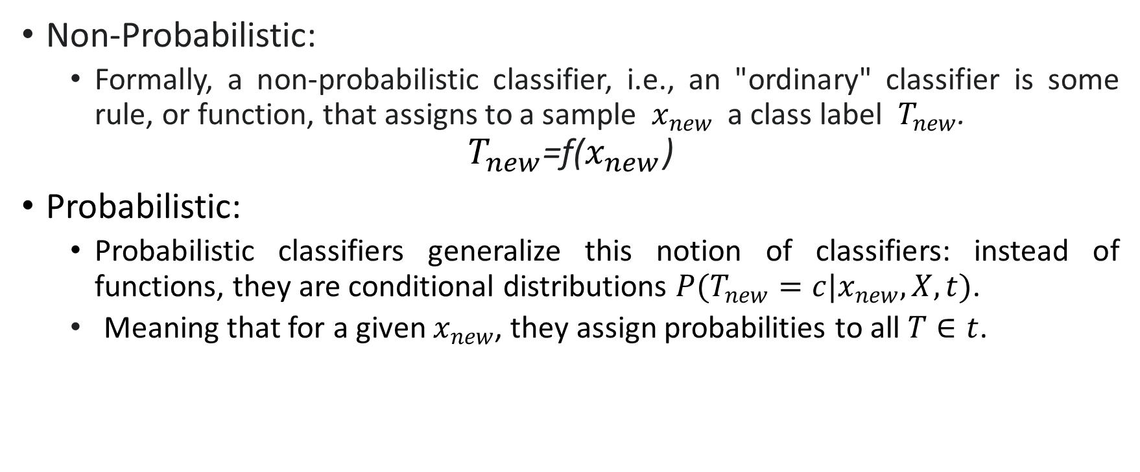
Probabilistic vs Non-Probabilistic Classifiers
Non-Probabilistic:
Formally, a non-probabilistic classifier, i.e., an "ordinary" classifier is some rule, or function, that assigns to a sample $x_{new}$ a class label $T_{new}$.
$$T_{new}\text{=}\text{f}\text{(}x_{new}\text{)}$$
Probabilistic:
Probabilistic classifiers generalize this notion of classifiers: instead of functions, they are conditional distributions $P(T_{new}=c|x_{new},X,t)$.
Meaning that for a given $x_{new}$, they assign probabilities to all $T∈t$.

Slide 6

Probabilistic vs Non-Probabilistic Classifiers
For example, a binary classification to classify cats and dogs.
Once a model was built using training images of dogs and cats, Given a new image
A non-probabilistic classifier assigns a label cat or dog to the new image with 100% certainty.
A probabilistic classifier, instead of assigning a label, will give probability like 0.7 chance that the image is a dog and 0.3 chance that the image is a cat.

Slide 7
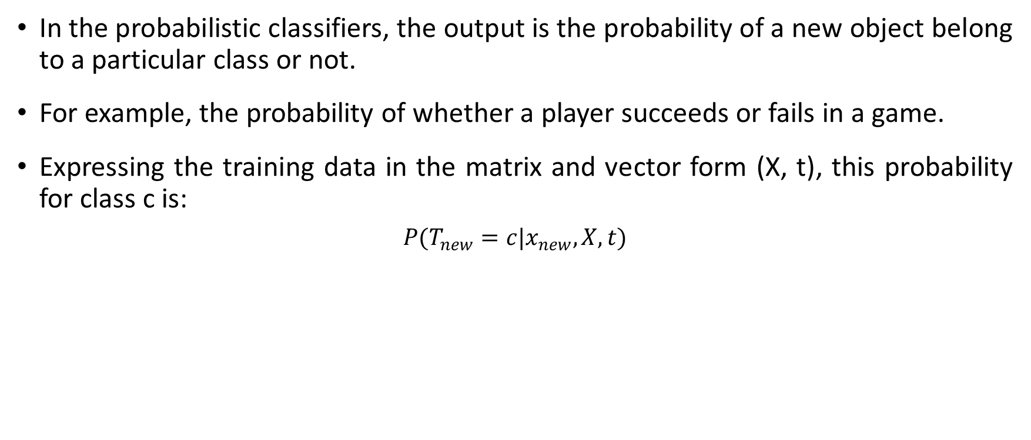
Probabilistic Classifiers
In the probabilistic classifiers, the output is the probability of a new object belong to a particular class or not.
For example, the probability of whether a player succeeds or fails in a game.
Expressing the training data in the matrix and vector form (X, t), this probability for class c is:
$$P(T_{new}=c|x_{new},X,t)$$

Slide 8
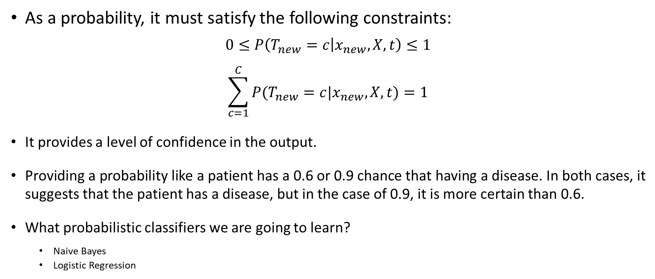
Probabilistic Classifiers
As a probability, it must satisfy the following constraints:
$$0≤P\left(T_{new}=c | x_{new},X,t\right)≤1$$
$$\sum_{c=1}^{C}{P(T_{new}=c|x_{new},X,t)}=1$$
It provides a level of confidence in the output.
Providing a probability like a patient has a 0.6 or 0.9 chance that having a disease. In both cases, it suggests that the patient has a disease, but in the case of 0.9, it is more certain than 0.6.
What probabilistic classifiers we are going to learn?
Naive Bayes
Logistic Regression

Slide 9
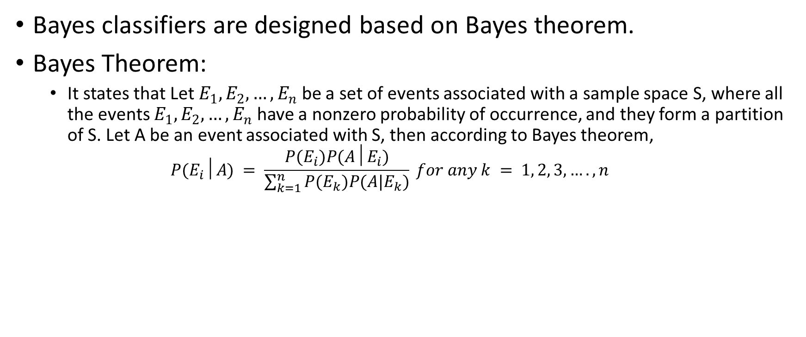
The Bayes Classifier
Bayes classifiers are designed based on Bayes theorem.
Bayes Theorem:
It states that Let $E_{1}, E_{2},…, E_{n}$ be a set of events associated with a sample space S, where all the events $E_{1}, E_{2},…, E_{n}$ have a nonzero probability of occurrence, and they form a partition of S. Let A be an event associated with S, then according to Bayes theorem,
$$P(E_{i}│A) = \frac{P(E_{i})P(A│E_{i})}{\sum_{k=1}^{n}{P(E_{k})P(A|E_{k})}} for any k = 1, 2, 3, …., n$$

Slide 10
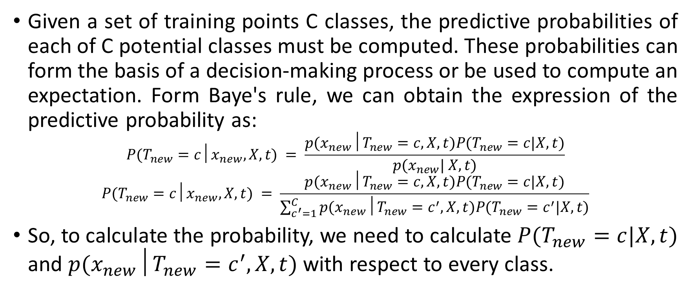
The Bayes Classifier
Given a set of training points C classes, the predictive probabilities of each of C potential classes must be computed. These probabilities can form the basis of a decision-making process or be used to compute an expectation. Form Baye's rule, we can obtain the expression of the predictive probability as:
$$P(T_{new}=c│x_{new},X,t) = \frac{p(x_{new}│T_{new}=c, X,t)P(T_{new}=c|X,t)}{p(x_{new}| X,t)}$$
$$P(T_{new}=c│x_{new},X,t) = \frac{p(x_{new}│T_{new}=c, X,t)P(T_{new}=c|X,t)}{\sum_{c^{′}=1}^{C}{p(x_{new}│T_{new}=c^{′}, X,t)P(T_{new}=c^{′}|X,t)}}$$
So, to calculate the probability, we need to calculate $P(T_{new}=c|X,t)$ and $p(x_{new}│T_{new}=c^{′}, X,t)$ with respect to every class.

Slide 11
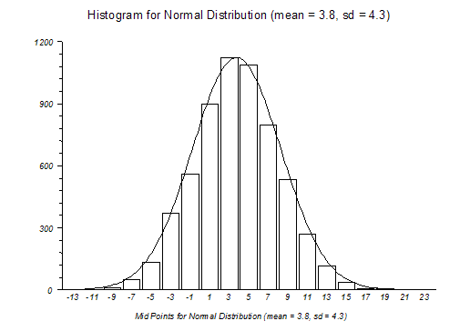
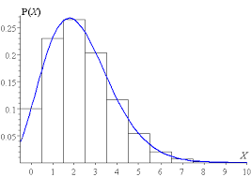
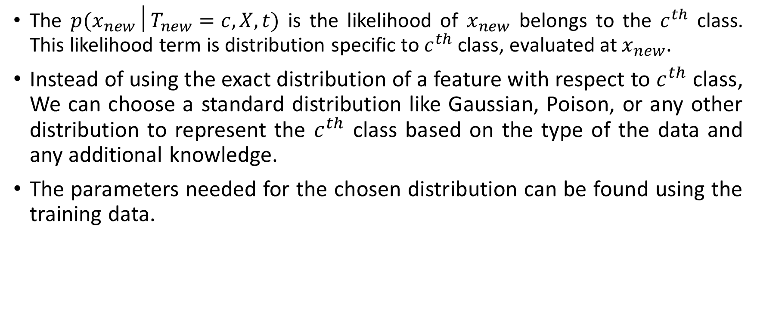
The Bayes Classifier
The $p(x_{new}│T_{new}=c, X,t)$ is the likelihood of $x_{new}$ belongs to the $c^{th}$ class. This likelihood term is distribution specific to $c^{th}$ class, evaluated at $x_{new}$.
Instead of using the exact distribution of a feature with respect to $c^{th}$ class, We can choose a standard distribution like Gaussian, Poison, or any other distribution to represent the $c^{th}$ class based on the type of the data and any additional knowledge.
The parameters needed for the chosen distribution can be found using the training data.
Notes:
If there is a class c that is extremely rare, then the probability of the $c^{th}$ the class will be very low. So, a new object will only be classified as the $c^{th}$ class if and only if the likelihood is very high. But if the $c^{th}$ class is very crucial, and we want to misclassify an object of $c^{th}$ class, then we bias the probability and can give a higher value for the probability of $c^{th}$ class.

Slide 12
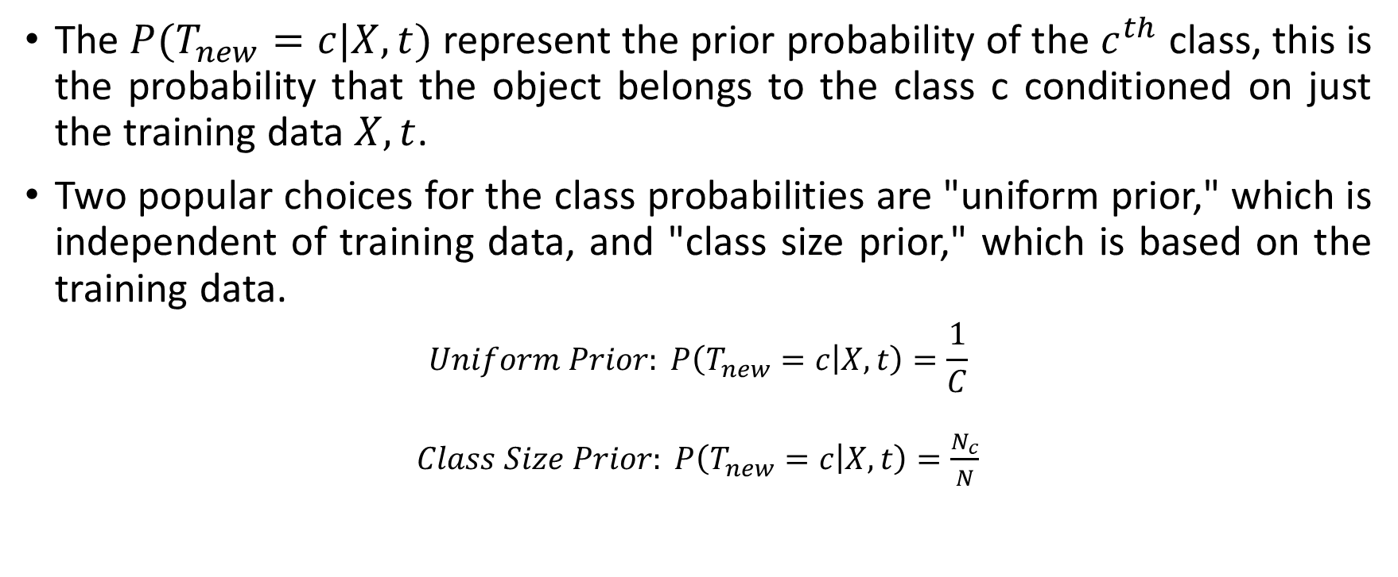
The Bayes Classifier
The $P(T_{new}=c|X,t)$ represent the prior probability of the $c^{th}$ class, this is the probability that the object belongs to the class c conditioned on just the training data $X,t$.
Two popular choices for the class probabilities are "uniform prior," which is independent of training data, and "class size prior," which is based on the training data.
$$Uniform Prior: P\left(T_{new}=c | X,t\right)=\frac{1}{C}$$
$Class Size Prior: P\left(T_{new}=c | X,t\right)=\frac{N_{c}}{N}$
Notes:
If there is a class c that is extremely rare, then the probability of the $c^{th}$ the class will be very low. So, a new object will only be classified as the $c^{th}$ class if and only if the likelihood is very high. But if the $c^{th}$ class is very crucial, and we want to misclassify an object of $c^{th}$ class, then we bias the probability and can give a higher value for the probability of $c^{th}$ class.

Slide 13
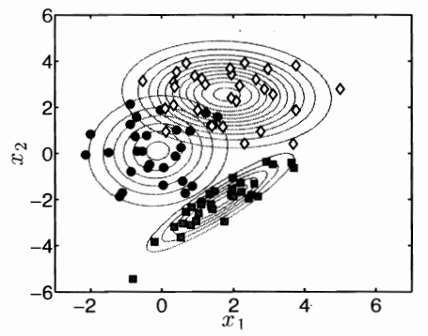
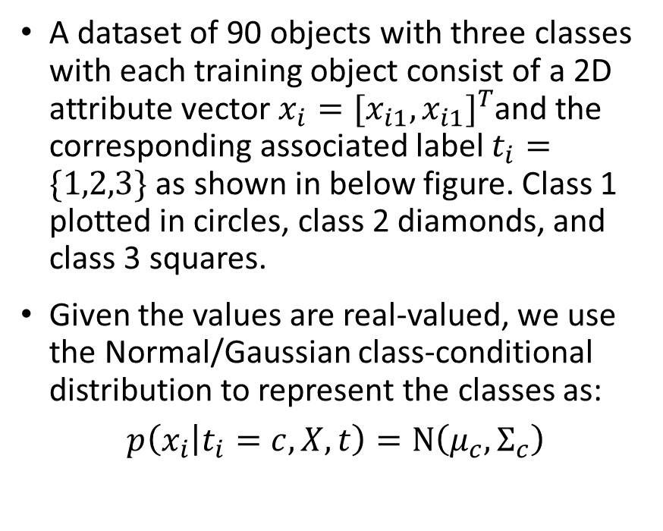
Example
A dataset of 90 objects with three classes with each training object consist of a 2D attribute vector $x_{i}={[x_{i1},x_{i1}]}^{T}$and the corresponding associated label $t_{i}=\{1,2,3\}$ as shown in below figure. Class 1 plotted in circles, class 2 diamonds, and class 3 squares.
Given the values are real-valued, we use the Normal/Gaussian class-conditional distribution to represent the classes as:
$$p\left(x_{i} | t_{i}=c, X,t\right)=Ν\left(μ_{c},Σ_{c}\right)$$

Slide 14

Example
where$μ_{c}$ and $Σ_{c}$calculated based on the training data using the equation as:
$$μ_{c}=\frac{1}{N_{c}}\sum_{i=1}^{N_{c}}{x_{i}}$$
$$Σ_{c}=\frac{1}{N_{c}}\sum_{i=1}^{N_{c}}{(x_{i}−μ_{c}){(x_{i}−μ_{c})}^{T}}$$

Slide 15
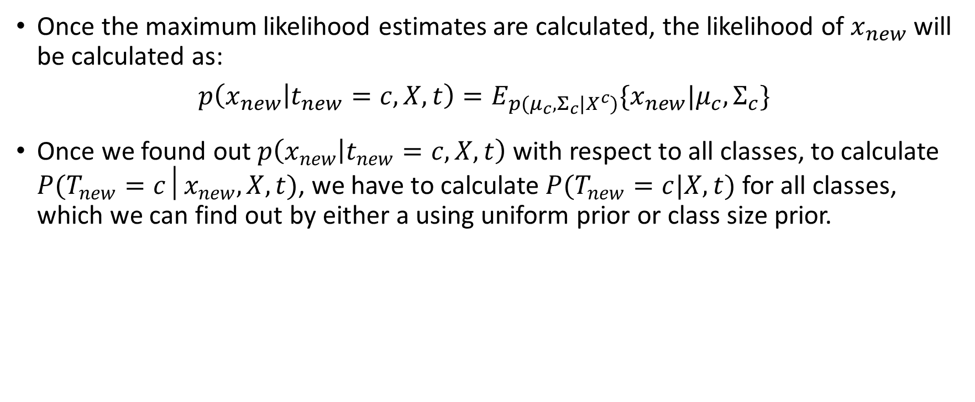
The Bayes Classifier
Once the maximum likelihood estimates are calculated, the likelihood of $x_{new}$ will be calculated as:
$$p\left(x_{new} | t_{new}=c, X,t\right)=E_{p(μ_{c},Σ_{c}|X^{c})}\{x_{new}|μ_{c},Σ_{c}\}$$
Once we found out $p\left(x_{new} | t_{new}=c, X,t\right)$ with respect to all classes, to calculate $P(T_{new}=c│x_{new},X,t)$, we have to calculate $P(T_{new}=c|X,t)$ for all classes, which we can find out by either a using uniform prior or class size prior.
Notes:
If there is a class c that is extremely rare, then the probability of the $c^{th}$ the class will be very low. So, a new object will only be classified as the $c^{th}$ class if and only if the likelihood is very high. But if the $c^{th}$ class is very crucial, and we want to misclassify an object of $c^{th}$ class, then we bias the probability and can give a higher value for the probability of $c^{th}$ class.

Slide 16
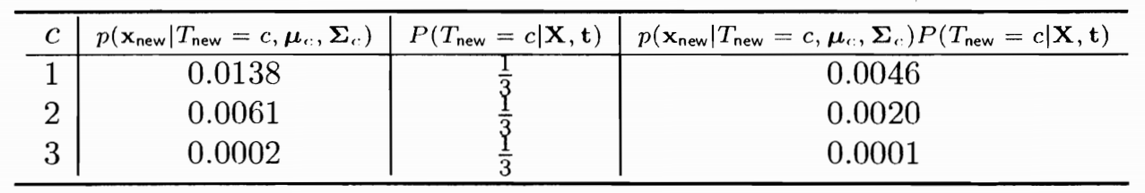

Example
Once the likelihoods of $x_{new}$ with respect to the three classes and the class probabilities (uniform prior) were calculated (As given in the following table), let's calculate the probabilities of a new object $x_{new}={[2,0]}^{T}$ belongs to either class 1 or 2 or 3.

Slide 17
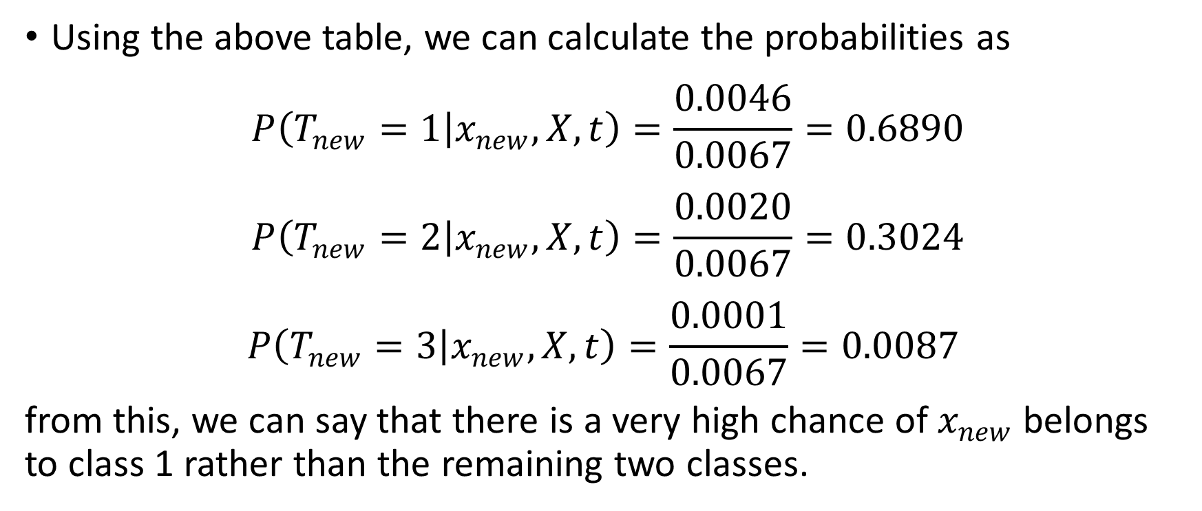
Example
Using the above table, we can calculate the probabilities as
$$P\left(T_{new}=1 | x_{new},X,t\right)=\frac{0.0046}{0.0067}=0.6890$$
$$P\left(T_{new}=2 | x_{new},X,t\right)=\frac{0.0020}{0.0067}=0.3024$$
$$P\left(T_{new}=3 | x_{new},X,t\right)=\frac{0.0001}{0.0067}=0.0087$$
from this, we can say that there is a very high chance of $x_{new}$ belongs to class 1 rather than the remaining two classes.

Slide 18
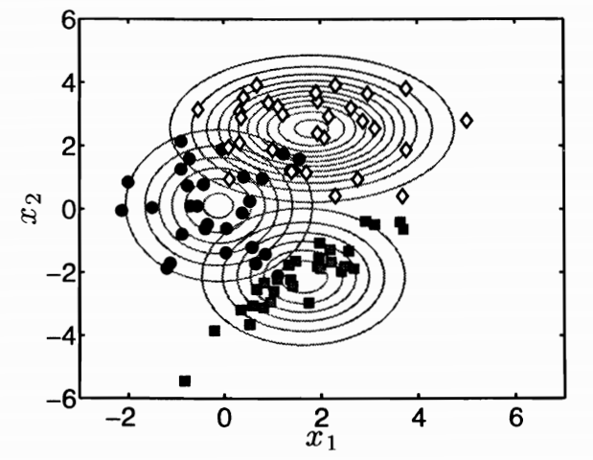
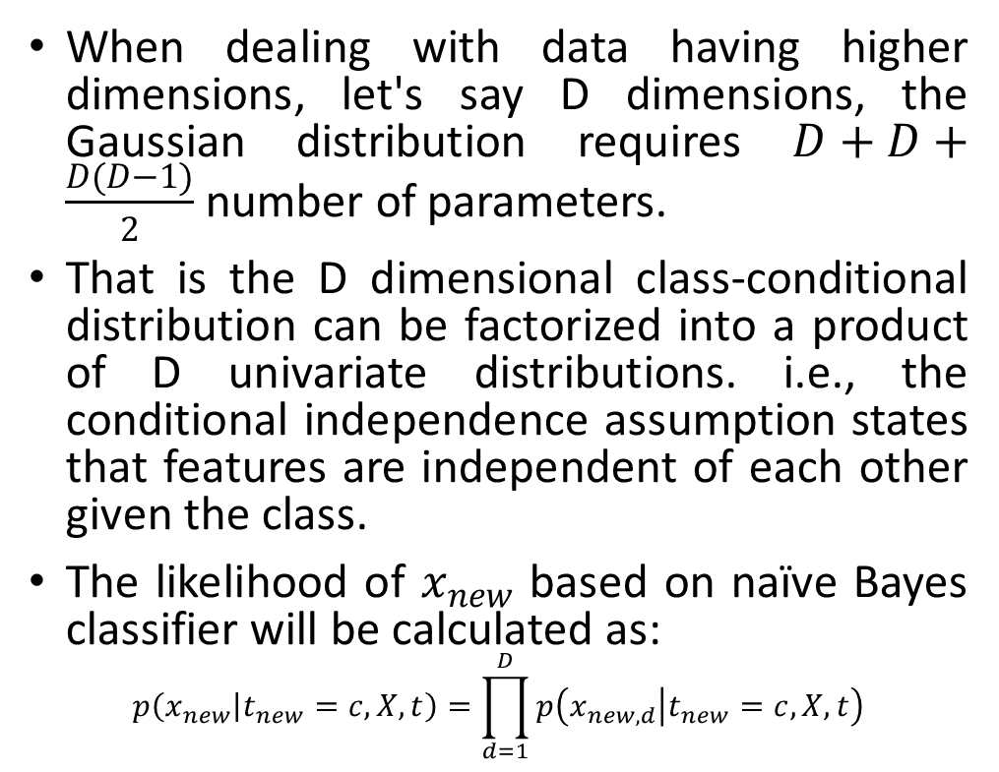
Naïve Bayes Assumption:
When dealing with data having higher dimensions, let's say D dimensions, the Gaussian distribution requires $D+D+\frac{D(D−1)}{2}$ number of parameters.
That is the D dimensional class-conditional distribution can be factorized into a product of D univariate distributions. i.e., the conditional independence assumption states that features are independent of each other given the class.
The likelihood of $x_{new}$ based on naïve Bayes classifier will be calculated as:
$$p\left(x_{new} | t_{new}=c, X,t\right)=\prod_{d=1}^{D}{p\left(x_{new,d} | t_{new}=c, X,t\right)}$$

Slide 19
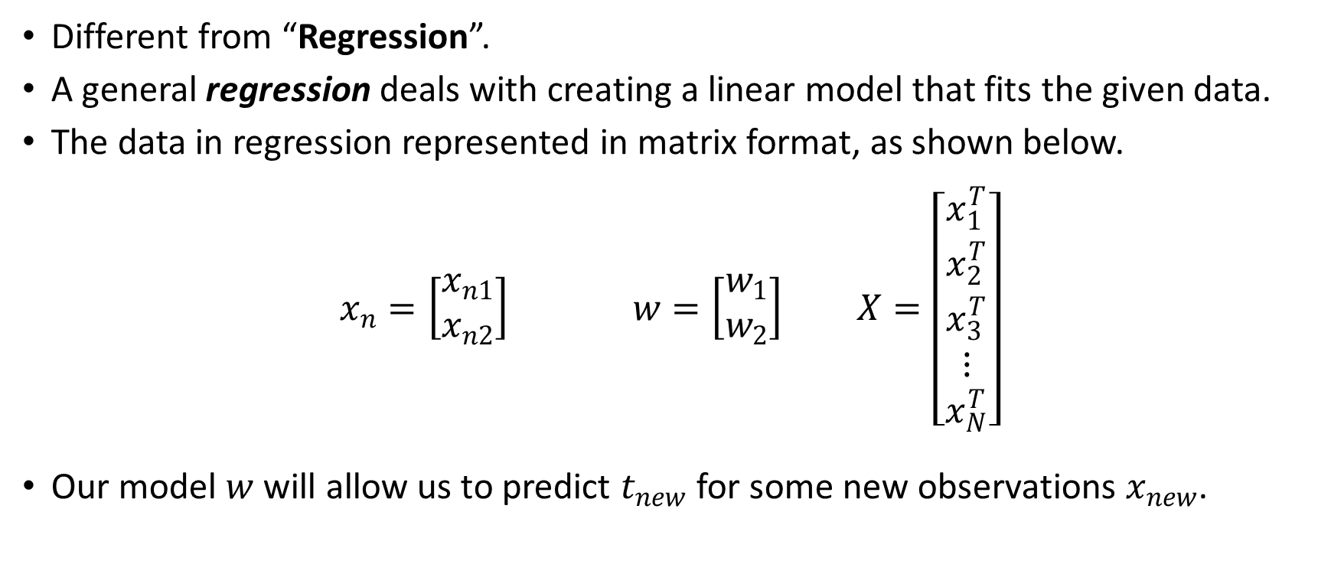
Logistic Regression
Different from “Regression”.
A general regression deals with creating a linear model that fits the given data.
The data in regression represented in matrix format, as shown below.
$$x_{n}=\left[\begin{matrix}x_{n1} \\ x_{n2}\end{matrix}\right] w=\left[\begin{matrix}w_{1} \\ w_{2}\end{matrix}\right] X=\left[\begin{matrix}x_{1}^{T} \\ x_{2}^{T} \\ \begin{matrix}x_{3}^{T} \\ ⋮ \\ x_{N}^{T}\end{matrix}\end{matrix}\right]$$
Our model $w$ will allow us to predict $t_{new}$ for some new observations $x_{new}$.

Slide 20
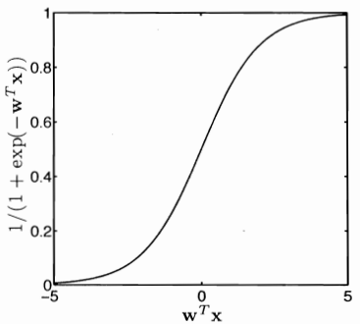
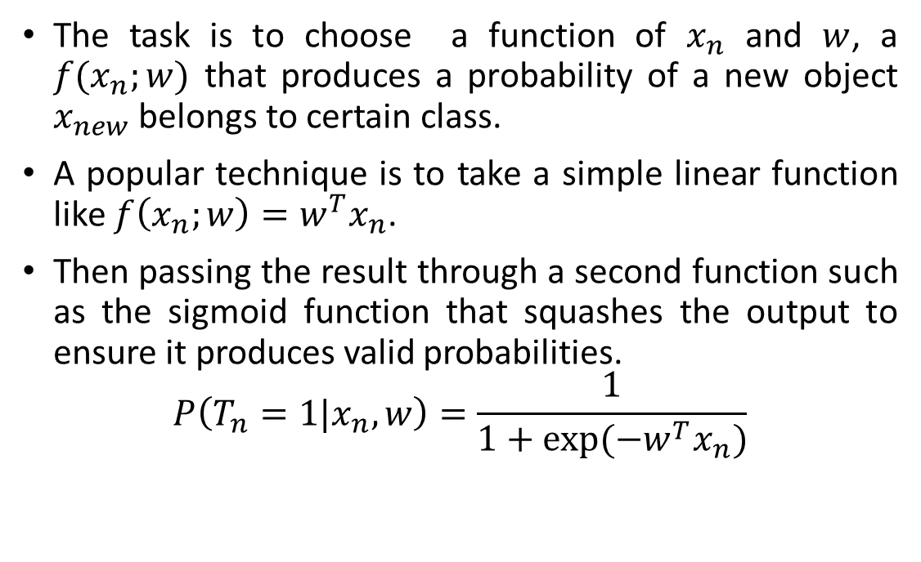
Logistic Regression
The task is to choose a function of $x_{n}$ and $w$, a $f(x_{n};w)$ that produces a probability of a new object $x_{new}$ belongs to certain class.
A popular technique is to take a simple linear function like $f\left(x_{n};w\right)=w^{T}x_{n}$.
Then passing the result through a second function such as the sigmoid function that squashes the output to ensure it produces valid probabilities.
$$P\left(T_{n}=1|x_{n},w\right)=\frac{1}{1+exp⁡(−w^{T}x_{n})}$$

Slide 21
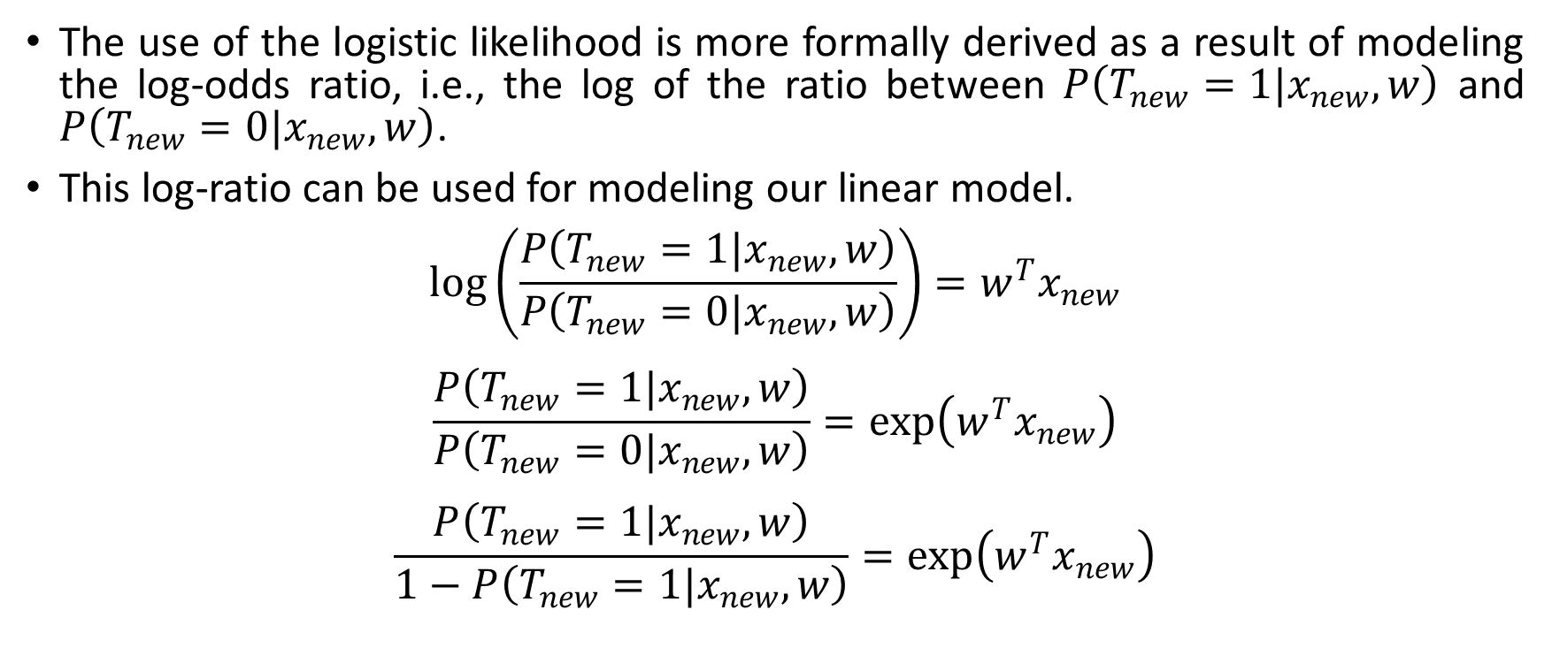
Logistic Regression
The use of the logistic likelihood is more formally derived as a result of modeling the log-odds ratio, i.e., the log of the ratio between $P\left(T_{new}=1|x_{new},w\right)$ and $P\left(T_{new}=0|x_{new},w\right)$.
This log-ratio can be used for modeling our linear model.
$$\log\left(\frac{P\left(T_{new}=1|x_{new},w\right)}{P\left(T_{new}=0|x_{new},w\right)}\right)=w^{T}x_{new}$$
$$\frac{P\left(T_{new}=1|x_{new},w\right)}{P\left(T_{new}=0|x_{new},w\right)}=\exp\left(w^{T}x_{new}\right)$$
$$\frac{P\left(T_{new}=1|x_{new},w\right)}{1−P\left(T_{new}=1|x_{new},w\right)}=\exp\left(w^{T}x_{new}\right)$$
Notes:
If the former is greater than the latter, then the log ratio will take a large positive value, and if the former is less than the latter, then the log ratio will take a large negative value.

Slide 22
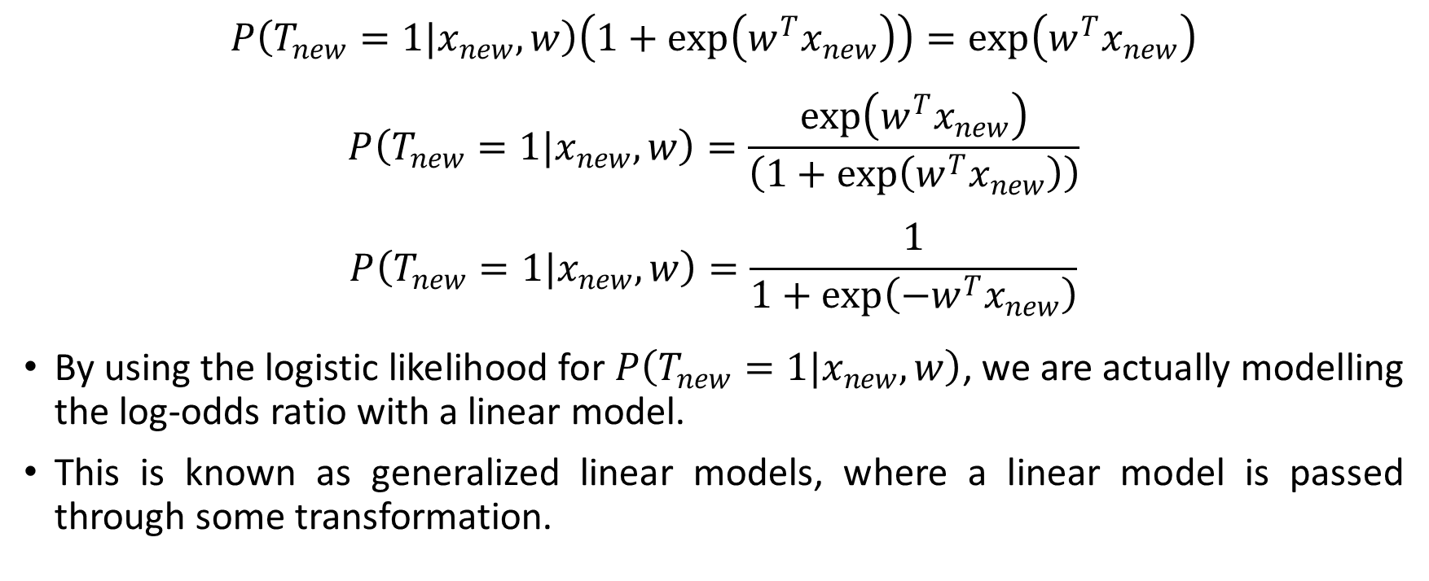
Logistic Regression
$$P\left(T_{new}=1|x_{new},w\right)\left(1+\exp\left(w^{T}x_{new}\right)\right)=\exp\left(w^{T}x_{new}\right)$$
$$P\left(T_{new}=1|x_{new},w\right)=\frac{\exp\left(w^{T}x_{new}\right)}{\left(1+\exp\left(w^{T}x_{new}\right)\right)}$$
$$P\left(T_{new}=1|x_{new},w\right)=\frac{1}{1+\exp\left(−w^{T}x_{new}\right)}$$
By using the logistic likelihood for $P\left(T_{new}=1|x_{new},w\right)$, we are actually modelling the log-odds ratio with a linear model.
This is known as generalized linear models, where a linear model is passed through some transformation.
Notes:
If the former is greater than the latter, then the log ratio will take a large positive value, and if the former is less than the latter, then the log ratio will take a large negative value.

Slide 23
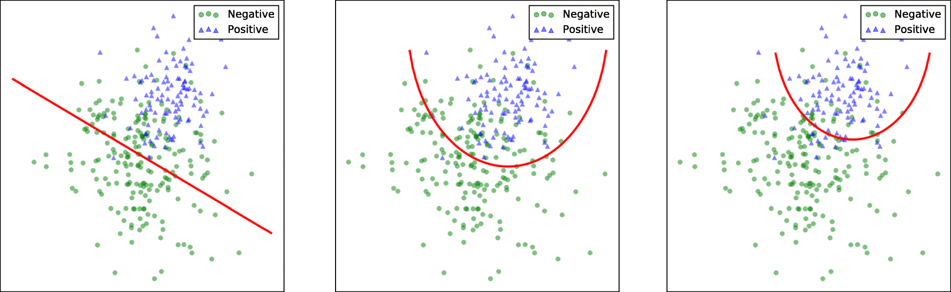
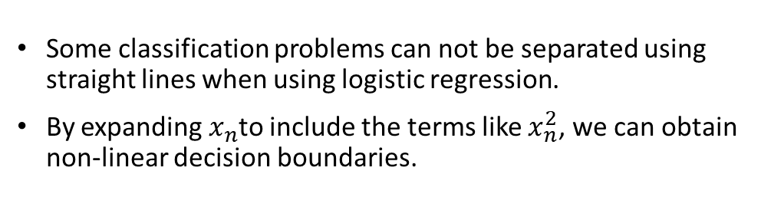
Logistic Regression
Some classification problems can not be separated using straight lines when using logistic regression.
By expanding $x_{n}$to include the terms like $x_{n}^{2}$, we can obtain non-linear decision boundaries.
Notes:
But it is important to remember that over-fitting and poor generalization is very much possible when making the non-linear models more compared to linear models.

Slide 24
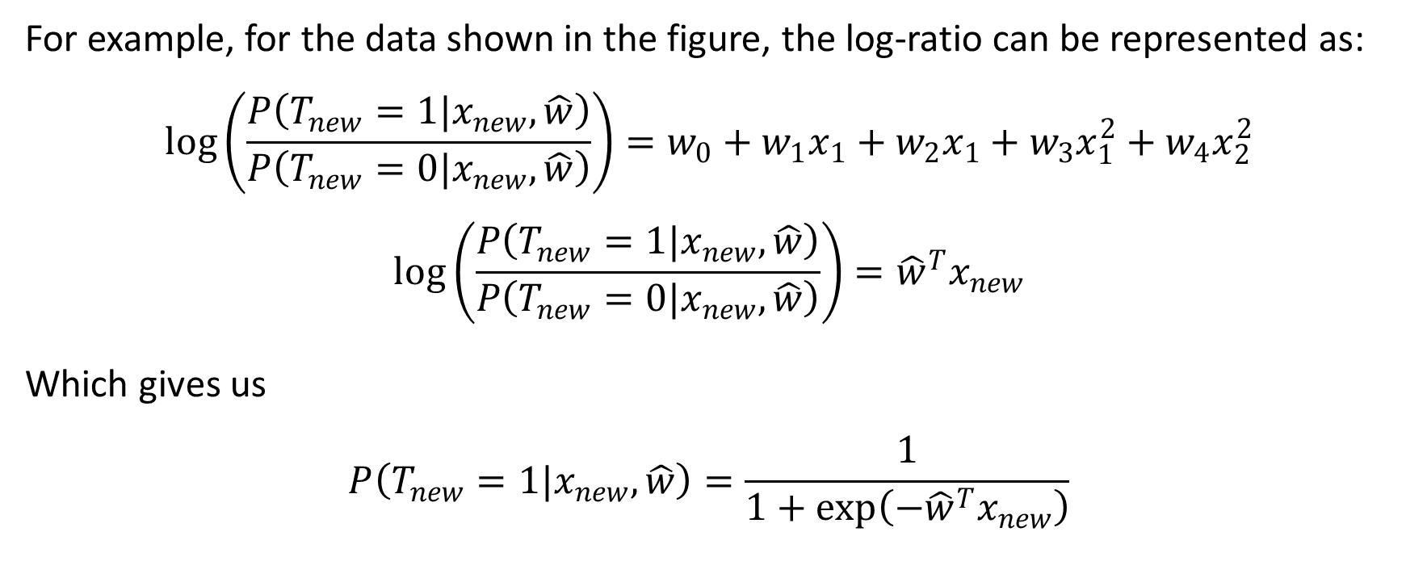
Logistic Regression
For example, for the data shown in the figure, the log-ratio can be represented as:
$$\log\left(\frac{P\left(T_{new}=1|x_{new},\hat{w}\right)}{P\left(T_{new}=0|x_{new},\hat{w}\right)}\right)=w_{0}+w_{1}x_{1}+w_{2}x_{1}+w_{3}x_{1}^{2}+w_{4}x_{2}^{2}$$
$$\log\left(\frac{P\left(T_{new}=1|x_{new},\hat{w}\right)}{P\left(T_{new}=0|x_{new},\hat{w}\right)}\right)={\hat{w}}^{T}x_{new}$$
Which gives us
$$P\left(T_{new}=1|x_{new},\hat{w}\right)=\frac{1}{1+\exp\left(−{\hat{w}}^{T}x_{new}\right)}$$
Notes:
Sometimes it is better to go with nonparametric models like the Gaussian models instead of sticking to parametric models, i.e., linear and non-linear polynomial models. A parametric model is parameterized by a finite number of parameters, whereas a limited number of parameters can not parameterize a nonparametric model. For example, a Gaussian model is characterized by two functions: a mean function and a covariance function.

Slide 25
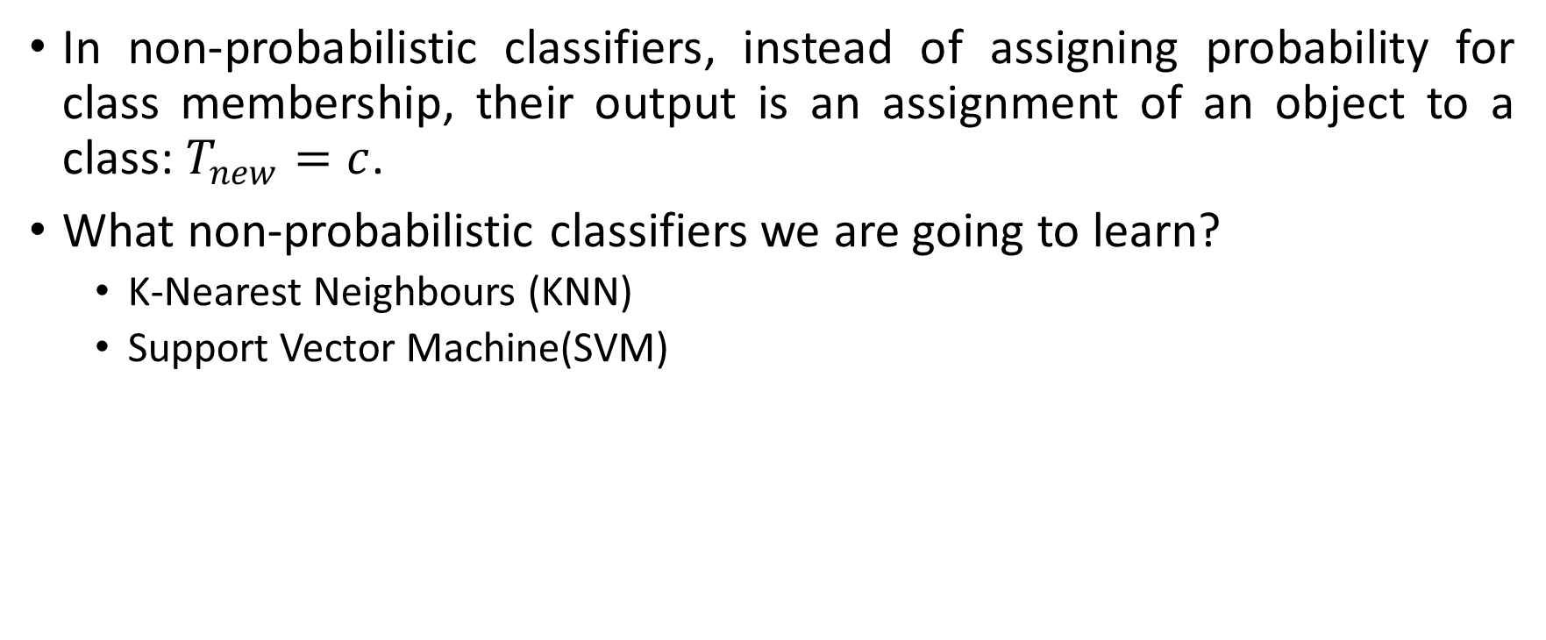
Non-probabilistic Classifiers
In non-probabilistic classifiers, instead of assigning probability for class membership, their output is an assignment of an object to a class: $T_{new}=c$.
What non-probabilistic classifiers we are going to learn?
K-Nearest Neighbours (KNN)
Support Vector Machine(SVM)

Slide 26
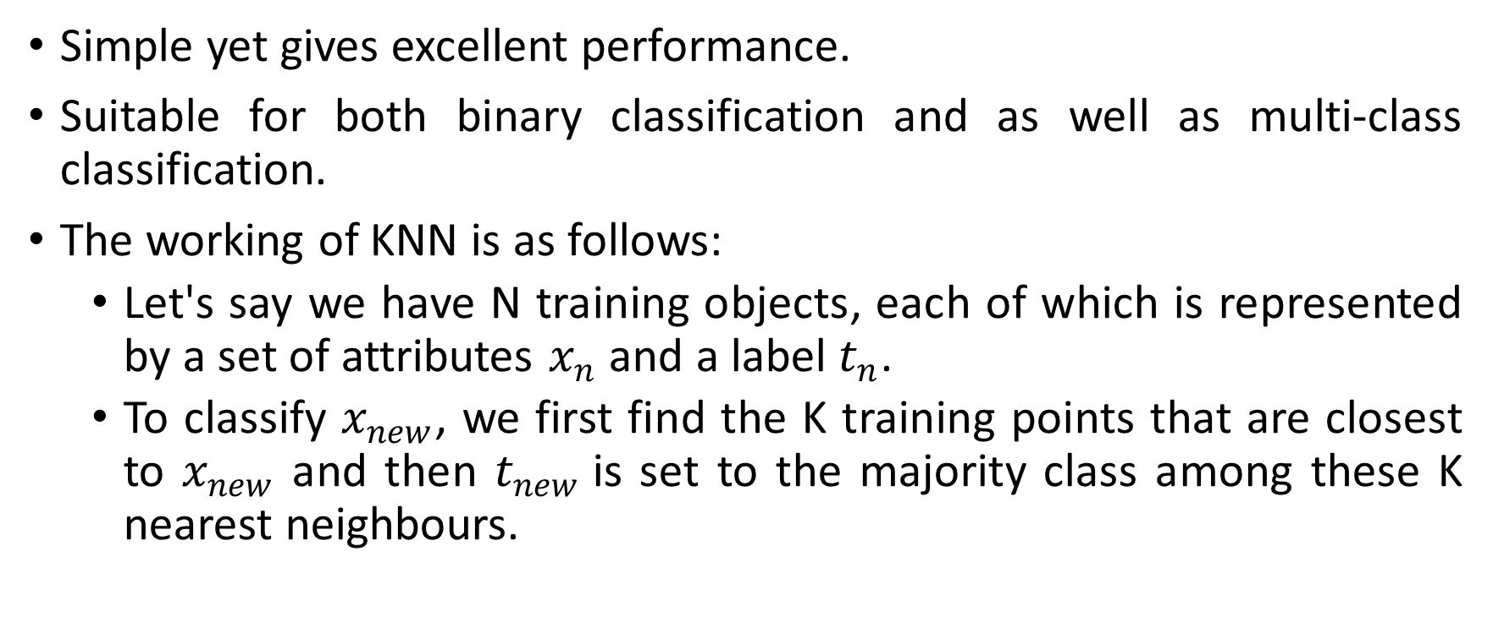
K-Nearest Neighbours (KNN)
Simple yet gives excellent performance.
Suitable for both binary classification and as well as multi-class classification.
The working of KNN is as follows:
Let's say we have N training objects, each of which is represented by a set of attributes $x_{n}$ and a label $t_{n}$.
To classify $x_{new}$, we first find the K training points that are closest to $x_{new}$ and then $t_{new}$is set to the majority class among these K nearest neighbours.
Notes:
Logically speaking, KNN has no training phase.

Slide 27
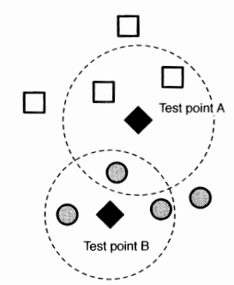
K-Nearest Neighbours (KNN)
The main drawback of KNN is the issue of ties, i.e., if two are more classes have an equal and majority number of votes.
Solution:
One good solution to this drawback in binary classification is assigning an odd number to K always.
A more general solution is weighing the votes as per their distance from the new data point.
Notes:
For example, as shown in the above figure that shows a binary classification problem, where class 1 is represented with squares and class 2 is represented with circles. Now, two new objects A and B, have to be classified. Now the K value chosen here is 3, i.e., to classify a new object, we will check the three nearest neighbors, and the new object will be assigned with the majority class. Hence, object A will be classified as class 1 as 2 out of 3 nearest neighbors are of class 1, and object B will be classified as class 2 as all the three nearest neighbors are of class 2.

Slide 28
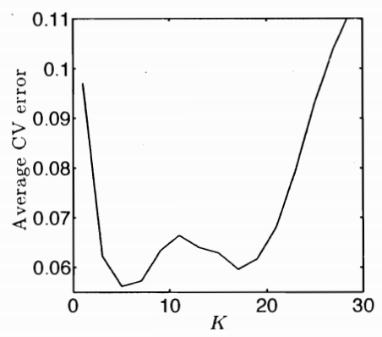
K-Nearest Neighbours (KNN)
So, how to choose the K value?
If K is too small, the classification will be heavily influenced by noise, and if the K value is too high, we will lose the true pattern in the data.
The most popular method for choosing K is cross-validation. By performing cross-validation with different K values, we will select the optimal value for K that gives less error.
Notes:
Logically speaking, KNN has no training phase.

Slide 29
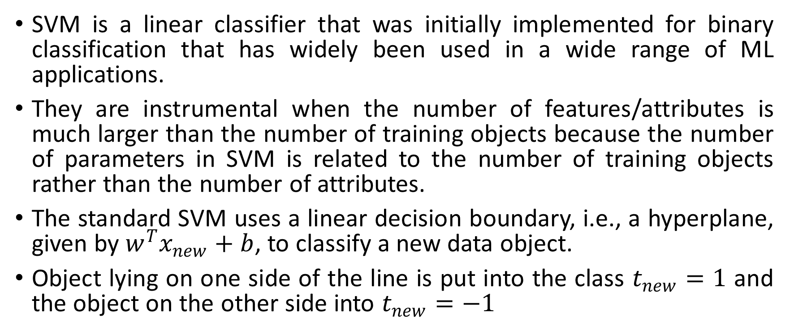
Support Vector Machine(SVM)
SVM is a linear classifier that was initially implemented for binary classification that has widely been used in a wide range of ML applications.
They are instrumental when the number of features/attributes is much larger than the number of training objects because the number of parameters in SVM is related to the number of training objects rather than the number of attributes.
The standard SVM uses a linear decision boundary, i.e., a hyperplane, given by $w^{T}x_{new}+b$, to classify a new data object.
Object lying on one side of the line is put into the class $t_{new}=1$ and the object on the other side into $t_{new}=−1$

Slide 30
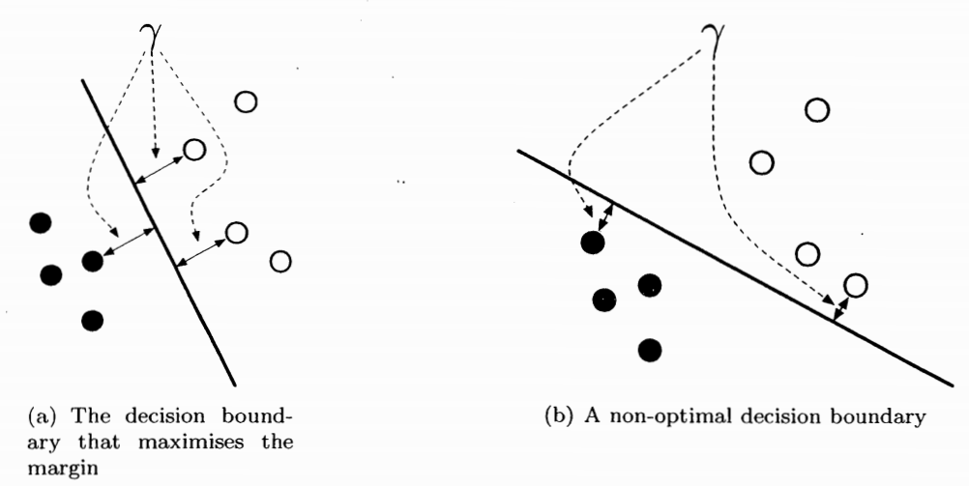
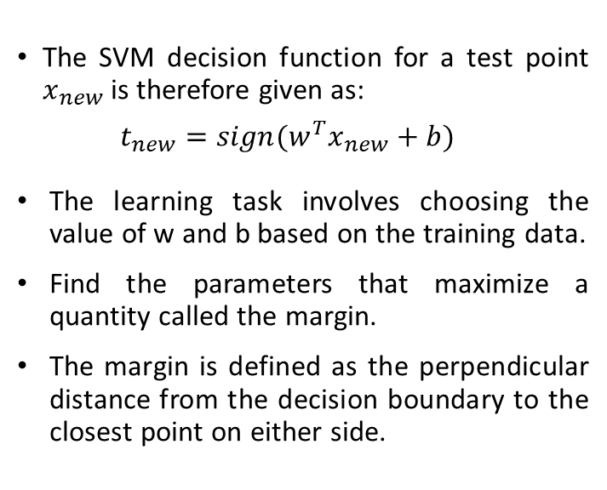
Support Vector Machine(SVM)
The SVM decision function for a test point $x_{new}$ is therefore given as:
$$t_{new}=sign(w^{T}x_{new}+b)$$
The learning task involves choosing the value of w and b based on the training data.
Find the parameters that maximize a quantity called the margin.
The margin is defined as the perpendicular distance from the decision boundary to the closest point on either side.

Slide 31
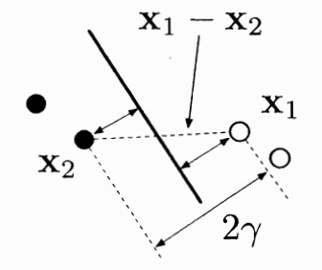
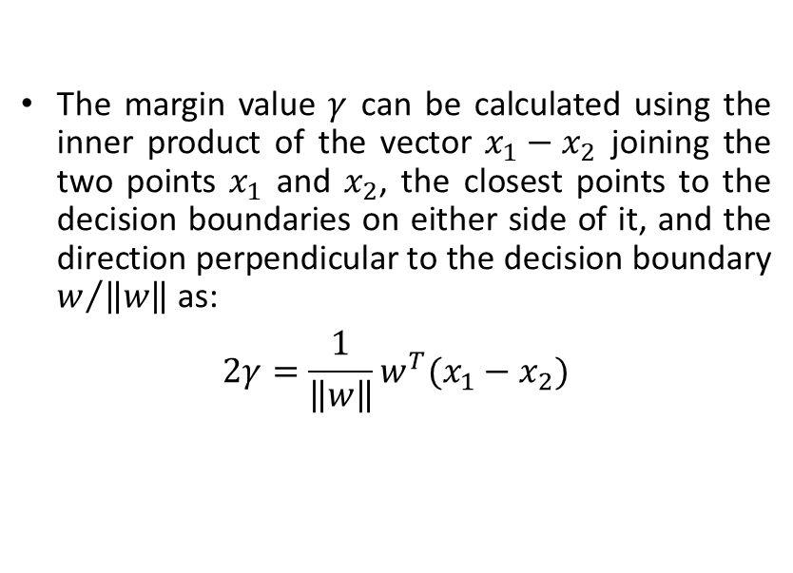
Support Vector Machine(SVM)
The margin value $γ$ can be calculated using the inner product of the vector $x_{1}−x_{2}$ joining the two points $x_{1}$ and $x_{2}$, the closest points to the decision boundaries on either side of it, and the direction perpendicular to the decision boundary $w/{\left\|w\right\|}$ as:
$$2γ=\frac{1}{\left\|w\right\|}w^{T}(x_{1}−x_{2})$$

Slide 32
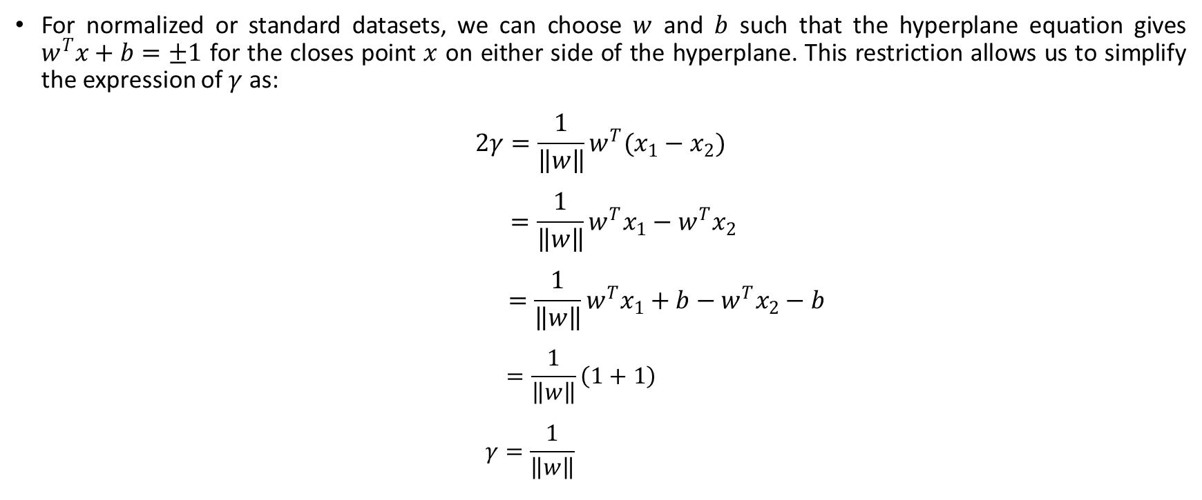
Support Vector Machine(SVM)
For normalized or standard datasets, we can choose $w$ and $b$ such that the hyperplane equation gives $w^{T}x+b=±1$ for the closes point $x$ on either side of the hyperplane. This restriction allows us to simplify the expression of $γ$ as:
$$2γ=\frac{1}{\left\|w\right\|}w^{T}(x_{1}−x_{2})$$
$$=\frac{1}{\left\|w\right\|}w^{T}x_{1}−w^{T}x_{2}$$
$$=\frac{1}{\left\|w\right\|}w^{T}x_{1}+b−w^{T}x_{2}−b$$
$$=\frac{1}{\left\|w\right\|}\left(1+1\right)$$
$$γ=\frac{1}{\left\|w\right\|}$$

Slide 33
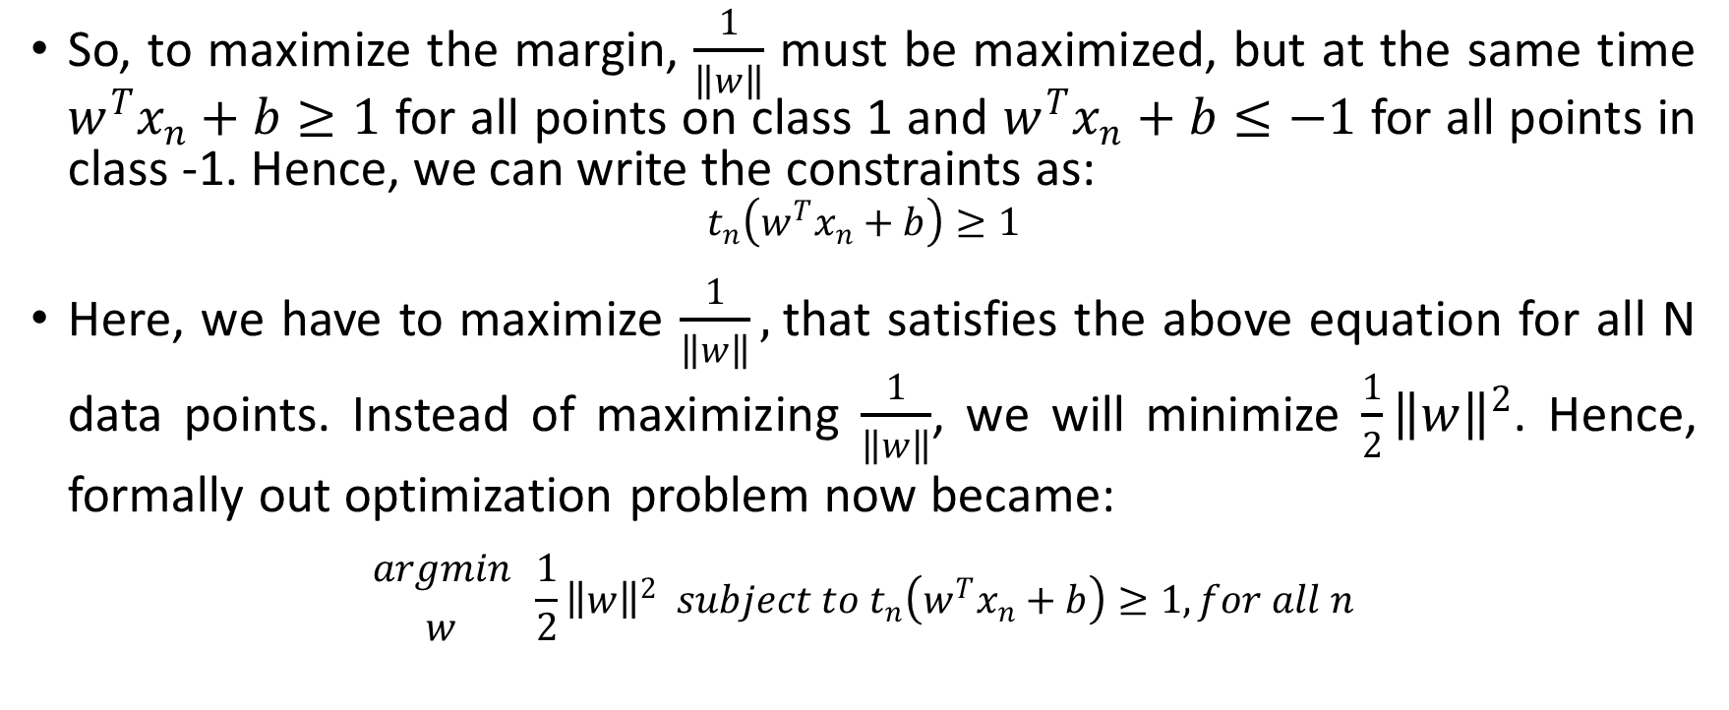
Support Vector Machine(SVM)
So, to maximize the margin, $\frac{1}{\left\|w\right\|}$ must be maximized, but at the same time $w^{T}x_{n}+b≥1$ for all points on class 1 and $w^{T}x_{n}+b≤−1$ for all points in class -1. Hence, we can write the constraints as:
$$t_{n}\left(w^{T}x_{n}+b\right)≥1$$
Here, we have to maximize $\frac{1}{\left\|w\right\|},$that satisfies the above equation for all N data points. Instead of maximizing $\frac{1}{\left\|w\right\|}$, we will minimize $\frac{1}{2}{\left\|w\right\|}^{2}$. Hence, formally out optimization problem now became:
$${argmin \atop w} \frac{1}{2}{\left\|w\right\|}^{2} subject to t_{n}\left(w^{T}x_{n}+b\right)≥1, for all n$$

Slide 34
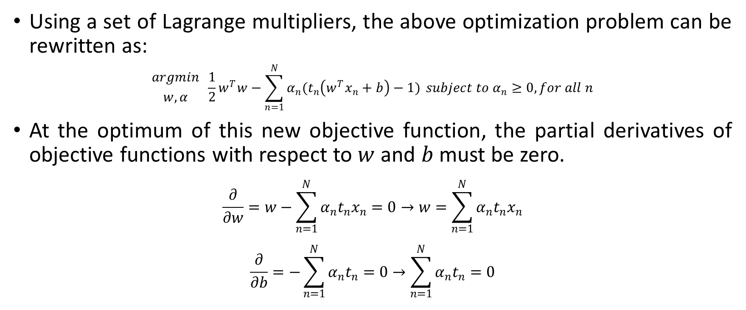
Support Vector Machine(SVM)
Using a set of Lagrange multipliers, the above optimization problem can be rewritten as:
$${argmin \atop w,α} \frac{1}{2}w^{T}w−\sum_{n=1}^{N}{α_{n}(t_{n}\left(w^{T}x_{n}+b\right)−1)} subject to α_{n}≥0, for all n$$
At the optimum of this new objective function, the partial derivatives of objective functions with respect to $w$ and $b$ must be zero.
$$\frac{∂}{∂w}=w−\sum_{n=1}^{N}{α_{n}t_{n}x_{n}}=0→w=\sum_{n=1}^{N}{α_{n}t_{n}x_{n}}$$
$$\frac{∂}{∂b}=−\sum_{n=1}^{N}{α_{n}t_{n}}=0→\sum_{n=1}^{N}{α_{n}t_{n}}=0$$

Slide 35
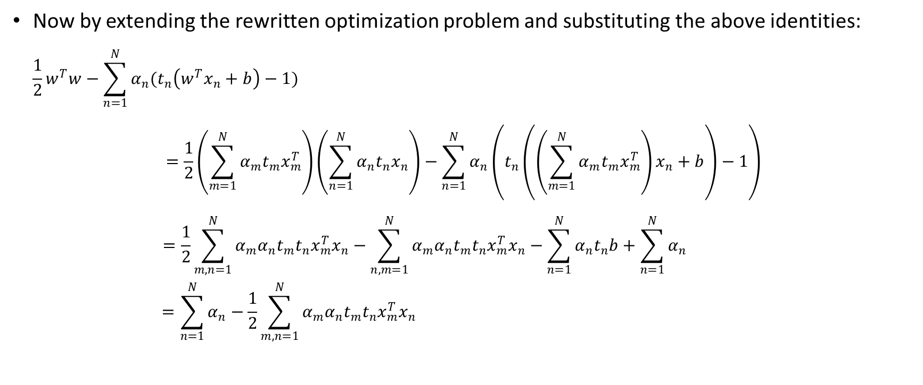
Support Vector Machine(SVM)
Now by extending the rewritten optimization problem and substituting the above identities:
$$\frac{1}{2}w^{T}w−\sum_{n=1}^{N}{α_{n}(t_{n}\left(w^{T}x_{n}+b\right)−1)}$$
$$=\frac{1}{2}\left(\sum_{m=1}^{N}{α_{m}t_{m}x_{m}^{T}}\right)\left(\sum_{n=1}^{N}{α_{n}t_{n}x_{n}}\right)−\sum_{n=1}^{N}{α_{n}\left(t_{n}\left(\left(\sum_{m=1}^{N}{α_{m}t_{m}x_{m}^{T}}\right)x_{n}+b\right)−1\right)}$$
$$=\frac{1}{2}\sum_{m,n=1}^{N}{α_{m}α_{n}t_{m}t_{n}x_{m}^{T}x_{n}}−\sum_{n,m=1}^{N}{α_{m}α_{n}t_{m}t_{n}x_{m}^{T}x_{n}}−\sum_{n=1}^{N}{α_{n}t_{n}b}+\sum_{n=1}^{N}{α_{n}}$$
$$=\sum_{n=1}^{N}{α_{n}}−\frac{1}{2}\sum_{m,n=1}^{N}{α_{m}α_{n}t_{m}t_{n}x_{m}^{T}x_{n}}$$

Slide 36
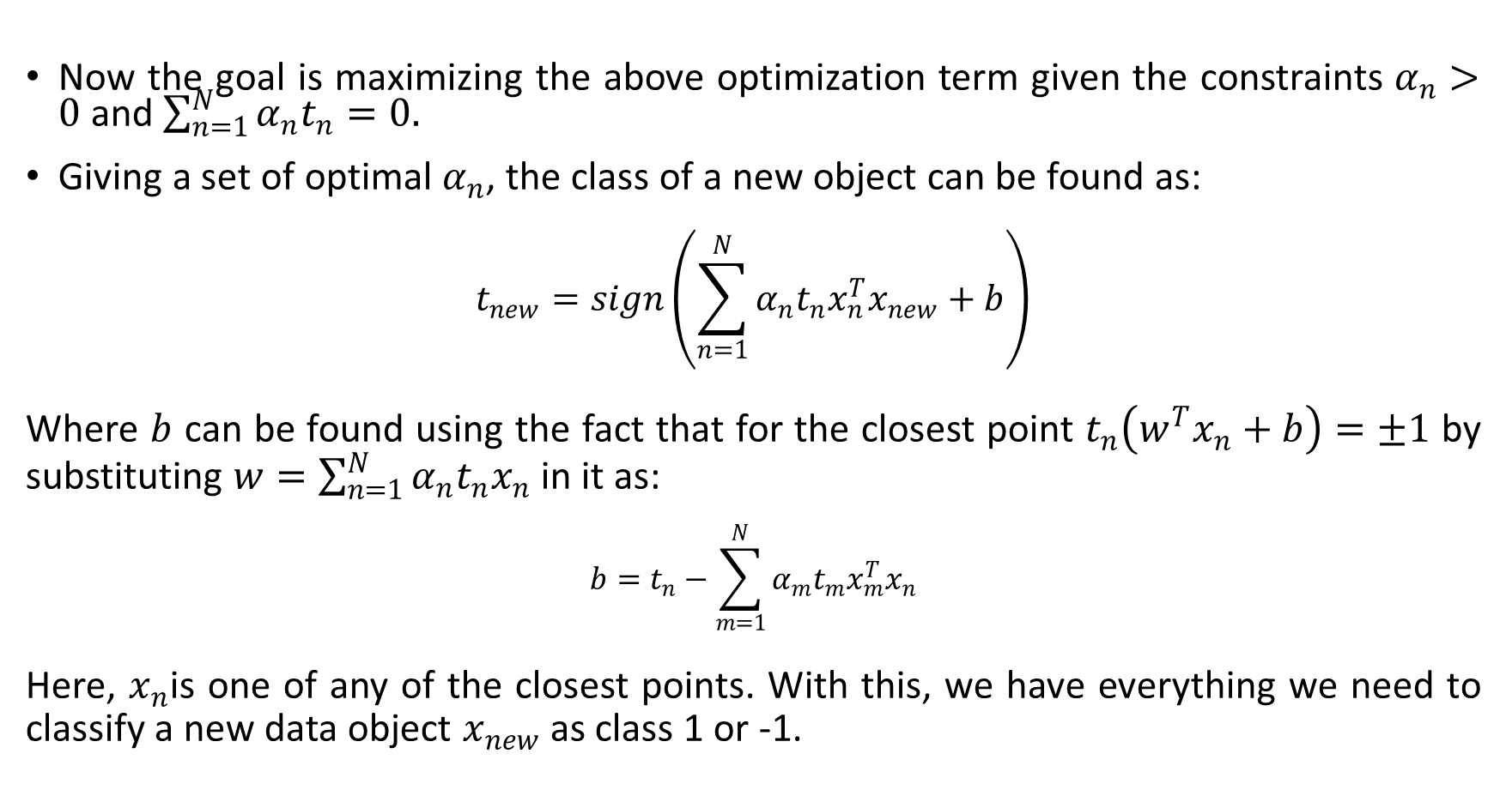
Support Vector Machine(SVM)
Now the goal is maximizing the above optimization term given the constraints $α_{n}>0$ and $\sum_{n=1}^{N}{α_{n}t_{n}}=0.$
Giving a set of optimal $α_{n}$, the class of a new object can be found as:
$$t_{new}=sign\left(\sum_{n=1}^{N}{α_{n}t_{n}x_{n}^{T}x_{new}+b}\right)$$
Where $b$ can be found using the fact that for the closest point $t_{n}\left(w^{T}x_{n}+b\right)=±1$ by substituting $w=\sum_{n=1}^{N}{α_{n}t_{n}x_{n}}$ in it as:
$$b=t_{n}−\sum_{m=1}^{N}{α_{m}t_{m}x_{m}^{T}x_{n}}$$
Here, $x_{n}$is one of any of the closest points. With this, we have everything we need to classify a new data object $x_{new}$ as class 1 or -1.
Notes:
Here, one can see that the optimization problem doesn't feature $w$. Instead, it has become a constrained quadratic programming task. There is no analytical solution to this problem; it is a straightforward numerical problem.

Slide 37
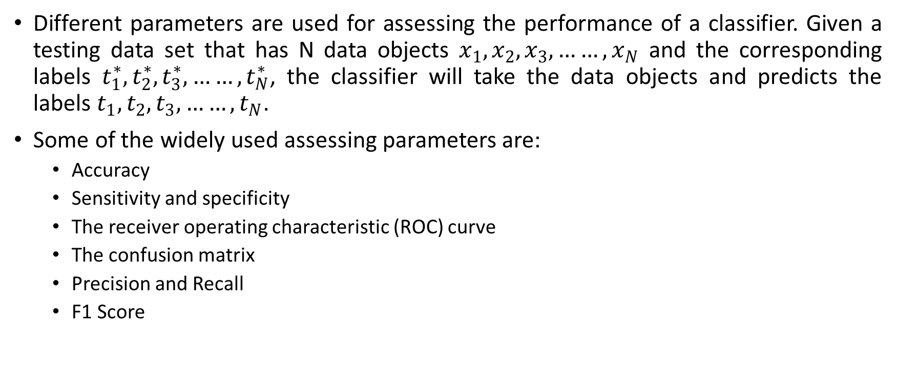
Assessing Classification Performance
Different parameters are used for assessing the performance of a classifier. Given a testing data set that has N data objects $x_{1},x_{2},x_{3},……,x_{N}$ and the corresponding labels $t_{1}^{∗},t_{2}^{∗},t_{3}^{∗},……,t_{N}^{∗}$, the classifier will take the data objects and predicts the labels $t_{1},t_{2},t_{3},……,t_{N}$.
Some of the widely used assessing parameters are:
Accuracy
Sensitivity and specificity
The receiver operating characteristic (ROC) curve
The confusion matrix
Precision and Recall
F1 Score

Slide 38
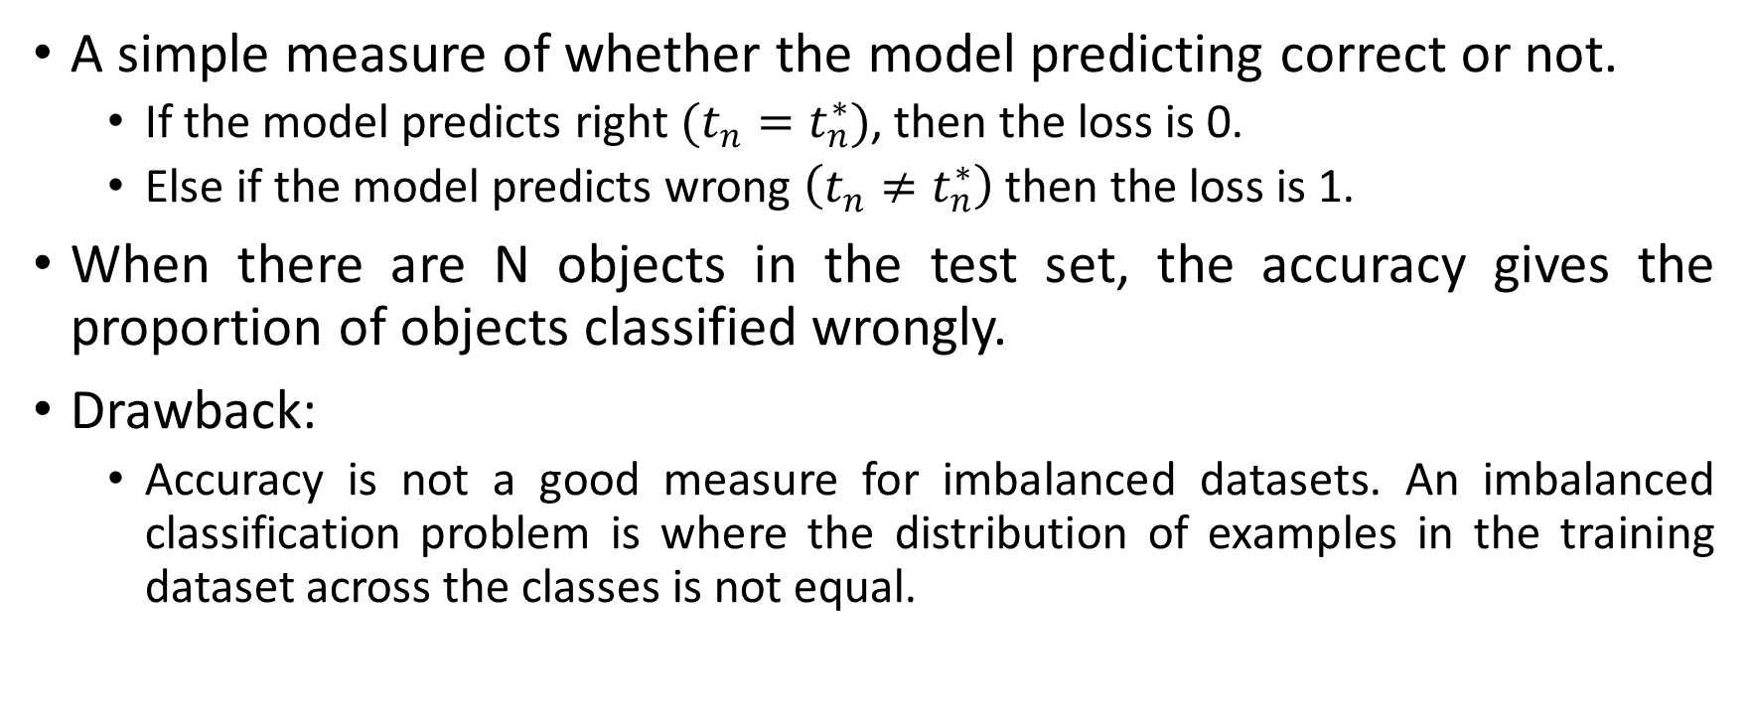
Accuracy (0/1 Loss)
A simple measure of whether the model predicting correct or not.
If the model predicts right $(t_{n}=t_{n}^{∗})$, then the loss is 0.
Else if the model predicts wrong $\left(t_{n}≠t_{n}^{∗}\right)$ then the loss is 1.
When there are N objects in the test set, the accuracy gives the proportion of objects classified wrongly.
Drawback:
Accuracy is not a good measure for imbalanced datasets. An imbalanced classification problem is where the distribution of examples in the training dataset across the classes is not equal.
Notes:
For example, let us consider a rare disease dataset, where 90% of the training data entries are of a no-disease class, and only 10% belong to the disease class. Even though all the objects are classified as a no-disease class, still the accuracy will be 90% with a 10% loss.
Hence, the other measures that are proposed for unbalanced datasets are the sensitivity and specificity pair, precision and recall pair, and F1 score.

Slide 39
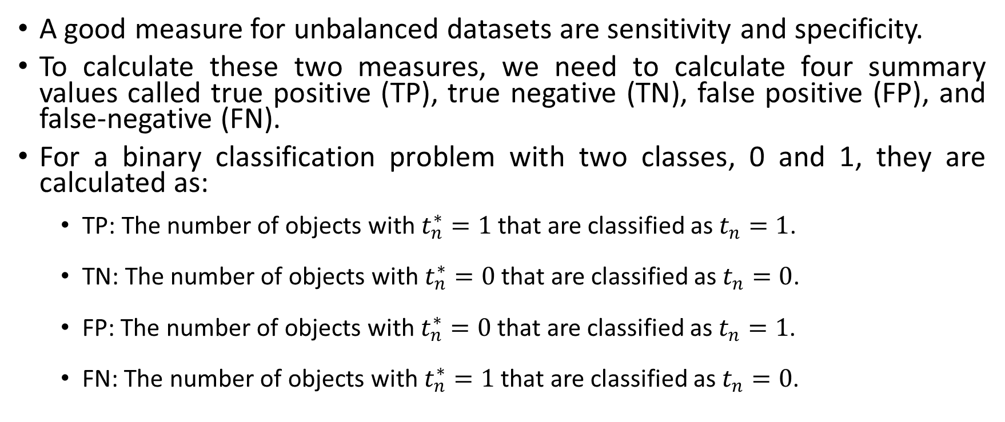
Sensitivity and Specificity
A good measure for unbalanced datasets are sensitivity and specificity.
To calculate these two measures, we need to calculate four summary values called true positive (TP), true negative (TN), false positive (FP), and false-negative (FN).
For a binary classification problem with two classes, 0 and 1, they are calculated as:
TP: The number of objects with $t_{n}^{∗}=1$ that are classified as $t_{n}=1$.
TN: The number of objects with $t_{n}^{∗}=0$ that are classified as $t_{n}=0$.
FP: The number of objects with $t_{n}^{∗}=0$ that are classified as $t_{n}=1$.
FN: The number of objects with $t_{n}^{∗}=1$ that are classified as $t_{n}=0$.

Slide 40
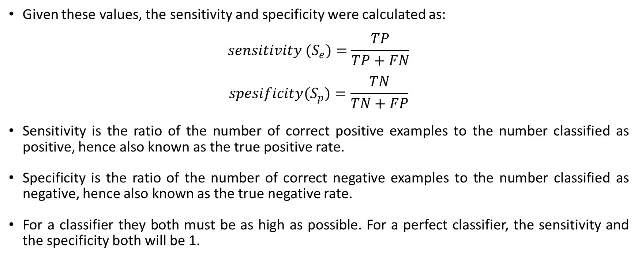
Sensitivity and Specificity
Given these values, the sensitivity and specificity were calculated as:
$$sensitivity (S_{e})=\frac{TP}{TP+FN}$$
$$spesificity(S_{p})=\frac{TN}{TN+FP}$$
Sensitivity is the ratio of the number of correct positive examples to the number classified as positive, hence also known as the true positive rate.
Specificity is the ratio of the number of correct negative examples to the number classified as negative, hence also known as the true negative rate.
For a classifier they both must be as high as possible. For a perfect classifier, the sensitivity and the specificity both will be 1.
Notes:
.Consider our rare disease example if the model classifies as all are healthy, then the specificity as a 1 and the sensitivity as a 0.

Slide 41
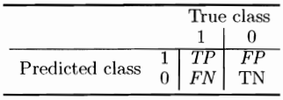
Confusion Matrix
A confusion matrix gives a tabular representation of how well the model able to predict the test objects.
A confusion matrix for a multi-class classification model with N classes contains N rows and N columns, where rows correspond to predicted classes and columns correspond to true classes.
This confusion matrix would let us explore in detail what the algorithm is getting right and what the algorithm is getting wrong.

Slide 42
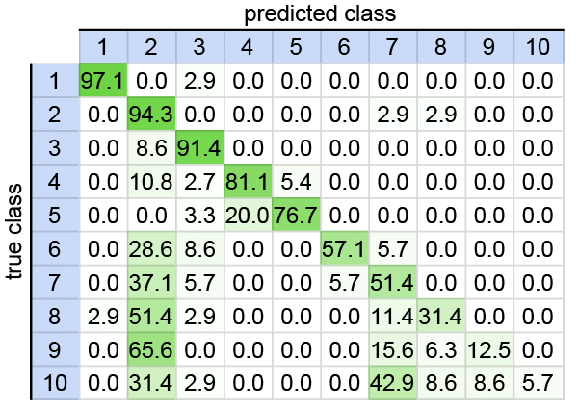
Confusion Matrix

Slide 43
Receiver Operating Characteristic (ROC) Curve
As discussed, some classification algorithms, instead of exactly telling which class the new object belongs to, provide real-valued output.
The real-valued output is compared with a threshold to get the class.
In such cases, any threshold value can be used, and based on the threshold value, the new object will be classified.
Now the question is which threshold value to choose to get the best for the model?
The answer is the ROC curve.
Notes:
For example, in Bayesian classification and logistic regression, we were provided with the probability $0<P\left(T_{new}=c | x_{new},X,t\right)<1$ of an object $x_{new}$belongs to class $c$. In SVM, we are provided with a real value that is then passed through a sign function.

Slide 44
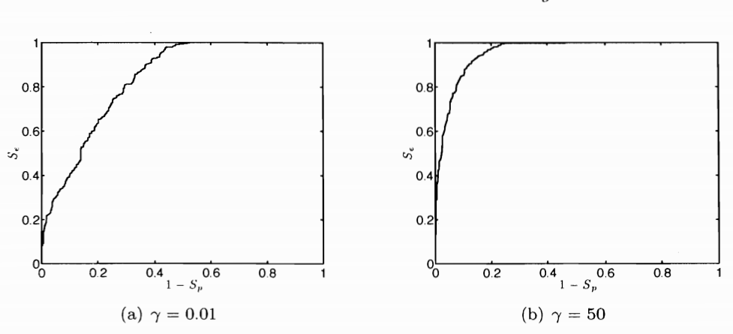
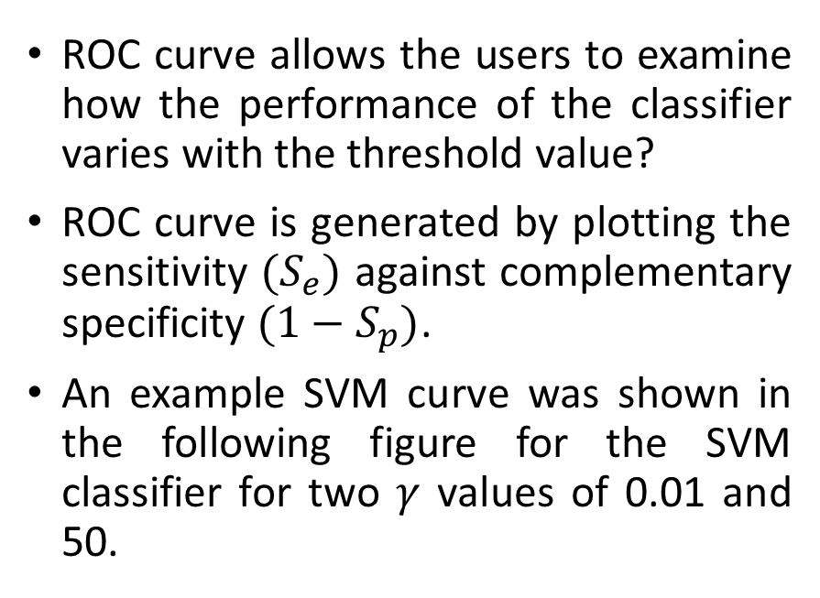
Receiver Operating Characteristic (ROC) Curve
ROC curve allows the users to examine how the performance of the classifier varies with the threshold value?
ROC curve is generated by plotting the sensitivity $(S_{e})$ against complementary specificity $(1−S_{p})$.
An example SVM curve was shown in the following figure for the SVM classifier for two $γ$ values of 0.01 and 50.
Notes:
For example, in Bayesian classification and logistic regression, we were provided with the probability $0<P\left(T_{new}=c | x_{new},X,t\right)<1$ of an object $x_{new}$belongs to class $c$. In SVM, we are provided with a real value that is then passed through a sign function.

Slide 45

Receiver Operating Characteristic (ROC) Curve
We know that the sensitivity and specificity must be as high as possible, i.e., the sensitivity must be high, and the complementary specificity must be as low as possible.
The closer the plot gets to the left top corner, the better the results will be. So based on the curves, $γ=50$ gives better performance than the $γ=0.01$.
We can quantify this performance by computing the area under the ROC curve (AUC).
Higher the AUC better the performance of the classifier.
A classifier with AUC=1 will be a perfect classifier.
The main drawback of the ROC curve is, it does not generalize to the multi-class classification problem.

Slide 46

Precision, Recall
The other measures used for accessing classifiers built using unbalanced datasets are:
Precision
Recall
F1 Score
$$Precision=\frac{TP}{TP+FP}$$
$$Recall=\frac{TP}{TP+FN}$$
Precision is the ratio of correct positive examples to the number of actual positive examples
Recall is the ratio of the number of correct positive examples to those that were classified as positive by the classifier, which is the same as sensitivity.

Slide 47

F1 Score
The precision and recall are, to some extent, inversely related, in that if the number of false positives increases, then the number of false negatives often decreases, and vice versa.
They can be combined to give a single measure, the F1 score, which can be written in terms of precision and recall as:
$$F1=2\frac{precision×recall}{precision+recall}$$
$$F1=\frac{TP}{TP+{(FN+FP)}/2}$$

