Slide 1

Machine Learning
CO-3: Tree Based Learning

Slide 2
S.No | Course Outcome | Intended Learning Outcomes (ILO) | Knowledge Level of ILO | No. of Hours
1 | CO 3 | Decision Trees: Construction of Decision Trees | K2 | 3
2 |  | Classification And Regression Trees (CART) | K2 | 1
3 |  | Classification Example | K2 | 2
4 |  | Ensemble Learning: Boosting, Adaboost, Stumping | K2 | 1
5 |  | Bagging and Subagging | K2 | 1
6 |  | Random Forests | K2 | 1

Slide 3
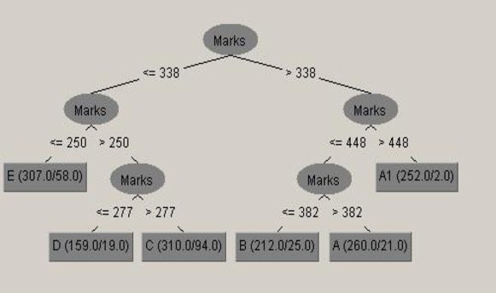

Slide 4
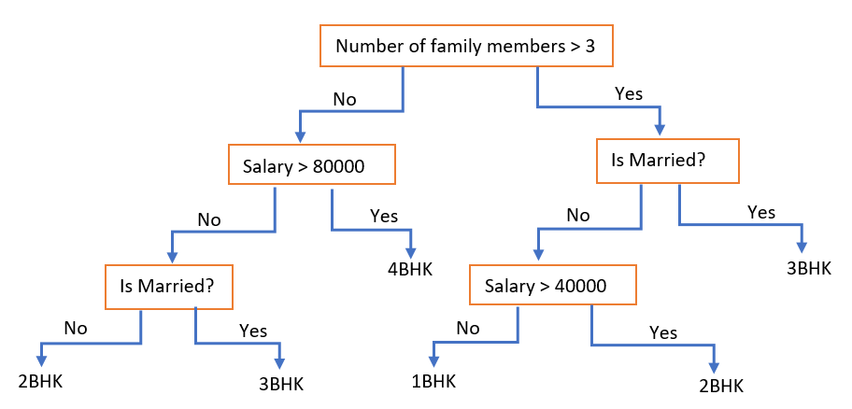

Slide 5
Decision tree(DT)
Based on one of the most common and powerful data structures in the whole of computer science: the binary tree.
Why decision trees?
Less computational cost.
Easy to understand
Transparent
Very simple working:
DT breaks classification down into a set of choices about each feature.
For classification, process starts at the root (base) of the tree and progressing down to the leaves. where we receive the classification decision.
Notes:
The computational cost of making the tree is fairly low, but the cost of using it is even lower: O(log N), where N is the number of datapoints.

Slide 6
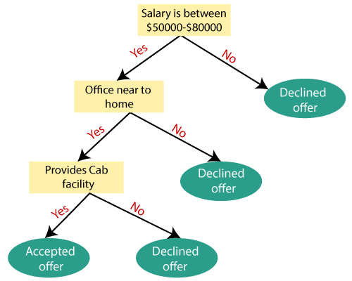
Using Decision tree

Slide 7
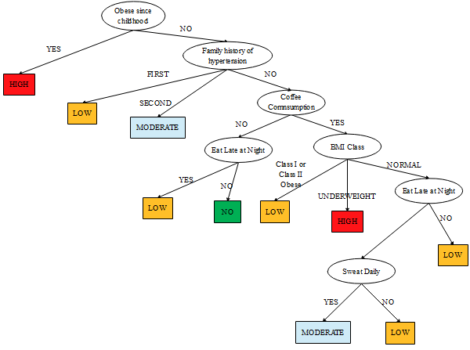
Using Decision tree

Slide 8
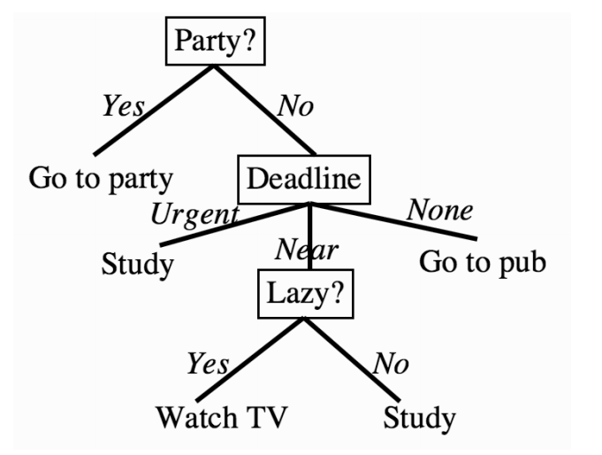
Using Decision tree

Slide 9
CONSTRUCTING DECISION TREES
For a given problem, multiple decision trees are possible for the given set of features.
The question we need to ask is how, based on those features, we can construct the tree.
Any DT algorithm constructs a DT in a greedy manner.
Choosing which feature to use next in the decision tree can be thought of as playing the game ‘20 Questions’.
So how to calculate which feature has more information?
Notes:
a greedy manner starting at the root, choosing the most informative feature at each step.

Slide 10
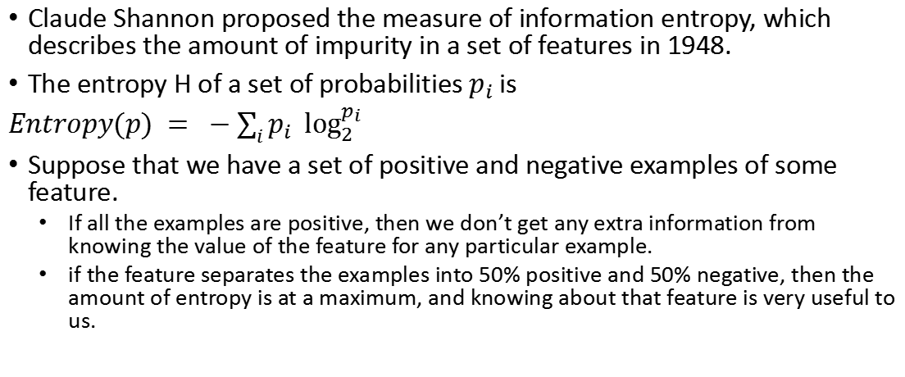
Entropy in Information Theory
Claude Shannon proposed the measure of information entropy, which describes the amount of impurity in a set of features in 1948.
The entropy H of a set of probabilities $p_{i}$ is
$Entropy(p) = −\sum_{i}{p_{i} \log_{2}^{p_{i}}}$
Suppose that we have a set of positive and negative examples of some feature.
If all the examples are positive, then we don’t get any extra information from knowing the value of the feature for any particular example.
if the feature separates the examples into 50% positive and 50% negative, then the amount of entropy is at a maximum, and knowing about that feature is very useful to us.
Notes:
a greedy manner starting at the root, choosing the most informative feature at each step.

Slide 11
Entropy in Information Theory
So how to use entropy in DT?
For our decision tree, the best feature to pick as the one to classify on now is the one that gives you the most information, i.e., the one with the highest entropy.
After using that feature, we re-evaluate the entropy of each feature and again pick the one with the highest entropy.
Notes:
a greedy manner starting at the root, choosing the most informative feature at each step.

Slide 12

ID3
ID3 is built based on information gain measured using entropy.
Information gain is defined as “the entropy of the whole set minus the entropy when a particular feature is chosen.”
$Gain\left(S,F\right)=Entropy\left(S\right)−\sum_{f∈F}{\frac{\left|S_{f}\right|}{S}Entropy(S_{f})}$

Slide 13
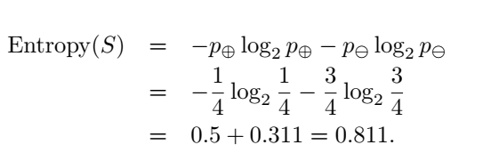
Information gain example
F | S
F2 | Ture
F2 | False
F3 | False
F1 | False

Slide 14
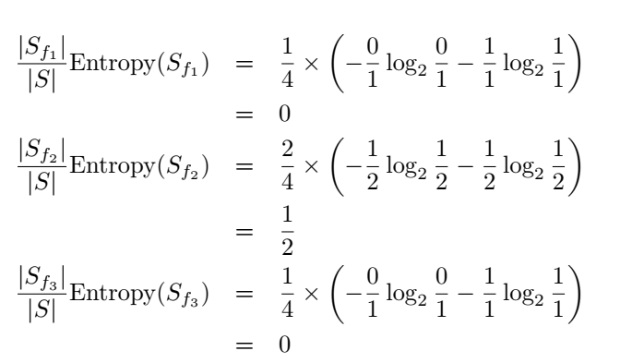
Information gain example
F | S
F2 | Ture
F2 | False
F3 | False
F1 | False

Slide 15
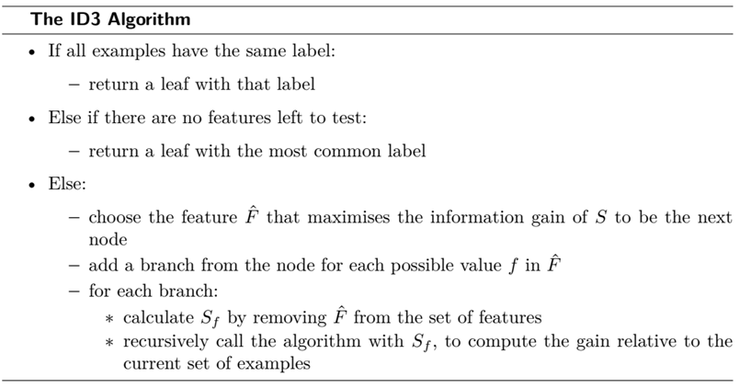
ID3

Slide 16
Color | Size | Act | Age | Inflated
YELLOW | SMALL | STRETCH | ADULT | T
YELLOW | SMALL | STRETCH | ADULT | T
YELLOW | SMALL | STRETCH | CHILD | F
YELLOW | SMALL | DIP | ADULT | F
YELLOW | SMALL | DIP | CHILD | F
YELLOW | LARGE | STRETCH | ADULT | T
YELLOW | LARGE | STRETCH | ADULT | T
YELLOW | LARGE | STRETCH | CHILD | F
YELLOW | LARGE | DIP | ADULT | F
YELLOW | LARGE | DIP | CHILD | F
PURPLE | SMALL | STRETCH | ADULT | T
PURPLE | SMALL | STRETCH | ADULT | T
PURPLE | SMALL | STRETCH | CHILD | F
PURPLE | SMALL | DIP | ADULT | F
PURPLE | SMALL | DIP | CHILD | F
PURPLE | LARGE | STRETCH | ADULT | T
PURPLE | LARGE | STRETCH | ADULT | T
PURPLE | LARGE | STRETCH | CHILD | F
PURPLE | LARGE | DIP | ADULT | F
PURPLE | LARGE | DIP | CHILD | F

Slide 17
Dealing with Continuous Variables
Entropy and information gain is for discrete variables.
So, what about continuous variables?
The simplest solution is to discretize the continuous variable.
In general, only one split is made to a continuous variable, rather than allowing for three-way or higher splits.
Choosing the best place to split a continuous variable is another challenge.

Slide 18
Univariate and multivariate Trees
Univariate Trees:
They pick one feature (dimension) at a time and split according to that one.
Simpler and tend to get good results.
Provides useful way to visualize what the decision tree is doing
Multivariate Trees:
They pick a combination of features (dimensions) at a time and split according to them.
They can make considerably smaller trees if the combinations are chosen properly.

Slide 19
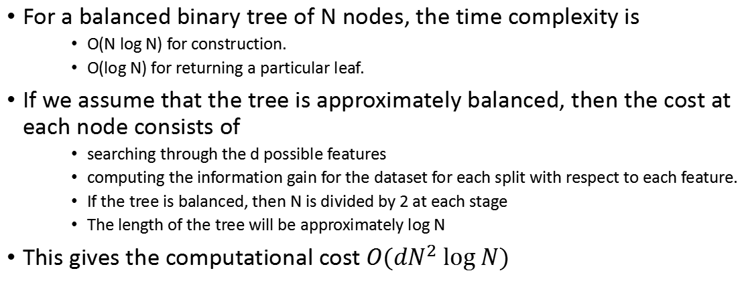
Computational Complexity
For a balanced binary tree of N nodes, the time complexity is
O(N log N) for construction.
O(log N) for returning a particular leaf.
If we assume that the tree is approximately balanced, then the cost at each node consists of
searching through the d possible features
computing the information gain for the dataset for each split with respect to each feature.
If the tree is balanced, then N is divided by 2 at each stage
The length of the tree will be approximately log N
This gives the computational cost $O(dN^{2} log⁡N)$

Slide 20
CLASSIFICATION AND REGRESSION TREES (CART)
Another well-known tree-based algorithm.
Used for both classification and regression.
It is usually constrained to construct binary trees.
A different information measure is commonly used.
Gini Impurity
Notes:
say the question about when your nearest assignment deadline is, which is either ‘urgent’, ‘near’, or ‘none’
can be split into two questions: first, ‘is the deadline urgent?’, and then if the answer to that is ‘no’, second ‘is the deadline near?’

Slide 21
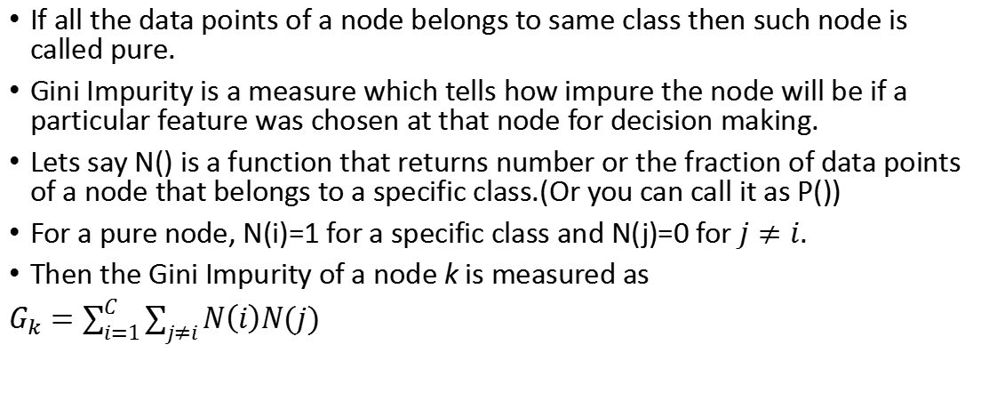
CART- Gini Impurity
If all the data points of a node belongs to same class then such node is called pure.
Gini Impurity is a measure which tells how impure the node will be if a particular feature was chosen at that node for decision making.
Lets say N() is a function that returns number or the fraction of data points of a node that belongs to a specific class.(Or you can call it as P())
For a pure node, N(i)=1 for a specific class and N(j)=0 for $j≠i$.
Then the Gini Impurity of a node k is measured as
$G_{k}=\sum_{i=1}^{C}{\sum_{j≠i}{N\left(i\right)N(j)}}$

Slide 22
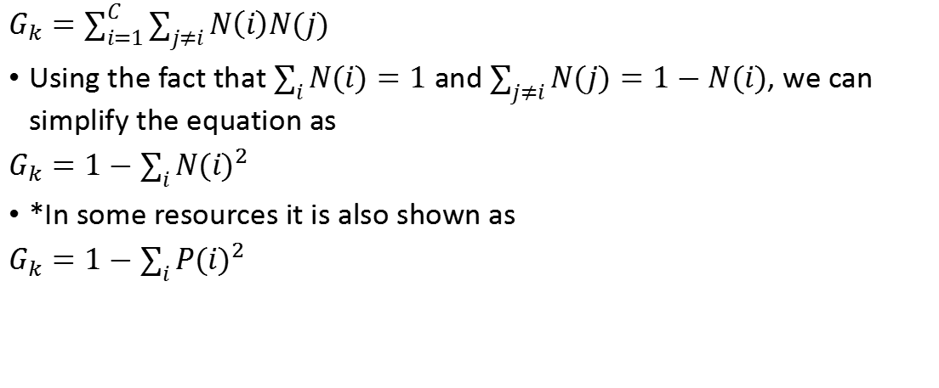
CART- Gini Impurity
$G_{k}=\sum_{i=1}^{C}{\sum_{j≠i}{N\left(i\right)N(j)}}$
Using the fact that $\sum_{i}{N(i)}=1$ and $\sum_{j≠i}{N(j)}=1−N(i)$, we can simplify the equation as
$G_{k}=1−\sum_{i}{{N(i)}^{2}}$
*In some resources it is also shown as
$G_{k}=1−\sum_{i}{{P(i)}^{2}}$

Slide 23
Gini Impurity: Example
Day | Outlook | Temp. | Humidity | Wind | Decision
1 | Sunny | Hot | High | Weak | No
2 | Sunny | Hot | High | Strong | No
3 | Overcast | Hot | High | Weak | Yes
4 | Rain | Mild | High | Weak | Yes
5 | Rain | Cool | Normal | Weak | Yes
6 | Rain | Cool | Normal | Strong | No
7 | Overcast | Cool | Normal | Strong | Yes
8 | Sunny | Mild | High | Weak | No
9 | Sunny | Cool | Normal | Weak | Yes
10 | Rain | Mild | Normal | Weak | Yes
11 | Sunny | Mild | Normal | Strong | Yes
12 | Overcast | Mild | High | Strong | Yes
13 | Overcast | Hot | Normal | Weak | Yes
14 | Rain | Mild | High | Strong | No

Slide 24
Gini Impurity: Example
Outlook | Yes | No | Number of instances
Sunny | 2 | 3 | 5
Overcast | 4 | 0 | 4
Rain | 3 | 2 | 5
Lets see how much purity will be there if we use outlook feature as decision feature at root.
Outlook is a nominal feature. It can be sunny, overcast or rain. I will summarize the final decisions for outlook feature.

Slide 25
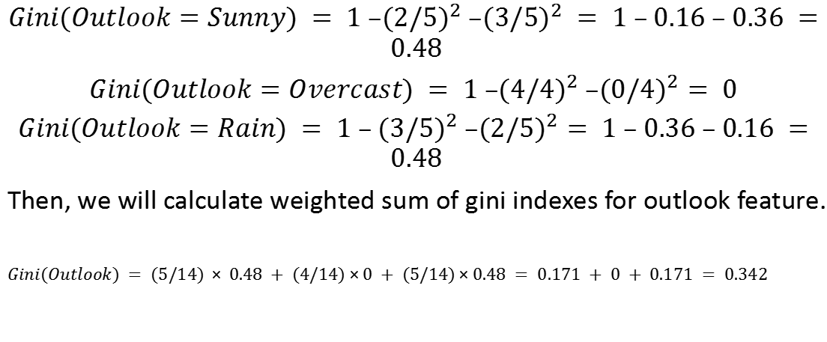
Gini Impurity: Example
$Gini(Outlook=Sunny) = 1 –{(2/5)}^{2} –{(3/5)}^{2} = 1 – 0.16 – 0.36 = 0.48$
$Gini(Outlook=Overcast) = 1 –{(4/4)}^{2} –{(0/4)}^{2}= 0$
$Gini(Outlook=Rain) = 1 – {(3/5)}^{2} –{(2/5)}^{2}= 1 – 0.36 – 0.16 = 0.48$
Then, we will calculate weighted sum of gini indexes for outlook feature.
$Gini(Outlook) = (5/14) × 0.48 + (4/14)×0 + (5/14)×0.48 = 0.171 + 0 + 0.171 = 0.342$

Slide 26
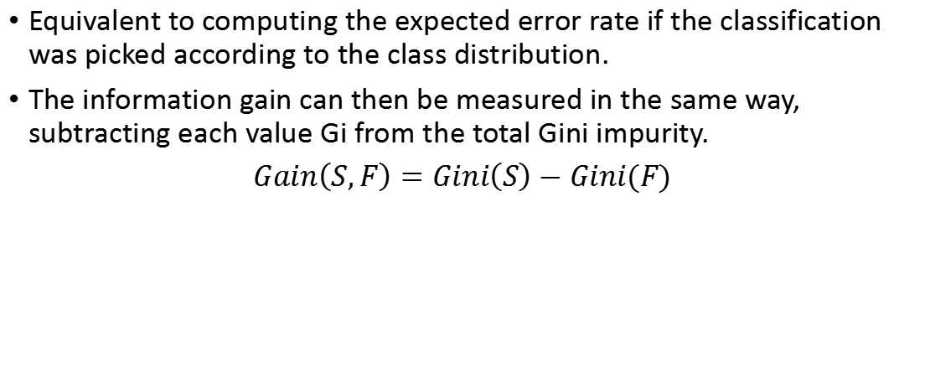
Gini impurity
Equivalent to computing the expected error rate if the classification was picked according to the class distribution.
The information gain can then be measured in the same way, subtracting each value Gi from the total Gini impurity.
$Gain\left(S,F\right)=Gini\left(S\right)−Gini(F)$

Slide 27
CART-Regression
Decision trees can be used for regression.
CART can built regression decision trees.
Cant use Entropy or Gini-impurity based information gain as measure.
So, which measure to use?
The sum-of-squares error

Slide 28
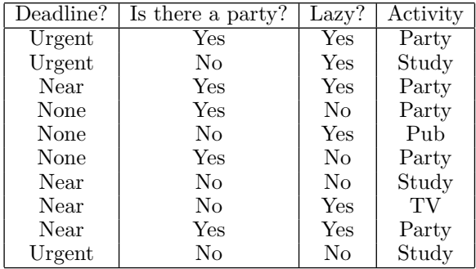
Example: What to do in the evening?

Slide 29
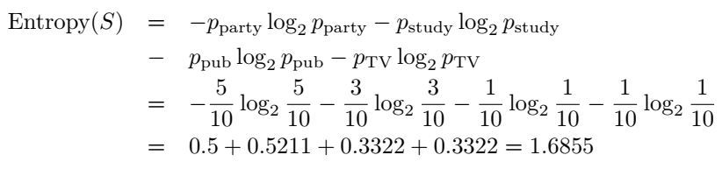
What to do in the evening? - ID3

Slide 30
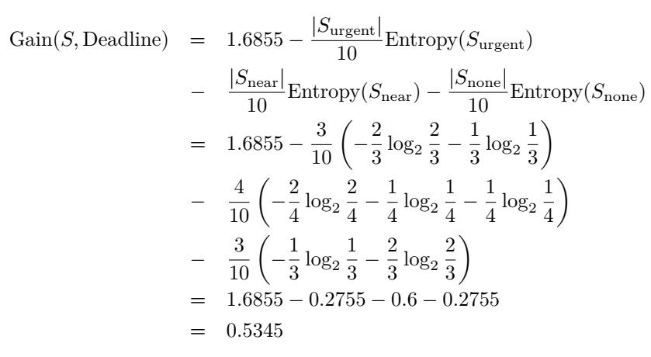
What to do in the evening? - ID3

Slide 31
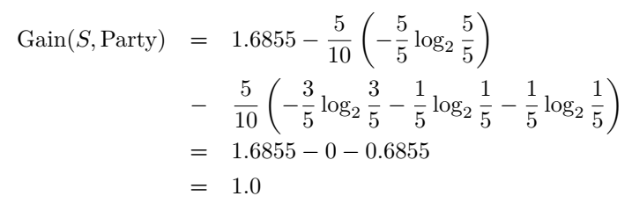
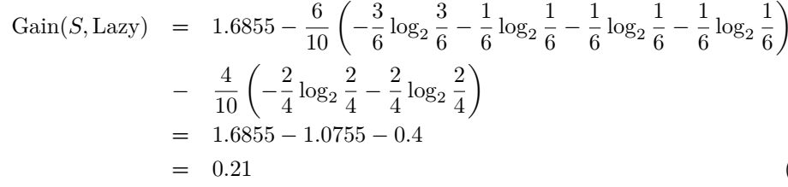
What to do in the evening? - ID3

Slide 32
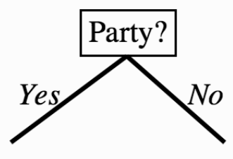
What to do in the evening? - ID3

Slide 33
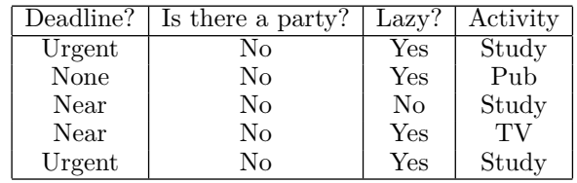
What to do in the evening? - ID3

Slide 34
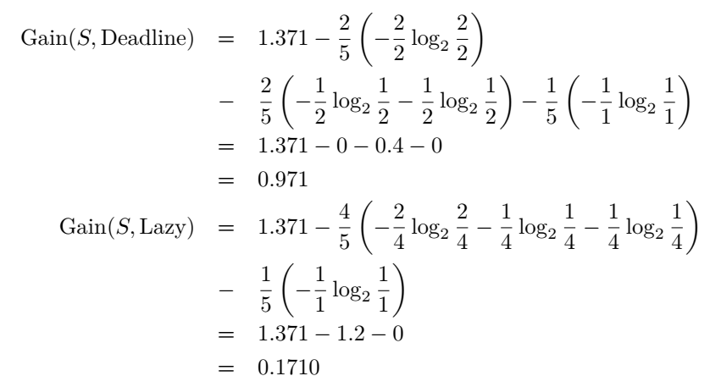
What to do in the evening? - ID3

Slide 35
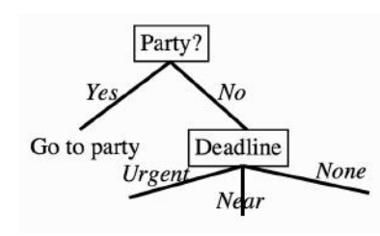
What to do in the evening? - ID3

Slide 36
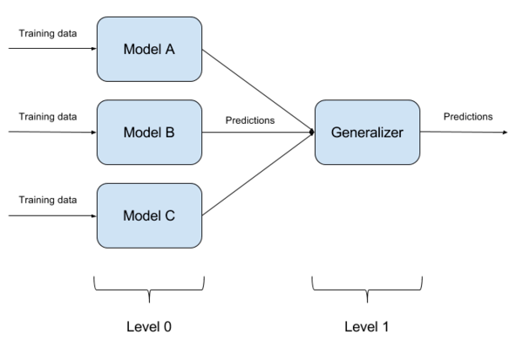
Ensemble learning
Basic idea is that by having lots of learners that each get slightly different results on a dataset and putting them together.
Ensemble methods do very well when there is very little data as well as when there is too much.
Notes:
The old saying has it that two heads are better than one. Which naturally leads to the idea that even more heads are better than that, and ends up with decision by committee, which is famously useless for human activities (as in the old joke that a camel is a horse designed by a committee). For machine learning methods the results are rather more impressive, as we’ll see in this chapter.

Slide 37
Boosting
A most popular ensemble method.
Take a collection of very poor learners that performs just a little and apply weights according to their performances and put them together to create a ensemble learner.
Examples: AdaBoost, CoBoosting, Gradient boosting, LPBoost, etc.

Slide 38
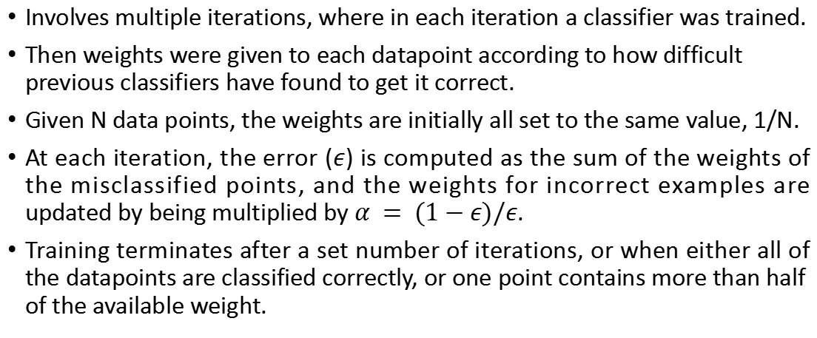
adaboost
Involves multiple iterations, where in each iteration a classifier was trained.
Then weights were given to each datapoint according to how difficult previous classifiers have found to get it correct.
Given N data points, the weights are initially all set to the same value, 1/N.
At each iteration, the error ($ε$) is computed as the sum of the weights of the misclassified points, and the weights for incorrect examples are updated by being multiplied by $α = (1−ε)/ε$.
Training terminates after a set number of iterations, or when either all of the datapoints are classified correctly, or one point contains more than half of the available weight.

Slide 39
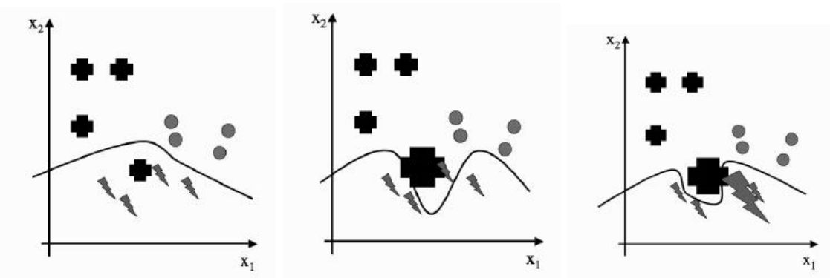
adaboost

Slide 40
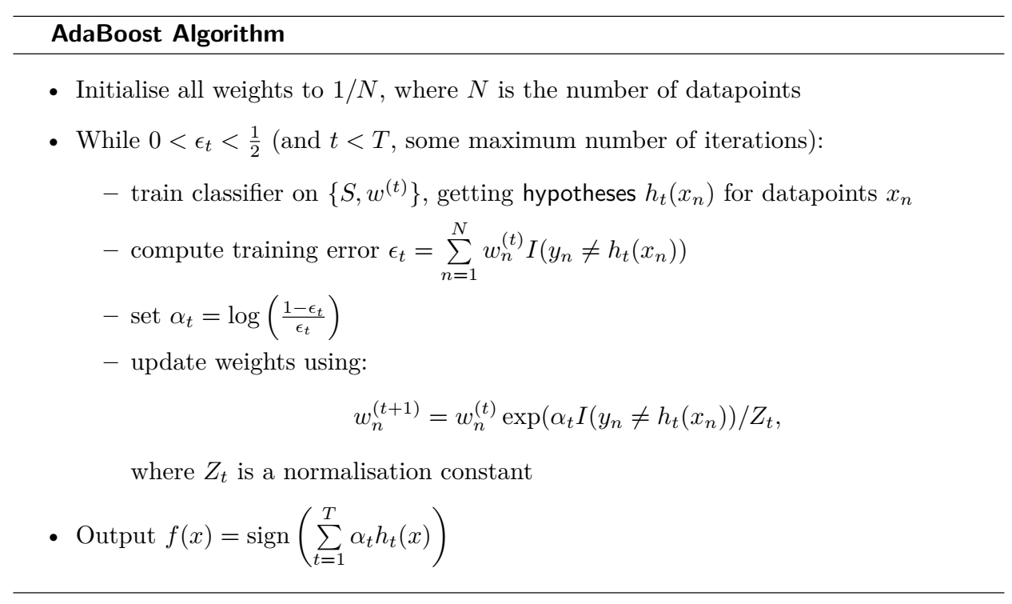

Slide 41
Stumping
A very extreme form of boosting that is applied to trees.
A decision stump is a Decision Tree, which uses only a single attribute for splitting. It only contains one node the root node.
Decision stumps are also often used as weak learners in ensemble methods such as boosting.

Slide 42
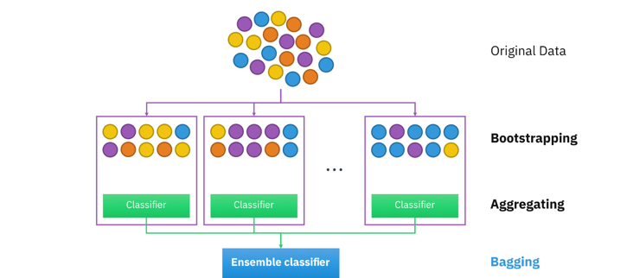
Bagging - bootstrap aggregating

Slide 43
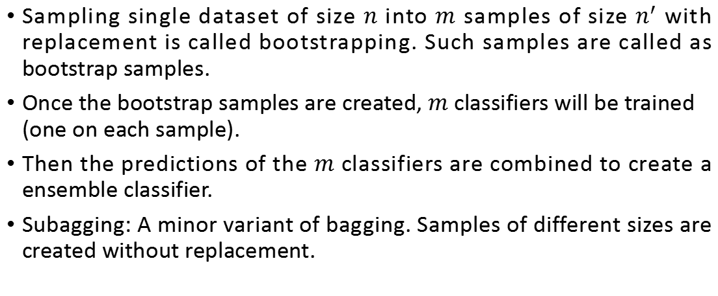
Bagging - bootstrap aggregating
Sampling single dataset of size $n$ into $m$ samples of size $n^{′}$ with replacement is called bootstrapping. Such samples are called as bootstrap samples.
Once the bootstrap samples are created, $m$ classifiers will be trained (one on each sample).
Then the predictions of the $m$ classifiers are combined to create a ensemble classifier.
Subagging: A minor variant of bagging. Samples of different sizes are created without replacement.

Slide 44
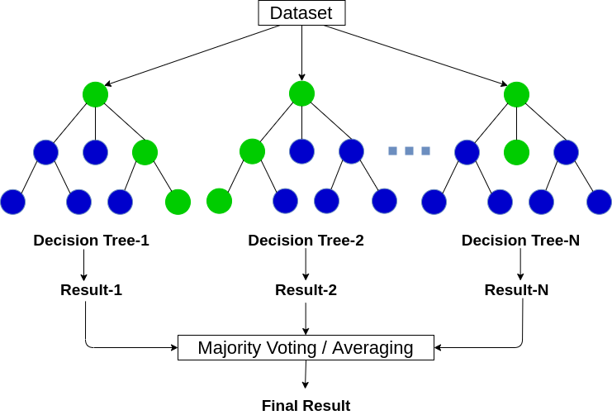
Random forest
The idea is largely that if one tree is good, then many trees (a forest) should be better, provided that there is enough variety between them.
Is a bagging algorithm with decision trees with more randomness added to it.

Slide 45
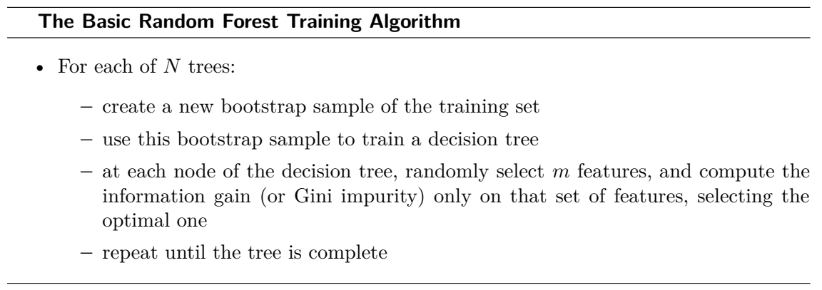
Random Forest

